Slide 1
Differential Voltage Analysis:
How to find out why cells are failing and how to find out what Samsung, etc. is doing ☺
Jeff Dahn
with Hannah Dahn, Chris Burns, Aaron Smith, Reza Fathi Asher Wright, Jessie Harlow and David Stevens

Slide 2
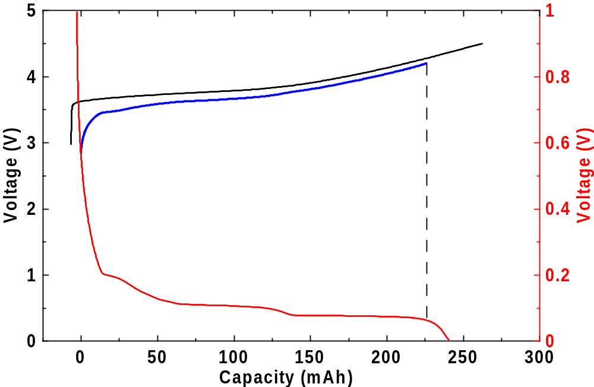
Li-ion cells have two intercalation electrodes
Both have voltage (vs. Li) -capacity curves that show features.
The full cell voltage curve depends on the N:P ratio and the relative electrode slippage.
Positive vs Li
Full cell
Negative vs Li

Slide 3
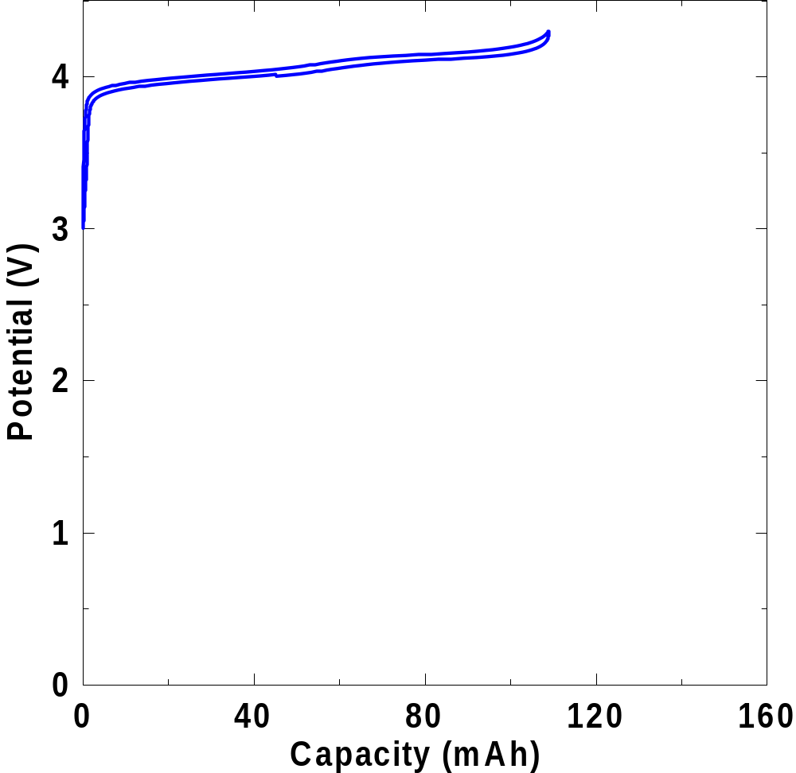
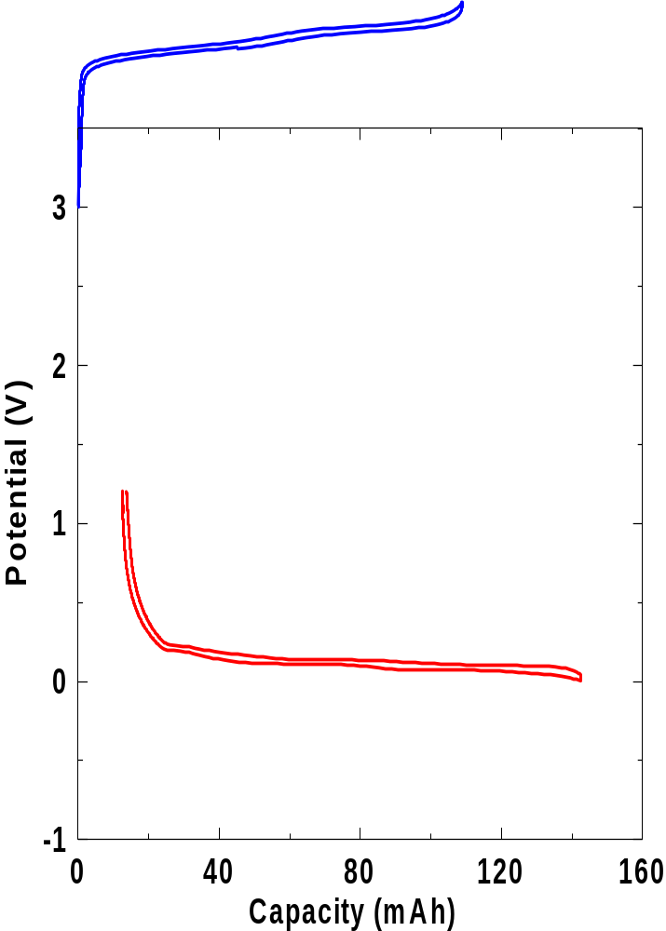
Relative electrode slippage, N:P ratio and active material loss affect the full cell voltage curve.

Slide 4
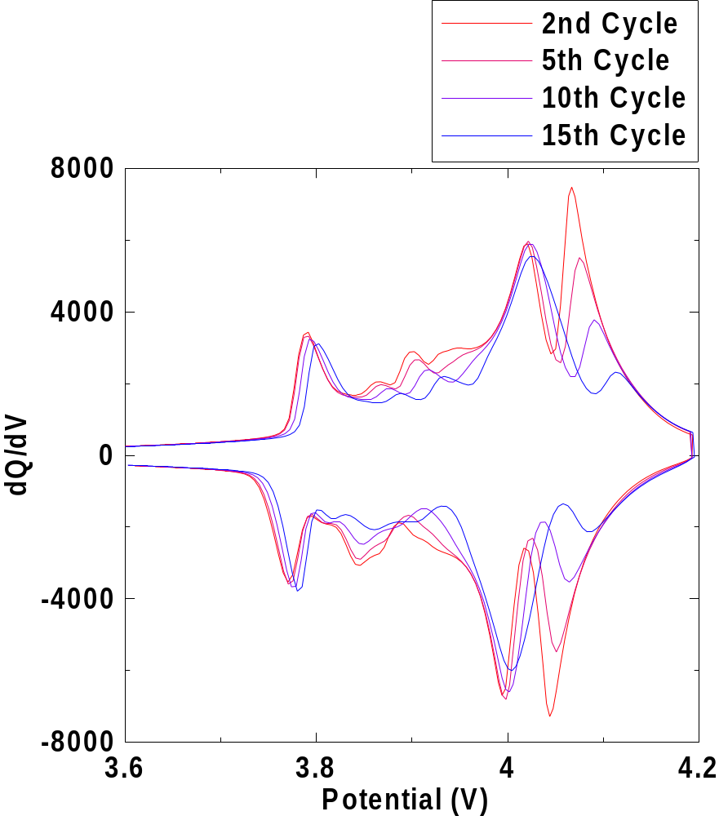
dQ/dV vs V changes with cycle number
Li ion 18650 Moli Energy
- Type : Spinel/Graphite (1400 mAh)
- Temperature : 50C
- V Limits : 3.0 – 4.2V
- Rate : C/14
What is happening here?
Why is the differential capacity changing with cycle number?
Is there loss of active material?
Is there relative electrode slippage?
What do we do to fix this problem?

Slide 5
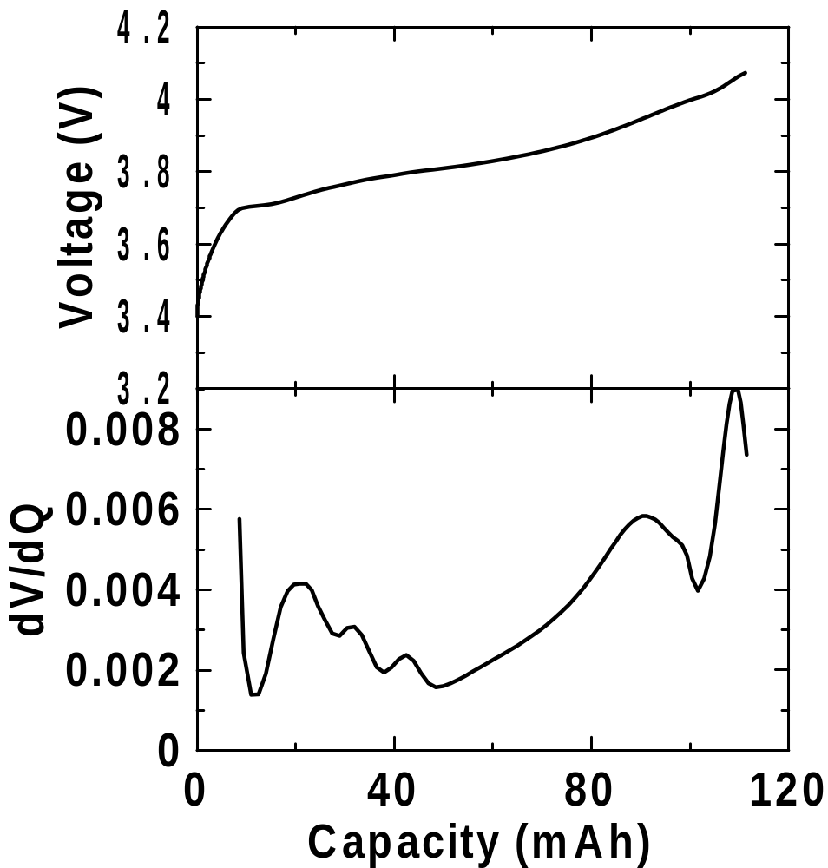
dV/dQ analysis Software
Why is dV/dQ useful?
  Features are more prominent than in simple voltage curves
  Easier to fit and obtain information about electrode behaviour
Hannah M. Dahn, A.J. Smith, J.C. Burns, D.A. Stevens and J.R. Dahn, User-Friendly Differential Voltage Analysis Freeware for the Analysis of Degradation Mechanisms in Li-ion Batteries, J. Electrochem. Soc 159, A1405-A1409 (2012).

Slide 6
Why use dV/dQ versus Q, instead of
dQ/dV vs V
dQ/dV vs Q
Or
dV/dQ vs V
A nice paper by Konkura of Hitachi explains this well.
V_{cell}(Q) = V_{pos}(Q) – V_{neg}(Q)
So
dV_{cell}/dQ = dV_{pos}/dQ – dV_{neg}/dQ
Calculations are VERY easy if one does things this way.

Slide 7
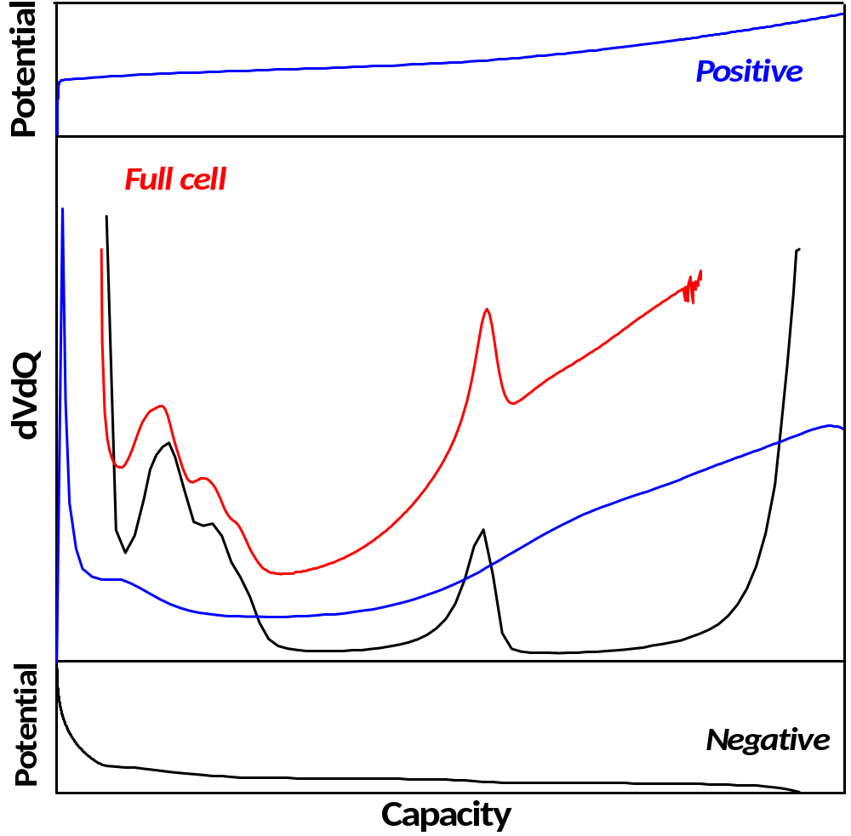
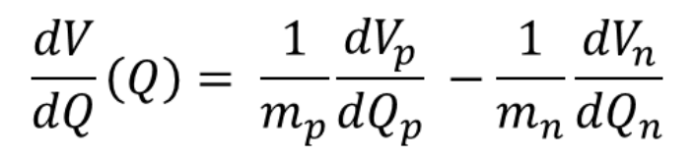
Differential voltage (dV/dQ vs Q) analysis

Slide 8
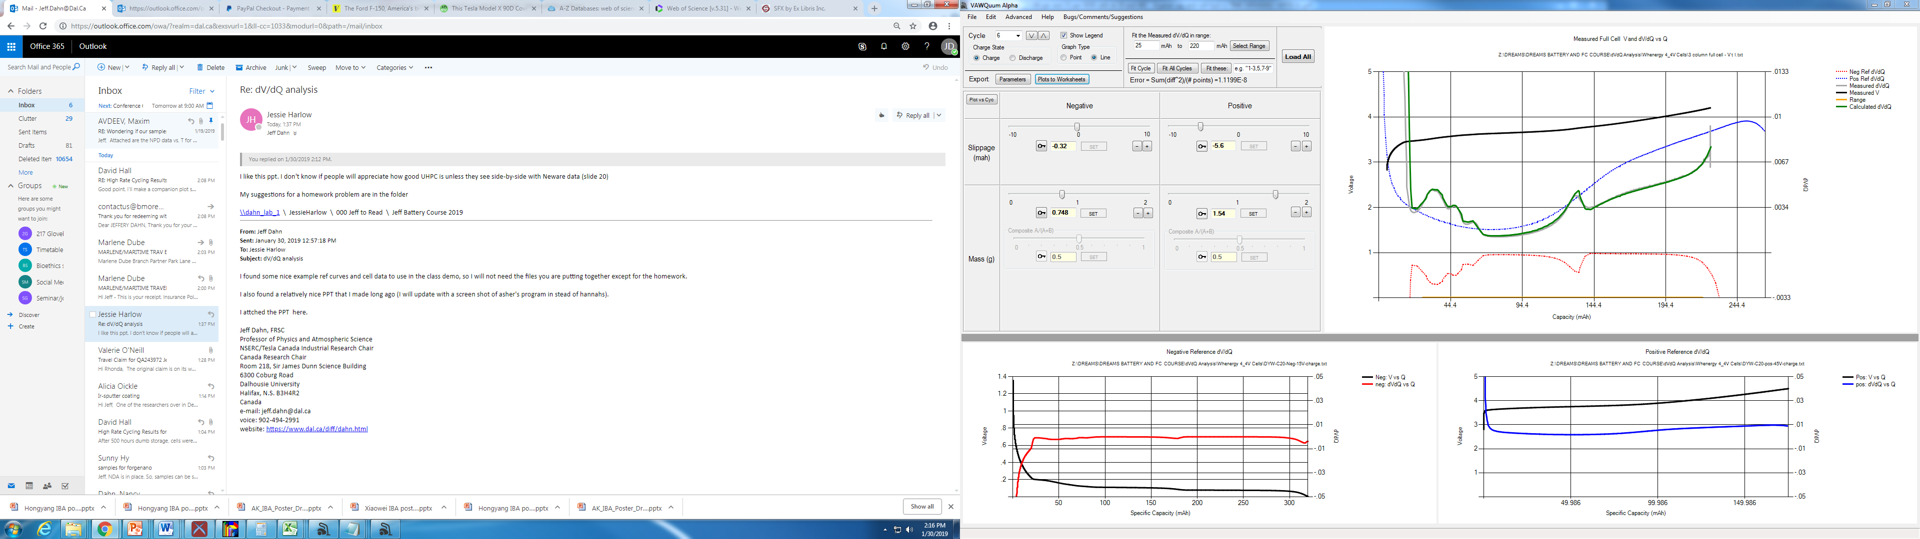
VAWQuum Alpha Software – by Asher wright
Capacity vs. dV/dQ for measured (grey) and calculated (green) full cell data. Reference curves displayed also (blue and red). Measured V (black) and fitting range (gold)
Cycle selection
Fitting capabilities
Slider controls for slippage and mass
Specific Capacity vs. Voltage for negative reference electrode
Specific Capacity vs. Voltage for positive reference electrode

Slide 9
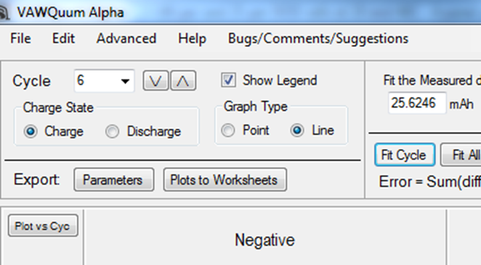
If you press the edit button, you get an option to create the graph on the next slide

Slide 10
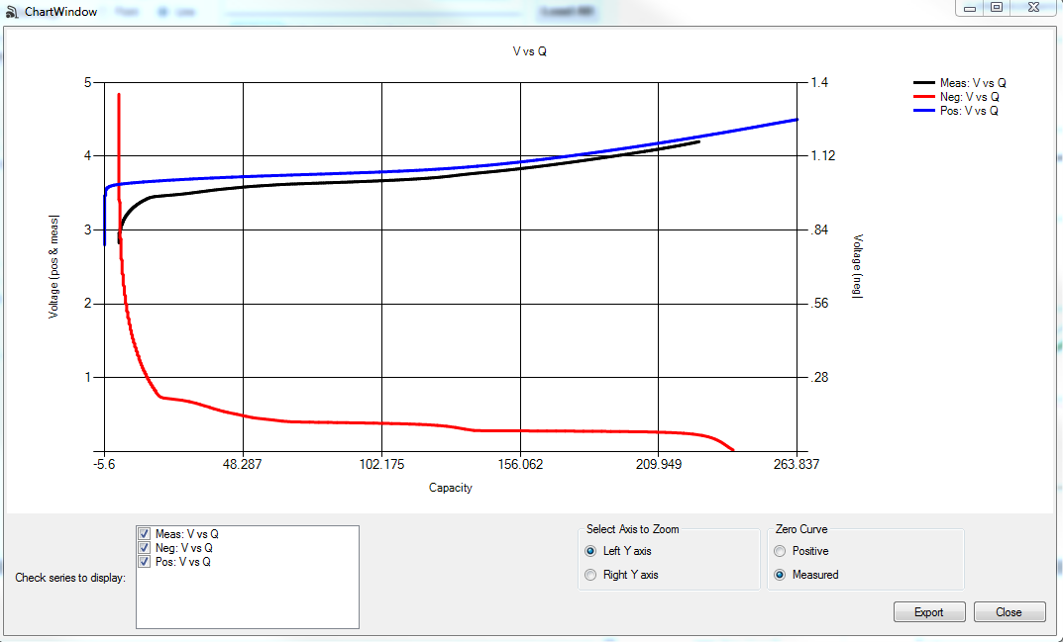
If you press the export button, you can get a spreadsheet of values for plotting
Our lab convention is to say capacity = 0 when the full cell is discharged, as in this graph.

Slide 11
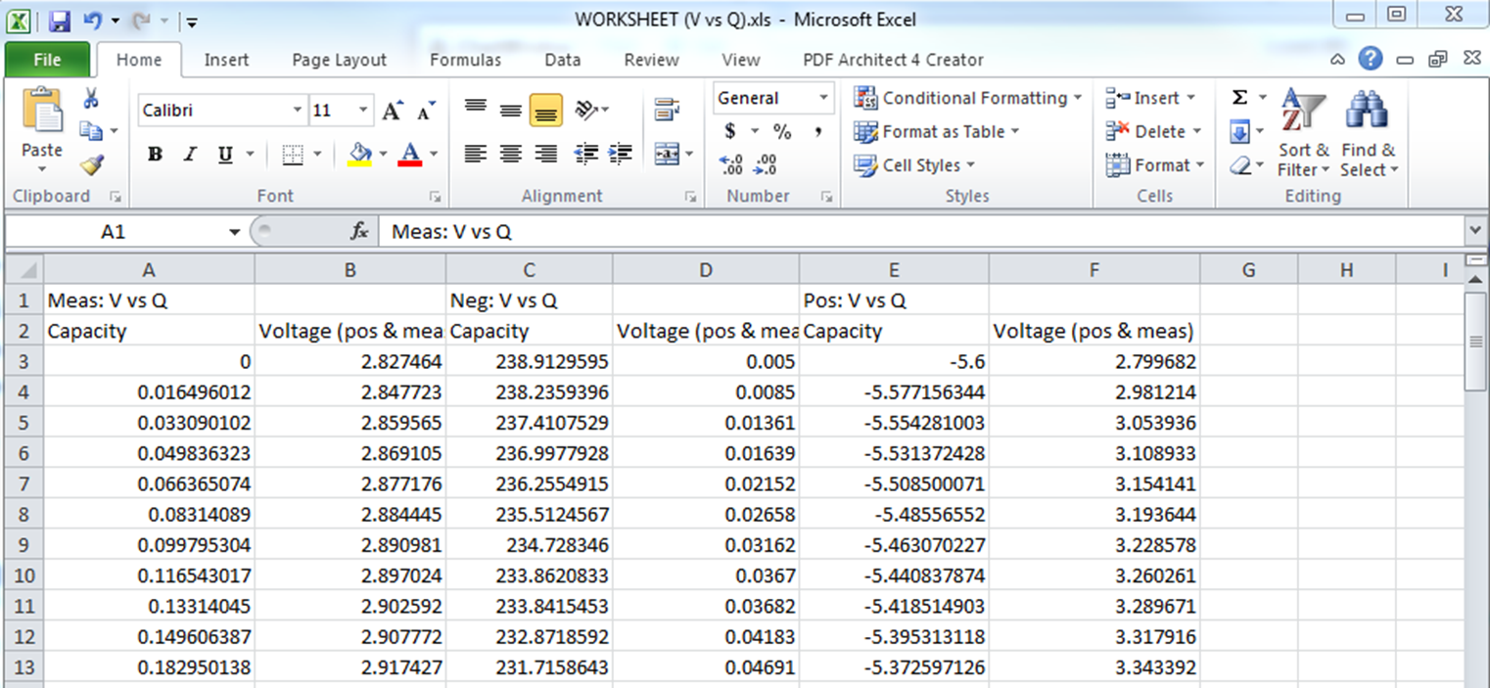
Full Cell
Negative electrode
Positive Electrode

Slide 12
Software Demo
Chinese Graphite/NMC111 cell - C/20
Reference Curves:
  Anode: Graphite/Li Half Cell
  Cathode: NMC111/Li Half Cell

Slide 13
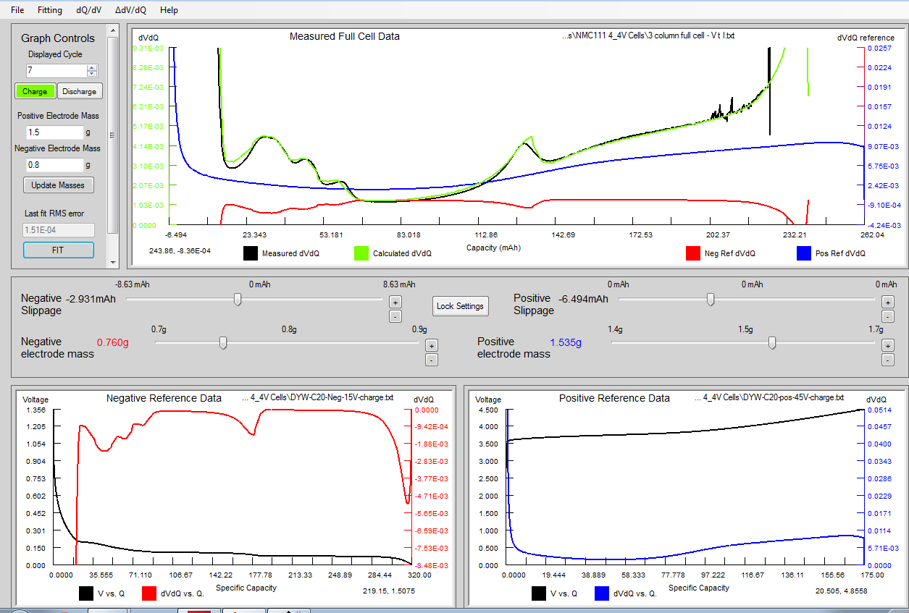
This is an analysis of cycle 6 for this cell. This is an NMC111/graphite pouch cell.

Slide 14

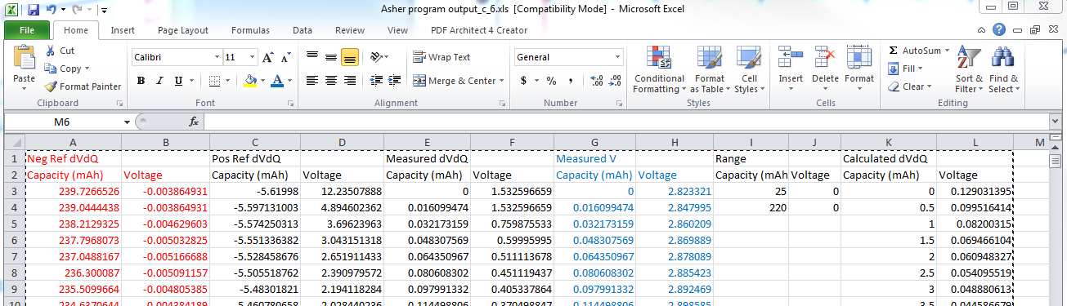
This is an analysis of cycle 6 for this cell. This is an NMC111/graphite pouch cell.

Slide 15
Now let’s look at some case studies

Slide 16
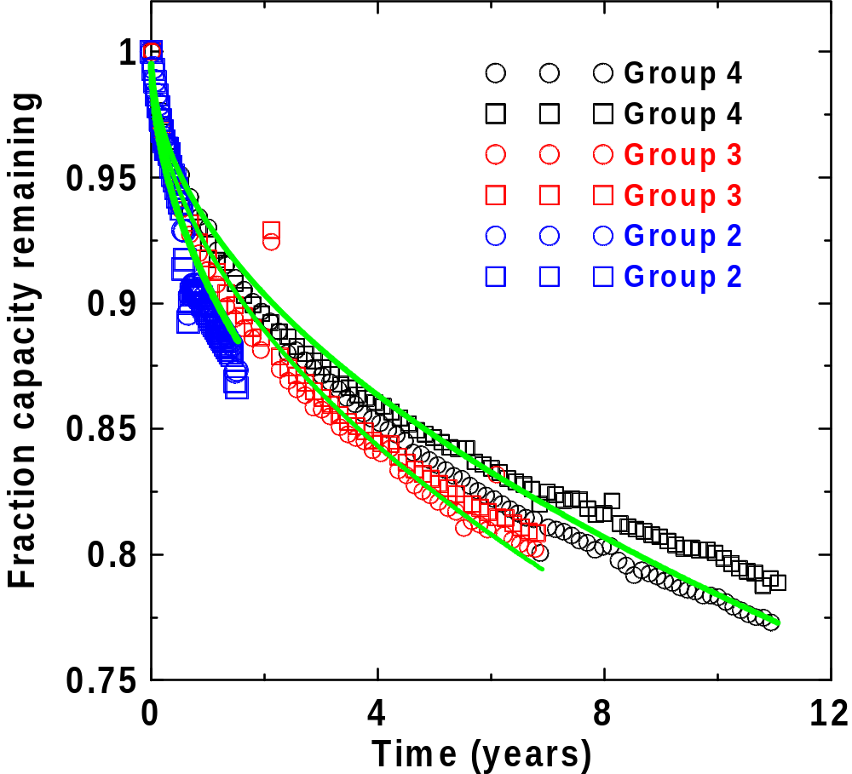
This are LiCoO₂/graphite cells that were made in 2002, 2006 and 2012. We also have brand new cells. They all have exactly the same chemistry. The cycling is low rate.
What is the reason for capacity loss?

Slide 17
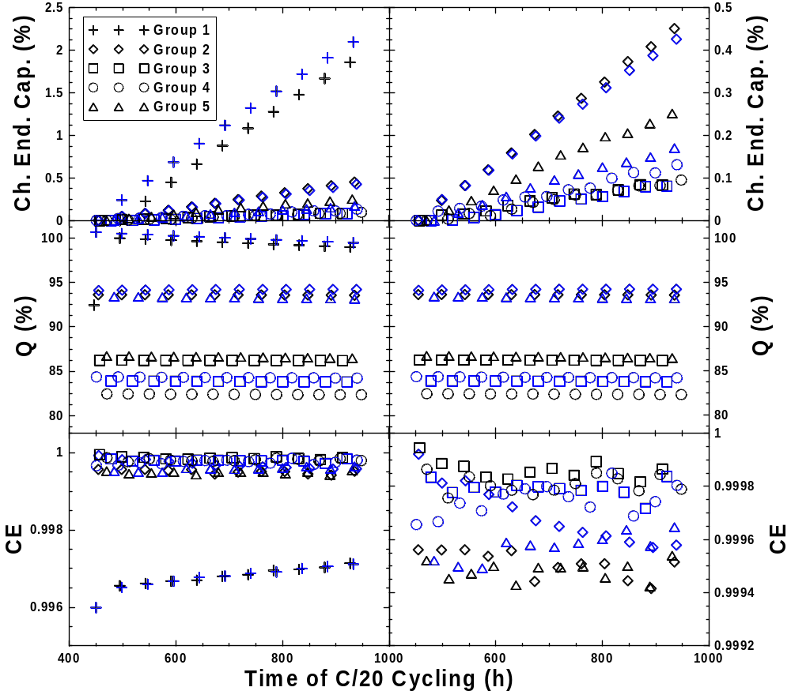
It is very interesting to see how impressive the CE of the 8 and 12 year old cells are!

Slide 18
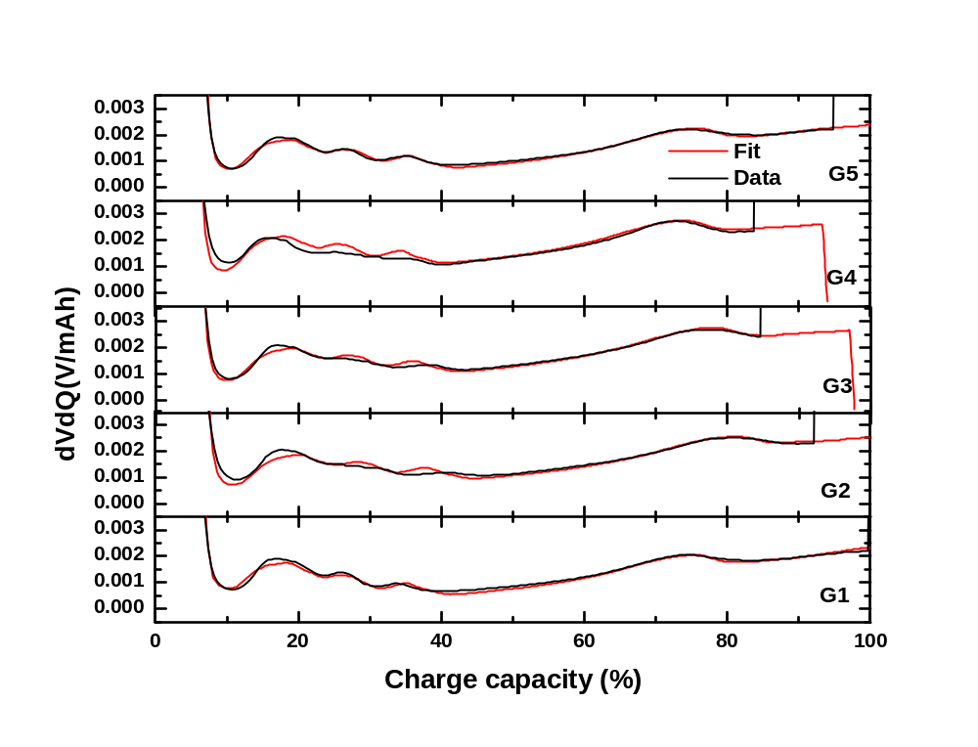
Implanted for 8 years
Tested for 12 years
Tested for 8 years
Tested for 2 years
Fresh cells
dV/dQ analysis of these cells shows good fits based on reference curves from the fresh electrodes

Slide 19
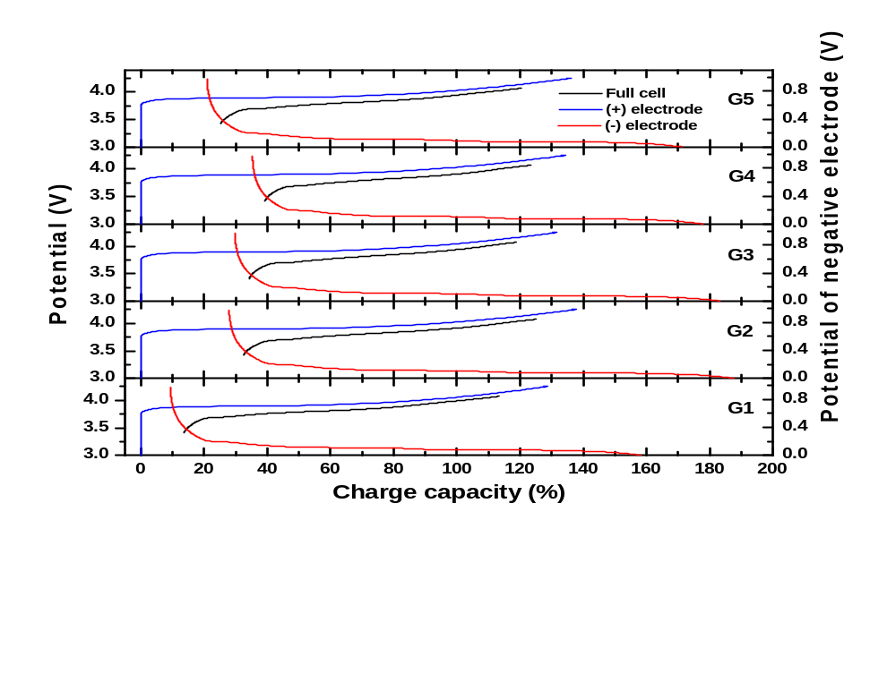
Implanted for 8 years
Tested for 12 years
Tested for 8 years
Tested for 2 years
Fresh cells
Notice the increased relative slippage due to SEI build up. The implanted cells appear to have a lower age – did not see full SOC as much.

Slide 20
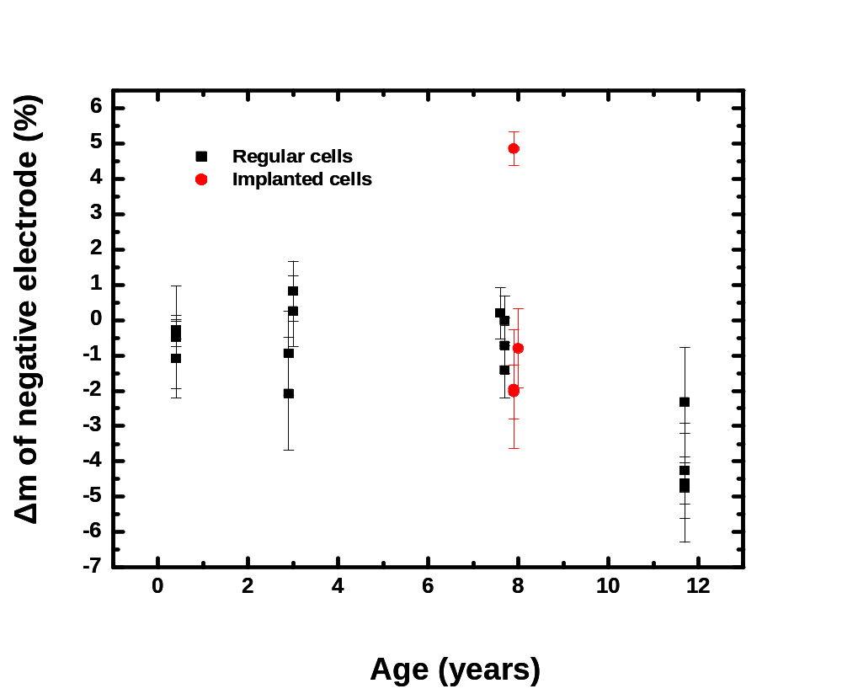
This is the key outcome of this work. Virtually no loss of active mass during the cycle testing. To improve these cells there is no need to work on electrode materials or electrode design. It is all about electrode/electrolyte reactions!

Slide 21
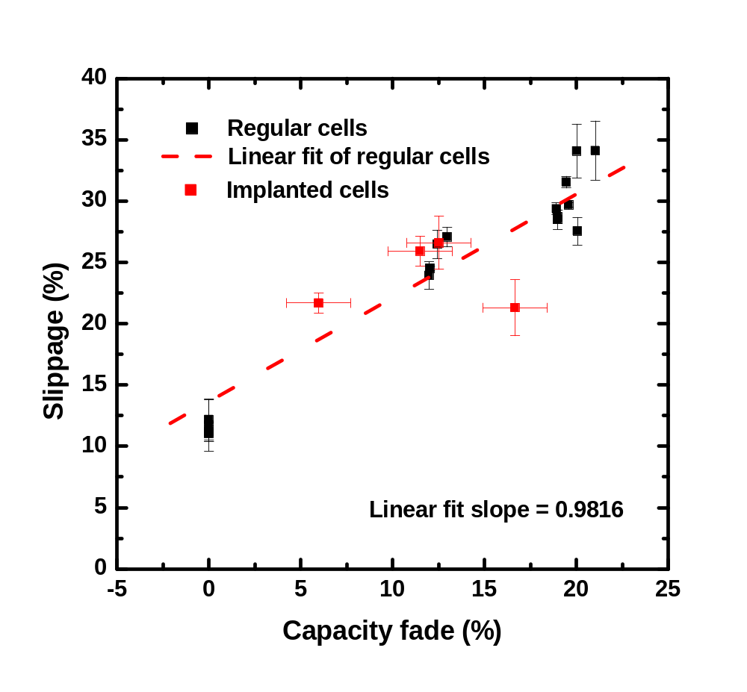
The slope of the line is 1.0. All capacity loss can be explained by slippage. Electrolyte additives can fix this.

Slide 22
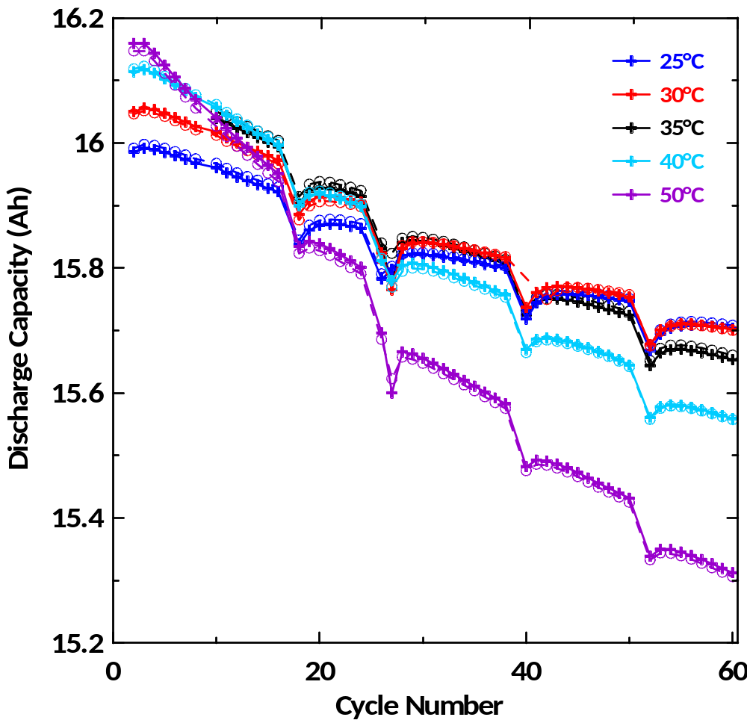
Automotive Li-ion pouch cells – Chevy Volt 1
The capacity fade in these cells cycled at C/20 to 4.15V is really pretty severe.
What is the origin of this fade?

Slide 23
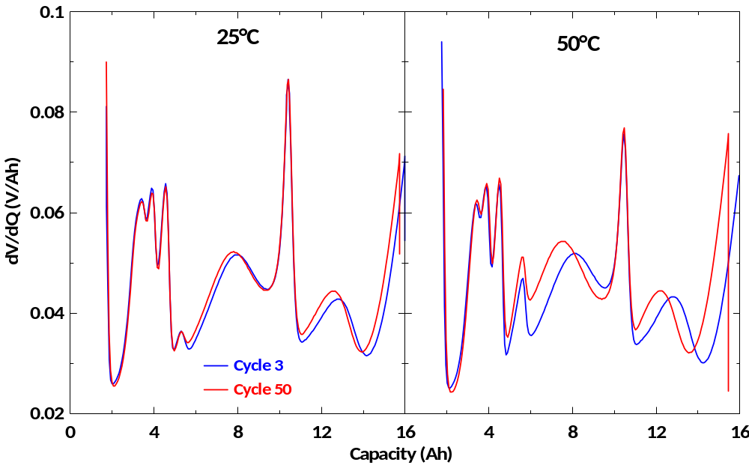
dV/dQ vs Q of Automotive cells
Testing was at C/20 to 4.15 V. Notice the impressive fidelity of this data collected using the Dalhousie UHPC equipment.

Slide 24
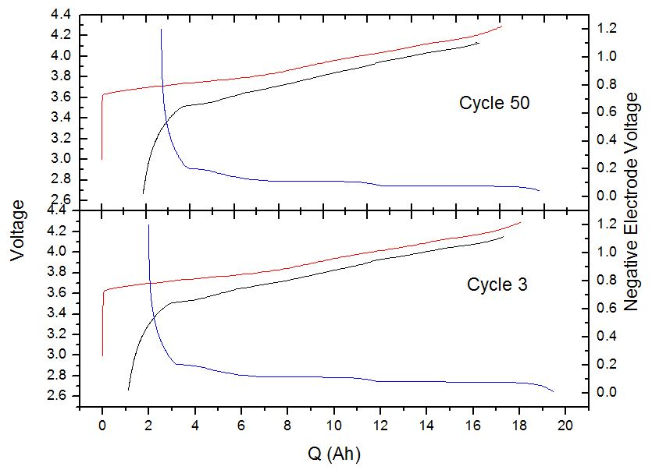
dV/dQ analysis for the Automotive cells cycled at 50ºC
GMR-130612-109A_2590_50C
Black = Full cell
Red = Positive
Blue = Negative
Outcome is that there is no active mass loss during these 50 cycles at C/20. All capacity fade is due to relative slippage between positive and negative electrodes. This is caused by continuing SEI growth and thickening at the negative electrode side.. Electrode quality is not an issue in these cells. Improvements can be made through electrolyte.

Slide 25
Summary
dV/dQ analysis is an extremely useful tool.
For cells that have features in the positive and negative electrode potential-capacity curves the software eliminates the need for reference electrodes.
LFP and LTO are problematic.
The software can treat blended electrodes and we have used it successfully on LMO/NMC blended positive electrodes. Would be excellent for Si/graphite negatives.
We have used the software to reverse engineer cells from many commercial cell makers. We have reference curves for most common electrode materials.
Learning why cells are failing helps the researcher and engineer focus on those problems that are most important.

