Slide 1
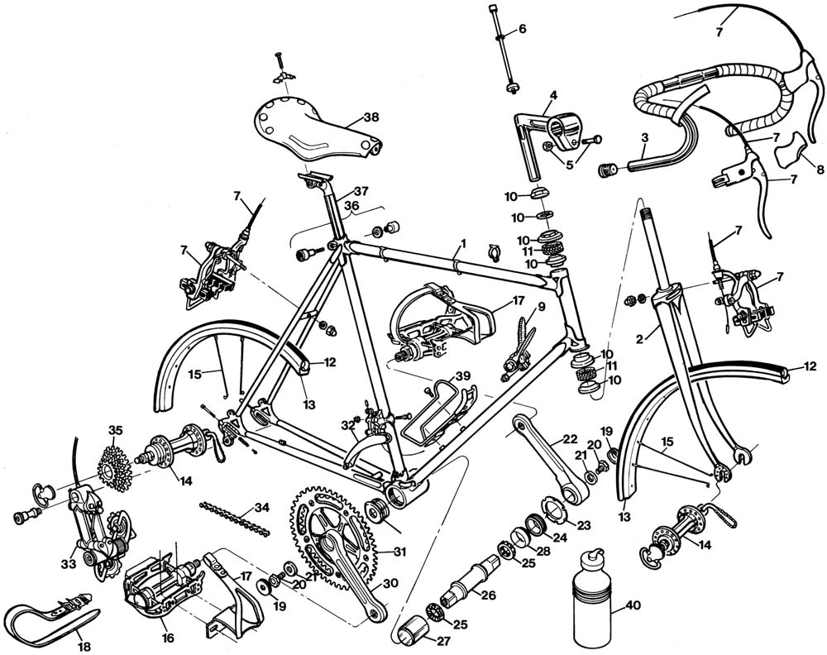

Ultimate Covert Security for your Bicycle
Michaël Memeteau
Notes:
Logo with 1 liner
Put another object to give sense of scale

Slide 2
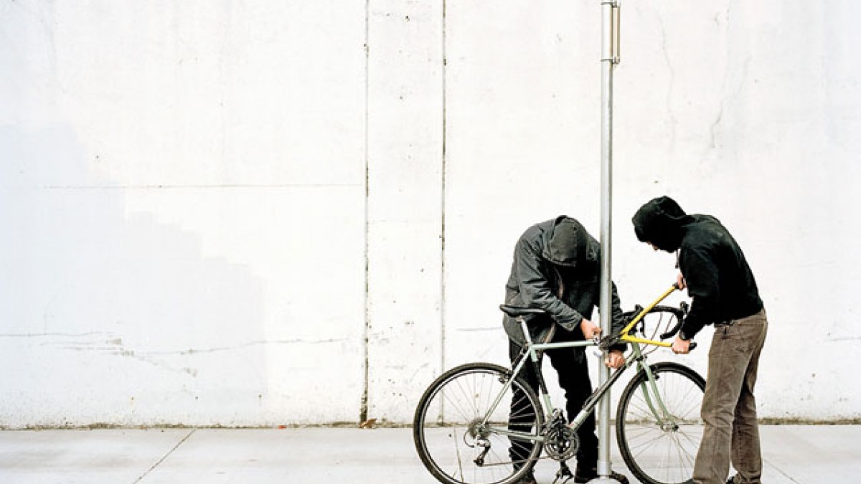
1 of 3 cyclists have already been victim of theft
1 bicycle stolen every 10 seconds in EU
Source: European Bicycle Market – CONEBI (2015)
Notes:
Worth 450 000 M€ per year
20M sold every year / 16M built in EU
Only 50% of the thefts are usually reported
Between 1 and 3 % recovery only
Netherland, Germany and France are TOP 3
25 000 e-Bikes stolen in the Netherlands amounts to 45 M€ in 2013
Less than half is reported

Slide 3
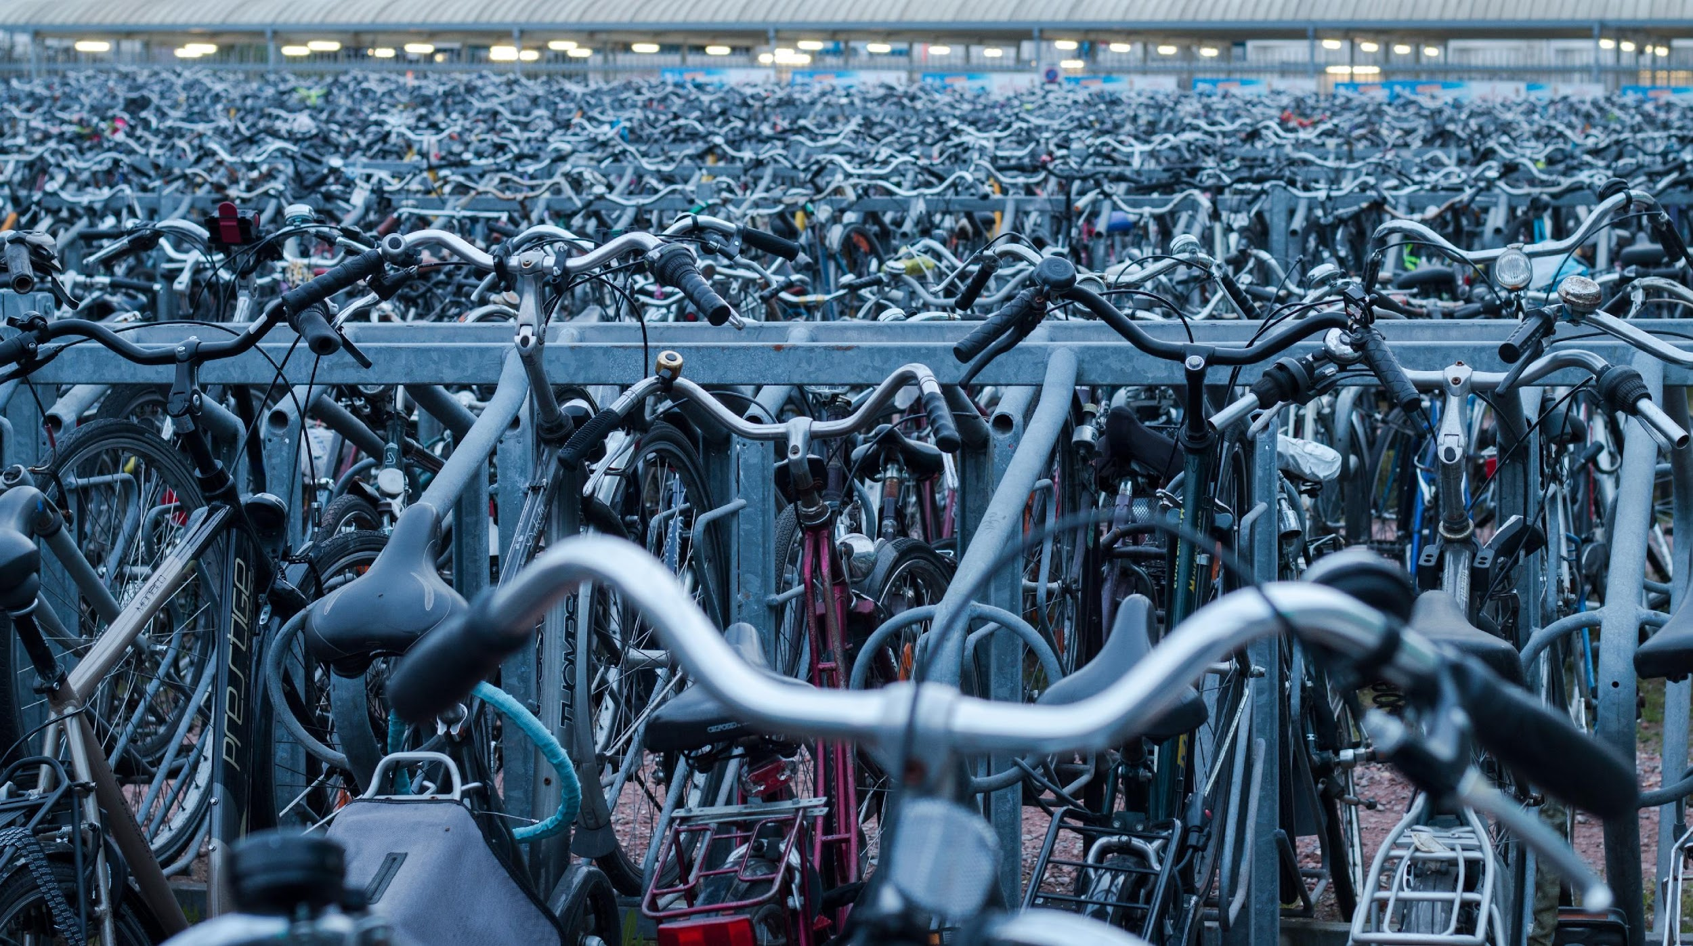
Recovery rate 2% only
Low priority for law enforcement
Sources: Free Wheels: An Assessment of Bicycle Theft in Denmark (2013)
Source: Free Wheels: An Assessment of Bicycle Theft in Denmark (2013)
Notes:
Worth 450 000 M€ per year
20M sold every year / 16M built in EU
Only 50% of the thefts are usually reported
Between 1 and 3 % recovery only
Netherland, Germany and France are TOP 3
25 000 e-Bikes stolen in the Netherlands amounts to 45 M€ in 2013
Less than half is reported

Slide 4
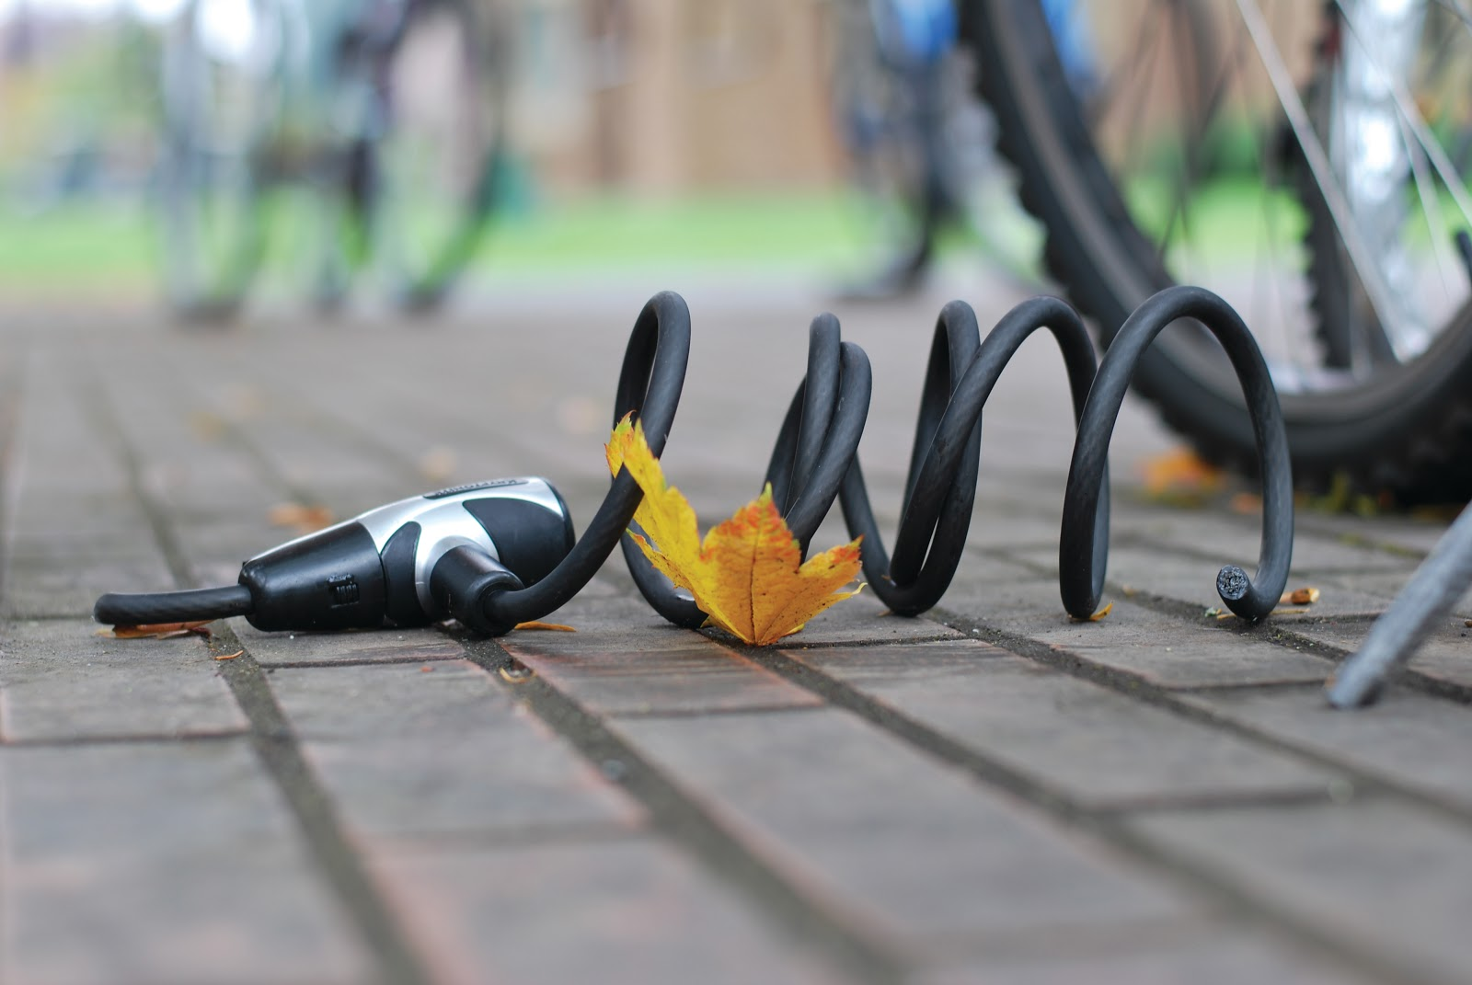
Existing solutions are not working…
Notes:
Worth 450 000 M€ per year
20M sold every year / 16M built in EU
Only 50% of the thefts are usually reported
Between 1 and 3 % recovery only
Netherland, Germany and France are TOP 3
25 000 e-Bikes stolen in the Netherlands amounts to 45 M€ in 2013
Less than half is reported

Slide 5
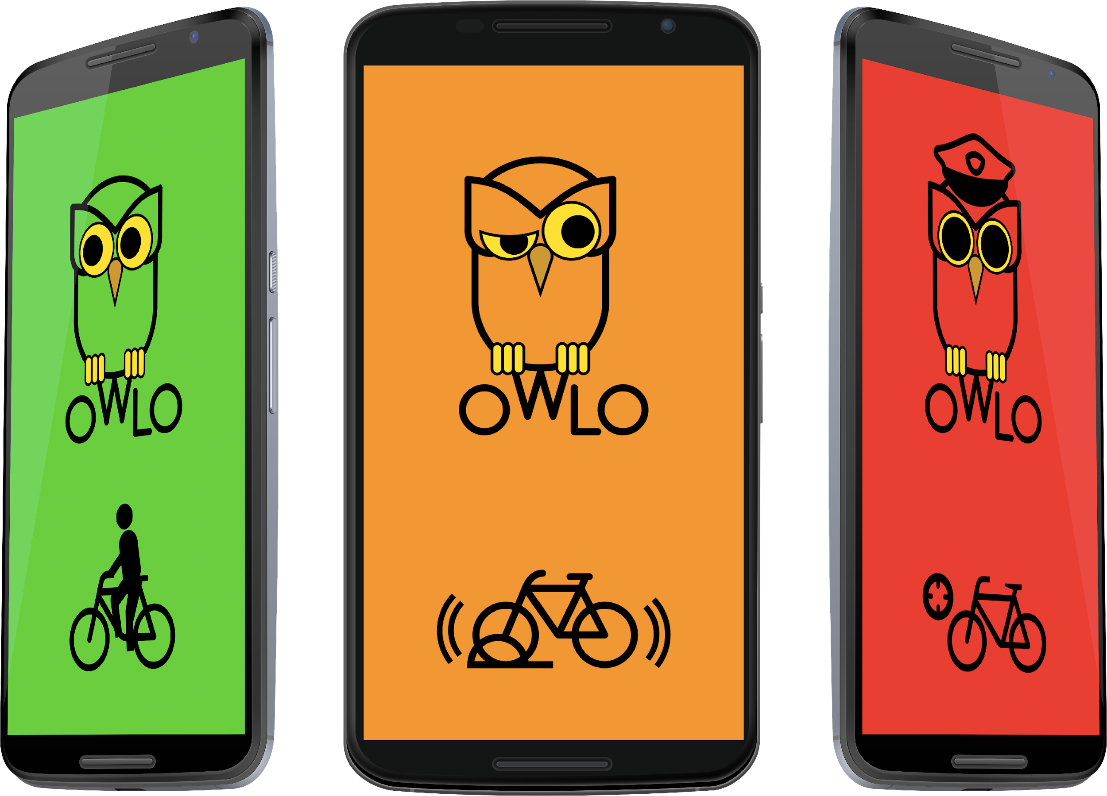
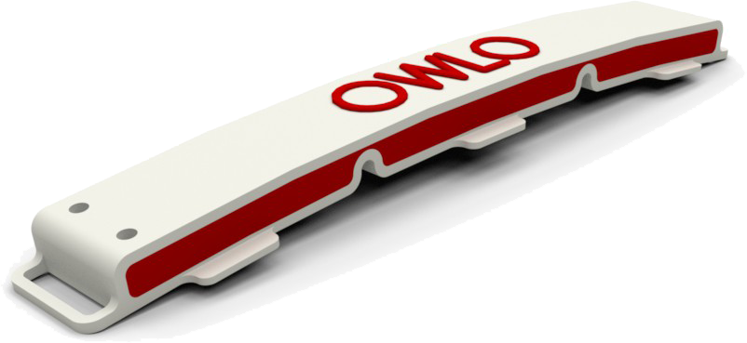
Our proposal
Notes:
3. The Solution
Battery will be user replaceable

Slide 6
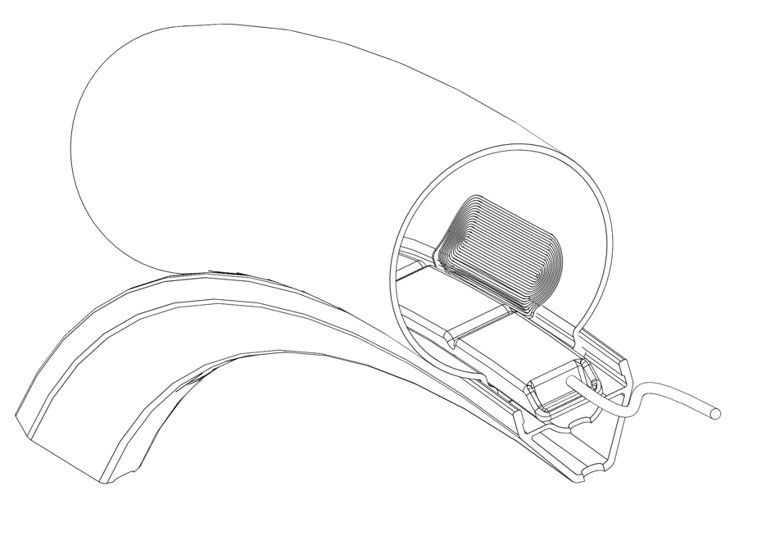
Our proposal
Long range
Large autonomy (+1 year)
Totally invisible
Notes:
3. The Solution
Battery will be user replaceable

Slide 7








Our proposal
Mobile App
BLE connection
Alarm & Battery Status
Notes:
3. The Solution
Battery will be user replaceable

Slide 8
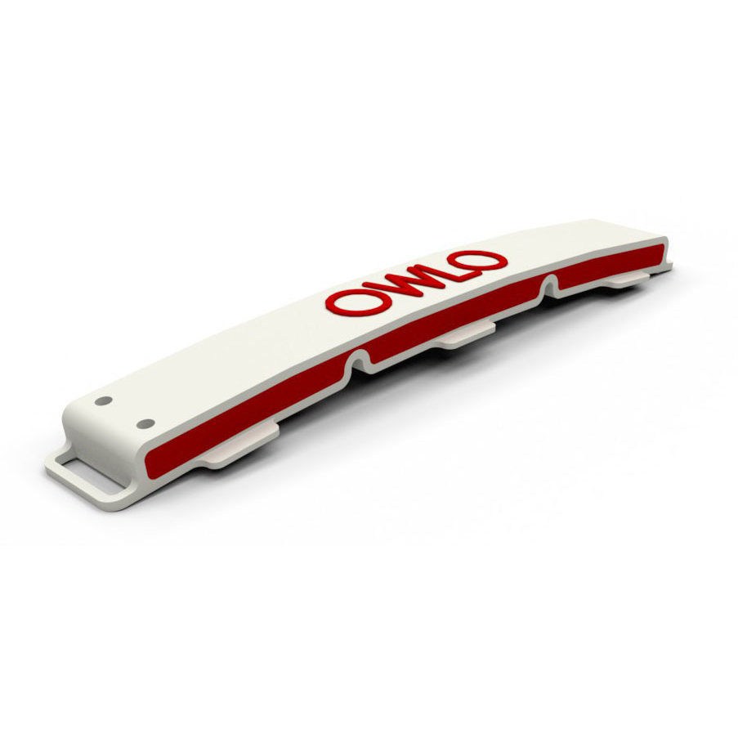
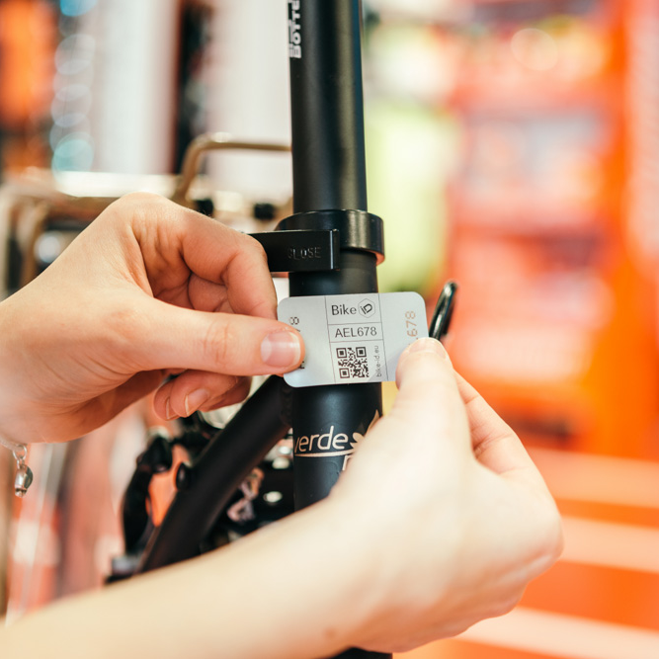
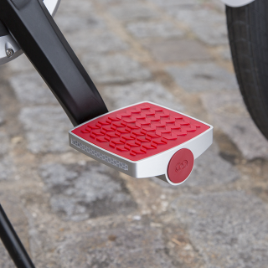
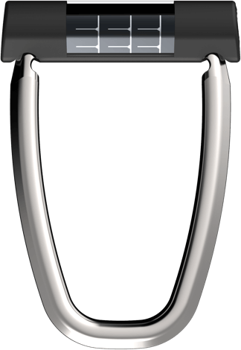
Price | 95 €* | 20 € | 175 €* | 250 €
Long range | √ |  | √
Autonomy | √ |  | √ | √
Prevention | √ | √ |  | √
Recovery | √ | √ | √
(*) Plus annual fee for communications
Notes:
Harmonize shadows
8. Differentiation
=> Matrix

Slide 9
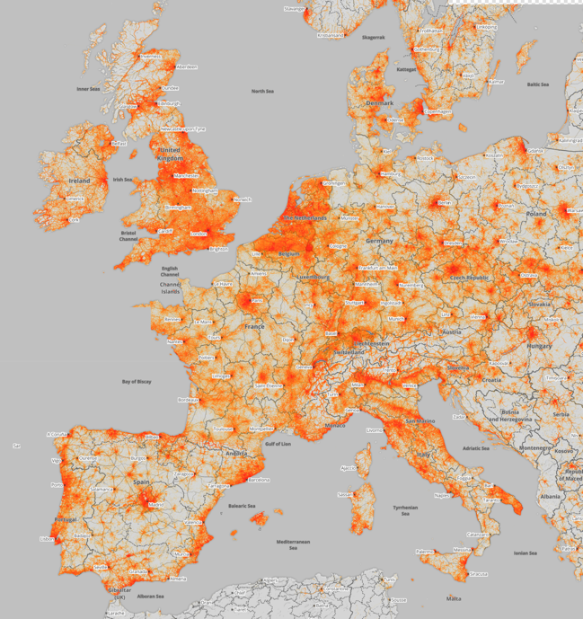
20 M bicycle sold per year in EU
15 % are owner of bicycle > 1000 €
Sources: Strava Global Heatmap (2016) & European Bicycle Market – CONEBI (2015)
Notes:
France – Specialized holds 43% of market size and 50% in value | Sport chains are holding 52 % | Internet is 15% and rising
Netherlands – More than 1 million sold in 2014 | 1 in 5 new bicycles sold is an e-bike. Avg price of a bike 828€
UK – 2 manufacturers Brompton & Pashley | Specialist retailers are 40% of sales by value | Largest is Halfords with 1/3 of retail sales
Germany - Avg. price for a bike is 528€
Denmark – 75% have their bike stolen once | Avg. Price 676€
Italy - Trekking and city bike models (32%), followed by mountain bikes (31%), children's bikes (18%), racing (6%), classic road (9%) and electric (4%) bikes.
1 Euro invested in cycling infrastructures gives back 4 or 5 Euros to the community in less than a year's time. 1 meter of bike lane may cost from 20 to 400 Euros”.

Slide 10
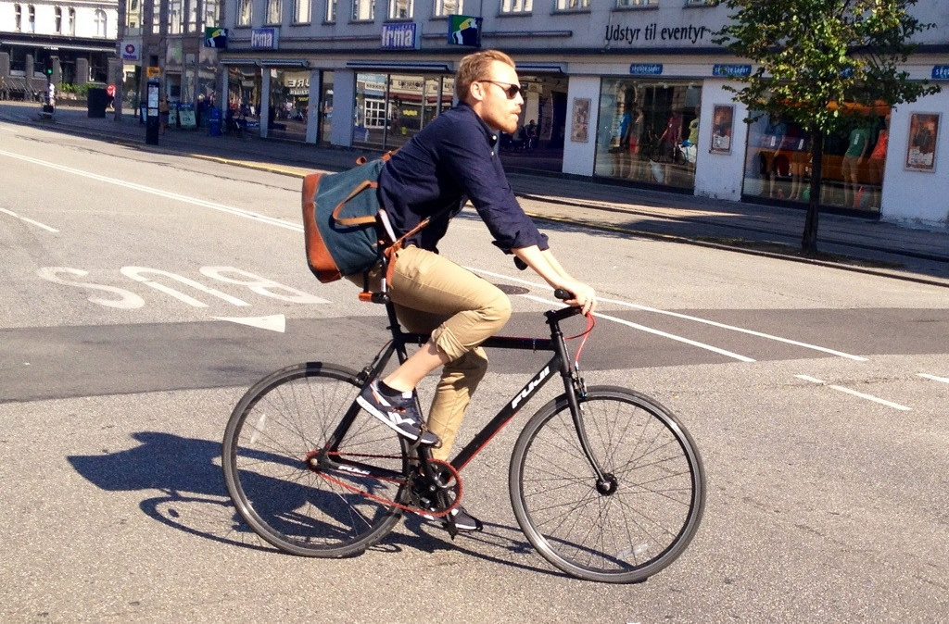
Commuter
Notes:
France – Specialized holds 43% of market size and 50% in value | Sport chains are holding 52 % | Internet is 15% and rising
Netherlands – More than 1 million sold in 2014 | 1 in 5 new bicycles sold is an e-bike
UK – 2 manufacturers Brompton & Pashley | Specialist retailers are 40% of sales by value | Largest is Halfords with 1/3 of retail sales
Germany - Avg. price for a bike is 528€
Denmark – 75% have their bike stolen once | Avg. Price 676€
Italy - Trekking and city bike models (32%), followed by mountain bikes (31%), children's bikes (18%), racing (6%), classic road (9%) and electric (4%) bikes.
1 Euro invested in cycling infrastructures gives back 4 or 5 Euros to the community in less than a year's time. 1 meter of bike lane may cost from 20 to 400 Euros”.

Slide 11
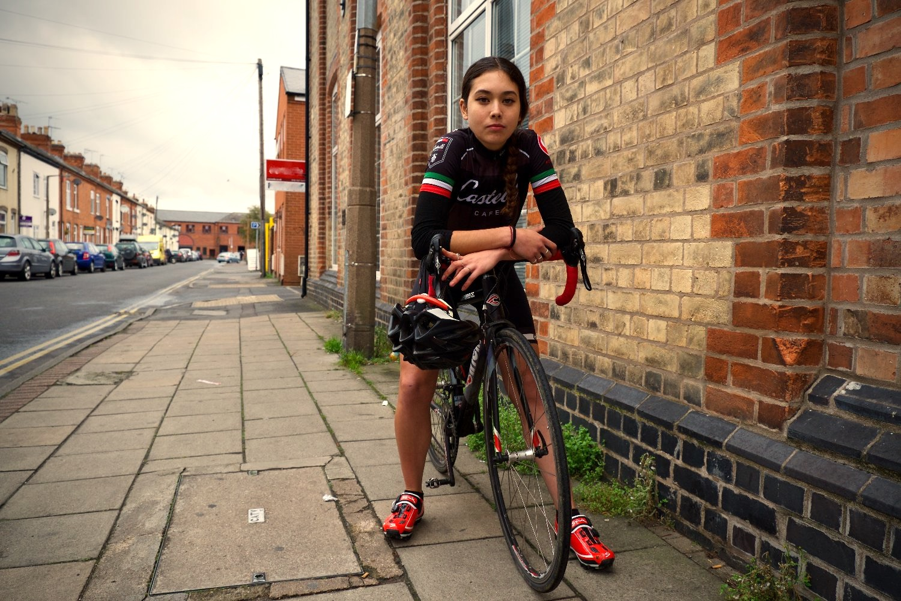
Week-end Warrior
Notes:
France – Specialized holds 43% of market size and 50% in value | Sport chains are holding 52 % | Internet is 15% and rising
Netherlands – More than 1 million sold in 2014 | 1 in 5 new bicycles sold is an e-bike
UK – 2 manufacturers Brompton & Pashley | Specialist retailers are 40% of sales by value | Largest is Halfords with 1/3 of retail sales
Germany - Avg. price for a bike is 528€
Denmark – 75% have their bike stolen once | Avg. Price 676€
Italy - Trekking and city bike models (32%), followed by mountain bikes (31%), children's bikes (18%), racing (6%), classic road (9%) and electric (4%) bikes.
1 Euro invested in cycling infrastructures gives back 4 or 5 Euros to the community in less than a year's time. 1 meter of bike lane may cost from 20 to 400 Euros”.

Slide 12
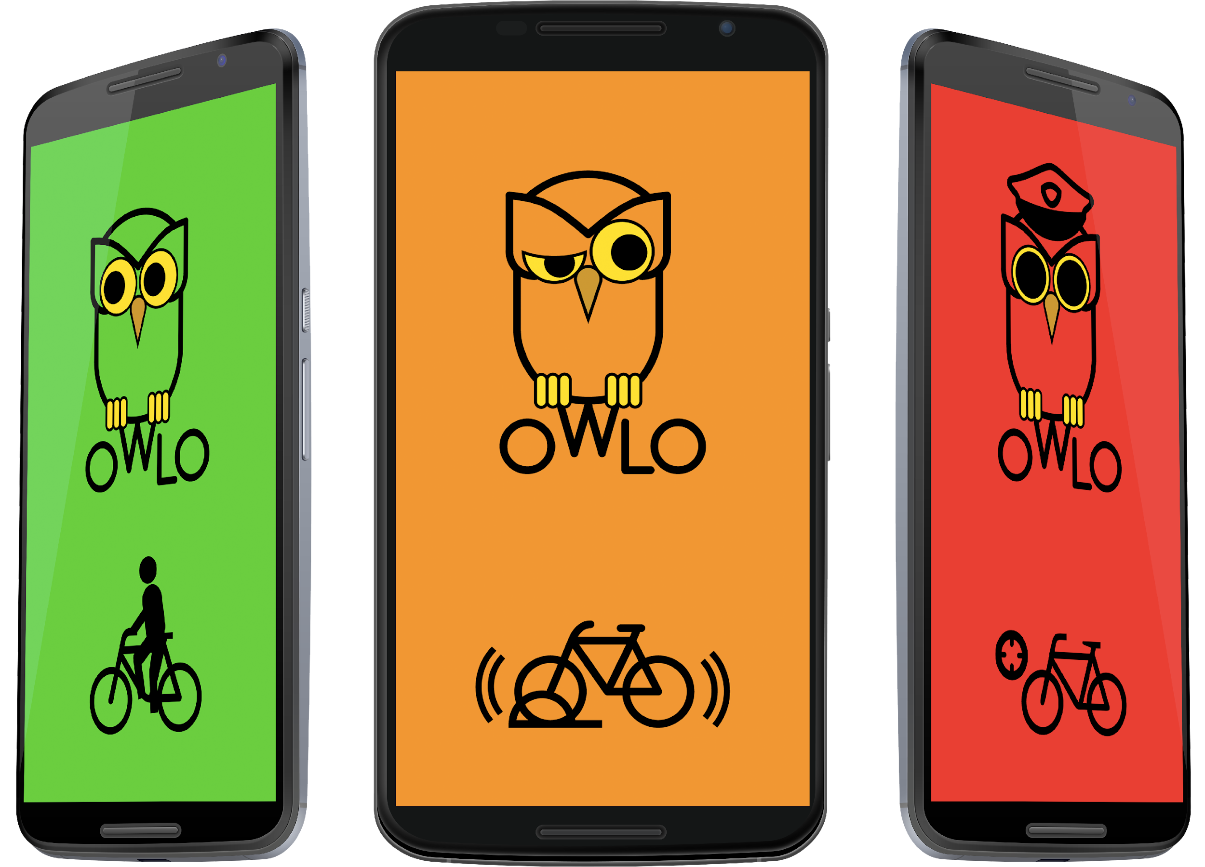
Revenue Stream
COGS 25 €
PVP 95 €
Subscription Fee
12 € / year
Notes:
Note: Full economic viability study is under way…

Slide 13

Busine$$ Model
B2C
B2B
Online
Retail
Speciality
Big box
Insurance
Tour Operator
Bike Sharing
OEM
Licensing

Slide 14
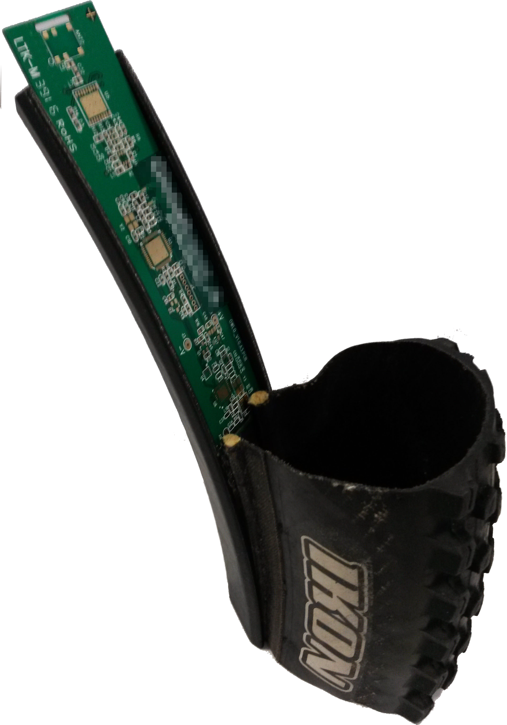
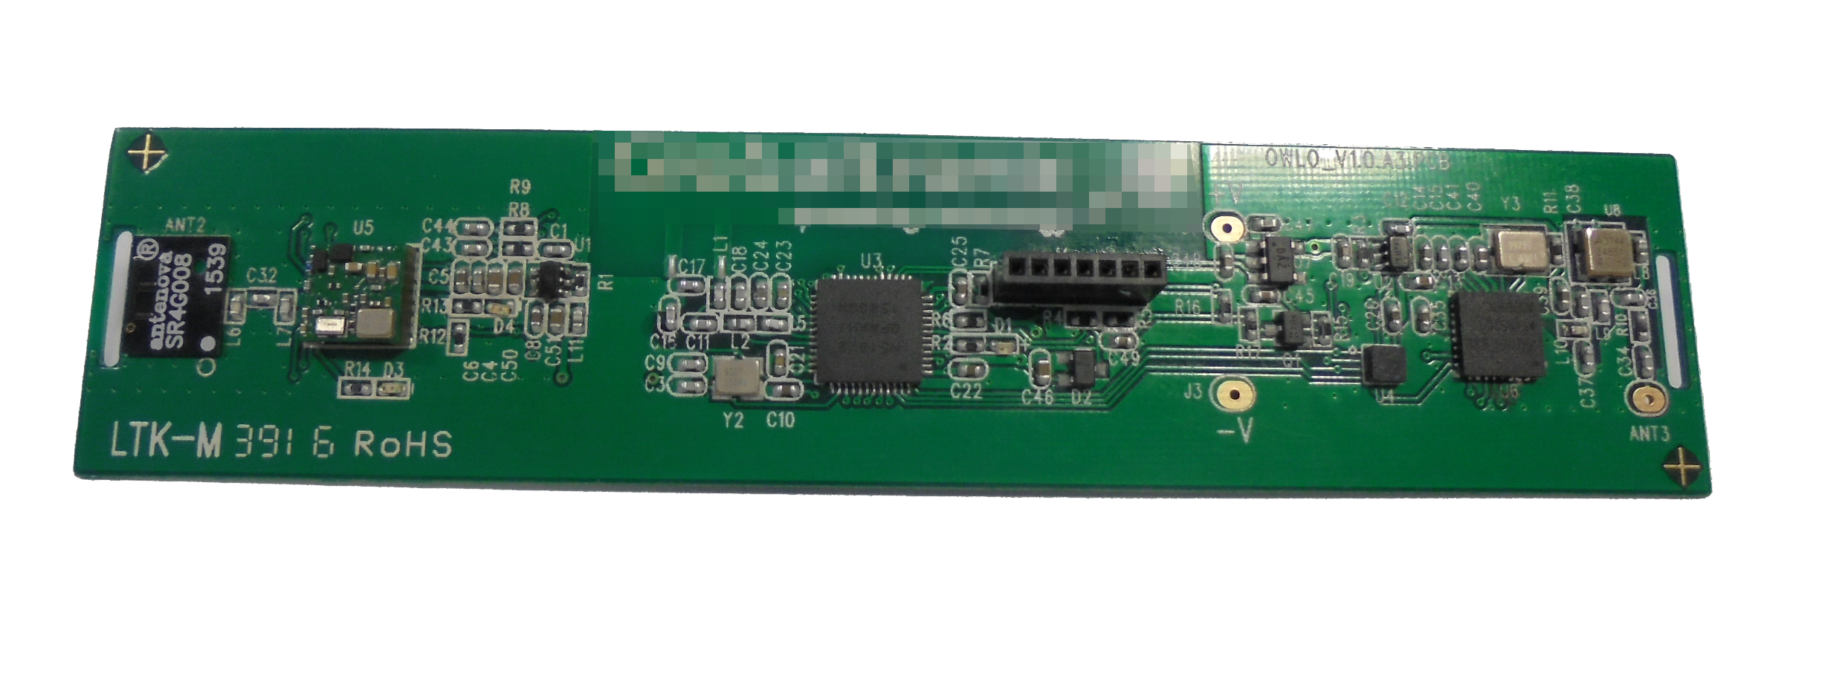
Prototype

Slide 15
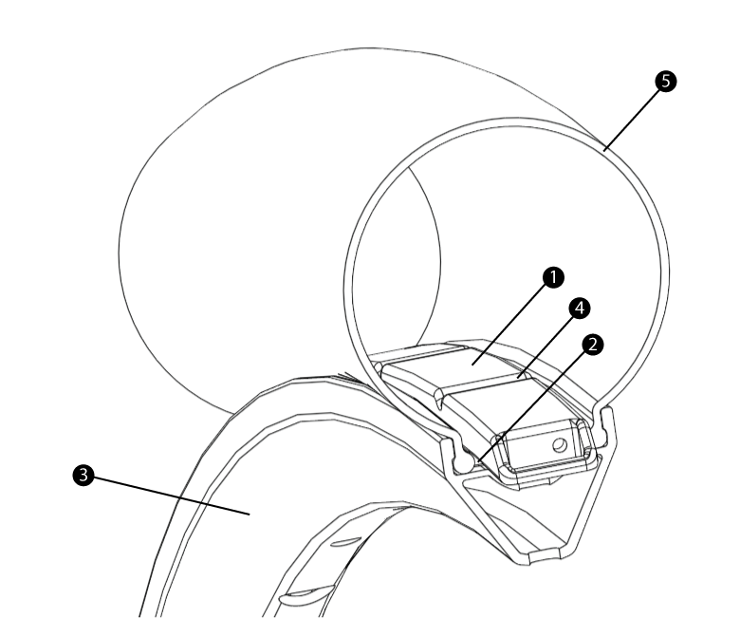




Timeline
Finalist in Singapore
OpenInnov ENGIE
Pre-série / Validation
Participation to
Portugal Bike Value
Production
1st Batch of 500
Patent Filed (PPP)
June
July
July
Aug
Dec
Notes:
10. Timeline | Milestones | Traction
Make it a real timelime…

Slide 16
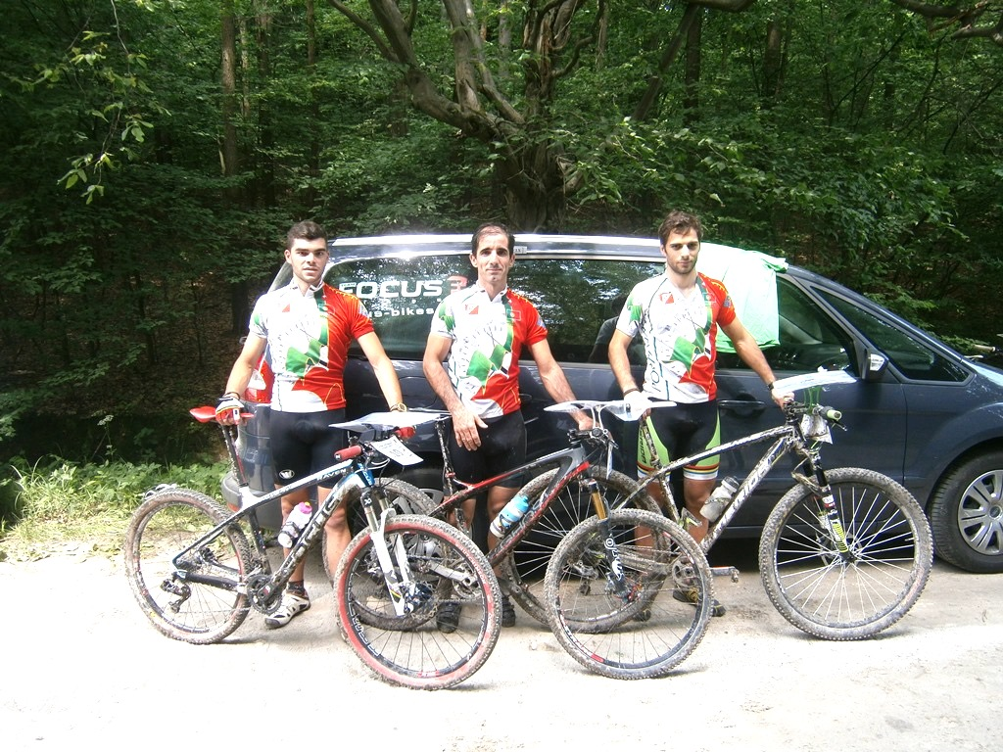

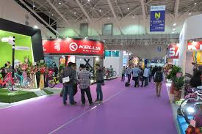

Marketing Effort
Presence in Sport Events
Indiegogo
Campaign
International Cycling Fairs
Specialized Press
Notes:
Publish recipe in IFTTT could be an interesting channel.
Speak with new bike shop
Targeted action towards Police force specialized in combat against bicycle related crime (London, Berlin, Paris, etc…)

Slide 17
Others Markets
B2C
B2B
Scooters & Motorcycle
Children
Pets
Sport Equipment
Tobacco vending machine
Fridge / Second Placement

Slide 18








Next on the list...

Slide 19
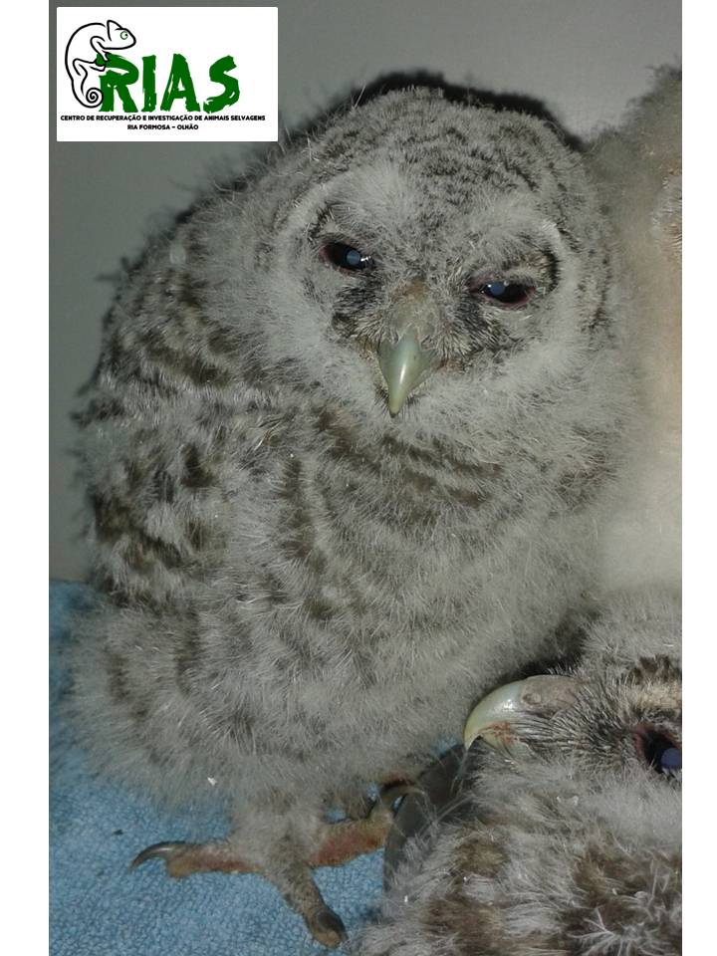

A little help can’t hurt…
Since we’re using an owl as logo,
we needed a way to return the favor…

Slide 20


Contact Info
Michaël MEMETEAU
mmu@nesto.io
+351 91 225 87 14
Notes:
13. Contact Info

Slide 21
Our proposal
Notes:
3. The Solution
Battery will be user replaceable

