Slide 1
Projects Portfolio

Slide 2

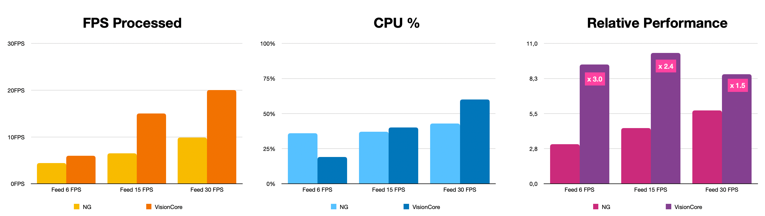
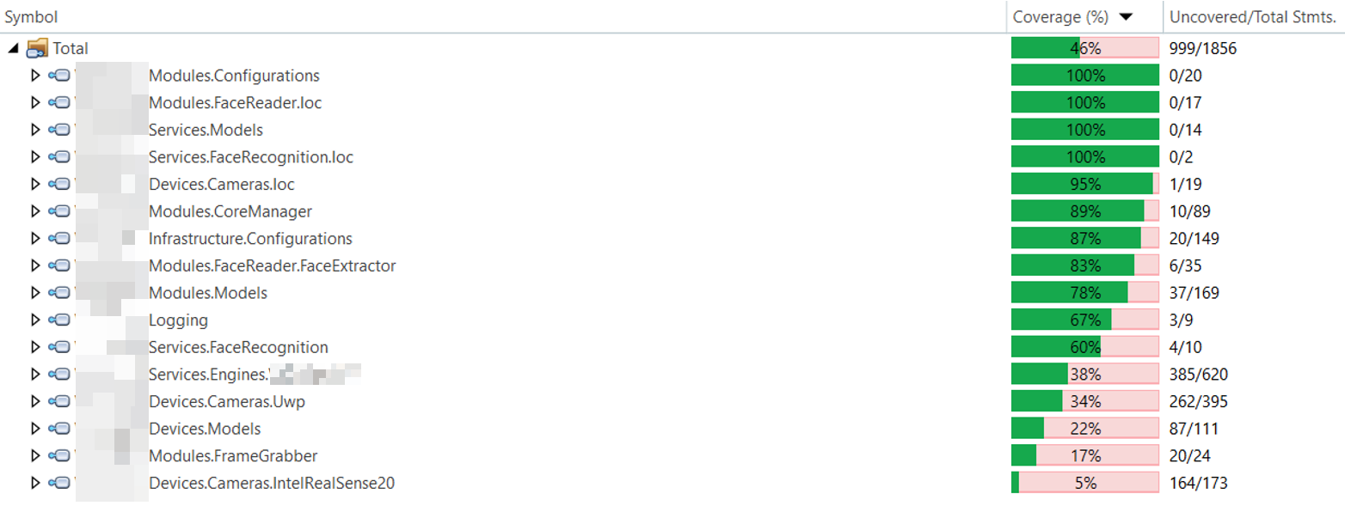
Context
Approach
Results
Customer
Automated Biometric Solutions for Passengers & Border Management
30% of the Global Market Share in Automated Border Control
2 Billion users processed
15000 Touchpoints deployed
500 Employees
Recently acquired by a major player for 320 M€
Challenges
Refactoring of the core middleware of the company after the departure of the main developer while also ensuring the migration from .NET Framework to .NET Core.
Mission critical for Vision-Box to meet stakeholders expectation.
Poor API documentation and excessively complex data model.
Poor performance from the current implementation (Face Recognition must typically be made under 30 ms).
Need to be platform-agnostic (Windows & Linux) and use C++ for critical components.
Challenging working environment as the team had to start the new development while still giving support to the existing solution.
Highly-regulated industry regarding privacy and security for Biometrics (ICAO, NIST).
Team & Timeframe
1 Solutions Architect / Product Owner
5 C# Developers
30 Months
Tool Stack
.NET Core 7.0
Visual Studio 2022
OpenTelemetry
GitLab
SonarQube w/ Test Automation
JIRA & Confluence
gRPC & REST
Methodology
High-performance Squad in hybrid work regime fully integrated with customer’s workforce following Agile methodology with multiple checkpoints & milestones along the projects.
Gradual hand-over in the last 6 months to gradually replace InnoTech’s developers by in-house developers.
Multi-mode biometrics device implementation starting with the most challenging to validate technical choices.
Achievements
Solution in production since October 2023.
Very significant performance improvement (up to 120% in some cases) enabling Vision-Box to achieve top-tier classification in several demanding tenders.
Start-up time reduced by an order of magnitude.
Implementation of an AI-driven fraudulent passage detection using sensor fusion.
Integration of several third-party biometric engines from the TOP5 NIST benchmarks (Paravision, ID R&D).
Code coverage increased from 13% to 46%.
Documented and future-proof implementation able to conform to most of the use-cases without performance penalty.

Slide 3
Structure
1. Header Section
- Project Title: Name the project to grab attention.
- Consultancy Firm Logo: Build brand recognition.
2. Introduction
- Briefly introduce the consultancy firm and its expertise.
- State the objective or purpose of the project.
3. Client Overview
- Name and describe the client (if permissible).
- Highlight the client's industry or sector.
4. Problem Statement
- Clearly articulate the issue or challenge the client faced.
- Emphasize the significance or impact of this challenge.
5. Consultancy Approach
- Outline the methodologies, strategies, or tools used.
- Highlight unique approaches or innovative solutions employed.
6. Implementation
- Describe how the consultancy strategies were put into action.
- Discuss any obstacles faced and how they were overcome.
7. Key Deliverables and Results
- Enumerate the tangible outcomes achieved.
- Quantify improvements (e.g., increased revenue by X%, cost reduction of Y%).
8. Testimonials or Case Study Highlights
- Incorporate quotes or testimonials from satisfied clients.
- Showcase specific success stories or impactful moments.
9. Visual Aids
- Include graphs, charts, or infographics showcasing data and progress.
- Use visuals to complement and reinforce key points.
10. Conclusion
- Summarize the overall impact on the client's business.
- Reiterate the value brought by the consultancy project.
11. Call to Action (CTA)
- Encourage potential clients to take action (e.g., contact for consultation).
12. Contact Information
- Provide clear and accessible contact details for inquiries.

