Slide 1
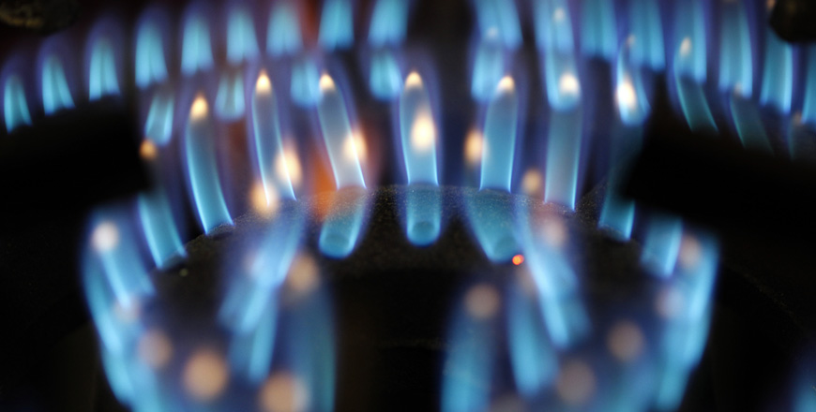


NESTO Gas
Digitalization of the bottled LPG value chain
Powered by

Slide 2
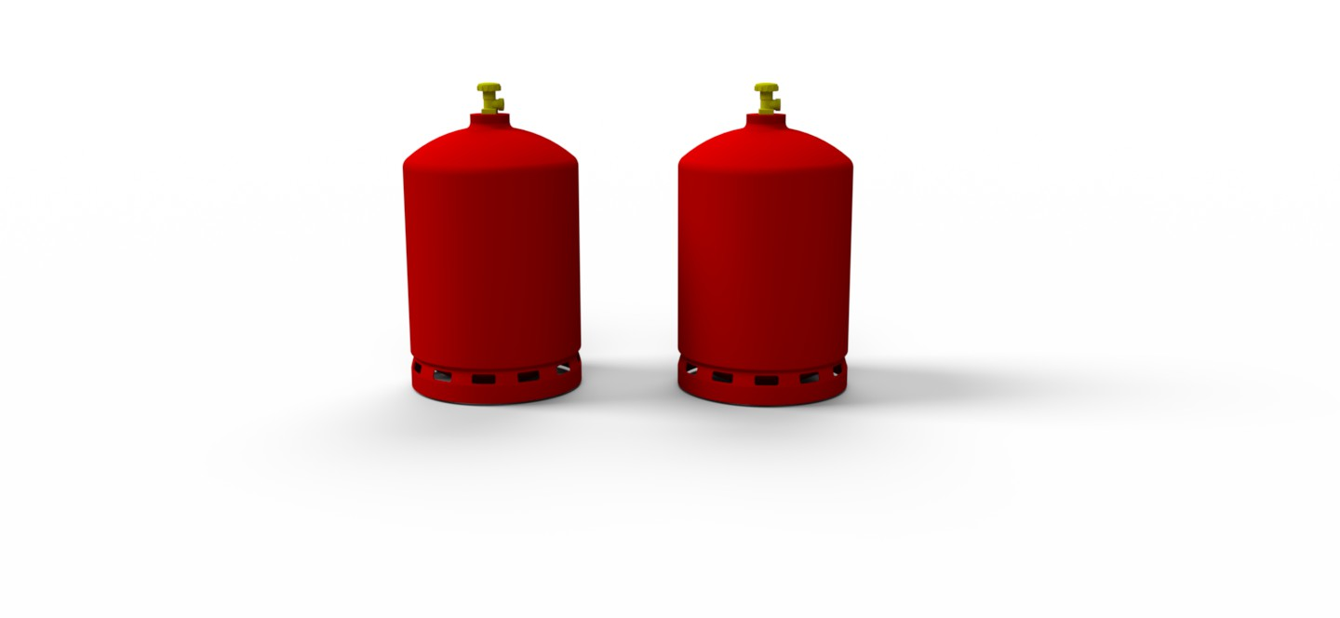
Can you tell the difference?
Notes:
Neither do we…
(One is full, the other is empty)

Slide 3

Neither does she… Cold shower syndrome

Slide 4
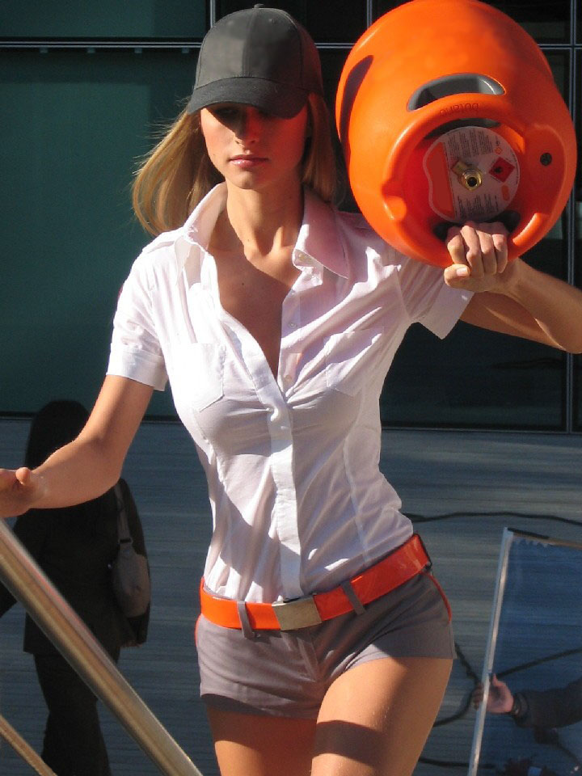
LPG companies want you to think they are like this …

Slide 5
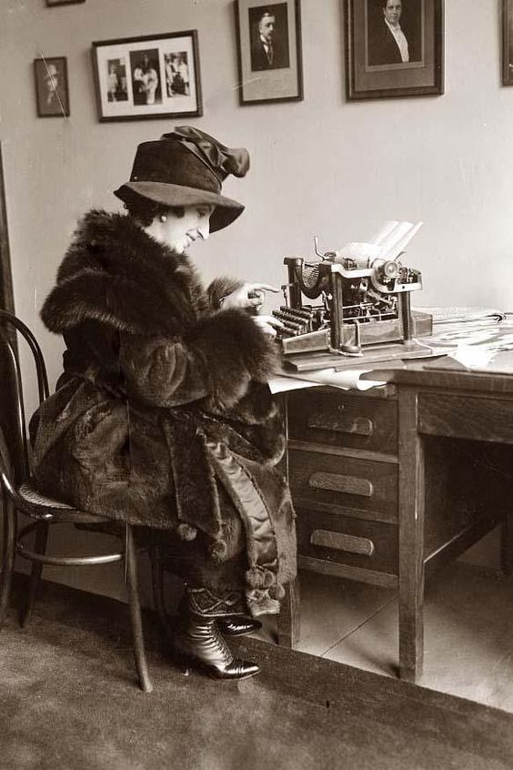
But it’s actually more like this…

Slide 6

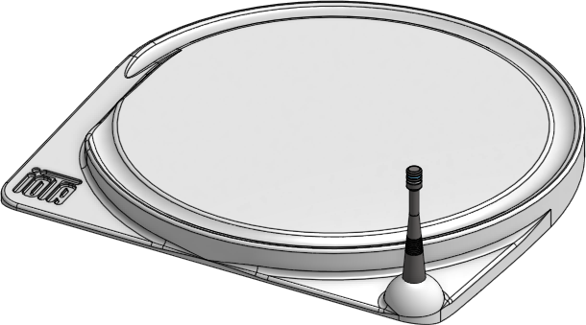
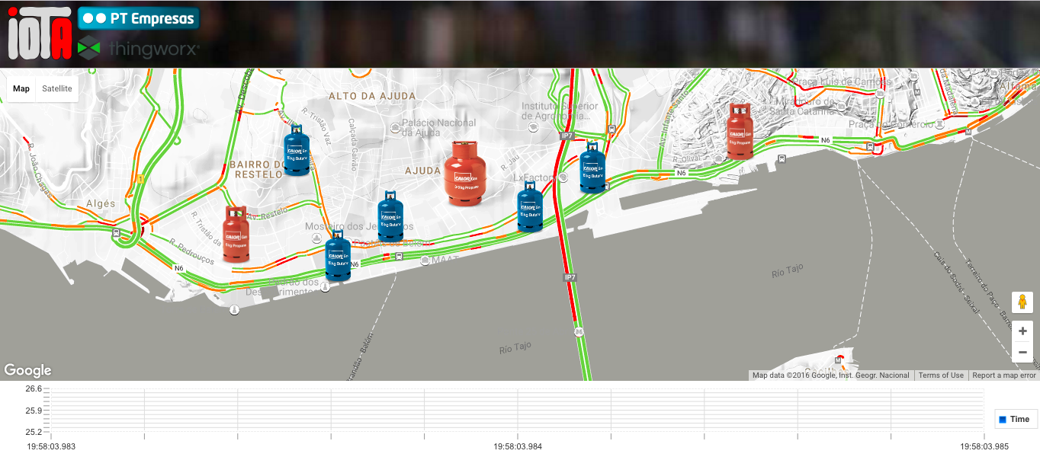
Never run out of gas ever again…
A smart battery-powered weight scale with IoT connectivity
A mobile app for consumers & distributors
A back-end with predictive analytics and routing capabilities
Notes:
Large autonomy;
Not depending on existing connection (no need for Internet);
Independent from the LPG bottle;
The initial setup allows to set the tare of the cylinder placed on the balance. It may be possible to try to “guess” which brand/bottle it is automatically since the different values are discrete and quite apart from one another but would still requires a UI to deliver the info and ask for confirmation.
The system is also self-calibrating over time (to minimize fluctuation on measurement over time and conditions like ambient temperature, vibrations, pressure difference, moisture, EMF and dirt).
A few euros in hardware and communication fees/year) with expected battery life up to 5 years.
The system is able to send weight + date + battery level twice a day and can deliver the information back to the customer.
Through a local algorithm, it would be possible to typify the consumer and the kind of equipment he possess (hot water heater, central heating system or just recreational).
This information is quite valuable and is paramount to the business model. I’m not sure this currently captured by any solution on the market yet (it will come for sure, especially with the smart connected bottles like “Genie” from LINDE or equivalent.
Estimation of consumption based on past behavior and machine learning could help to manage and program the deliveries, especially in more remote location.
One could even think of offering a better price if the customer agrees to get delivered at a specific date/time, in a such way that minimize the overall cost of the delivery for the distributor.
A smart algorithm to maintain or unbalance the market according to paying customers (distributors/LPG brands) of NESTO is key to business, especially in urban area where the competition is more fierce.
The largest GPL bottle manufacturer has a factory in Portugal AMTROL-ALPHA and is developing such products.

Slide 7
IoT platform to manage deliveries
Notes:
Large autonomy;
Not depending on existing connection (no need for Internet);
Independent from the LPG bottle;
The initial setup allows to set the tare of the cylinder placed on the balance. It may be possible to try to “guess” which brand/bottle it is automatically since the different values are discrete and quite apart from one another but would still requires a UI to deliver the info and ask for confirmation.
The system is also self-calibrating over time (to minimize fluctuation on measurement over time and conditions like ambient temperature, vibrations, pressure difference, moisture, EMF and dirt).
A few euros in hardware and communication fees/year) with expected battery life up to 5 years.
The system is able to send weight + date + battery level twice a day and can deliver the information back to the customer.
Through a local algorithm, it would be possible to typify the consumer and the kind of equipment he possess (hot water heater, central heating system or just recreational).
This information is quite valuable and is paramount to the business model. I’m not sure this currently captured by any solution on the market yet (it will come for sure, especially with the smart connected bottles like “Genie” from LINDE or equivalent.
Estimation of consumption based on past behavior and machine learning could help to manage and program the deliveries, especially in more remote location.
One could even think of offering a better price if the customer agrees to get delivered at a specific date/time, in a such way that minimize the overall cost of the delivery for the distributor.
A smart algorithm to maintain or unbalance the market according to paying customers (distributors/LPG brands) of NESTO is key to business, especially in urban area where the competition is more fierce.
The largest GPL bottle manufacturer has a factory in Portugal AMTROL-ALPHA and is developing such products.

Slide 8
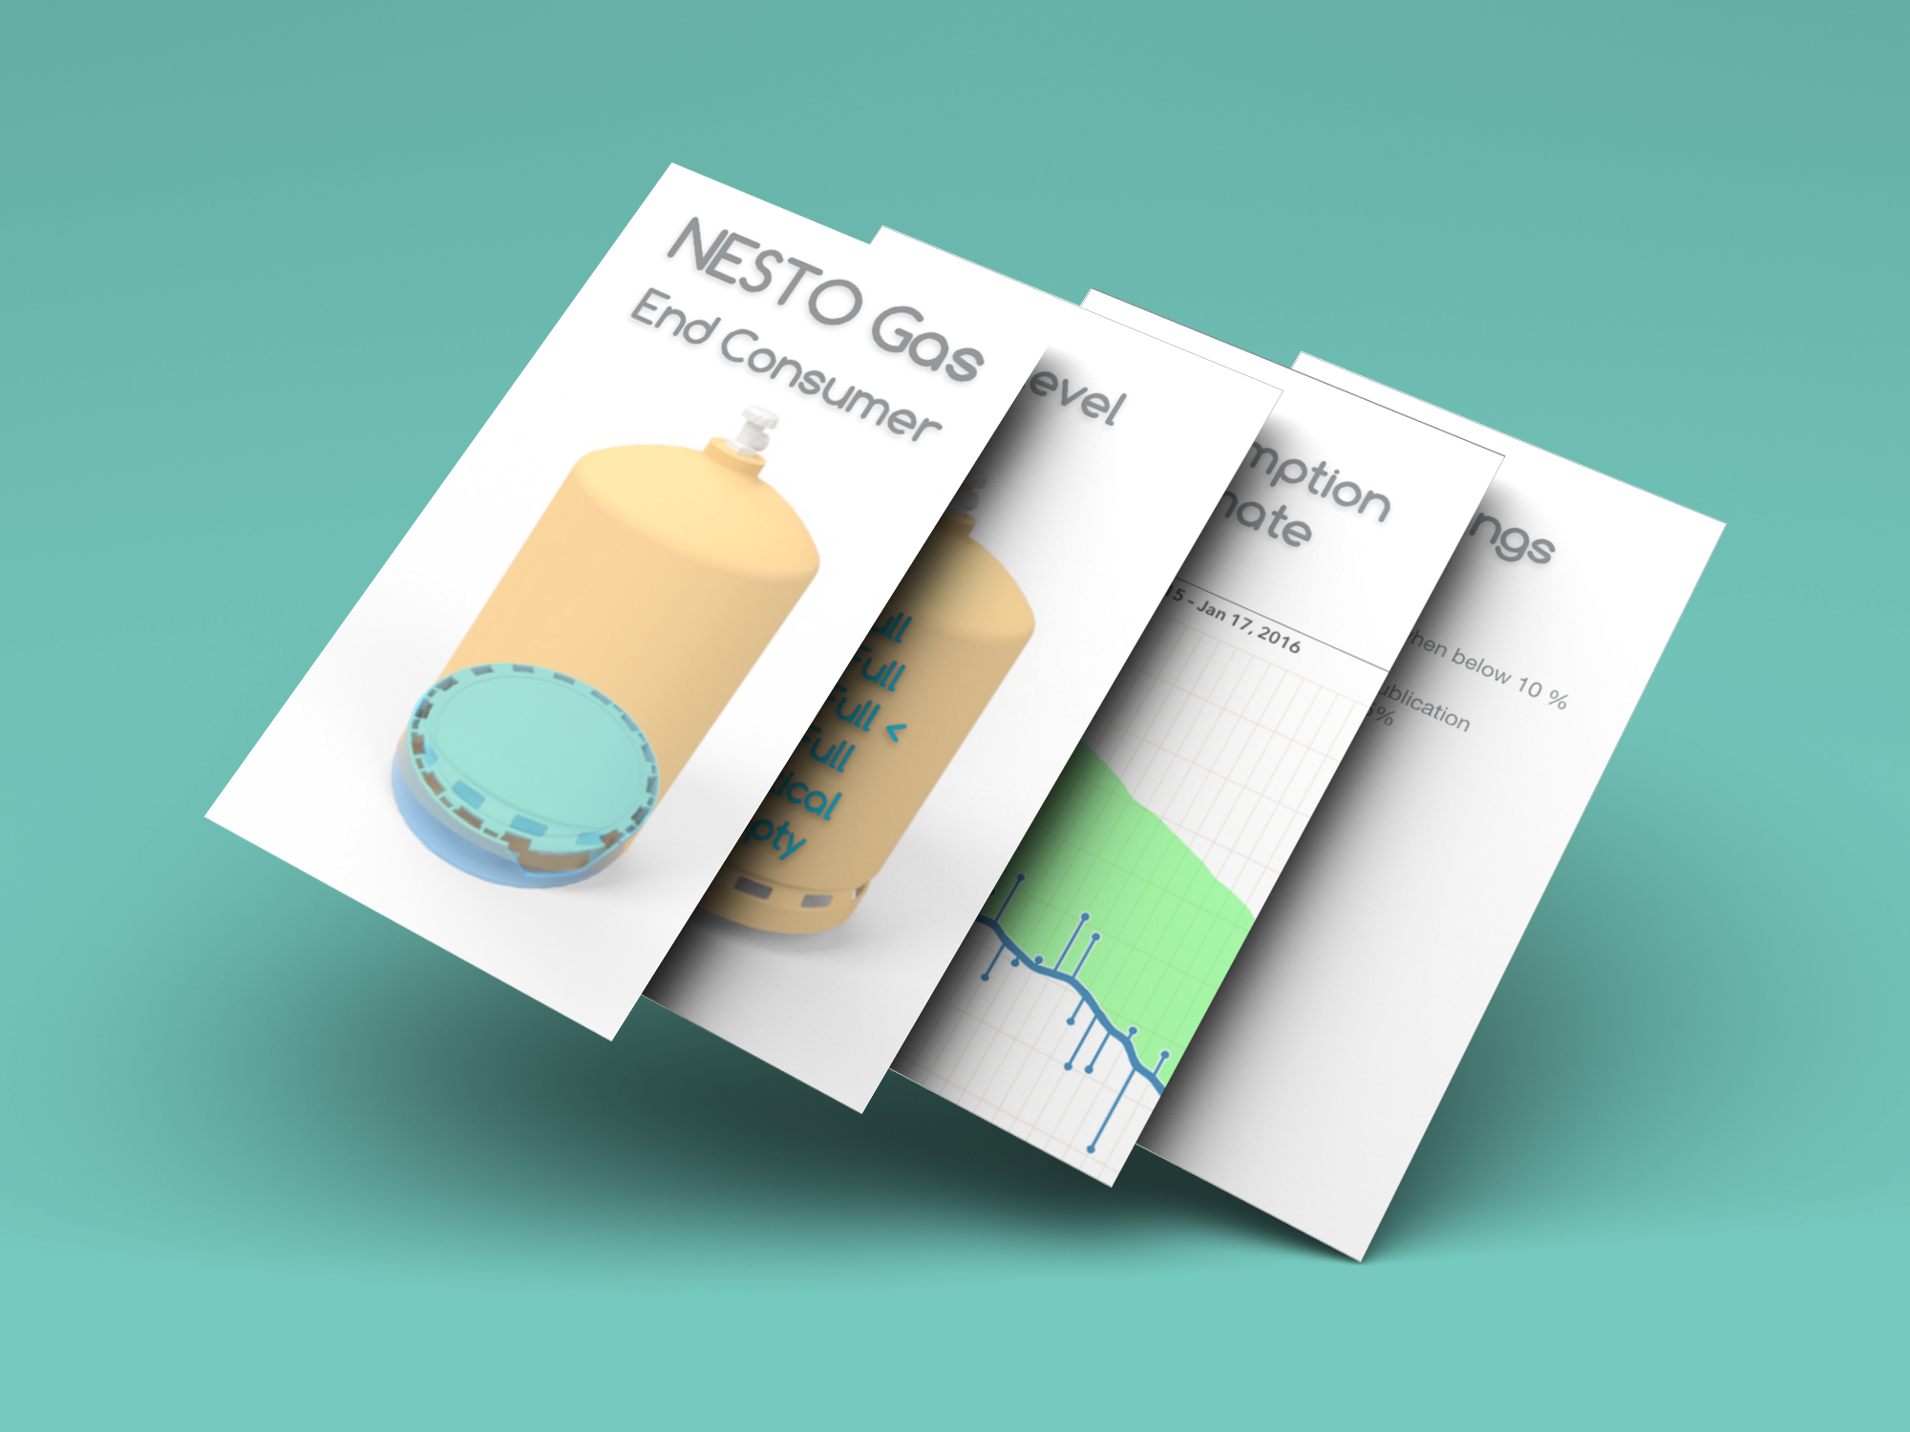
App for End-Consumers
Current gas level indication
Gas duration based on use
Scheduling doorstep delivery
Notes:
Add estimated date for new bottle request on the third screen
Fuel Level Window: A total of 88 percent of respondents identified “Can’t tell fuel level” as a complaint or concern about their steel propane cylinders. Asked later in the survey to rate the importance of various possible features of composite cylinders, this group awarded “View window for fuel level” a full 94 percent of the total possible points.
(Source: http://www.propanecouncil.org/uploadedFiles/Council/Research_and_Development/REP_10662%20Composite%20Cylinder%20Market%20Study.pdf)

Slide 9
Added Value Everywhere
End Consumer
Current level indication with alarm configuration
Scheduling doorstep delivery with real-time follow-up
Leak detection by smart measuring techniques
Brand
Improve customer retention
Reduction of gas cylinder inventory to cover new customers
Direct channel to end-user through the mobile application
Distributor
Dynamic optimized delivery route (-30% in distribution cost)
Automated pre-delivery check to insure customer presence
Accommodate manual delivery to ease market penetration
Notes:
The initial setup allows to set the tare of the cylinder placed on the balance. It may be possible to try to “guess” which brand/bottle it is automatically since the different values are discrete and quite apart from one another but would still requires a UI to deliver the info and ask for confirmation.
The system is also self-calibrating over time (to minimize fluctuation on measurement over time and conditions like ambient temperature, vibrations, pressure difference, moisture, EMF and dirt).
A few euros in hardware and communication fees/year) with expected battery life up to 5 years.
The system is able to send weight + date + battery level twice a day and can deliver the information back to the customer.
Through a local algorithm, it would be possible to typify the consumer and the kind of equipment he possess (hot water heater, central heating system or just recreational).
This information is quite valuable and is paramount to the business model. I’m not sure this currently captured by any solution on the market yet (it will come for sure, especially with the smart connected bottles like “Genie” from LINDE or equivalent.
Estimation of consumption based on past behavior and machine learning could help to manage and program the deliveries, especially in more remote location.
One could even think of offering a better price if the customer agrees to get delivered at a specific date/time, in a such way that minimize the overall cost of the delivery for the distributor.
A smart algorithm to maintain or unbalance the market according to paying customers (distributors/LPG brands) of NESTO is key to business, especially in urban area where the competition is more fierce.
The largest GPL bottle manufacturer has a factory in Portugal AMTROL-ALPHA and is developing such products.

Slide 10

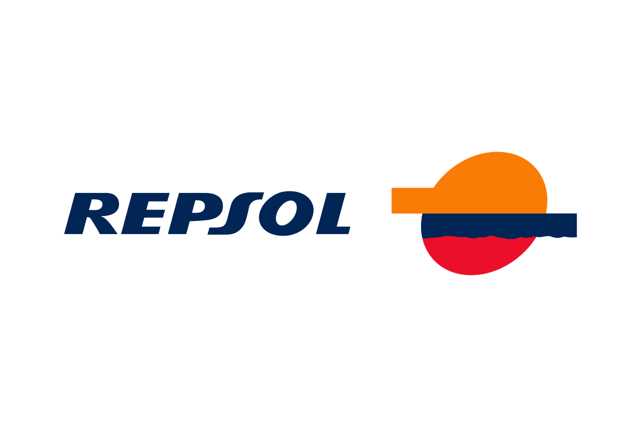



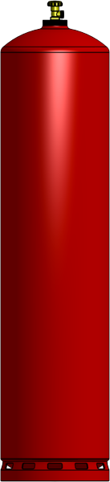
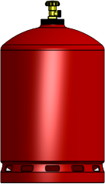
Business model - B2B
NESTO scale is paid by LPG brand ~25 €
(eventually charged back to end-consumer as a deposit)
NESTO service fee per delivery
Access to platform per distributor / per month
3 €
1 €
Notes:
88% of end user is actually ready to pay for a device that tells them how much gas is left in the bottle (* survey result).

Slide 11
World – 266 B€
Portugal – 659 M€
Others
Sources: Transparent Market Research 2014
Notes:
659 M€ in 2010
http://www.poupenabotija.pt/poupenabotija/precos;
http://www.enmc.pt/pt-PT/noticias/arquivo-de-noticias/o-mercado-do-gpl-em-portugal/
http://cpa.idea-factory.pt/UserFiles/rita-alves-prio.pdf
Repsol => Shell sold in 2004;
OZ => From Champalimaud since 2009 after buying from Galp Energia And Esso;
Rubis => French 2014, bought what was left from BP Portugal;
Prio => 95% OxyCapital / 5% Martifer
O novo diploma vai obrigar a CLC, companhia logística detida maioritariamente pela Galp, a garantir o acesso de outras empresas ao oleoduto entre Sines e Aveiras. A Galp tem 65% da CLC, a BP e a Repsol têm ambas participações de 15% e a Rubis Energia tem 5% do capital.
(Source: https://www.publico.pt/economia/noticia/lei-do-petroleo-obriga-galp-a-abrir-o-oleoduto-entre-sines-e-aveiras-1704872)
Source:
https://www.iseg.ulisboa.pt/aquila/getFile.do?fileId=530960&method=getFile
http://www.portugalglobal.pt/PT/PortugalNews/RevistaImprensaNacional/Investimento/Documents/Prio_DE170315.pdf
http://economico.sapo.pt/noticias/prio-controla-7-do-mercado-e-ja-faz-sombra-as-grandes-petroliferas_214075.html
Was Galp, BP, Repsol & Cepsa.
Market doesn’t move since 50 years!
Repsol is in re-structuration, they shouldn’t be able to move quickly.
Galp wants to maintain the status-quo.
Our most important storage unit is located at Sigás, where Galp Energia has a 60% stake in partnership with Rubis (35%) and Repsol (5%). Galp Energia's share in the infrastructures of Sigás guarantees a total storage capacity of 34,800 tonnes.
Galp Energia has its own LPG-filling infrastructure in Sines and at the Perafita park. CLC, in which Galp Energia has a 65 per cent stake, also has filling infrastructure. This plays an essential role in the logistics of the LPG bottles sub-segment.
From these three facilities, we deliver LPG in bulk to customers by tank trucks, and LPG bottles by pick-up trucks.
We deliver LPG bottles to 300 resellers across Portugal. These resellers then distribute the bottles to second-line resellers, almost 700 service stations and more than 20,000 points of sale.
Some of the companies that supply transport services are:
Transporte Amaral & Frias, Lda,
Transportes Rodoviários J. Barroso, Lda,
Esporgás, Lda, Camionagem Central de Cheleiros, Lda,
Transportes Rodoviários Monte da Caparica, Lda,
Transportes Paulo Duarte, Lda
Transportes Rodoviários de Mercadorias da Agueira, Lda.
Normally the cost of secondary transport between the supply point and the distributor’s storage units is covered by the suppliers and downstream the cost is factored into the price charged to the customer.
Butane and propane in bottle is sold through a network of first line distributors, who set the prices of the product on the basis of purchase prices and the specific situations in the area where they sell. The wholesalers are supplied by the oil companies as per the orders they put in and are bound by contracts that provide for technical and commercial support, equipment on a no-charge basis (especially the bottles themselves), measuring and illustrational equipment (for example display units for their point of sale, connectors, rubber tubing and clips). The contract also in many cases includes management software that is specific for sales of bottled LPG. In terms of the four companies - Galp, Esso, Repsol and BP – they have around 1,000 first line distributors in Portugal.
The contractual relationships between the suppliers and the first line distributors are governed by supply contracts. In general, these contracts contain the following terms:
(i) they are exclusive, with demarcation of specific geographical areas;
(ii) the first line distributors can use their own network of second line distributors;
(iii) the bottles of LPG, the pallets for transport and display and advertising material belong to the supplier;
(iv) the products are normally delivered to the warehouse of the first line distributors, and these must have licenced premises in accordance with the standards in force and
(v) the offloading of the bottles of butane and propane is to the account and at the responsibility of the first line distributors.
(Source: http://www.concorrencia.pt/vEN/Estudos_e_Publicacoes/Estudos_Economicos/Energia_e_Combustiveis/Documents/Final_Report_on_Liquid_and_Gas_Fuels_March_2009_English_version.pdf)

Slide 12

Some Figures for Portugal
58 % of the total consumption in gas is from bottled LPG
Highest LPG consumption per capita in EU
3rd highest price in EU
Source: DECC Consumer association (2015)
Notes:
Additional value could eventually be captured by serving as a buffer between customer and distributers by insuring that final customer is getting the value equivalent to the gas left in the cylinder back and negotiating with distributers.
Average of 300 gr per cylinder is unconsumed which amount to 72 € year

Slide 13
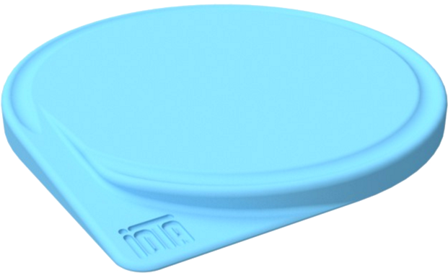
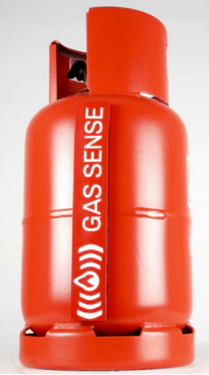
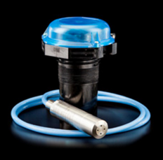
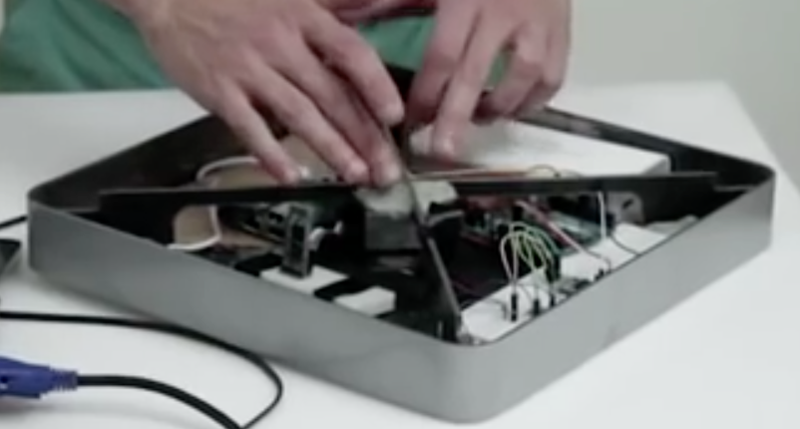
 | Nesto by Iota | GasSense by George Edwards | SkyBlitz | Gascale by Mabe | Refuel by Quirky
What ? | SIGFOX Connected Scale | BLE Magnetic Linear Temperature Sensor | GPRS Connected Pressure Sensor | BLE Connected Scale | Wi-Fi Connected Scale
Pro | Doesn’t depend on user connectivity | Smart & un-obstructive | Usable for tank as well | Free* | Cheap
Cons |  | Only for metallic bottle Not accurate | Expensive | Only in Ecuador | Only for BBQ Wi-Fi Only Not accurate
Price | 39€ | 40 € | 8€/month | - | 14 €
Business Model | Platform | One Shot / B2C | Platform | One Shot / B2B | One Shot / B2C
Competition
Notes:
Beside
LPG brands
Gas cylinders manufacturers
M2M / Telemetry specialist
Other Nesto’s?
About transparent cylinders:
COMET cylinder is not transparent, avoiding the impression caused on end customers when ob­serv­ing the liquid gas vaporization (boiling) and noticing the gas residue when the cylinder is “empty”.

Slide 14
Differentiator
A service, not a product
Strategically positioned between the end-user and the brand
Holistic approach
Notes:
Unoccupied space, but for how long?

Slide 15
Go to Market Strategy
Phase 1 – Large LPG cylinder in rural area (with brand exclusivity)
Phase 2 – Small LPG cylinder
Phase 3 – Smart rack for service station and small self-service distribution point
Notes:
Mention Nanotech
Speak of complete view of the logistics system

Slide 16



SCTN / Industry Partner
NDA & MoU
Provide ready-to-use communication module for the Pilot
Provide access to their IoT platform
Later access to international partners through their network
NDA
Provide access to validated suppliers for strain gauge
Open to be the partner for industrialization (facilities in Ningbo, China)
NDA & Former relationship
Will provide the route optimization of the pilot for free
NDA
Proposal to raise defensibility of the product by integrating nanotechnology for cheap weight sensing
Notes:
Will organize a working weekend to gather all CEO’s partners.
Smart algorithm to propose delivery time where the user is likely to be at home.
Other partnership.
- Nanolike
- Connit & Gazbox
- NTU (Singapore)

Slide 17
The secret sauce
Experienced industrial partners;
The one-bottle model could allow brands to increase profit;
Security features (leak, usage pattern detection);
Holistic view of the bottle LPG supply-chain (complete range of product);
Angle on nanotech (1000 x less consumption & 10 x more sensible);

Slide 18


Team
Michaël Memeteau
M2M/IoT Specialist
Co-Founder of the first Portuguese fleet management application
Entrepreneur x 3
Pedro Filipe
Business Developer with proven track of records in complex project management and logistics
Notes:
Explain that Pedro is a temporary member.
Plan to find a suitable CFO is to follow the Founder Institute session that will start in October 2016 and end in Jan 2017.

Slide 19








Traction
1st Place in Productized
Lisbon Hardware Accelerator
Portugal Venture
Submission Call Industry 4.0
Winner in Singapore
“the Game Changer”
Featured Start-up
@PT IoT Challenge
Alpha Pass Web Summit
Patent Filed
June
July
July
Aug
Oct
Nov
Notes:
Accepted by BrightPixel
Accepted by Vodafone PowerLab
EDP is watching us
Alpha Pass Summit from MEO
Founder Institute in October
Invited by HWTrek to Asian Tour

Slide 20
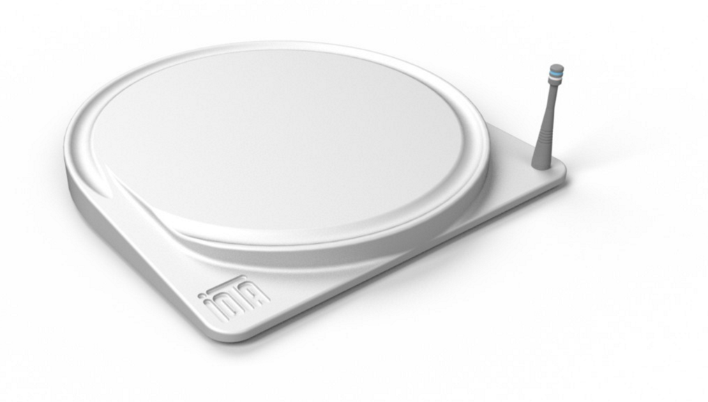
Contact
Michaël MEMETEAU
michael@iotagas.com
+351 91 225 87 14
+351 21 887 04 87

Slide 21
Next steps
Tech
Business
Field coverage test
Pilot with a national player
Mobile app development & back-end integration
Product development & Industrialization
Refine financials & business model
Apply for Portugal 2020
Get customers
Get grant for research with INL
Complete IP & Rise defensibility
Notes:
Will organize a working weekend to gather all CEO’s partners
NTU – Singapore
Nanolike
CONNIT & Gazbox

Slide 22
Investment
Milestone (end of the month) | Deliverables | Price/Unit | Funding needs* | Portugal Ventures Investment ** | Promotor's Investment *** | Investment by other Investors
December 2016 | Functional Prototype |  | €60 000,00 | €40 000,00 | €15 000,00 | €5 000,00
March 2017 | SIGFOX Certification |  | €20 000,00 | €20 000,00 | €- | €-
June 2017 | Pilot Run - 1st Batch 100 |  | €25 000,00 | €25 000,00 | €- | €-
June 2017 | Molds (final) |  | €30 000,00 | €30 000,00 | €- | €-
September 2017 | Customer Approval |  |  |  | €- | €-
November 2017 | Mass Production - 2nd Batch 500 | 100 € | €50 000,00 | €25 000,00 | €- | €25 000,00
December 2017 | Mass Production - 3rd Batch 2500 | 50 € | €125 000,00 | €25 000,00 | €- | €100 000,00
March 2018 | National Roll-out (1st Phase) |  | €700 000,00 | €335 000,00 | €365 000,00 | €-
TOTAL |  |  | €1 010 000,00 | €500 000,00 | €380 000,00 | €130 000,00
Notes:
Will organize a working weekend to gather all CEO’s partners
NTU – Singapore
Nanolike
CONNIT & Gazbox

Slide 23
Exit strategy
When?
Between 4 to 6 years (when consolidated in Portugal and at least one large market has been won, ex.: Mexico, Brazil, Thailand) & growth rate is looking good
How?
More likely by Acquisition (or eventually M&A) than IPO
For how much?
6M€ is a minimum according to projections

Slide 24
Additional Support Material

Slide 25
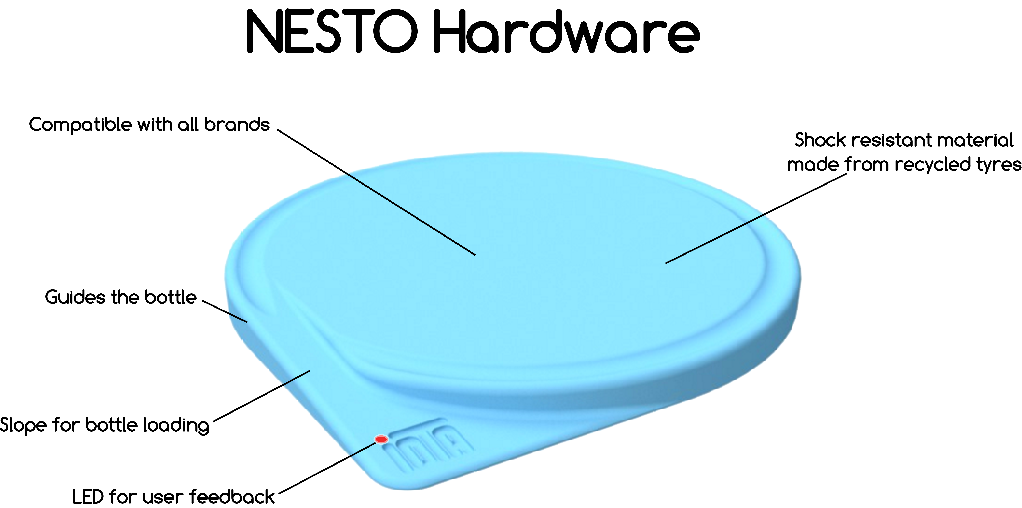

Slide 26
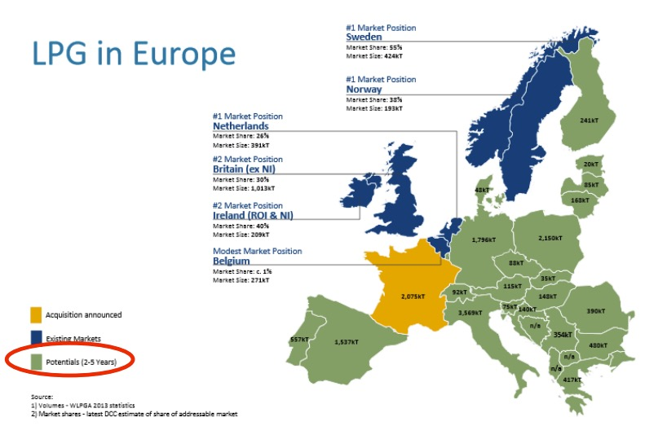
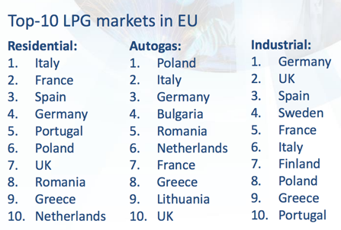
Europe
Market

Slide 27
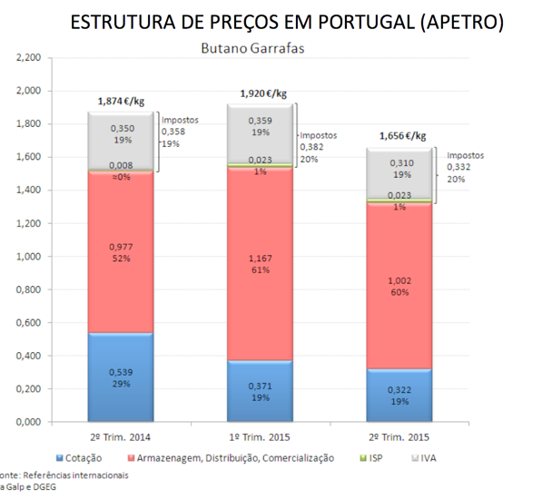
LPG Cost structure

Slide 28
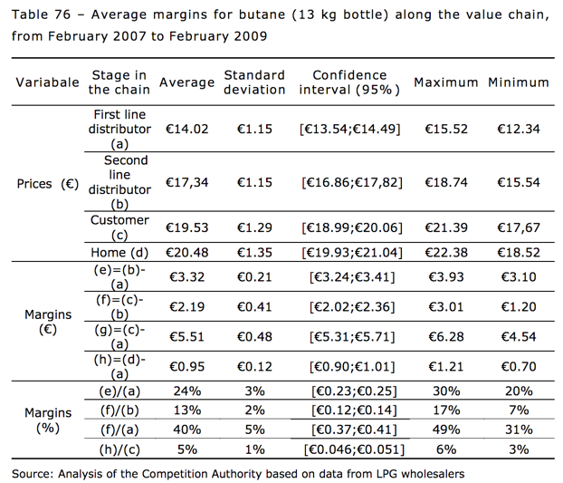
Margins along the Value Chain
Source: Detailed analysis of the liquid fuel and bottled gas sectors in Portugal (2007-2009) - Final Report - Autoridade da Concorrência
Notes:
Source: Detailed analysis of the liquid fuel and bottled gas sectors in Portugal (2007-2009) - Final Report - Autoridade da Concorrência
Table 76 – Average margins for butane (13 kg bottle) along the value chain, from February 2007 to February 2009 Variabale Stage in the chain Average Standard deviation Confidence interval (95%) Maximum Minimum Prices (€) First line distributor (a) €14.02 €1.15 [€13.54;€14.49] €15.52 €12.34 Second line distributor (b) €17,34 €1.15 [€16.86;€17,82] €18.74 €15.54 Customer (c) €19.53 €1.29 [€18.99;€20.06] €21.39 €17,67 Home (d) €20.48 €1.35 [€19.93;€21.04] €22.38 €18.52 Margins (€) (e)=(b)- (a) €3.32 €0.21 [€3.24;€3.41] €3.93 €3.10 (f)=(c)- (b) €2.19 €0.41 [€2.02;€2.36] €3.01 €1.20 (g)=(c)- (a) €5.51 €0.48 [€5.31;€5.71] €6.28 €4.54 (h)=(d)- (a) €0.95 €0.12 [€0.90;€1.01] €1.21 €0.70 Margins (%) (e)/(a) 24% 3% [€0.23;€0.25] 30% 20% (f)/(b) 13% 2% [€0.12;€0.14] 17% 7% (f)/(a) 40% 5% [€0.37;€0.41] 49% 31% (h)/(c) 5% 1% [€0.046;€0.051] 6% 3% Source: Analysis of the Competition Authority based on data from LPG wholesalers

Slide 29
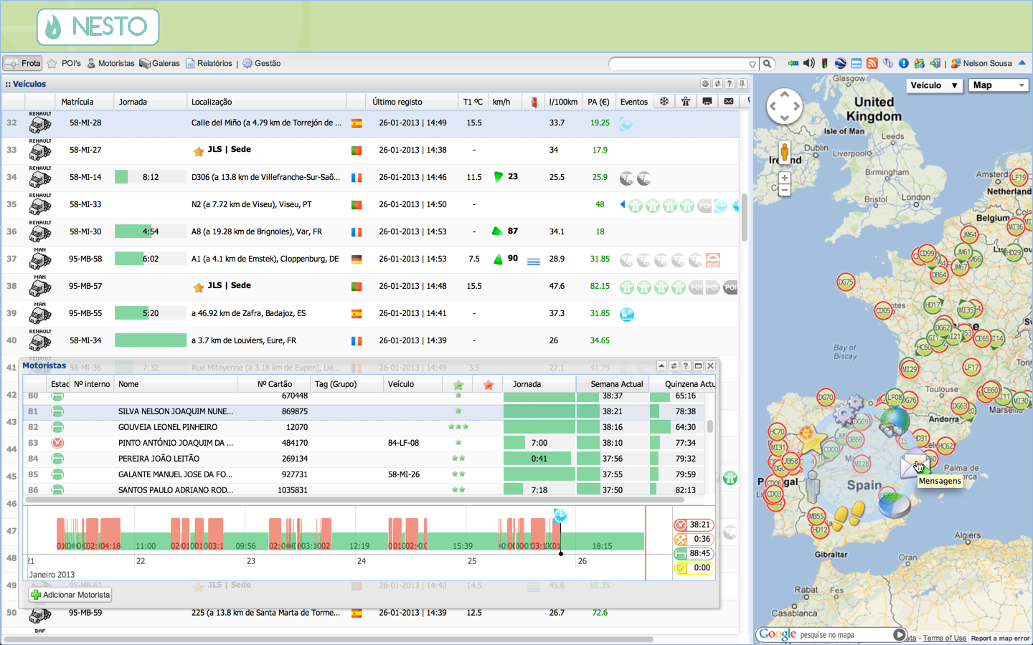
App & Front-end for Distributors (*)
Dynamic deliveries optimization
Distributor scorecard
Easy satisfaction
Notes:
Brand agnostic
Accommodate manual delivery
Customer metrics
Leverage gas left in canister
Leverage open channel to end customer for advertising

