Slide 1
CSE185 Introduction to Computer Vision Lab 01: Image Processing in MATLAB
Instructor: Prof. Ming-Hsuan Yang
TA: Taihong Xiao & Tiantian Wang

Slide 2
Lecture and Labs
Lecture:
Monday 15:00 – 16:15 @ COB2 130
Tuesday 15:00 – 16:15 @ COB2 130
Labs:
02L: Monday 16:30 – 19:20 @ COB1 281
03L: Monday 19:30 – 22:20 @ COB1 281
04L: Friday 10:30 – 13:20 @ SE1 100
05L: Monday 07:30 – 10:20 @ COB1 281

Slide 3

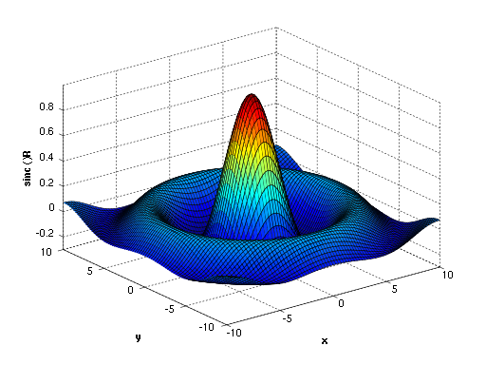
Introduction to MATLAB
MATLAB is a numerical computing environment
Allow easy operation on matrix, image, N-D data
Easily plot and visualize data
Simple GUI
Interface with other languages (e.g. C/C++, Python)

Slide 4
Variable
Variable: no declaration, implicit type conversion
>> x = 10
x =
10
>> x = ‘test’ (use single quote for string)
x =
test
>> z = 10; y = z + 10
y =
20
>> y = z^2
y =
100
>> y = mod(z, 3)
y =
1

Slide 5
Vector
Vector: use [ ] or init:step:end
Use ( ) to access elements (index starts from 1):
Access part of vector:
>> vec = [1, 100]
vec =
1 100
>> vec = 1:2:10
vec =
1 3 5 7 9
>> vec(3)
ans = 5
>> vec(2:4)
ans =
3 5 7

Slide 6
Matrix
Matrix: use semicolon to separate each row
Access elements:
Access sub-matrix:
>> A = [1 2 3; 4 5 6; 7 8 9]
A =
1 2 3
4 5 6
7 8 9
>> A(2, 3)
ans =
6
>> A(1:2, 2:3)
ans =
2 3
5 6

Slide 7
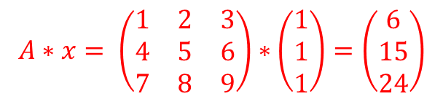
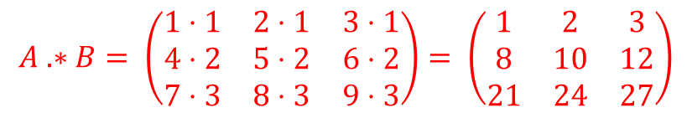
Multiplication
Matrix-vector multiplication:
Element-wise multiplication:
>> A = [1 2 3; 4 5 6; 7 8 9];
>> x = [1; 1; 1];
>> A * x
ans =
6
15
24
>> A = [1 2 3; 4 5 6; 7 8 9];
>> B = [1 1 1; 2 2 2; 3 3 3];
>> A .* B
ans =
1 2 3
8 10 12
21 24 27

Slide 8
If statement
If statement
If-else statement
if EXPRESSION
...
end
if EXPRESSION
...
else
...
end
if EXPRESSION
...
elseif EXPRESSION
...
else
...
end

Slide 9
Loop
For loop
While loop
for i = 1:10
...
end
while EXPRESSION
...
end

Slide 10
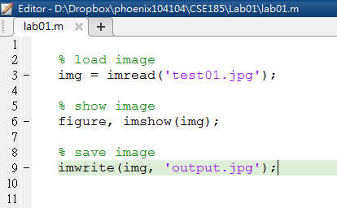
M file
MATLAB executable file/script, function: *.m file

Slide 11
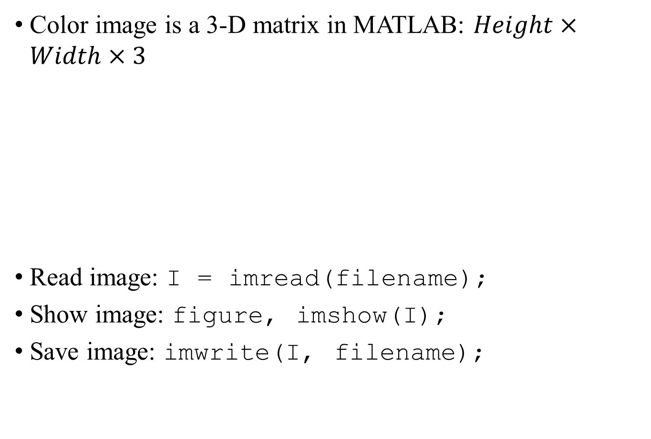
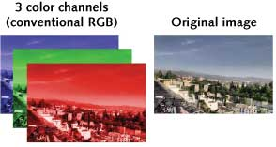
Color Image
Hint: type help imread in command window, or press F1 on function name to see the usage of the function

Slide 12
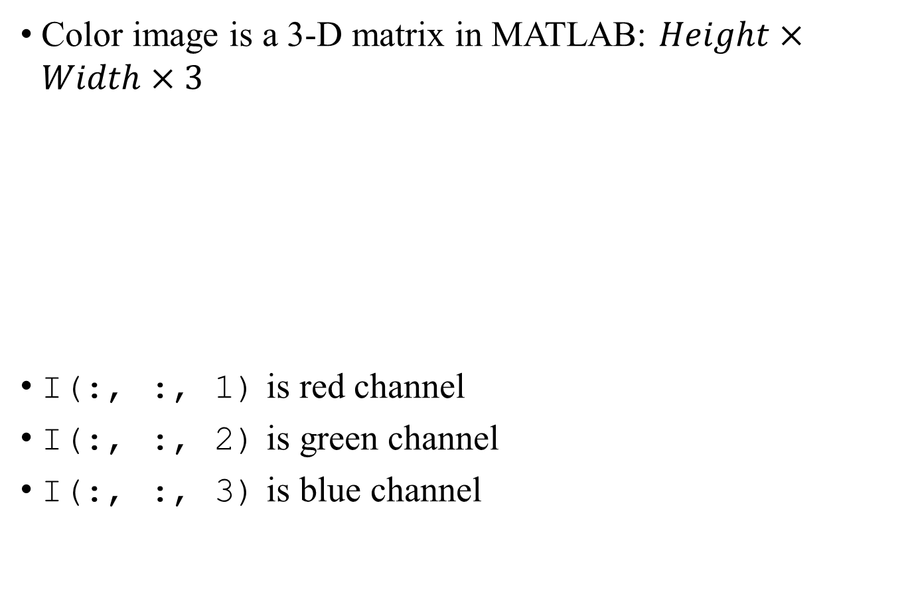
Color Image
: means select all elements in this dimension

Slide 13
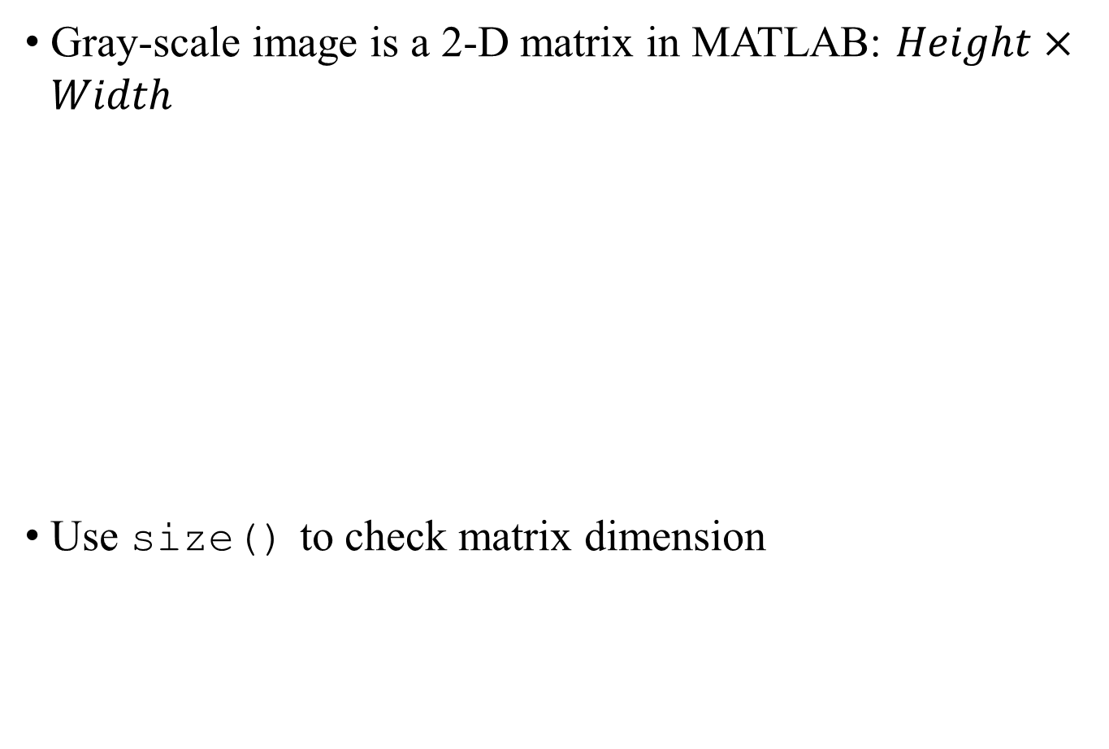
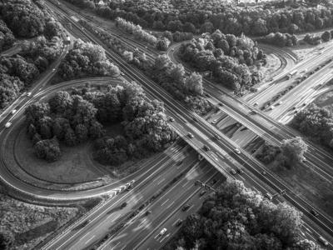
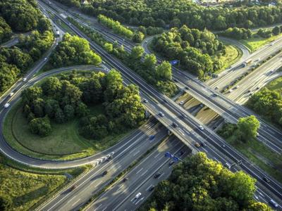
Gray-scale Image
Gray-scale image
Color Image
>> I = imread(’01_gray.jpg’);
>> size(I)
ans =
300 400

Slide 14
Pixel Range and Type
When loading image to MATLAB:
Default data type is uint8
Each pixel/element has a value between 0 and 255 (8 bits)
Use im2double() to convert data type to double:
pixel range is between 0 and 1
>> I = imread(’01.jpg’);
>> I(1, 1)
ans =
34
>> I = im2double(I);
>> I(1, 1)
ans =
0.1333
The same as I = double(I) / 255.0;

Slide 15
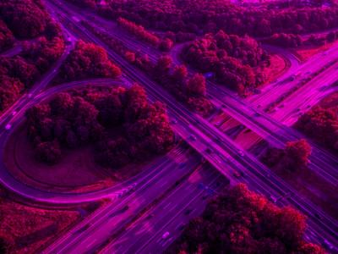
Image Processing in MATLAB
Set the value of green channel to zero

Slide 16
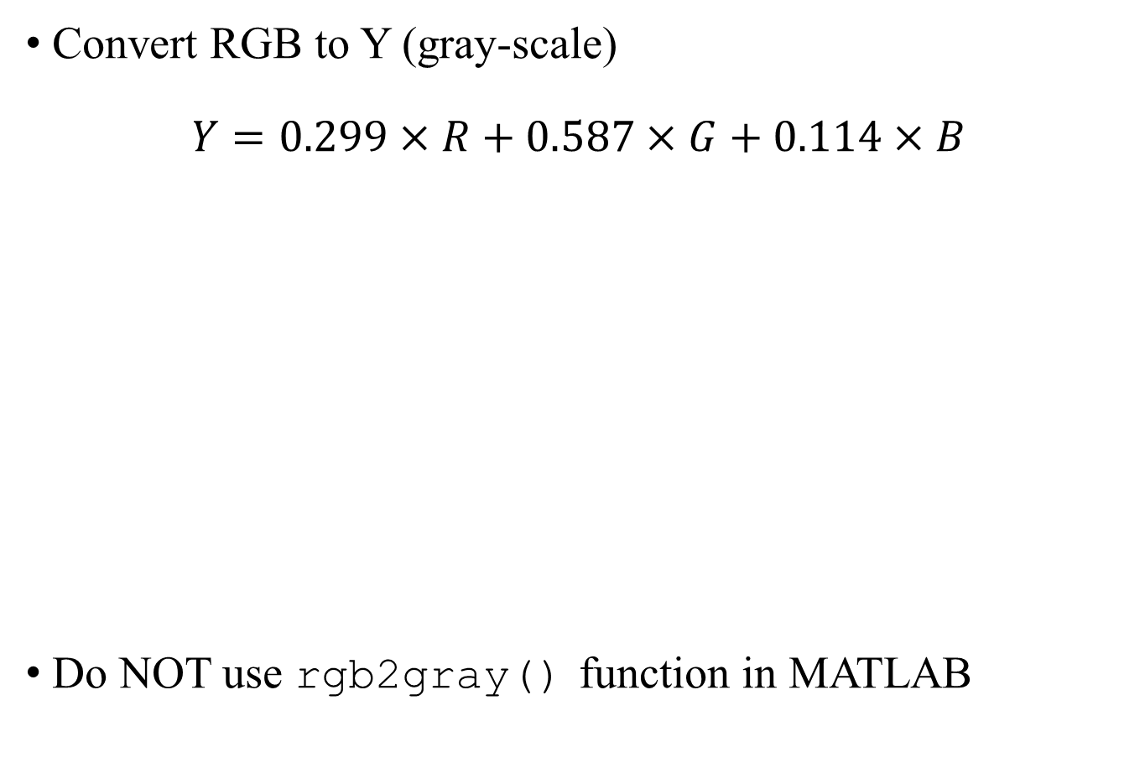

Image Processing in MATLAB
Reference: RGB to YUV https://en.wikipedia.org/wiki/YUV

Slide 17
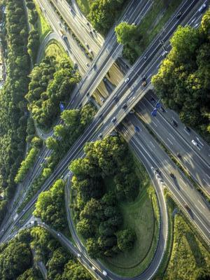
Image Processing in MATLAB
Rotate image 90 degree: use imrotate()

Slide 18
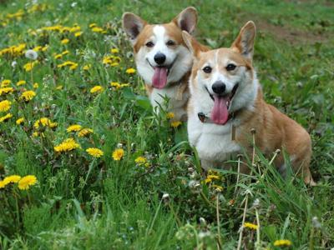
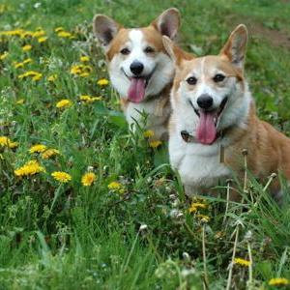
Image Processing in MATLAB
Crop image boundary: extract sub-matrix given the upper left and lower right positions

Slide 19
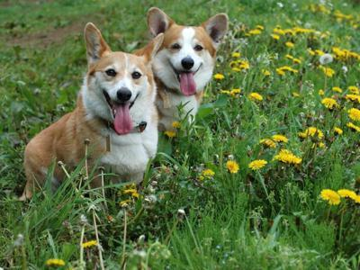
Image Processing in MATLAB
Horizontally flip image: use flip()

Slide 20
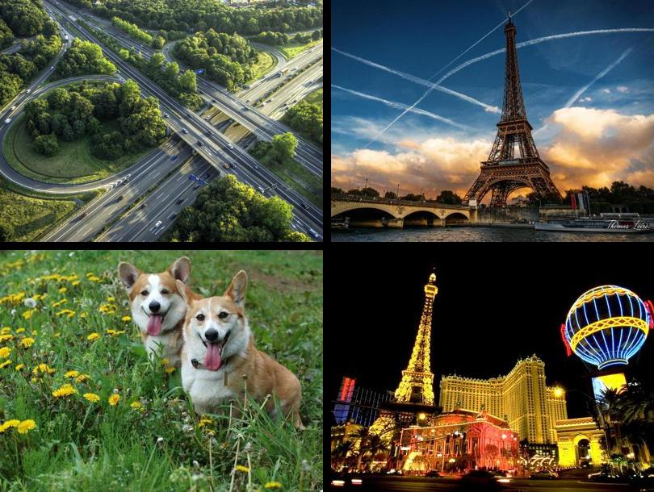
Image Processing in MATLAB
Combine 4 images into one image with 2 x 2 grid

Slide 21
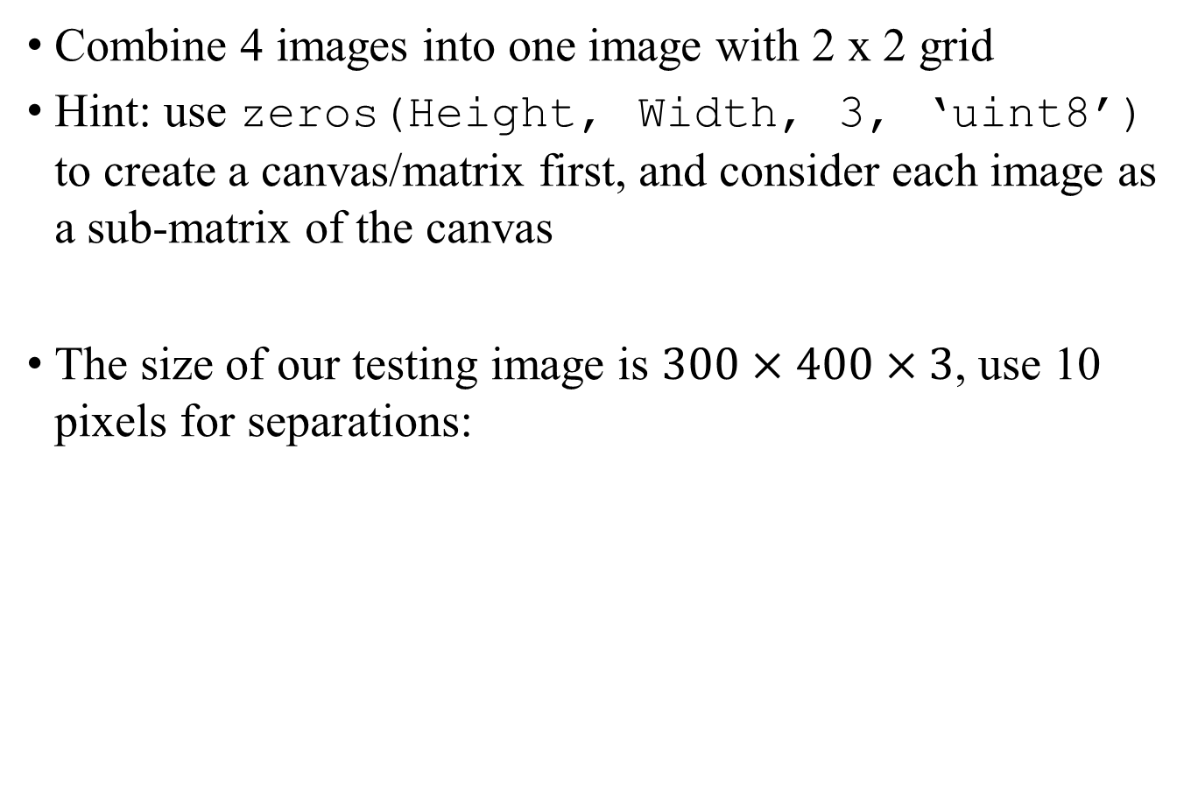
Image Processing in MATLAB
I1 = imread(’01.jpg’);
canvas = zeros(300 * 2 + 10, 400 * 2 + 10, 3, ‘uint8’);
canvas(1:300, 1:400, :) = I1;

Slide 22
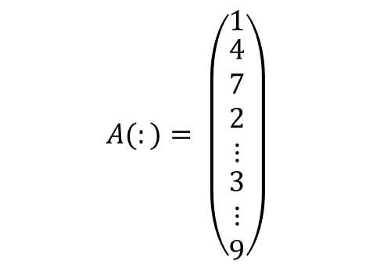
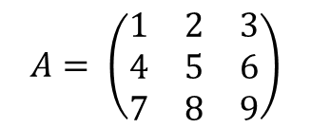

Image Processing in MATLAB
Use (:) to convert image/matrix to vector
matrix in MATLAB is column-major
Use reshape() to convert vector to image/matrix
>> I = imread(’01.jpg’);
>> I = I(:);
>> size(I)
ans =
360000 1
>> I = reshape(I, 300, 400, 3);
>> size(I)
ans =
300 400 3

Slide 23
Lab 01 Assignment
Set green channel to zero, and save as green.jpg
Convert image from RGB to gray scale without using built-in functions, and save as gray.jpg
Rotate 90 degree, and save as rotate.jpg
Crop any image given the upper left point (30, 100) and lower left point (270, 300), and save as crop.jpg
Horizontally flip the image, and save as flip.jpg
Combine 4 images (01.jpg ~ 04.jpg) into one matrix with 2 x 2 grid and 10 pixels separations, and save as combine.jpg
Convert images (05.jpg and 06.jpg) to vectors, average them, and save as average.jpg
Upload all output images and your lab01.m
* For problem 1 – 5, choose 01.jpg as the input only.

Slide 24
Reference
MATLAB: http://www.mathworks.com/products/matlab/
Octave: https://www.gnu.org/software/octave/
Introduction to MATLAB with Image Processing http://www.slideshare.net/Sutanshu_Raj/introduction-to-matlab-with-image-processing-5495912

