Slide 1
COMP 204 Programming Studio
Project 1 : Online Coloring
MERT DOĞAN
041502002
Date: 06.03.2018

Slide 2
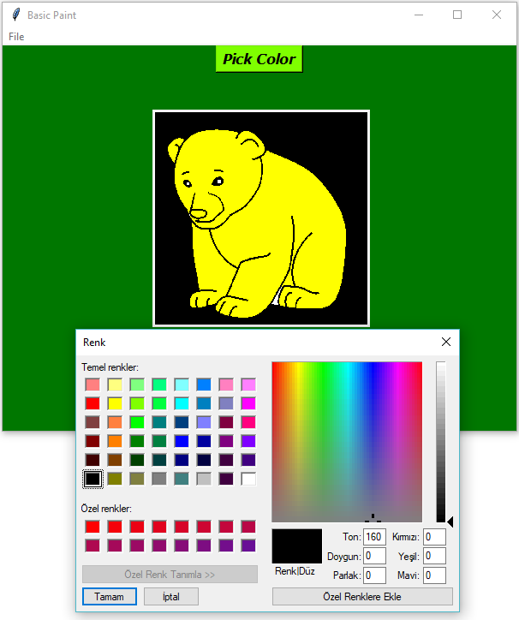
MY GUI
I use file menu and add commands on the GUI
I add open, draw, save, clear and exit labels.
I add a color palette which is askcolor()

Slide 3
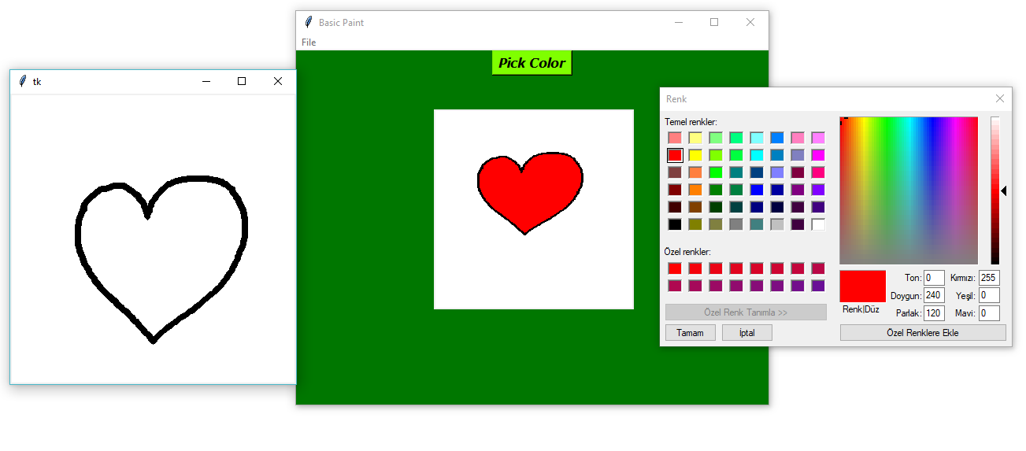
MY GUI
I create drawing option.
User can draw any shape.
If user can draw a png image, the image can also paint from the app.
Just click open and choose the saved drawing image

Slide 4
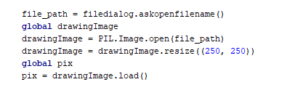
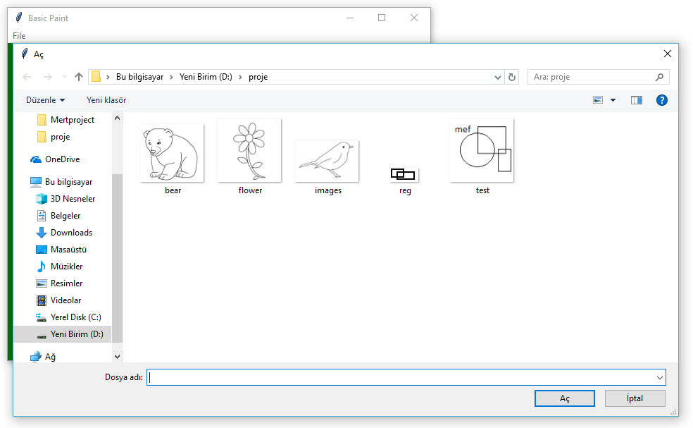
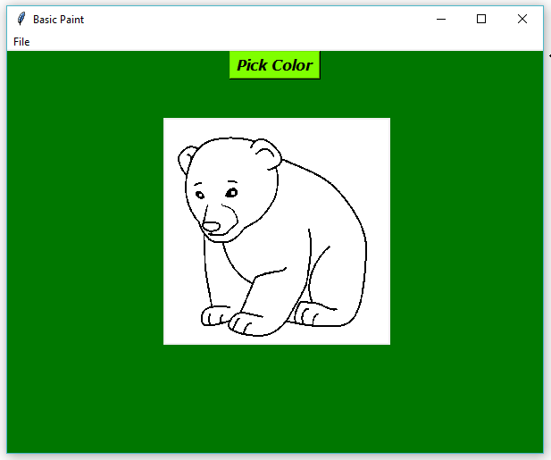
Reading and Display The Image
I use the filedialog and PIL.Image to opem, read and resize the input image file.
I use ImageTk to Show the image on the screen and with convert the input file’s rgb values to binary value.

Slide 5
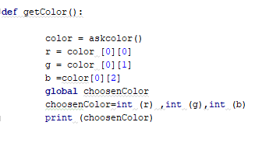
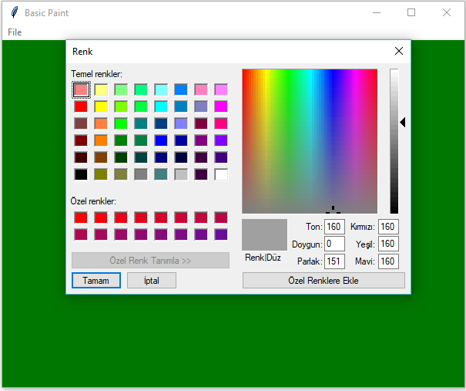
Get Coordinate and Color The Image
I use the askcolor() for display the color palette.This method gives us 2 taple and I use this convert this taples to r,g,b values in getColor method
In printcoords I take the eventx and eventy, send them into paintRegion, equal the pixel values and put t k values into drawingImage.

Slide 6
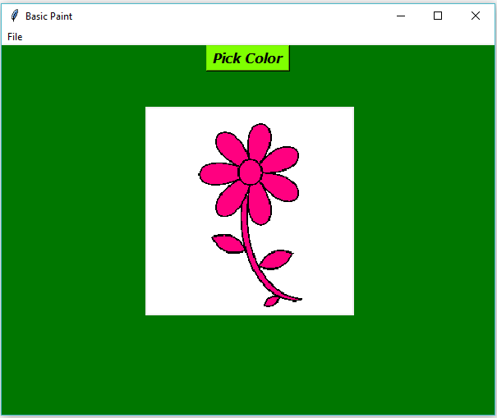
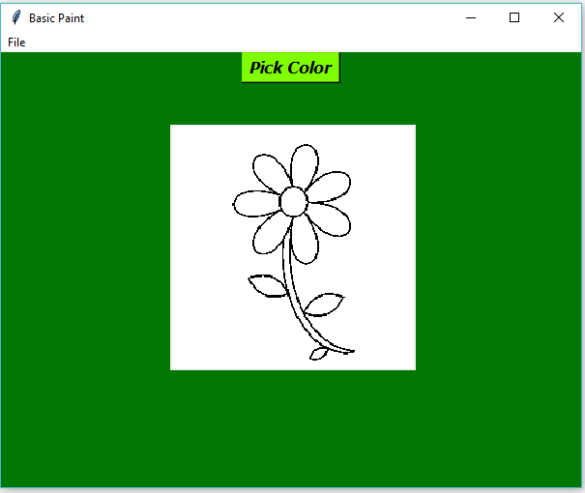
Save and Clear The Drawing Image
In the save method I use simple .save code.
In the clear method first, I equal drawingImages’ size to xSize and ySize and then I look at if labelValues[i][j] not equal to 1, I put the pix[i,j] White (255,255,255) and I put the pixels from i,j ‘s 255 values.

Slide 7
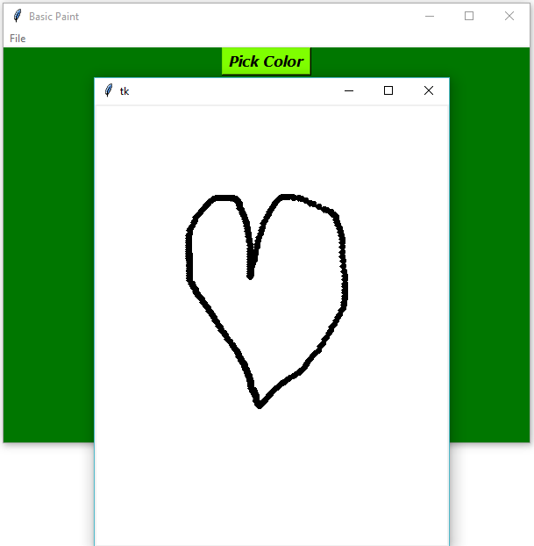
Drawing Shapes
In addition, I write a method which is Drawing. I create a canvas and make its background white.
I create an oval line and draw the line. In the end I save the drawing with using the saveDrawing method.

