Slide 1
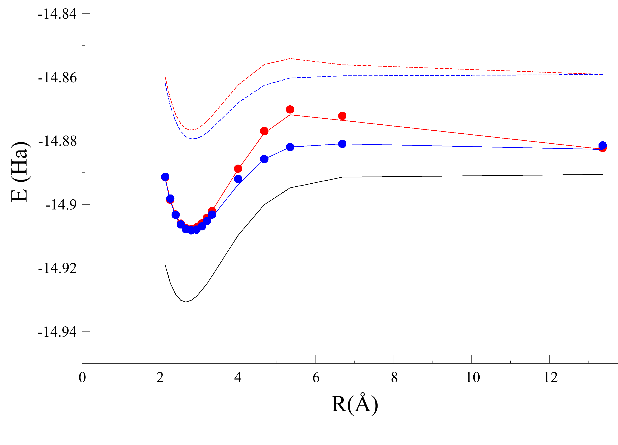
10-orbital (CCSD)
7-orbital (CCSD)
7-orbital (DUCC)
10-orbital (DUCC)
FCI – all virtual orbitals
7-orbital DUCC (VQE)
10-orbital DUCC (VQE)

Slide 2
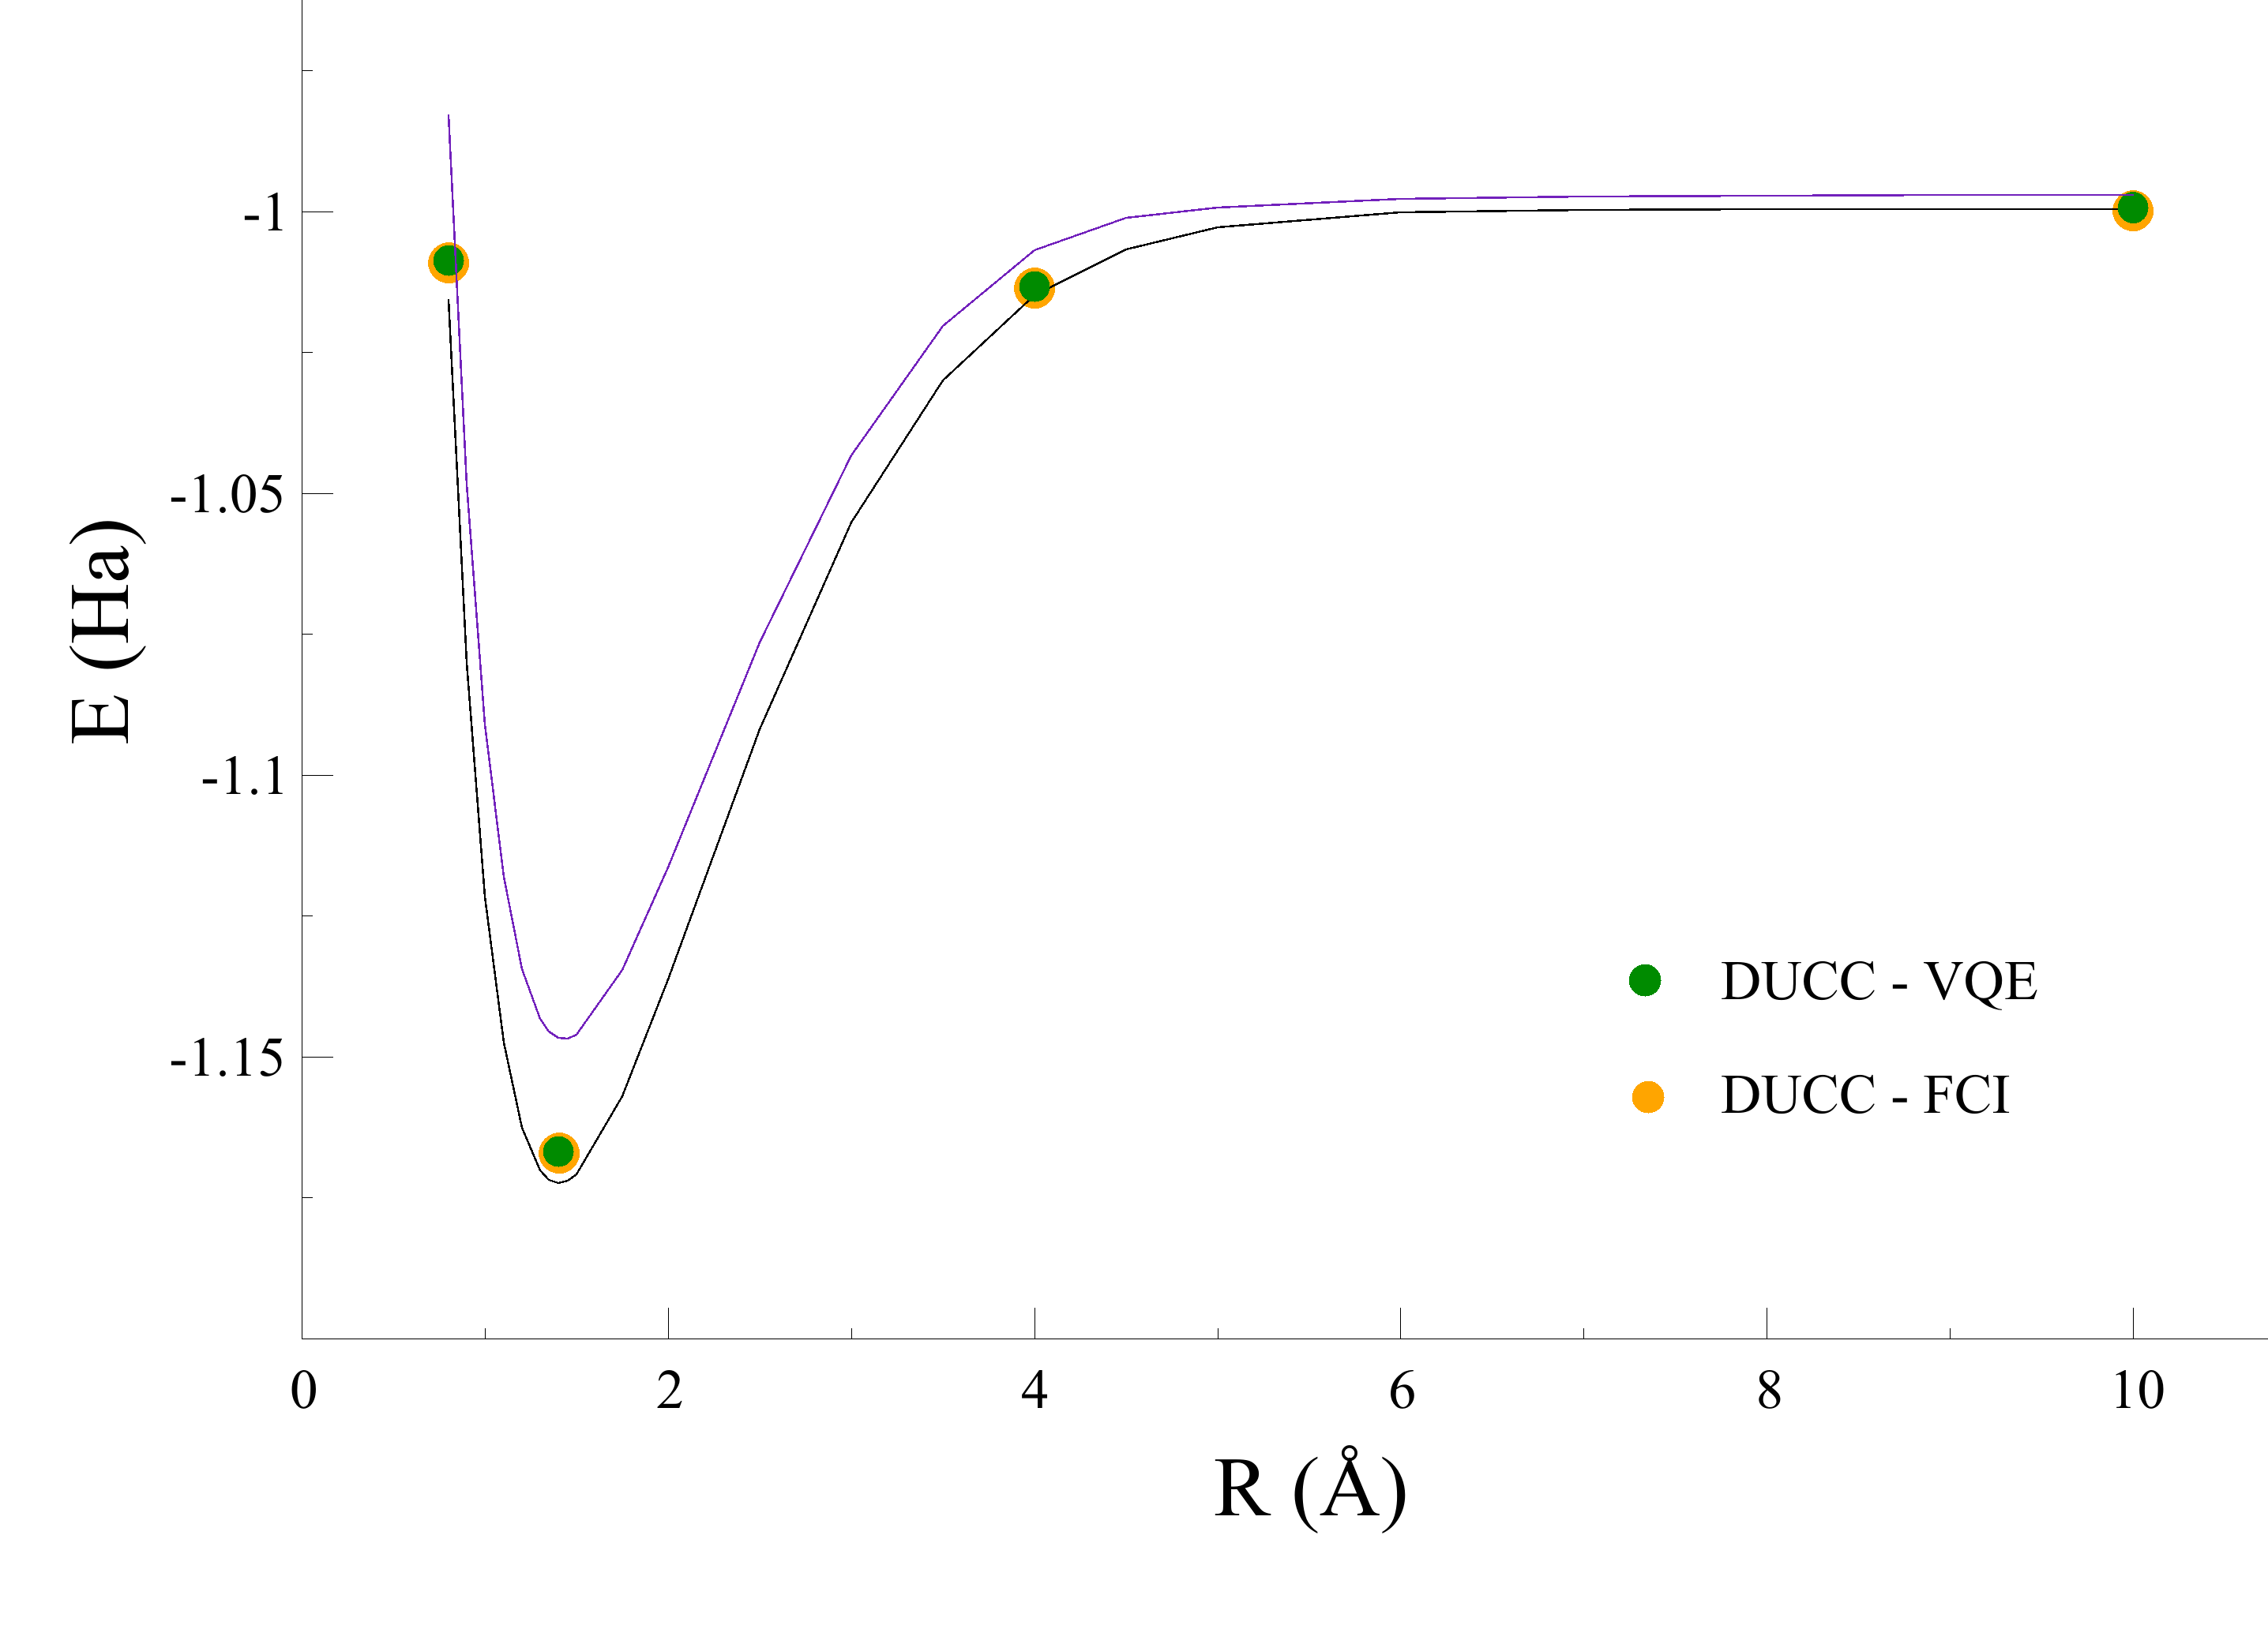
4-orbital (cc-pvtz)
FCI

Slide 3
FCI
Correlation Consistent Basis
Reduced Dimensionality
Correlation Consistent Basis
Unoccupied
Classical Optimizer
Downfolded
DUCC
Updated Parameters
…
…
Prepare Parameterized
Wavefunction
H_{eff}
Occupied

Slide 4
Classical Optimizer
Updated Parameters
Prepare Parameterized
Wavefunction

