Slide 1

Fear the ponies

Slide 2

Breaking new!
Ponies just forged a secret alliance in order to end human civilization and their first move should happen in less than 1 hour. We require your help to access their information which should allow us to devise a strike back plan or at least buy us time.
Start your mission and don't fail. You're our only hope...
your spymaster

Slide 3

Some Tips!
It’s preferable to use a language you know
It’s about « hacking », not clean code norTDD
Be prepared to do HTTP requests
Be curious
And don’t hesitate to ask questions
your spymaster

Slide 4
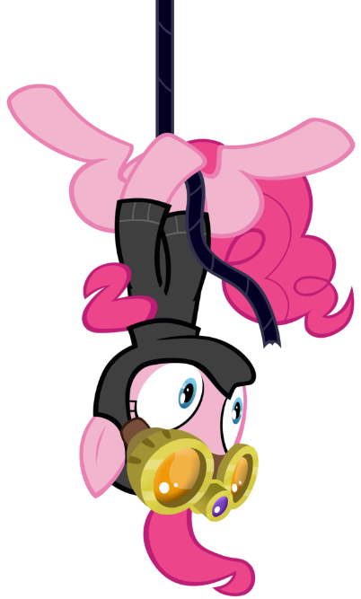
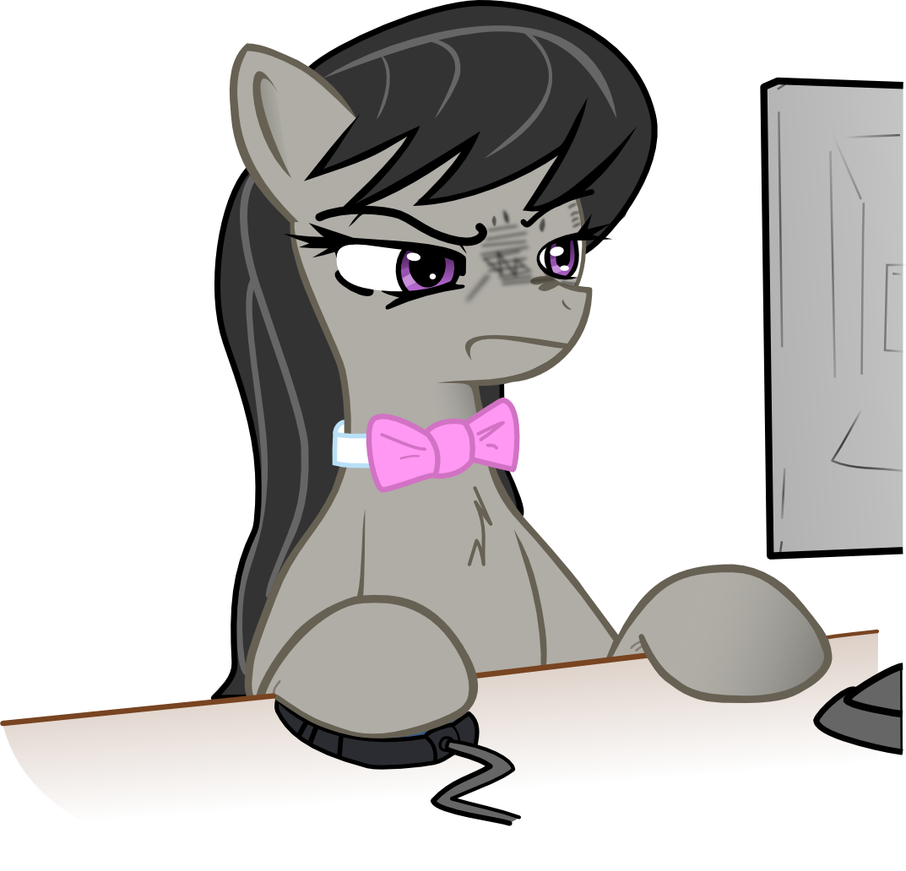
Wi-Fi: - | Password: -
http://-

Slide 5

Caesar Cipher
The Caesar cipher is one of the simplest and most widely known encryption techniques in which each letter in the plaintext is replaced by a letter some fixed number of letters shifted up or down in the alphabet.
The Caesar cipher can be easily broken even in a ciphertext-only scenario using techniques such as frequency analysis or brute force because of the limited number of possible shifts.
your spymaster

Slide 6
Simple Substitution Cipher
Simple substitution ciphers is a method of encrypting by which units of plaintext are replaced with cyphertext. It’s done by writing out an cipher alphabet using a shift like in the Caesar cipher or using any method able to scramble the alphabet.
Even if the number of possible keys is very large contrary to the Caesar cipher, simple substition can be easily broken by analyzing the frequency distribution of the ciphertext for a message of reasonable length and by knowing the original language.
your spymaster

Slide 7
Vigenere Cipher
The Vigenere cipher is a method of encrypting alphabetic text by using a series of interwoven Caesar ciphers, based on the letters from a keyword. It was originally described in 1553 and it resisted all attempts to break it for three centuries.
Even if the Vigenere cipher disguises the plaintext letter frequency, its primary weakness is the repeating nature of its key. Once the key’s length is discovered, the cipher text can be treated as interwoven Caesar ciphers.
your spymaster

Slide 8

THANKS
https://github.com/mmetesreau/FearThePonies

Slide 9
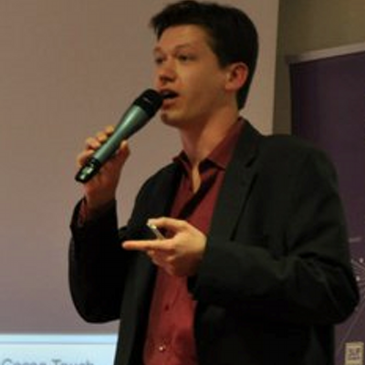

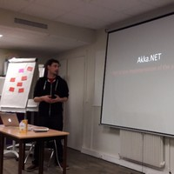
Raphael
raphaelwach
WACH
raphaelwach
Apple technologies expert at SOAT
Mickael
mmetesreau
METESREAU
mmetesreau
Founder and fullstack developer at SOFTCRAFT

