Slide 1
Home Automation Control Interface On Windows Tablet

Slide 2
HTTP requests, library choice
Name | Language | Simple | Complete | Multi-OS | Complete documetation
libcurl | C | - | + | + | +
http-tiny | C | + | - | + | -
Winhttp | C/C++ | - | + | - | +
HappyHtpp | C++ | + | + | + | -

Slide 3
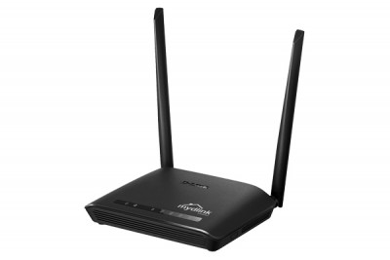
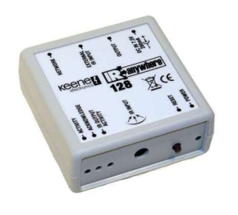
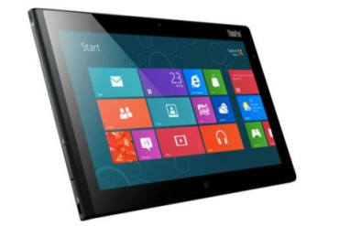



Queries with Kira
192
rj45
Kira 128
Window 8
Wifi
Router
IR
TV

