Slide 1
Home Automation Control Interface On Windows Tablet
Practical study 06/01/2016
Tutors François Pasteau Marie Babel | Team members Iman Akabi Diane Dewez Enora Lucas Meven Moser Corentin Chatellier

Slide 2
Contents
Context
Specifications
Pre-study
What we have done
What’s next
Conclusion
2

Slide 3

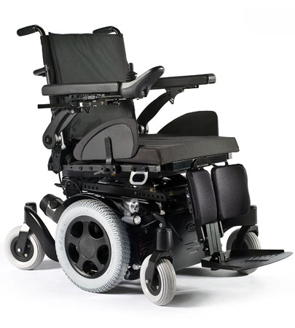
I. Context
sells and repairs wheelchairs
develop home automation solutions
4

Slide 4
I. Context
WHY did we choose this subject ?
Technical challenge
Human values
WHAT IS THE AIM?
Need of a simple interface for disabled people
Existing solutions but too complex and inadapted
5

Slide 5
I. Context
What has been done by the previous team ?
6

Slide 6
II. Specifications
8

Slide 7
III. Pre-study
BLOCS
10

Slide 8
III. Pre-study
Language choices
11

Slide 9
HTTP requests, library choice
 | libcurl | http-tiny | Winhttp | HappyHttp
Language | C | C | C/C++ | C++
Multi-OS | + | + | - | +
Easy-to-use | - | + | - | +
Documentation | + | - | + | +
12

Slide 10


III. Pre-study
Interface | Model | Communication with Kira | Communication with Fibaro
 |  | HappyHttp : C++ library
13

Slide 11
III. Pre-study
Programming
Visual Studio
Versioning
Git
14

Slide 12
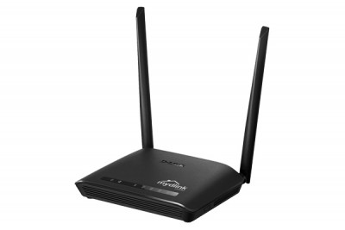
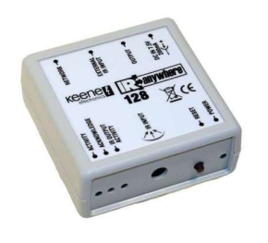
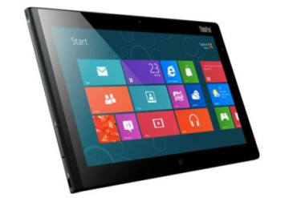



Queries with Kira
192
rj45
Kira 128
Window 8
Wifi
Router
IR
TV
15

Slide 13
IV. What we have done

Slide 14
V. What’s next
Communication with the wheelchair
Communication with Fibaro
17

Slide 15
V. What’s next
C++
C#
master versioning
18

