Slide 1
Home Automation Control
Interface on Windows Tablet
Tutors François Pasteau Daniel Guillard Marie Babel | Team members Iman Akabi Diane Dewez Enora Lucas Meven Moser Corentin Chatellier
Practical study 06/01/2016

Slide 2
Contents
Context
Specifications
Pre-study
What we have done
What’s next
Conclusion
2

Slide 3

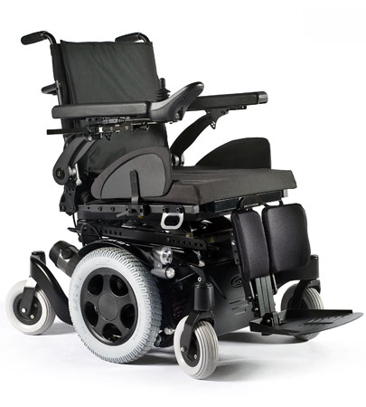
I. Context
sells and repairs wheelchairs
develop home automation solutions
3

Slide 4
I. Context
Why did we choose this subject ?
HUMAN VALUES
CHALLENGING
GUI
4

Slide 5
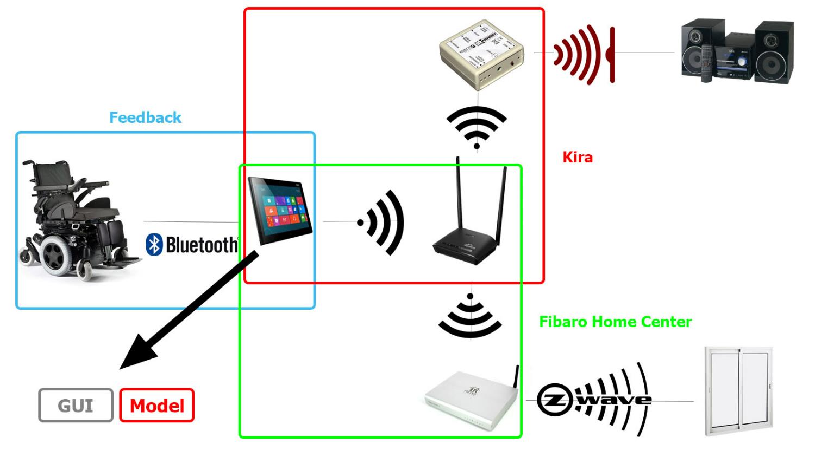
I. Context
5

Slide 6
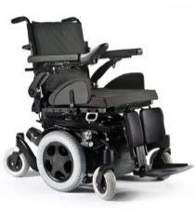
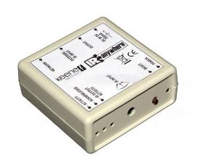
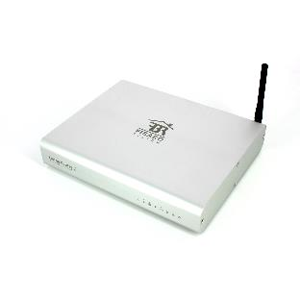
II. Specifications
Communication
With the wheelchair for a feedback
With Kira to control appliances with IR
With Fibaro Home Center to control appliances with Z-wave
6

Slide 7
II. Specifications
Graphic User Interface and Model
Adapted to any disabled user Contrast Fewer icons, visible
Simple to use
Selection mode
Transferable
7

Slide 8
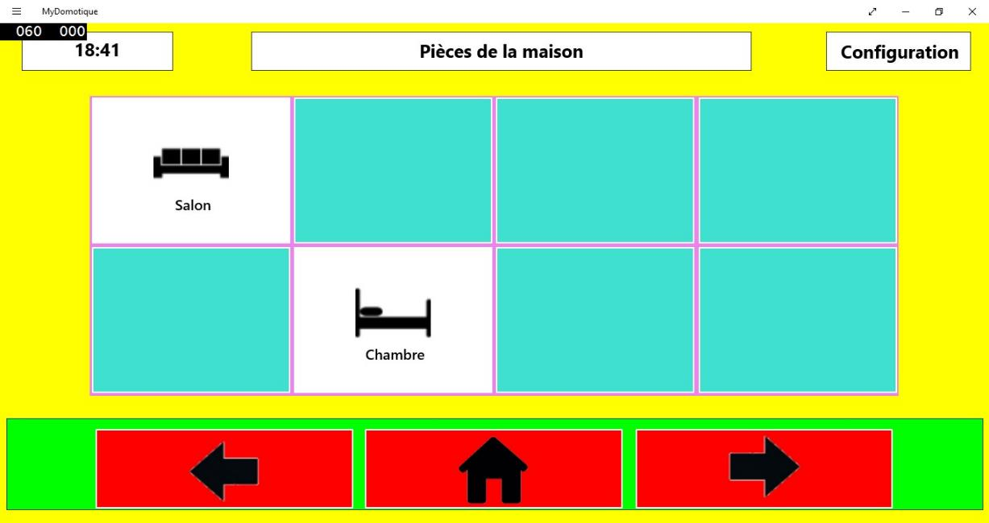
III.Pre-study
What has been done by the previous team ?
8

Slide 9
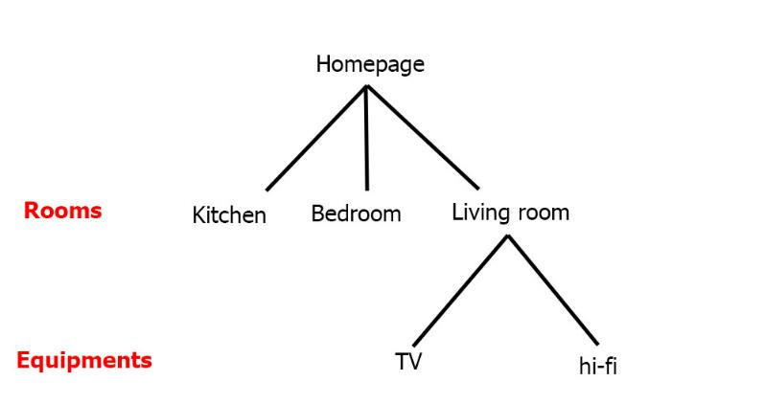
III.PRE STUDY
Algorithm core : a tree
Why C# ?
Ideal for Windows
9

Slide 10
III. Pre-study
Language choices
 | WPF | Qt | GTKmm | wxWindows | Fltk
Multi-OS |  |  | Mostly on Linux |  | Yes
Adapted to tactile |  | No
Light |  | No | No |  | Yes (but lots of libraries to install)
11

Slide 11
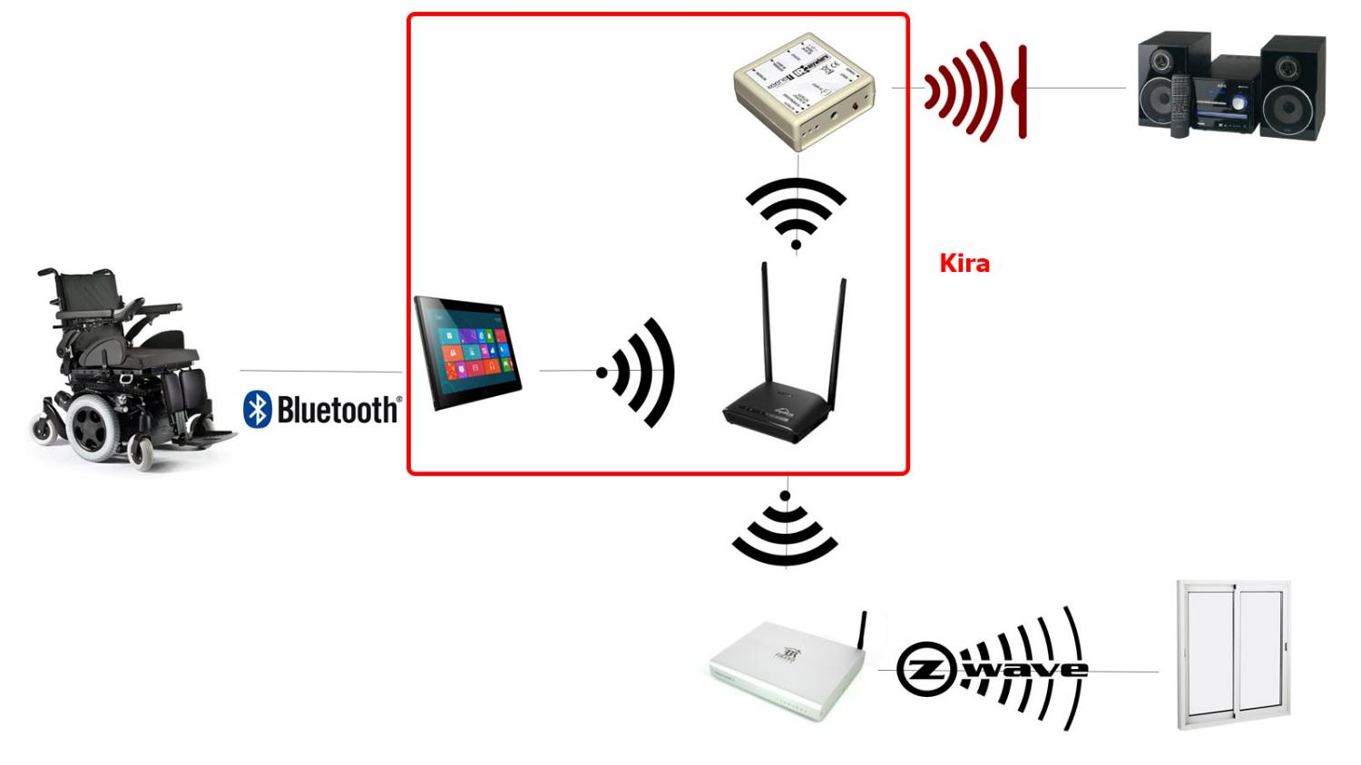
III. PRE-STUDY
10

Slide 12









III. PRE-STUDY
HTTP requests, library choice
 | libcurl | http-tiny | Winhttp | HappyHttp
Language | C | C | C/C++ | C++
Multi-OS
Easy-to-use
Documentation
11

Slide 13


III. Pre-study
Interface | Model | Communication with Kira | Communication with Fibaro
WPF, XaML |  | HappyHttp : C++ library
12

Slide 14



III. Pre-study
Tools used
to code : Visual Studio, Code Blocks
for versioning : Git
13

Slide 15
What we have done
Familiarize with the previous code
Communication with a Kira, technically usable on every system
Implemented it in our interface for a prototype
14

Slide 16
IV. What WE HAVE DONE
Prototype
14

Slide 17
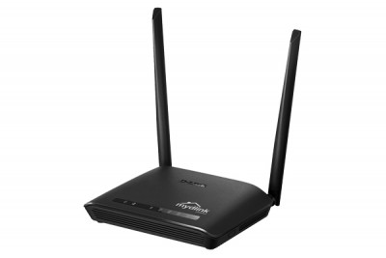
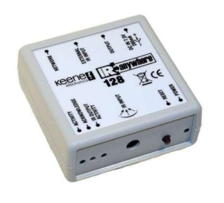
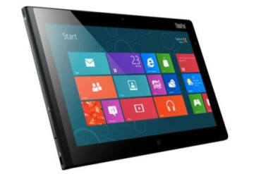


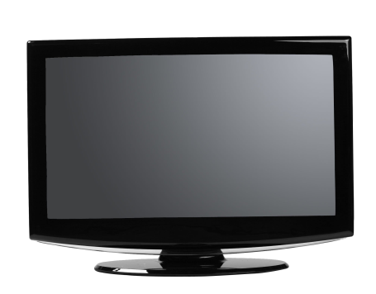
PROTOTYPE
Kira 128
Windows 8
Wifi
Router
IR
TV
15

Slide 18
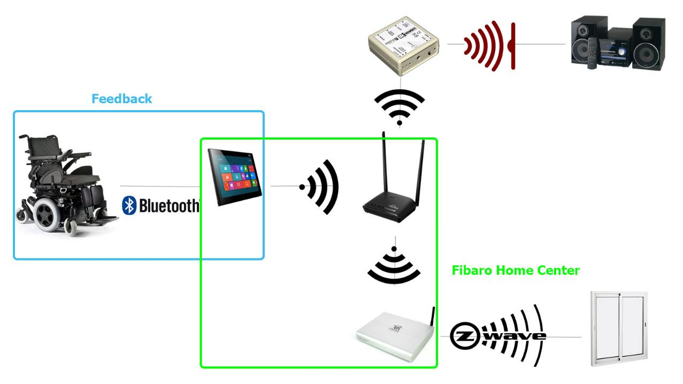
V. What’s next
Communication with Fibaro and the wheelchair
15

Slide 19
V. What’s next
Improvements on the interface :
Render it usable by everyone (all types of disabilities)
Aesthetics enhancement
Make it transferable : translate all the algorithm in C++
16

Slide 20


VI. conclusion
What we learn
HTTP requests
17

Slide 21
Questions ?
18

