Slide 2
HTTP requests, library choice
Name | Language | pros | cons
libcurl | C | complete and portable | Not everything is needed
libwww | C | complete(caching) | complicated
http-tiny | C | Concise and portable | Only queries
Winhttp | C/C++ | Made for Windows | Not portable
qDecoder | C/C++ | C or C++ (choice) | Unix-like OS only
HTTPClient | Java | Portable | Only in Java
HappyHttp | C++ | Portable and simple No need to wait between queries | Documentation not very complete

Slide 3
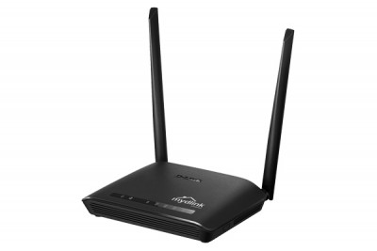
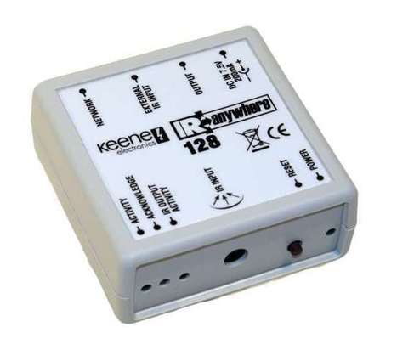
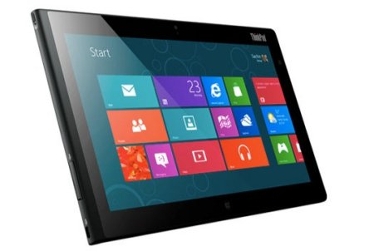



Queries with Kira
rj45
Kira 128
Window 8
Wifi
router
IR
TV

