Slide 1

Domotic control interface on tablet

Slide 2
Contents
• Context
• Pre-study
• Specifications

Slide 3
Context
Need of a simple interface for disabled people
Existing solutions but too complex and inadapted
Knowledge transfer from Insa to Ergovie
Ergovie is a Breton society who sells and repairs wheelchairs. They recently began to develop domotic solutions.

Slide 4
Pre-study
Interface in XaML, C#
Algorithm in C++
API to control Kira : (protocol HTTP)
API to control Fibaro : (protocol HTTP)
API Bluetooth :

Slide 5
HTTP requests, library choice
Name | Language | pros | cons
libcurl | C | complete and portable | Not everything is needed
http-tiny | C | Concise and portable | Only queries
Winhttp | C/C++ | Made for Windows | Not portable
qDecoder | C/C++ | C or C++ (choice) | Unix-like OS only
HappyHttp | C++ | Portable and simple No need to wait between queries | Documentation not very complete

Slide 6
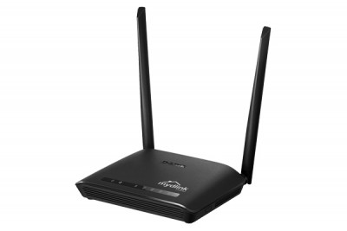
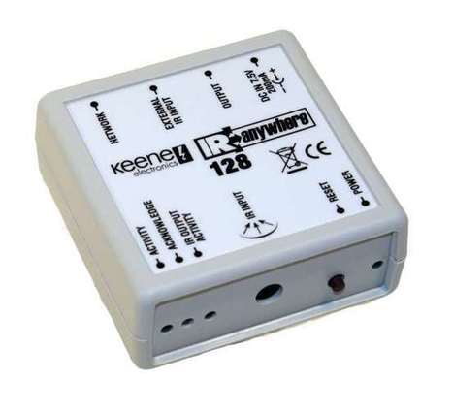
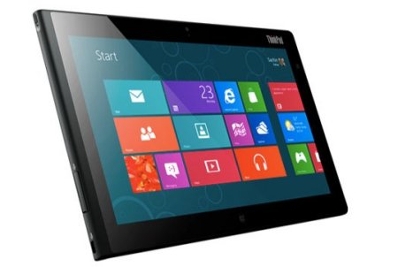


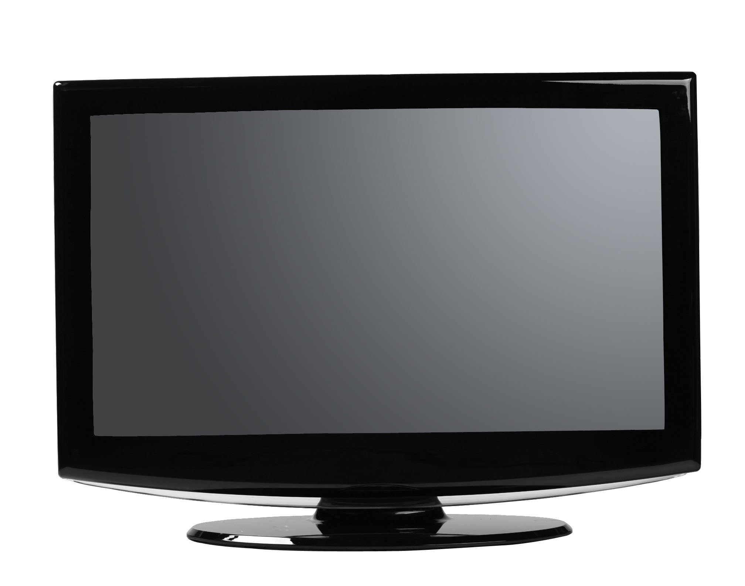
Queries with Kira
rj45
Kira 128
Window 8
Wifi
router
IR
TV

Slide 7
Specifications
Enabling people to switch on/off machines
Adapted to users
A « scrolling » mode (traduction à revoir)
Configuration available, only for technician
Feedback from the wheelchair

