Slide 1

Home Automation Control Interface On Windows Tablet

Slide 2
Contents
Context
Specifications
Pre-study
What’s next
Conclusion
2

Slide 3
I. Context

Slide 4
I. Context
Ergovie is a Breton society who sells and repairs wheelchairs. They recently begin to develop domotic solutions.
4

Slide 5
I. Context
Need of a simple interface for disabled people
Existing solutions but too complex and inadapted
5

Slide 6
I. Context
What has been done by the previous team
6

Slide 7
II. specifications

Slide 8
II. Specifications
Enabling people to switch on/off machines
Adapted to every disabled users
A « scrolling » mode (traduction à revoir)
Configuration available only for the technician
Feedback from the wheelchair
8

Slide 9
III. Pre-STUDY

Slide 10
III. Pre-study
BLOCS
10

Slide 11
III. Pre-study
Language choices
11

Slide 12
HTTP requests, library choice
Name | Language | Simple | Complete | Multi-OS | Complete documetation
libcurl | C | - | + | + | +
http-tiny | C | + | - | + | -
Winhttp | C/C++ | - | + | - | +
HappyHtpp | C++ | + | + | + | -
12

Slide 13


III. Pre-study
Interface | Model | Communication with Kira | Communication with Fibaro
 |  | HappyHttp : C++ library
13

Slide 14
III. Pre-study
Programming
Visual Studio
Versioning
Git
14

Slide 15
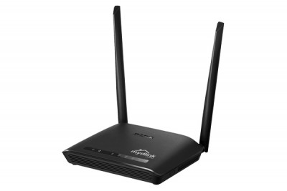
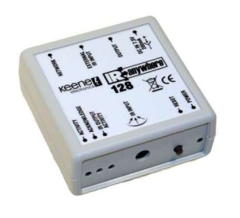
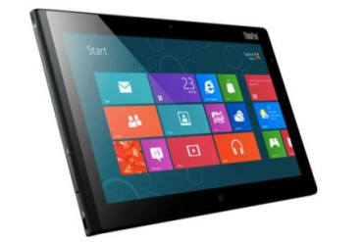



Queries with Kira
192
rj45
Kira 128
Window 8
Wifi
Router
IR
TV
15

Slide 16
IV. What’s next

Slide 17
IV. What’s next
Communication with the wheelchair
Communication with Fibaro
17

Slide 18
IV. What’s next
C++
C#
master versioning
18

