Slide 1
Home Automation Control Interface On Windows Tablet

Slide 2
Contents
• Context
• Pre-study
• Specifications

Slide 3
Context
Need of a simple interface for disabled people
Existing solutions but too complex and inadapted
Knowledge transfer from Insa to Ergovie
Ergovie is a Breton society who sells and repairs wheelchairs. They recently begin to develop domotic solutions.

Slide 4
Pre-study
Interface in XaML, C#
Algorithm in C++
API to control Kira : (protocol HTTP)
API to control Fibaro : (protocol HTTP)
API Bluetooth :

Slide 5
HTTP requests, library choice
Name | Language | Simple | Complete | Multi-OS | Complete documetation
libcurl | C | - | + | + | +
http-tiny | C | + | - | + | -
Winhttp | C/C++ | - | + | - | +
HappyHtpp | C++ | + | + | + | -

Slide 6
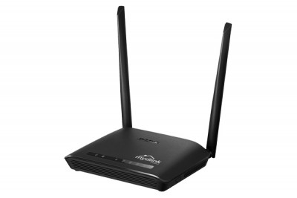
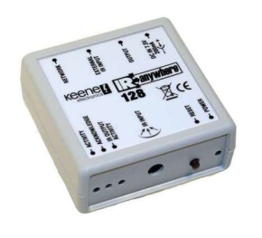
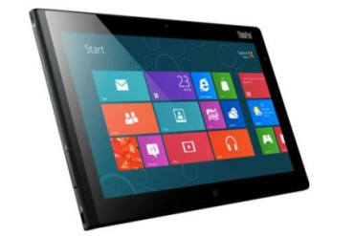


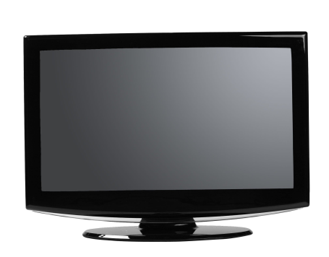
Queries with Kira
192
rj45
Kira 128
Window 8
Wifi
Router
IR
TV

Slide 7
Specifications
Enabling people to switch on/off machines
Adapted to users
A « scrolling » mode (traduction à revoir)
Configuration available, only for technician
Feedback from the wheelchair

