Slide 1
Home Automation Control Interface On Windows Tablet
Practical study 06/01/2016
Tutors François Pasteau Marie Babel | Team members Iman Akabi Diane Dewez Enora Lucas Meven Moser Corentin Chatellier

Slide 2
Contents
Context
Specifications
Pre-study
What we have done
What’s next
Conclusion
2

Slide 3

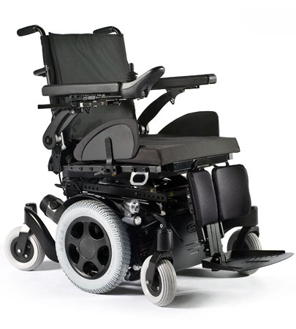
I. Context
sells and repairs wheelchairs
develop home automation solutions
4

Slide 4
context
Dessins Enora (diapo à peut-être fusionner avec la suivante)

Slide 5
I. Context
Why did we choose this subject ?
What is the aim?
Need of a simple interface for disabled people
Existing solutions but too complex and inadapted
HUMAN VALUES
CHALLENGING
GUI
5

Slide 6
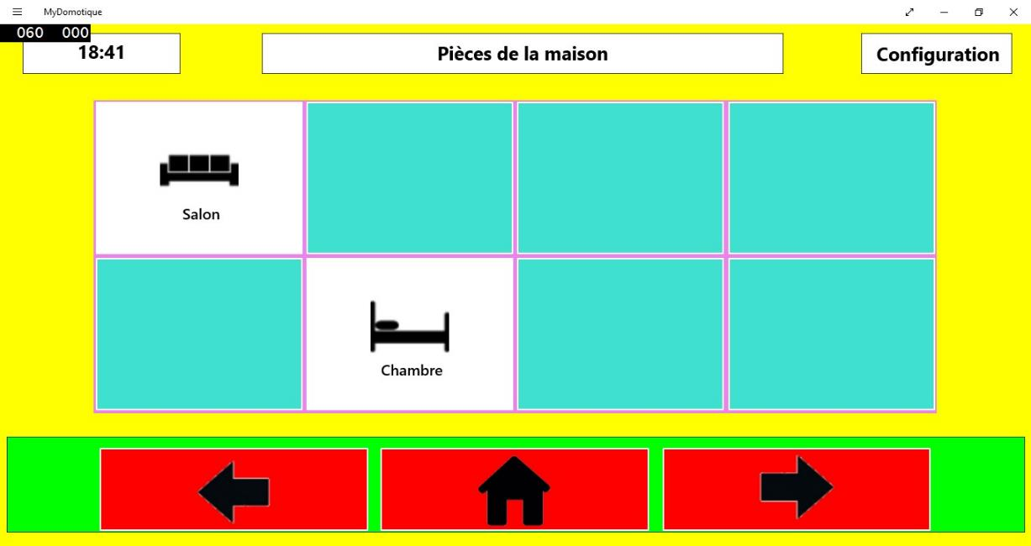
I. Context
What has been done by the previous team ?
6

Slide 7
II. Specifications
GUI | Communication
Adapted to any disabled user | With the wheelchair for a feedback
Simple to use | With Kira to control appliances with IR
Portable | With Fibaro Home Center to control appliances with Z-wave
8

Slide 8
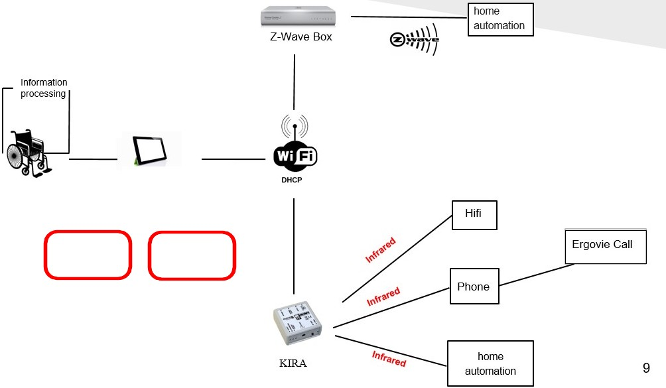
III. Pre-study
10

Slide 9
III. Pre-study
Language choices (peut-être pas à détailler parce que c’est chiant, en gros on a choisi de continuer avec ce qu’ils ont commencé parce que c’est plutôt adapté et simple)
 | WPF | Qt | GTKmm | wxWindows | Fltk
Multi-OS |  |  | Mostly on Linux |  | Yes
Adapted to tactile |  | No
Light |  | No | No |  | Yes (but lots of libraries to install)
11

Slide 10









HTTP requests, library choice
 | libcurl | http-tiny | Winhttp | HappyHttp
Language | C | C | C/C++ | C++
Multi-OS
Easy-to-use
Documentation
12

Slide 11


III. Pre-study
Interface | Model | Communication with Kira | Communication with Fibaro
WPF, XaML |  | HappyHttp : C++ library
13

Slide 12


III. Pre-study
Tools used
to code : Visual Studio
for versioning : Git
14

Slide 13
IV. What we have done
Familiarize with the previous code
Communication with a Kira, technically usable on every system
Implemented in our interface for a prototype

Slide 14
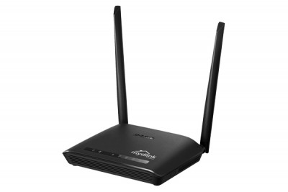
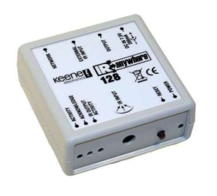
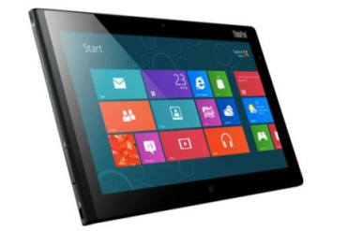


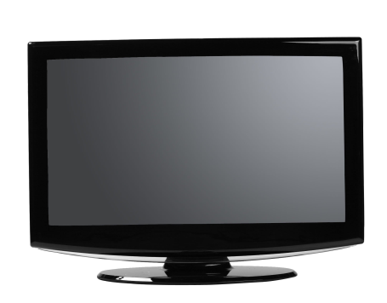
Queries with Kira
192
rj45
Kira 128
Windows 8
Wifi
Router
IR
TV
15

Slide 15
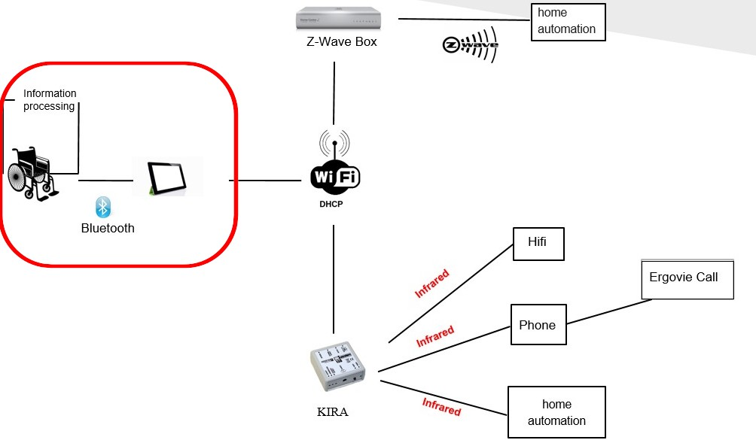
V. What’s next
Communication with the wheelchair
17

Slide 16
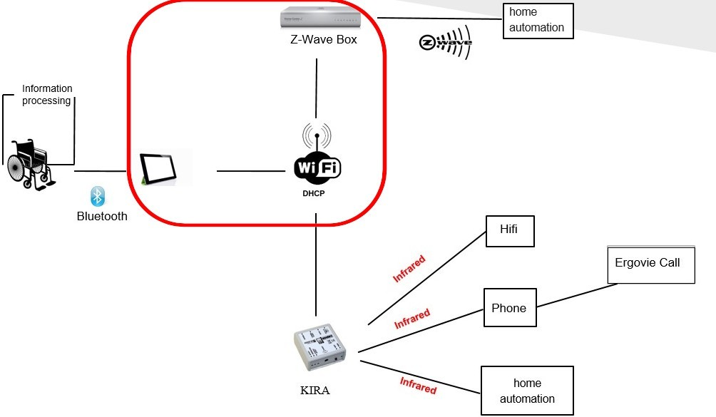
V. What’s next
Communication with Fibaro

Slide 17
V. What’s next
Improvements on the interface :
Render it usable by everyone (all types of disabilities)
Display the feedback from the wheelchair in real-time
Fibaro support
Aesthetics enhancement

Slide 18


V. What’s next
What we will learn / have learnt
HTTP requests
18

Slide 19
Questions ?

