Slide 1
Home Automation Control
Interface on Windows Tablet
Tutors François Pasteau Daniel Guillard Marie Babel | Team members Iman Akabi Diane Dewez Enora Lucas Meven Moser Corentin Chatellier
Practical study 06/01/2016

Slide 2
Contents
Context
Specifications
Pre-study
What we have done
What’s next
Conclusion
2

Slide 3

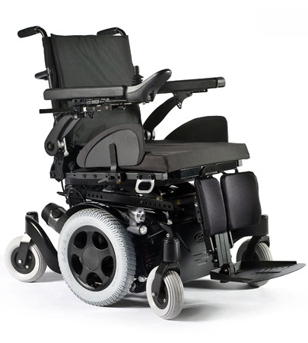
I. Context
sells and repairs wheelchairs
develop home automation solutions
3

Slide 4
I. Context
Why did we choose this subject ?
HUMAN VALUES
CHALLENGING
GUI
4

Slide 5
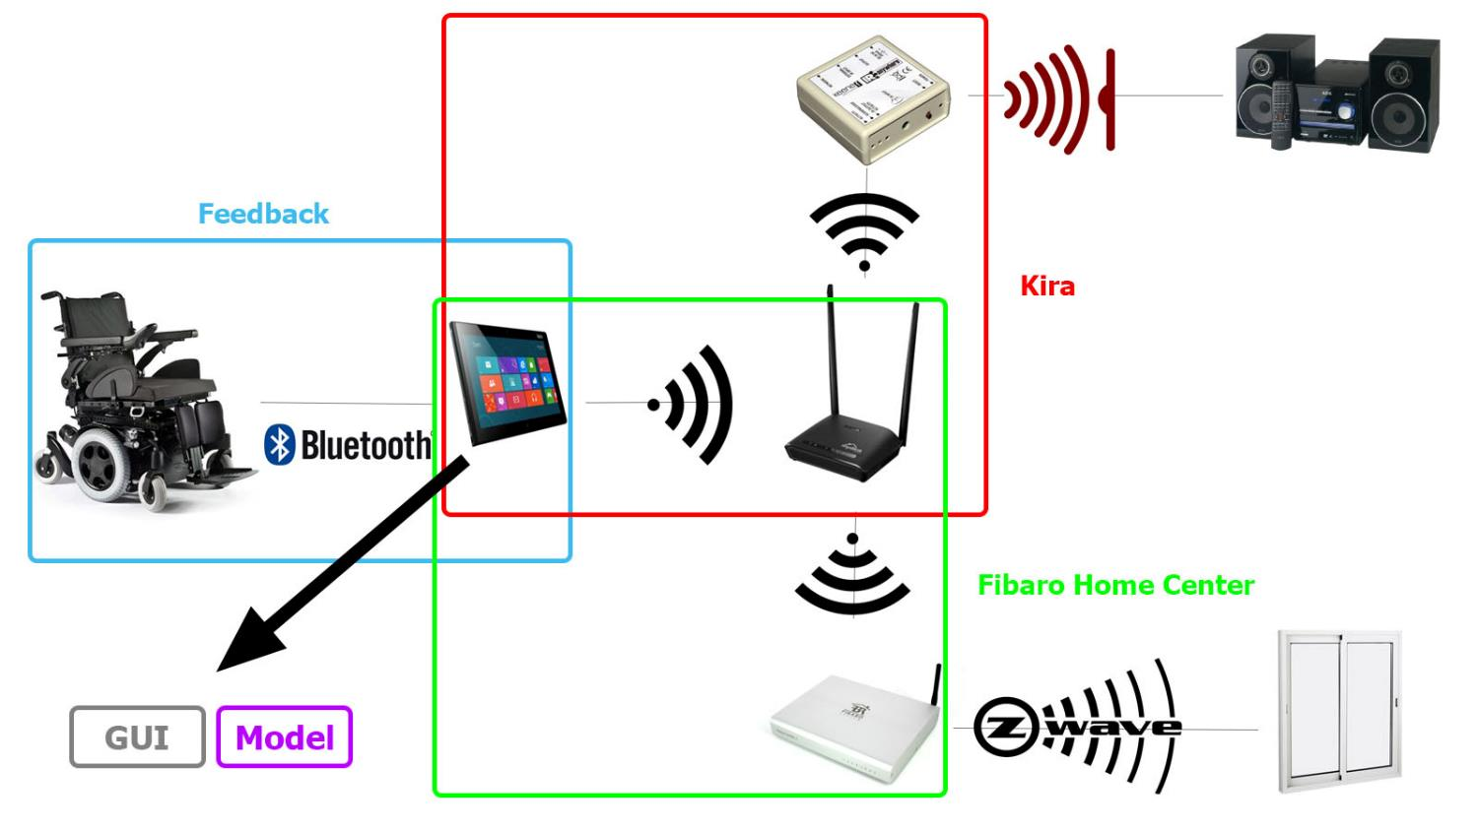
I. Context
5

Slide 6
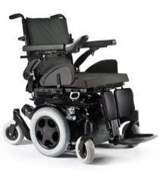
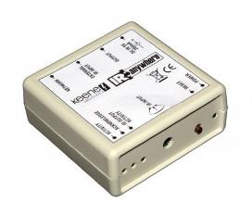
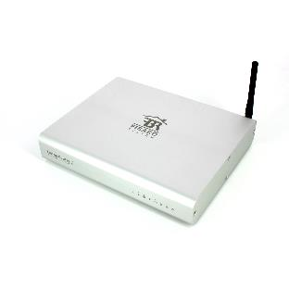
II. Specifications
Communication
With the wheelchair for a feedback
With Kira to control appliances with IR
With Fibaro Home Center to control appliances with Z-wave
6

Slide 7
II. Specifications
Graphic User Interface and Model
Adapted to any disabled user Contrast Fewer icons, visible
Simple to use
Selection mode
Portable
7

Slide 8
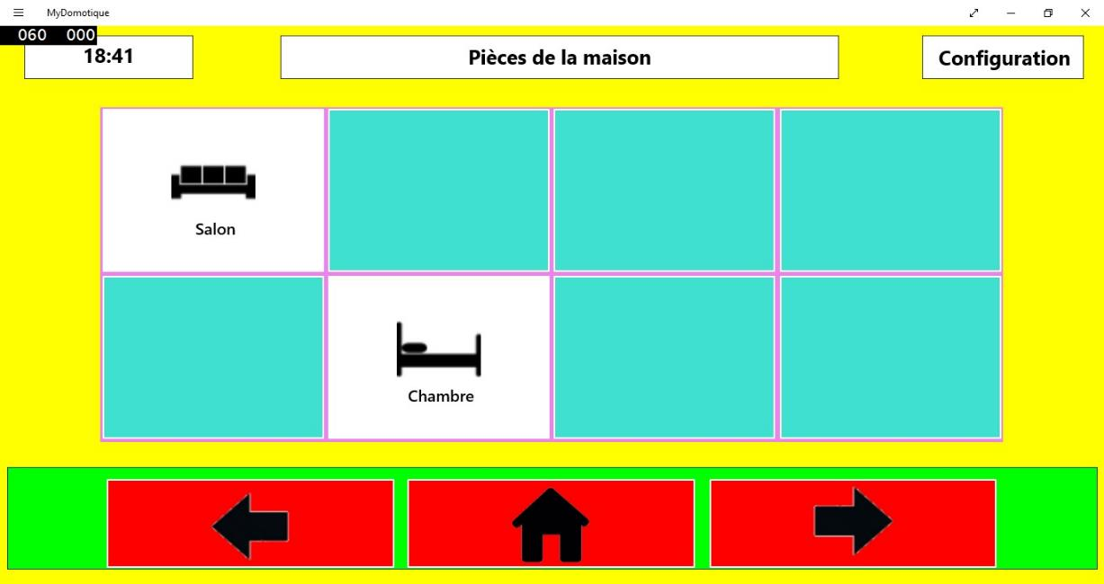
III.Pre-study
What has been done by the previous team ?
8

Slide 9
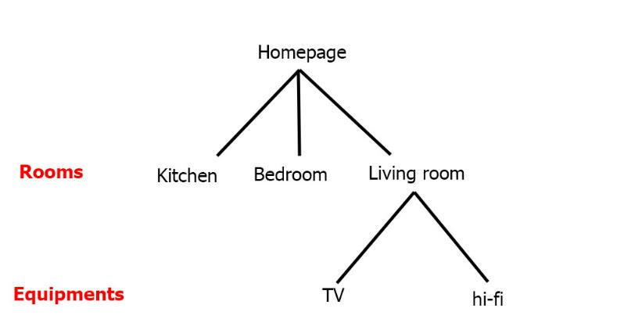
III.PRE STUDY
Algorithm core : a tree
Why C# ?
Ideal for Windows
9

Slide 10
III. Pre-study
Language choices
 | WPF | Qt | GTKmm | wxWindows | Fltk
Multi-OS |  |  | Mostly on Linux |  | Yes
Adapted to tactile |  | No
Light |  | No | No |  | Yes (but lots of libraries to install)
11

Slide 11
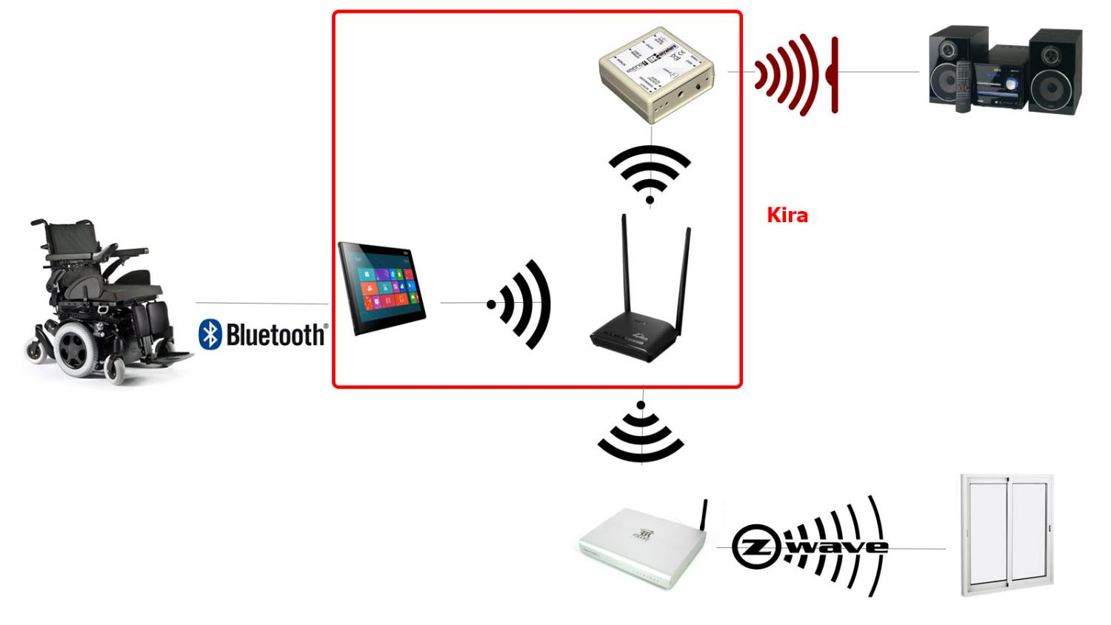
III. PRE-STUDY
10

Slide 12









III. PRE-STUDY
HTTP requests, library choice
 | libcurl | http-tiny | Winhttp | HappyHttp
Language | C | C | C/C++ | C++
Multi-OS
Easy-to-use
Documentation
11

Slide 13


III. Pre-study
Interface | Model | Communication with Kira | Communication with Fibaro
WPF, XaML |  | HappyHttp : C++ library
12

Slide 14



III. Pre-study
Tools used
to code : Visual Studio, Code Blocks
for versioning : Git
13

Slide 15
IV. What WE HAVE DONE
Prototype
14

Slide 16
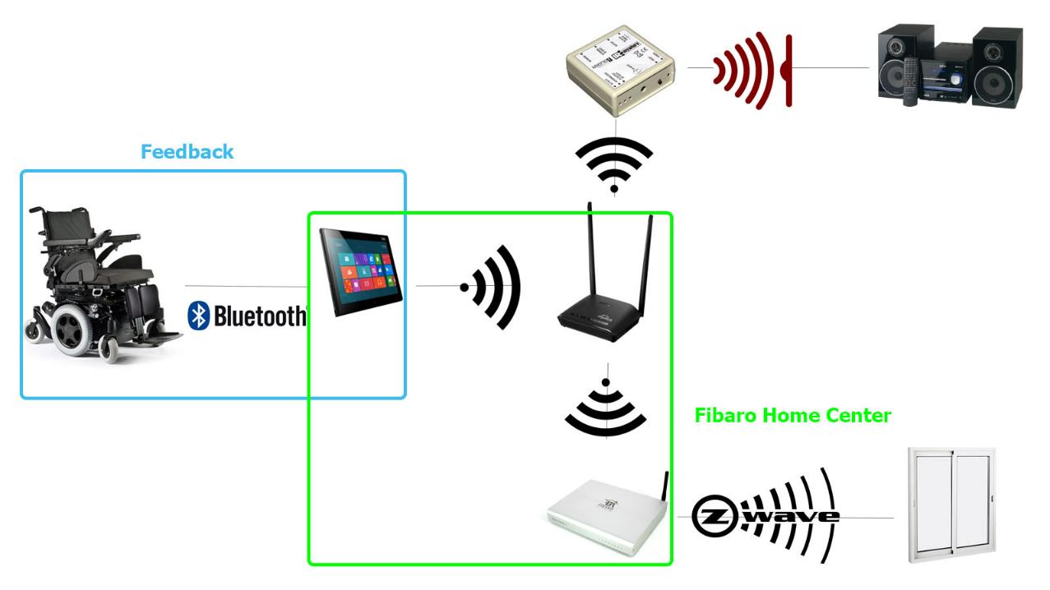
V. What’s next
Communication with Fibaro and the wheelchair
15

Slide 17
V. What’s next
Improvements on the interface :
Render it usable by everyone (all types of disabilities)
Aesthetics enhancement
Make it portable : translate all the algorithm in C++
16

Slide 18


VI. conclusion
What we learn
HTTP requests
17

Slide 19
Questions ?
18

