Slide 1
Home Automation Control Interface On Windows Tablet

Slide 2
Contents
• Context
• Pre-study
• Specifications

Slide 3
Context

Slide 4
Context
Ergovie is a Breton society who sells and repairs wheelchairs. They recently begin to develop domotic solutions.

Slide 5
context
Need of a simple interface for disabled people
Existing solutions but too complex and inadapted

Slide 6
context
What has been done by the previous team

Slide 7
specifications

Slide 8
Specifications
Enabling people to switch on/off machines
Adapted to every disabled users
A « scrolling » mode (traduction à revoir)
Configuration available only for the technician
Feedback from the wheelchair

Slide 9
Pre-STUDY

Slide 10
Pre-study
Interface in XaML, C#
Model made in C++
API to control Kira : HappyHttp (HTTP protocol)
API to control Fibaro : (HTTP protocol)

Slide 11
Pre-study
Programming
Visual Studio
Versioning
Git

Slide 12
HTTP requests, library choice
Name | Language | Simple | Complete | Multi-OS | Complete documetation
libcurl | C | - | + | + | +
http-tiny | C | + | - | + | -
Winhttp | C/C++ | - | + | - | +
HappyHtpp | C++ | + | + | + | -

Slide 13
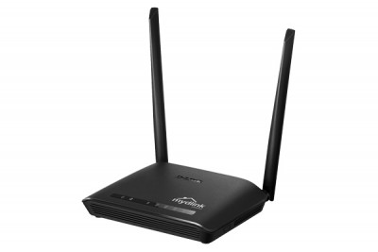
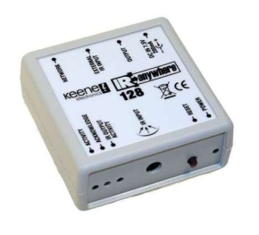
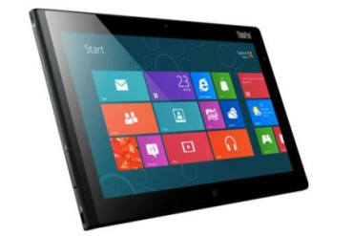


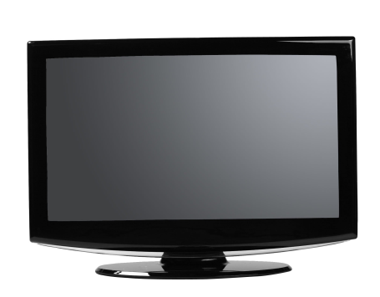
Queries with Kira
192
rj45
Kira 128
Window 8
Wifi
Router
IR
TV

Slide 14
What’s next ?

Slide 15
What’s next
Communication with the wheelchair
Communication with Fibaro

Slide 16
what’s next ?
C++
C#
master versioning

