Slide 1
IST 246 Data Structures and Algorithms
Fall 2021
OpenMPI, part 1

Slide 2
Outline
Introduction to parallelism
Parallel computing architectures
Design of parallel programs

Slide 3
Introduction to Parallelism

Slide 4
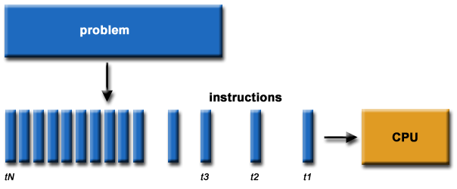
Difference from sequential programs
In sequential processing (everything we've done so far), the problem is broken down into steps, which are executed in order by the CPU
One one step is actively being computed at any one time

Slide 5
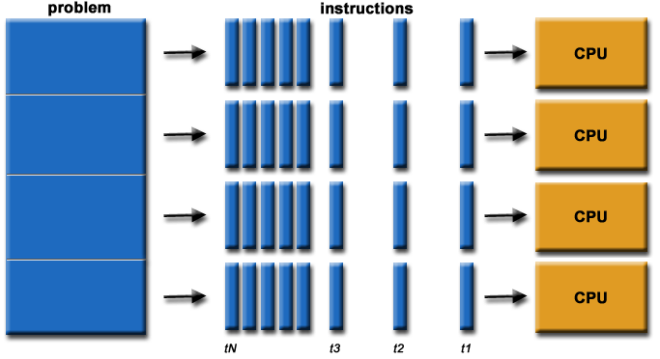
Difference from sequential programs
In parallel computing, the problem is broken down into pieces that can run concurrently on multiple processors
Each piece might be composed of several steps, or even large subroutines

Slide 6
Rationale for parallelism
The obvious goal for parallelism is to speed up computation, via multiple processors
Traditionally, parallel computing has been high-end stuff, reserved for the realm of supercomputers
Now, parallelism is mainstream:
Multicore processors in every computing device
Linux clusters

Slide 7
Rationale for parallelism
Parallelism:
Saves time and money by solving problems faster
Allows us to solve larger instances of problems in the same amount of time
Allows us to use non-local resources, e.g., SETI@Home
Moore's law may be reaching its limit, so parallelism may be the way to continue to achieve improved performance

Slide 8
Parallel Computing Architectures

Slide 9
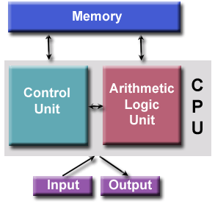
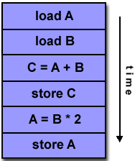
Parallel computing architectures
Basic von Neumann architecture:

Slide 10
Parallel computing architectures
Parallel architectures still retain the basic von Neumann architecture, but with multiple copies of some of the parts (CPU, memory, etc.)
Parallel architectures can be classified with Flynn's Taxonomy, circa 1966:
SISD - single instruction, single data, aka one CPU
SIMD
MISD
MIMD

Slide 11
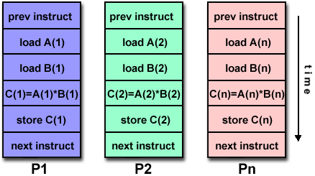
Parallel computing architectures
SIMD: Single Instruction, Multiple Data
All processors execute same instruction on a given clock cycle, but each may operate on a different data element; good for things like graphics / image processing (think GPUs)

Slide 12
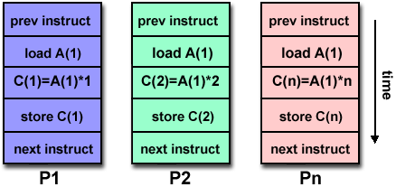
Parallel computing architectures
MISD: Multiple Instruction, Single Data
Each processor operates on same data independently, via separate instruction streams
Only a few research machines have applied this model

Slide 13
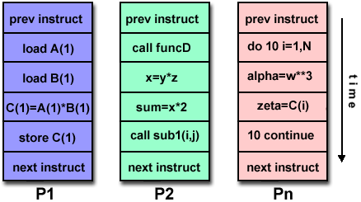
Parallel computing architectures
MIMD: Multiple Instruction, Multiple Data
Each processor may have different instruction stream
Each processor may be working on different data
Most common type today: Supercomputers, clusters, multicore PCs

Slide 14
Parallel computing architectures
What about memory? Options:
Shared: All CPUs have direct access to physical memory. E.g., a multicore PC
Distributed: Network-based memory access
A computing node can only see its local memory
For other memory, the node must go over the interconnection network to access another node's memory
E.g., a cluster computer

Slide 15
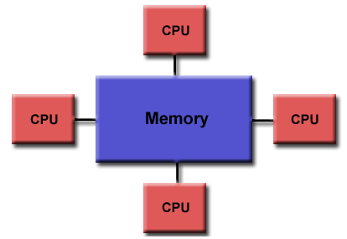
Parallel computing architectures
UMA: Shared memory, Uniform Memory Access

Slide 16
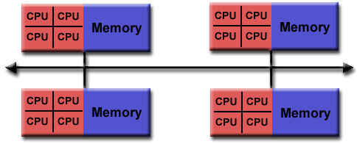
Parallel computing architectures
Hybrid distributed / shared: Typical of today’s supercomputers / clusters

Slide 17
Design of Parallel Programs

Slide 18
Design of parallel programs
Make sure to understand your problem and existing, mono-processor algorithms to solve it
Can the problem even be parallelized?
What are the "hotspots" in existing algorithms? Maybe use profiling tools to find out
What are potential bottlenecks, like I/O?
What data dependencies are there?

Slide 19
Design of parallel programs
Partition the problem
Break it into chunks that can be done in parallel, either by data or by function
Data example: image filtering
Function example: multi-stage, pipelined signal filter

Slide 20
Design of parallel programs
Understand communications requirements
"Embarrassingly parallel" programs need little communication between nodes
If communication is required between nodes, consider carefully!
Communication over the network is SLOW, relatively speaking; it is often the bottleneck preventing speedup

Slide 21
Design of parallel programs
Synchronization issues
How do different processes manage access to shared resources?
Load balancing
Keep all CPUs equally busy all the time, ideally
Understand limits / costs
What is the actual speedup? Is it worth it?

Slide 22
References
Barney, Blaise. "Introduction to Parallel Computing." Lawrence Livermore National Laboratory. 8 Aug. 2011. <https://computing.llnl.gov/tutorials/parallel_comp/>

