Slide 1

Data Visualization Service
Lu Han
COMP531 2016FALL

Slide 2




Data visualization platform for developers
Want a customized, dynamic, interactive visualization and analytics
Define data model, how to visualize
Don’t want to worry about extract, transform, load of data or building scalable infrastructures
Reflect: A discrete modular tool for adding data visualization to any web or mobile application in minutes
Notes:
1: Debugging your web app and see if it match your application, users of the application he want to see the analysis of the data.
Data should be viewed in what way, what data you want to analyze.
But you don’t want to worry about
Database analysis, healthiness of the data, check logs, thus you need to visualize the data.
Imagine you have own a website that sell a diverse type of merchandise. You want to analyze shopping habits of your customer, or xxxxx, instead of building one data visualization tool from scratch, you can use reflect, to visualize your data in customized

Slide 3
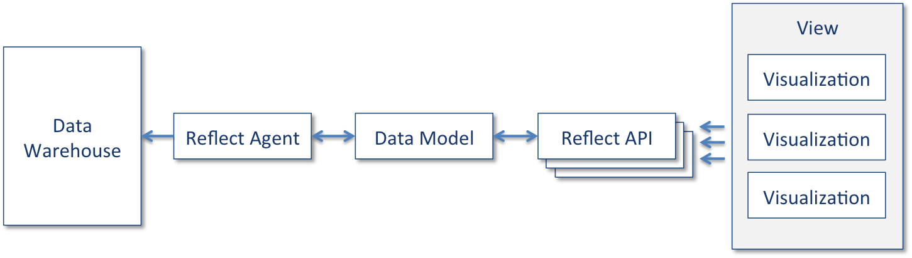
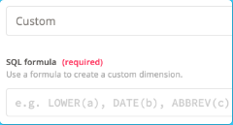
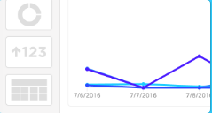
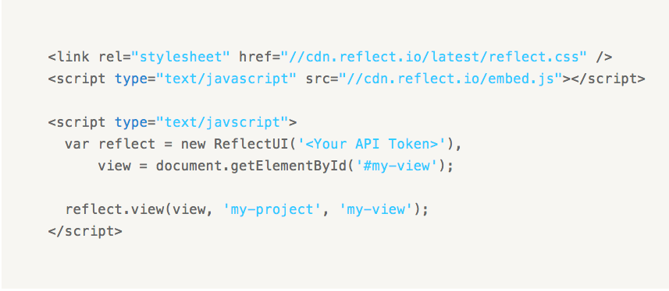
How to use
<Connect to database>
<Design visualization>
<Embedding>
Notes:
Connect to your database
When loading a visualization, Reflect's services transparently query the data source in its native query language. We refer to the layer between Reflect's API and your data source as our agent. The agent is separate from our API both so we can provide advanced security and because it gives you the option to run the agent in your own infrastructure.
Design stunning visualizations
Once you have your data source connected, creating beautiful views into your data is easy. Reflect offers an advanced browser-based editor that makes building impressive dashboards and interactions a breeze. The features offered in the UI based editor are all accessible through Reflect's API, allowing you to programmatically create and modify views.
Embed into your applications
Reflect's Javascript library makes it trivial to render the views that you've created directly into your product. With a few lines of Javascript, an entire dashboard can be embedded in your product or service.
Sample embedding code
Data models
Authentication: a keyed-hash message authentication code
Security
Embedding

Slide 4
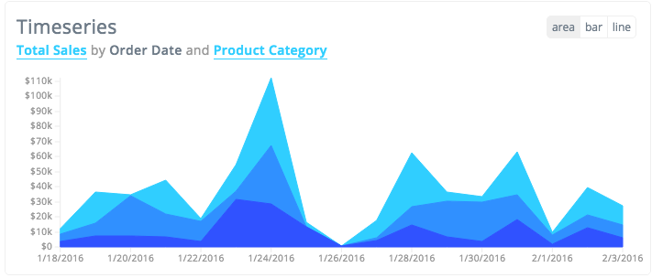
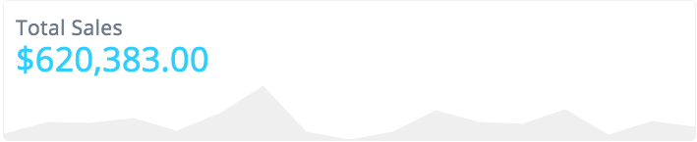
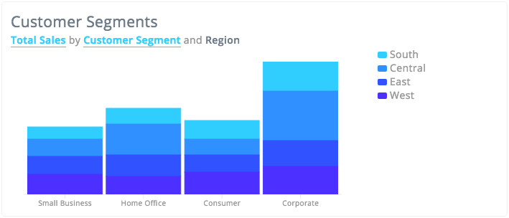
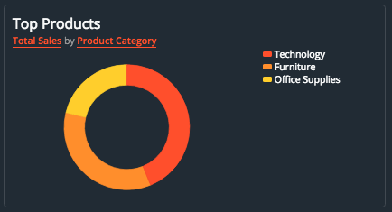
UI component
Demo
Notes:
Now let’s look at how these charts look like on a sample web application.
Data type.
Granularity
Filter.

Slide 5
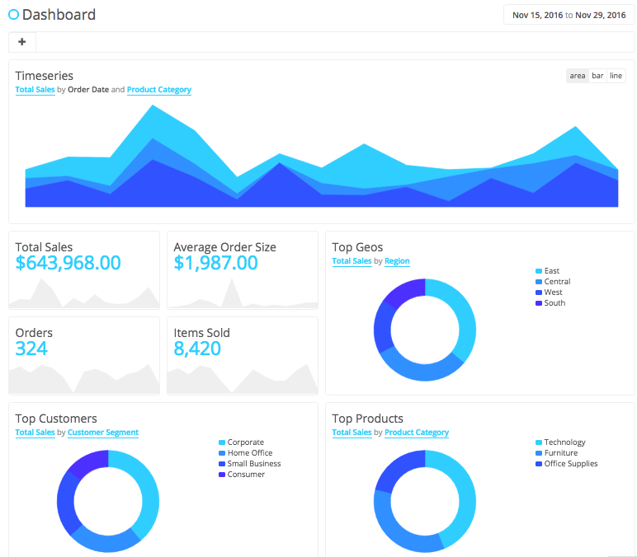

Summary
Reflect: A discrete modular tool for adding data visualization to any web or mobile application in minutes
Limited visualization method
Not open-source
Not free

Slide 6
Thank you!
Reference:
https://reflect.io/
https://techcrunch.com/2016/07/26/data-visualization-service-reflect-raises-2-5m-seed-round-led-by-dfj/
http://www.computerworld.com/article/3099119/application-development/reflect-raises-cash-to-be-the-visualization-engine-for-the-modern-world.html
http://www.creativebloq.com/design/seven-dirty-secrets-data-visualisation-2132787

