Slide 1
Consuming USGS Geo Data Portal Services in VisTrails
Seamless delivery of large or cumbersome data to
researchers and managers
Ability to use and summarize THREDDS data from a variety
of sources such as CIDA, ORNL, NOAA, and EROS.
Customizable user interface for Geo Data Portal functionality
Provenance, workflow and visualization capabilities
provided through VisTrails
Integration with other modeling packages such as
the Software for Assisted Habitat Modeling (SAHM)
Future integration with other online data sources such as
ScienceBase, BISON, and others

Slide 2
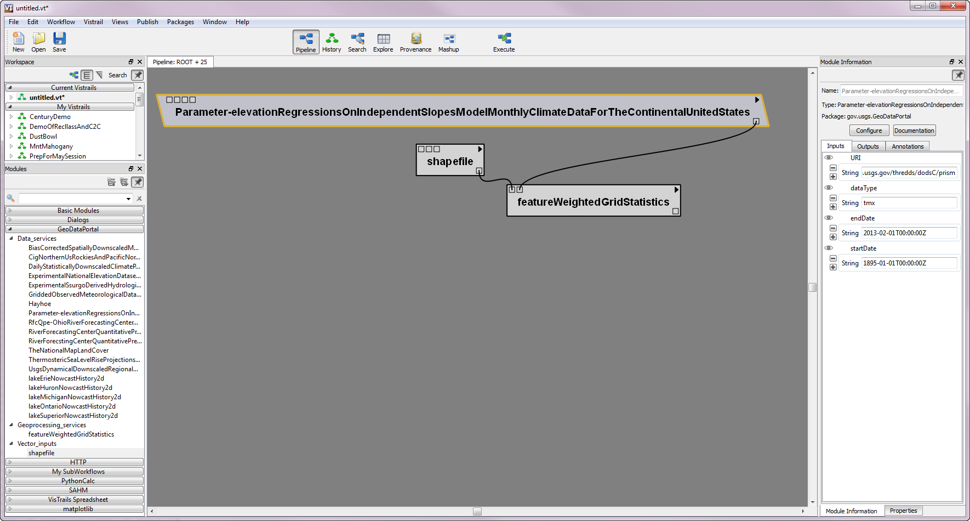
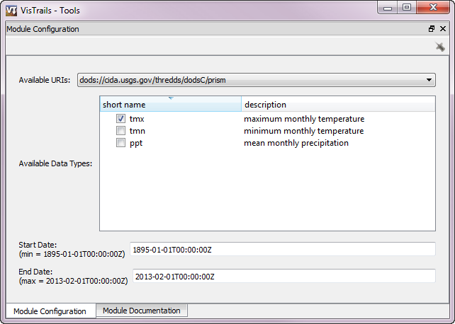
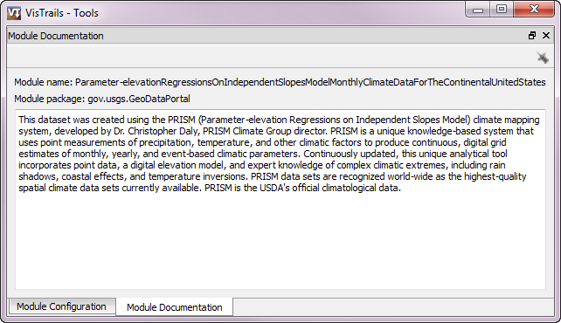
VisTrails User Interface
Dynamically generated modules for each service
User friendly interaction
Built in documentation

Slide 3
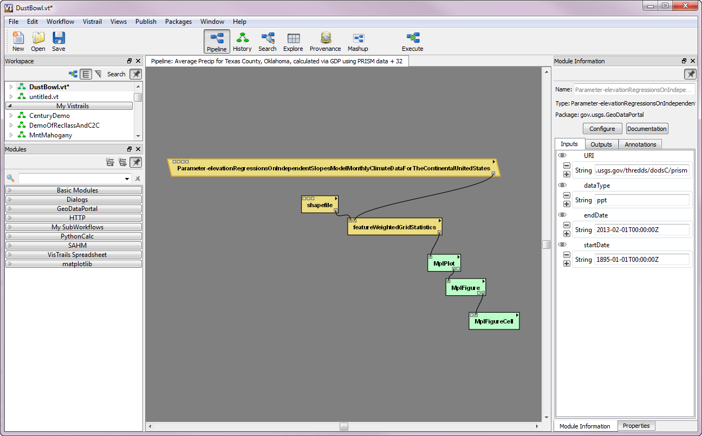
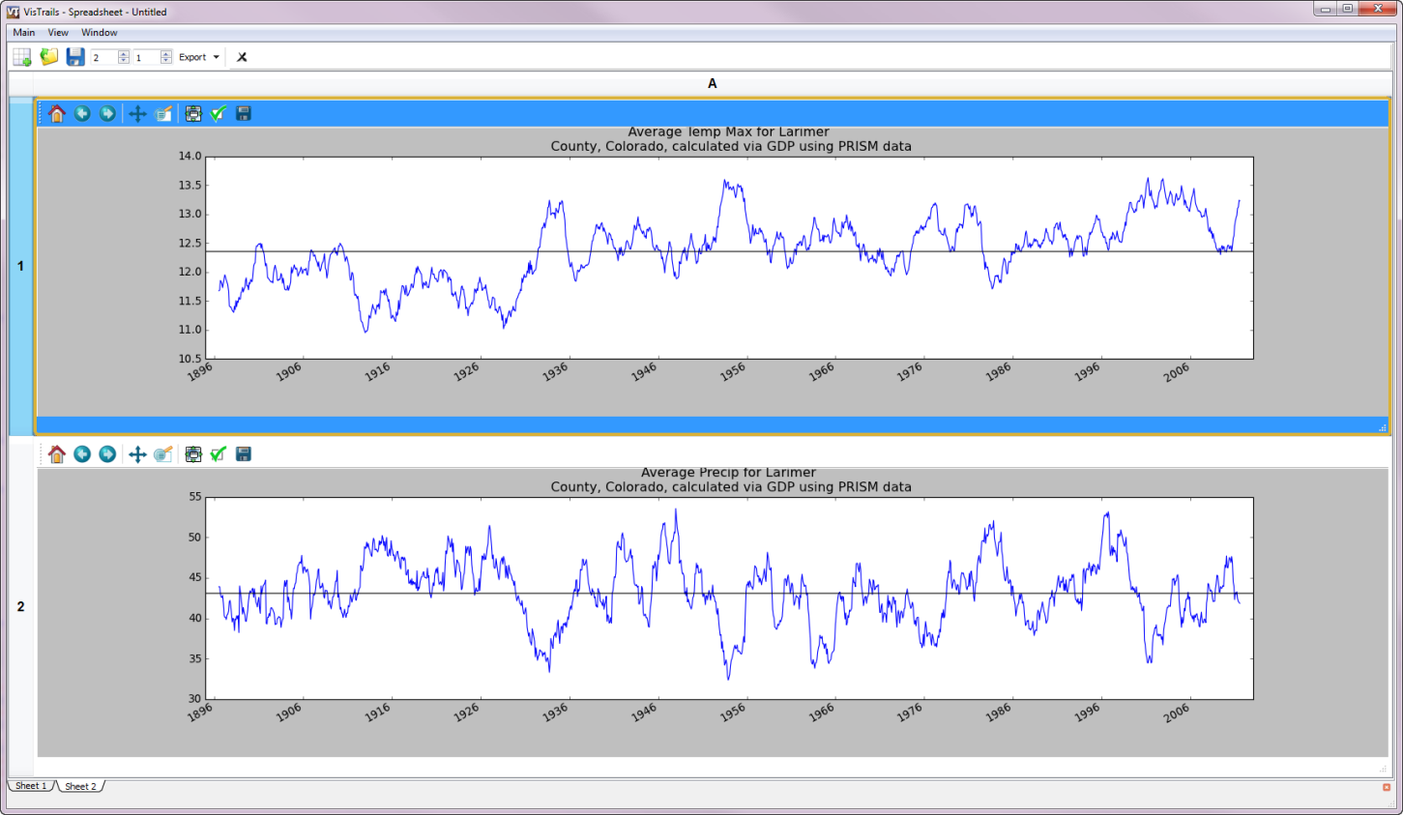
VisTrails Workflow example

