Slide 1
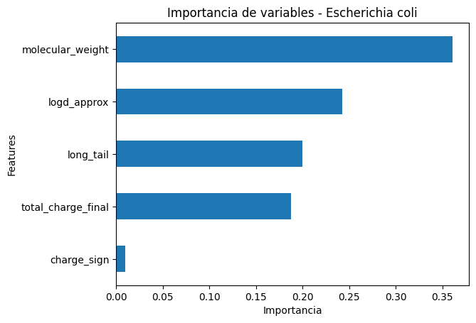
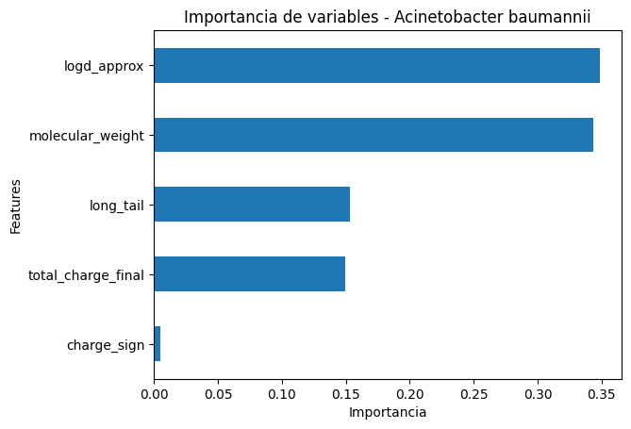
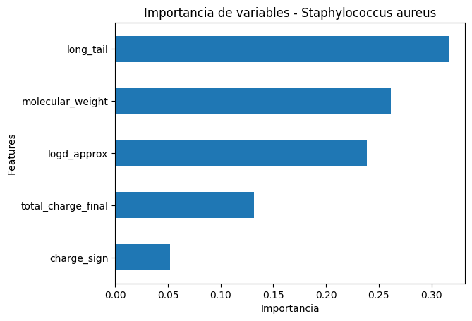
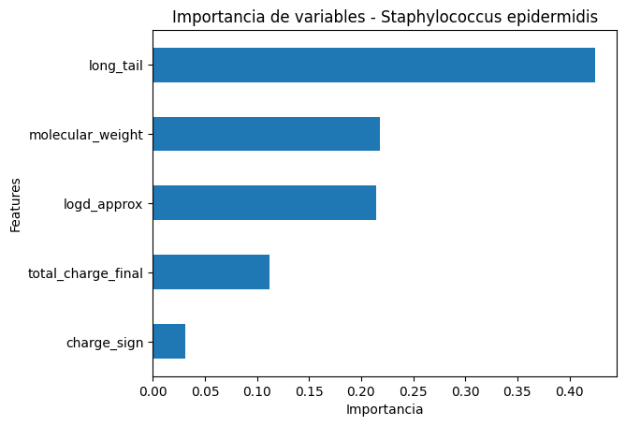
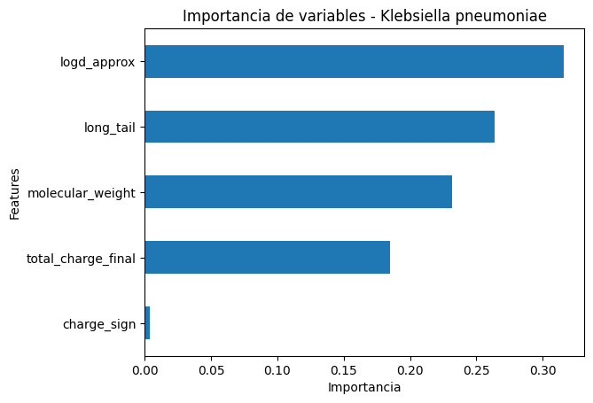
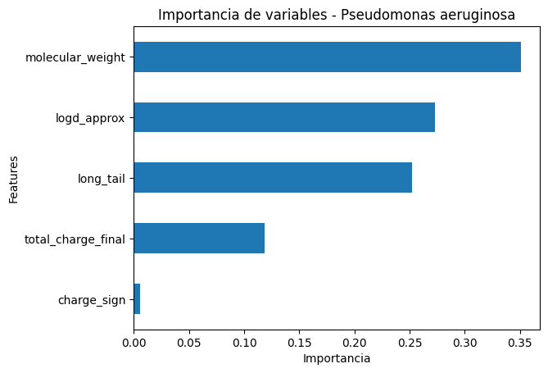
GRAM +
GRAM -
Escherichia coli
Acinetobacter baumannii
Staphylococcus aureus
Pseudomonas aeruginosa
Klebsiella pneumoniae

Slide 2
Escherichia coli
Staphylococcus aureus
Pseudomonas aeruginosa
Acinetobacter baumannii
Klebsiella pneumoniae

