Slide 1
Police procedural justice
Police procedural justice
Police procedural justice
Police legitimacy
Police legitimacy
Police legitimacy
Fear of the police
Fear of the police
Fear of the police
Time 1 Time 2 Time 3

Slide 2
Event
Person
Time

Slide 3
Event
Person
Time
Panel study

Slide 4
Event
Person
Time

Slide 5
Event
Person
Time
RCS

Slide 6
Event
Person
Time
RCS
Panel study

Slide 7
How many interviews?
Over how many days?
What is the recommended bandwidth?
How long should we keep interview open?

Slide 8


Slide 9
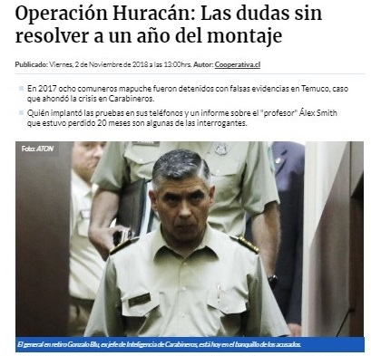

Slide 10
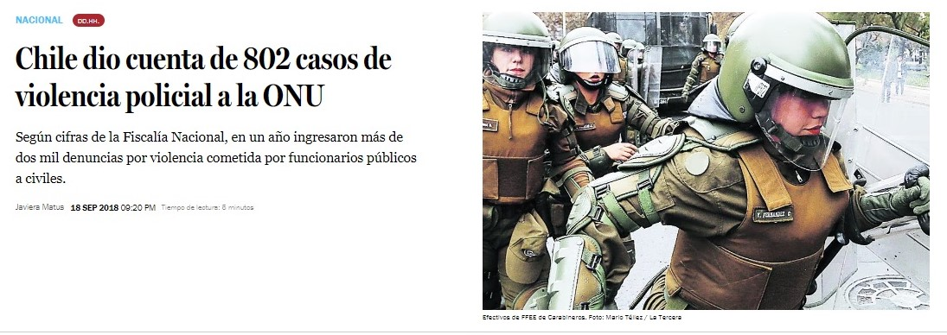

Slide 11
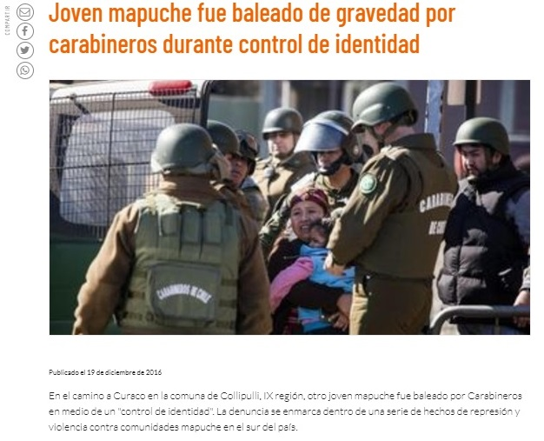

Slide 12
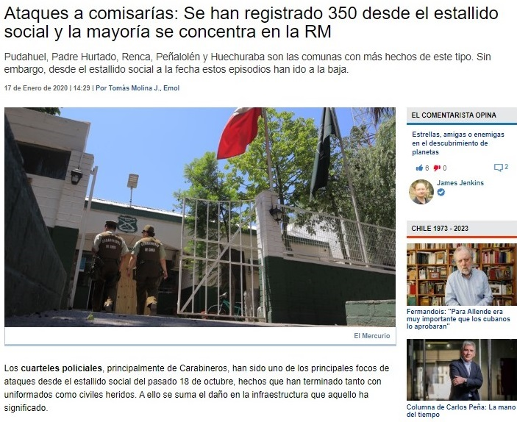

Slide 13
