Slide 1
Using Fuzzy k-Modes to Analyze Patterns of System Calls for Intrusion Detection
A Master’s Thesis
by Michael M. Groat
Advisor: Dr. Hilary Holz
Thesis Committee: Dr. Eric Suess, and Dr. William Nico

Slide 2
Overview
Computer Security
Intrusion Detection Systems based on process traces
Background discussion
Fuzzy k-modes
Our process data model
Comparing new process traces
Experiments and Results
Conclusion

Slide 3

Is Your Computer Safe?
Somewhere someone is trying to break in to your system.
Hackers are prevalent

Slide 4

Computer Security
Need to prevent intrusions
Protect data and information
Secure Privacy

Slide 5

Intrusion Detection Systems (IDS)
Attempt to detect viruses, worms, Trojan horses or other hacking attempts
Two Types of IDS
  Misuse based
  Anomaly based

Slide 6

Immune System: The Body’s Intrusion Detection System
Protects the body from invasion
Determines what is not a part of itself
Removes foreign material

Slide 7

Immunocomputing: A Computer’s Security Force
Protects the computer from intrusions
Determines, like the natural immune system, what is not itself.

Slide 8
Overview
Computer Security
Intrusion Detection Systems based on process traces
Background discussion
Fuzzy k-modes
Our process data model
Comparing new process traces
Experiments and Results
Conclusion

Slide 9
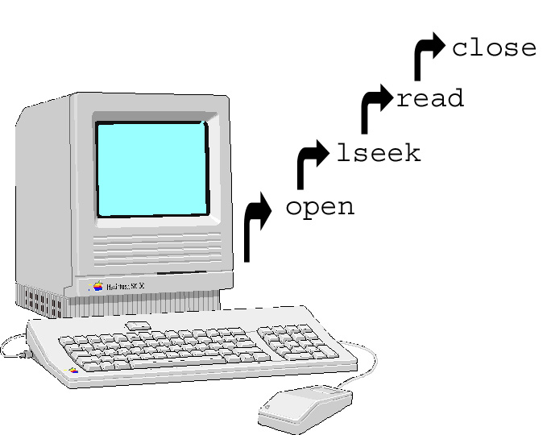
How Do You Model “Self” in a Computer?
We build a sense of self with patterns of system calls
A certain pattern of system calls define normal behavior
A program is defined by the pattern of system calls it emits

Slide 10
Sense of Self => Anomaly Based Intrusion Detection System
One that analyzes patterns of system calls or process traces
We determine the normal patterns and look for deviations from the normal patterns

Slide 11
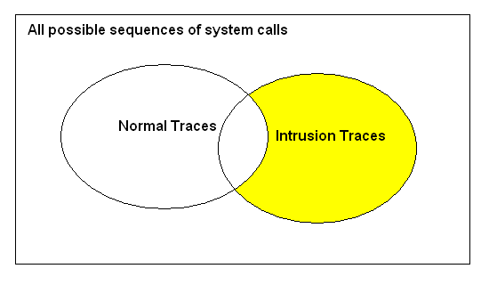
Deviations from Normal Behavior
In the state space of all possible sequences of system calls we plot normal and intrusion traces
We attempt to determine if new traces fall in the yellow

Slide 12
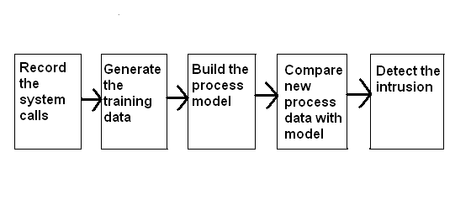
Five Step to Determine the “Yellow” Behavior
Intrusion Detection Systems based on analyzing process traces
  We execute the following 5 steps

Slide 13
Step One: Record the System Calls
Special programs such as strace
Collects process ids and system call numbers
System call numbers are found by their order in syscall.h file
    2032 32
    2032 23
    2033 54
    2033 2
    2043 3
    2033 63
    2032 34
    2032 33
    2043 23
    2032 2
    2033 4
    2033 5

Slide 14
Step 2: Convert the Data to the Training Data
List of process Ids and system calls are converted to n length strings
n is 6, 10, or 14
Take a sliding window across the data
n = 3
32 23 34
23 34 33
54 2 63
2 63 4
63 4 5
34 33 2

Slide 15
Step 2 – Further Explained
    2032 32
    2032 23
    2033 54
    2033 2
    2043 3
    2033 63
    2032 34
    2032 33
    2043 23
    2032 2
    2033 4
    2033 5
32 23 34

Slide 16
Step 2 – Further Explained
    2032 32
    2032 23
    2033 54
    2033 2
    2043 3
    2033 63
    2032 34
    2032 33
    2043 23
    2032 2
    2033 4
    2033 5
32 23 34
23 34 33

Slide 17
Step 2 – Further Explained
    2032 32
    2032 23
    2033 54
    2033 2
    2043 3
    2033 63
    2032 34
    2032 33
    2043 23
    2032 2
    2033 4
    2033 5
32 23 34
23 34 33
54 2 63

Slide 18
Step 2 – Further Explained
    2032 32
    2032 23
    2033 54
    2033 2
    2043 3
    2033 63
    2032 34
    2032 33
    2043 23
    2032 2
    2033 4
    2033 5
32 23 34
23 34 33
54 2 63
2 63 4

Slide 19
Step 3: Build the Process Data Model
The process data model is a mathematical representation of normal behavior
Improving the process data model improves the model of normal behavior.
It should represent the underlying truth of normalcy of the data

Slide 20
A New Process Data Model
We represent normal behavior with a statistical method called fuzzy k-modes
  Uses cluster centers or centroids
  Uses distances away from the centroids
We add the element of fuzzy logic to our method
  Fuzzy logic should better model the uncertainty in the data
  It allows as to determine to what degree an intrusion is.
  If a string is off by one system call in a hard method then it is completely off.
  If a string is off by one system call in a fuzzy method then it is still pretty much normal.

Slide 21
Other Process Data Modeling Techniques Have Been Used
Previous used techniques include:
  Stide Forrest et. al.
  Frequency stide Warrender et. al.
  A rule based method Lee et. al. & Helmer et. al.
  Hidden Markov Models Warrender et. al.
  Automata Kosoresow et. al.
No one method has been proven the best

Slide 22
Step 4: Compare New Process Data with the Process Data Model
New process data is converted to a form that can be compared against the process data model.
  Our form is also a set of strings
This new data is compared and later classified in step 5 as normal or abnormal behavior

Slide 23
Step 5: Determine an Intrusion
Hard limits are given to the intrusion signal to determine if new process data is either a normal or abnormal behavior
One and a half times the maximum self test signal is considered a true negative. Anything less is a false negative.

Slide 24
Five steps for Intrusion Detection Systems Based on Process Traces
Five steps revisited

Slide 25
Overview
Computer Security
Intrusion Detection Systems based on process traces
Background discussion
Fuzzy k-modes
Our process data model
Comparing new process traces
Experiments and Results
Conclusion

Slide 26
Background Discussion
What are clusters?
What are cluster centers?
What are memberships?
What is the difference between quantitative data and categorical data?

Slide 27
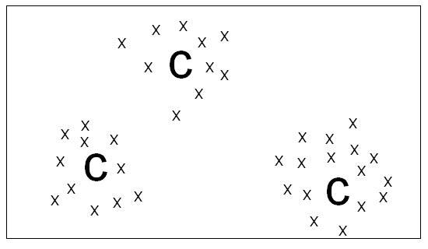
What are Clusters?
Two dimensional state space of all the possible strings. We then find the centers of the clusters or centroids
Clusters are groupings of similar objects
C are the Centroids
X are the strings

Slide 28
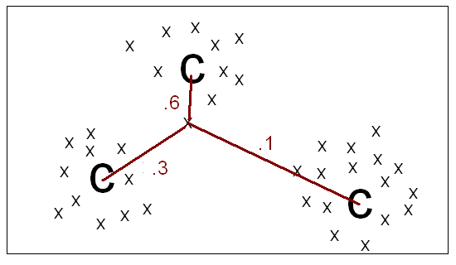
What are Memberships?
The distance to the closest centroid is taken as that strings memberships
Distances are inverted – closer to 0 is further away
C are the cluster centers, or centroids
X are the strings

Slide 29
What is Categorical Data?
Previous graphs were based on quantitative data
  Our data is categorical
Categorical data is data like the following
  Red, blue, green, yellow
  Ford, Honda, GM, Ferrari
There is no distance between categories
  The 6th system call is not twice as far as the 3rd system call.

Slide 30
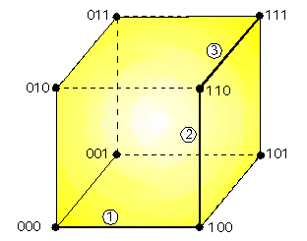
Categorical Hamming Distance
We have 8 strings of length 3
2 categories in each string position, 0 and 1

Slide 31
Overview
Computer Security
Intrusion Detection Systems based on process traces
Background discussion
Fuzzy k-modes
Our process data model
Comparing new process traces
Experiments and Results
Conclusion

Slide 32
Why use Fuzzy k-Modes?
We use the fuzzy k-modes algorithm to find centroids and memberships of the strings to the centroids
Fuzzy k-modes finds trends in the data that represent the most normal behavior

Slide 33
It is Supervised Learning, Unsupervised Clustering.
Supervised Learning
  Data is previously known to be normal or abnormal
Unsupervised Clustering
  Number of clusters is not known, we do not seed the clusters with known cluster centers

Slide 34
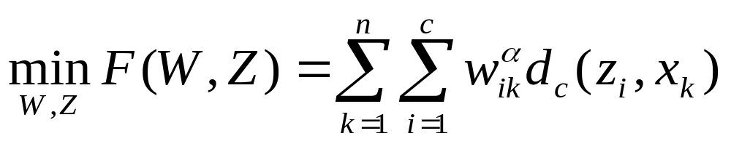
Fuzzy k-Modes Explained
Fuzzy k-modes consists of minimizing the following equation:
W is the memberships matrix
Z is the centroid matrix
d sub c is the dissimilarity measure
n is the number of strings
c is the number of clusters
alpha is a fuzzifying factor

Slide 35
Matrixes
Membership matrix
  the number of strings by the number of clusters.
  It consists of the memberships to each centroid.
Centroid matrix
  the number of clusters by the string length
  It consists of all the centroids.

Slide 36
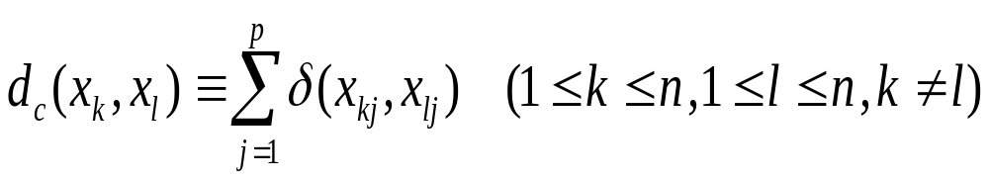
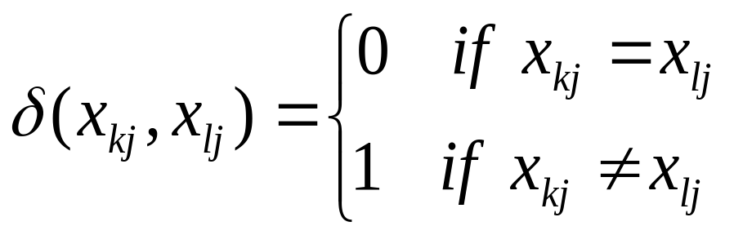
Dissimilarity Measure
The following is the published fuzzy k-modes dissimilarity measure.
Generalized Hamming distance
p is the string length
x is a string

Slide 37
Example of Dissimilarity Measure
3 5 10 5 7 4
3 7 10 2 3 4
This gives a value of 3

Slide 38
We Created a New Dissimilarity Measure
More weight should be given to less difference than many differences.
The third difference should rate higher than the twelfth difference
We want a non linear weight to differences

Slide 39
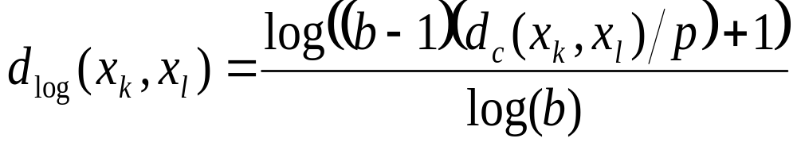
New dissimilarity measure
Logarithmic Hamming distance
Normalized on string length
b = 1000 - anything less and our logarithmic curve
would be too linear
p is string length

Slide 40
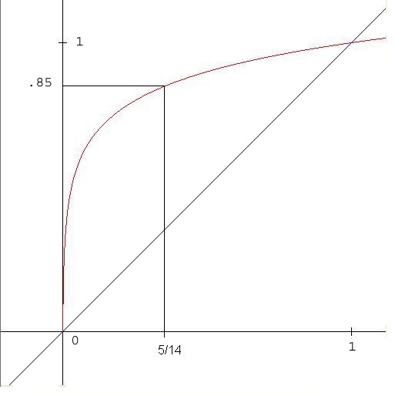
New measure example
A string that has 5 differences out of 14 is .85

Slide 41
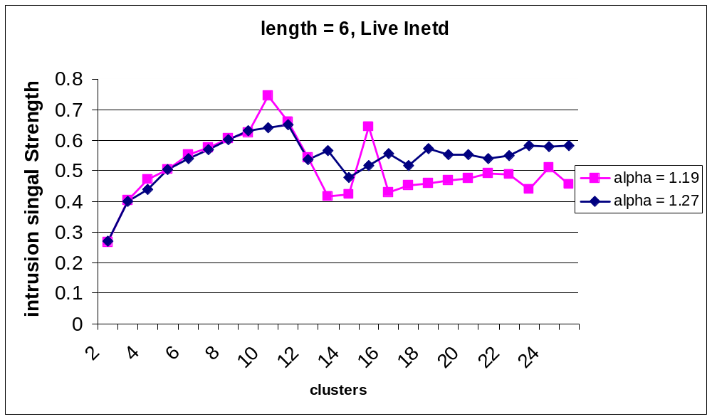
Effect of Logarithmic Measure on Intrusion Signal
Previous linear measure
Note how signal becomes random after 10 clusters.

Slide 42
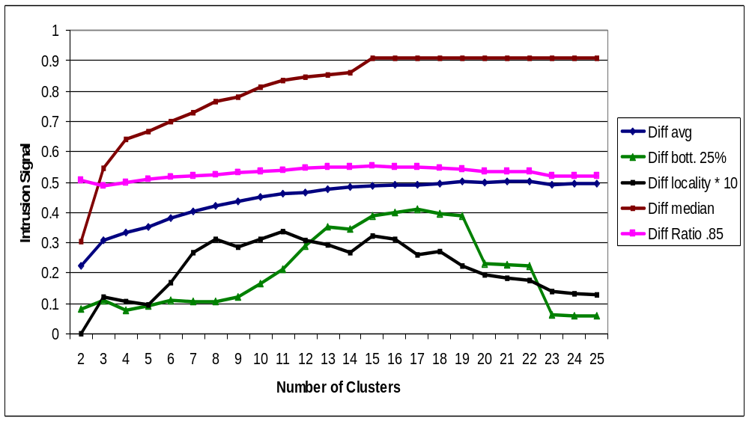
Effect of Logarithmic Measure on Intrusion Signal
Note how signal stays strong after 10 clusters
After 18 clusters we start to see repeated centroids
Lines are more smooth

Slide 43
Fuzzy k-Modes Algorithm
To find the minimum of the equation given earlier (F) we try to solve a system of non-linear equations.
  No solution is known to solve a system of non-linear equations
  Best solution so far is given below
Algorithm
  Initialize the parameters
  Fix the Centroids, then update the Memberships
  Fix the Memberships, then update the Centroids
  Continue to step 2 until some criteria is met.

Slide 44
Fuzzy k-Modes, Step 1:
Initialize the Parameters
Choose alpha and number of clusters
Then seed the centroid matrix
  Published algorithm called for a random seeding
  We chose a smart seeding
    Most common occurring symbols in first centroid
    Second most common occurring symbols in second centroid, etc.

Slide 45
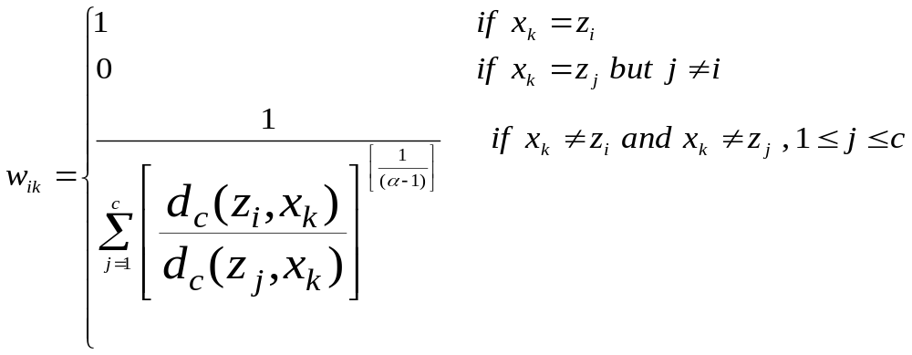
Fuzzy k-Modes Step 2:
Fix Centroids, Update Memberships
We update the memberships according to the following equation
z is a centroid
x is a string
c is the number of clusters

Slide 46
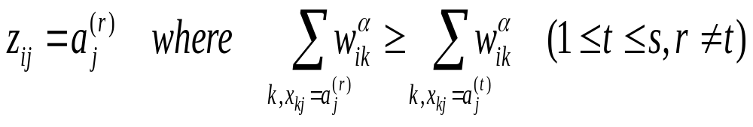
Fuzzy k-Modes Step 3:
Fix Memberships, Update Centroids
We update Z according to the following equation
z is a centroid
w is a membership
r and t are system call numbers
Find the symbol with the highest summation of
memberships to the i-th centroid with that symbol in the
j-th position
Assign that to the i-th centroid’s j-th position

Slide 47
Reduced Time Complexity in this Step
Reduced from cpsn to cpn
  c is the number of clusters
  p is the string length
  s is the number of system calls
  n is the number of strings
Accomplished this with an accumulation matrix that is later sorted

Slide 48
Step 4: Stop at Some Criteria
When the fuzzy k-modes equation (F) in the current step equals the equation (F) in the previous step.
F is the fuzzy k-modes equation that we try to minimize.

Slide 49
Fuzzy k-Modes Drawbacks
Sensitive to initialization
a priori knowledge of the number of clusters

Slide 50
Overview
Computer Security
Intrusion Detection Systems based on process traces
Background discussion
Fuzzy k-modes
Our process data model
Comparing new process traces
Experiments and Results
Conclusion

Slide 51
Our Process Data Model Algorithm
Fix the number of clusters then run fuzzy k-modes several times and choose the run with the optimal alpha
Fix that alpha then run fuzzy k-modes several times to choose the run with the optimal number of clusters
Take the memberships and centroids found with the best alpha and number of clusters and use those to compare new process data

Slide 52
Step 1: How do We Pick the Best Alpha?
Run the fuzzy k-modes several times
Choose the run that gives the best alpha according to some criteria.
  Our Criteria is the best uniform distribution of memberships
How do we determine a uniform distribution of memberships?
  We tried the Chi Square index

Slide 53
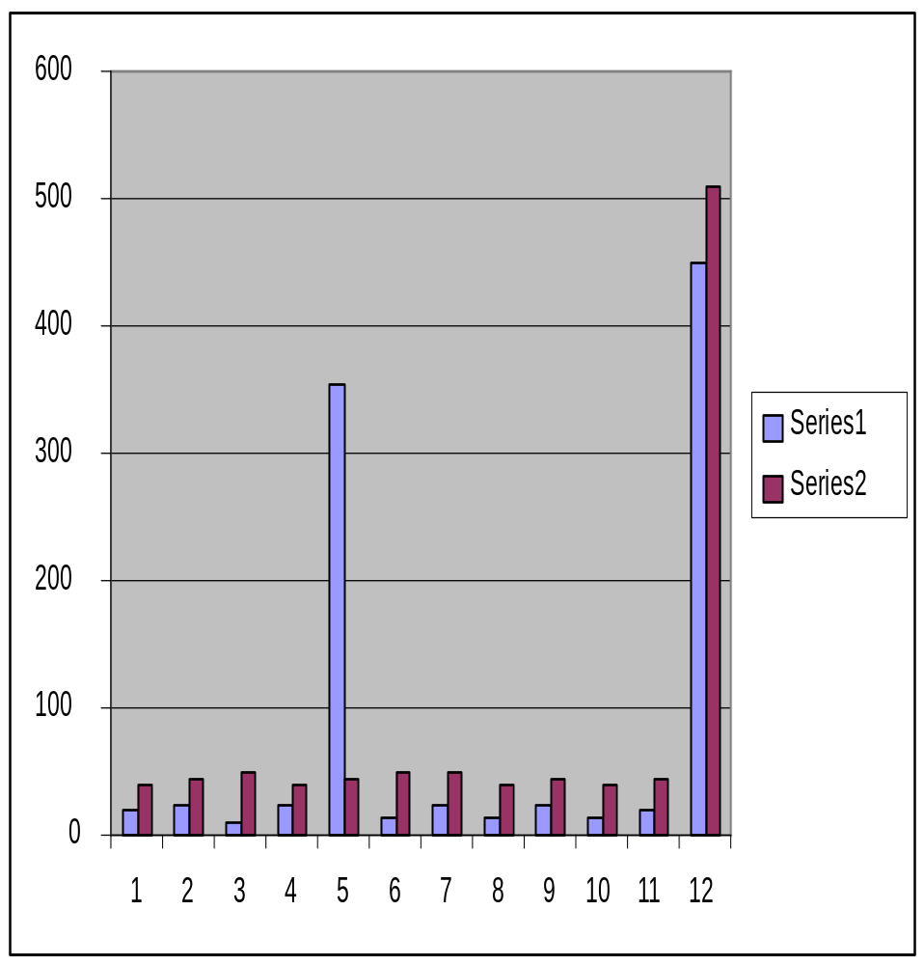
Problem with Chi Square Index
The chi square index favors the wrong distribution.
We want the red distribution, chi square favors the blue distribution
Otherwise we don’t get a nice U shape curve.

Slide 54
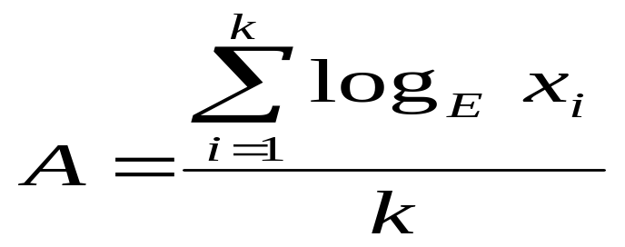
New Uniform Measure
We created the adjusted chi square index to favor the second distribution
E is the expected number of objects per class
x is the number of objects for that class
k is the number of classes.
We divide this measure into the chi square
measure to get the adjusted measure.

Slide 55
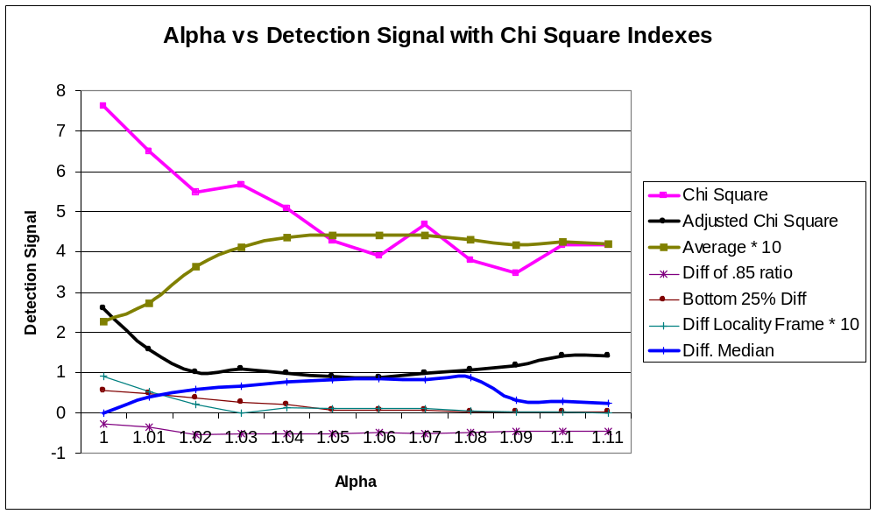
How do Uniform Memberships Affect Intrusion Signal?

Slide 56
Our Process Data Model Algorithm
Fix the number of clusters then run fuzzy k-modes several times and choose the run with the optimal alpha
Fix the alpha then run fuzzy k-modes several times to choose the run with the optimal number of clusters
Take the memberships and centroids found with the best alpha and number of clusters and use those to compare new process data

Slide 57
Step 2: Now We Determine the Number of Clusters
Use alpha found in the previous step
Run fuzzy k-modes for various numbers of clusters
Choose one run according to some criteria.
  Our criteria are validity indexes.

Slide 58
Validity Indexes
Validity indexes are our criteria to choose the optimal number of clusters
They represent the underlying truth in the data
We considered the following
  Kim’s index
  Kwon’s index
  Bezdek’s partition entropy index

Slide 59
Conversion of Indexes
Kim’s and Kwon’s index work only with quantitative data
  We converted the indexes from quantitative to categorical
Our results were not favorable
  Indexes tended to monotonically or semi-monotonically decrease as the number of clusters approached the number of data samples

Slide 60
Bezdek’s Worked the Best
With Bezdek’s partition entropy index we chose values around 15 to 18 consistently.

Slide 61
New Validity Index Published
Tsekouras et. al.
Published after completion of thesis
Works with fuzzy categorical clustering

Slide 62
Our Process Data Model Algorithm
Fix the number of clusters then run fuzzy k-modes several times and choose the run with the optimal alpha
Fix the alpha then run fuzzy k-modes several times to choose the run with the optimal number of clusters
Take the memberships and centroids found with the best alpha and number of clusters and use those to compare new process data

Slide 63
Overview
Computer Security
Intrusion Detection Systems based on process traces
Background discussion
Fuzzy k-modes
Our process data model
Comparing new process traces
Experiments and Results
Conclusion

Slide 64
Comparing New Process Data
New process data is compared against the process data model
Memberships of the new strings are found to the centroids found from the process data model
The distance to the closets centroid is taken as that strings membership value.

Slide 65
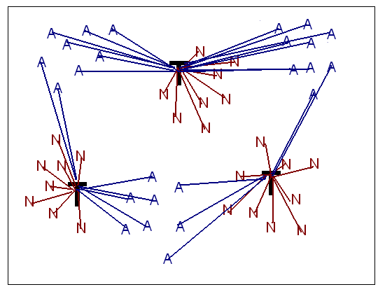
Comparing New Process Data
Image a 2 feature quantitative state space.
2 classes of new process data, 3 clusters each
A is Abnormal data
N is Normal data
T are the centroids from the training data

Slide 66
Comparing Algorithm
Find the distances of the training strings to the centroids found from the process data model
Find the distances of the new strings to the same centroids
Take the differences of the distances

Slide 67
Step 1: Find the Distances for the Training Strings
We find the following distances of the memberships to the closest centroid found from the process data model
  Average membership
  Median membership
  Average of the bottom 25% of memberships
  Ratio of strings below .85 to all strings
  Minimum average membership across 10 consecutive strings (locality frame)

Slide 68
Step 2: Find the New String’s Distances
We find the distances of the new strings to the training centroids from the process data model
We calculate the new strings memberships using step 2 of fuzzy k-modes: Fix the centroids and update the memberships.
  Average membership
  Median membership
  Bottom 25% average membership
  Ratio of strings below .85 to all strings
  Minimum average across 10 consecutive strings (locality frame)

Slide 69
Step 3: Take the Differences
We take the differences of the training strings distances and the new strings distances
These are our intrusion signals

Slide 70
Overview
Computer Security
Intrusion Detection Systems based on process traces
Background discussion
Fuzzy k-modes
Our process data model
Comparing new process traces
Experiments and Results
Conclusion

Slide 71
The Experiments
Self tests
  Trained 50% of data, tested other 50%
  Did this twice
Intrusion Tests
  Intrusions
  Error conditions
  Unsuccessful intrusions

Slide 72
The Data Set
Collected by Dr. Stephanie Forrest at the University of New Mexico
Contains two types of data
  Synthetic Data
    Created artificially
    Did not self test
  Live Data
    From a real working environment

Slide 73
The Programs
Live ps
  Reports process status
Live login
  Sign onto a system
Synthetic LPR
  Submit print requests
Live inetd
  Listens to network requests for services

Slide 74
The Intrusions
Live ps and Live login
  Trojan code from the Linux root kit
Synthetic LPR
  lprcp intrusion
Live inetd
  Denial of service attack

Slide 75
Comparison Against Stide
We compared our results against stide
An m look ahead table lookup
Runs in O(n) time where n is the number of strings

Slide 76
Data is Normalized
All data is normalized between zero and one.
Fuzzy k-Modes emited signals between -1 and 1. They are normalized to 0 and 1 as follows
  A – Training strings are maximal distant from centroids
  B – New strings and training strings are equally distant
  C – New strings are maximal distant from centroids
-1
0
1
0
.5
1
A
B
C

Slide 77
Live Inetd
No Self Tests for live inetd
  Data Set too small – only about 500 system calls

Slide 78
Live Inetd – Intrusion Tests
Live inetd | Stide |  | Fuzzy k-Modes
String Length | Locality Frame | Mis-match | Median | Avg. | Bottom 25% | Locality Frame | Ratio of .85
6 | 1.0000 | 0.5552 | 0.9234 | 0.7438 | 0.7048 | 0.5105 | 0.7672
10 | 1.0000 | 0.5829 | 0.9311 | 0.7429 | 0.6940 | 0.5161 | 0.7758
14 | 1.0000 | 0.6045 | 0.9164 | 0.7490 | 0.7254 | 0.5141 | 0.7848
All numbers are normalized between 0 and 1
Closer to 0 is more normal, closer to 1 is intrusive

Slide 79
Live Ps – Self Tests
Live ps | Stide |  | Fuzzy k-Modes
Trace # | Locality Frame | Mis- match | Median | Avg. | Bottom 25% | Locality Frame | Ratio of .85
1 | 0.5000 | 0.0094 | 0.5000 | 0.5012 | 0.4963 | 0.5000 | 0.4955
2 | 1.0000 | 0.0775 | 0.5000 | 0.5105 | 0.5143 | 0.5095 | 0.5177
0.5 for fuzzy k-modes indicates normal behavior – new strings are same
distance to centroids as training strings
less than 0.5 is more normal, greater is more abnormal
Green indicates false positive

Slide 80
Live Ps – Intrusion Tests
Two types of intrusions
  Homegrown
  Recovered
  Red in next slide indicates false negative

Slide 81
Live Ps - Homegrown
Live ps | Stide |  | Fuzzy k-Modes
Trace # | Locality Frame | Mis- match | Median | Avg. | Bottom 25% | Locality Frame | Ratio of .85
1 | 0.5000 | 0.0945 | 0.5008 | 0.5377 | 0.5686 | 0.5000 | 0.5579
2 | 0.5000 | 0.0903 | 0.5008 | 0.5328 | 0.5627 | 0.5000 | 0.5500
3 | 0.5000 | 0.0866 | 0.5008 | 0.5284 | 0.5581 | 0.5000 | 0.5427
4 | 0.5000 | 0.0831 | 0.5005 | 0.5244 | 0.5517 | 0.5000 | 0.5360
5 | 0.5000 | 0.0799 | 0.5002 | 0.5207 | 0.5467 | 0.5000 | 0.5298
6 | 0.5000 | 0.0308 | 0.5000 | 0.4788 | 0.4221 | 0.5000 | 0.4601
7 | 0.5000 | 0.0287 | 0.5000 | 0.4778 | 0.4197 | 0.5000 | 0.4583
8 | 0.5000 | 0.0301 | 0.5000 | 0.4705 | 0.3897 | 0.5000 | 0.4509
9 | 0.5000 | 0.0264 | 0.5000 | 0.4686 | 0.3825 | 0.5000 | 0.4482
10 | 0.5000 | 0.0642 | 0.5245 | 0.5640 | 0.5627 | 0.5000 | 0.6055
11 | 0.6500 | 0.0789 | 0.5268 | 0.5678 | 0.5687 | 0.5000 | 0.6097
12 | 0.7000 | 0.0924 | 0.5377 | 0.5703 | 0.5663 | 0.5000 | 0.6146
13 | 0.7000 | 0.0681 | 0.5000 | 0.5040 | 0.5171 | 0.5000 | 0.4989
14 | 0.7000 | 0.2150 | 0.6907 | 0.6153 | 0.6098 | 0.5000 | 0.6933
15 | 0.7000 | 0.0570 | 0.5000 | 0.5067 | 0.5175 | 0.5000 | 0.5086

Slide 82
Live Ps - Recovered
Live ps | Stide |  | Fuzzy k-Modes
Trace # | Locality Frame | Mis- match | Median | Avg. | Bottom 25% | Locality Frame | Ratio of .85
16 | 1.0000 | 0.1409 | 0.5008 | 0.5294 | 0.5495 | 0.5037 | 0.5500
17 | 1.0000 | 0.1346 | 0.5008 | 0.5248 | 0.5464 | 0.5037 | 0.5422
18 | 1.0000 | 0.1288 | 0.5005 | 0.5207 | 0.5394 | 0.5037 | 0.5350
19 | 1.0000 | 0.1235 | 0.5002 | 0.5169 | 0.5326 | 0.5037 | 0.5284
20 | 1.0000 | 0.1186 | 0.5001 | 0.5134 | 0.5256 | 0.5037 | 0.5224
21 | 1.0000 | 0.0569 | 0.5000 | 0.4742 | 0.4040 | 0.5037 | 0.4609
22 | 1.0000 | 0.0529 | 0.5000 | 0.4712 | 0.3921 | 0.5037 | 0.4536
23 | 1.0000 | 0.1191 | 0.5000 | 0.4982 | 0.4953 | 0.5037 | 0.4985
24 | 0.9500 | 0.2688 | 0.6879 | 0.6205 | 0.6133 | 0.5037 | 0.7035
25 | 1.0000 | 0.1004 | 0.5000 | 0.5025 | 0.5033 | 0.5037 | 0.5068
26 | 0.9500 | 0.1341 | 0.5455 | 0.5685 | 0.5636 | 0.5037 | 0.6157

Slide 83
Live Login – Self Tests
Live login | Stide |  | Fuzzy k-Modes
Trace # | Locality Frame | Mis- match | Median | Avg. | Bottom 25% | Locality Frame | Ratio of .85
1 | 0.4500 | 0.0031 | 0.5000 | 0.4999 | 0.4998 | 0.4971 | 0.5000
2 | 0.6500 | 0.0092 | 0.5020 | 0.5001 | 0.5002 | 0.5007 | 0.5000
0.5 for fuzzy k-modes means new strings are same
distance as training strings to centroids

Slide 84
Live Login – Intrusion Tests
Live login | Stide |  | Fuzzy k-Modes
Trace # | Locality Frame | Mis- match | Median | Avg. | Bottom 25% | Locality Frame | Ratio of .85
Hm/1 | 0.0000 | 0.0000 | 0.5074 | 0.5008 | 0.5005 | 0.5000 | 0.5012
Hm/2 | 1.0000 | 0.1183 | 0.5611 | 0.5153 | 0.5026 | 0.4916 | 0.5162
Hm/3 | 0.0000 | 0.0000 | 0.5348 | 0.5039 | 0.5009 | 0.4885 | 0.5042
Hm/4 | 0.8000 | 0.0566 | 0.4601 | 0.4423 | 0.4696 | 0.4861 | 0.4153
Rc/5 | 1.0000 | 0.2095 | 0.4601 | 0.4586 | 0.4875 | 0.4998 | 0.4330
Rc/6 | 1.0000 | 0.2095 | 0.4601 | 0.4586 | 0.4875 | 0.4998 | 0.4330
Rc/7 | 1.0000 | 0.2386 | 0.4601 | 0.4662 | 0.4899 | 0.4998 | 0.4439
Rc/8 | 1.0000 | 0.1777 | 0.4601 | 0.4463 | 0.4844 | 0.4982 | 0.4151
Rc/9 | 1.0000 | 0.2386 | 0.4601 | 0.4662 | 0.4899 | 0.4998 | 0.4439

Slide 85
Synthetic LPR – Intrusion Tests
No Self Tests because synthetic data
Synth. LPR | Stide |  | Fuzzy k-modes
String Length | Locality Frame | Mis- match | Median | Avg. | Bottom 25% | Locality Frame | Ratio of .85
6 | 0.6500 | 0.0980 | 0.5995 | 0.5692 | 0.5453 | 0.5346 | 0.6046
10 | 1.0000 | 0.1625 | 0.7405 | 0.6024 | 0.5200 | 0.5155 | 0.6497
14 | 1.0000 | 0.2229 | 0.5136 | 0.5540 | 0.5968 | 0.5462 | 0.6001

Slide 86
Other Results
New uniform measure
New dissimilarity measure
Reduced time complexity
Invalidity of converting quantitative validity indexes to categorical data

Slide 87
Overview
Computer Security
Intrusion Detection Systems based on process traces
Background discussion
Fuzzy k-modes
Our process data model
Comparing new process traces
Experiments and Results
Conclusion

Slide 88
Discussion
Pros
  Fast once trained
  Better accuracy on some processes
Cons
  Long learning time
  Must be collected during a clean period

Slide 89
Conclusions
Fuzzy k-modes as analyzing patterns of system calls is not panacea.
Works good for some not for all
Works just as good as stide
Is it worth the extra computational cost? Depends on the processes in question.

Slide 90
Future Work
Boiling Frog in the Pot
System of non-linear equations
System call timing
Sensitivity of fuzzy k-modes
Fuzzy grammar inference

Slide 91
Questions?

