Slide 1
Practical Quantum Communication:
From Lab to Real-World Applications
Md Mehdi Hassan
Quantum Research Fellow
Nasdaq
October 2026

Slide 2
Outline
Quantum Network
Quantum Clock Synchronization
Quantum in HFT

Slide 3
Classical Network
Channel
Channel
Node
Switch
Node
Quantum Network
Channel
Channel
Node
Switch
Node

Slide 4
Classical Network
Channel
Channel
Node
Switch
Node
Quantum Network
Channel
Channel
Node
Switch
Node

Slide 7
P.C.: https://www.aliroquantum.com/

Slide 8
Bird’s Eye View
UTK
ORNL
Challenges:
1. Transfer information to an optical carrier
2. Distribute through the Quantum Channels
3. Repeater/Swapping to cover the range
4. Synchronize the operation

Slide 9
Clock Synchronization

Slide 10
Clock Synchronization

Slide 11
Clock Synchronization
32,768 Hz = 2¹⁵ Hz
Why not a
Crystal Oscillator?
frequency divider
2⁰ Hz

Slide 12
Clock Synchronization

Slide 13
Clock Synchronization

Slide 14
Clock Synchronization

Slide 15
Clock Synchronization

Slide 16
Clock Synchronization
Which one to choose?
Fractional frequency uncertainty of 1x10⁻¹⁸
¹⁷¹Yb (ytterbium) lattice clocks
¹⁷¹Yb (ytterbium) lattice clocks
Photo Credit: J. Burrus/NIST

Slide 17
Clock Synchronization
Cesium-133
Rubidium-87
Low operating power
Smaller footprint
Lightweight
Faster lock time
Suitable for portable/GPS-denied/mobile systems
Better Allan deviation
Lower monthly/yearly drift
Better holdover time
Better phase noise
Better temperature stability
Wider input-voltage range
Free-space system
Fiber-integrated system

Slide 18
Clock Synchronization
Type-II SPDC

Slide 19
Clock Synchronization

Slide 20
Clock Synchronization

Slide 21
Clock Synchronization

Slide 22
Clock Synchronization

Slide 23
Clock Synchronization

Slide 24
Clock Synchronization
~ SyncE

Slide 25
Clock Synchronization

Slide 26
Clock Synchronization

Slide 27
Clock Synchronization
PC1
PC2

Slide 28
Clock Synchronization
PC

Slide 29
Clock Synchronization

Slide 30
Clock Synchronization
On-chip Rb atomic clocks can retrieve quantum correlation (for more than an hour)
We can use this for our quantum clock synchronization protocol
One can even further improve the correlation graph by analyzing drift statistics and post-processing

Slide 31
High-Frequency Trading
Overcoming the delay obstacle using quantum technology
CHSH Game analogy:
3 min*
they choose the same color when at least one player receives Head
they choose different color when both receives Tail

Slide 32
High-Frequency Trading
Overcoming the delay obstacle using quantum technology
CHSH Game analogy:
3 min*
they choose the same color when at least one player receives Head
they choose different color when both receives Tail

Slide 33
High-Frequency Trading
Overcoming the delay obstacle using quantum technology
CHSH Game analogy:
Success Probability ≈ 0.8536
3 min*

Slide 34
High-Frequency Trading
Overcoming the delay obstacle using quantum technology
THE MARKET REALITY
200 microseconds sounds impressive, but stock prices change even faster.
56.3 km
187.8 μs (Physical Limit)
Notes:
Suppose you have some stock in Nasdaq and some in NYSE. The stock prices are correlated. For example, the stock price of oil (ExxonMobil (NYSE: XOM) ) and the stock price of airlines (United Airlines (NASDAQ: UAL)); An increase in oil prices may benefit ExxonMobil while increasing fuel costs for United Airlines, so they are anti-correlated.

Slide 35
CHSH Game- Toy Model
Overcoming the delay obstacle using quantum technology
Notes:
Your strategy might me if the oil price tends to go up, you immediately want to buy some oil stock and to sell some Airline stocks.
But if you want to wait 200 microsec, the price may have already changed in an unfavorable way.
You want a strategy for Tacit Coordination
Can Quantum Mechanics help you in this scenario?

Slide 36
CHSH Game- Toy Model
Overcoming the delay obstacle using quantum technology
:: Utility Matrix ::

Slide 37
CHSH Game- Toy Model
Overcoming the delay obstacle using quantum technology
:: Utility Matrix ::
Notes:
Payoff-matrix: Here, instead of Head=0, Tail=1, we say Indicator=0, no-indicator=1

Slide 38
High-Frequency Trading
Overcoming the delay obstacle using quantum technology
probability p : the indicator I is observed
Credit: http://arxiv.org/abs/2407.21723

Slide 39
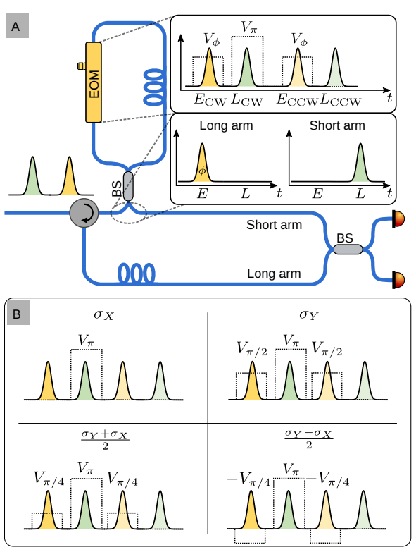
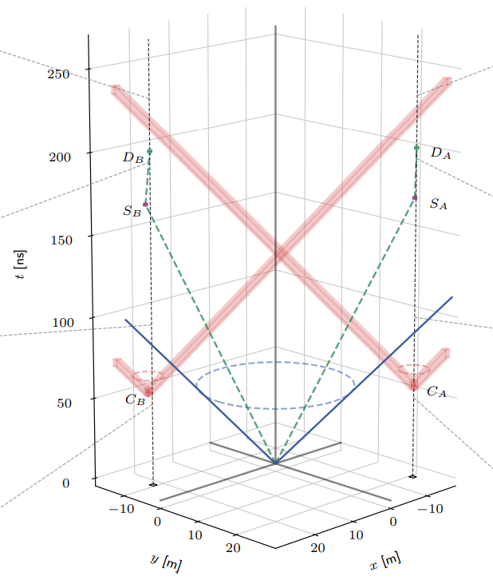
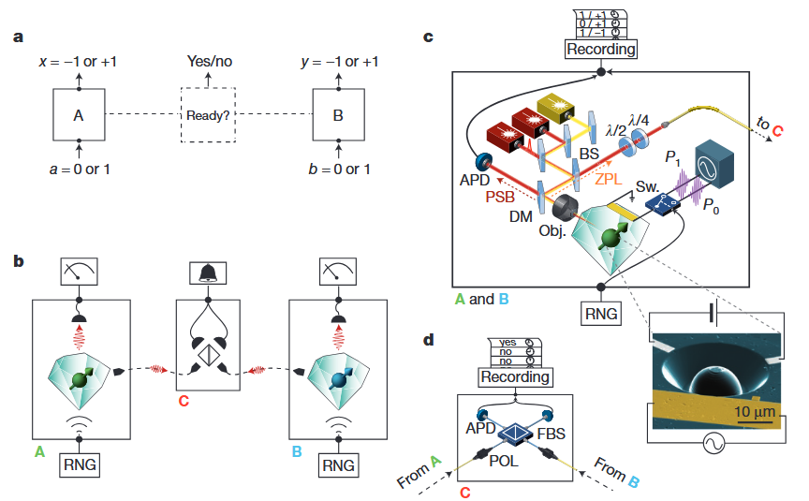
Experimental Implementation
CHSH Game -> Bell Test

Slide 40
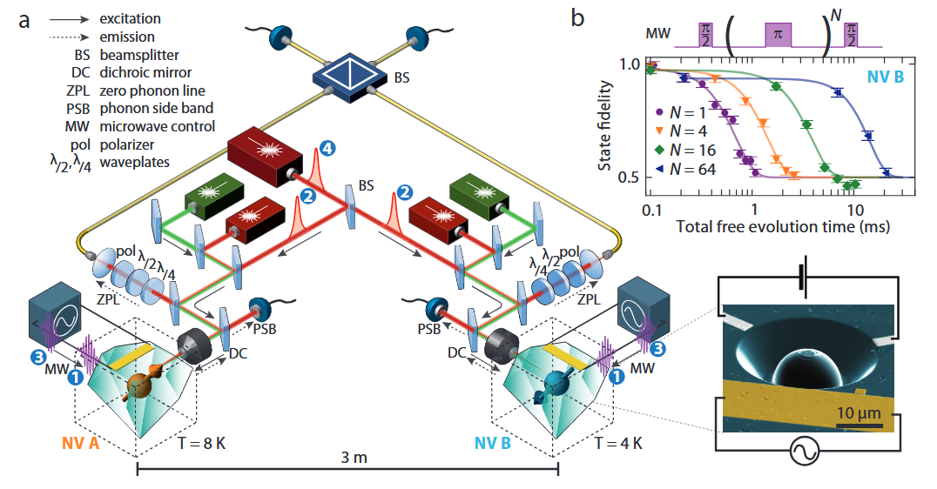
Loophole-Free Bell Test
(Using NV Center in Diamond)
Credit: http://arxiv.org/abs/1212.6136

Slide 41
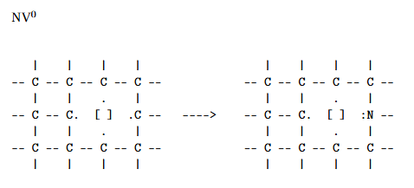
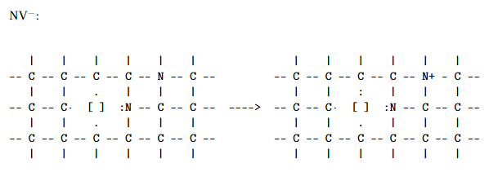
Loophole-Free Bell Test
(Using NV Center in Diamond)
NV Center Electronic Structure

Slide 42
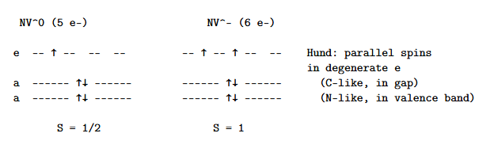
Loophole-Free Bell Test
(Using NV Center in Diamond)
NV- is preferable since it gives you at least two spin state
m_{s}=0 and m_{s} =-1

Slide 43
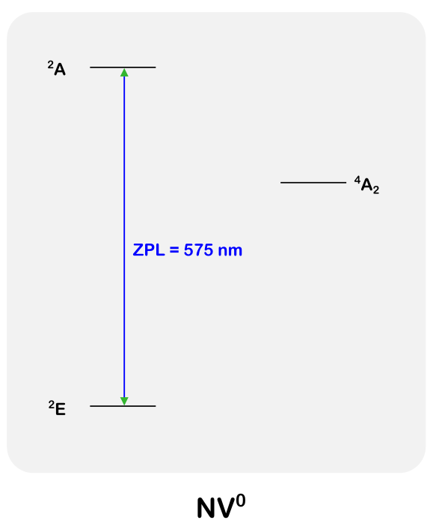
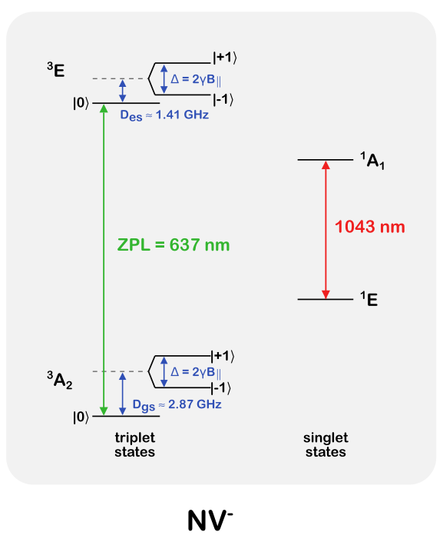
Loophole-Free Bell Test
(Using NV Center in Diamond)
NV Center Electronic Structure
Notes:
^4A_2: electron-electron interactions

Slide 44
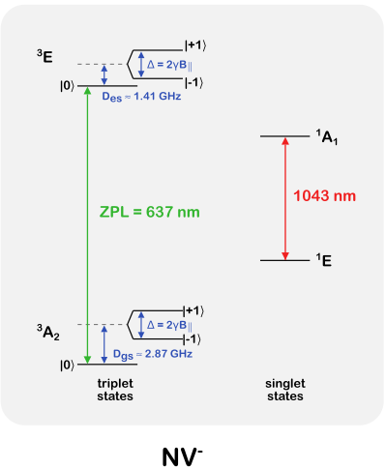
Loophole-Free Bell Test (Using NV Center in Diamond)
* Which Ground State to choose?
*Not universal
The local defect electric field dictates the gap
Selection Engineering
NV Center Electronic Structure
Notes:
^4A_2: electron-electron interactions

Slide 45
Loophole-Free Bell Test
(Using NV Center in Diamond)
Selection Engineering
NV Center Electronic Structure
*How to choose a particular state?
Notes:
^4A_2: electron-electron interactions

Slide 46
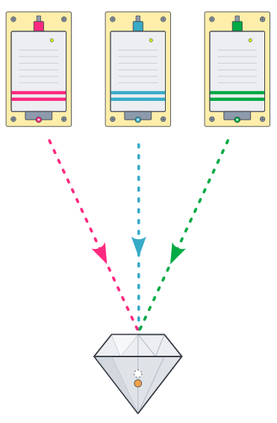
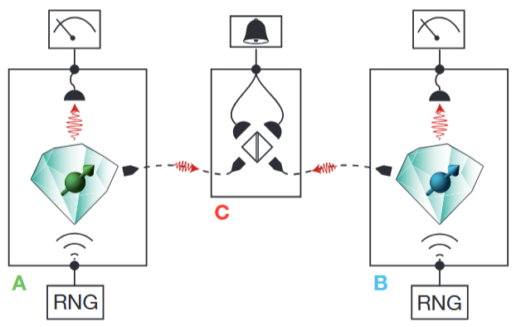
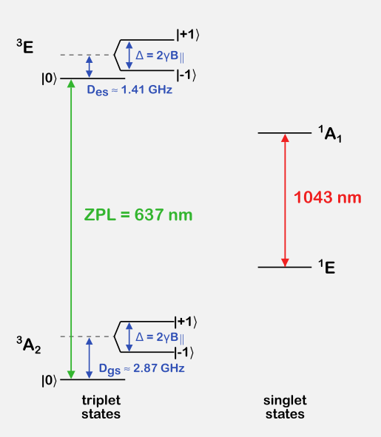
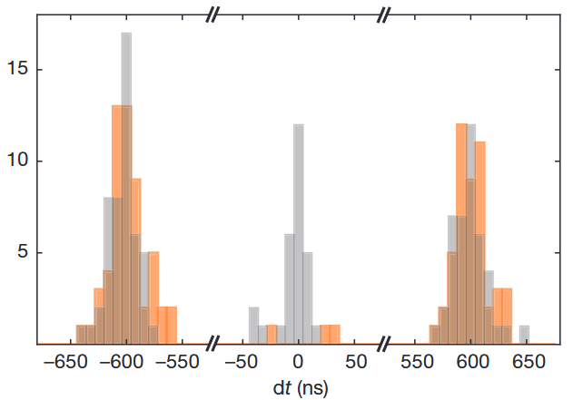
Loophole-Free Bell Test
(Using NV Center in Diamond)
Selection Engineering
NV Center Electronic Structure
Notes:
^4A_2: electron-electron interactions

Slide 47
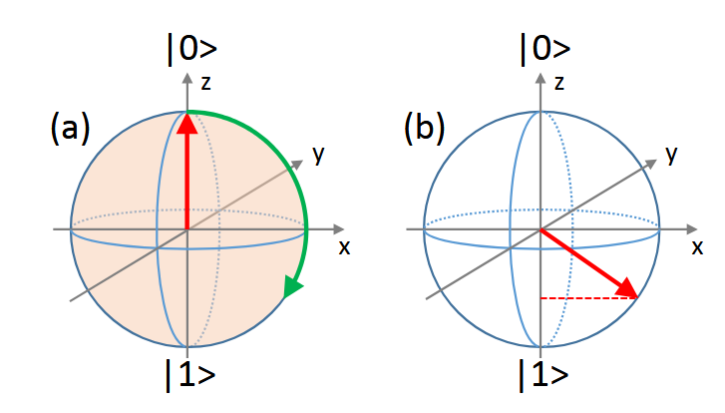
Loophole-Free Bell Test
(Using NV Center in Diamond)
Selection Engineering
NV Center Electronic Structure
?
Notes:
^4A_2: electron-electron interactions

Slide 48

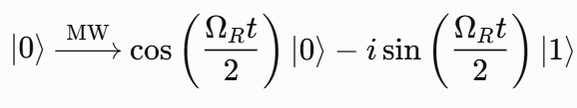
Loophole-Free Bell Test
(Using NV Center in Diamond)
Starting from state |0>:
Notes:
^4A_2: electron-electron interactions

Slide 49
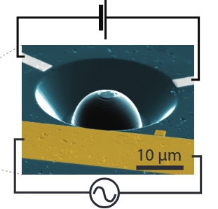
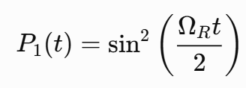
Selection Engineering:
What wavelength to choose?
# The rotation would be about Y axis
# π/2 rotation ->
# The cycling of population between
the two states is denoted as
“Rabi oscillation”
Notes:
^4A_2: electron-electron interactions

Slide 50
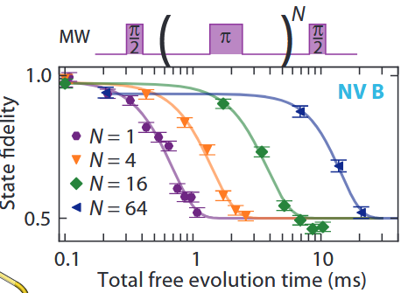
Selection Engineering:
What wavelength to choose?
Notes:
^4A_2: electron-electron interactions

