Slide 1
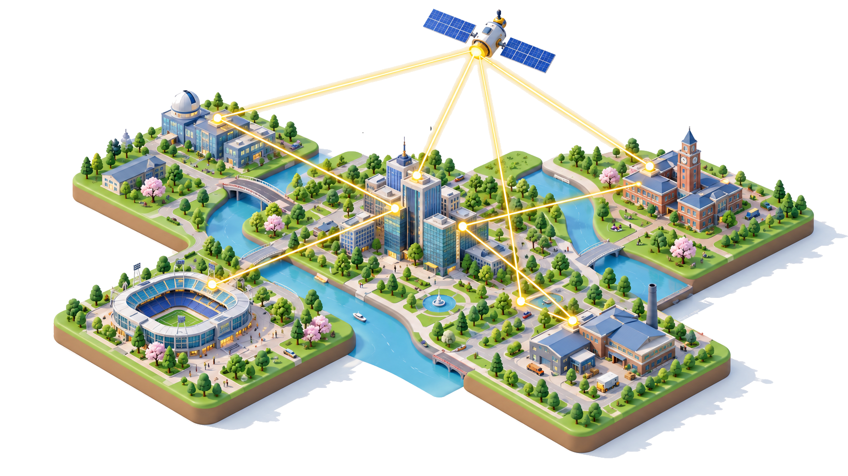
Practical Quantum Communication:
From Lab to Real-World Applications
Md Mehdi Hassan
Quantum Research Fellow
Nasdaq

Slide 2
Recap: Last Week
Quantum Network
Quantum Clock Synchronization
Outline: Today
Quantum Communication in HFT
Experimental Implementation:
- NV Center in Diamond

Slide 3
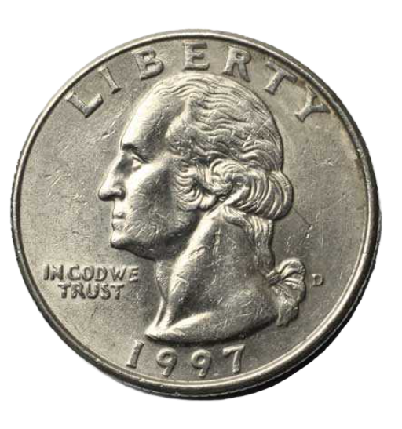
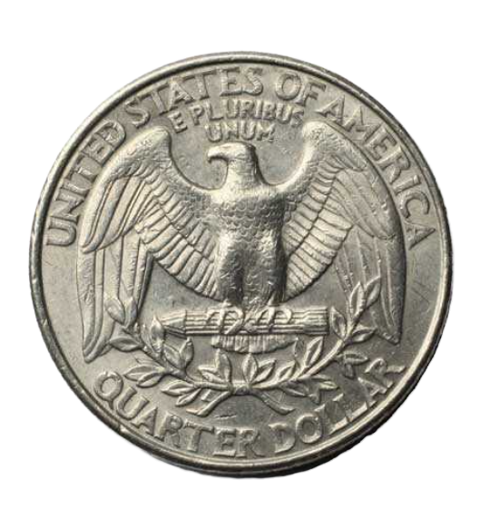


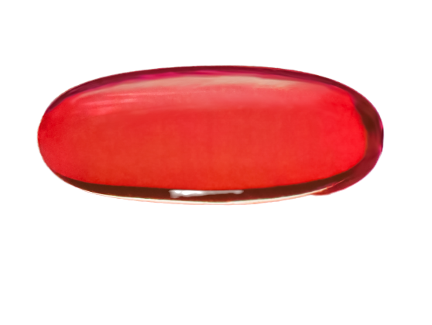


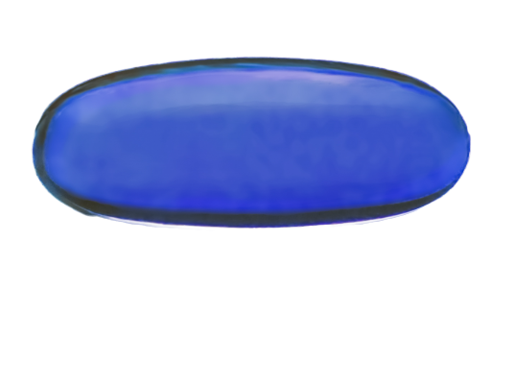



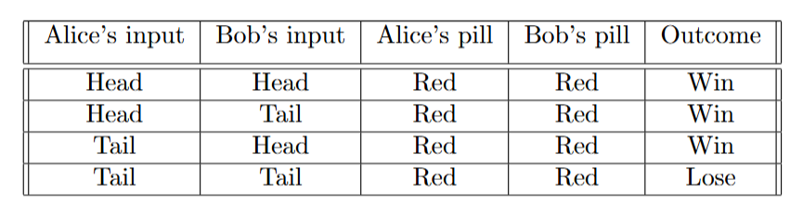
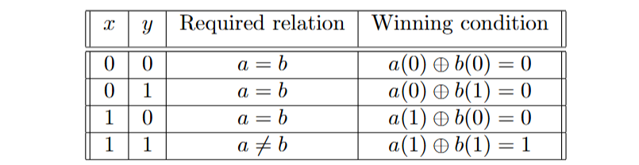
High-Frequency Trading
Overcoming the delay obstacle using quantum technology
CHSH Game analogy:
3 min*
they choose the same color when at least one player receives Head
they choose different color when both receives Tail

Slide 4
High-Frequency Trading
Overcoming the delay obstacle using quantum technology
CHSH Game analogy:
3 min*
they choose the same color when at least one player receives Head
they choose different color when both receives Tail

Slide 5


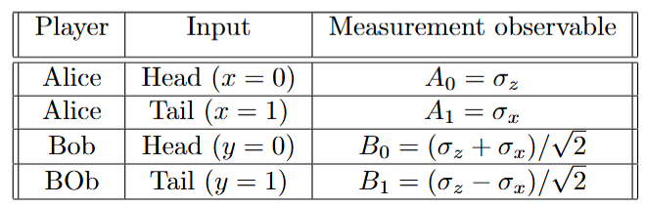
High-Frequency Trading
Overcoming the delay obstacle using quantum technology
CHSH Game analogy:
Success Probability ≈ 0.8536
3 min*

Slide 6

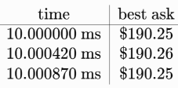

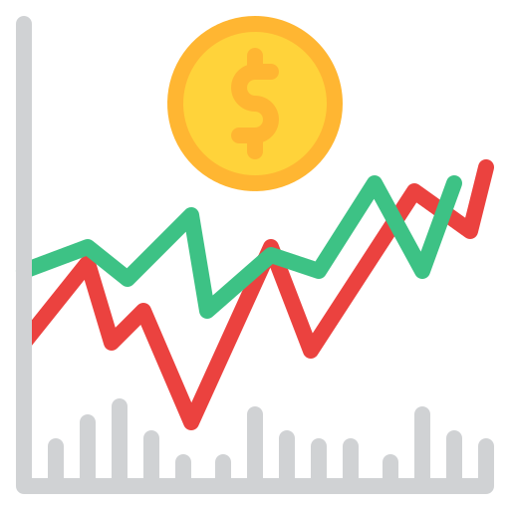
High-Frequency Trading
Overcoming the delay obstacle using quantum technology
THE MARKET REALITY
200 microseconds sounds impressive, but stock prices change even faster.
56.3 km
187.8 μs (Physical Limit)
Notes:
Suppose you have some stock in Nasdaq and some in NYSE. The stock prices are correlated. For example, the stock price of oil (ExxonMobil (NYSE: XOM) ) and the stock price of airlines (United Airlines (NASDAQ: UAL)); An increase in oil prices may benefit ExxonMobil while increasing fuel costs for United Airlines, so they are anti-correlated.

Slide 7
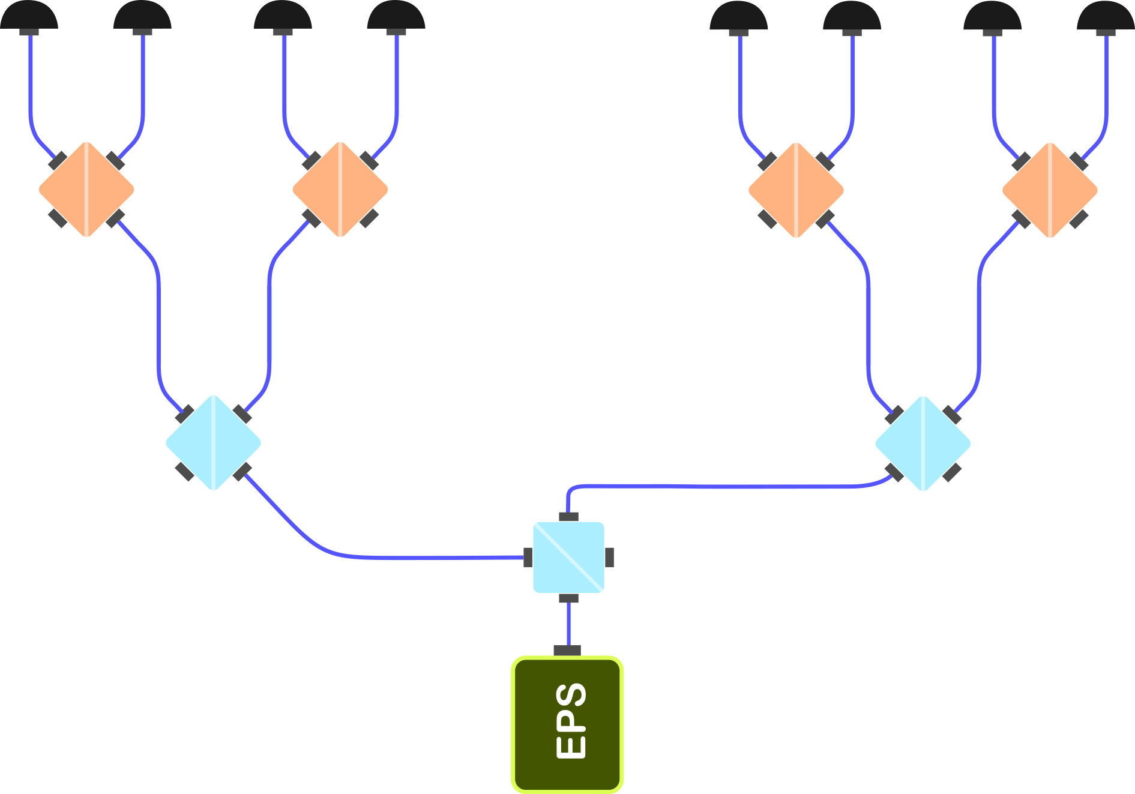


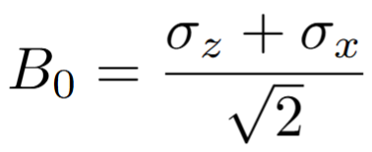
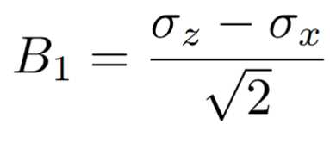
CHSH Game- Toy Model
Overcoming the delay obstacle using quantum technology
Notes:
Your strategy might me if the oil price tends to go up, you immediately want to buy some oil stock and to sell some Airline stocks.
But if you want to wait 200 microsec, the price may have already changed in an unfavorable way.
You want a strategy for Tacit Coordination
Can Quantum Mechanics help you in this scenario?

Slide 8
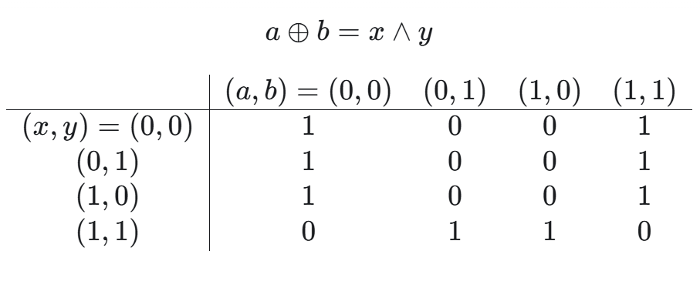
CHSH Game- Toy Model
Overcoming the delay obstacle using quantum technology
:: Utility Matrix ::

Slide 9
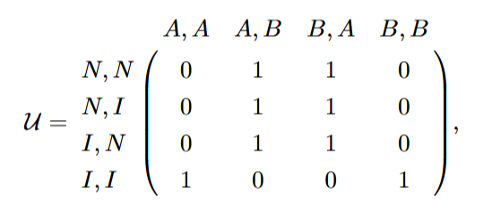
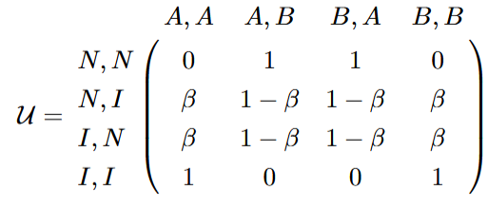
CHSH Game- Toy Model
Overcoming the delay obstacle using quantum technology
:: Utility Matrix ::
Notes:
Here, instead of Head=0, Tail=1, we say Indicator=0, no-indicator=1

Slide 10
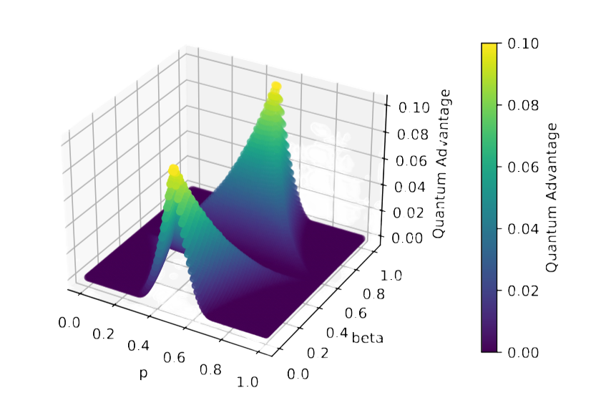
High-Frequency Trading
Overcoming the delay obstacle using quantum technology
probability p : the indicator I is observed
Credit: http://arxiv.org/abs/2407.21723

Slide 11
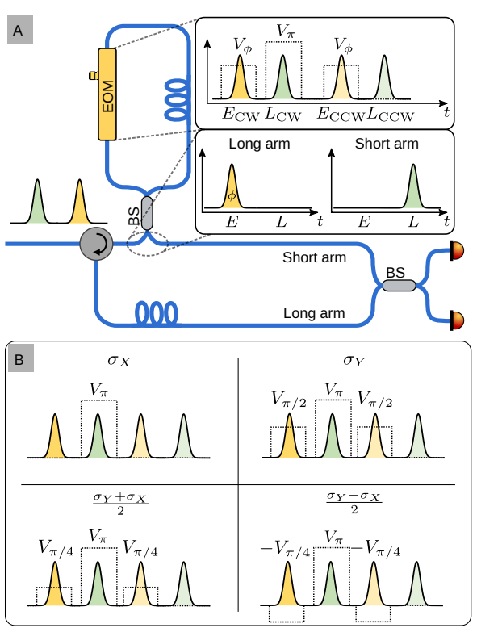
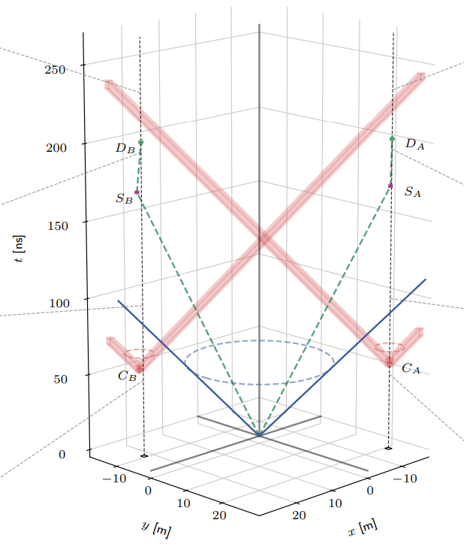
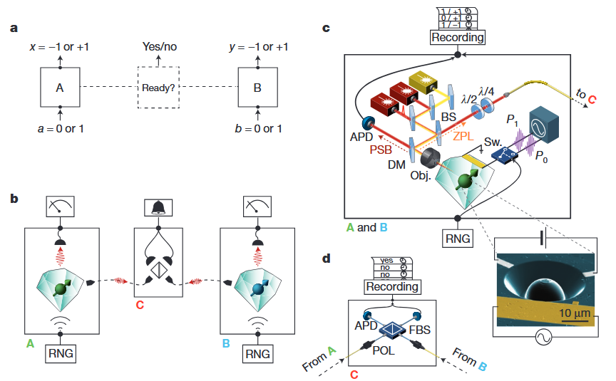
Experimental Implementation
CHSH Game -> Bell Test
Using
NV Center in Diamond

Slide 12
Bell Test: Variation
Loophole-Free Bell Test
Defect Qubit
(XV Center)
Photonic
Superconducting
Qubit
Polarization
Time-bin

Slide 13
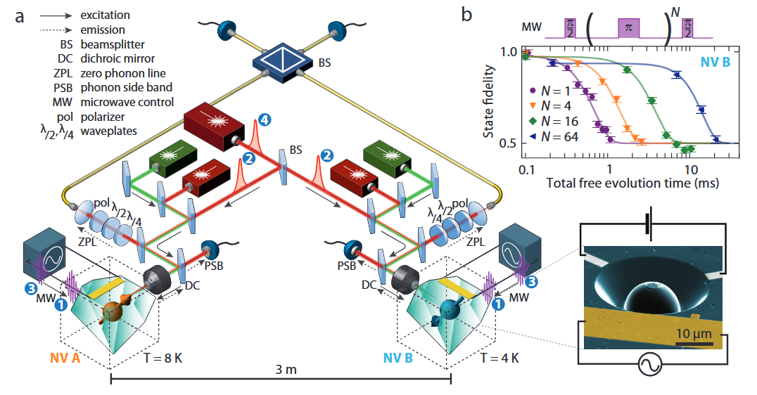
Loophole-Free Bell Test
(Using NV Center in Diamond)
Credit: http://arxiv.org/abs/1212.6136

Slide 14
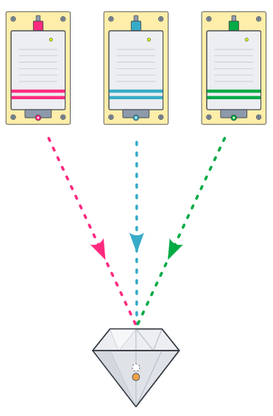
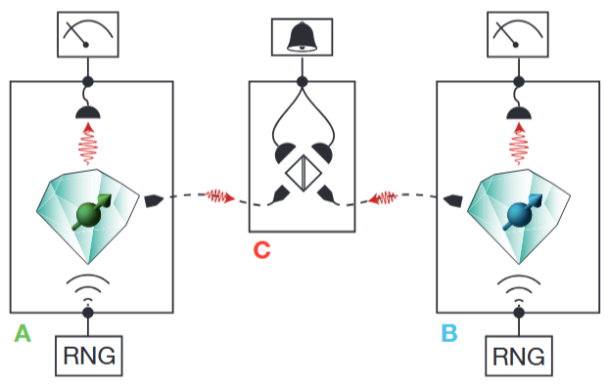
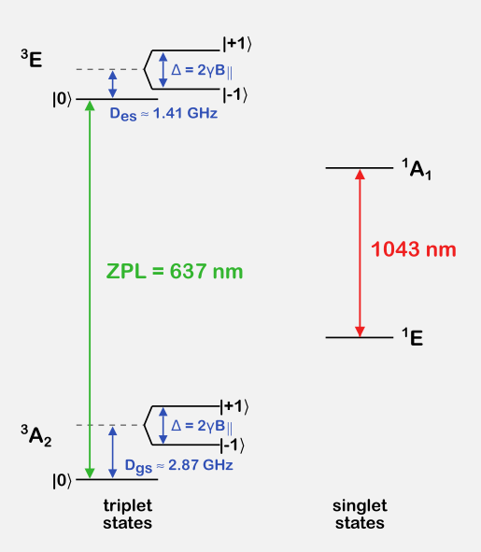
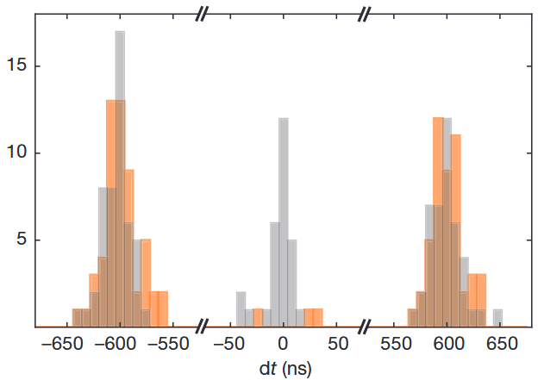
Loophole-Free Bell Test
(Using NV Center in Diamond)
Outline
How NV Center in Diamond is Created
What version of NV is desired
How to achieve that version
What hardware would be necessary?

Slide 15
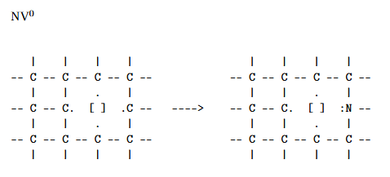
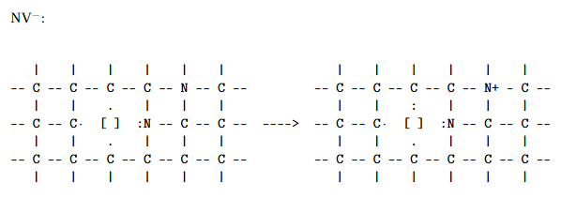
1. How NV center is created:
NV Center Electronic Structure
Notes:
Kick out one carbon in the middle
Replace another neighbor carbon with Nitrogen -> You got NV center
This is NV(0). Sometimes from the defects of neighboring NV-0 center, an electron escape and join to the system of interest.
It makes NV(-) system

Slide 16
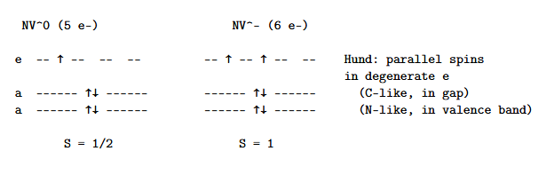
2. What version of NV center is desired:
NV- is preferable since it gives you at least two spin state
m_{s}=0 and m_{s} =-1

Slide 17
3. How to achieve NV⁻ state:
Prepare NV⁻ instead of NV⁰
Once NV⁻ is present, optically pump its ground-state spin predominantly into m_{s}=0
Notes:
Goal is to make NV(-) state probability higher than NV(0).
Aper preparing, there is a readout process to verify if it was really in NV(-) state or not

Slide 18
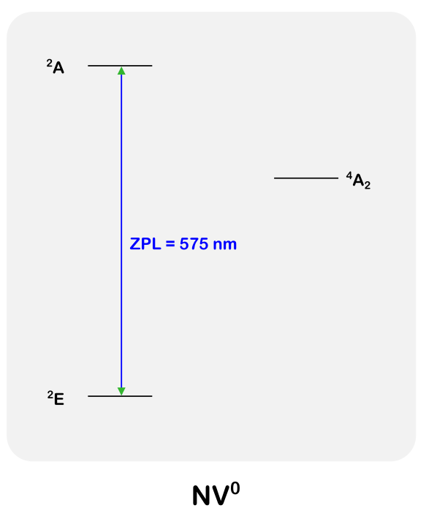
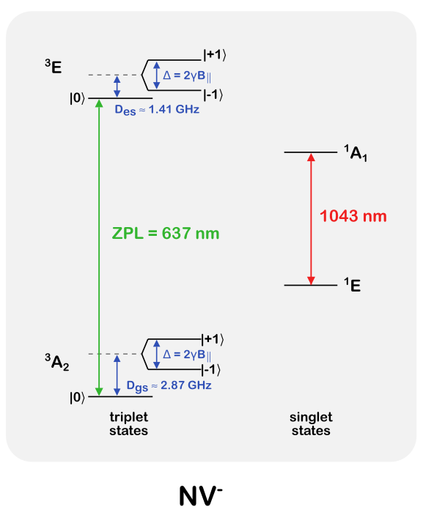
3. How to achieve NV⁻ state:
NV Center Electronic Structure
Notes:
^4A_2: electron-electron interactions
Since S=1 here in NV(-), there would be m_s = -1, 0, +1 spin states is spin triplet state, and S=0 in spin singlet state m_s = 0
m_s = 0 of triplet state and m_s = 0 from singlet state are different in the energy level.

Slide 19
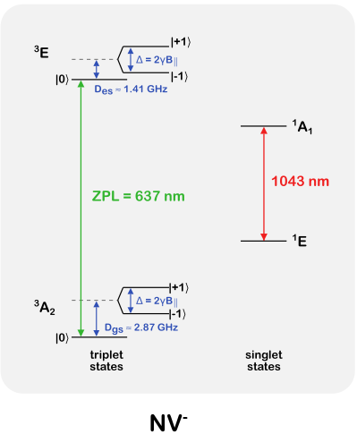
3. How to achieve NV⁻ state:
* Which Ground State to choose?
*Not universal
The local defect electric field dictates the gap
Selection Engineering
NV Center Electronic Structure
Notes:
You can apply external static electric field to mess up with the system and it will let you control the energy gap between ground and exited states.

Slide 20
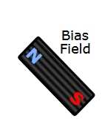
3. How to achieve NV⁻ state:
Selection Engineering
NV Center Electronic Structure
*How to choose a particular state?
Zero-field Splitting
(Spin-Spin interaction)
Notes:
By applying static magnetic field, you can split the energy level between m_s=-1 and m_s =+1 via Zeeman effect.

Slide 21
3. How to achieve NV⁻ state:
*Apply laser pulses with 535 nm wavelength
- Where does it go?
Notes:
^4A_2: electron-electron interactions

Slide 22
3. How to achieve NV⁻ state:
Non-Radiative
Decay
³E
*Apply laser pulses with 535 nm wavelength
- Goes above and then decays back or goes to another site
Off-Resonant
637-800 nm
Excitation
Phonon-Sideband
Fluorescence
³A₂
Zero-Phonon
Line
(637 nm)
Notes:
^4A_2: electron-electron interactions

Slide 23
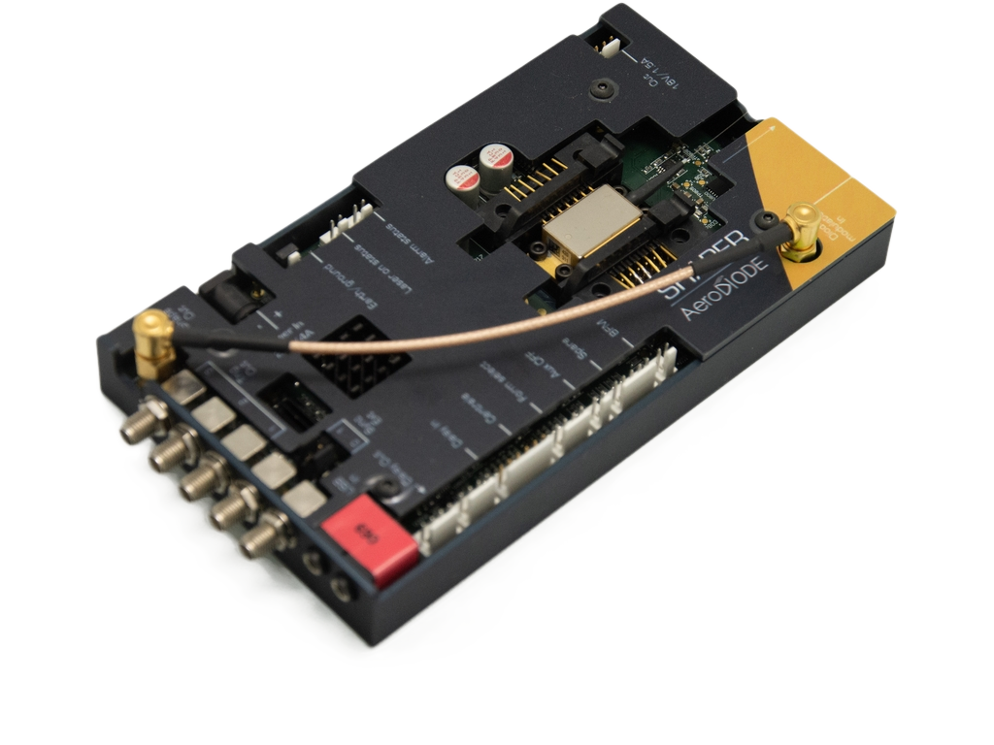
4. Hardware requirements:
*Apply laser pulses with 535 nm wavelength
- Where does it go?
2 μs pulse at approximately 400 μW
During optical cycling, electrons can transfer from nearby donors or traps to NV⁰, producing NV⁻
Notes:
^4A_2: electron-electron interactions

Slide 24
# How to verify NV⁻ state?
-> Using ZPL line: 637 nm or 575 nm? Using green laser.
# How long it will remain over there?
-> There is no single fixed lifetime. In the dark, NV⁻ can remain stable for a long time, but optical illumination can photoionize it into NV⁰
# How to select m_s=0 state in NV- system?
->532 nm Laser, 1-5 micro-sec pulse, at 100 micro-watt power
Notes:
^4A_2: electron-electron interactions

Slide 25
3.1 How to achieve NV⁻ state
with m_{s} = 0:
To generate a photon entangled with the spin state |0>: ³E -> ³A₂
Notes:
^4A_2: electron-electron interactions

Slide 26
3.1 How to achieve NV⁻ state
with m_{s} = 0:
To generate a photon entangled with the spin state |0>: ³E -> ³A₂
The resonant wavelength would be 637 nm (ZPL).
How to excite it from the ground state to the excited state?
?
Notes:
^4A_2: electron-electron interactions

Slide 27
3.1 How to achieve NV⁻ state
with m_{s} = 0:
What about this one?
Notes:
2.87 GHz in microwave frequency level.

Slide 28
-How to achieve NV⁻ state:
What about this one?
- Non-radiative decay (phonon/heat)
Notes:
^4A_2: electron-electron interactions

Slide 29
-How to achieve NV⁻ state:
To generate a photon entangled with the spin state |0>: ³E -> ³A₂
The resonant wavelength would be 637 nm.
How to excite it from the ground state to the excited state?
Notes:
^4A_2: electron-electron interactions

Slide 30
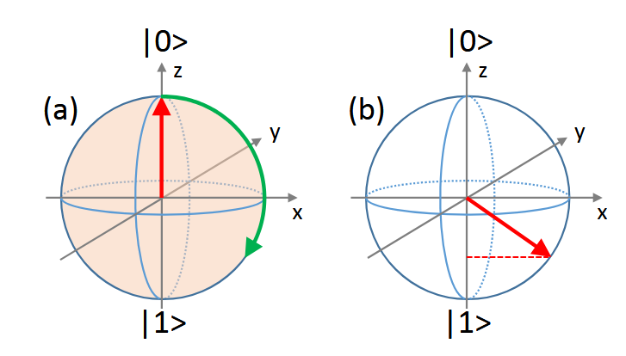
Loophole-Free Bell Test
(Using NV Center in Diamond)
Selection Engineering
NV Center Electronic Structure
?
Notes:
A resonant \pi/2 microwave pulse rotates the NV spin from m_s=0 into an equal coherent superposition of m_s=0 and m_s=-1

Slide 31

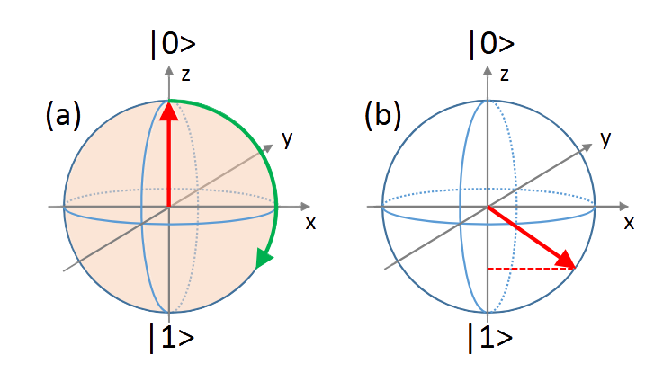
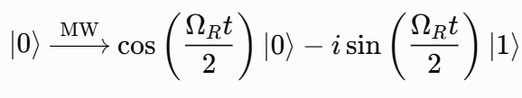
Loophole-Free Bell Test
(Using NV Center in Diamond)
Starting from state |0>:
Notes:
^4A_2: electron-electron interactions

Slide 32
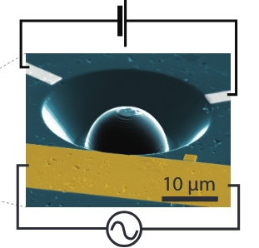
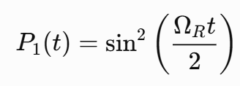
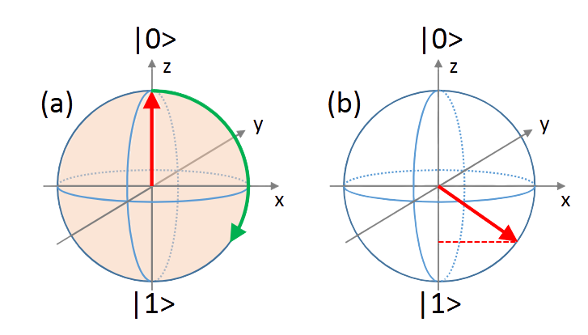
Selection Engineering:
What wavelength to choose?
# The rotation would be about Y axis
# π/2 rotation ->
# The cycling of population between
the two states is denoted as
“Rabi oscillation”
Notes:
^4A_2: electron-electron interactions

Slide 33
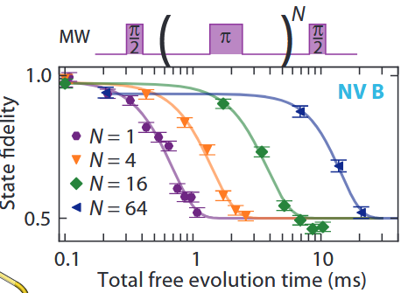
Selection Engineering:
What wavelength to choose?
Notes:
^4A_2: electron-electron interactions

