Slide 1
The Age of Things:
Sticks, Stones and the Universe
Lecture 1: Introduction,
the time scales of the universe and the calendars of the Maya
http://cfcp.uchicago.edu/~mmhedman/compton1.html

Slide 2
The plan
1. Introduction; the time scales of the Universe and the calendars of the Maya
2. Precession, Polaris and the Pyramids of Egypt
3. The Quantum Physics Principles of Carbon 14 Dating
4. The Archeaological Reality of Carbon 14 Dating
5. Potassium, Argon and Walking Upright
6. Molecular Dating and the Many Different Types of Mammals
7. Meteorites and the Origin of the Solar System
8. Colors, Brightness and the Age of Stars
9. The Age of the Universe, Part I
10. The Age of the Universe and Concluding Remarks

Slide 3
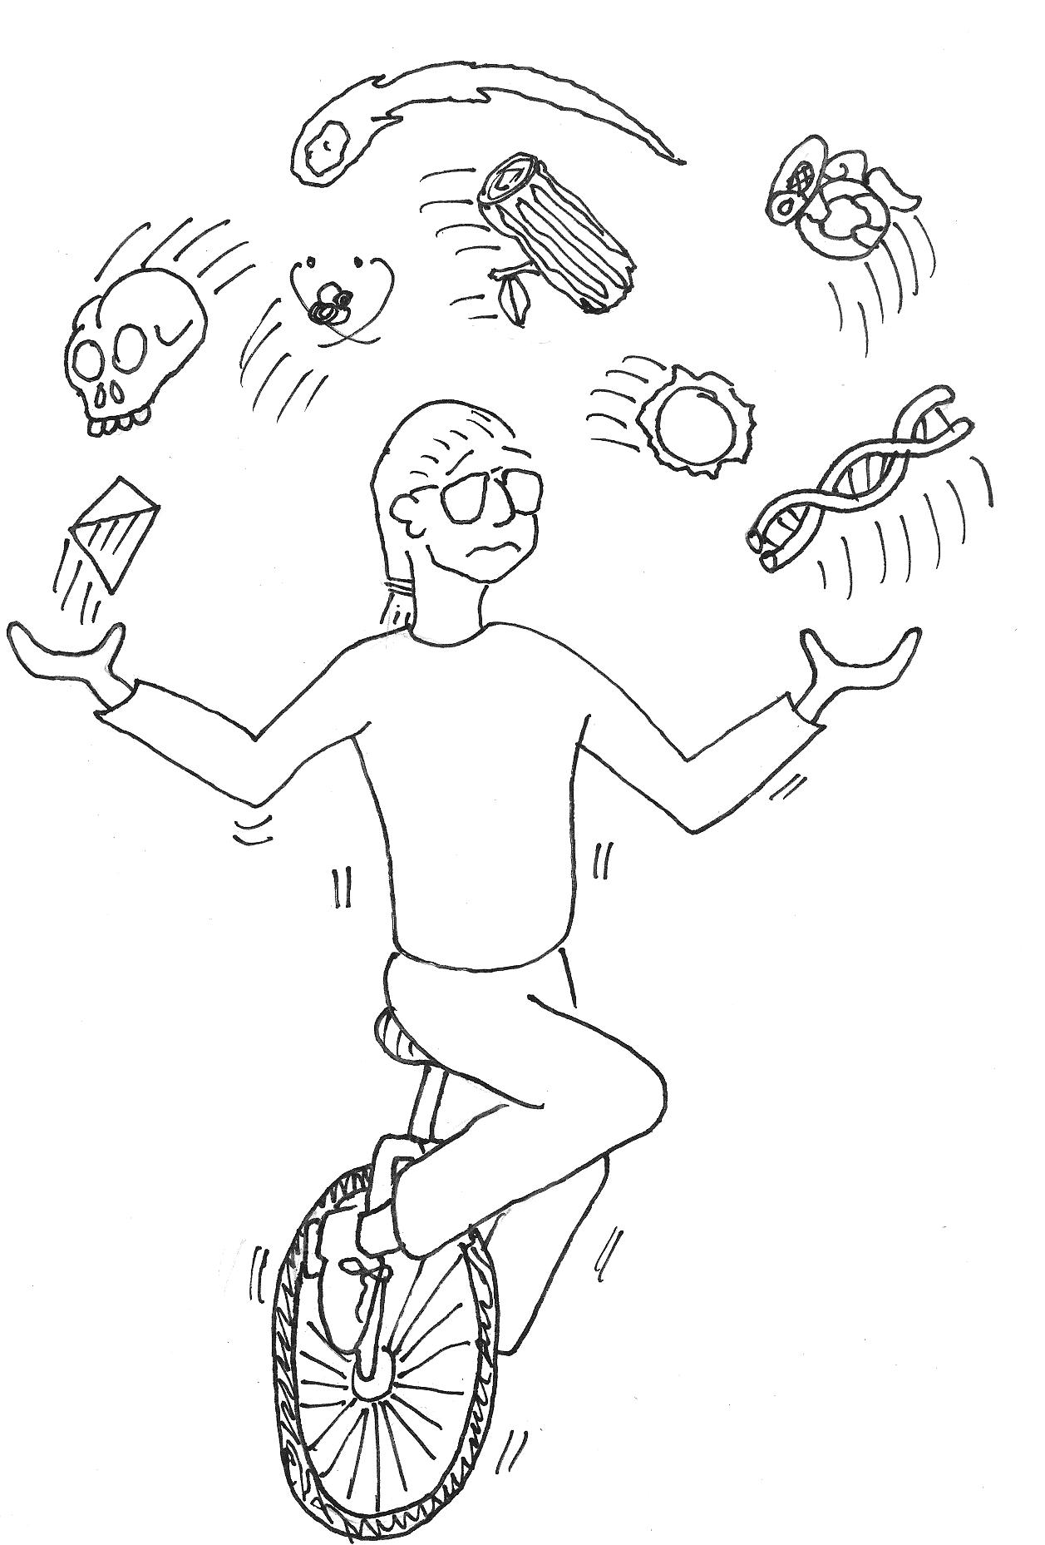
Warning!
Astrophysicist Juggling Too Many Subjects!

Slide 4
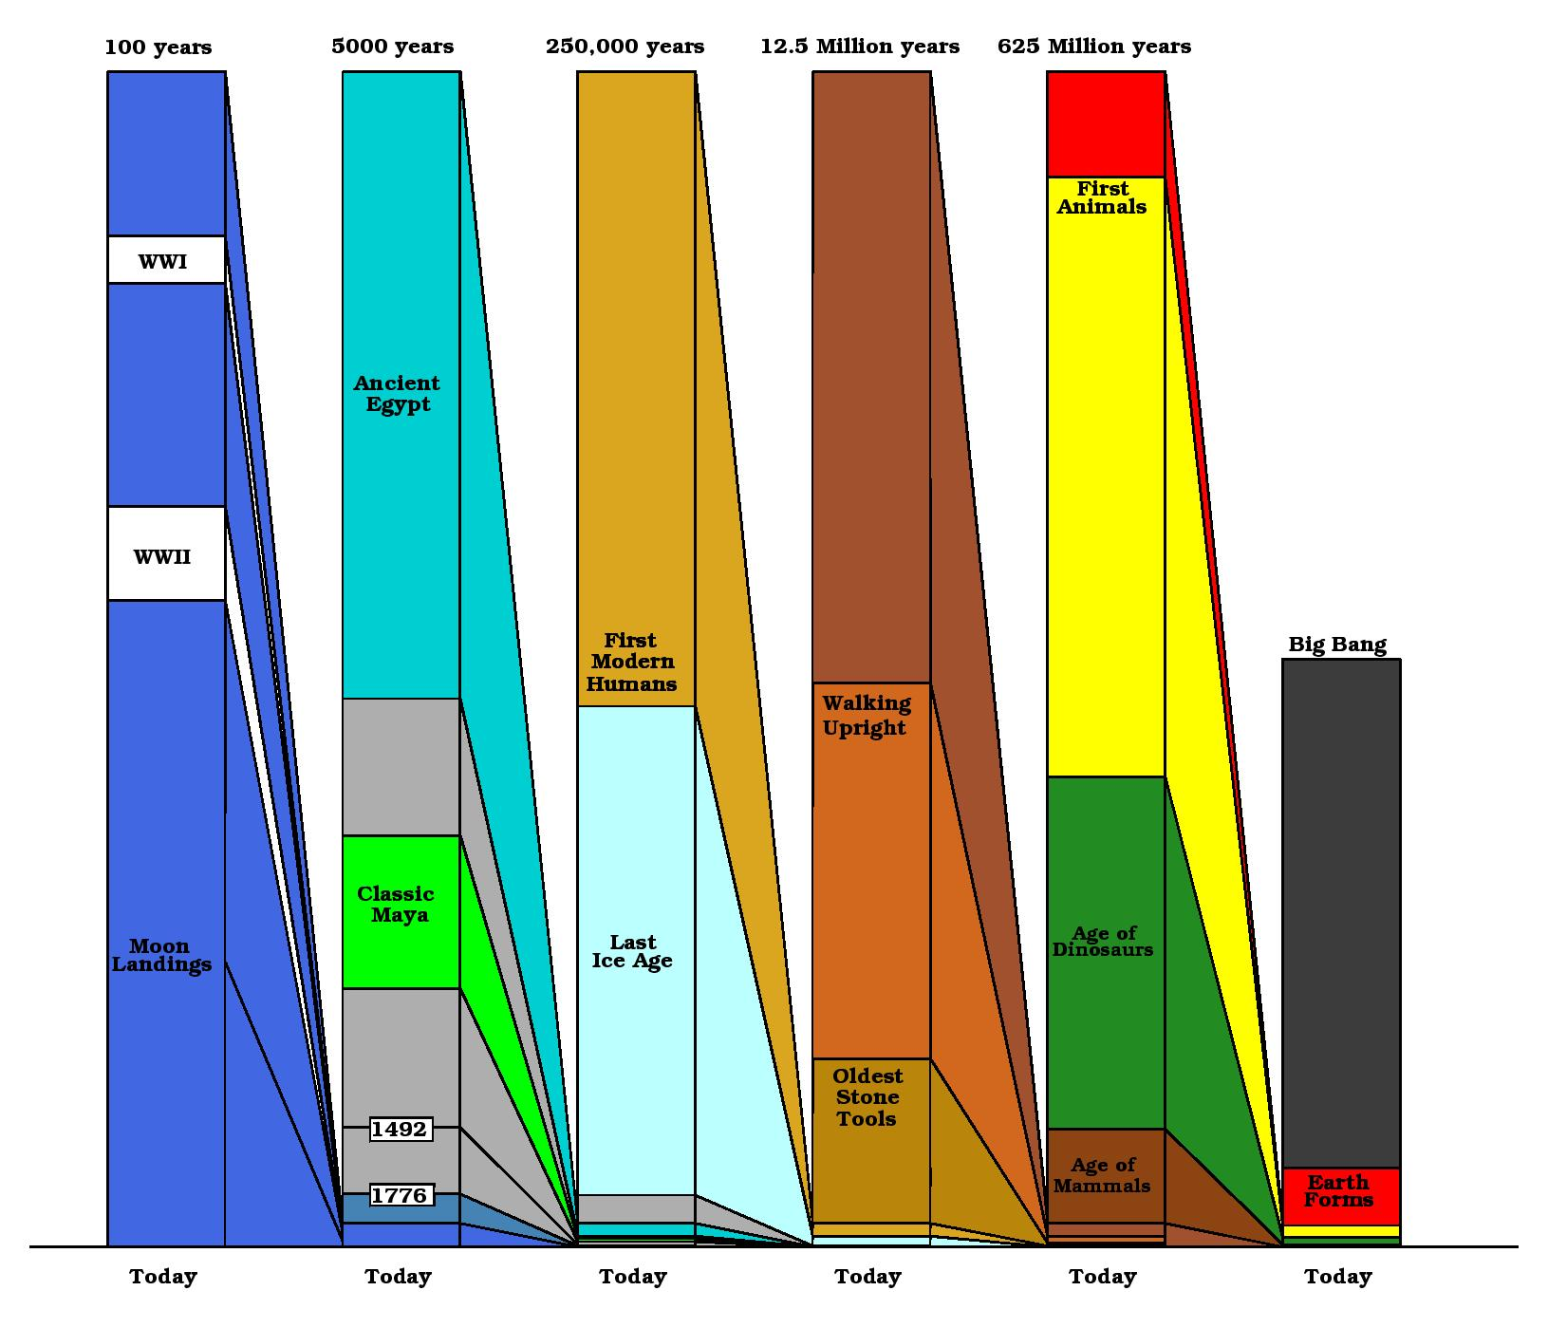
The Timescales of the Universe

Slide 5
The Timescales of the Universe

Slide 6
The Timescales of the Universe

Slide 7
The Timescales of the Universe

Slide 8
The Timescales of the Universe

Slide 9
The Timescales of the Universe

Slide 10
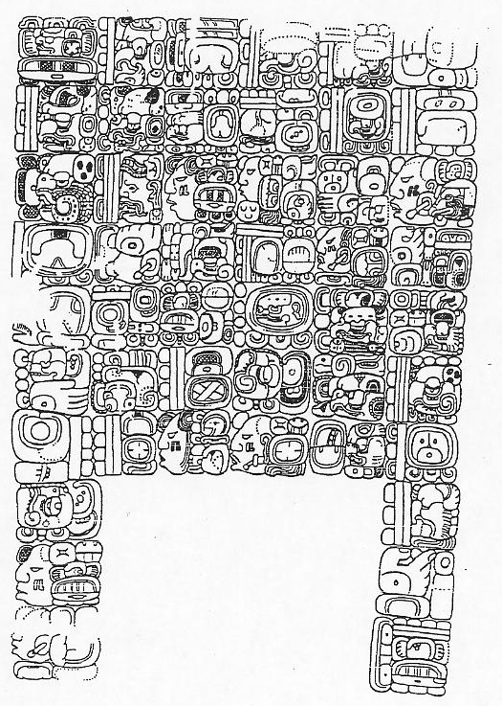
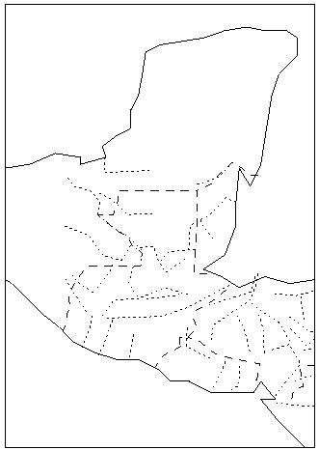
The Calendars of the Classic Maya
100 miles
~300-900 CE
Piedras Negras Stela 3, Drawn by Linda Schele

Slide 11
Calendars are the Key to Mayan History
Mayan Texts provide dating information for nearly every event they record
Piedras Negras Stela 3, Drawn by Linda Schele

Slide 12
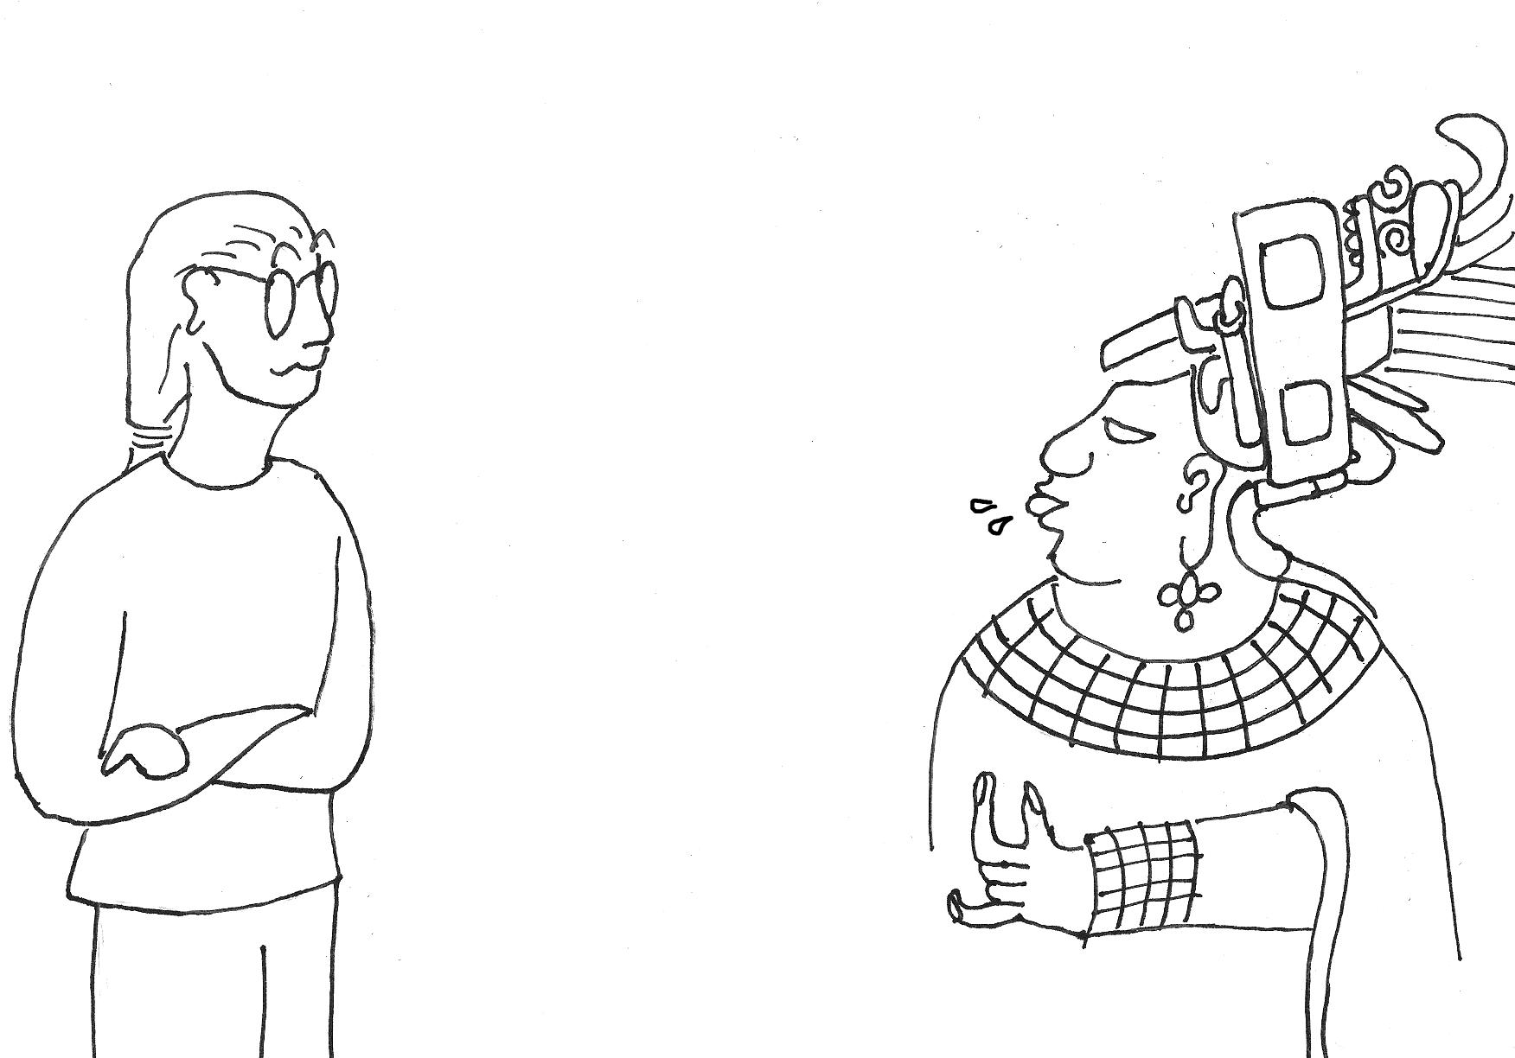
Warning! Astrophysicist talking about Mayan Hieroglyphs!

Slide 13
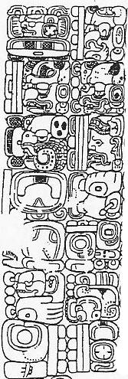
The Calendar of the Maya: The Long Count
9 . 12 . 2 . 0 . 16
9 * 144000 + 12*7200 + 2*360 + 0*20 + 16 days
= 1,383,136 Days since August 3114 BCE
The Long Count is the number of days that have elapsed since some event long ago (in 3114 BCE)

Slide 14
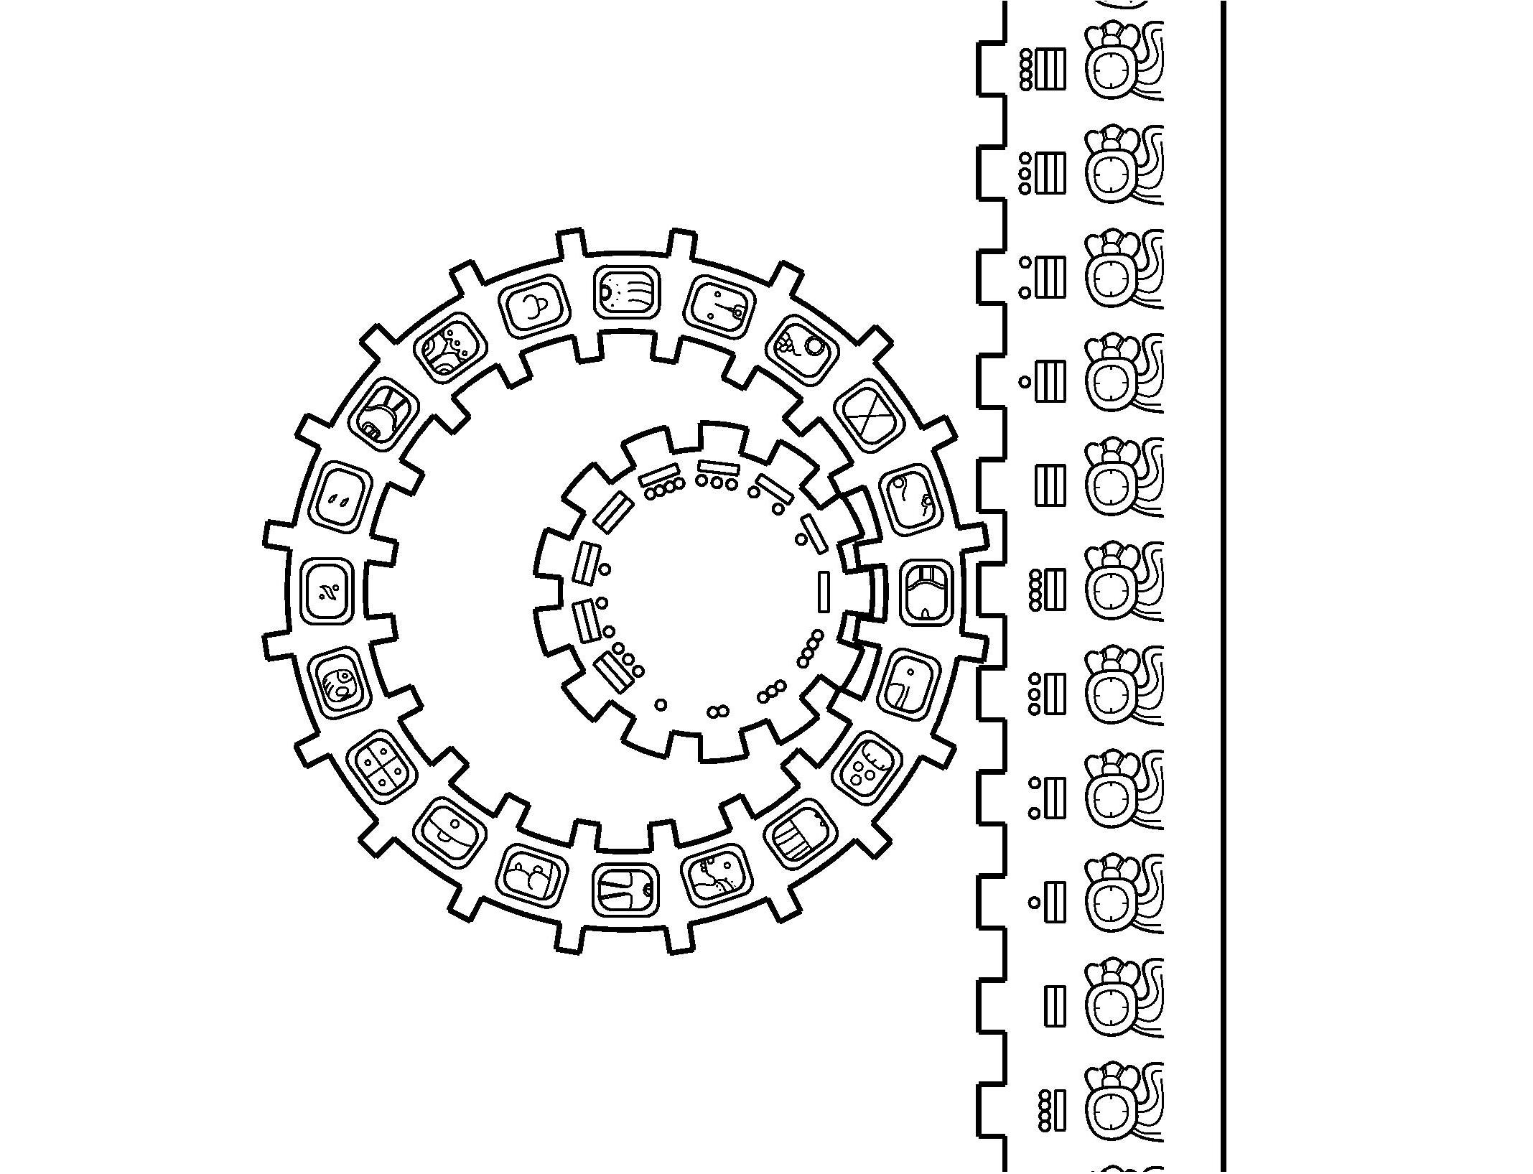
The Calendar of the Maya: The Calendar Round
The Calendar Round is a combination of 260 day cycle (the Tzolkin) and a 365 day cycle (the Haab), which together make a cycle of 18,980 days (about 52 years)

Slide 15
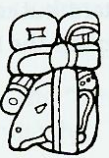
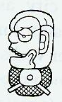
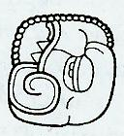
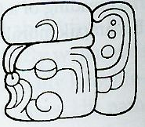
Using the Mayan Calendar to Translate Mayan Texts
In 1960, Tatiana Proskouriakoff found that in related collections of texts, there were four texts that always occurred in a fixed sequence.
Drawings by J. Montgomery
A Few Decades
A Few Decades
A Few Days

Slide 16
Using the Mayan Calendar to Translate Mayan Texts
Using the dates of these events, she interpreted these as important events in one person’s history. This proved Mayan texts contained historical information and was instrumental in the translation of these texts.
A Few Decades
A Few Decades
A Few Days
Birth
Sih
Becoming Ruler
Hohya Ahawlel
Death
Kimi
Burial
Mukah

Slide 17
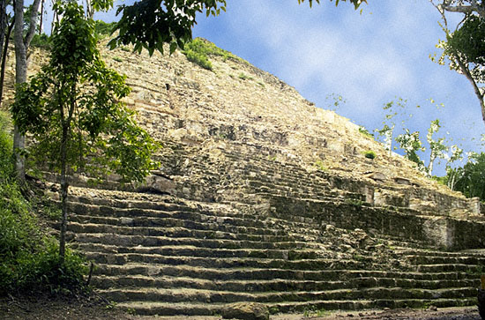
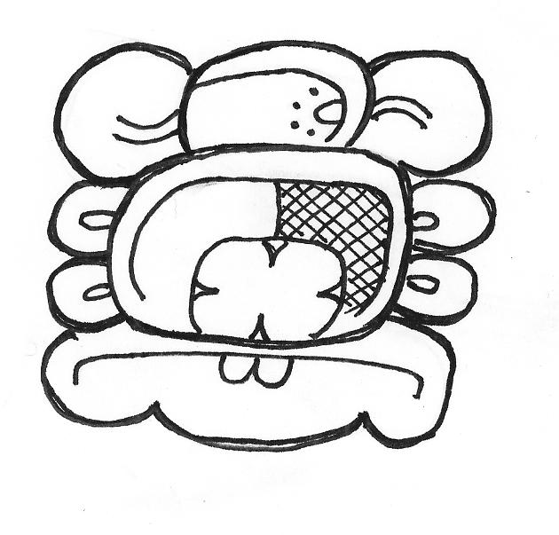
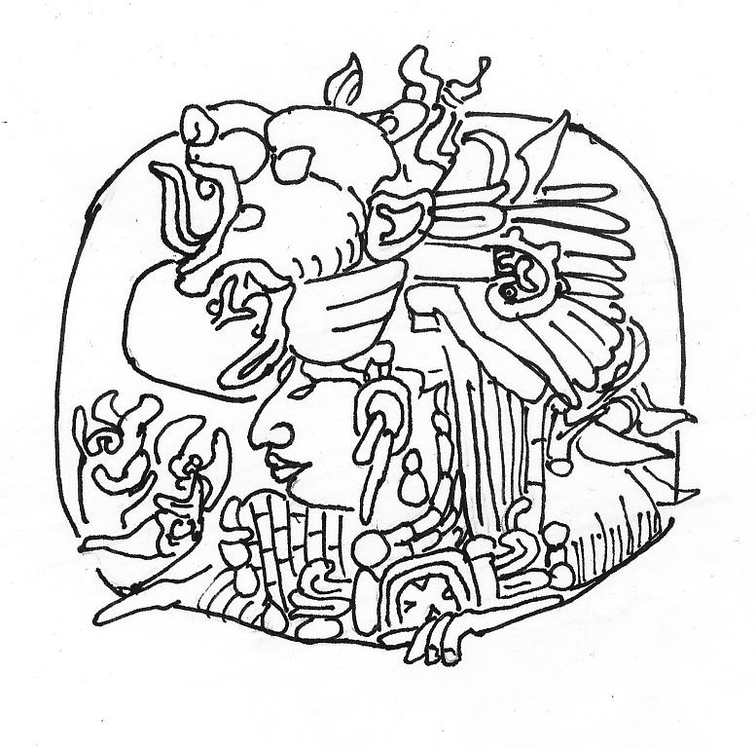
The Life and Times of Yuknoom Ch’en
100 miles
Calakmul

Slide 18
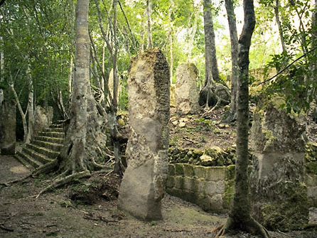

Slide 19
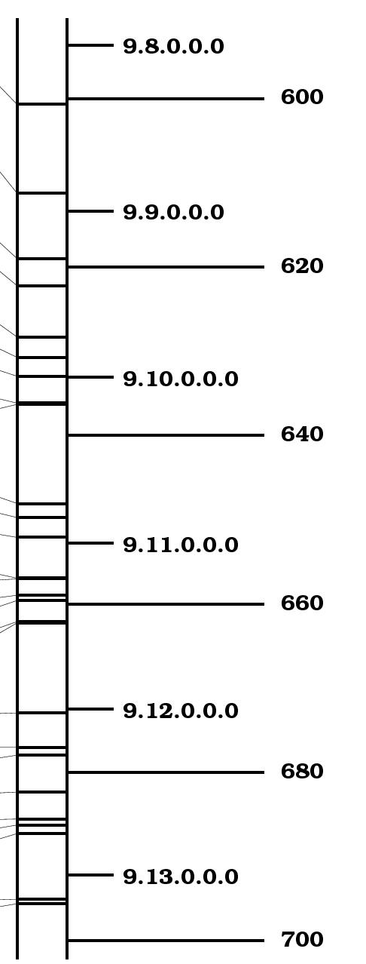
Events Recorded in and around Calakmul
Yuknoom Ch’en is Born
Yuknoom Ch’en becomes ruler of Calakmul
100 miles
Calakmul
Yich’aak K’ak’ is Born
La Corona
El Peru
Yich’aak K’ak’ becomes ruler of Calakmul

Slide 20
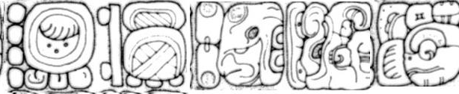




Events before Yuknoom Ch’en Became ruler
Yuknoom Ch’en is Born
Drawn by Linda Schele
Drawn by Carl Beetz
100 miles
Drawn by Ian Graham
Calakmul
Drawn by Ian Graham
Palenque
Caracol
Drawn by Ian Graham
Yuknoom Ch’en becomes ruler of Calakmul

Slide 21
Events before Yuknoom Ch’en Became ruler
Yuknoom Ch’en is Born
Scroll Serpent of Calakmul sacks Palenque
Yuknoom Chan of Calakmul oversees event at Caracol
Tajoom Uk’ab K’ak’ becomes ruler of Calakmul
100 miles
Tajoom Uk’ab K’ak’ dies
Calakmul
Yuknoom Head sacks Naranjo
Palenque
Yuknoom Head of Calakmul sacks an unknown site
Caracol
Yuknoom Ch’en becomes ruler of Calakmul

Slide 22

Yuknoom Ch’en’s early activities in the South
Yuknoom Ch’en is Born
Yuknoom Ch’en becomes ruler of Calakmul
Drawn by Stephen Houston
Balah Chan K’awil of Dos Pilas Does Battle as a servant of Yuknoom Ch’en
100 miles
Calakmul
Tikal
Yuknoom Ch’en oversees rituals at Cancuen
Dos Pilas
Cancuen
Drawn by Linda Schele

Slide 23
Conflict with the lords of Mutul
100 miles
Yuknoom Ch’en is Born
Calakmul
Yuknoom Ch’en becomes ruler of Calakmul
Tikal
Dos Pilas
Yuknoom Ch’en sacks Tikal, drives Nuun Ujol Chaak into exile
Yuknoom Ch’en sacks Dos Pilas, drives Balah Chan K’awil into exile
Drawi ngs for www.famsi.org

Slide 24
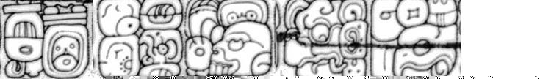
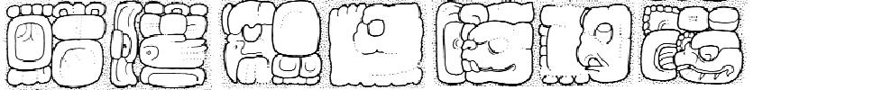
Attention turns Westwards
100 miles
Yuknoom Ch’en is Born
Calakmul
Yuknoom Ch’en becomes ruler of Calakmul
Moral
Palenque
Piedras Negras
Drawn by Linda Schele
Nuun Ujol K’awil arrives in Palenque
Calakmul oversees ritual in Piedras Negras
Yuknoom Ch’en oversees ritual in Moral
Drawn by Simon Martin

Slide 25
The end of the conflict with the Lord of Tikal
100 miles
Yuknoom Ch’en is Born
Calakmul
Yuknoom Ch’en becomes ruler of Calakmul
Tikal
Dos Pilas
Nuun Ujol Chaak of Tikal sacks Dos Pilas
Yuknoom Ch’en and Balah Chan K’awil of Dos Pilas battle and defeat Nuun Ujol Chaak
Yuknoom Ch’en and Balah Chan K’awil Dance
Yich’aak K’ak’ becomes ruler of Calakmul
Drawi ngs for www.famsi.org

Slide 26
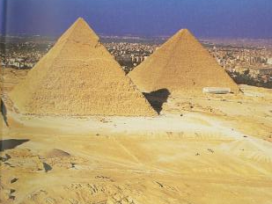
Next Time:
Precession, Polaris and the Pyramids

