Slide 1
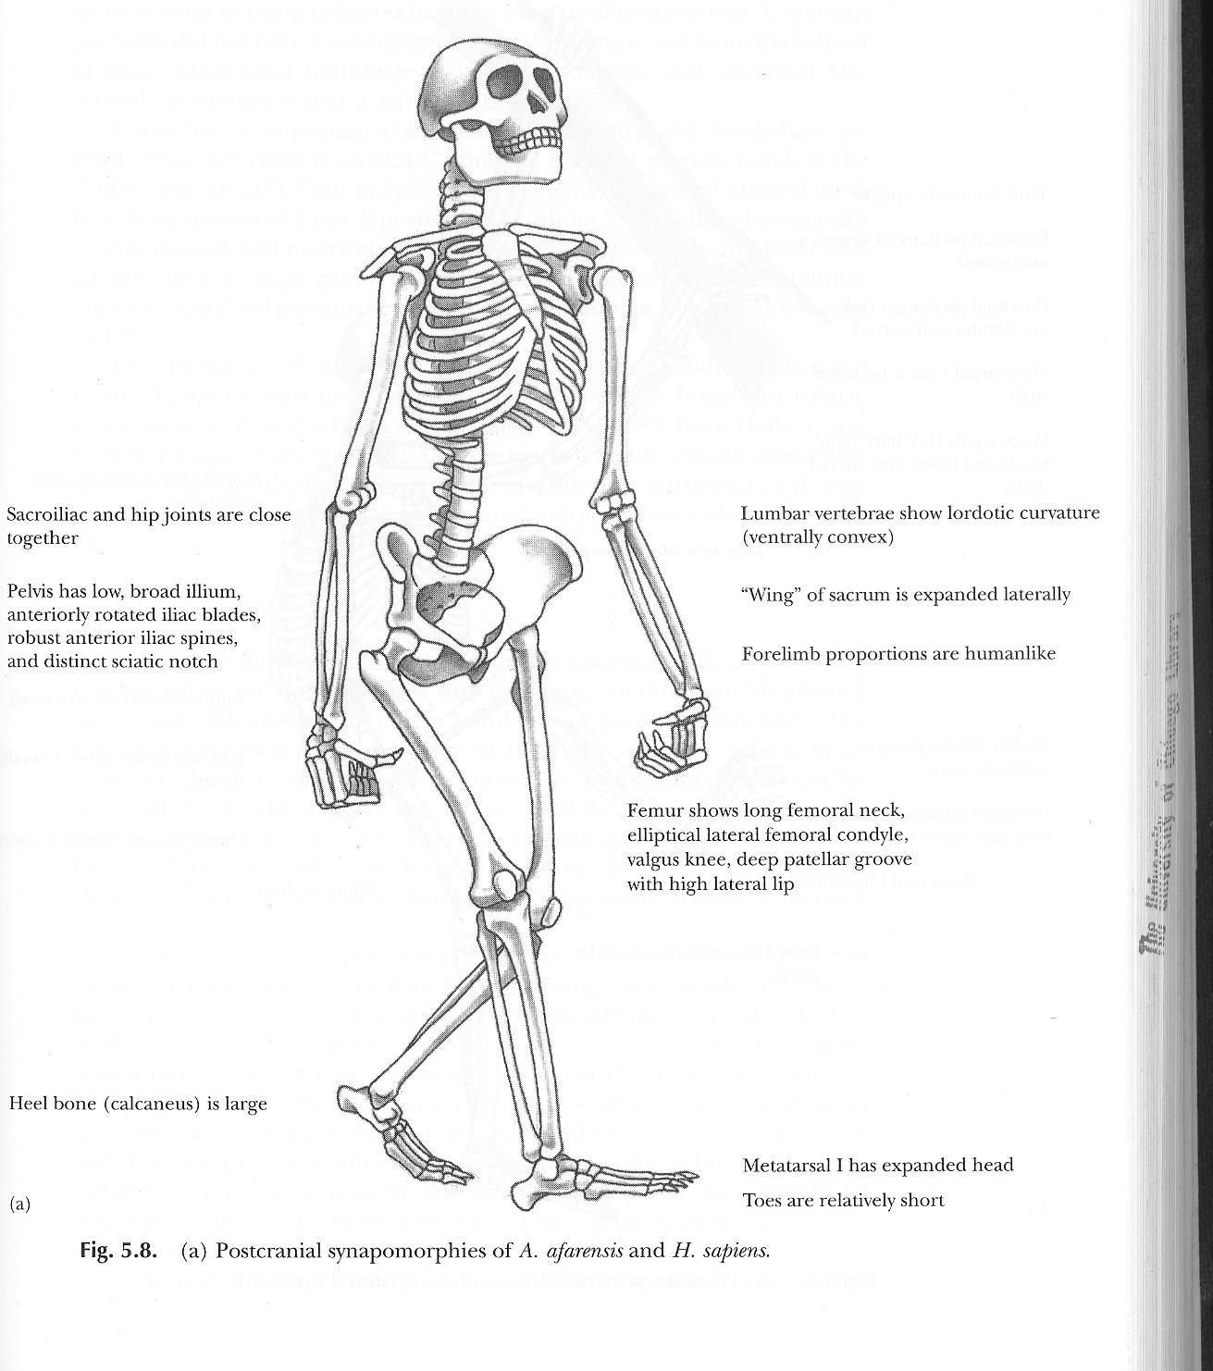
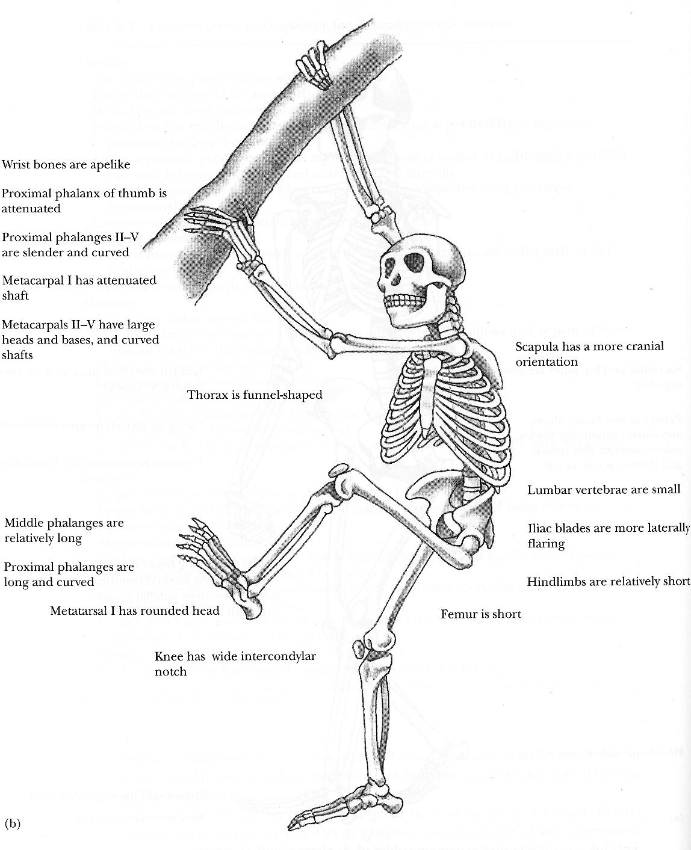
The Age of Things:
Sticks, Stones and the Universe
Potassium, Argon, DNA and Walking Upright
http://cfcp.uchicago.edu/~mmhedman/compton1.html

Slide 2
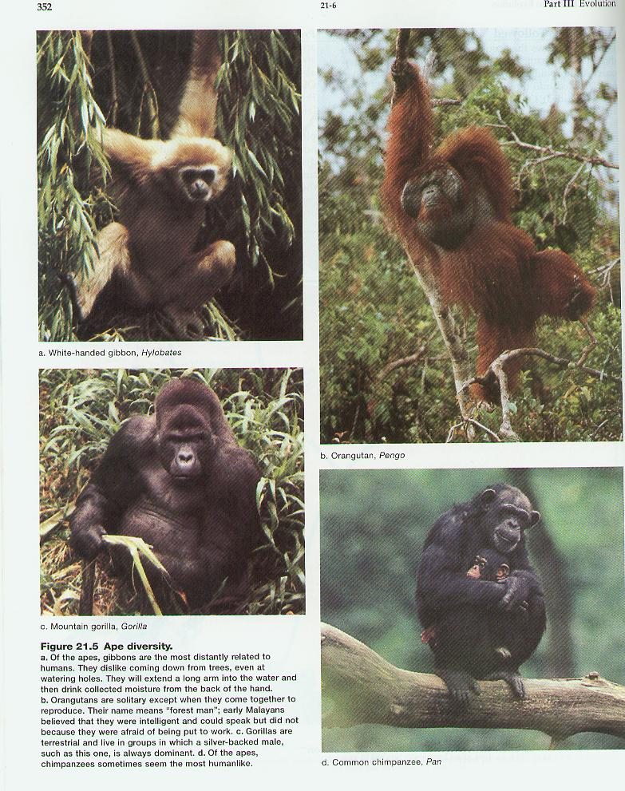

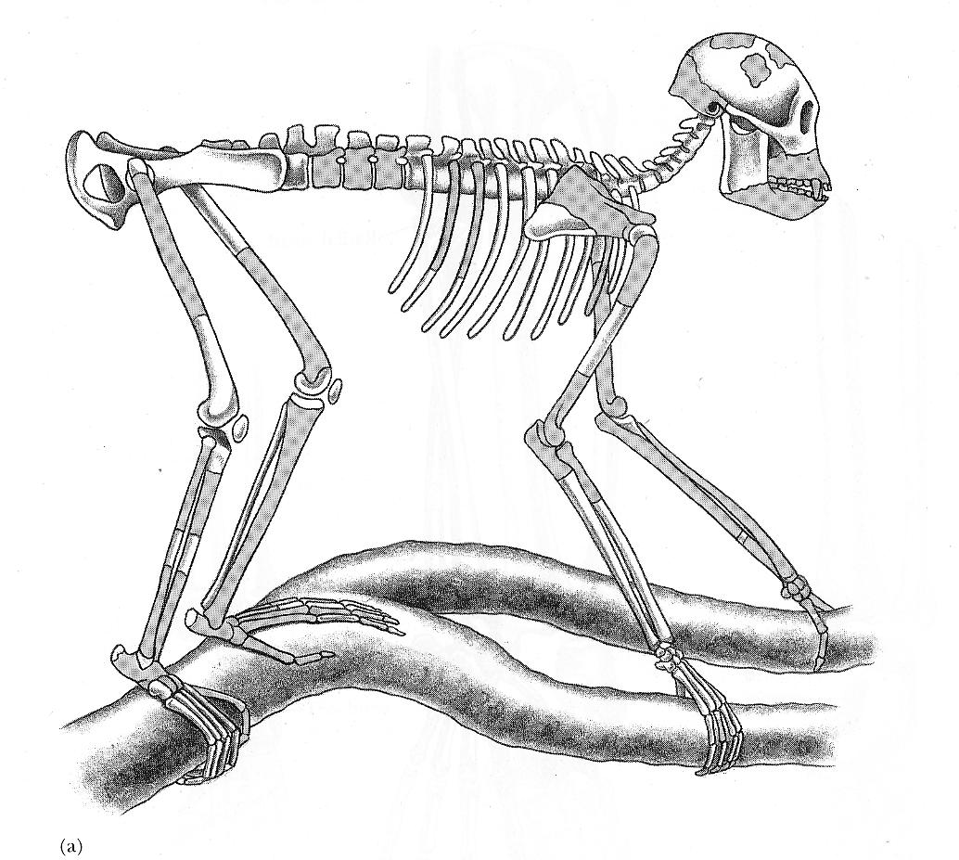
Proconsul

Slide 3
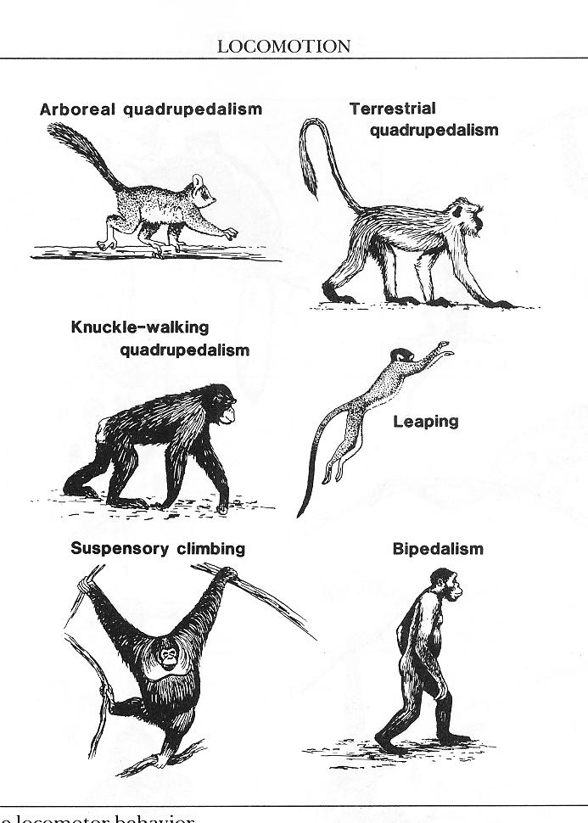
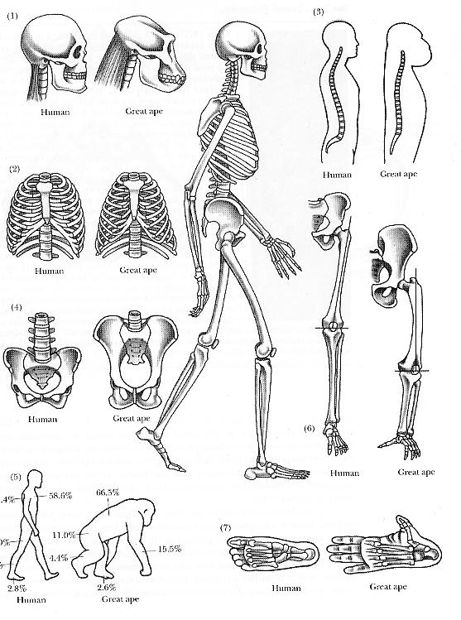

Slide 4
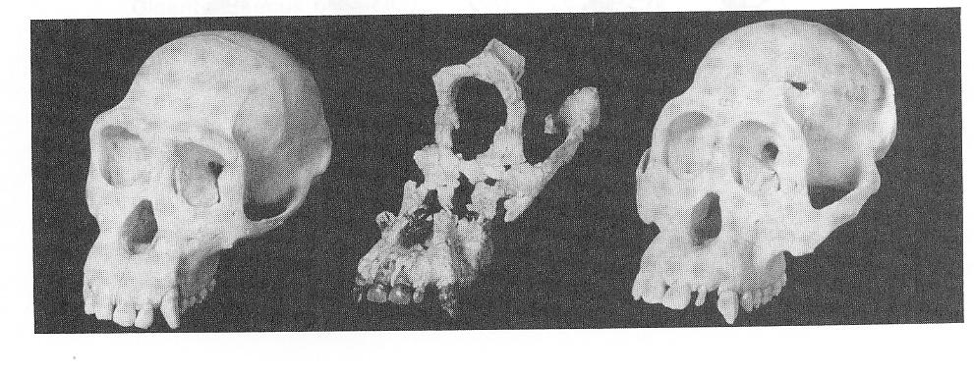
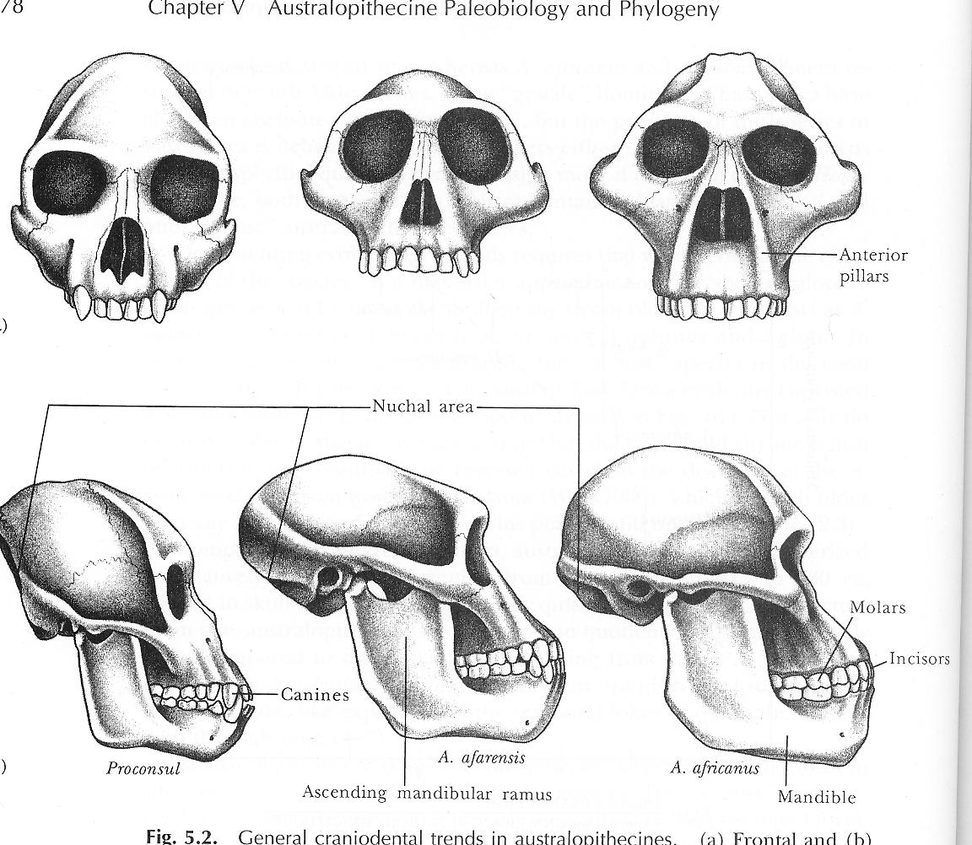
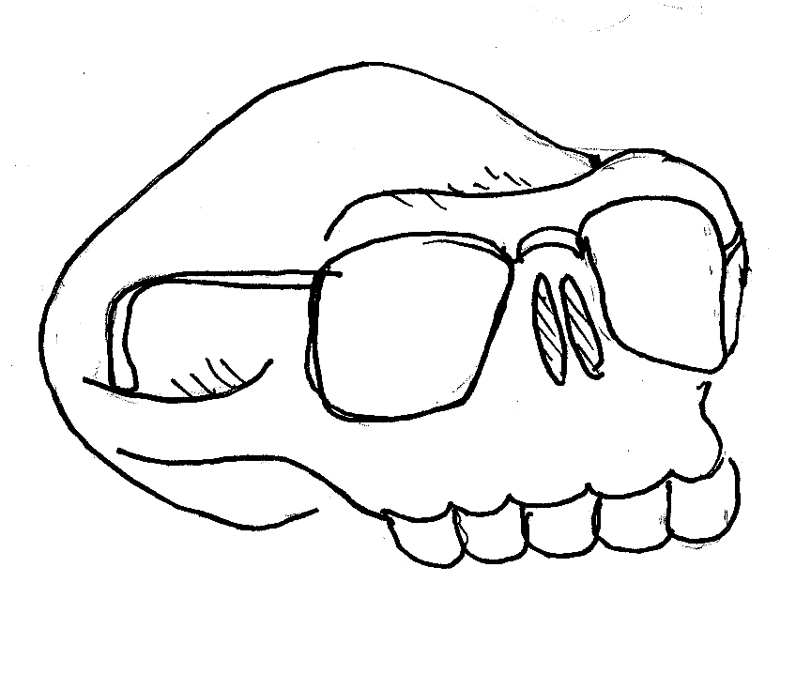
WARNING!
Astrophysicist talking
about Paleoanthropology
Australopithecus
Sivapithecus
Proconsul

Slide 5
Australopithecus
Sivapithecus
Proconsul

Slide 6
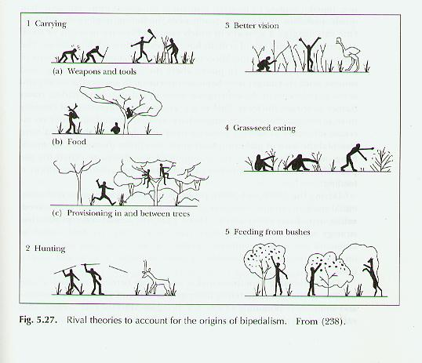
Bipedalism is a uniquely human trait

Slide 7
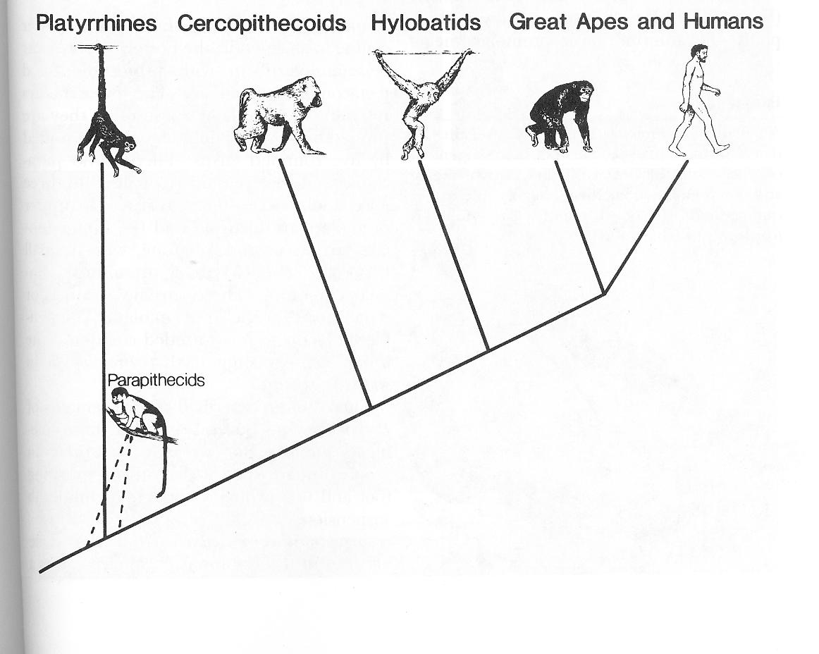
Time

Slide 8
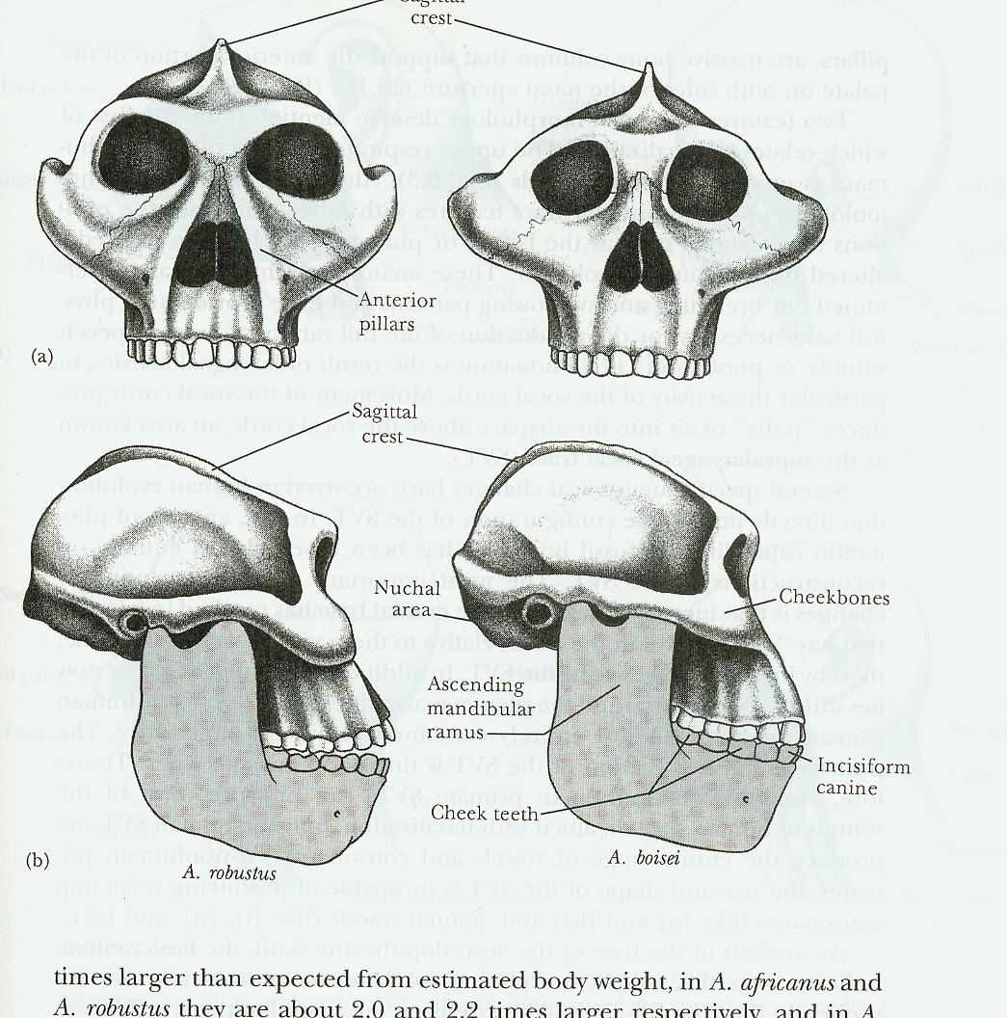
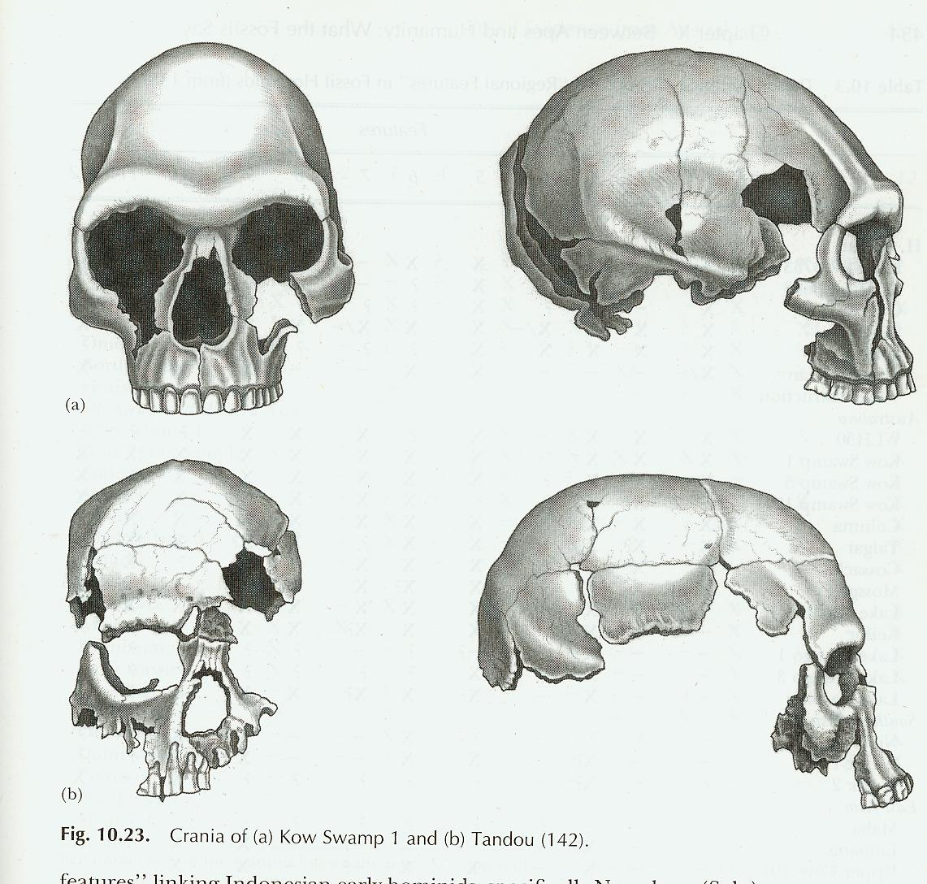
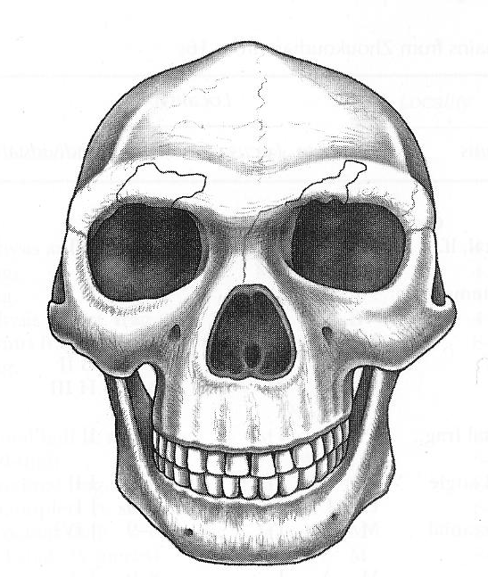
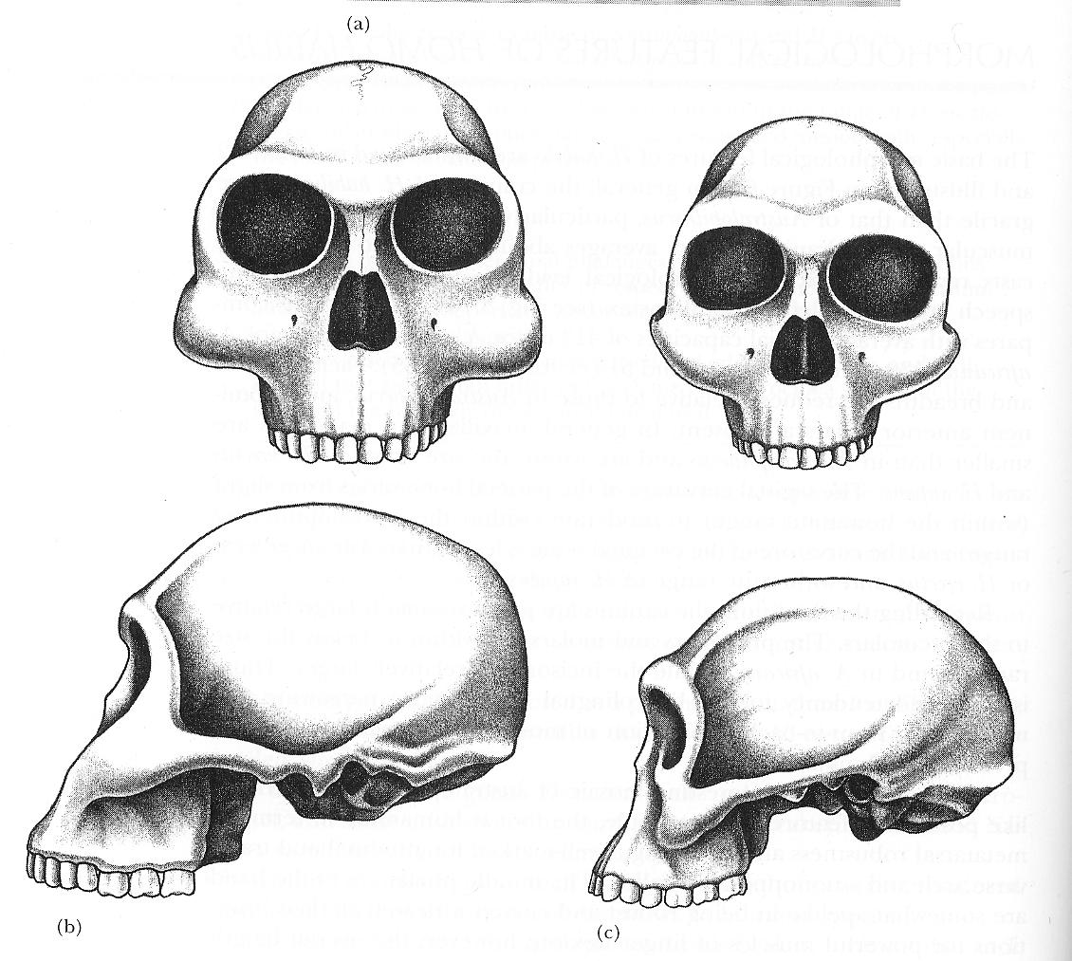
Different Types of Hominids
Australopithecus afarensis
Australopithecus africanus
Paranthropus robustus
Paranthropus bosei
Homo habilis
Homo sapiens
Homo erectus

Slide 9
Hominids
0
Paranthropus robustus
Paranthropus bosei
Homo sapiens
1 mya
Australopithecus africanus
2 mya
Homo erectus
Homo habilis
3 mya
4 mya
Australopithecus afarensis
(mya = millions of years ago)

Slide 10
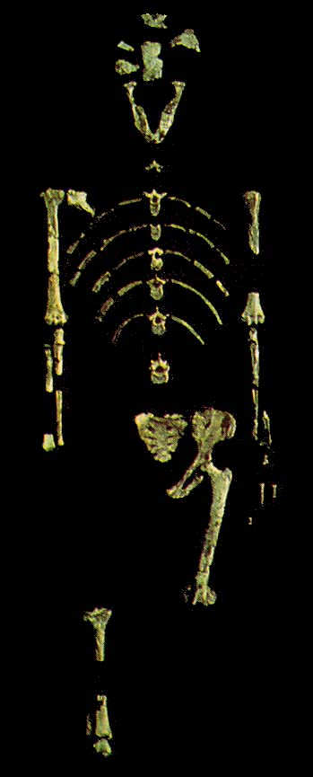
All these hominids could walk on two legs
Australopitchecus afarensis

Slide 11
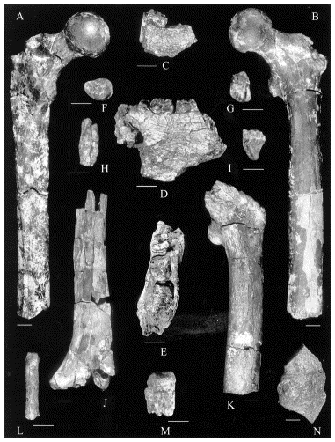
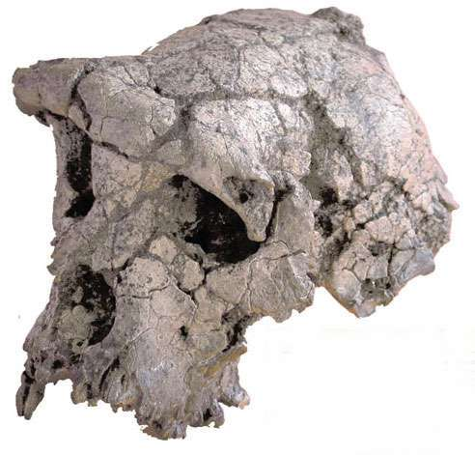
Recent hominid finds
Sahelanthropus
tchadensis
Orrorin tugenensis
Age of the fossils Time when hominids first became bipedal
Based on Geological Data
Based on Molecular Data

Slide 12
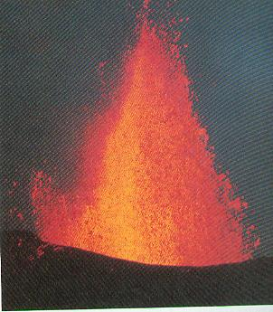
Dating the Fossils with the Potassium-Argon method

Slide 13
Potassium-Argon Dating
Proton
Neutron
Carbon 14
Nitrogen 14
electron
neutrino
Potassium 40
Calcium 40
electron
neutrino

Slide 14
Potassium-40 has two ways it can decay
Potassium 40
Calcium 40
90%
electron
neutrino
Potassium 40
Argon 40
10%
electron
neutrino

Slide 15
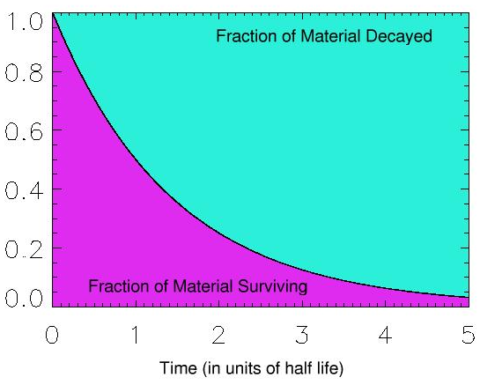
R=
Current amount of Potassium-40
Original amount of Potassium-40
R
Half-Life of Potassium-40 is1.25 billion years

Slide 16
Potassium-40 decay in molten rock
Potassium-40
Argon-40
Calcium-40

Slide 17
Potassium-40 decay in solid rock
Potassium-40
Argon-40
Calcium-40

Slide 18
The Rock Today
Potassium-40
Argon-40
Calcium-40

Slide 19
The Rock Today
Potassium-40
Argon-40
Calcium-40
Potassium 40
Calcium-40
The Original Rock

Slide 20
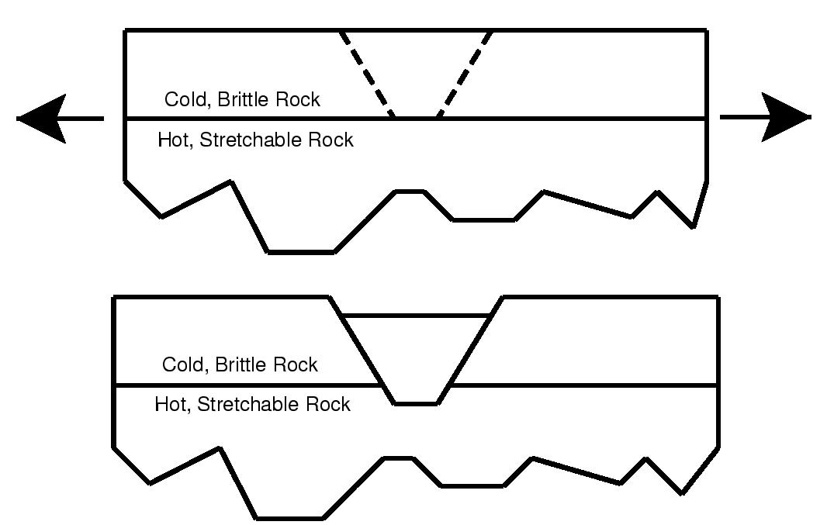
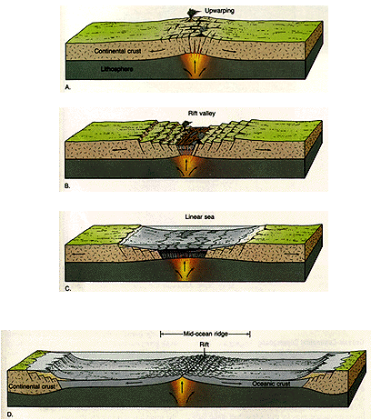
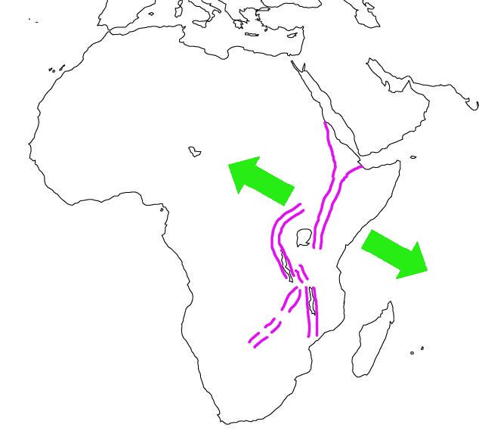
The East African Rift System

Slide 21
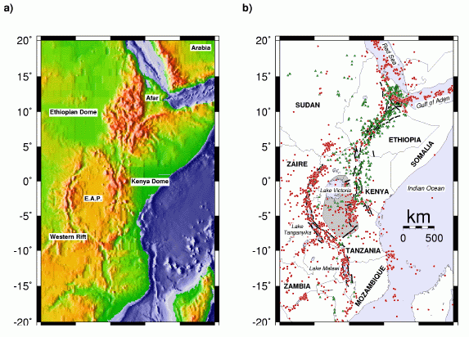
Red Circles=Earthquakes
Green triangles=Volcanoes

Slide 22
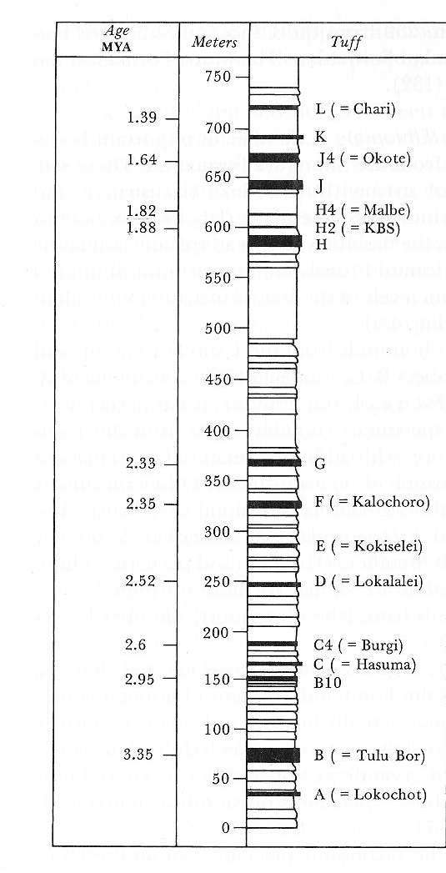
2.5 Million Years Ago
3 Million Years Ago

Slide 23
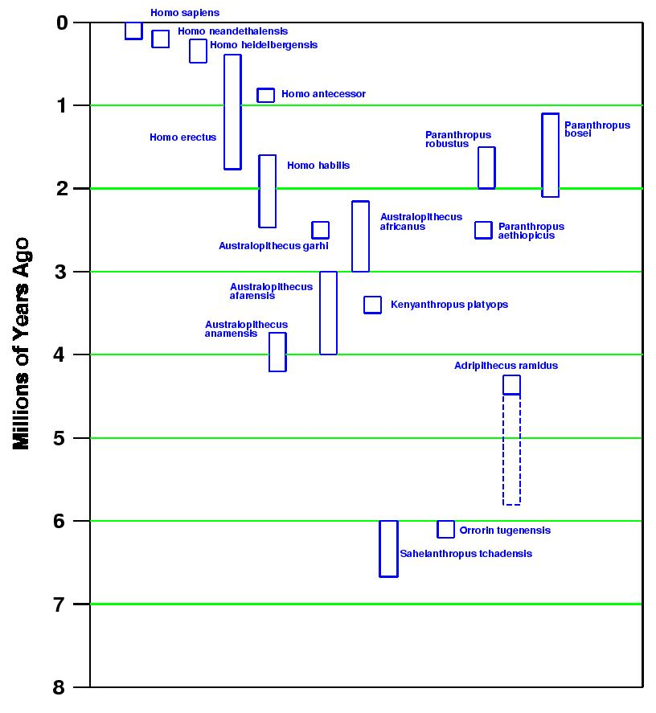
Ardipithecus ramidus

Slide 24
Ardipithecus ramidus

Slide 25
Recent hominid finds
Sahelanthropus
tchadensis
Orrorin tugenensis
Age of the fossils Time when hominids first became bipedal
Based on Geological Data
Based on Molecular Data

Slide 26
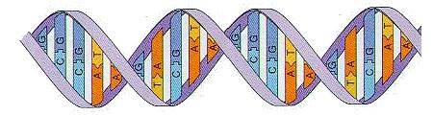
Molecular Dating Methods
WARNING!
Astrophysicist talking
about Molecular Biology
C C C A A G A G T T C C C A A G A G T T

Slide 27
Molecular Dating Methods
C C C A A G A G T T C C C A A G A G T T

Slide 28
Mutations in DNA
Original
CCCAAGAGTTCCCAAGAGTT
Substitution
CCCATGAGTTCCCAAGAGTT
GAGT
Deletion
CCCAATCCCAAGAGTT
Insertion
CCCAAGAGTTCACTTCCAAGAGTT
Inversion
CCCAAGCTTGACCAAGAGTT

Slide 29
The accumulation of mutations over time
CCCATGAGTT
GCCATGAATT
CCCAAGAGTG
CCTCAGAGTG
CCCAAGAGTT
TIME
CCCAAGAGTT

Slide 30
The accumulation of mutations over time
GCCATGAATT
CACCAGAGTG
CCTCAGAGTG
CCCCAGAGTG
TIME
CCCAAGAGTT

Slide 31
Could mutations accumulate at a constant rate ?
Two conditions must be met
1. Mutations occur at the same rate in all animals
Possible, mutations are due to biochemical processes that are
almost identical in different animals
2. Mutations are equally likely to be passed on in all animals
Unlikely, if mutations affect physical characteristics of animal
(Rate depends on environment, etc.)
True if mutations have no impact on the health or appearance of the animal
Neutral or “Silent” mutations

Slide 32
The accumulation of mutations over time
CCCATGAGTT
GCCATGAATT
CCCAAGAGTG
CCTCAGAGTG
CCCAAGAGTT
TIME
CCCAAGAGTT

Slide 33
The accumulation of mutations over time
CCCATGAGTTCGCAAGAATT
6 differences
CCCAAAAGTGCCCAAGACTT
TIME
CCCAAGAGTTCCCAAGAGTT

Slide 34
Using mutations to establish relationships
CCCATGAGTTCGCAAGAATT
CCCAAGAGTGCCCATGACTT
CCCAAAAGTGCCCAAGACTT
TIME
CCCAAGAGTTCCCAAGAGTT

Slide 35
Time

Slide 36
The accumulation of mutations over time
CCCATGAGTTCGCAAGAATT
6 differences
CCCAAAAGTGCCCAAGACTT
CCCATGAGTTCGCAAGAGTT
4 differences
CCCAAGAGTGCCCAAGACTT
CCCATGAGTTCCCAAGAGTT
2 differences
CCCAAGAGTGCCCAAGAGTT
TIME
CCCAAGAGTTCCCAAGAGTT

Slide 37



The environment constrains certain mutations
TIME

Slide 38
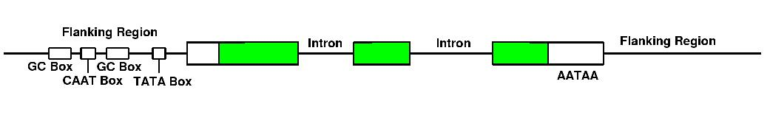
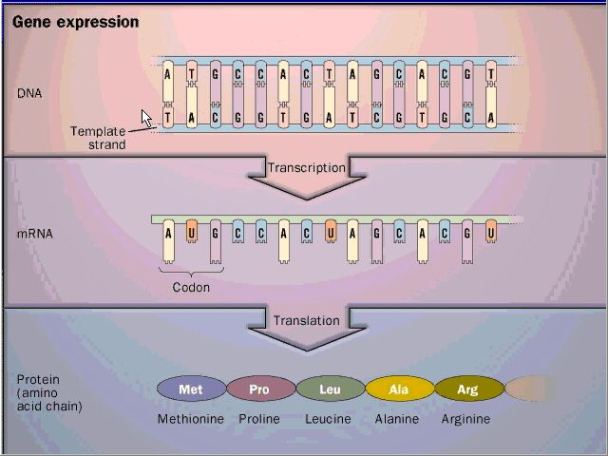
Identifying “useful” regions of DNA

Slide 39
Proconsul

Slide 40
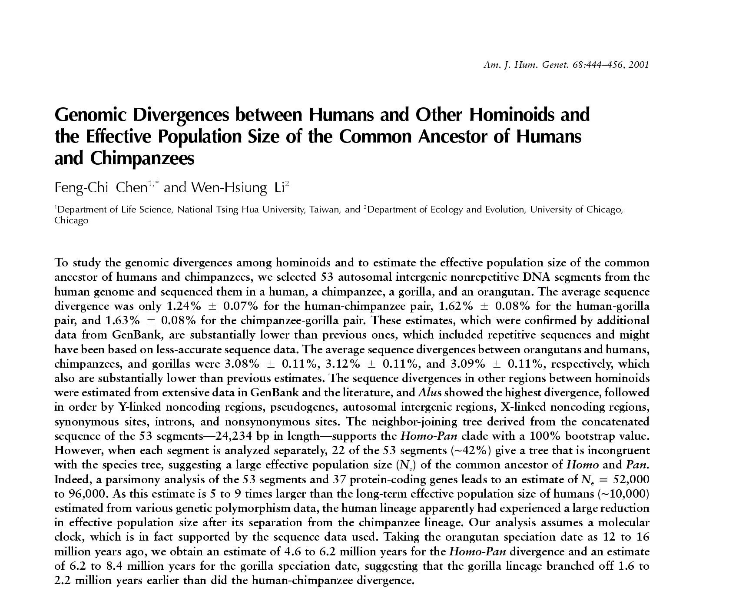
Molecular Dating in Humans and Apes

Slide 41
TAGGATCGATATAAGATAGCCGAACGAGACTATGGCTAGAGTGCATAGAC
TAGGATCGATATAACATAGCCGAACGAGACTATGGCTAGAGAGCATAGAC
TAGGATCGATATAAGATAGCCGATCGAGACTATGGCTAGAGAGCATAGAC
TACGATCGATATAAGATAGCCGAAGGAGACTATGGATAGAGAGCATAGAC

Slide 42
Chimp Gorilla Orangutan
Human 1.24% 1.62% 3.08%
Chimp 1.63% 3.12%
Gorilla 3.09%
Human Chimp Gorilla Orangutan

Slide 43
Chimp Gorilla Orangutan
Human 1.24% 1.62% 3.08%
Chimp 1.63% 3.12%
Gorilla 3.09%
Human Chimp Gorilla Orangutan
1%
2%
3%

Slide 44
Calibrating the molecular clock
Human Chimp Gorilla Orangutan
1%
2%
Sivapithecus
3%
More than
12 million
years old

Slide 45
Proconsul
Sivapithecus
Calibrating the molecular clock
Human Chimp Gorilla Orangutan
1%
2%
Sivapithecus
3%
Proconsul

Slide 46
Proconsul
Sivapithecus
Calibrating the molecular clock
Human Chimp Gorilla Orangutan
5
1%
Millions of years ago
10
2%
Sivapithecus
15
3%
Proconsul

Slide 47
Ardipithecus ramidus
Estimated time when humans and chimps last had a common ancestor

Slide 48
Human Chimp Gorilla Orangutan
5
1%
Millions of years ago
10
2%
Sivapithecus
15
3%
Proconsul

Slide 49
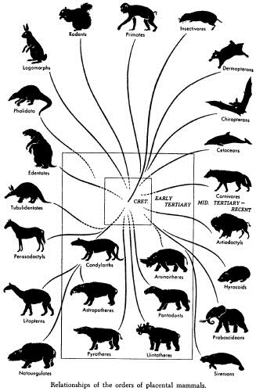
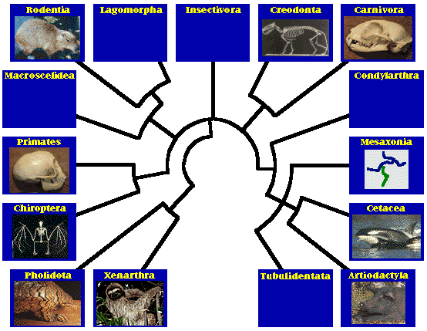
Next Time:
Molecular Dating and the Many Kinds of Mammals

