Slide 1
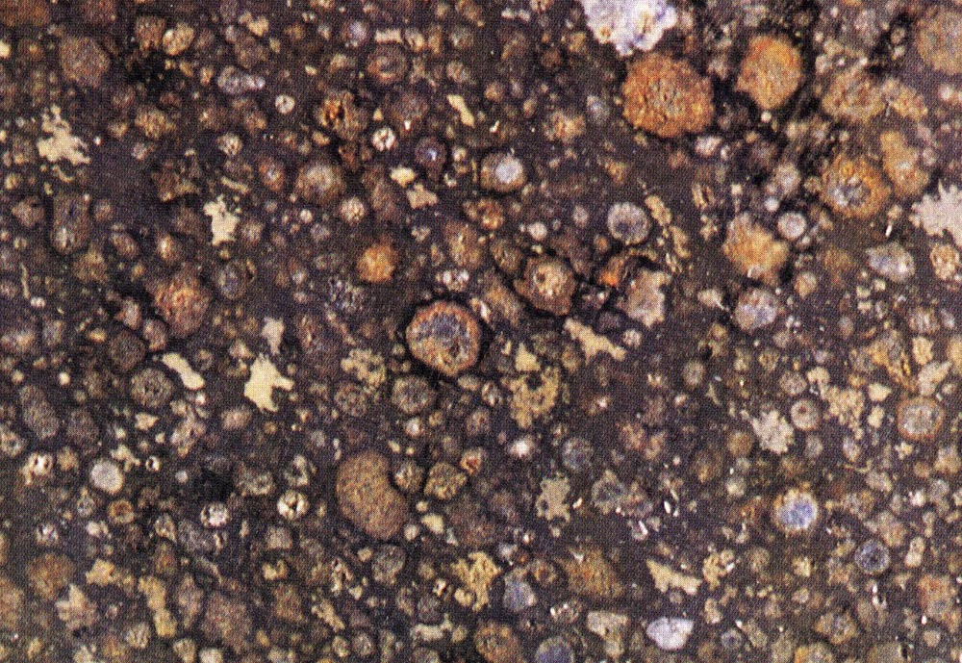
The Age of Things:
Sticks, Stones and the Universe
Meteorites and the Age of the Solar System
http://cfcp.uchicago.edu/~mmhedman/compton1.html

Slide 2
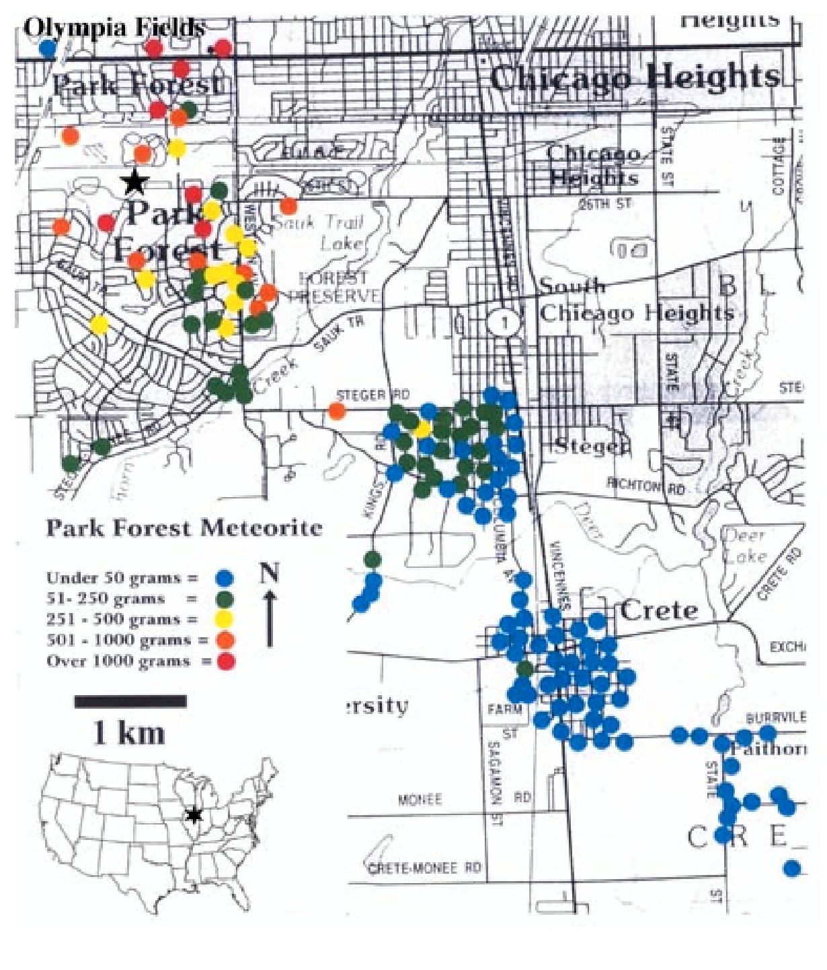
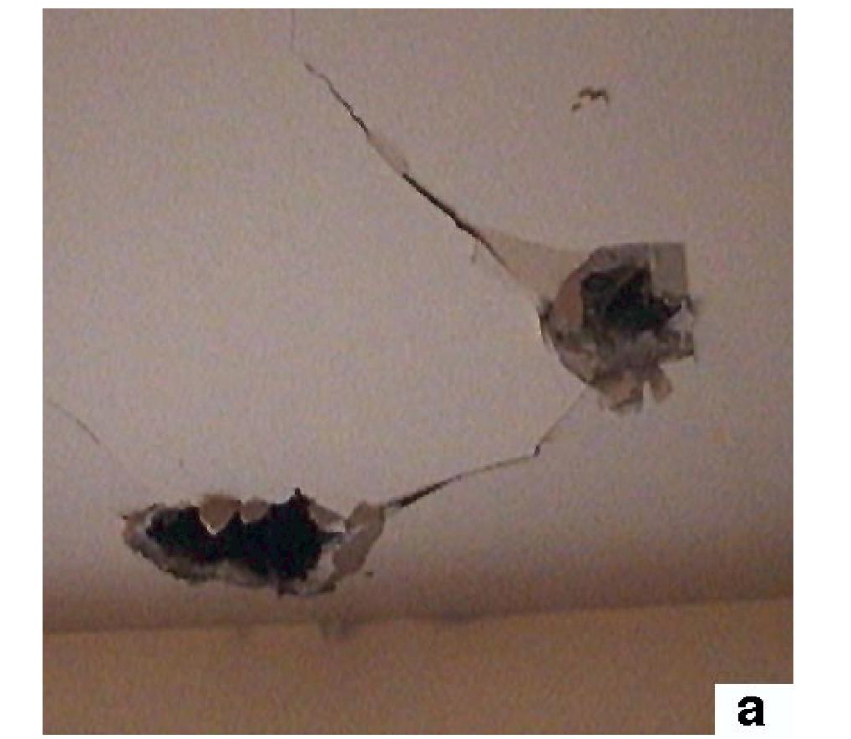
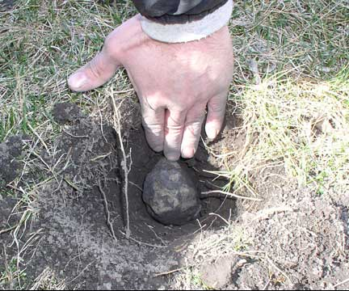
March 26, 2003 The Park Forest Meteorite
Images from Simon et al Meteoritics and Planetary Science Vol 39 (2004)

Slide 3
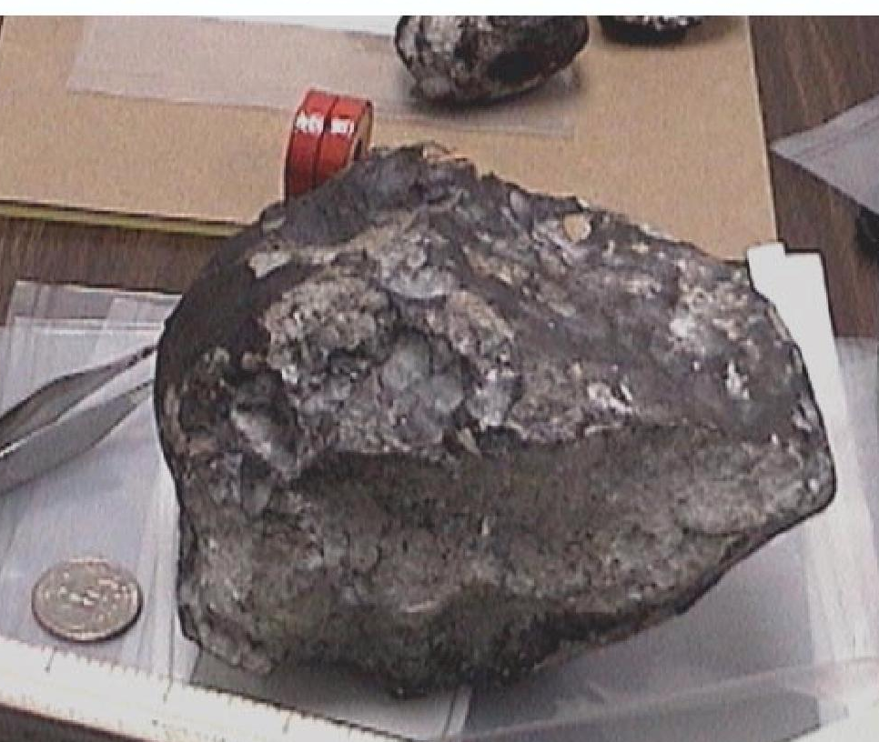
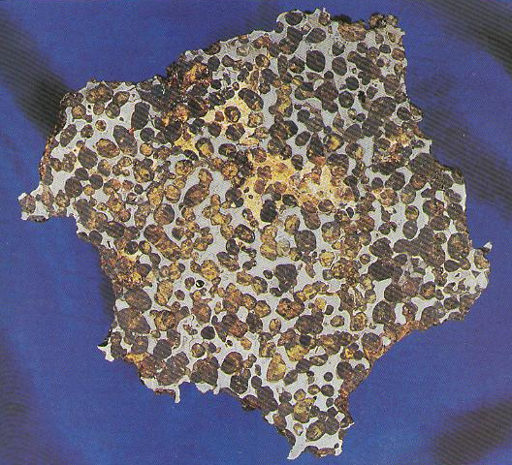
Different Types of Meteorites
Iron
Stony

Slide 4
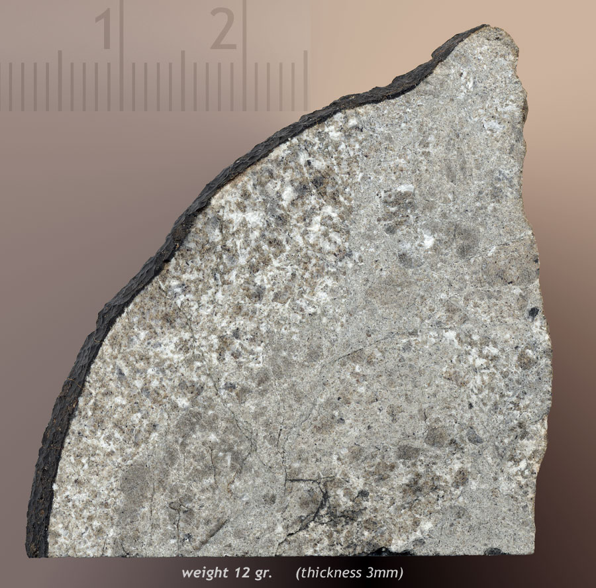
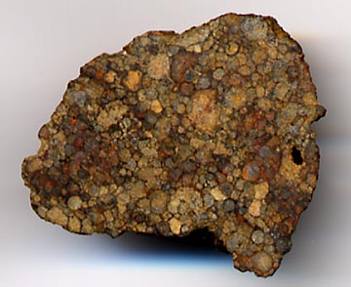
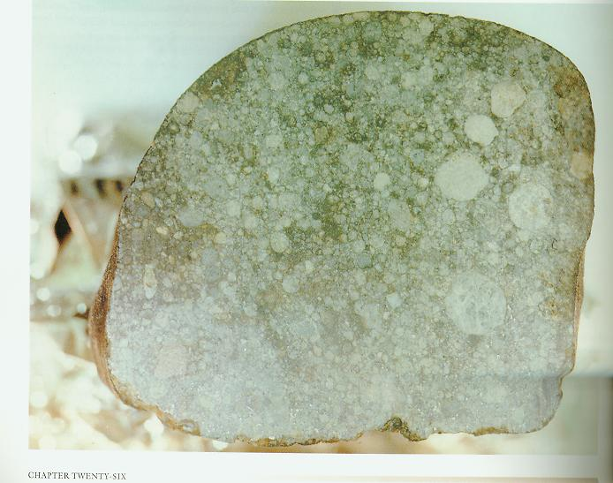
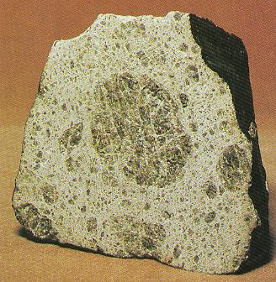
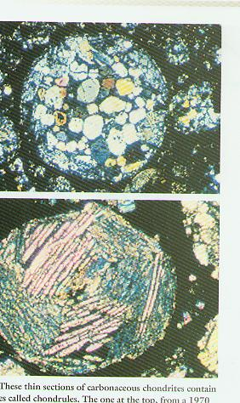
Different Types of Stony Meteorites
Achondrite
Chondrite

Slide 5
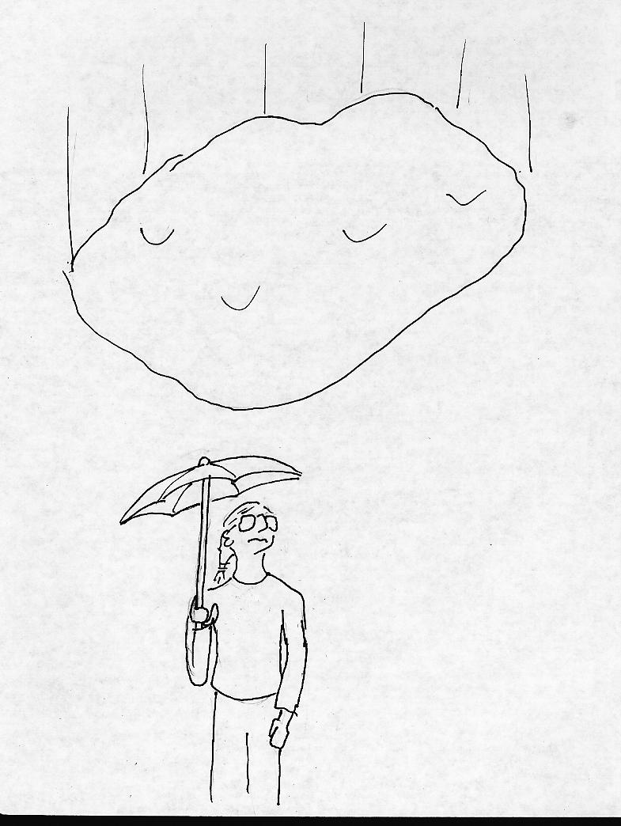
WARNING!
Astrophysicist talking
about Meteorites!

Slide 6
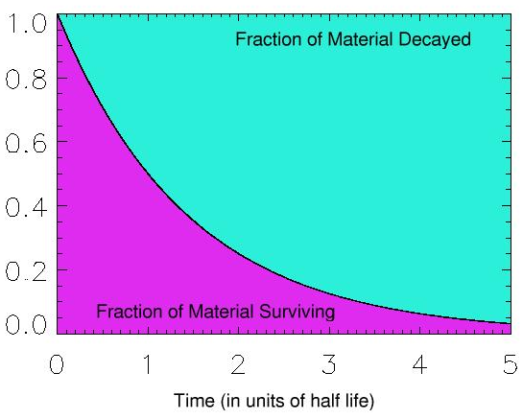
R=
Current amount of Radioactive Nuclei
Original amount of Radioactive Nuclei
R

Slide 7
Potassium-Argon System
Proton
Neutron
Potassium 40
Calcium 40
90%
electron
neutrino
Potassium 40
Argon 40
10%
electron
neutrino

Slide 8
The Rock Today
Potassium-40
Argon-40
Calcium-40
Potassium 40
Calcium-40
The Original Rock

Slide 9
R=
Current amount of Potassium-40
Original amount of Potassium-40
R
Half-Life of Potassium-40 is1.25 billion years

Slide 10
Potassium-40 decay in molten rock
Potassium-40
Argon-40
Calcium-40

Slide 11
Potassium-40 decay in solid rock
Potassium-40
Argon-40
Calcium-40

Slide 12
Rubidium-Strontium System
Proton
Neutron
Carbon 14
Nitrogen 14
electron
neutrino
Half-Life = 5700 Years
Rubidium-87
Strontium-87
electron
neutrino
Half-life = 49 Billion Years

Slide 13
Rubidium-Strontium Dating
Rubidium-87
Strontium-87
Today
Mineral 1

Slide 14
Rubidium-Strontium Dating
Rubidium-87
Strontium-87
Today
Mineral 1
Originally
Mineral 1

Slide 15
Rubidium-Strontium Dating
Rubidium-87
Strontium-87
Today
Mineral 1
Originally
Mineral 1

Slide 16
Strontium-86
Rubidium-87
Strontium-87
Mineral 2
Mineral 1

Slide 17
Strontium-86
Strontium-87
Mineral 2
Mineral 1

Slide 18
Rubidium-Strontium Dating
Rubidium-87
Strontium-87
Strontium-86
Today
Mineral 1
Mineral 2

Slide 19
Rubidium-Strontium Dating
Rubidium-87
Strontium-87
Strontium-86
Today
Mineral 1
Mineral 2
7 billion years ago
Mineral 1
Mineral 2

Slide 20
Rubidium-Strontium Dating
Rubidium-87
Strontium-87
Strontium-86
Today
Mineral 1
Mineral 2
3 billion years ago
Mineral 1
Mineral 2

Slide 21
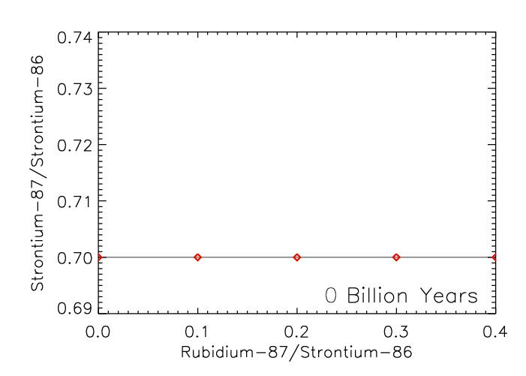
Rubidium-Strontium Isochron Plots

Slide 22
Rubidium-Strontium Isochron Plots

Slide 23
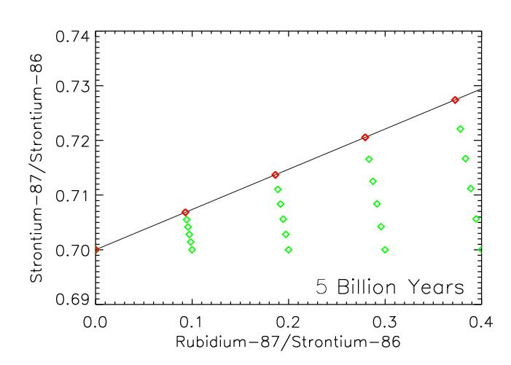
Rubidium-Strontium Isochron Plots

Slide 24
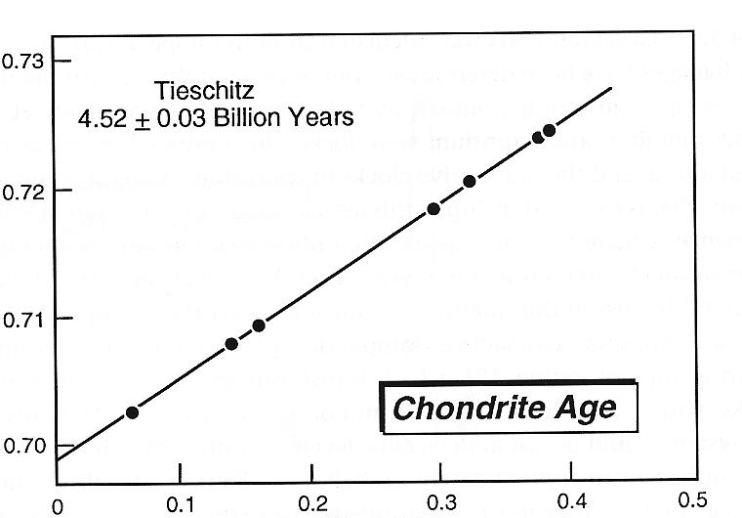
Rubidium-Strontium Ages
Strontium-87/Strontium-86
Rubidium-87/Strontium-86
From McSween 2000 Meteorites and Their Parent Planets

Slide 25
Different Types of Stony Meteorites
Achondrite
Chondrite

Slide 26
Chondrules, etc.
Condensation,
Melting, Evaporation
Aggregation
Dust and Gas
“Chondritic” Objects
Meteoroids
Chondrite
Fragmentation
Achondrite
Iron
Melting, Differentiation
“Achondritic” Objects
Planets
Aggregation

Slide 27
Aluminum-26 System
Proton
Neutron
Carbon 14
Nitrogen 14
electron
neutrino
Half-Life = 5700 Years
Aluminum-26
Magnesium-26
positron
neutrino
Half-Life = 700,000 Years

Slide 28
Magnesium-24
Aluminum-27
Aluminum-26
Magnesium-26

Slide 29
Magnesium-24
Aluminum-27
Aluminum-26
Magnesium-26

Slide 30
Magnesium-24
Aluminum-27
Aluminum-26
Magnesium-26

Slide 31
Magnesium-24
Magnesium-26
Aluminum-27

Slide 32
Magnesium-24
Magnesium-26
Aluminum-27

Slide 33
Aluminum-26 Dating
Aluminum-27
Aluminum-26
Magnesium-26
Magnesium-24
Today
Mineral 1
Mineral 2

Slide 34
Aluminum-26 Dating
Aluminum-27
Aluminum-26
Magnesium-26
Magnesium-24
Today
Mineral 1
Mineral 2
Originally
Mineral 1
Mineral 2

Slide 35
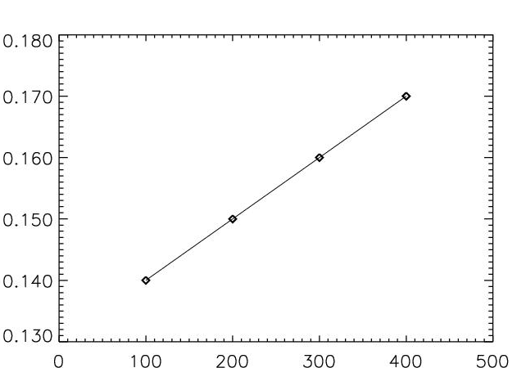
Aluminum-26 Isochron Plot
Magnesium-26/ Magnesium-24
Aluminum-27/ Magnesium-24

Slide 36
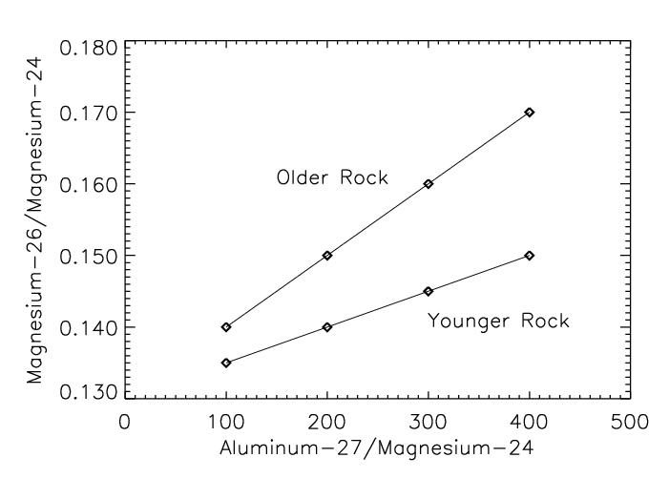
Aluminum-26 Isochron Plot
Magnesium-26/ Magnesium-24
Aluminum-27/ Magnesium-24

Slide 37
Aluminum-26 Isochron Plot
Magnesium-26/ Magnesium-24
Aluminum-27/ Magnesium-24

Slide 38
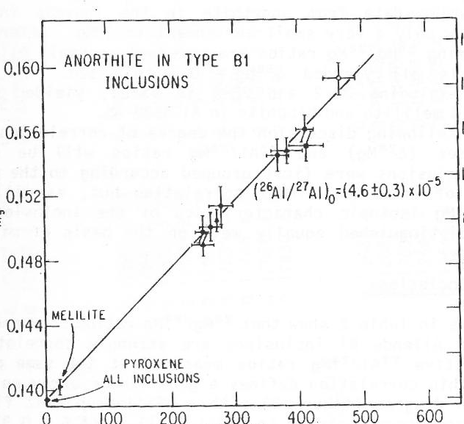
Relative Dating from Aluminum-26
Magnesium-26/ Magnesium-24
Aluminum-27/ Magnesium-24
From Hutcheon 1982 in Nuclear and Chemical Dating Techniques
More Aluminum-26
Aluminum-26
Chondrule
Achondrite

Slide 39
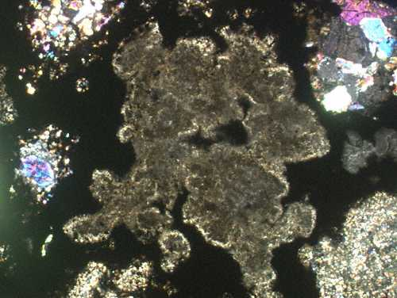
Relative Dating from Aluminum-26
Magnesium-26/ Magnesium-24
Chondrule
Calcium-Aluminum-Rich Inclusion
Aluminum-27/ Magnesium-24
From Hutcheon 1982 in Nuclear and Chemical Dating Techniques
More Aluminum-26
Aluminum-26
CAI
Chondrule
Achondrite

Slide 40
Relative Dating from Aluminum-26
Magnesium-26/ Magnesium-24
Chondrule
Calcium-Aluminum-Rich Inclusion
Aluminum-27/ Magnesium-24
From Hutcheon 1982 in Nuclear and Chemical Dating Techniques
-10
-5
0
5
10
15
Millions of Years
Aluminum-26
CAI
Chondrule
Achondrite

Slide 41
Uranium-Lead System
Uranium-238
α
Uranium-235
α
Thorium-234
β
Thorium-231
Protactinium-234
β
β
Protactinium-231
Uranium-234
α
α
Actinium-227
Thorium-230
α
β
Radium-226
Thorium-227
α
α
Radon-222
α
Radium-223
α
Polonium-218
α
Radon-219
Lead-214
α
β
Polonium-215
Bismuth-214
α
β
Lead-211
Polonium-214
α
β
Thallium-210
Bismuth-211
β
β
Lead-210
Polonium-211
β
α
Bismuth-210
β
Thallium-207
Polonium-210
β
α
Lead-207
Lead-206
Half-Life = 700 Million Years
Half-Life = 4.5 Billion Years

Slide 42
Uranium-235
Lead 204
Uranium-238
Lead 206
Lead 207

Slide 43
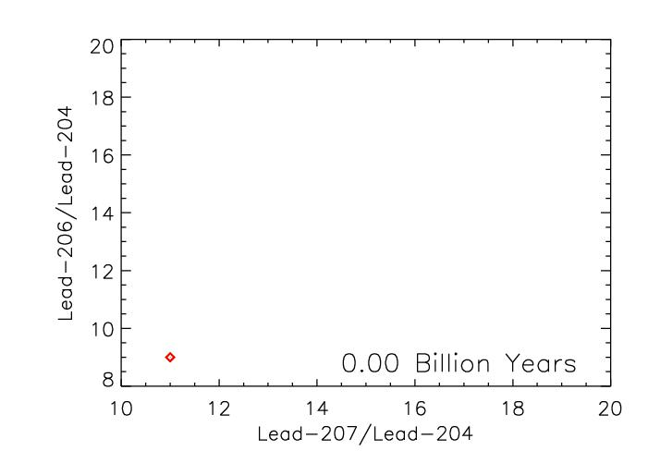
Lead-Lead Isochron Plot

Slide 44
Lead-Lead Isochron Plot

Slide 45
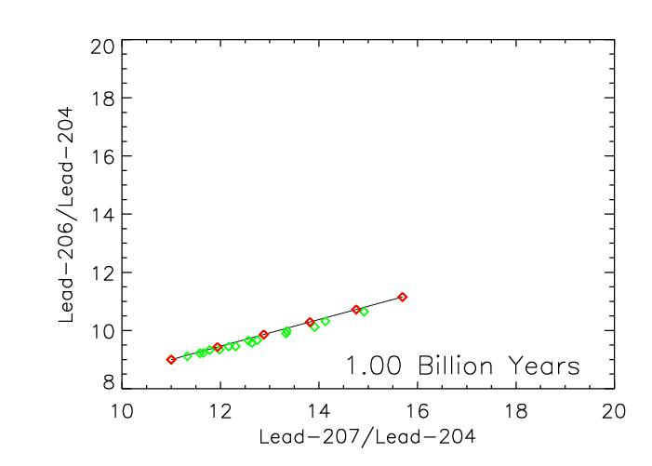
Lead-Lead Isochron Plot

Slide 46
Lead-Lead Isochron Plot

Slide 47
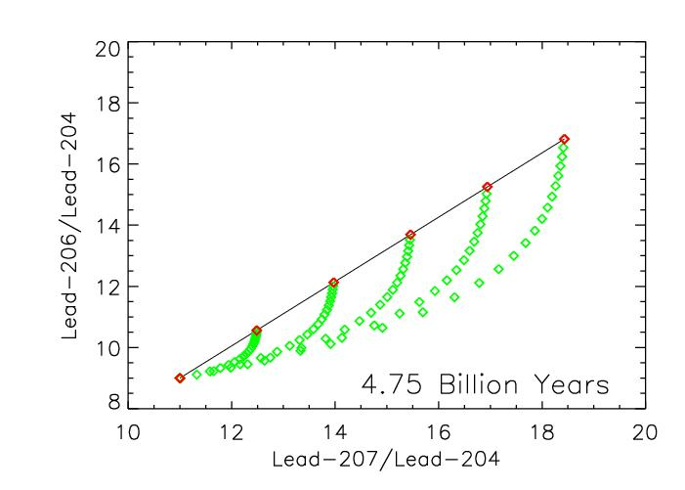
Lead-Lead Isochron Plot

Slide 48
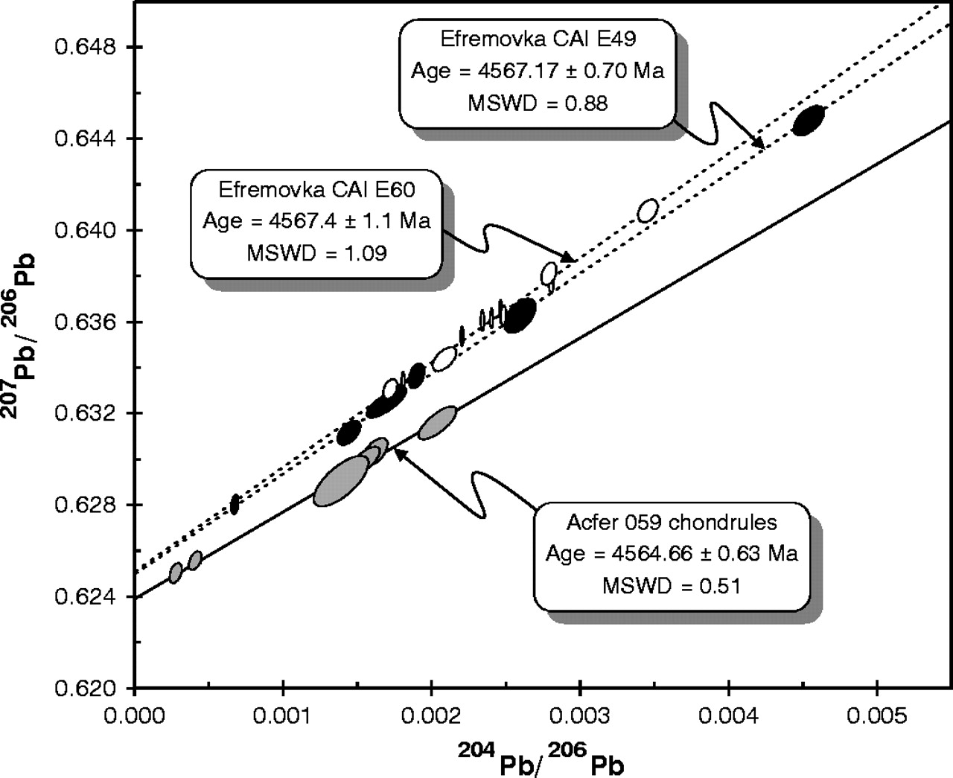
Lead-Lead Isochron Dates
Lead 207/Lead 206
From Amelin et al 2002 Science 297 p 1678
Lead 204/Lead 206
Achondrite
Lead Isochron
4575
4570
4565
4560
4555
4550
Millions of Years

Slide 49
Lead-Lead Isochron Dates
Chondrule
Lead 207/Lead 206
From Amelin et al 2002 Science 297 p 1678
Calcium-Aluminum-Rich Inclusion
Lead 204/Lead 206
Achondrite
CAI
Chondrules
Lead Isochron
4575
4570
4565
4560
4555
4550
Millions of Years

Slide 50
Lead-Lead Isochron Dates
Chondrule
Lead 207/Lead 206
From Amelin et al 2002 Science 297 p 1678
Calcium-Aluminum-Rich Inclusion
Lead 204/Lead 206
-10
-5
0
5
10
15
Millions of Years
Aluminum-26
Achondrite
CAI
Chondrules
Lead Isochron
4575
4570
4565
4560
4555
4550
Millions of Years

Slide 51
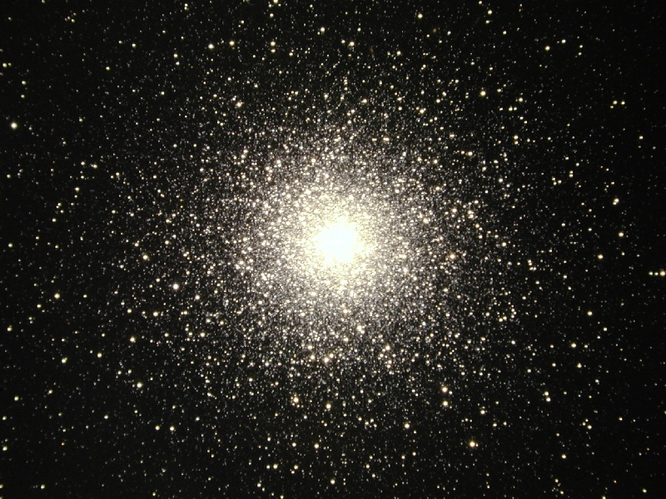
Next time:
Colors, Brightness and the Age of Stars

