Slide 1
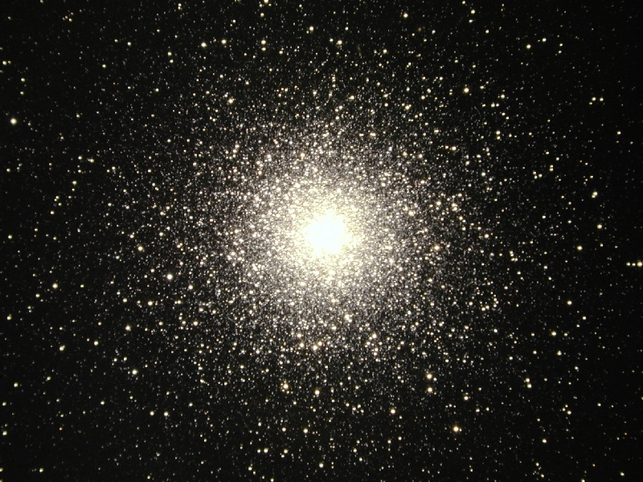
The Age of Things:
Sticks, Stones and the Universe
Colors, Brightness, and the Age of Stars
http://cfcp.uchicago.edu/~mmhedman/compton1.html

Slide 2
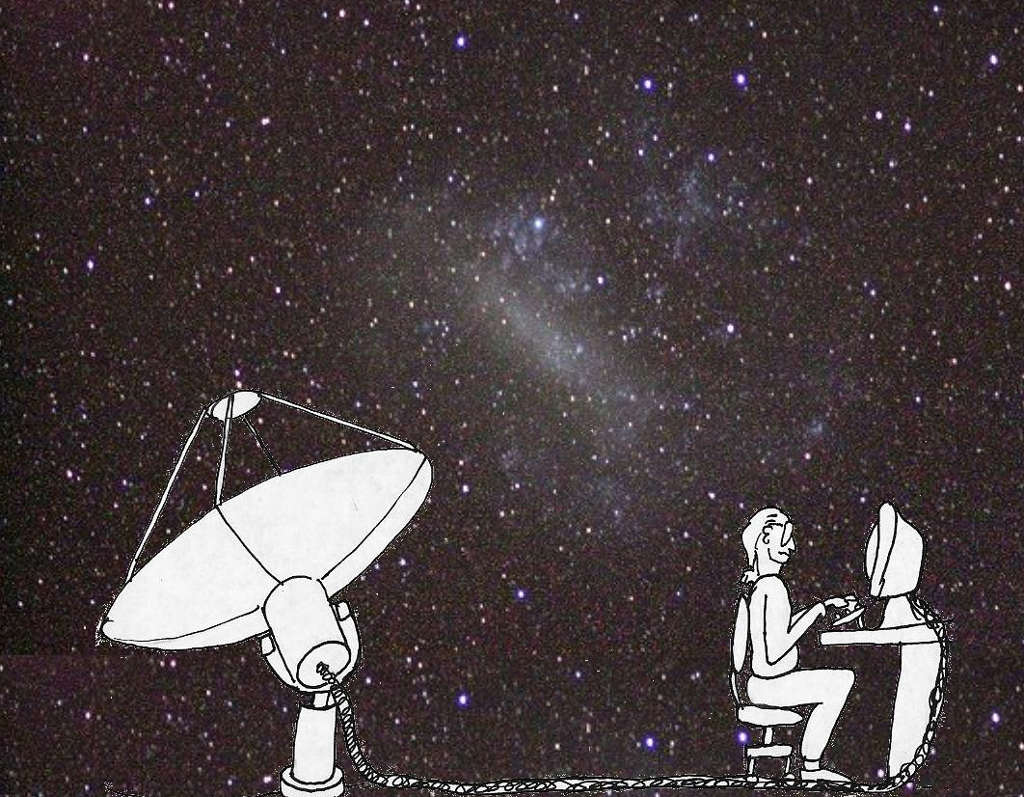
WARNING!
(Radio) Astrophysict talking about Astronomy!

Slide 3
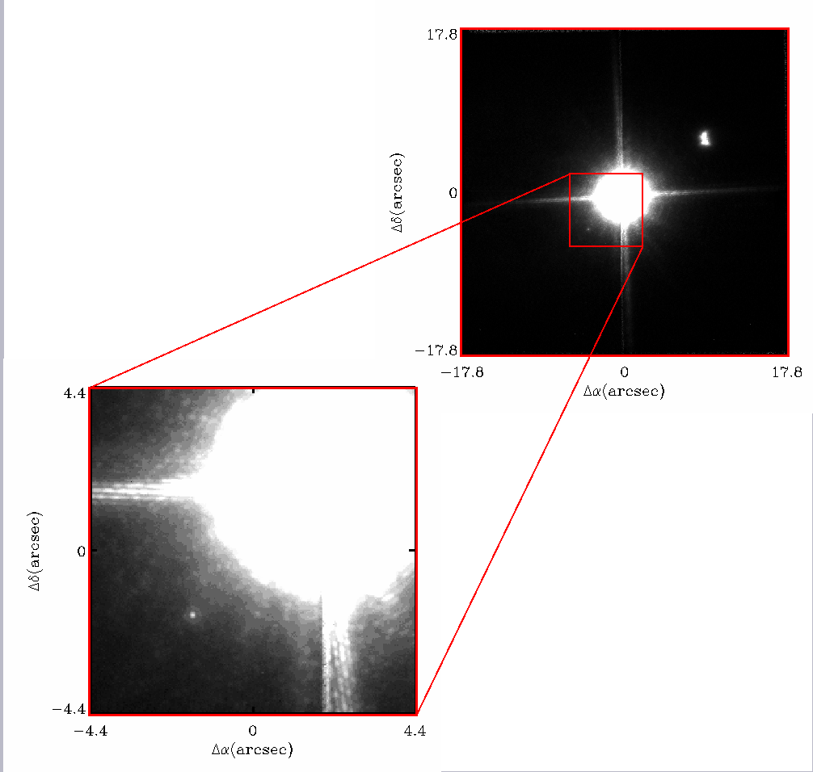
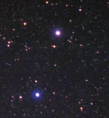
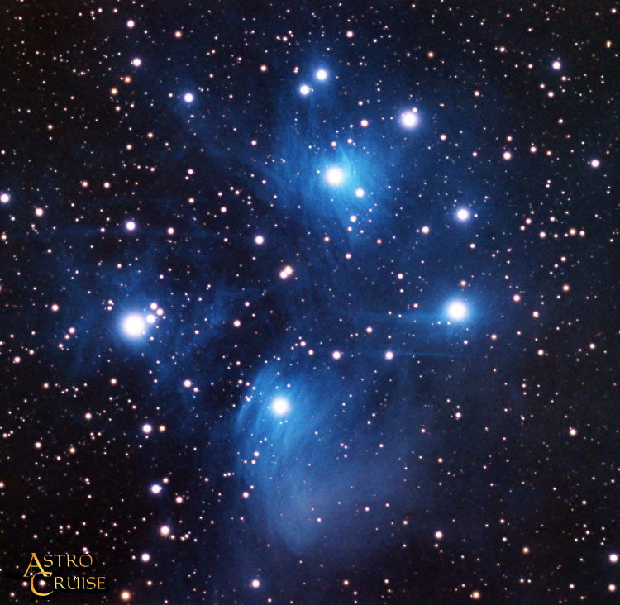
The Brightness of Stars
Sirius
Pollux
Castor
The Pleades
Sirius B
Luminosity = Total power emitted by star
in the form of light.

Slide 4
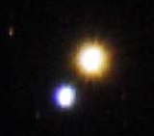
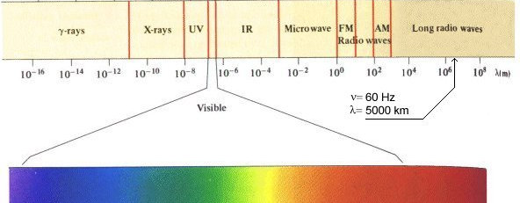
Colors and Spectra
Alberio
1 pm
1 nm
1 μ m
1 mm
1 m
1 km
Visible
400 nm
500 nm
600 nm
700 nm
Wavelength

Slide 5
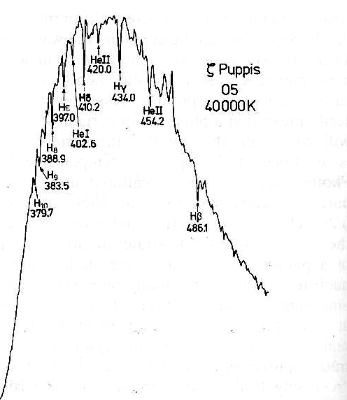
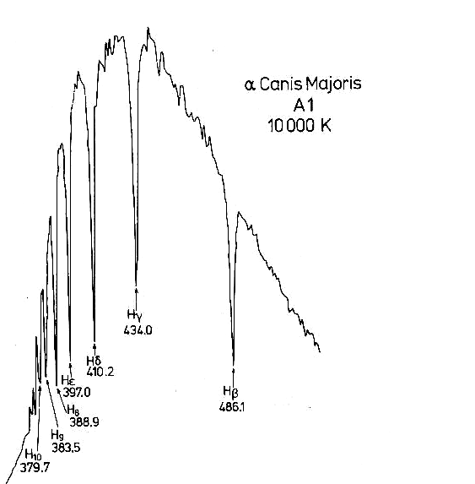
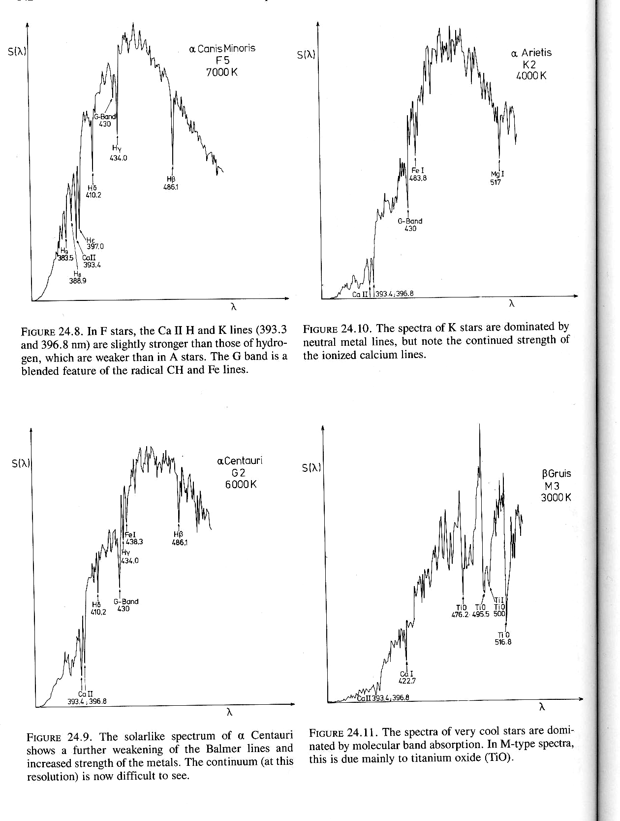
The Spectra of Stars
Brightness
Brightness
Brightness
Brightness
Wavelength
Wavelength
Wavelength
Wavelength

Slide 6
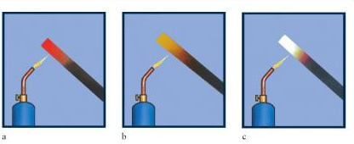
Thermal Radiation

Slide 7
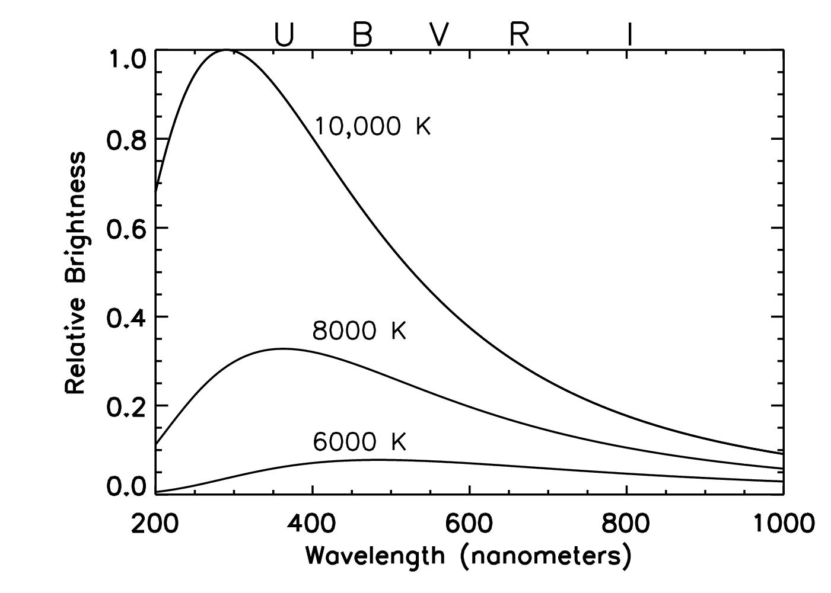
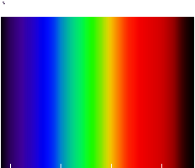
Thermal Spectrum

Slide 8
Astronomical Filters

Slide 9
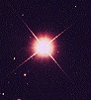
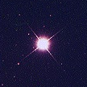
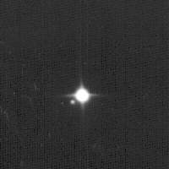
Magnitudes
Magnitude 0
Arcturus
2.5 times brighter
Magnitude 1
Spica
2.5 times brighter
Magnitude 2
Polaris
2.5 times brighter
Magnitude 3

Slide 10
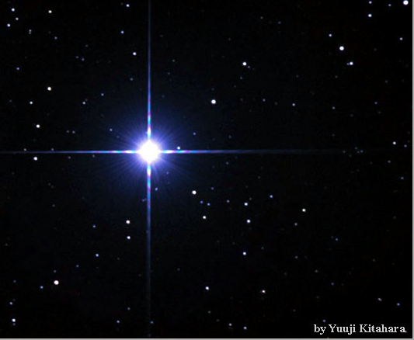
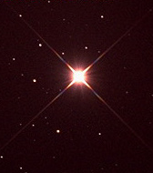
Colors
Rigel,
B-V = - 0.03
Betelgeuse,
B-V = 1.85

Slide 11
Measuring Distance to the stars using Parallax
Background Stars
Nearby Stars
Earth
Sun
Earth

Slide 12
Magnitudes
37 Light years Away
Magnitude 0
Arcturus
262 Light Years Away
Magnitude 1
Spica
431 Light Years Away
Magnitude 2
Polaris
Magnitude 3

Slide 13
Magnitudes
37 Light years Away
Magnitude 0
Arcturus
Absolute Magnitude - 0.30
262 Light Years Away
Magnitude 1
Spica
Absolute Magnitude - 3.55
431 Light Years Away
Magnitude 2
Polaris
Absolute Magnitude - 3.59
Magnitude 3

Slide 14
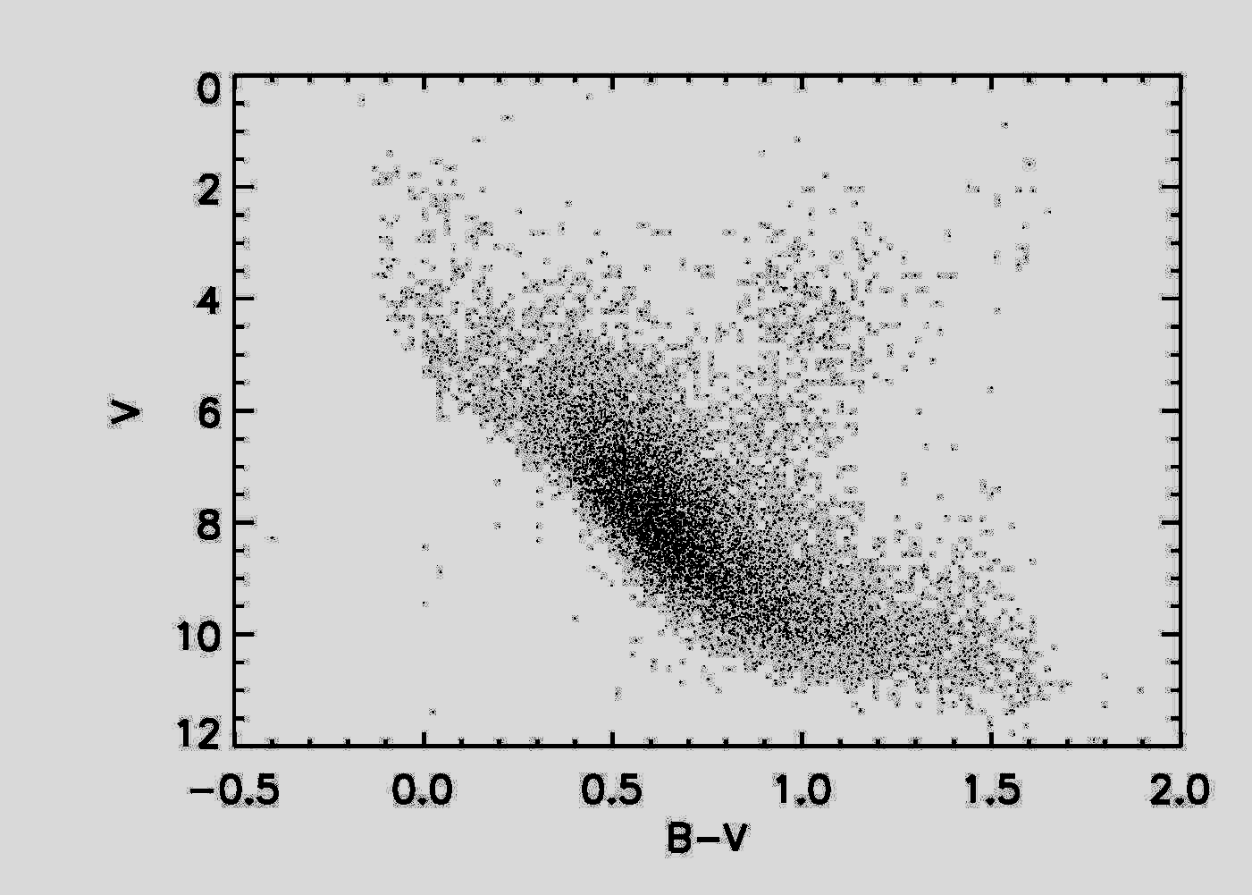
Color-Magnitude Diagram
Nearby stars (data from the Hipparcos satellite)
More Luminous
Absolute Magnitude
Less Luminous
Blue
Color
Red

Slide 15
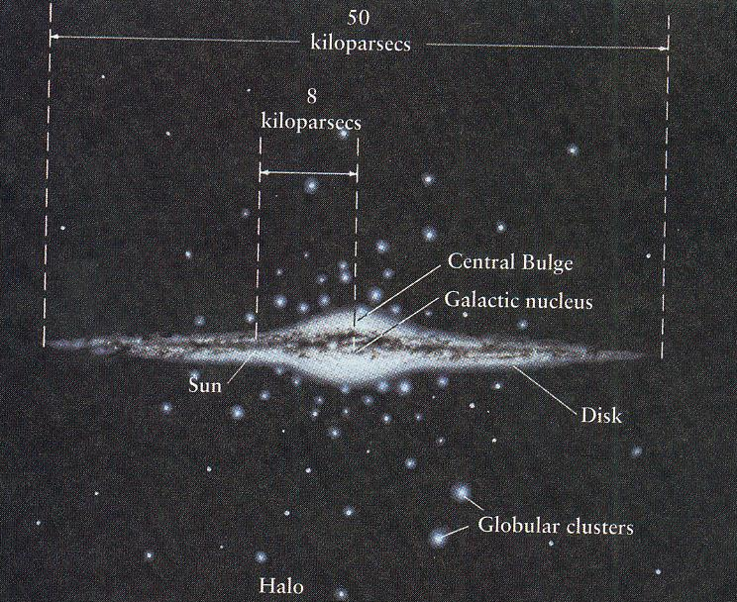
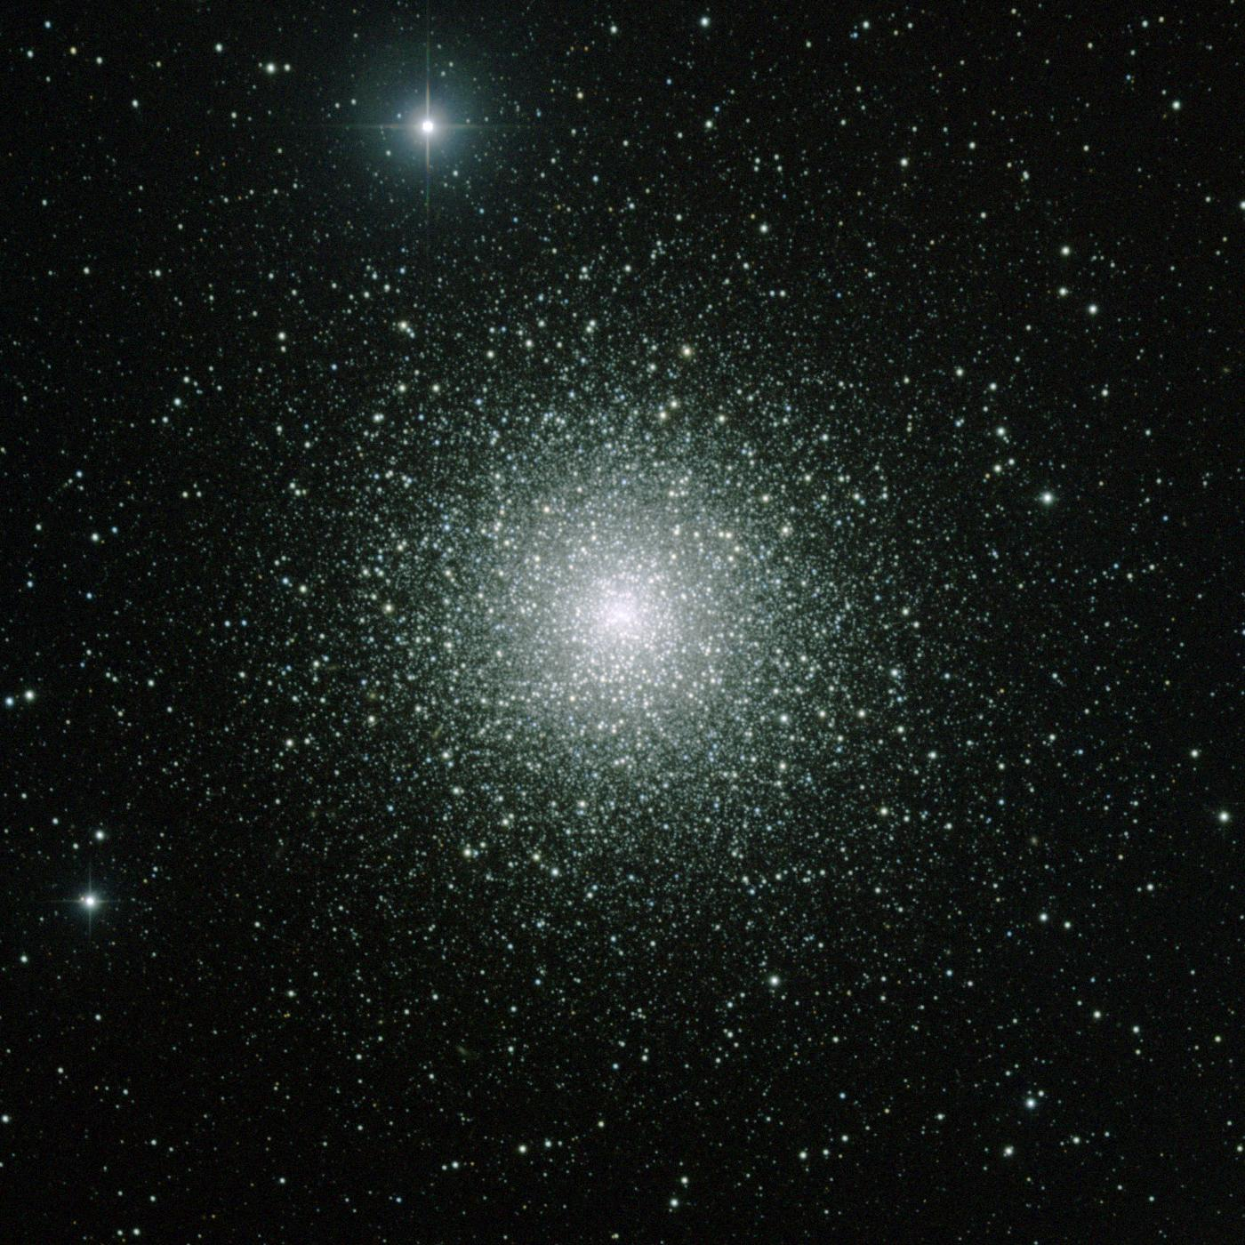
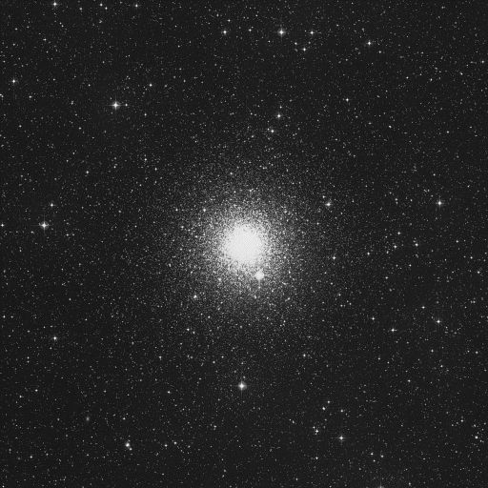
Globular Clusters
NGC 362
M15

Slide 16
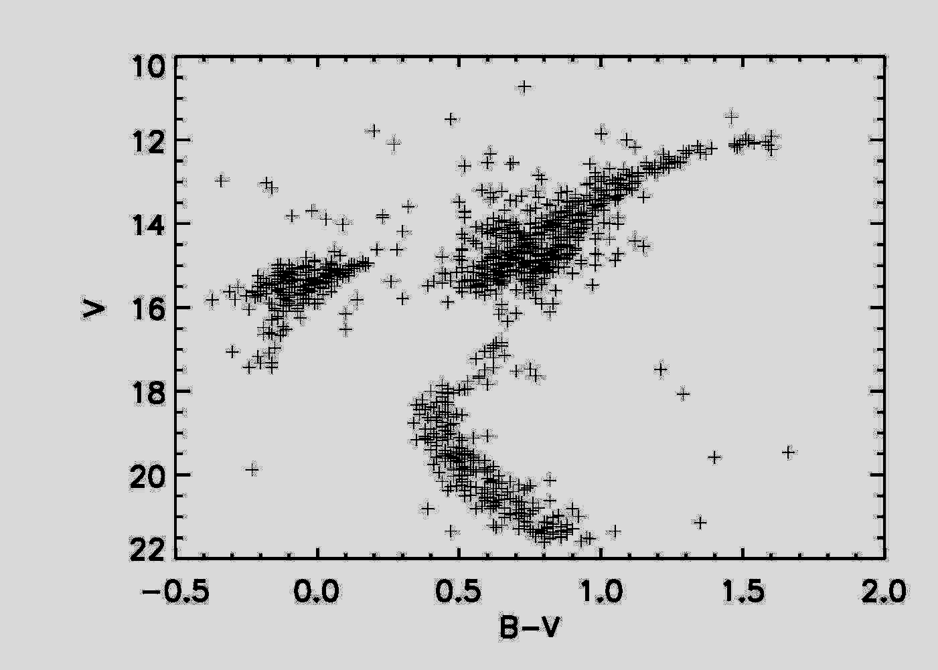
Color-Magnitude Diagrams of Globular Clusters
Nearby Stars
Globular Cluster M13

Slide 17
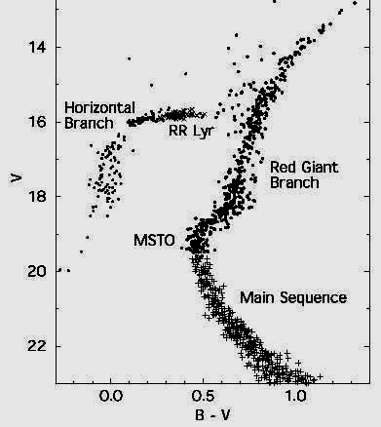
Another Globular Cluster: M15

Slide 18
Nuclear Fusion
Positron
Proton
Neutrino
Photon
Proton
Proton
Deuterium
Proton
Helium-3
Proton
Helium-4
Proton
Helium-3
Deuterium
Proton
Positron
Photon
Proton
Neutrino

Slide 19
Equilibrium in Main Sequence Stars
Gravity
Fusion

Slide 20
Equilibrium in Main Sequence Stars
Gravity
Fusion

Slide 21
Equilibrium in Main Sequence Stars
Gravity
Fusion

Slide 22
Equilibrium in Main Sequence Stars
Gravity
Fusion

Slide 23
Equilibrium in Main Sequence Stars
Gravity
Fusion

Slide 24
Supporting the Mass of the Star
Mass = M
Mass = 2M
2 times as much material to support

Slide 25
Supporting the Mass of the Star
Mass = M
Mass = 2M
2 times as much material to support
2 times the gravitational force on each particle

Slide 26
Supporting the Mass of the Star
Mass = M
Mass = 2M
2 times as much material to support
2 times the gravitational force on each particle
2-4 times more rapid rate of energy transport, loss through surface.

Slide 27
Supporting the Mass of the Star
Mass = M
Mass = 2M
2 times as much material to support
2 times the gravitational force on each particle
2-4 times more rapid rate of energy transport, loss through surface.
Luminosity = L
Luminosity ~ 10 L

Slide 28
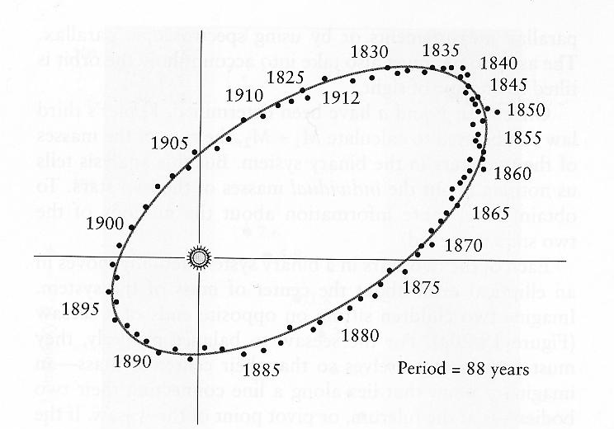
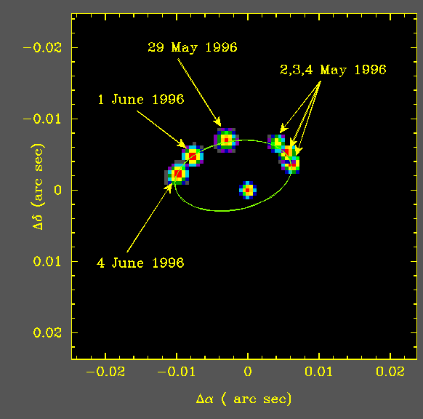
Mass Estimates from Binary stars
Mizar 1
70 Ophiuci

Slide 29
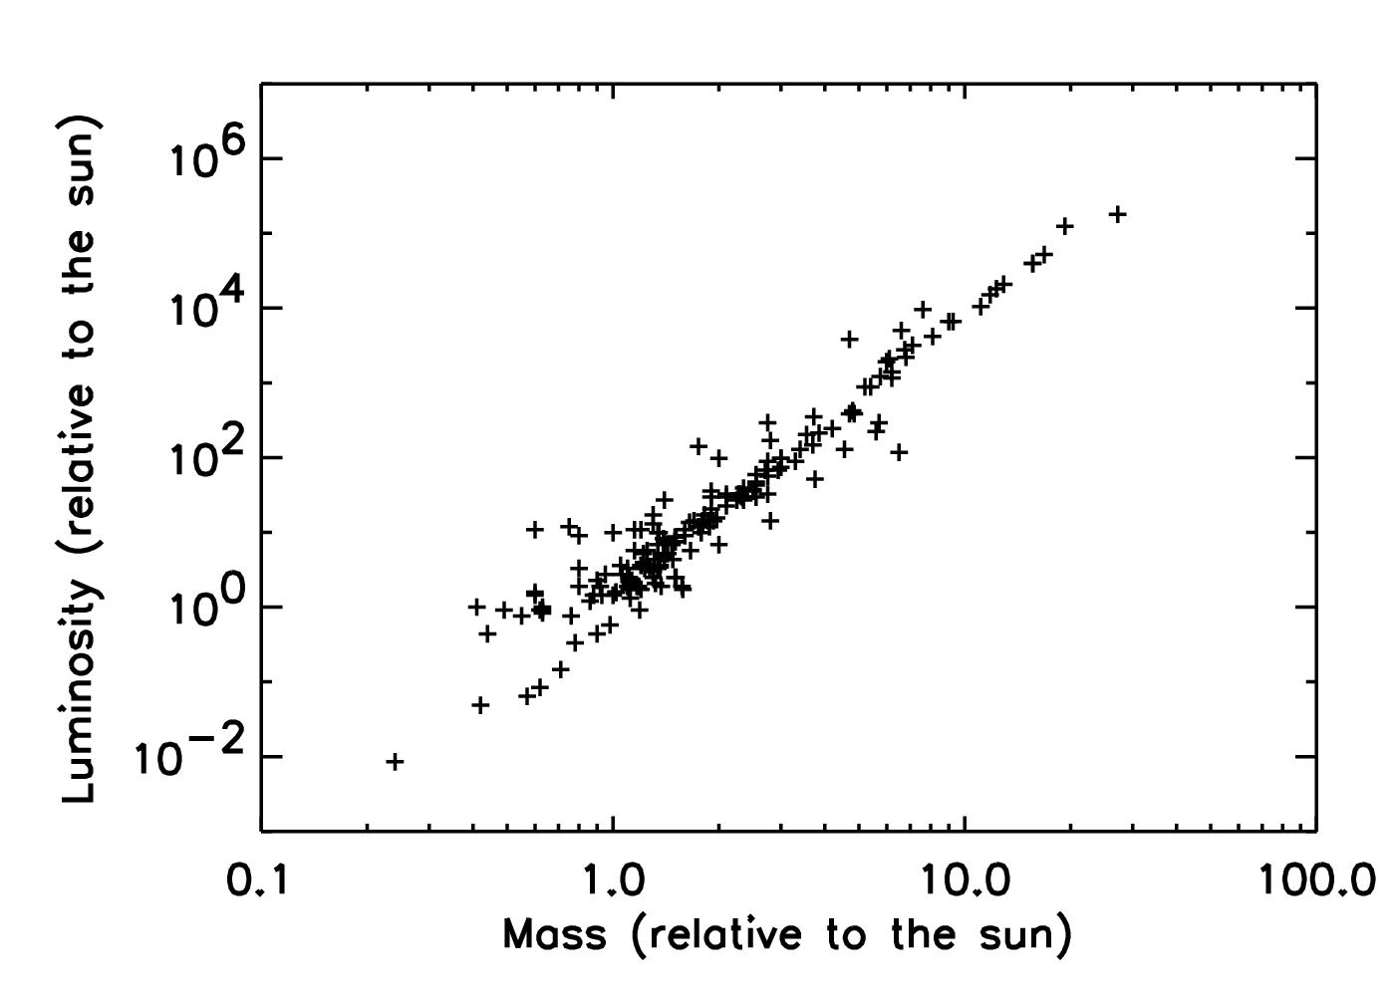
Mass-Luminosity Relation
1,000,000
10,000
100
1
0.01

Slide 30
Mass-Luminosity Relation
1,000,000
10,000
100
1
0.01

Slide 31
Main Sequence Lifetimes
1,000,000
10,000
100
Rate that Hydrogen atoms convert into Helium atoms
1
0.01
Total number of Hydrogen atoms
Time to convert all Hydrogen to Helium
150 billion years

Slide 32
Lifetime of a Main Sequence Star
Luminosity = 4 * 10²⁶ Watts
1.5 * 10¹⁷ kilograms/ Year
Mass = 2 * 10³⁰ kilogram
All Hydrogen would be converted to Helium in 150 billion years

Slide 33
The Schonberg-Chandrasekhar Limit
Helium has 4 times more mass than Hydrogen
Fusing H
Hydrogen
Helium
Helium undergoes fusion at much higher temperatures than Hydrogen
H + H → D D + H → He³ He³ + He³ → He⁴
He + He + He → C
He
H
As Helium accumulates in the core, it
becomes more and more difficult to support
A main-sequence star cannot maintain equilibrium if more than 10% of its total mass has been converted into Helium

Slide 34
Different Stars, Different Lifetimes
Mass = M
Luminosity = L
Lifetime = 10 Billion Years
Mass = 2M
Luminosity ~ 10 L
Lifetime = 2 Billion Years

Slide 35
Main Sequence Lifetimes
1,000,000
10,000
100
Rate that Hydrogen atoms convert into Helium atoms
1
0.01
Total number of Hydrogen atoms
Time to convert 10% of the Hydrogen to Helium
10 billion years

Slide 36
Main Sequence Lifetimes
1,000,000
10,000
100
1
0.01
Time to convert 10% of the Hydrogen to Helium
10 billion years
Time to convert 10% of the Hydrogen to Helium
2 billion years

Slide 37
The Changing Main Sequence
Time = 0 Billion Years

Slide 38
The Changing Main Sequence
Time = 1 Billion Years

Slide 39
The Changing Main Sequence
Time = 4 Billion Years

Slide 40
The Changing Main Sequence
Time = 13 Billion Years

Slide 41
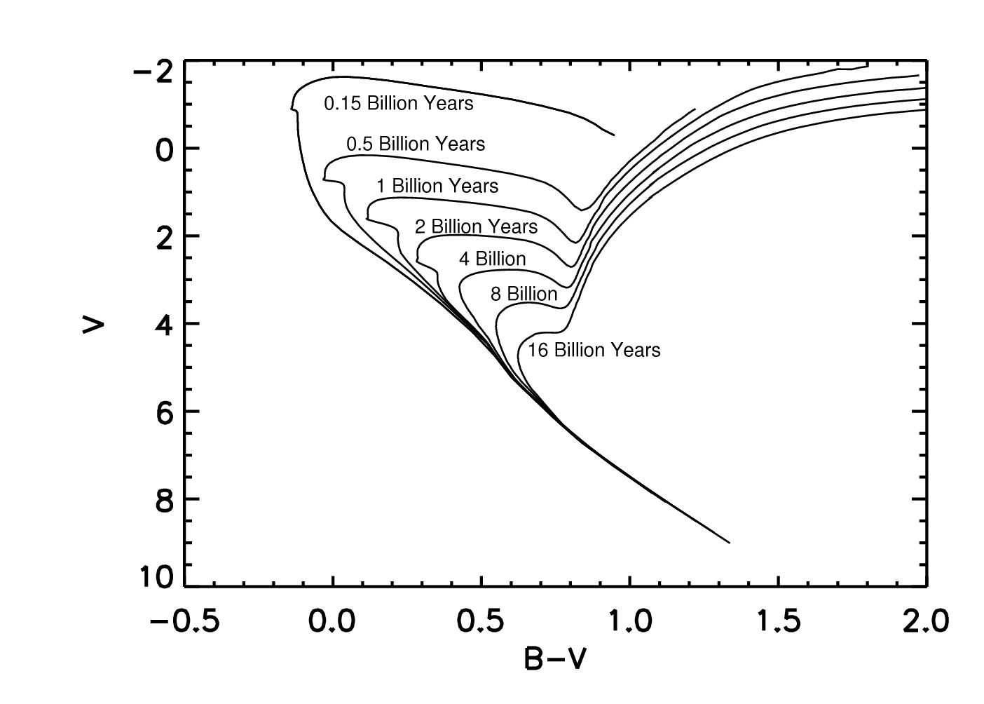
Measuring the Age of Globular Clusters

Slide 42
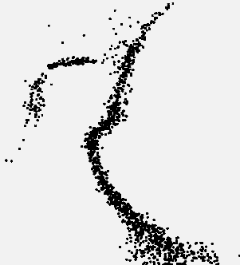
Measuring the Age of Globular Clusters

Slide 43
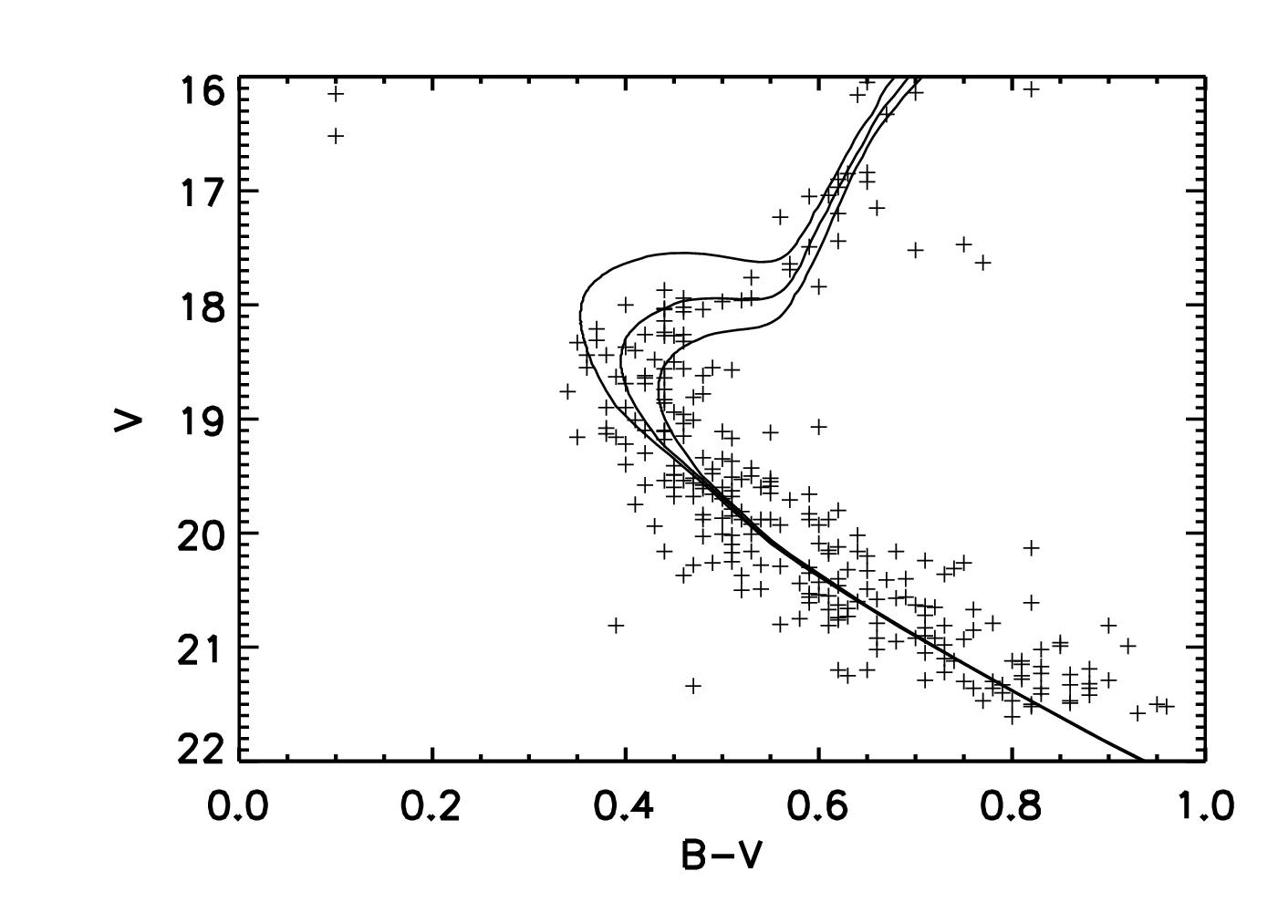
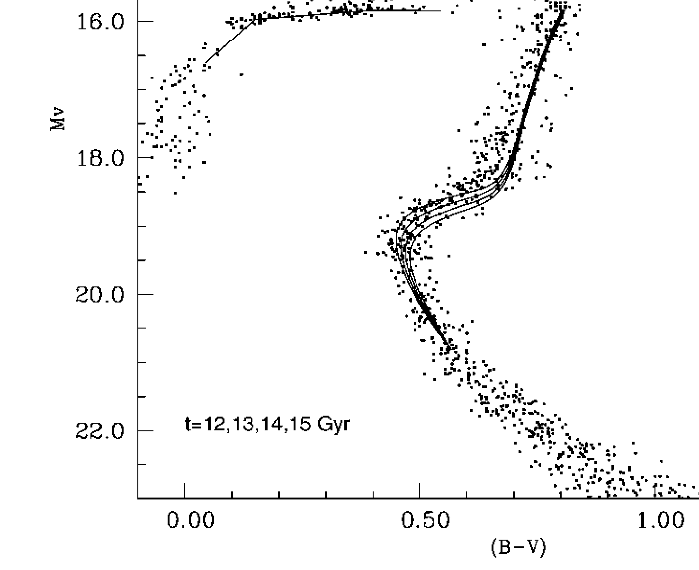
The Challenge of Measuring
Globular Cluster Ages
10 Billion Years
20 Billion Years
M13
12 Billion Years
V
15 Billion Years
M15
B - V

Slide 44
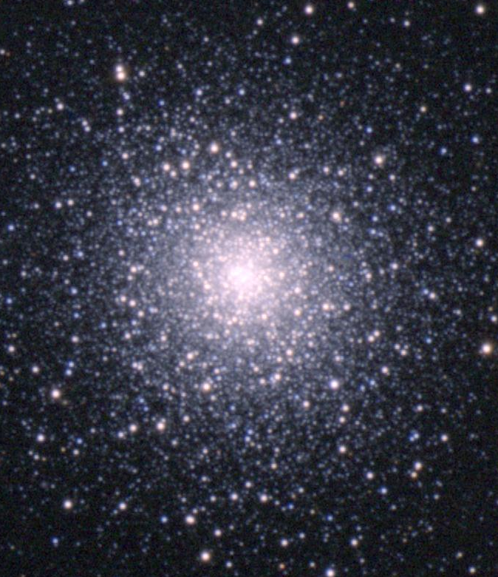
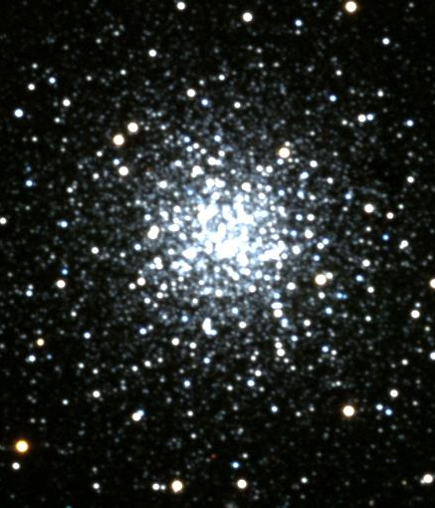
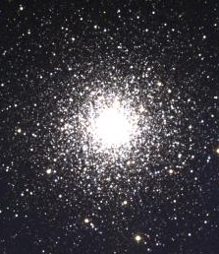
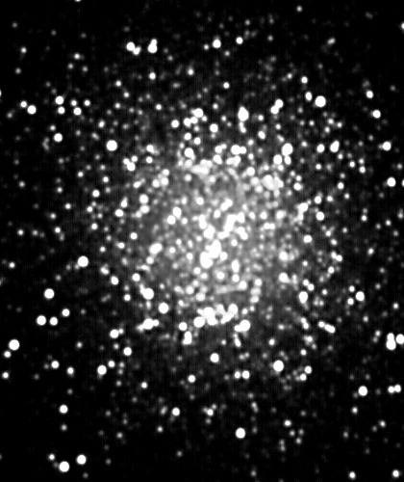
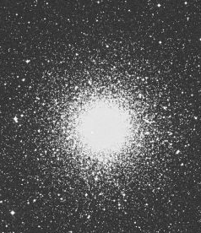
The Oldest Globular Clusters
11.5 ± 1.3 billion years 12 ± 1 billion years 11.8 ± 1.2 billion years 14.0 ± 1.2 billion years 12 ± 1 billion years
12.2 ± 1.8 billion years
Multiple analyses yield ages of
12 billion years, and an uncertainty of about
1 or 2 billion years
M92
M68
M30
M13
NGC362
NGC6752
Other methods yield similar ages

Slide 45
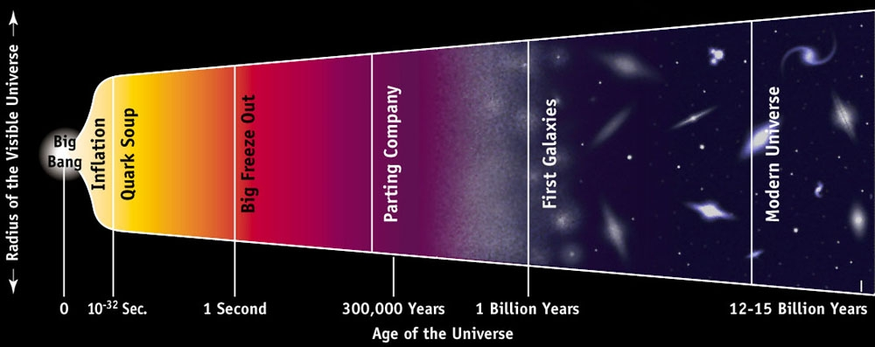
Next Time
The Age of the Universe

