Slide 1
Railway Management System
Data Flow Diagram
Group - 5

Slide 2
Context Diagram
0. Railway Management System
1. User Management
2. Administration
3. E-Ticketing
4. Information

Slide 3
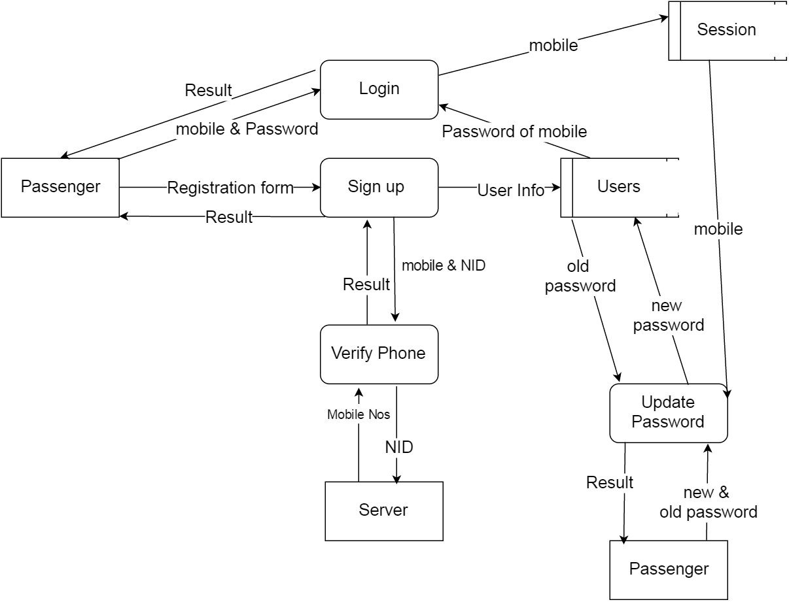
User Management Subsystem

Slide 4
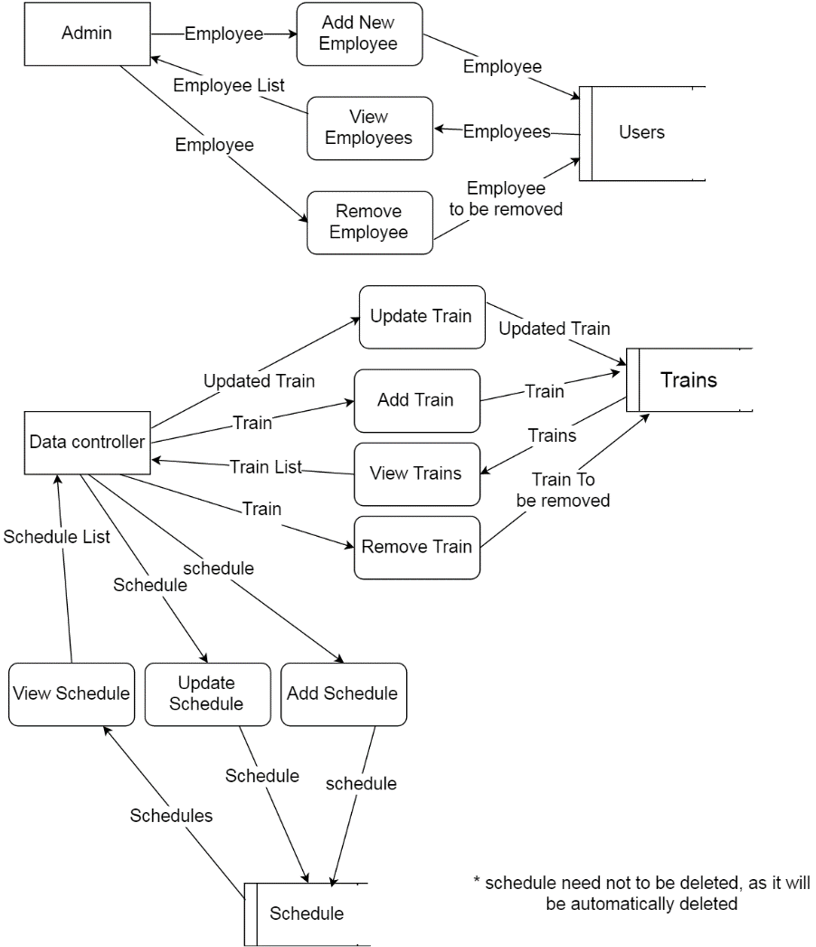
Administration Subsystem

Slide 5
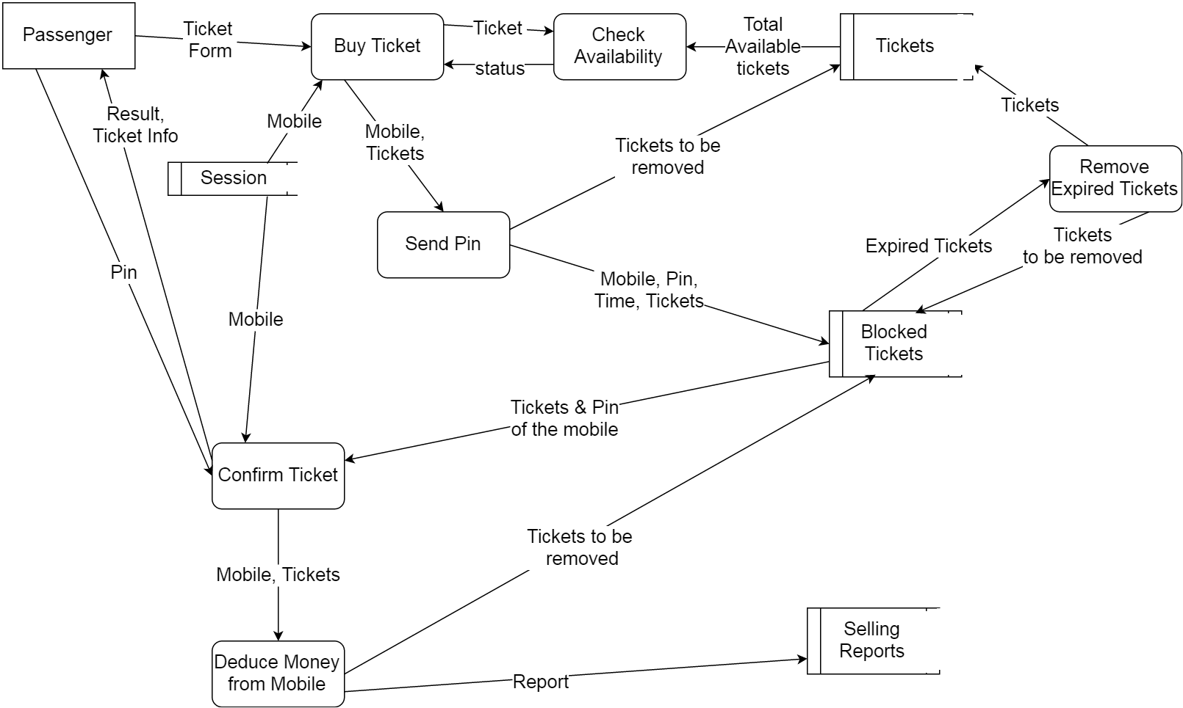
E-Ticketing Subsystem

Slide 6
Summary
Data Flow Diagram is a process model used to
Depict the flow of data through a system
The work or processing performed by the system
We have 4 subsystems
Presented Data Flow Diagram of 3 subsystems
Explained how data flows from one entity to another

Slide 7
Thanks for your attention Any Question?

