Slide 1
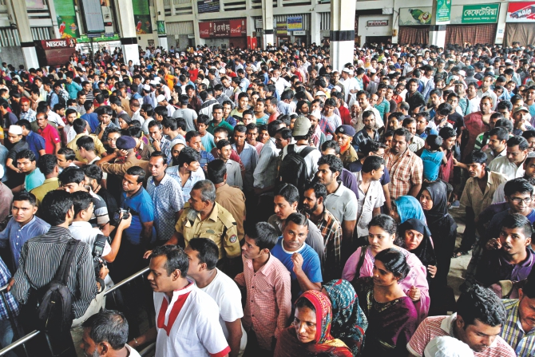
Railway Management System
Why the line is not moving !!!

Slide 2
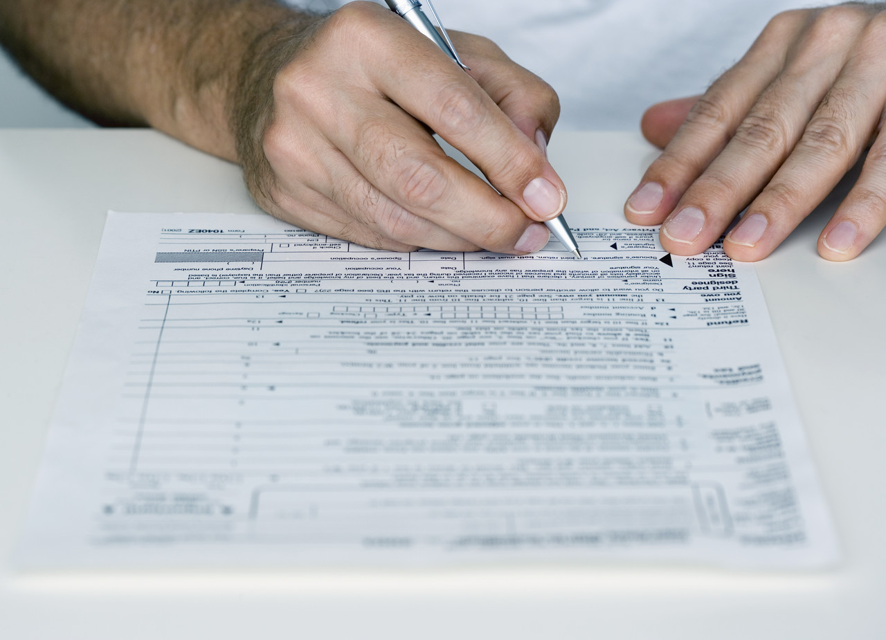
Too Slow . . . . .

Slide 3
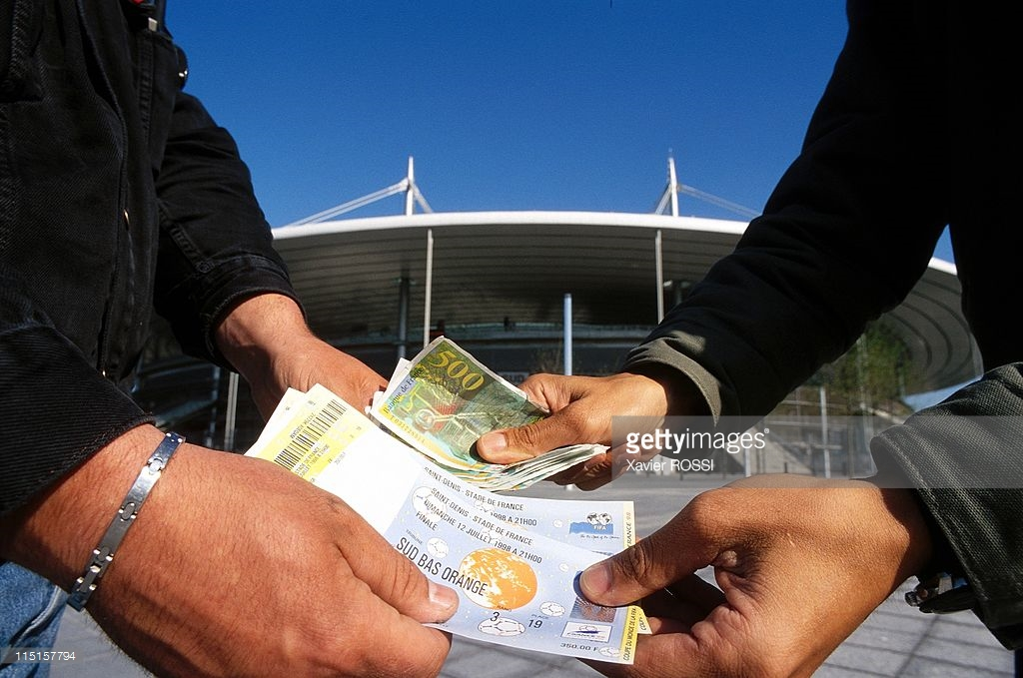

Slide 4
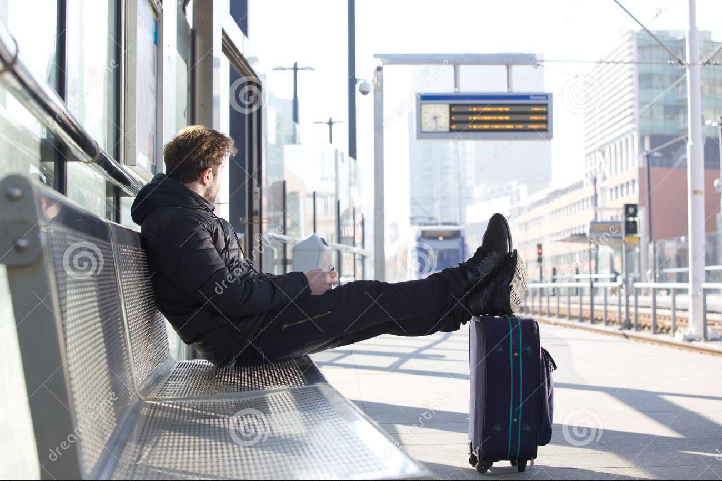
The waiting never ends……..

Slide 5
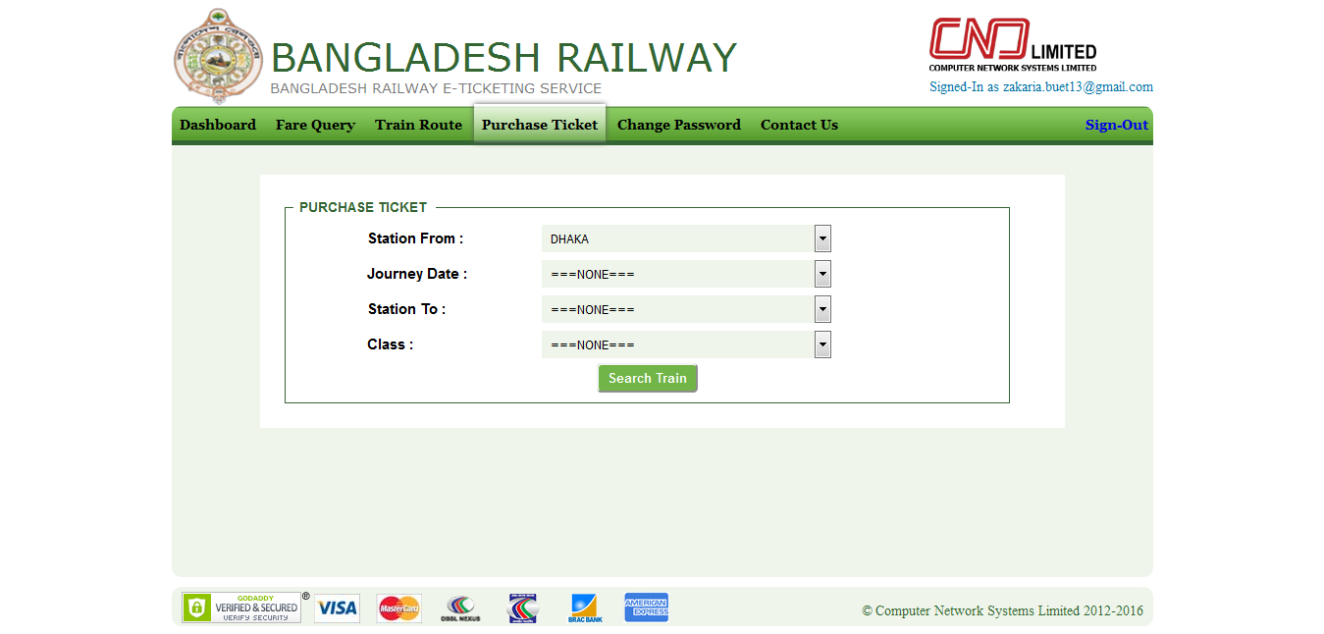
Black Marketing
Collect ticket Physically
Good Enough?
Only few tickets

Slide 6
Problems
Harassment for Ticket
Missing Schedule
Black Marketing
Internal Management

Slide 7

How to solve these problems?

Slide 8


Just One Click!

Slide 9



Slide 10


Slide 11
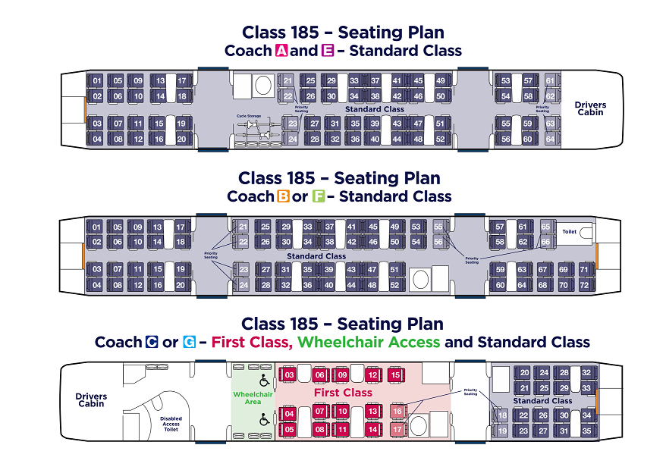
Book Seats ONLINE
Limited seats per person

Slide 12

Digitalize the Station

Slide 13
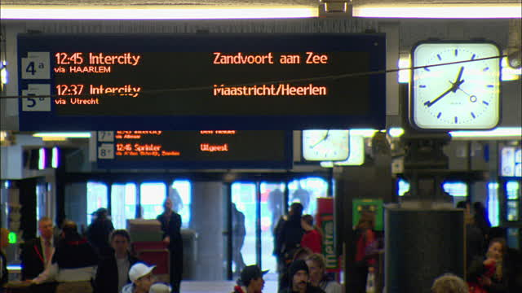
GPS SYSTEM

Slide 14
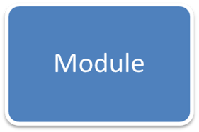
Summing-up
System
Harassment for Ticket
Black Marketing
Missing Schedule
Internal Management
Online Booking
Mobile & NID Verification
GPS

Slide 15

Questions

Slide 16
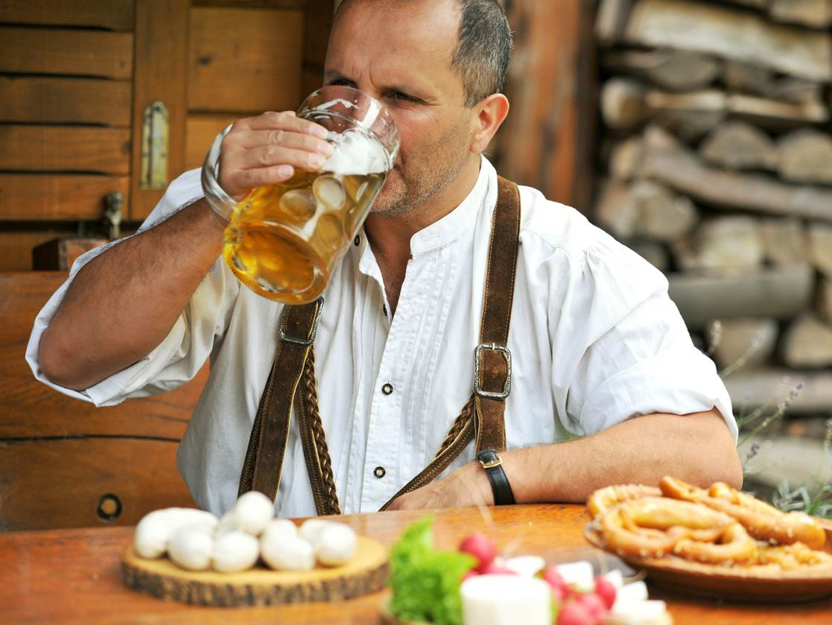
Thank you - Enjoy the rest of your day

