Slide 1
Railway Management System

Slide 2
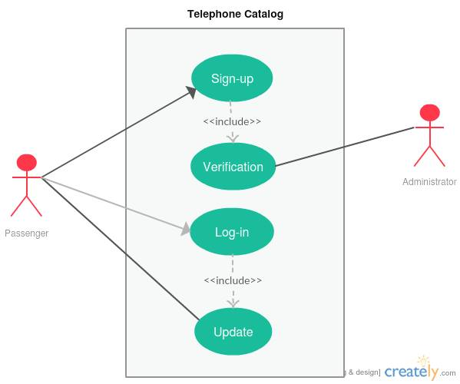
1.User Manipulation : Account Verification

Slide 3
1.User Manipulation : Account Verification
Use Case Name: | Account Verification
Priority: | High
Primary Actor: | Passenger
Secondary Actor: | Govt. Database of NID
Precondition: | The individual submitting the information must have NID number and verified mobile number.
Trigger: | This use case is initiated when a Sign Up is submitted.
Description: | When a user tries to sign up this case occurs to verify whether he has given all the correct information or not.

Slide 4
1.User Manipulation : Account Verification
Typical Course of Events:
Actor Action | System Response
Step 1 : User will provide NID number and mobile number along with some other information. | Step 2 : System will check the validity of the NID. Step 3 : System will then check whether the mobile number is registered with the NID or not. Step 4 :If all the above steps are done successfully then a auto generated code will be sent to the mobile number which the user have to enter into the signup window within 2 minutes.

Slide 5
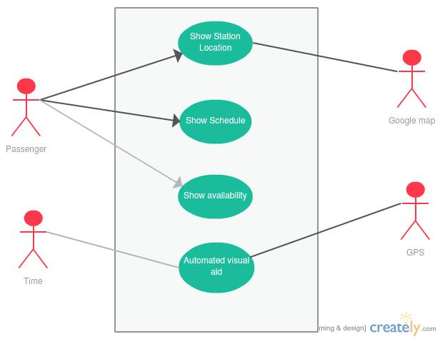
2.Information : Automated Visual Aid

Slide 6
2.Information : Automated Visual Aid
Use Case Name: | Automated Visual Aid
Priority: | High
Primary Actor: | Time
Secondary Actor: | GPS System
Precondition: | None
Trigger: | None
Description: | The current location of all the trains and how much time is needed to reach the station is being showed in a Television screen which is automatically updated with the information of GPS system installed within the trains.

Slide 7
2.Information : Automated Visual Aid
Typical Course of Events:
Actor Action | System Response
Step 1 : After 2 minutes the monitor screen will automatically be refreshed. | Step 2 : The system will get the current location of each train and the speed. Step 3 : Then it will calculate the approximate arrival time of a specific train I a specific station. Step 4 :Then the data will be sent to the visual aid for the passengers on the station.

Slide 8
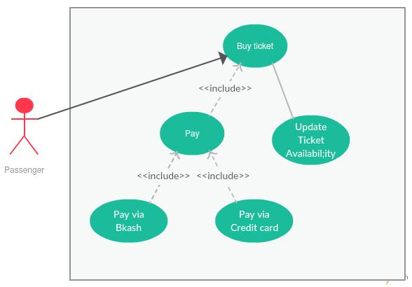
3.E Ticket : Purchase Ticket

Slide 9
3.E Ticket : Purchase Ticket
Use Case Name: | Purchase Ticket
Priority: | High
Primary Actor: | Passenger
Secondary Actor: | None
Precondition: | The passenger must have logged into a valid user account.
Trigger: | This use case is initiated when a buy ticket request is submitted.
Description: | When a passenger clicks to buy a ticket the internal database will verify whether he has bought more than 8 tickets in the current month and will restrict one user to 4 tickets at one time per NID.

Slide 10
3.E Ticket : Purchase Ticket
Typical Course of Events:
Actor Action | System Response
Step 1 : Passenger specifies the route and ticket class. | Step 2 : System checks whether ticket is available. Step 3 : If available then checks whether the passenger has purchased 8 or more tickets. Step 4 : If not then system automatically charges money through credit card or bKash Step 5 : A send of the ticket is send to the email address of the passenger in pdf format having a Auto generated serial number

Slide 11
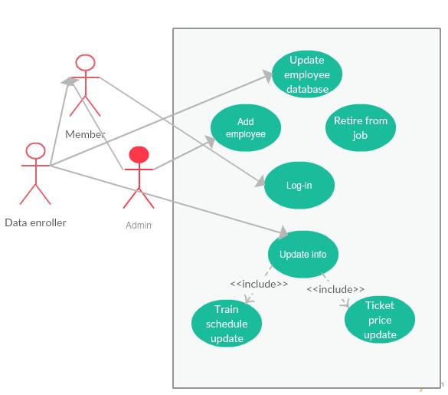
4.Administration : Update Info

Slide 12
4.Administration : Update Info
Use Case Name: | Update Info
Priority: | Medium
Primary Actor: | Data Enroller
Secondary Actor: | None
Precondition: | User must have logged in an admin or data enroller account.
Trigger: | None
Description: | The information about the fair of the ticket fare and the scheduling of the trains can change over time. This case will handle those.

Slide 13
4.Administration : Update Info
Typical Course of Events:
Actor Action | System Response
Step 1 : Data enroller enters if any ticker price or train schedule is changed over time. | Step 2 : The system verifies the authority of the data enroller. Step 3 : If verified then the system waits for the approval of the admin. Step 4 : If admin approves then the system automatically updates the database holding these information. Step 5 : In the website the changes are showed via notification to the corresponding passengers.

Slide 14
Thank You

