Slide 1
Subsystems
User manipulation subsystem
Information subsystem
Online ticketing subsystem
Administration subsystem

Slide 2
Glossary for User Manipulation Subsystem
Use case name | Actors | Description
Sign up | Passenger | This use case describes the event of creating a new account for the passenger.
Log in | Passenger | This use case describes the event of entering in an existing account.
Account Verification | NID server | This use case describes the event of verification of mobile number against NID and other verification while creating an account.
Update information | Passenger | This use case describes the event of updating account information.

Slide 3
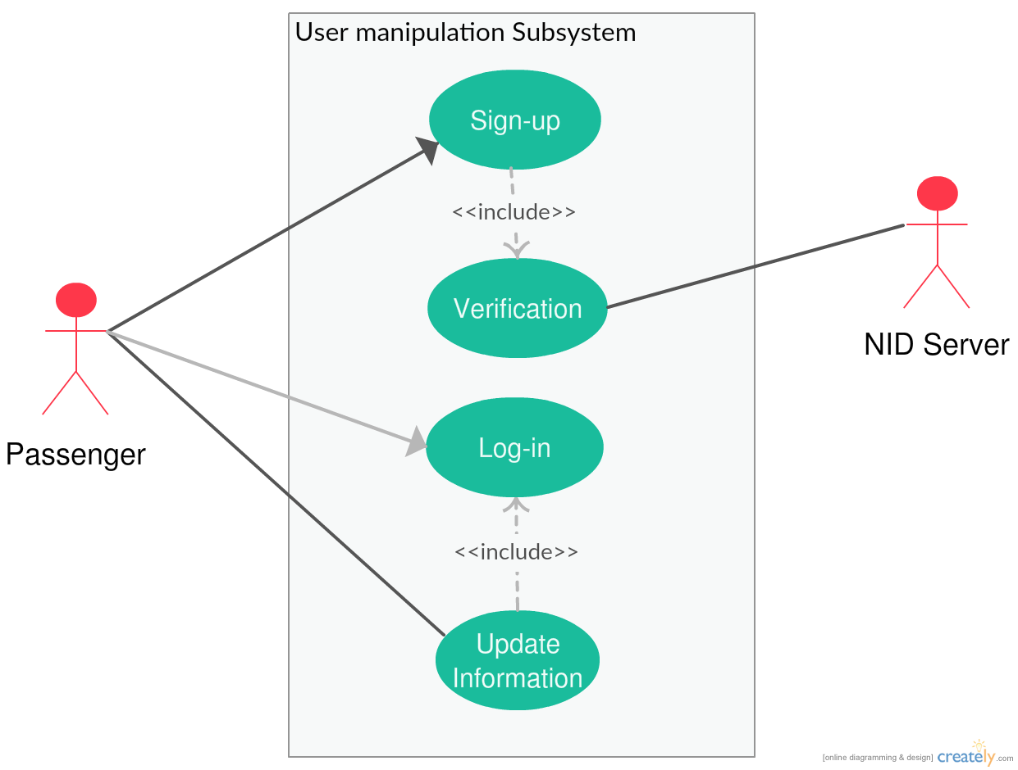
Use case diagram for User manipulation Subsystem

Slide 4
Glossary for Information Subsystem
Use case name | Actors | Description
Show station location | Passenger(Primary) Google map | This use case describes the event of showing exact station location via google map.
Show schedule | Passenger | This use case describes the event of entering in an existing account.
Show availability | Passenger | This use case describes the event of verification of mobile number against NID and other verification while creating an account.
Automated visual aid | Time(Primary) GPS | This use case describes the event of updating account information.

Slide 5
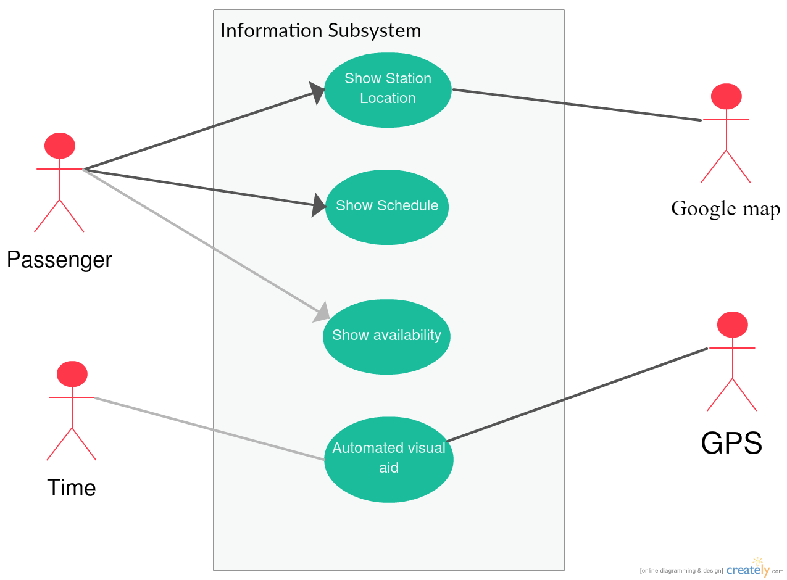
Use case diagram for Information Subsystem

Slide 6
Glossary for Online Ticketing Subsystem
Use case name | Actors | Description
Buy ticket | Passenger | This use case describes the event of buying ticket.
Pay |  | This use case describes the event of paying for ticket .
Pay via Bkash |  | This use case describe the event of make payment for tickets via Bkash.
Pay via Credit card |  | This use case describe the event of make payment for tickets via credit card.
Update ticket availability |  | This use case describes the event of updating available ticket information after selling ticket.

Slide 7
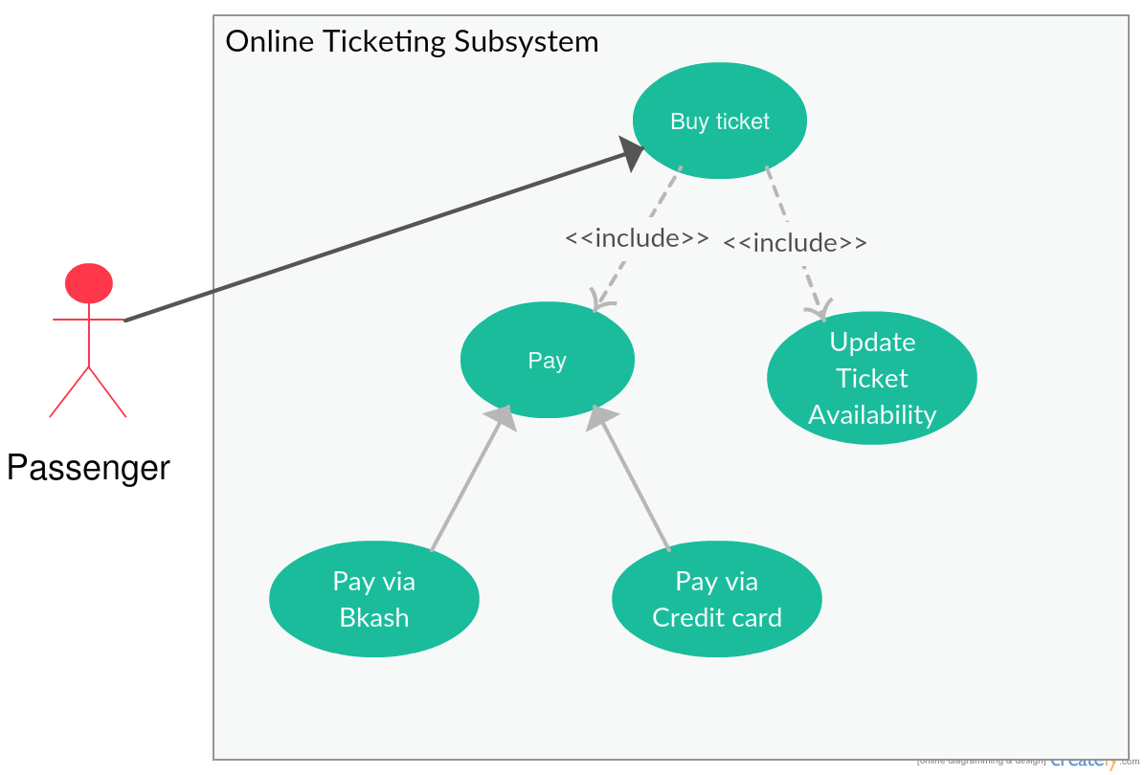
Use case diagram for Online Ticketing Subsystem

Slide 8
Glossary for Administration Subsystem
Use case name | Actors | Description
Update employee database | Database controller | This use case describe the event of updating employee information.
Add employee | Admin | This use case describe the event of recruiting new employee .
Retire from job |  | This use case describe the event of updating database if an employee retires .
Log in | Member | This use case describe the event of Log into account for employee.
Update information | Database controller | This use case describe the event of Updating various information about train.
Train schedule update |  | This use case describe the event of updating train schedule.
Ticket price Update |  | This use case describe the event of Updating ticket price.

Slide 9
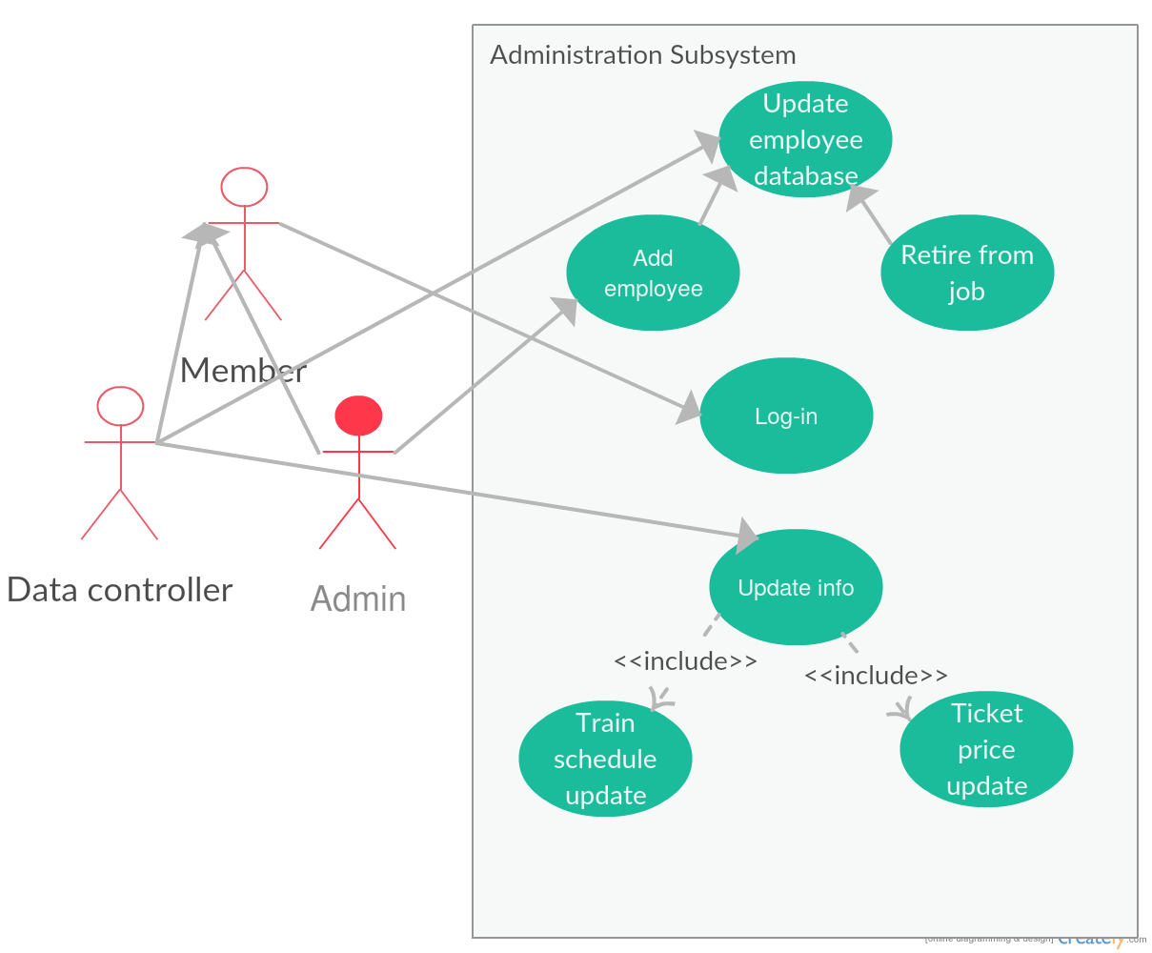
Use case diagram for Administration Subsystem

