Slide 1


Developing a distributed processing cloud platform using Fully Homomorphic Encryption
Scientific coordinator:
Lecturer Ph.D. Andrei TOMA
Graduate:
Mihai TURCU
Notes:
Good day. The goal of my dissertation paper is to prove the technological viability of developing a distributed processing cloud platform using Fully Homomorphic Encryption. The scientific process was coordinated by Mr. Andrei Toma.

Slide 2
Overview
Problem formulation
Solution architecture
Solution implementation
Conclusions

Slide 3




1.
Problem formulation
Cloud privacy & Cloud processing conflict
Notes:
So first up is the problem formulation, where cloud privacy is tackled in conjunction with Fully Homomorphic Encryption.

Slide 4





Cloud processing
Flawed from the start
User uploads data => decryption necessary for processing
FHE safeguards data during processing
Notes:
Well, cloud processing was flawed from the start. This is because, in order to use analytics on data, it must be in a plaintext format. This puts sensitive classes of data, such as financial or health data, at risk.
Fully Homomorphic Encryption solves this by keeping data encrypted at all times, which means at rest, in transit, and, uniquely so, during processing. This can happen because, in order to process data, you only need access to the public key. Therefore, the only person that is able to decrypt the data is the owner that has access to the secret key. This works well in an outsourced computation paradigm.

Slide 5

2. Solution Architecture
Actors & modules
Notes:
Ok, so the solution architecture. I’ll present the actors and modules of the system.

Slide 6
What is Breadwinner?
Secure distributed & outsourced processing cloud platform
Uses Fully Homomorphic Encryption to solve cloud privacy & processing conflict
Offers alternative web monetization scheme
Notes:
Breadwinner is a secure outsourced processing cloud platform, which uses Fully Homomorphic Encryption as a means of protecting data throughout its entire lifecycle, including while it’s being processed.
In short, it allows clients to upload data to be processed in a secure way, according to some operations that they choose, and the actors that provide the processing infrastructure get paid for it.
It nourishes a positive loop between the users of the system. This creates financial opportunities which may be used instead of or alongside advertisements.

Slide 7
Actors
Data suppliers – desire cloud storage & processing
Data processors – looking for an alternative monetization scheme for their website
Website visitors – offer devices as infrastructure
Notes:
So first we have the data suppliers, which want to upload data and process it via a complex computational pipeline in a secure and performant way.
Then we have the data processors, who are website owners are looking for an alternative monetization scheme for their website. By partnering with the Breadwinner system, they embed a web module within their website, and then the devices of their website visitors will process a data chunk every 10 minutes, let’s say. At the end of the week, the data processors get paid for all the chunks that they have processed.
Lastly, the website visitors. Instead of being bombarded with ads, their device silently processes data chunks so that they may enjoy a more peaceful browsing experience.
As you can see, the system is beneficial to everyone.
The system is also highly scalable, thanks to the large number of devices available on the Internet.

Slide 8
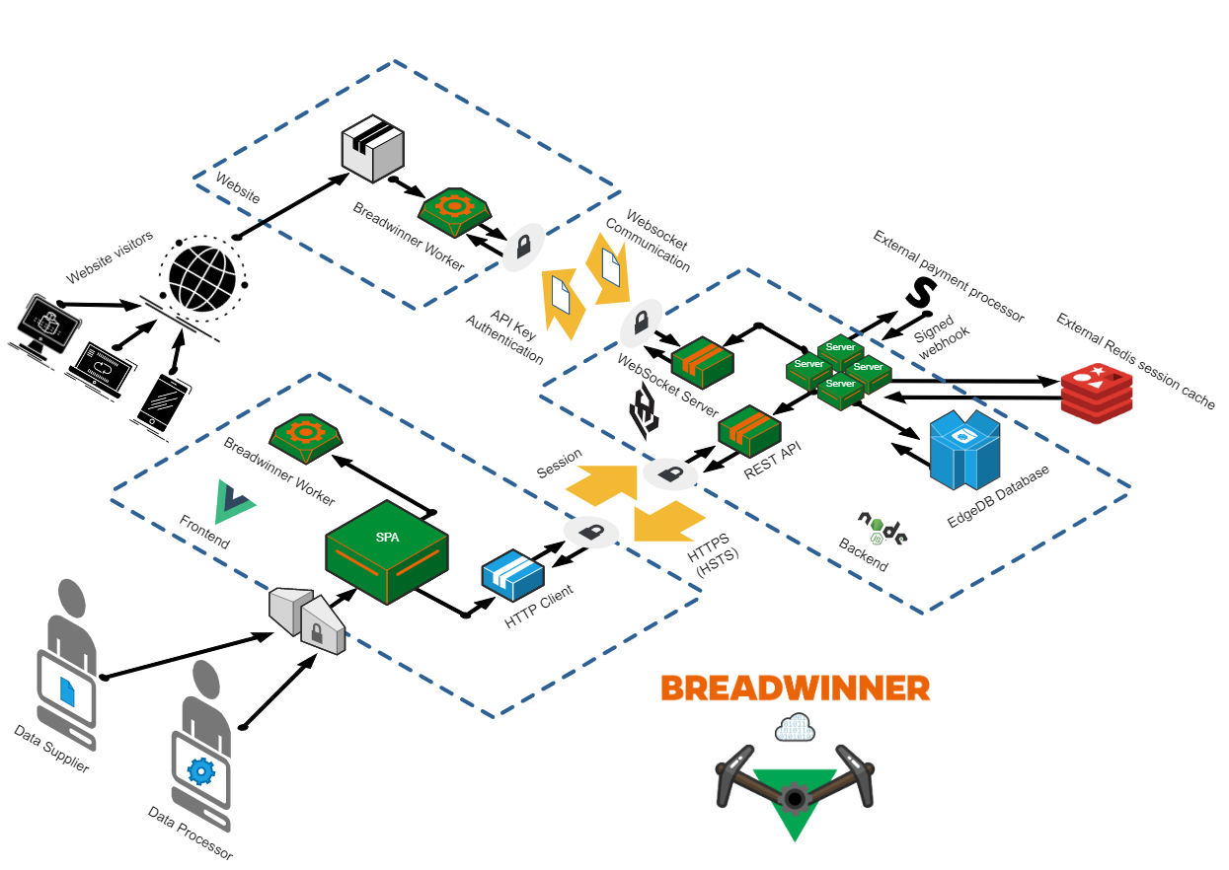
Notes:
In terms of architecture, we have 3 main modules.
The heart of the system is the web module, which is embedded into partnered websites. It manages the WebSocket connection to the backend and processes data received from it. Most of it lives on a background thread, and therefore it does not impact the browsing experience.
The second module is the frontend. It directly interfaces with the human actors of the system, the Data Suppliers and Data Processors. It allows them to perform operations such as configuring their account, uploading data and issuing API keys for their website.
The last module is the backend, which orchestrates the data processing and communicates with third-party services such as Stripe, through which payments are fulfilled.

Slide 9
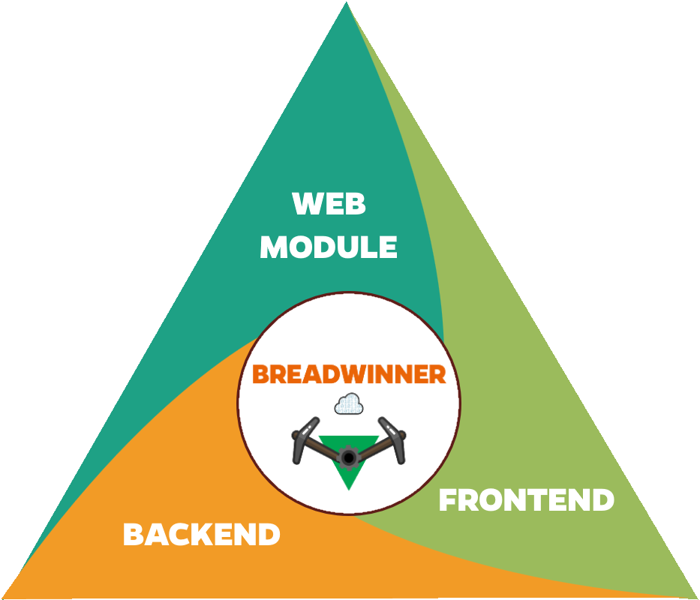
3. Solution implementation
Notes:
I’ll briefly go over the technology stack of the system.

Slide 10
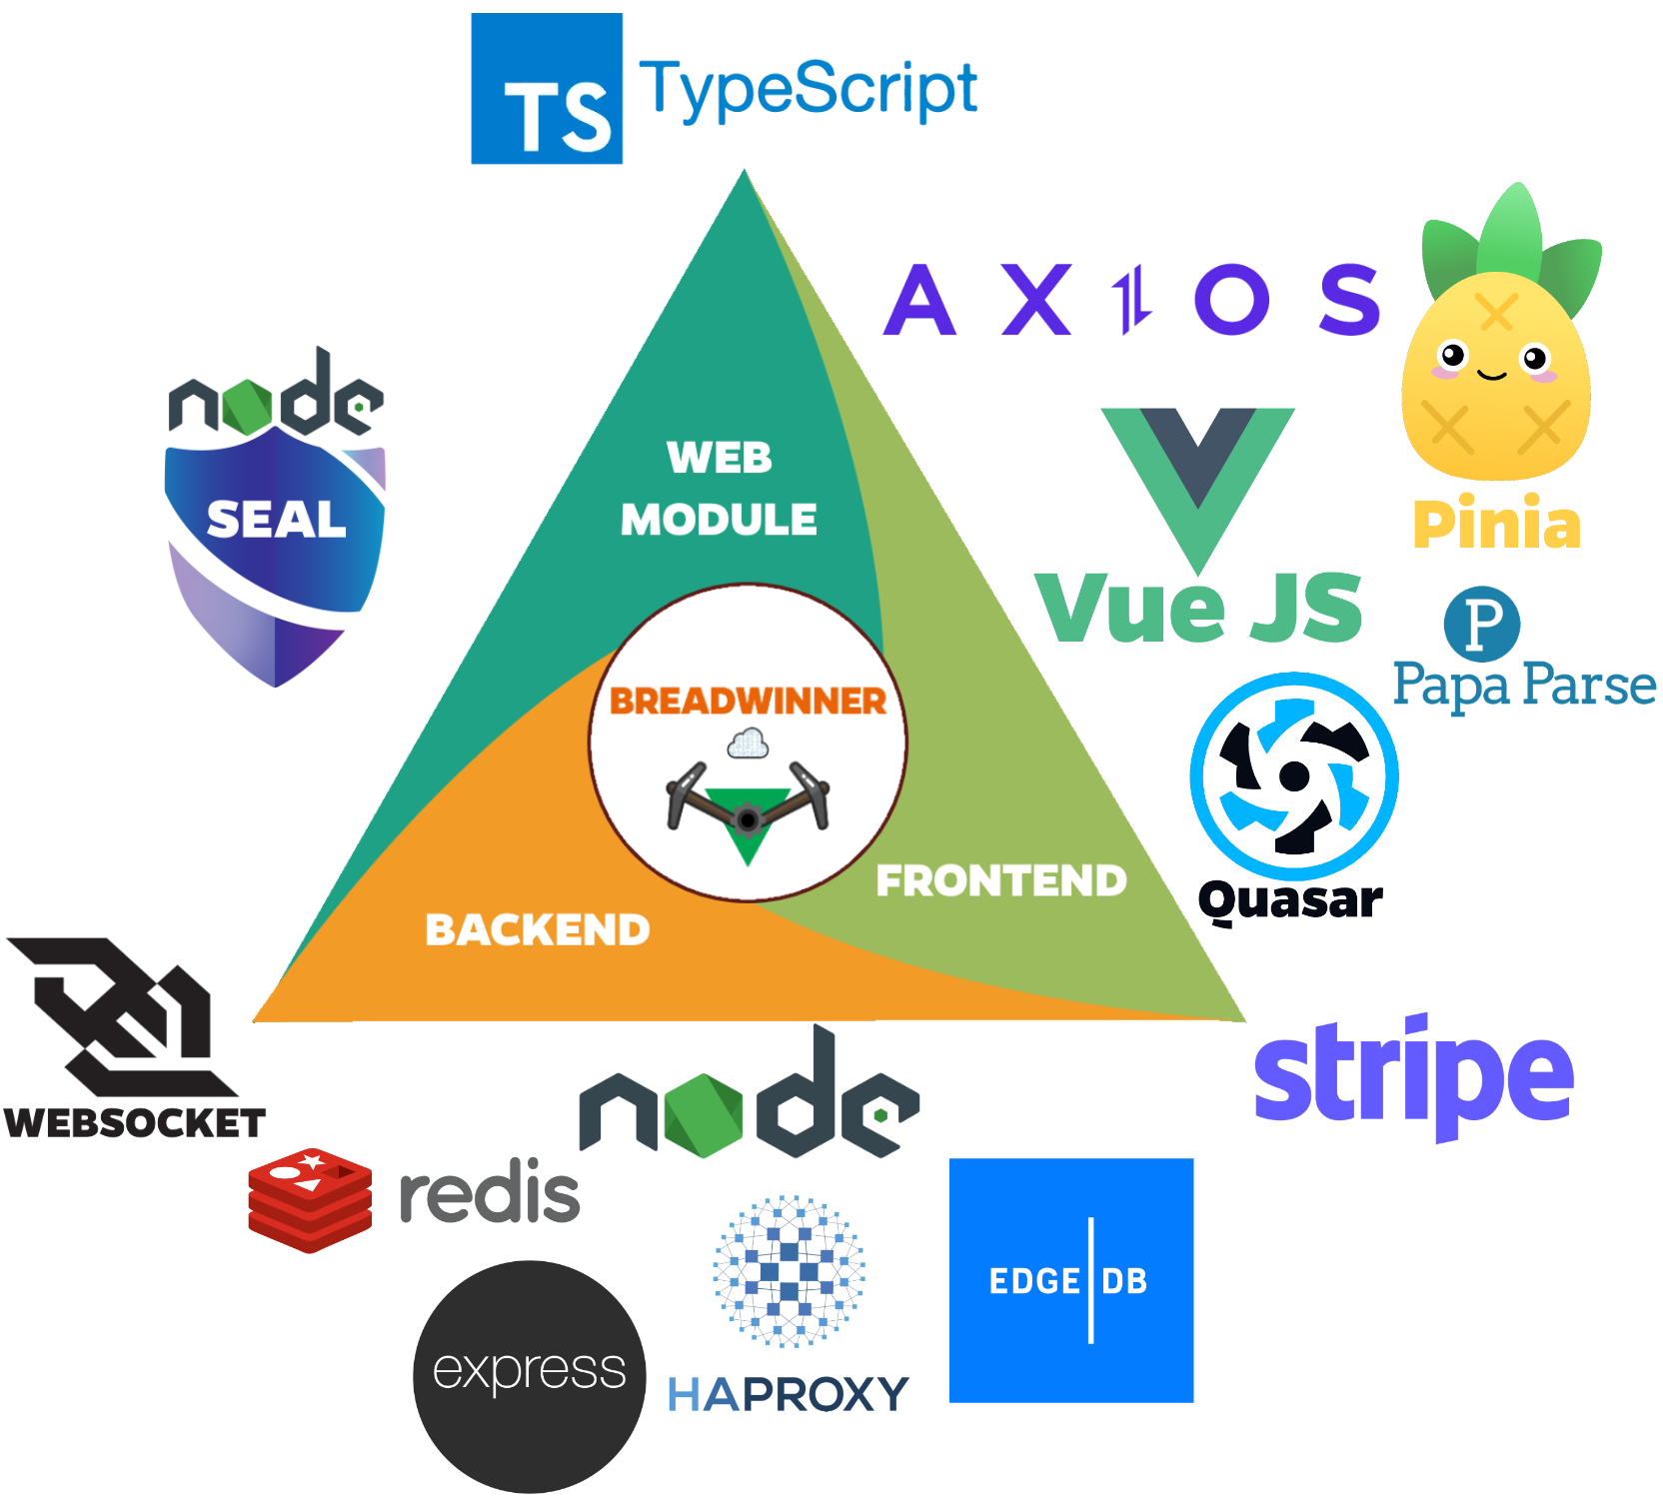
Notes:
All of the modules are written in TypeScript, which is strongly typed and helps in scaling up the codebase and preventing some bugs.
Ok, for the web module, the only dependency is the Node SEAL library, which offers FHE scheme implementations. It’s written in WebAssembly, so it’s portable and usable within a web context.
The backend uses the Node JS runtime. It exposes a REST API by using express, and it communicates with the web module via WebSocket connections. Session data is stored in an in-memory Redis cache, to allow for quick retrieval. The database of choice is EdgeDB. It’s a new graph-relational database that also provides a typesafe query builder, which is performant. Finally, the backend uses the HAProxy load balancer to be able to scale and run multiple instances of the server.
The frontend module is written in Vue JS, whose main benefit is the powerful reactivity system it offers.
The computer system interacts with Stripe in order to process payments. Data suppliers are requested to pay for the data payloads they upload, and data processors get paid for the data chunks processed by their website visitors.
This happens automatically, so the system basically runs itself.

Slide 11
Security considerations
Confidentiality – FHE, TLS, Access Control (Sessions), Argon2
Integrity – TLS, FE & BE validations, tokens when sending data chunks to web modules
Availability – Load balancing, Internet devices as infrastructure
Notes:
I’ll briefly cover the CIA triad.
For confidentiality we rely on FHE to encrypt data, but also TLS to encrypt the communication between frontend and backend, thanks to HTTPS, but also between web modules and backend, thanks to WSS.
The platform has strong access control validations implemented within. For instance, the backend only allows users to access their resources, based on their associated session.
Argon2 is a password hashing and salting algorithm recommended by OWASP.
In terms of integrity, TLS ensures it through message digests. Validations are implemented both on FE and BE. Lastly, when a data chunk is sent from backend to a web module, it is accompanied by a random token that is verified upon receiving the output, this pattern does not allow for unsolicited outputs.
For availability, the main way in which this is achieved is through load balancing the servers. Additionally, since the Internet provides plenty of devices that can do processing, it adds fault tolerance.

Slide 12
Conclusions
Technical viability of secure outsourced processing has been proven
Limitation – verifiable computation (ongoing research)
Economic viability of the platform – left as future work
Fully Homomorphic Encryption – evolving and preparing for the future (Hardware acceleration, quantum)
Notes:
In conclusion, the technical viability of the project has been proved.
However, there are some remarks.
There is a limitation to the platform, in the form of verifiable computation. This means that there exist no practical means to verify, with a trivial amount of effort, that someone performed exactly the operations that you instructed them to on the data. There is, however, ongoing research in the ecosystem, and I’ve covered a framework for ring arithmetic which aims to fix this.
The economic viability of bringing the platform to the real world is left as future work, as there should be thorough research on several factors such as hosting prices, storage prices, but also the ability to compete with advertisements as a monetization scheme.
Fully Homomorphic Encryption is an emerging domain which is constantly improving its performance. It definitely has the potential to revolutionize the Internet security paradigm., and, with time, it may also be shown if it can withstand the quantum test.

Slide 13



Thank you!
Questions?
Notes:
Now, before we move on to the live demo of the application, I would be glad to answer any questions that you may have.

