Slide 1
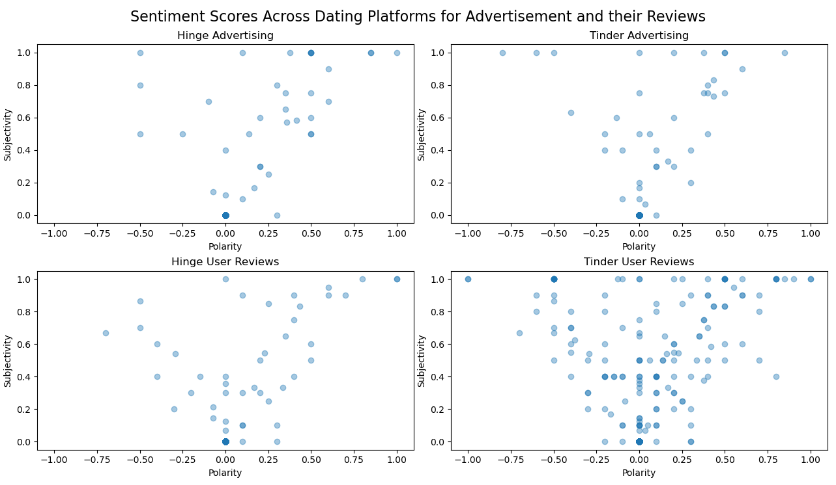
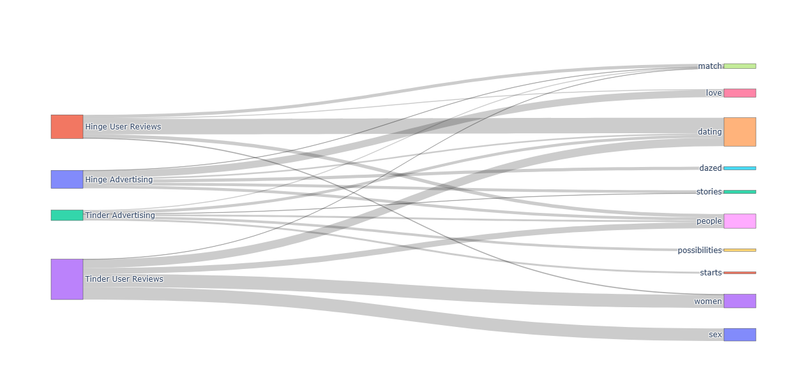
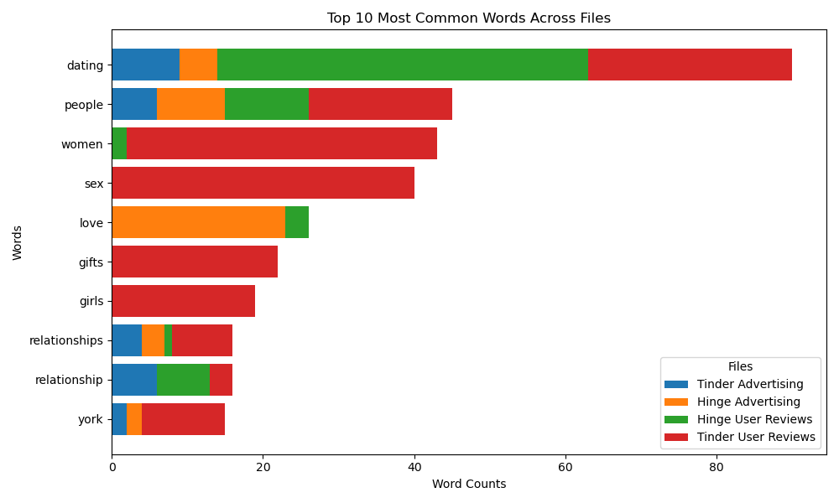
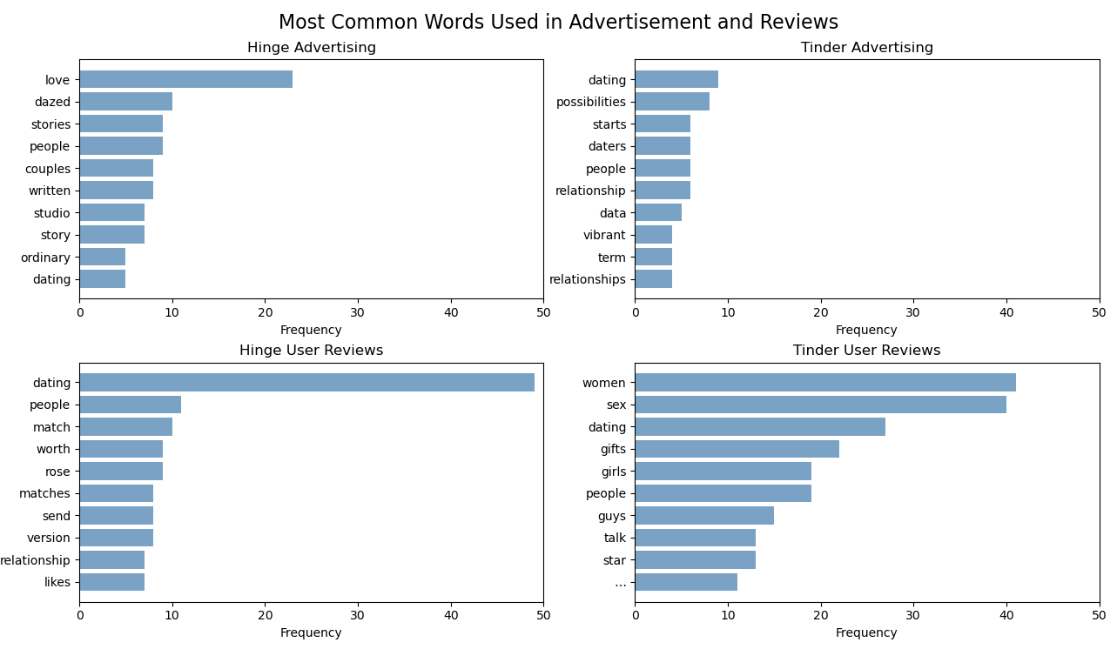
Mentor Name. : John Rachlin
Subject/Category : Business
Class : DS3500 Group # : 1
Analysis of Advertising Language and User Reviews Across Dating Platforms
Mika Nguyen
Background
Dating platforms have become a cornerstone of modern relationships, boasting millions of users worldwide. Each platform advertises itself using carefully crafted messaging to attract users. However, user experiences often tell a different story, highlighting frustrations with features, user behavior, or unmet expectations. By analyzing these divergent narratives, this project seeks to uncover the disparity between how platforms market themselves and how they are perceived.
Process and Methods
To investigate the disconnect between advertising language and user perceptions, I conducted a text analysis of the two most popular dating platforms, Tinder and Hinge. The analysis utilized marketing campaigns (text from recent ads published by Tinder and Hinge) and user reviews (excerpts from articles that discuss personal experiences on these dating platforms. I applied natural language processing (NLP) techniques to analyze word frequency and sentiment. This approach enabled a comparative assessment of how each platform's branding aligns—or diverges—from user feedback.
Findings
Figure 2
Figure 1
These subplots of scatterplots visualize the polarity and subjectivity of text in Tinder and Hinge advertisements and their user reviews. Sentiment scores for Tinder advertising indicates moderately positive and opinionated content. Hinge advertising demonstrates a similar distribution but with a slightly broader range of positive polarity, suggesting Hinge's advertisements may have a more upbeat tone. Tinder user reviews, displays a more diverse range of polarity, indicating mixed user feedback with a balance of objective and subjective expressions. Hinge user reviews reveals a similar trend but with slightly more data points leaning towards positive polarity and higher subjectivity, suggesting Hinge users may provide more favorable and opinion-driven reviews overall.
This Sankey Diagram highlights the flow and overlap between common themes or words used in advertising and user reviews for Tinder and Hinge. Words like "dating" and "people" appear across both advertising and reviews, indicating some alignment in focus. Divergence is evident in terms like "love" (prominent in Hinge advertising) and "women" or "sex" (more frequent in Tinder user reviews), showing a potential mismatch in expectations or experience.
Figure 3
Figure 4
This bar chart shows the most common words across all advertisements and user reviews. The term dating is most dominant across all categories, indicating its central relevance in both advertisements and user reviews for these platforms. Words like women, sex girls, and gifts are prominent in Tinder User Reviews, suggesting users frequently discuss gender interactions, relationships, and other engagement elements. Hinge Advertising emphasizes emotional themes such as love, reflecting a more serious or connection-driven marketing approach compared to Tinder.
These plots provide a breakdown of frequently used words in each dataset. In Tinder's advertising, words such as "dating," "possibilities," "starts," and "relationship" dominate, suggesting a focus on opportunities and connections. Hinge's advertising emphasizes words like "love," "dazed," "stories," and "couples," which align with a more romantic and narrative-driven branding strategy. Among Tinder reviews, terms like "women," "sex," and "gifts" reveal a focus on interactions that are potentially more casual or transactional. In Hinge user reviews, words such as "worth" and "relationship" indicate users evaluating the app's value for forming connections.
Conclusion
Overall, this analysis provides insight into the divergence between the language used in brand marketing compared to user perception of the brand. Tinder’s advertising emphasizes connections ("people," "match"), while user reviews frequently mention terms like "sex" and "women," suggesting a perception of more casual interactions. Hinge’s advertising centers on meaningful relationships ("love," "stories"), aligning with its branding as "designed to be deleted." User reviews, however, reflect mixed feelings about app features and value ("worth," "relationship"). In terms of sentiment, while advertisements are overwhelmingly positive and subjective, user reviews show broader variability in sentiment, revealing areas of unmet expectations.
Notes:
Analyzing Marketing Language and User Reviews Across Different Dating Platforms
For this project, I analyzed the difference in advertising language and user reviews across difference dating platforms, specifically Hinge and Tinder. I chose this topic since dating apps are highly popularized and different dating platforms are often associated with a certain brand image by their users. I wanted to analyze the disparities between the ways these dating platforms analyze themselves compared to user reviews/perception. For example, Tinder is known as a platform for more casual relationships while Hinge is associated with building deeper, romantic relationships that are less surface level. For this analysis, I used Tinder’s recent “It Starts With a Swipe” campaign and Hinge’s “No Ordinary Love” campaign and compared them with user review excerpts.
My first visualization is a Sankey diagram highlighting the flow and overlap between common themes/words used in advertising and user reviews for both Tinder and Hinge. Divergence between advertising and user reviews is evident in terms of how words like “love” is prominent in Hinge advertising however “women” and “sex” are more frequent in Tinder user reviews, indicating a potential mismatch in expectations/experience.
Figure 2 visualizes the polarity and subjectivity of the text in Tinder and Hinge advertisements and their user reviews. Advertisement for Hinge and Tinder reveal a similar distribution, however Hinge has a slightly broader range of polarity, suggesting a more upbeat tone. Tinder reviews reveal a diverse range of polarity – indicating mixed user feedback. Hinge’s distribution is similar, however more data points lean towards positive polarity suggesting more user satisfaction.
Figure 3 shows the most common words across all advertisements and user reviews. Terms like “women”, “sex”, “girls”, “gifts” are prominent in Tinder user reviews – suggesting discussions of gender interactions and relations. The high frequency of “sex” may be associated with Tinder’s perceived hook-up culture. Hinge advertising emphasizes emotional themes love – reflecting a more connection driven approach.
Figure 4 takes a closer look into the most common words in each individual file. "dating," "possibilities," "starts," and "relationship" dominate, suggesting a focus on opportunities and connections. Hinge's advertising emphasizes words like "love," "dazed," "stories," and "couples," which align with a more romantic and narrative-driven branding strategy. Among Tinder reviews, terms like "women," "sex," and "gifts" reveal a focus on interactions that are potentially more casual or transactional. In Hinge user reviews, words such as "worth" and "relationship" indicate users evaluating the app's value for forming connections.
Overall, this analysis provides insight into the divergence between the language used in brand marketing compared to user perception of the brand. Tinder’s advertising emphasizes connections ("people," "match"), while user reviews frequently mention terms like "sex" and "women," suggesting a perception of more casual interactions. Hinge’s advertising centers on meaningful relationships ("love," "stories"), aligning with its branding as "designed to be deleted." User reviews, however, reflect mixed feelings about app features and value ("worth," "relationship"). In terms of sentiment, while advertisements are overwhelmingly positive and subjective, user reviews show broader variability in sentiment, revealing areas of unmet expectations.

