Slide 1

A/B test of GloBox webpage
Consulting Proposal
Manuk Mikayelyan
May, 2023

Slide 2
Context:
GloBox's product offerings have expanded to include food and drink.
A banner highlighting key products in the food and drink category was designed to increase revenue on mobile users.
The A/B test was conducted to determine whether GloBox should launch the food and drink banner to all users.
The primary metrics used were the conversion rate (CR) and the average revenue per user (ARPU).

Slide 3
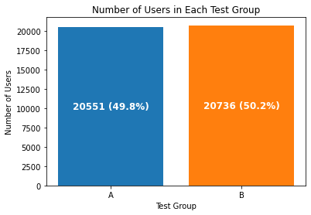
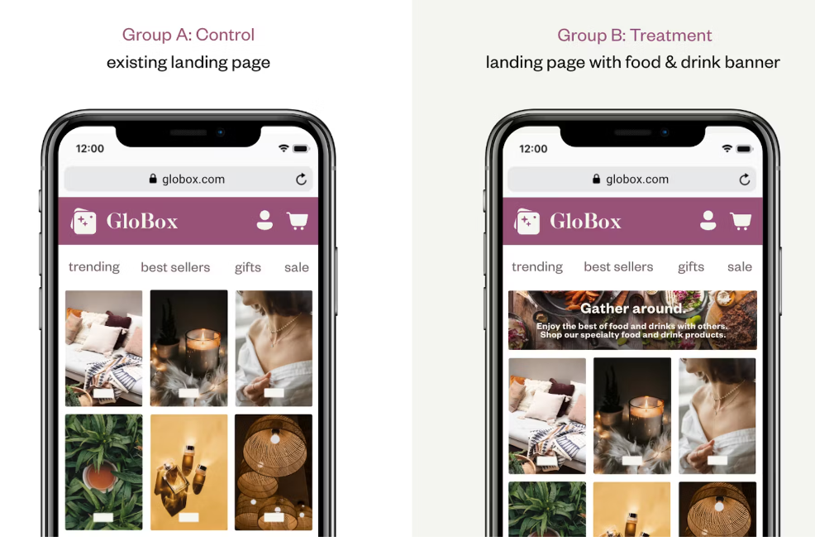
Experiment setup:
The test was run only on the mobile website.
Users were randomly assigned to either the control or test group upon visiting the GloBox main page on mobile devices.
There were 20551 users in the control (Group A), and 20736 users in the treatment (Group B).
The banner would show up if a user was assigned to the test group and would not show up if assigned to the control group.
The dataset used in this A/B test included user demographic information, user A/B test group assignment, and user purchase activity
The conversion rate (CR) and the average revenue per user (ARPU) were used to evaluate the impact of the banner on revenue.

Slide 4
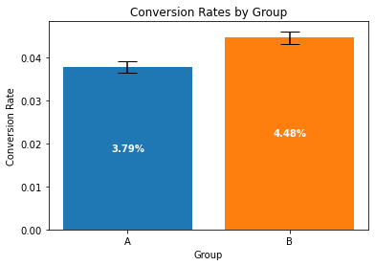
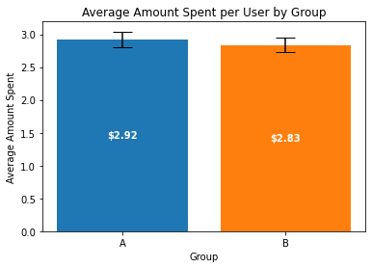
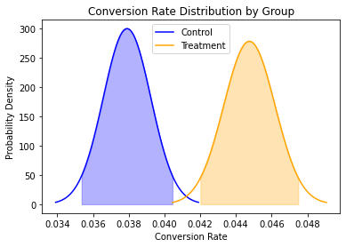
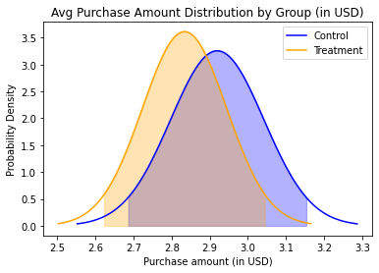
Key Results:
The conversion rate of all users is 4.13%.
The CRs for the control and treatment groups are 3.79% and 4.48% respectively.
The average revenue per user for the control and treatment groups are $2.92 and $2.83 respectively.
The test group had a significant increase in conversion rate.
There was no significant difference in average revenue per user between the control and test groups.
These findings suggest that the banner was effective in increasing conversions, but did not have a significant impact on revenue per user.

Slide 5
Recommendations:
GloBox should not launch the experience to all users based on the results of this A/B test.
Iterate on the experience and test it again with variations to the banner design, placement, and messaging.
Conduct a segmentation analysis to identify specific segments that drove the increase in CR.
Conduct funnel analysis to identify any specific areas of the website that need improvement to increase CR.
Price analysis to identify any specific price points that drive higher revenue.
Personalization analysis to identify the impact of product recommendations or messaging on CR and average spending.
Thank you!
Any questions or feedback are welcome.

