Slide 1

NYC Short-Term Rental Insights
Manuk Mikayelyan
June 2023

Slide 2
Context:
Objective: Provide insights for Pillow Palooza's business strategy in NYC
Data sources: Airbnb listings and Pillow Palooza's dataset
Tools used: Python, PostgreSQL, Tableau

Slide 3
Main KPIs of the market dynamics and performance :
Total Listings: 25,184 short-term rental options available in NYC
Average Price: $4,315 per listed property
Occupancy Rate: 59.89%
Total Revenue: $743,369,052
Average Revenue: $30,000 per month per listing

Slide 4
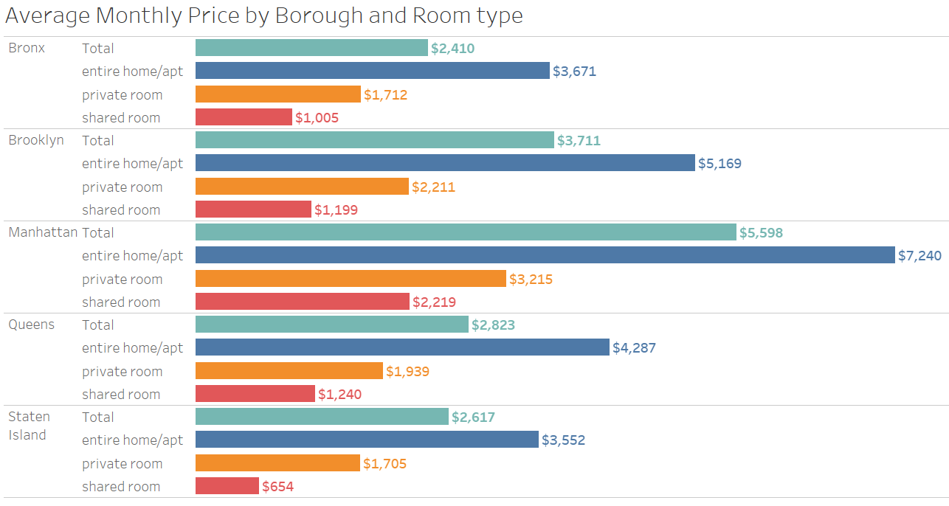
Key Results: Average Monthly Prices by Borough and Room Type
Manhattan and Brooklyn have highest average prices.
Bronx and Staten Island have lowest average prices.
"Entire home/apartment" listings are pricier across all boroughs.
"Private room" listings are more affordable.
"Shared room" listings are budget-friendly.

Slide 5
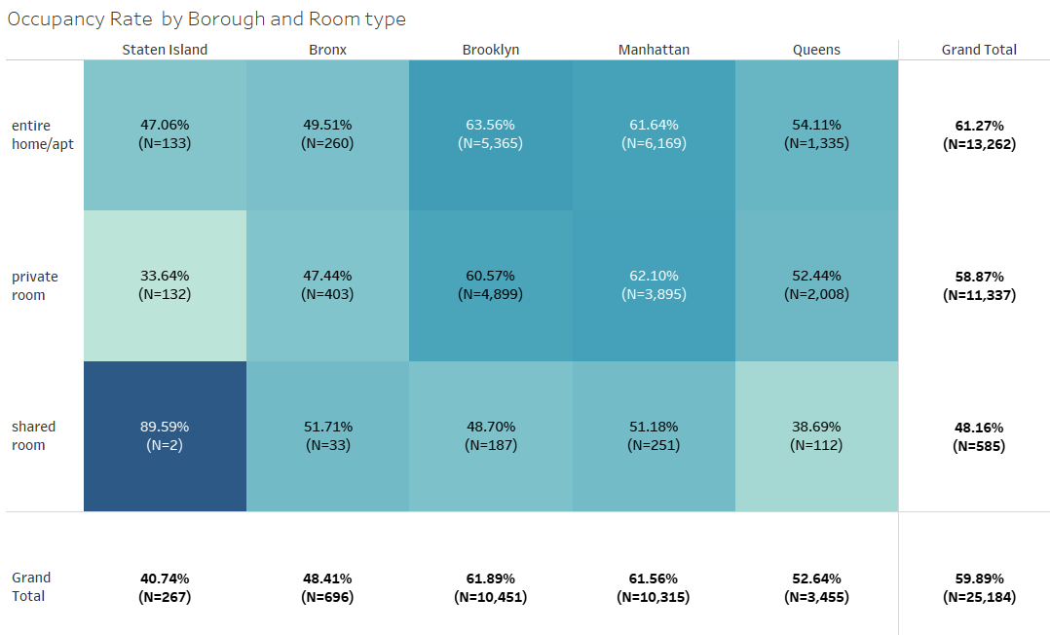
Key Results: Occupancy rate by borough and room type in New York
Manhattan and Brooklyn: high occupancy rates, strong demand.
The Bronx and Staten Island: lower occupancy rates, less demand.
Entire home/apartment listings preferred; shared rooms have lower occupancy rates.

Slide 6
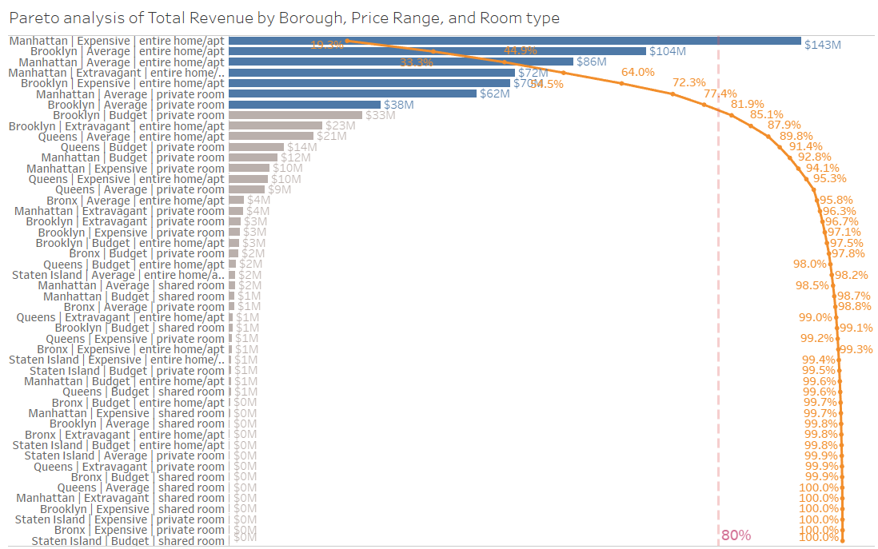
Key Results: Pareto Analysis of Total Revenue
80% of total revenue generated by "entire home/apartment" listings in expensive and average price ranges, primarily located in Manhattan
Importance of focusing on these segments to maximize revenue

Slide 7
Recommendations:
Focus on Expensive and Average Price Categories.
Target Manhattan and Brooklyn.
Optimize Entire Home/Apartment Listings.
Consider Pricing Strategies.
Expand Presence in Brooklyn.
Enhance Marketing Efforts.
Continuous Monitoring, Data Collection, and Analysis.
Thank you!
Any questions or feedback are welcome.

