Slide 1

Introduction to Python Programming
Building Foundations for All
Course: Advance Python Programming & Applications
Presented by: Muhammad Abbas
Corvit Systems Faisalabad

Slide 2
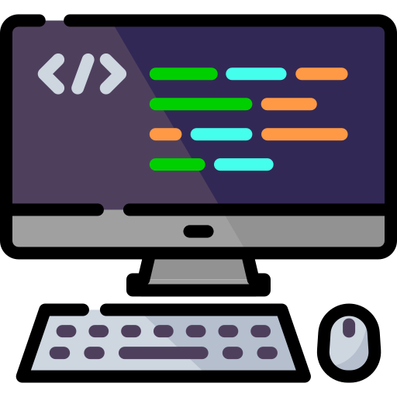
SECTION 1: What is Programming Really?
Instruct Computers to act.
Corvit Systems Faisalabad
Topic: What is Programming Really?

Slide 3


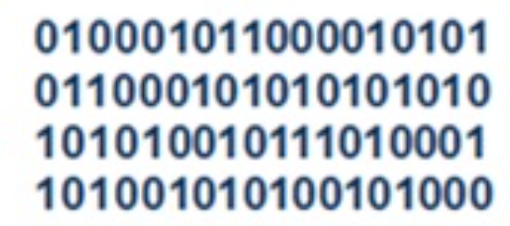
What is Programming Really?
Program: A program is a list of instruction that is executed by a computer to accomplish a particular task.
Computers are literal—they do exactly what you tell them.
Key Insight: You already solve problems in your field—programming is just expressing solutions in a way computers understand.
Natural Language Instructions
START: Patient has temperature reading.
INPUT: Get temperature value (e.g. 38.5°C).
PROCESS: Is temperature > 37.5°C?
IF YES: Go to step 5.
OUTPUT: Display “Fever detected!”
IF NO: Go to step 6.
OUTPUT: Display “No fever”.
END: Decision made.
Program
Source Code
Binary
Machine Code
.py file
Translator

Slide 4
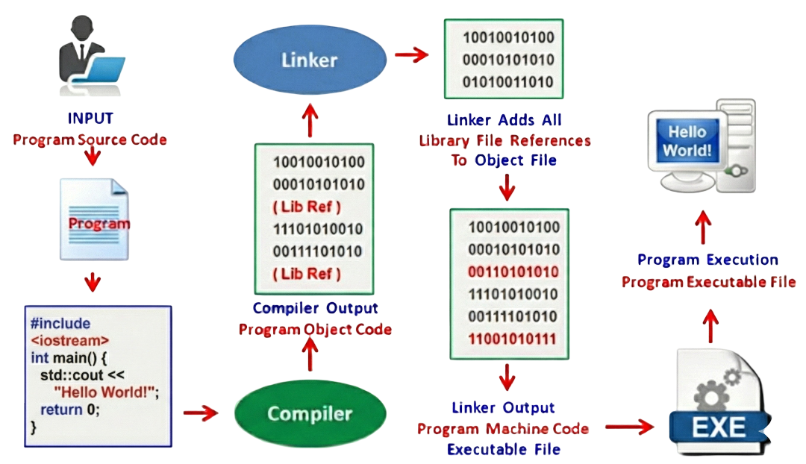
How Programs Get Executed

Slide 5
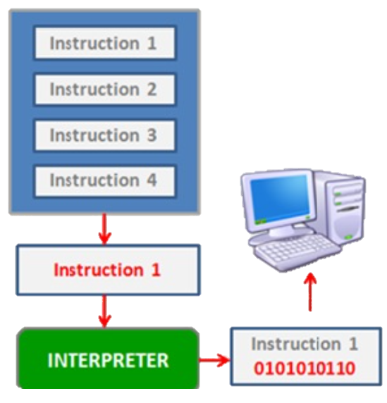
Compiler vs Interpreter
Compiler:
Translates all code at once → executable file
Example: C++, Java
Faster execution
Errors shown before running
Interpreter:
Translates line by line while running
Example: Python, JavaScript
Easier to test and debug
Errors shown as program runs
Program Execution Line-By-Line

Slide 6
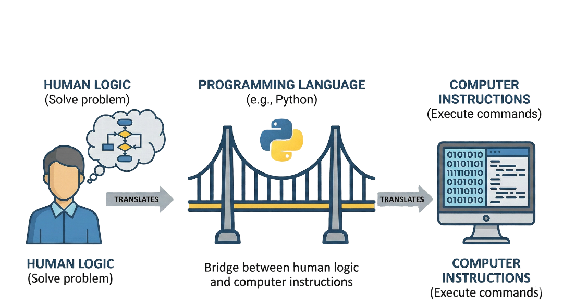
What is Programming Language?
A formal set of rules, syntax, and commands used by humans to write instructions (code) that a computer can understand and execute to perform specific tasks.
Humans and Computers speak different languages
Programming Language: Bridge between human logic and computer instructions
Example: Python, Java, C++, JavaScript
Python: Beginner friendly, reads almost like English
Used in: Data Science, AI, Web Development, Automation, etc.

Slide 7
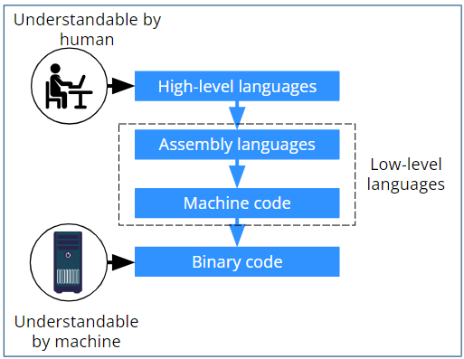
Different Levels of Programming Languages
Low-Level Languages:
Close to machine language (binary)
Example: Assembly, Machine Code
Very fast, but hard to write
High-Level Languages:
Close to human language
Example: Python, Java, JavaScript
Easier to write and understand
Python is high-level = beginner friendly!

Slide 8
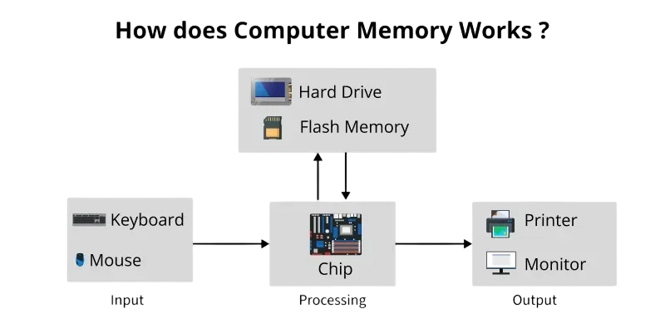
How Computers Work
Every computers follows the same basic pattern:
INPUT: Receive data (keyboard, mouse, files, sensors
PROCESS: Transform data using CPU and memory
OUTPUT: Display results (screen, files, speakers)
Understanding this helps you think like a programmer

Slide 9
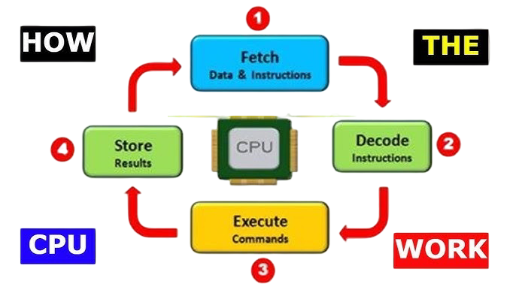
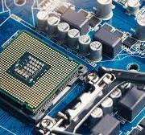
The CPU – The Brain
CPU = Central Processing Unit
The “brain” that executes your code
Performs Billions of calculations per second
Follows instructions one at a time
Your code tells the CPU what to do.
CPU

Slide 10
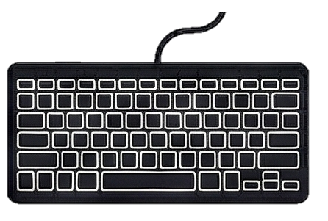


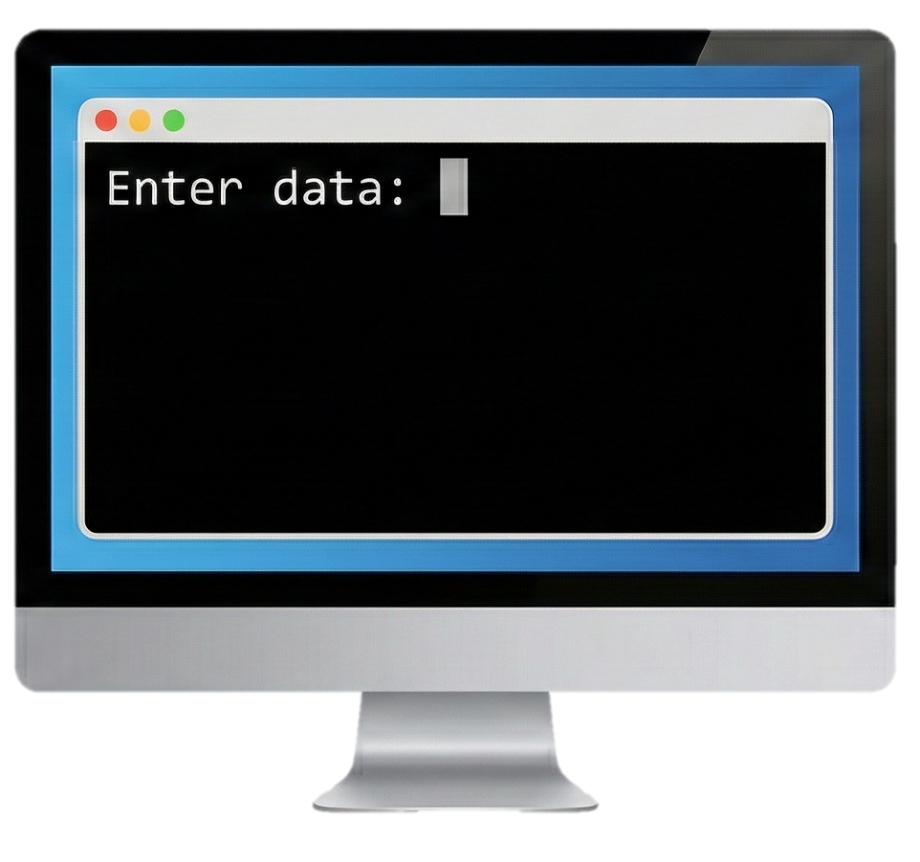

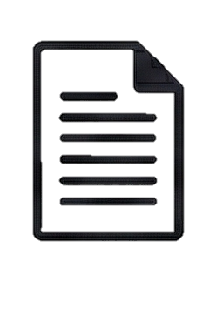

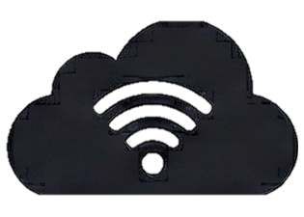
Input – Getting Data In
How computers receive information:
Keyboard typing
Mouse clicks
File uploads
Sensors (temperature, location, etc.)
Network data
In Python: You will use input() function to get user data
Typing…
Camera
Click!
File Upload
Network data
Voice!

Slide 11
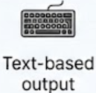
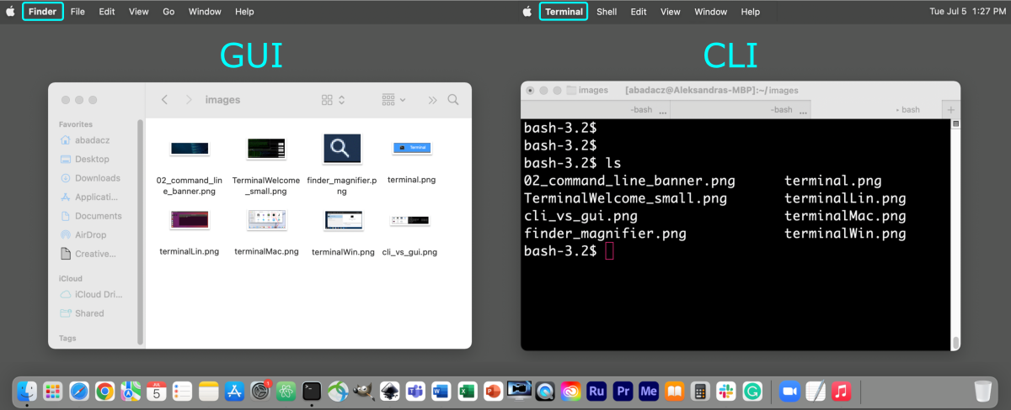
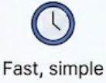
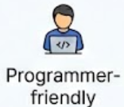
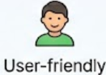
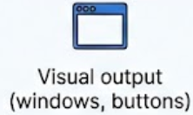
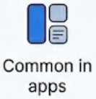
Output – Showing Results
CLI (Command Line Interface):
Text-based output
Block screen with text (Terminal/Command Prompt)
Fast, simple, programmer-friendly
GUI (Graphical User Interface):
Visual output with windows, buttons, images
User-friendly
What you normally see in applications
CLI
GUI

Slide 12
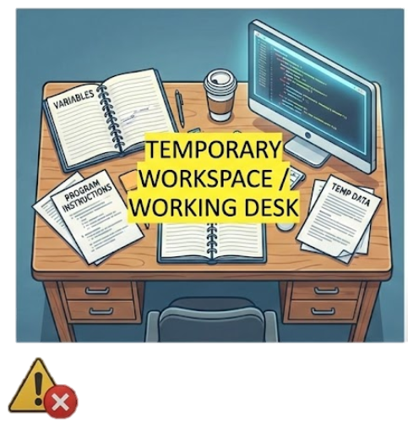
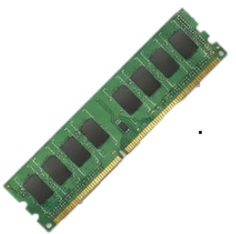
Memory (RAM)
RAM = Random Access Memory
Temporary, fast storage
Where your program runs and stores variables
Think of it as your computer’s “working desk”
Important: Data in RAM disappears when program ends
Typical size: 4GB, 8GB, 21GB
IMPORTANT: Data disappears with when program ends/power off.
RAM
(Random Access Memory)

Slide 13
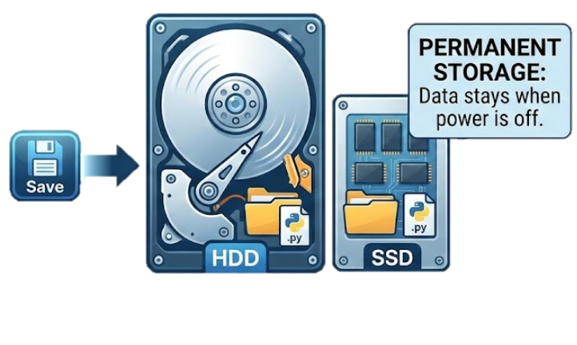
Storage (Hard Disk/SSD)
Permanent storage for files
Your Python code files (.py) are saved here
Data stays even when computer is off
Much larger but slower than RAM
Typical size: 256GB, 512GB, 1TB, 2TB
When you “save” code, it goes here

Slide 14
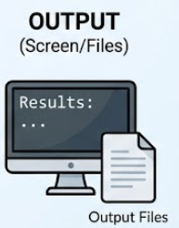

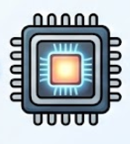
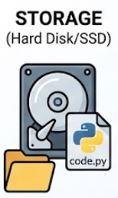
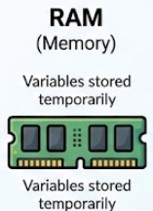
Connecting to Programming
What happens when you run Python code:
Your code file is read from storage
Loaded into RAM (memory)
GPU executes instructions line by line
Results shown as output (screen/files)
Variables stored temporarily in RAM
This is what happens behind every program you write!

Slide 15
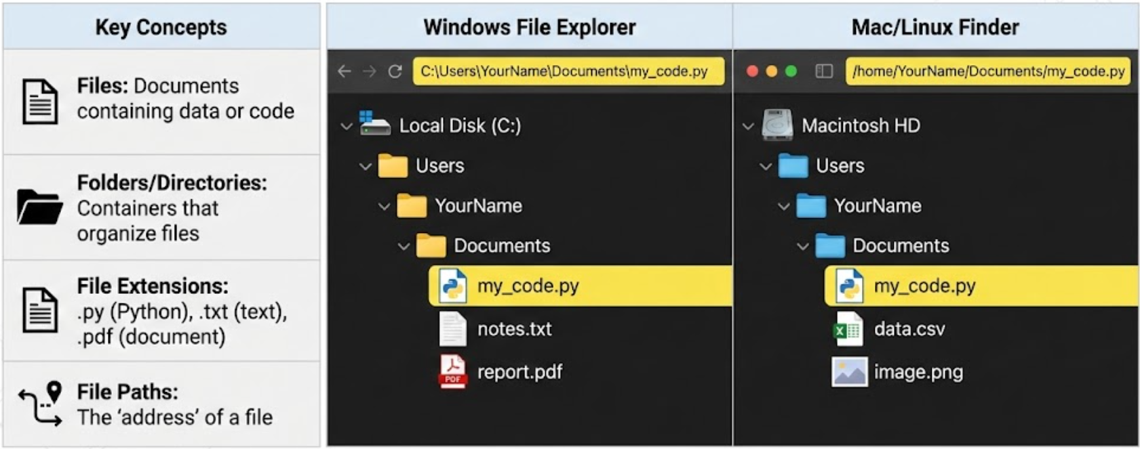
Files and File Systems

Slide 16
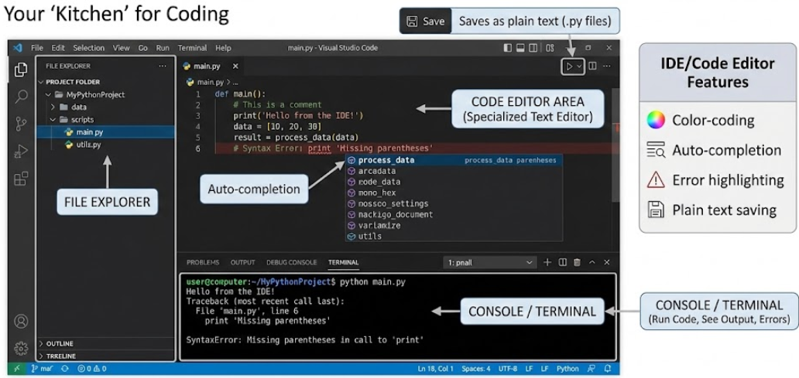
The Programming Environment

Slide 17
Computational Logic: The “Recipe”

Slide 18
Thank You
Ask!
The art and science of asking questions is the source of knowledge.
Thomas Berger

