Slide 1
Understanding Git
Nelson Elhage Anders Kaseorg
Student Information Processing Board
September 29, 2009
Understanding Git

Slide 2




Outline
The Git model
1
The Git model
2
Using Git
3
Collaboration with Git
4
Rewriting history
5
And beyond!
Understanding Git

Slide 3
The Git model
The Git model
A Git repository contains four kinds of objects.
An object is either a blob (file), a tree (directory), a commit
(revision), or a tag.
Every object is uniquely identified by a 40 hex digit number, which is the SHA-1 hash of its contents.
Don’t worry—identifiers can be abbreviated by truncation, or referenced with human-readable names.
Some objects refer to other objects using their identifiers.
Understanding Git

Slide 4
Objects
The Git model
Blobs and trees represent files and directories.
Tags are named references to another object, along with some additional metadata.
A commit object contains
a tree id
zero or more parents, which are commit ids an author (name, email, date)
a committer (name, email, date)
a log message
Understanding Git

Slide 5
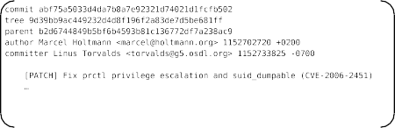
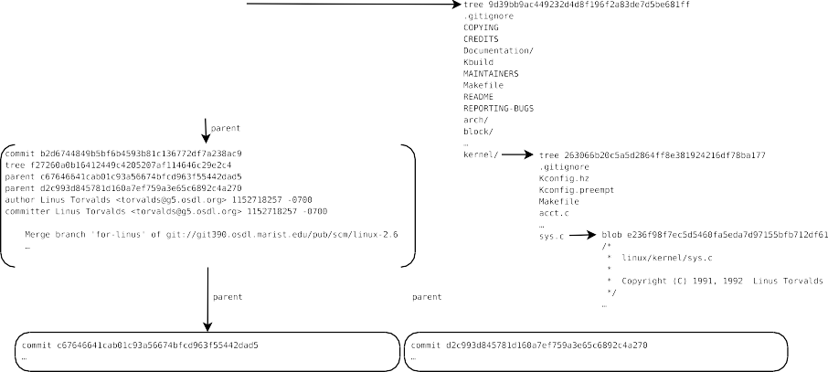
The Git model
A commit
Understanding Git

Slide 6
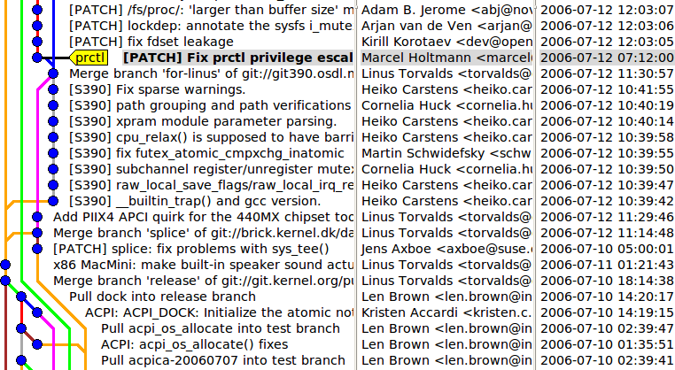
The Git model
More commits
Understanding Git

Slide 7
A Git repository
The Git model
A Git repository is a collection of refs—branches and tags. (Branches are also known as heads.)
A ref is a named mutable pointer to an object (usually a commit).
HEAD → refs/heads/master refs/heads/master → commit fec6ed... refs/heads/ftrace → commit ce5c1e... refs/tags/v2.6.8 → commit e8ce2f... refs/tags/v2.6.27 → tag 4b5127...
The repository automatically stores the directed acyclic graph of objects rooted at these refs.
Understanding Git

Slide 8
Branches
The Git model
Git was designed to enable lightweight branching and merging. Each repository can have any number of branches.
Branches are just refs—pointers into the DAG of commits—and these pointers themselves are not versioned.
So you don’t need to be afraid of making throwaway branches for experiments.
Understanding Git

Slide 9
Consequences of the Git model
The Git model
Git tracks the history of your whole project, not the history of individual files.
Best practice is to keep projects that are logically separate in separate Git repositories.
Git does not track renames as metadata in the repository.
Instead, renames are automatically detected based on content when this information is needed.
A commit ID cryptographically certifies the integrity of the entire history of the repository up to that commit.
Git has powerful tools for rewriting history—but this requires communication with everyone that has pulled any affected commits from your repository.
Understanding Git

Slide 10

Outline
Using Git
1
The Git model
2
Using Git
3
Collaboration with Git
4
Rewriting history
5
And beyond!
Understanding Git

Slide 11
Getting a Git repository
Using Git
git init
Create an empty Git repository in the current directory. By default it will have one branch named master.
git clone url Clone the Git repository from url . This may be over HTTP, SSH, or the Git protocol, or it may be a path to another local repository.
Both of these operations will create a working copy.
Understanding Git

Slide 12
Working copy
Using Git
Every working copy has its own Git repository in the .git
subdirectory (with arbitrarily many branches and tags).
The most important ref is HEAD, which refers to the current branch.
The .git subdirectory also stores the index: a staging area for changes on top of HEAD that will become part of the next commit.
Finally, the files outside of .git are the working tree.
Understanding Git

Slide 13

Git workflow
Using Git
Changes made to the working tree can be added to the index.
The index can be committed to the current branch (where it will then become the new HEAD).
Understanding Git

Slide 14
Constructing commits
Using Git
git add file
Add or update file from the working tree into the index.
Unstage changes to file in the index, without touching the working tree.
Undo modifications to file in the working tree by reading it back from the index.
Delete file from the index and the working tree.
git reset file
git checkout file
git rm file
git mv oldfile
newfile Shortcut for mv oldfile newfile plus the appropriate additions and removals in the index.
Display the files changed in the index and in the working tree.
Make a commit out of the current index. Shortcut for adding all modified files to the index and committing.
git status
git commit git commit -a
Understanding Git

Slide 15
Referring to objects
Using Git
fc8da7a06bb66b707e7f5406657d5a3b7ee42c66 You can always refer to an object by its full SHA-1 ID, but this gets unwieldy very quickly.
fc8da7 refname commit ^
You can use a truncated SHA-1 as long as it is unambiguous. You can refer to a branch or tag by name.
Append a ^ to get the (first) parent of a commit.
commit ^2 The second parent of a commit, etc.
commit ~4 Short for commit ^^^^—the great-great-grandparent of a commit.
commit :filename The given file or directory inside commit ’s tree.
. . . and more (see git help rev-parse for a full description of the syntax).
Understanding Git

Slide 16
Displaying changes
Using Git
git log
git show object
List the commits on the current branch.
Show an object (e.g. the log information and patch for a commit, or the contents of a file).
Show the differences between the index and the working tree.
git diff
git diff --cached Show the differences between HEAD and the index.
git diff commit
Show the differences between commit and the working tree.
Understanding Git

Slide 17
Manipulating branches and tags
Using Git
git branch
List the branches in your repository, with the current branch highlighted.
Switch to the branch named branch . This updates HEAD, the index, and the working tree.
git checkout branch
git checkout -b branch [commit ] Create a new branch named
branch starting at commit (defaulting to current HEAD), and switch to it.
git branch -d branch Delete the branch branch .
git branch -m oldbranch newbranch Rename oldbranch to
newbranch .
git tag tag [commit ] Attach a new tag named tag to commit
(defaulting to current HEAD).
git tag -d tag Delete the tag named tag .
Understanding Git

Slide 18
Configuration hints
Using Git
You should tell Git who you are:
$ git config --global user.name "Your Name "
$ git config --global user.email "your@email.edu "
And, if you’re feeling colorful,
$ git config --global color.ui auto
(This configuration is stored in ~/.gitconfig.)
Understanding Git

Slide 19
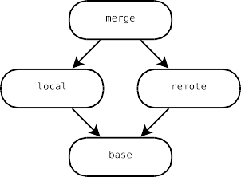
Merging
Using Git
git merge commit Merge commit into HEAD. The index must not
contain any staged changes.
In the general case, this will result in a merge commit—a commit with more than one parent.
If commit is an ancestor of HEAD, then the merge is a no-op.
If commit is a descendent of HEAD, then the merge degenerates into a fast-forward.
Understanding Git

Slide 20
Resolving merge conflicts
Using Git
git merge works roughly by creating a diff against the common ancestor commit, and applying it against the current HEAD. (The general case is much more complicated.)
Sometimes this patch will not apply to the current HEAD. This situation is called a merge conflict.
Git will respond by inserting conflict markers into the conflicted files, and asking you resolve the conflict.
Don’t panic!
To resolve the conflict, edit the conflicted files appropriately and then
git add them.
Alternatively, you can run git mergetool to resolve the conflicts interactively in a graphical diff program.
Understanding Git

Slide 21
Using Git
Merging example
$ seq 5 > numbers
Understanding Git
21 / 41

Slide 22
Merging example
Using Git
$ seq 5 > numbers
$ git init
Initialized empty Git repository in /tmp/foo/.git/
Understanding Git
21 / 41

Slide 23
Merging example
Using Git
$ seq 5 > numbers
$ git init
Initialized empty Git repository in /tmp/foo/.git/
$ git add numbers
Understanding Git
21 / 41

Slide 24

Merging example
Using Git
$ seq 5 > numbers
$ git init
Initialized empty Git repository in /tmp/foo/.git/
$ git add numbers
$ git commit -m ’1, 2, 3, 4, 5!’
Created initial commit 4172330: 1, 2, 3, 4, 5!
1 files changed, 5 insertions(+), 0 deletions(-) create mode 100644 numbers
Understanding Git
21 / 41

Slide 25

Merging example
Using Git
$ seq 5 > numbers
$ git init
Initialized empty Git repository in
$ git add numbers
$ git commit -m ’1, 2, 3, 4, 5!’
Created initial commit 4172330: 1, 2, 3, 4, 5!
1 files changed, 5 insertions(+), 0 deletions(-) create mode 100644 numbers
$ git checkout -b andersk
Switched to a new branch "andersk"
/tmp/foo/.git/
Understanding Git
21 / 41

Slide 26

Merging example
Using Git
$ seq 5 > numbers
$ git init
Initialized empty Git repository in /tmp/foo/.git/
$ git add numbers
$ git commit -m ’1, 2, 3, 4, 5!’
Created initial commit 4172330: 1, 2, 3, 4, 5!
1 files changed, 5 insertions(+), 0 deletions(-) create mode 100644 numbers
$ git checkout -b andersk
Switched to a new branch "andersk"
$ git branch
*andersk master
Understanding Git
21 / 41

Slide 27

Merging example
Using Git
$ seq 5 > numbers
$ git init
Initialized empty Git repository in /tmp/foo/.git/
$ git add numbers
$ git commit -m ’1, 2, 3, 4, 5!’
Created initial commit 4172330: 1, 2,
1 files changed, 5 insertions(+), 0 deletions(-) create mode 100644 numbers
$ git checkout -b andersk
Switched to a new branch "andersk"
$ git branch
*andersk master
$ (echo 0; cat numbers) | sponge numbers
3, 4, 5!
Understanding Git
21 / 41

Slide 28
Merging example
Using Git
1 files changed, 5 insertions(+), 0 deletions(-) create mode 100644 numbers
$ git checkout -b andersk
Switched to a new branch "andersk"
$ git branch
*andersk master
$ (echo 0; cat numbers) | sponge numbers
$ git diff
diff --git a/numbers b/numbers index 8a1218a..e8371f0 100644
--- a/numbers
+++ b/numbers @@ -1,3 +1,4 @@
+0
1
2
3
Understanding Git
21 / 41

Slide 29
Merging example
Using Git
create mode 100644 numbers
$ git checkout -b andersk
Switched to a new branch "andersk"
$ git branch
*andersk master
$ (echo 0; cat numbers) | sponge numbers
$ git diff
diff --git a/numbers b/numbers index 8a1218a..e8371f0 100644
--- a/numbers
+++ b/numbers @@ -1,3 +1,4 @@
+0
1
2
3
$ git add numbers
Understanding Git
21 / 41

Slide 30
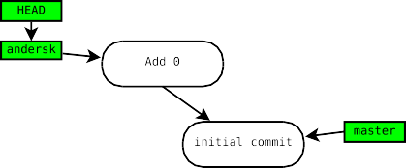
Merging example
Using Git
$ git branch
*andersk master
$ (echo 0; cat numbers) | sponge numbers
$ git diff
diff --git a/numbers b/numbers index 8a1218a..e8371f0 100644
--- a/numbers
+++ b/numbers @@ -1,3 +1,4 @@
+0
1
2
3
$ git add numbers
$ git commit -m ’Numbers start at 0.’ Created commit 7aeb494: Numbers start at 0.
1 files changed, 1 insertions(+), 0 deletions(-)
Understanding Git
21 / 41

Slide 31
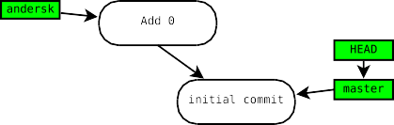
Merging example
Using Git
master
$ (echo 0; cat numbers) | sponge numbers
$ git diff
diff --git a/numbers b/numbers index 8a1218a..e8371f0 100644
--- a/numbers
+++ b/numbers @@ -1,3 +1,4 @@
+0
1
2
3
$ git add numbers
$ git commit -m ’Numbers start at 0.’ Created commit 7aeb494: Numbers start at 0.
1 files changed, 1 insertions(+), 0 deletions(-)
$ git checkout master Switched to branch "master"
Understanding Git
21 / 41

Slide 32
Merging example
Using Git
$ (echo 0; cat numbers) | sponge numbers
$ git diff
diff --git a/numbers b/numbers index 8a1218a..e8371f0 100644
--- a/numbers
+++ b/numbers @@ -1,3 +1,4 @@
+0
1
2
3
$ git add numbers
$ git commit -m ’Numbers start at 0.’ Created commit 7aeb494: Numbers start at 0.
1 files changed, 1 insertions(+), 0 deletions(-)
$ git checkout master Switched to branch "master"
$ echo 6 >> numbers
Understanding Git
21 / 41

Slide 33
Merging example
Using Git
$ git diff
diff --git a/numbers b/numbers index 8a1218a..e8371f0 100644
--- a/numbers
+++ b/numbers @@ -1,3 +1,4 @@
+0
1
2
3
$ git add numbers
$ git commit -m ’Numbers start at 0.’ Created commit 7aeb494: Numbers start at 0.
1 files changed, 1 insertions(+), 0 deletions(-)
$ git checkout master Switched to branch "master"
$ echo 6 >> numbers
$ git add numbers
Understanding Git
21 / 41

Slide 34
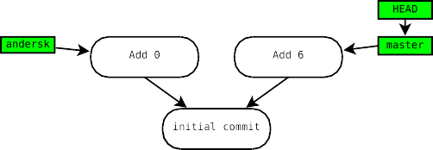
Merging example
Using Git
--- a/numbers
+++ b/numbers @@ -1,3 +1,4 @@
+0
1
2
3
$ git add numbers
$ git commit -m ’Numbers start at 0.’ Created commit 7aeb494: Numbers start at 0.
1 files changed, 1 insertions(+), 0 deletions(-)
$ git checkout master Switched to branch "master"
$ echo 6 >> numbers
$ git add numbers
$ git commit -m ’6 is a number too.’ Created commit 383c158: 6 is a number too.
1 files changed, 1 insertions(+), 0 deletions(-)
Understanding Git
21 / 41

Slide 35
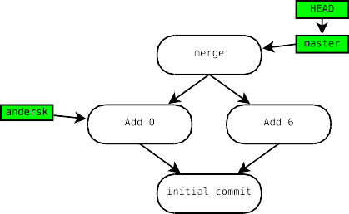
Merging example
Using Git
2
3
$ git add numbers
$ git commit -m ’Numbers start at 0.’ Created commit 7aeb494: Numbers start at 0.
1 files changed, 1 insertions(+), 0 deletions(-)
$ git checkout master Switched to branch "master"
$ echo 6 >> numbers
$ git add numbers
$ git commit -m ’6 is a number too.’ Created commit 383c158: 6 is a number too.
1 files changed, 1 insertions(+), 0 deletions(-)
$ git merge andersk Auto-merged numbers
Merge made by recursive. numbers | 1+
1 files changed, 1 insertions(+), 0 deletions(-)
Understanding Git
21 / 41

Slide 36

Merging example
Using Git
$ echo 6 >> numbers
$ git add numbers
$ git commit -m ’6 is a number too.’ Created commit 383c158: 6 is a number too.
1 files changed, 1 insertions(+), 0 deletions(-)
$ git merge andersk Auto-merged numbers
Merge made by recursive. numbers | 1+
1 files changed, 1 insertions(+), 0 deletions(-)
$ cat numbers 0
1
2
3
4
5
6
Understanding Git
21 / 41

Slide 37
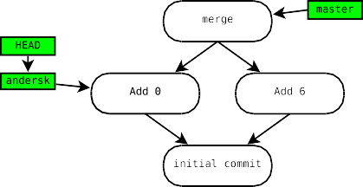
Merging example
Using Git
$ git commit -m ’6 is a number too.’ Created commit 383c158: 6 is a number too.
1 files changed, 1 insertions(+), 0 deletions(-)
$ git merge andersk Auto-merged numbers
Merge made by recursive. numbers | 1+
1 files changed, 1 insertions(+), 0 delet
$ cat numbers 0
1
2
3
4
5
6
$ git checkout andersk Switched to branch "andersk"
ions(-)
Understanding Git
21 / 41

Slide 38

Merging example
Using Git
Created commit 383c158: 6 is a number too.
1 files changed, 1 insertions(+), 0 deletions(-)
$ git merge andersk Auto-merged numbers
Merge made by recursive. numbers | 1+
1 files changed, 1 insertions(+
$ cat numbers 0
1
2
3
4
5
6
$ git checkout andersk Switched to branch "andersk"
$ echo 5½ >> numbers
), 0 d
elet
ions(-)
Understanding Git
21 / 41

Slide 39
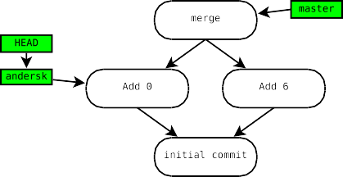
Merging example
Using Git
1 files changed, 1 insertions(+), 0 deletions(-)
$ git merge andersk Auto-merged numbers
Merge made by recursive. numbers | 1+
1 files changed, 1 insertions(+), 0 deletions(-)
$ cat numbers 0
1
2
3
4
5
6
$ git checkout andersk Switched to branch "andersk"
$ echo 5½ >> numbers
$ git add numbers
Understanding Git
21 / 41

Slide 40
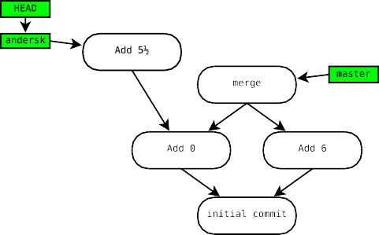
Merging example
Using Git
Merge made by recursive. numbers | 1+
1 files changed, 1 insertions(+), 0 d
$ cat numbers 0
1
2
3
4
5
6
$ git checkout andersk Switched to branch "andersk"
$ echo 5½ >> numbers
$ git add numbers
$ git commit -m ’5½ is a better number.’
eletion
s(-)
Created commit 5360c2d: 5½ is a better number.
1 files changed, 1 insertions(+), 0 deletions(-)
Understanding Git
21 / 41

Slide 41
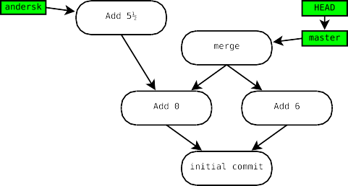
Merging example
Using Git
1 files changed, 1 insertions(+), 0 deletions(-)
$ cat numbers 0
1
2
3
4
5
6
$ git checkout andersk Switched to branch "andersk"
$ echo 5½ >> numbers
$ git add numbers
$ git commit -m ’5½ is a better number.’ Created commit 5360c2d: 5½ is a better number.
1 files changed, 1 insertions(+), 0 deletions(-)
$ git checkout master Switched to branch "master"
Understanding Git
21 / 41

Slide 42
Merging example
Using Git
2
3
4
5
6
$ git checkout andersk Switched to branch "andersk"
$ echo 5½ >> numbers
$ git add numbers
$ git commit -m ’5½ is a better number.’ Created commit 5360c2d: 5½ is a better number.
1 files changed, 1 insertions(+), 0 deletions(-)
$ git checkout master Switched to branch "master"
$ git merge andersk Auto-merged numbers
CONFLICT (content): Merge conflict in numbers
Automatic merge failed; fix conflicts and then commit the result.
Understanding Git
21 / 41

Slide 43
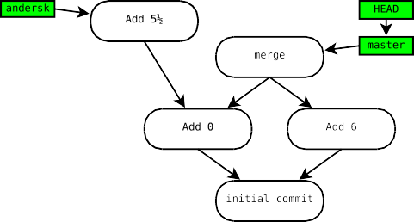
Merging example
Using Git
$ git commit -m ’5½ is a better number.’ Created commit 5360c2d: 5½ is a better number.
1 files changed, 1 insertions(+), 0 d
$ git checkout master Switched to branch "master"
$ git merge andersk Auto-merged numbers
CONFLICT (content): Merge conflict in numb
s(-)
eletion
ers
Automatic merge failed; fix conflicts and then commit the result.
$ git status numbers: needs merge # On branch master
# Changed but not updated:
# (use "git add <file>..." to update what will be committed) #
#unmerged: numbers #
no changes added to commit (use "git add" and/or "git commit -a")
Understanding Git
21 / 41

Slide 44
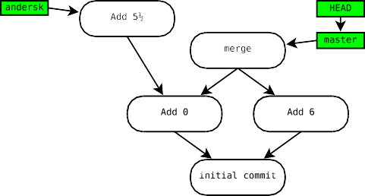
Merging example
Using Git
CONFLICT (content): Merge conflict in numbers
Automatic merge failed; fix conflicts and then commit the result.
$ git status numbers: needs merge # On branch master
# Changed but not updated:
# (use "git add <file>..." to update what com #
#unmerged: numbers #
will be
mitted)
no changes added to commit (use "git add" and/or
$ git mergetool
Merging the files: numbers
"git co
mmit -a")
Normal merge conflict for ’numbers’: local: modified
remote: modified
Hit return to start merge resolution tool (meld):
Understanding Git
21 / 41

Slide 45
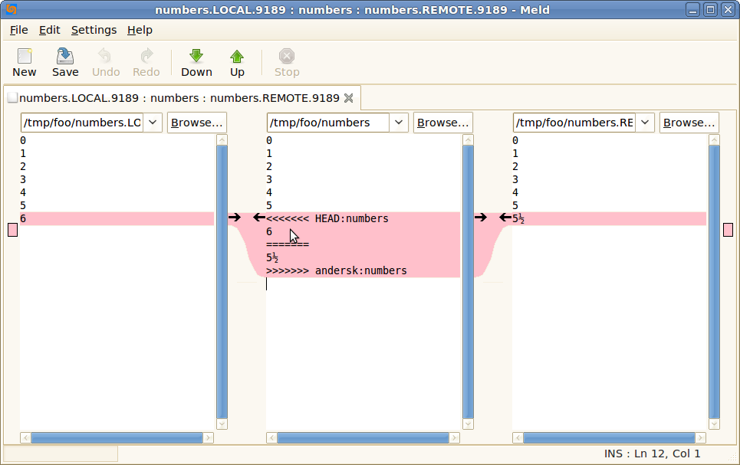
Merging example
Using Git
CONFLICT (content): Merge conflict in numbers
Automatic merge failed; fix conflicts and then commit the result.
$ git status numbers: needs merge # On branch master
# Changed but not updated:
# (use "git add <file>..." to update what com #
#unmerged: numbers #
will be
mitted)
no changes added to commit (use "git add" and/or
$ git mergetool
Merging the files: numbers
"git co
mmit -a")
Normal merge conflict for ’numbers’: local: modified
remote: modified
Hit return to start merge resolution tool (meld):
Understanding Git
21 / 41

Slide 46
Merging example
Using Git
#
no changes added to commit (use "git add" and/or "git commit -a")
$ git mergetool
Merging the files: numbers
Normal merge conflict for ’numbers’: local: modified
remote: modified
Hit return to start merge resolution tool (meld):
$ cat numbers 0
1
2
3
4
5
5½
6
Understanding Git
21 / 41

Slide 47
Merging example
Using Git
1
2
3
4
5
5½
6
$ git status
# On branch master
# Changes to be committed:
# (use "git reset HEAD <file>..." to unstage) #
#modified: numbers #
# Untracked files:
# (use "git add <file>..." to include in what will be committed) #
#numbers.orig
Understanding Git
21 / 41

Slide 48
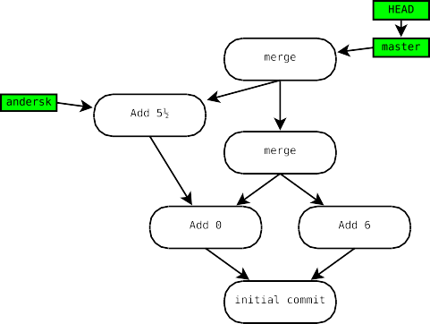
Merging example
Using Git
3
4
5
5½
6
$ git status
# On branch master
# Changes to be committed:
# (use "git reset HEAD <file>..." to unstage) #
#modified: numbers #
# Untracked files:
# (use "git add <file>..." to include in what will be committed) #
#numbers.orig
$ git commit
Created commit fc8da7a: Merge branch ’andersk’
Understanding Git
21 / 41

Slide 49
Getting out of trouble
Using Git
gitk --all
The graphical repository browser is immensely useful for visualizing what’s going on in your repository.
Show the reflog entries for HEAD. Show the reflog entries for ref .
Resets the ref pointed to by HEAD, as well as the index and working tree, to commit .
git reflog
git reflog show ref
git reset --hard commit
The reflog tracks all local changes to refs. Whenever a ref is updated to point at a new commit, it gets an entry in the reflog.
If you find yourself somewhere you don’t expect, you can examine the log or the reflog, and then use reset to get back to a known point.
This works even in a conflicted merge or rebase, if you just want to bail out and try something different.
Understanding Git

Slide 50
A peek at the reflog
Using Git
$ git reflog
fc8da7a...HEAD@0: commit (merge): Merge branch ’andersk’ 994be80...HEAD@1: checkout: moving from andersk to master 5360c2d...HEAD@2: commit: 5 ½ is a better number.
7aeb494...HEAD@3: checkout: moving from master to andersk 994be80...HEAD@4: merge andersk: Merge made by recursive. 383c158...HEAD@5: commit: 6 is a number too.
4172330...HEAD@6: checkout: moving from andersk to master 7aeb494...HEAD@7: commit: Numbers start at 0.
4172330...HEAD@8: checkout: moving from master to andersk
$ git reflog show master
fc8da7a...master@0: commit (merge): Merge branch ’andersk’ 994be80...master@1: merge andersk: Merge made by recursive. 383c158...master@2: commit: 6 is a number too.
4172330...master@3: commit (initial): 1, 2, 3, 4, 5!
$ git reflog show andersk
5360c2d...andersk@0: commit: 5 ½ is a better number. 7aeb494...andersk@1: commit: Numbers start at 0.
4172330...andersk@2: branch: Created from HEAD
Understanding Git

Slide 51
Cherry-picking and reverting
Using Git
git cherry-pick commit Constructs a new commit on HEAD that
performs the same changes as commit .
git revert commit
Constructs a new commit on HEAD that performs the reverse of the changes in commit .
These commands construct a new commit that does not preserve any parent information pointing back to the old one. Use with care.
Instead of cherry-picking from your development branch into your stable branch, for example, it is usually better to make the commit on stable and merge the entire stable branch into development.
Understanding Git

Slide 52


Outline
Collaboration with Git
1
The Git model
2
Using Git
3
Collaboration with Git
4
Rewriting history
5
And beyond!
Understanding Git

Slide 53
Collaboration with Git
Collaboration with Git
Git allows bidirectional communication between any pair of repositories.
Git speaks many protocols.
SSH HTTP/HTTPS DAV
Git protocol rsync
direct filesystem access
This flexibility lets you implement a wide range of centralized or distributed development models.
Understanding Git

Slide 54
The simple case
Collaboration with Git
A freshly cloned repository has one remote called origin, which is the default source for pulls and destination for pushes.
git fetch
Download commits from origin. Each remote branch branch will be made available with the name origin/branch .
git branch -r List the available remote branches.
git branch -a List the available local and remote branches.
Development is done on local branches. To work on a remote branch, you first create a local tracking branch, and then push any changes back to the remote branch as a separate operation.
Understanding Git

Slide 55
Tracking branches
Collaboration with Git
git checkout -b branch
origin/branch Create and switch to a new tracking branch named branch , set up to track the remote branch origin/branch .
Update the current tracking branch from origin/branch . Short for git fetch; git merge origin/branch .
Push the current tracking branch back to
origin/branch . This will only
fast-forward the remote branch by default, so you may need to git pull first.
Delete the remote branch branch .
Clean up any refs to branches that have been deleted remotely.
git pull
git push
git push origin :branch git remote prune origin
Understanding Git

Slide 56
Remotes
Collaboration with Git
A Git repository can be configured with references to any number of
remotes.
By default, a newly cloned repository has one remote named origin
pointing to the source of the clone.
$ git clone /mit/andersk/Public/git/nss_nonlocal.git Initialized empty Git repository in /tmp/nss_nonlocal/.git/
$ cat nss_nonlocal/.git/config
...
[remote "origin"]
url = /mit/andersk/Public/git/nss_nonlocal.git fetch = +refs/heads/*:refs/remotes/origin/* [branch "master"]
remote = origin
merge = refs/heads/master
Understanding Git

Slide 57
Hosting a public Git repository
Collaboration with Git
A repository that’s used for cloning, pulling, and pushing should usually be a bare repository (git clone --bare). A bare repository has no working tree, and lives in a directory named project.git instead of project /.git.
The quickest solution at MIT is to drop your repository into AFS.
To serve a repository on the web, you need to run git
update-server-info, and enable the hooks/post-update hook.
To serve a repository via the Git protocol, you need to create the
git-daemon-export-ok file inside it.
scripts.mit.edu provides a Git hosting service. Drop your repository into /mit/locker /Scripts/git/project.git and access it at git://locker.scripts.mit.edu/project.git.
Understanding Git

Slide 58


Outline
Rewriting history
1
The Git model
2
Using Git
3
Collaboration with Git
4
Rewriting history
5
And beyond!
Understanding Git

Slide 59
Rewriting history
Rewriting history
Git includes powerful tools for rewriting history.
Of course, since modifying a commit changes its SHA-1 identifier, by “rewriting history” we actually mean “transforming a sequence of commits into a different sequence of commits”.
You need to be careful about rewriting commits that others may have already pulled.
By default, Git will prevent you from pushing changes that are not fast-forwards, unless you ask very hard.
Rewriting is extremely useful for cleaning up a private branch before making it publicly available.
Understanding Git

Slide 60
Why rewriting is useful
Rewriting history
A good history will include one commit for each self-contained logical change to the tree.
Avoid cluttering the history with typos and trivial bugs that are fixed in the following commits.
This makes things more pleasant for anyone who wants to read or review your changes.
It also makes it easier to pinpoint bugs with git bisect.
You don’t need to worry about making your commits perfect as you write them, since you can rearrange them later.
Understanding Git

Slide 61
Resetting branches
Rewriting history
git reset --hard commit
Resets the current HEAD, as well as the index and working tree, to commit .
Resets the current HEAD and index to
commit, without touching the working tree.
Resets the current HEAD to commit, without touching the index or the working tree.
Adds the modifications in the index to the current commit at HEAD “in place”.
Approximately equivalent to git reset HEAD^; git commit.
git reset commit
git reset --soft commit
git commit --amend
Understanding Git

Slide 62
Rebasing
Rewriting history
git rebase commit Rebase HEAD onto commit .
git pull --rebase Short for git fetch; git rebase
origin/branch .
rebase finds all commits that are in HEAD but not in commit , and re-applies them starting with commit . The current branch is reset to the result.
This has a similar effect to a merge, but maintains a linear history, at the cost of losing some information.
rebase changes the object identifiers of the re-applied commits.
rebase is often preferred to keep history clean.
Understanding Git

Slide 63
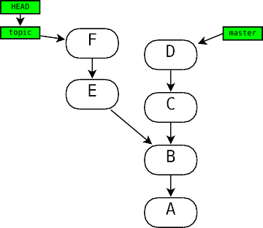
Rewriting history
Rebase vs. merge
We have development on both a topic branch and master.
Understanding Git
36 / 41

Slide 64
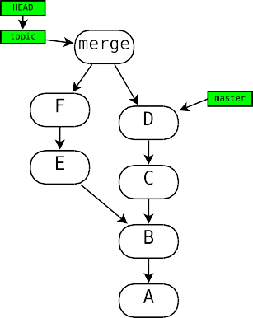
Rewriting history
Rebase vs. merge
merge results in a forked history:
Understanding Git
36 / 41

Slide 65
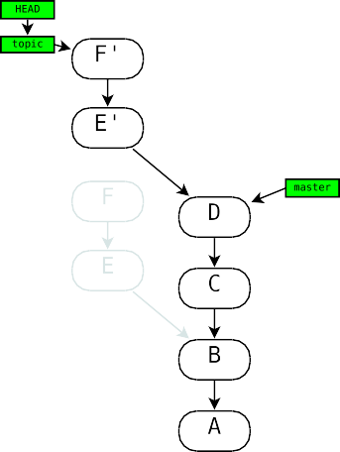
Rewriting history
Rebase vs. merge
rebase rewrites commits and maintains a linear history:
Understanding Git
36 / 41

Slide 66
Interactive rebasing
Rewriting history
git rebase -i commit Rebase HEAD onto commit , letting you
interactively edit the resulting history. (Typically commit will already be an ancestor of HEAD, to edit history “in place”.)
Git will start your editor on a list of the commits to be applied on top of commit.
You can cut and paste to arbitrarily reorder the commits. You can delete a line to remove that commit completely.
You can insert the squash directive to fuse a commit into the previous commit.
You can insert the edit directive to have Git pause after applying a commit, so you can amend it in place or insert new commits, before further commits are applied.
Understanding Git

Slide 67
Advanced rewriting
Rewriting history
git filter-branch Rewrite history by mapping each commit through
an arbitrary script.
.git/info/grafts
Causes the local repository to pretend that certain commits have different parents than their real ones. (git filter-branch can then rewrite the fake parents into real ones.)
Dump history in a human-readable format, with SHA-1 IDs replaced by symbolic marks, so that it can be edited by hand.
Read back commits produced by git fast-export.
git fast-export
git fast-import
Understanding Git

Slide 68


Outline
And beyond!
1
The Git model
2
Using Git
3
Collaboration with Git
4
Rewriting history
5
And beyond!
Understanding Git

Slide 69
Other awesome Git commands
And beyond!
git bisect
Easily pinpoint a regression in your history using a repeated bisection search.
Annotate each line of a file with information about its last modification.
git blame
git cvsimport, git svn Use Git to work with repositories in other
formats. (I think Git makes a much better CVS or SVN client than the native ones!)
git format-patch, git send-email, git am Send and receive Git
patches by email.
git grep git stash
Search for a regex in a Git tree.
Quickly stash away and reapply temporary changes while you do other work.
Manage a group of related Git repositories.
git submodule
Understanding Git

Slide 70
Exploring Git yourself
And beyond!
There are many commands we haven’t talked about, and the ones we have take additional options that can help you work more efficiently.
Anything you think you should be able to do within the Git model can probably be done.
Git is designed to be conveniently scriptable.
Git has extensive documentation—start with man git.
To get documentation on any git command , run git help command
or (equivalently) man git-command .
Understanding Git

