Slide 1
NBA ROSTER OPTIMIZATION ENGINE
Building the Statistically Optimal Team Under a Salary Cap
Data-Driven | PCA Composite Scoring | K-Means Archetypes | MILP Optimization | Synergy Model
1,185 Player-Seasons | 9 Validated Stats | 6 Archetypes | 10 Optimized Rosters

Slide 2
THE PROBLEM
NBA teams spend $150M+ on rosters — but how do you know you're spending it right?
Traditional roster building relies on scouts, gut feelings, and media narratives
Players are evaluated in isolation — but basketball is a team sport where fit matters
No single stat captures a player's total value — points ignore defense, rebounds ignore playmaking
GOAL: Build a mathematically optimal 15-man NBA roster that maximizes total player value
under a real salary cap constraint, using only publicly available data and zero human bias.

Slide 3
DATA COLLECTION
Source: NBA Stats API (nba_api) — official NBA.com backend. Same data NBA teams see.
3 seasons: 2021-22, 2022-23, 2023-24 (~400 players per season = 1,185 player-seasons)
Quality filter: minimum 20 games played and 10 minutes per game
Recency weights: 2021-22 (20%), 2022-23 (35%), 2023-24 (45%)
Salary data: 2023-24 verified contracts + 87 manual corrections for imputation errors
ON/OFF splits from 5-man lineup data (LeagueDashLineups API)
2-man lineup data for pairwise synergy computation (6,000+ pair-seasons)

Slide 4
FEATURE ENGINEERING — Cleaning the Signal
Team Context Adjustment: subtract team average from each stat to isolate individual contribution
Bayesian TS% Shrinkage: pull low-volume shooters toward league average (prevents small-sample inflation)
FG3% Neutralization: non-shooters (<0.5 FG3A/game) set to league avg — 'no info' not 'bad shooter'
W_PCT Residualization: OLS regression removes team-quality bias from ON_OFF_DIFF
INFLUENCE_SCORE = USG% x TS% — separates efficient volume scorers from inefficient ones
IS_SHOOTER flag: created before neutralization so optimizer knows who actually shoots threes

Slide 5
STAT SELECTION — Three-Framework Correlation Analysis
Framework 1: Team-adjusted stats vs Win% — which stats predict team winning?
Framework 2: Individual counting stats vs Win% — which individual skills tie to winning?
Framework 3: All stats vs Plus/Minus (team-adjusted) — captures invisible contributions
Spearman Validation: re-test everything with rank correlation to catch non-linear relationships
Selection Rule: stat included if p < 0.05 in at least one framework AND validated by Spearman
DREB_PCT eliminated: position-group adjustment revealed it was measuring height, not skill
RESULT: 9 stats survived — OFF_RATING_ADJ, DEF_RATING_ADJ, AST_PCT_ADJ, BLK, STL, TS%, FG3%, INFLUENCE_SCORE, ON_OFF_DIFF

Slide 6
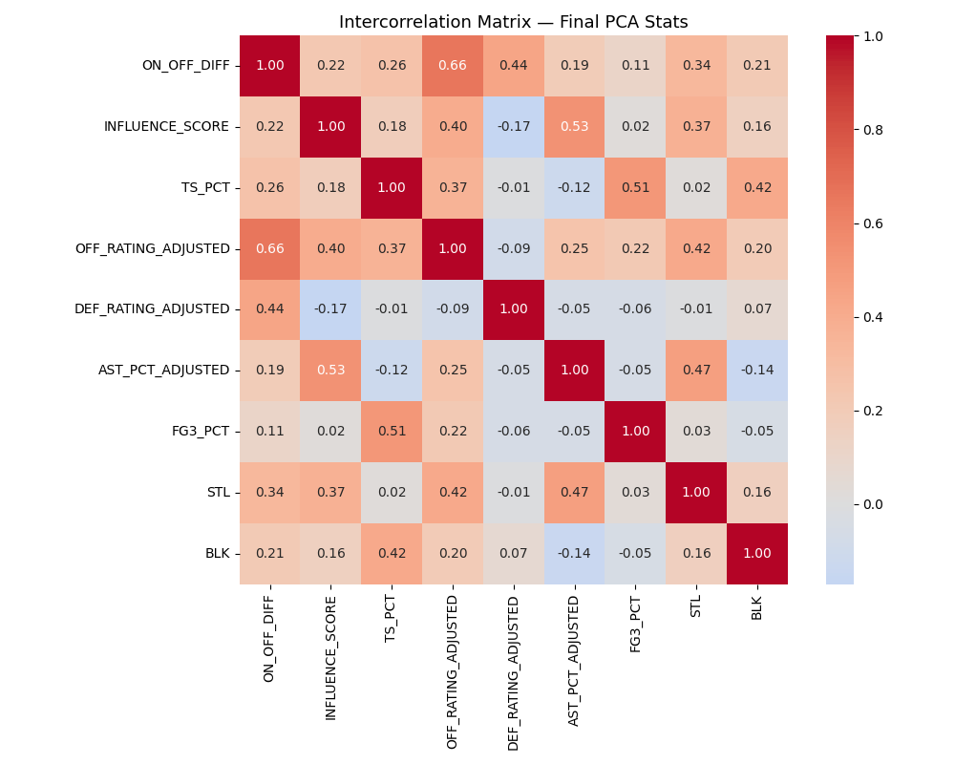
INTERCORRELATION CHECK
Before entering PCA, all 9 stats must be sufficiently independent. No pair exceeds |r| > 0.7 — each stat captures a unique dimension of player skill. PIE_ADJUSTED was removed due to r=0.78 with INFLUENCE_SCORE (redundant).

Slide 7
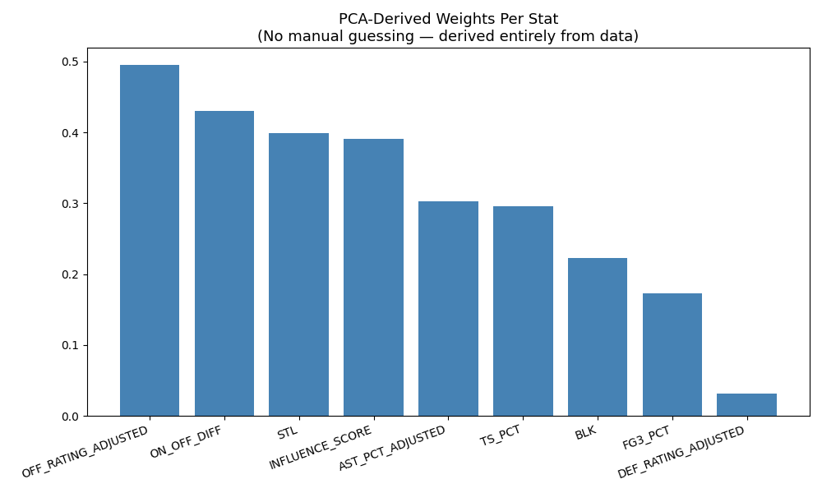
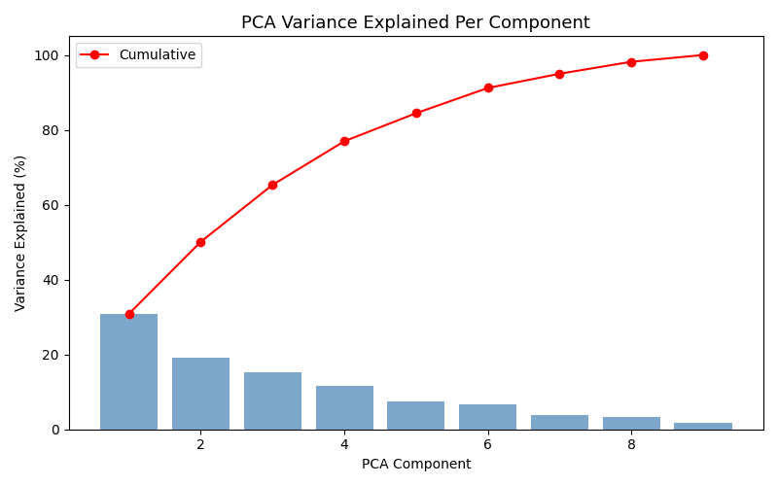
PCA — Deriving the Composite Score
PCA (Principal Component Analysis) takes 9 stats per player and compresses them into a single score (0-100). The weights are not chosen by us — they are derived entirely from the data. PC1 alone captures ~30% of variance. We use PC1+PC2+PC3 (65% combined), weighted by their variance-explained shares: PC1: 47% | PC2: 29% | PC3: 24% This ensures the dominant basketball excellence signal (PC1) carries the most weight while PC2/PC3 add independent information.

Slide 8
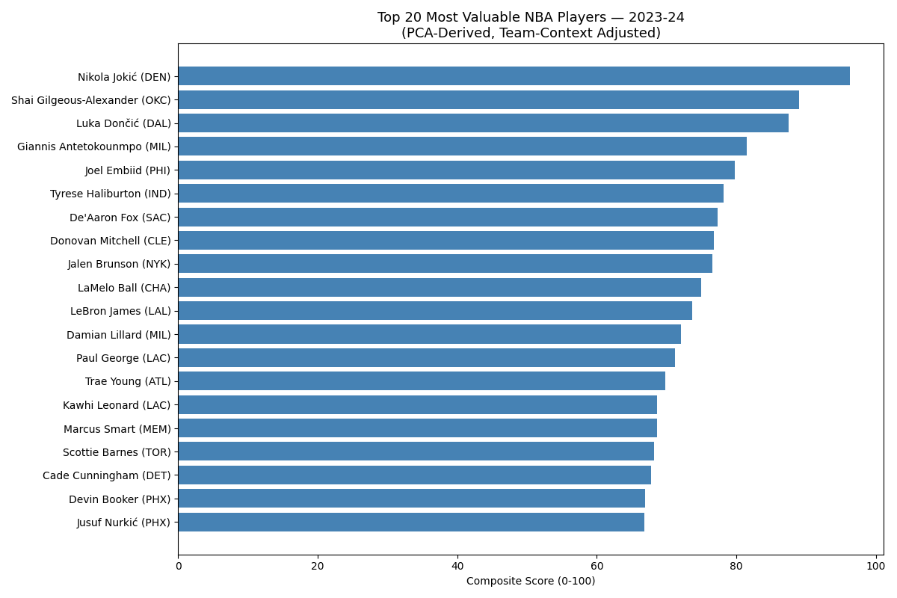
TOP 20 PLAYERS — 2023-24
1. Nikola Jokić 96.3 2. Shai Gilgeous-Alexander 89.0 3. Luka Dončić 87.5 4. Giannis Antetokounmpo 81.5 5. Joel Embiid 79.8 6. Tyrese Haliburton 78.2 7. De'Aaron Fox 77.3 8. Donovan Mitchell 76.7 9. Jalen Brunson 76.6 10. LaMelo Ball 75.0 11. LeBron James 73.6 12. Damian Lillard 72.1 13. Paul George 71.2 14. Trae Young 69.8 15. Kawhi Leonard 68.7 16. Marcus Smart 68.6 17. Scottie Barnes 68.2 18. Cade Cunningham 67.8 19. Devin Booker 66.9 20. Jusuf Nurkić 66.8

Slide 9
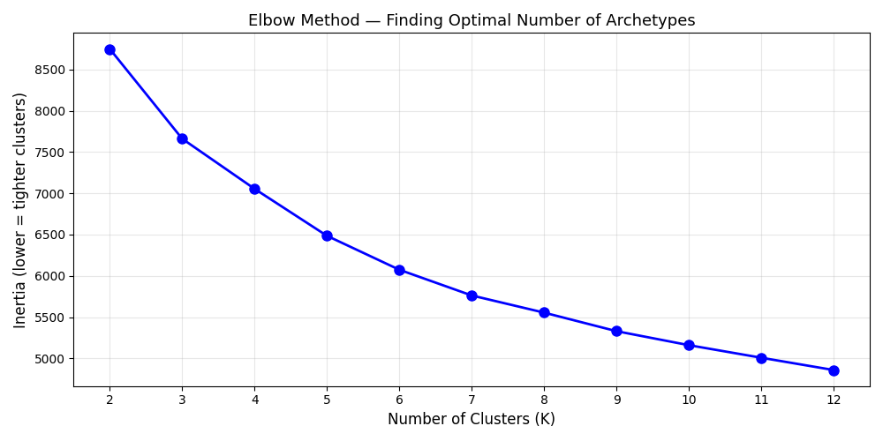
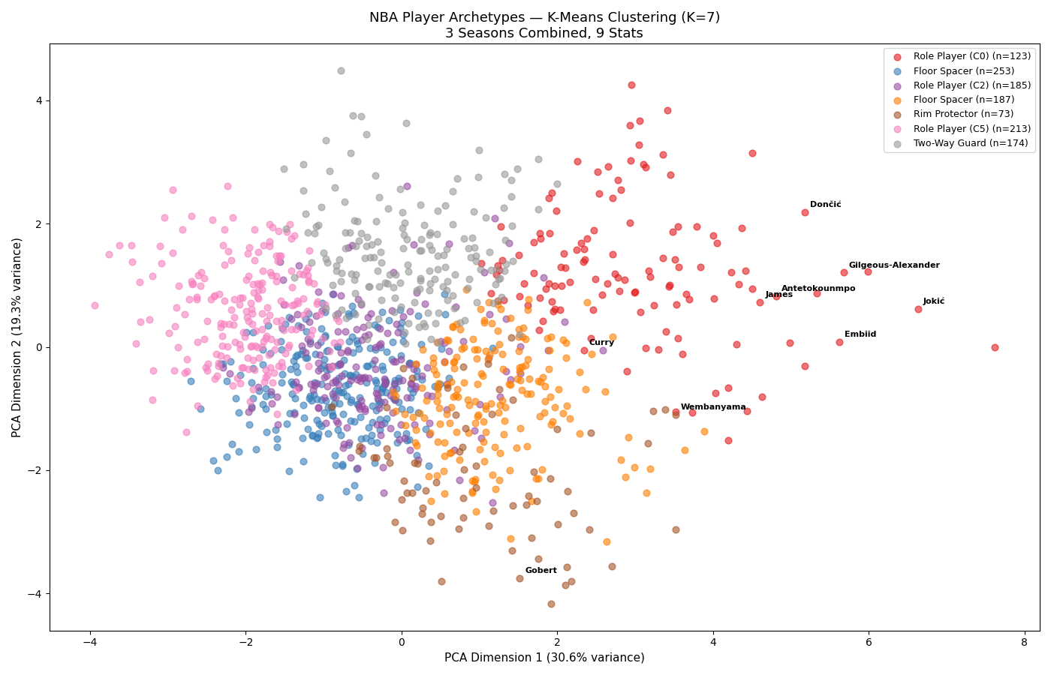
K-MEANS CLUSTERING — Discovering Player Archetypes
K-Means groups 1,185 player-seasons into clusters based on their 9-stat profiles. Players with similar statistical fingerprints land in the same group. Elbow method validated K=7 as optimal (7 clusters mapped to 6 archetype labels). Dynamic labeling: archetypes assigned by centroid statistics, not hardcoded cluster numbers. This prevents labels from breaking when data changes.
6 ARCHETYPES: Elite Playmaker — Jokic, SGA, Luka, Embiid, Giannis Two-Way Big — Wembanyama, AD, Gobert Versatile Scorer — Franz Wagner, Garland, Randle Defensive Wing — OG Anunoby, KCP, Aaron Gordon Perimeter Scorer — Markkanen, RJ Barrett Bench / Role Player — Depth pieces

Slide 10
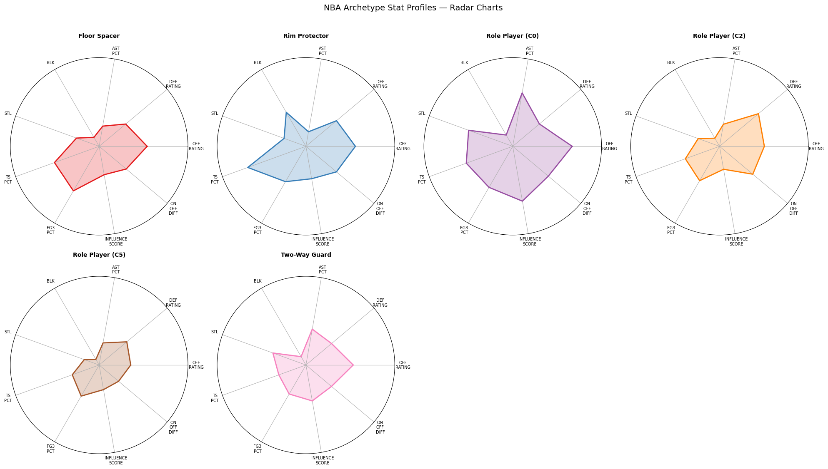
ARCHETYPE STAT PROFILES
Each archetype has a distinct statistical fingerprint — radar charts show average stat profile on a 0-1 normalized scale.

Slide 11
MILP OPTIMIZATION — Building the Roster
MILP (Mixed Integer Linear Programming): mathematically proven optimal solution, not heuristic
399 binary decision variables: each player is either on the roster (1) or not (0)
Objective: maximize total composite score (or variant objectives per scenario)
HARD CONSTRAINTS:
- Salary cap (varies by scenario: $90M to $165M)
- Exactly 15 players on the roster
- Archetype minimums (at least 1 Elite Playmaker, 2 Two-Way Bigs, etc.)
- Max 2 players from any single NBA team (team diversity)
- Max 5 big men on roster
VARIANT CONSTRAINTS (per scenario):
- Rebuild: at least 9 players age 24 or younger
- Win-Now: at least 9 veterans age 28 or older
- Three-Point Era: at least 10 real shooters (IS_SHOOTER flag)
- Small Ball: max 1 Two-Way Big

Slide 12
SYNERGY MODEL — Player Chemistry
PROBLEM: The base optimizer treats players independently. Basketball is a team sport.
Some pairs elevate each other (Jokic + shooters). Some pairs clash.
THREE SYNERGY LAYERS:
Layer 1 — Player Profile: each player's average NET_SYNERGY across all observed 2-man pairs.
Players who consistently elevate teammates get a score boost. Weight = 0.4.
Layer 2 — Pairwise Bonus: if two specific players with observed positive synergy are both
selected, the optimizer gets a bonus. Linearized via binary y_ij variables in MILP.
Layer 3 — Defensive Coverage Zones: hard constraints requiring paint protection (BLK >= 1.5),
perimeter disruption (STL >= 1.3), and switchability (4+ defensive-archetype players).
VALIDATION: W_NET_SYNERGY has highest correlation with Win% (r=+0.568) across all 3 seasons.
The data chose NET_SYNERGY — not us.

Slide 13
10 OPTIMIZATION SCENARIOS
Scenario A — Hard Cap ($136M) Standard baseline roster Scenario B — Luxury Tax ($165M) Best roster money can buy Scenario C — Budget Team ($90M) Small-market constraint Scenario D — Rebuild Mode ($136M) Min 9 players age <= 24 Scenario E — Win-Now ($165M) Min 9 veterans age >= 28 Scenario F — Defensive Identity Maximize defensive rating Scenario G — Offensive Identity Maximize offensive rating Scenario H — Three-Point Era Min 10 real 3PT shooters Scenario I — Small Ball Max 1 Two-Way Big Scenario J — Value / Efficiency Maximize VORPD (Moneyball)
Each scenario solves a different real-world GM question. All 10 produce mathematically optimal rosters — proven by the MILP solver, not approximated.

Slide 14
SCENARIO A — Hard Cap Roster ($136M)
# Player Archetype Score Salary ------------------------------------------------------------------------------ 1 Shai Gilgeous-Alexander Elite Playmaker 89.1 $ 33,729,226 2 Marcus Smart Elite Playmaker 70.4 $ 17,528,347 3 Jusuf Nurkić Perimeter Scorer 67.7 $ 17,048,050 4 Victor Wembanyama Two-Way Big 65.6 $ 11,770,308 5 Tre Jones Defensive Wing 63.2 $ 7,039,195 6 De'Anthony Melton Perimeter Scorer 61.6 $ 2,710,900 7 Bogdan Bogdanović Perimeter Scorer 59.1 $ 14,095,988 8 Russell Westbrook Versatile Scorer 58.6 $ 2,020,490 9 Dennis Smith Jr. Defensive Wing 58.5 $ 3,000,000 10 Alperen Sengun Elite Playmaker 55.7 $ 3,922,440 11 Tari Eason Defensive Wing 54.2 $ 4,994,103 12 Scotty Pippen Jr. Elite Playmaker 53.7 $ 1,998,018 13 Vasilije Micic Versatile Scorer 50.0 $ 2,000,000 14 Chet Holmgren Two-Way Big 40.2 $ 12,082,222 15 Bones Hyland Bench / Role Player 33.3 $ 2,020,490 TOTAL 880.9 $135,959,777

Slide 15
BUGS FOUND & FIXED — Quality Assurance
87 salary imputation errors: Jimmy Butler showed $1.1M instead of $45.2M. Manually verified all 87.
74 duplicate player-season rows: NBA API artifact. Same player selected twice on roster. Fixed with dedup.
Hardcoded cluster labels broke on every data change: Jokic labeled 'Bench Player'. Fixed with dynamic centroid labeling.
Non-shooters passed 3PT constraint: FG3% neutralization set Gobert to league avg, making him a 'shooter'. Fixed with IS_SHOOTER flag.
Stale archetype name 'Two-Way Guard': optimizer constraint silently matched 0 players. Renamed to 'Versatile Scorer'.
Equal PCA weights: LaMelo ranked #4 over Embiid. Fixed with variance-explained weighting.
Stale methodology text: dashboard described old approach. Corrected.
AUTOMATED VERIFICATION: 175 checks across all pipeline outputs — all passing.

Slide 16
LIMITATIONS — What the Model Cannot Do
1. Salary Approximation: older-season salaries estimated via cap-ratio scaling, not actual contracts.
2. Defensive Measurement: DEF_RATING is shared across all 5 players on court — can't assign individual credit.
PCA weight of 0.039 reflects this honest limitation. STL and BLK carry the defensive signal instead.
3. Advanced Defensive Stats: D-EPM and D-LEBRON require proprietary tracking data (Second Spectrum).
Public APIs don't expose this. NBA front offices have better defensive data than we do.
4. Team Context: residualization reduces but can't fully eliminate teammate-quality contamination.
Role players on elite teams still get a slight bump.
5. No Future Projection: model scores past performance, not future potential. Can't predict breakouts,
aging curves, or injuries. Builds the best team from what already happened.

Slide 17
PIPELINE ARCHITECTURE — 9 Scripts, End to End
fix_salaries.py Correct 87 salary imputation errors in master data | 01_feature_engineering Team adjustment, Bayesian shrinkage, correlation analysis, | PCA scoring, VORPD computation v 02_clustering K-Means (K=7) on 9 stats -> 7 clusters | 03_fix_labels Dynamic centroid-based archetype labeling -> 6 names | 04_optimizer_expanded Pre-synergy MILP optimizer (10 scenarios) | 05_compute_synergy 2-man lineup synergy (DEF + OFF + NET) | 06_validate_synergy Statistical validation (W_NET_SYNERGY r=+0.568 vs W_PCT) | 07_optimizer_synergy Final MILP with 3-layer synergy model (10 scenarios) | 08_build_dashboard Excel dashboard (8 tabs) + Charts | 09_verify_pipeline 175 automated checks — all passing

Slide 18
TOOLS & TECHNOLOGIES
Python 3 — primary language for all pipeline scripts
pandas / NumPy — data manipulation and numerical computation
scikit-learn — PCA, K-Means clustering, StandardScaler
SciPy — Pearson and Spearman correlation analysis
PuLP (CBC solver) — Mixed Integer Linear Programming optimization
matplotlib / seaborn — statistical visualization (7 charts)
openpyxl — Excel dashboard generation (8 tabs)
nba_api — official NBA Stats API data extraction
python-pptx — this presentation

Slide 19
NBA ROSTER OPTIMIZATION ENGINE
1,185 players scored | 175 automated checks passed | 10 optimized rosters
Public data. Zero bias. Mathematically proven optimal.

