Slide 1
Network providers would like to integrate with oVirt
Nuage
Midokura
Cisco
…
OpenStack Neutron API is planned as the standard API for external network providers

Slide 2
Setting up Neutron or providing it along ovirt-engine is cumbersome ...
… but all we need it the Neutron API
Engine
KeyStone
3rd party mgmt
Neutron

Slide 3
A simple tool mocking Keystone and Neutron is all that is needed to show the communication details.
Engine
KeyStone Mock
Neutron Mock

Slide 4
The external provider API in oVirt uses 3 API calls:
authentication (Keystone)
connection test (Neutron)
network list (Neutron)
authentication
KeyStone Mock
Engine
Neutron Mock
connection test
network list

Slide 5
The tool mock the 3 calls.
It accepts queries from the oVirt engine, and provides a response like Neutron.
POST: http://host::35357/v2.0/tokens
Headers: Accept=application/json
{
"username": <user name>,
"password": <password>
}
Engine
Neutron Mock Tool
Response code: 200
"Content-Type", "Application/json"
{
"token":"b591657e.."
}

Slide 6
Going into details:
Adding a network provider to ovirt engine
(using the provider mock tool)

Slide 7
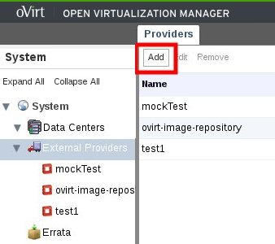
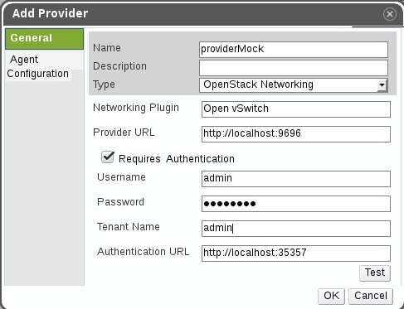
Adding a network provider to ovirt engine
Click “Add” button.
Fill out the fields as shown above.
- Name
- Provider URL – (eg. http://<host>:9696)
- Authentication URL – (eg. http://<host>:35357)
The other authentication fields are ignored by the provider mock tool.
The “Test” button will verify if the connection to the provider is successful.

Slide 8
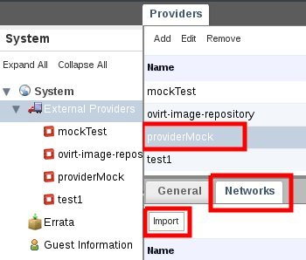
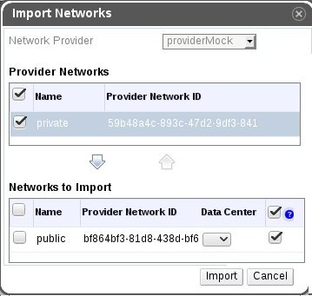
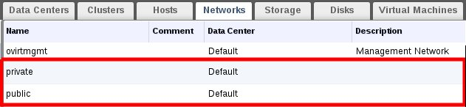
Importing networks from external provider
In the newly created network provider go to the “Networks” tab.
Click “Import buton”.
Mark the networks you want to import and move them using the down arrow.
Check Networks to see the imported networks.

Slide 9
Even deeper into the details:
Protocol details

Slide 10
Authentication
Query from ovirt engine:
POST: http://<host>:<port – default:35357>/v2.0/tokens
Headers: Accept=application/json
Body:
{ "auth": {
"tenantName": <tenant name>,
"passwordCredentials": {
"username": <user name>,
"password": <password>
}}}
Minimal response from provider:
Response code: 200
Required headers: "Content-Type", "Application/json"
Body:
{
"access":{
"token":{
"id": "b591657e28e54b4ca1032cfc3e426e0a"
}}}
The token id must be used as the value of the “X-Auth-Token” header to authenticate any following requests

Slide 11
Test connection
Query from ovirt engine:
GET: http://<host>:<port – default:9696>/v2.0/
Headers:
Accept=application/json
X-Auth-Token=<token from authentication request>
Minimal response from provider:
Response code: 200
Required headers: "Content-Type", "Application/json"
Body: anything, ovirt engine just checks the response code

Slide 12
Network import
Query from ovirt engine:
GET: http://<host>:<port – default:9696>/v2.0/networks/
Headers:
Accept=application/json
X-Auth-Token=<token from authentication request>
Minimal response from provider:
Response code: 200
Required headers: "Content-Type", "Application/json"
Body (with sample values):
"networks": [
{
"status": "ACTIVE",
"subnets": ["dc594048-a9e2-4ec9-9928-4157cea7e530"],
"name": "public",
"provider:physical_network": null,
"admin_state_up": true,
"tenant_id": "547deac3d7f64e2688de188365a139aa",
"mtu": 0,
"router:external": true,
"shared": false,
"provider:network_type": "vxlan",
"id": "bf864bf3-81d8-438d-bf68-4b0c357309b3",
"provider:segmentation_id": 35
},
{ … }
}

Slide 13
Running the mock tool
python httpServer.py

