Slide 1
Collection Tree Protocol
Omprakash Gnawali (Stanford University)
with
Rodrigo Fonseca (Brown University)
Kyle Jamieson (University College London)
David Moss (People Power Company)
Philip Levis (Stanford University)
ACM SenSys
November 4, 2009

Slide 2
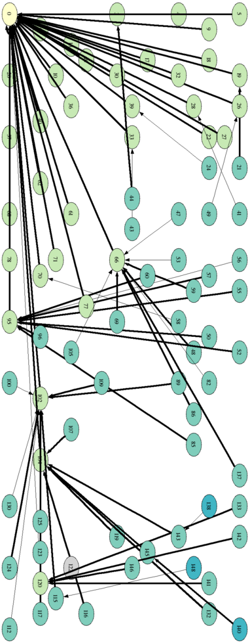
Collection
sink
Anycast route to the sink(s)
  Used to collect data from the network to a small number of sinks (roots, base stations)
  Network primitive for other protocols
A distance vector protocol

Slide 3
Common Architecture
Control Plane
Data Plane
Router
Application
Fwd
Table
Link Estimator
Forwarder
Link Layer

Slide 4
Prior Work
Control Plane
Data Plane
ETX, MT, MultiHopLQI, EAR, LOF, AODV, DSR, BGP, RIP, OSPF, Babel
Flush, RMST, CODA, Fusion, IFRC, RCRT
Link Layer

Slide 5
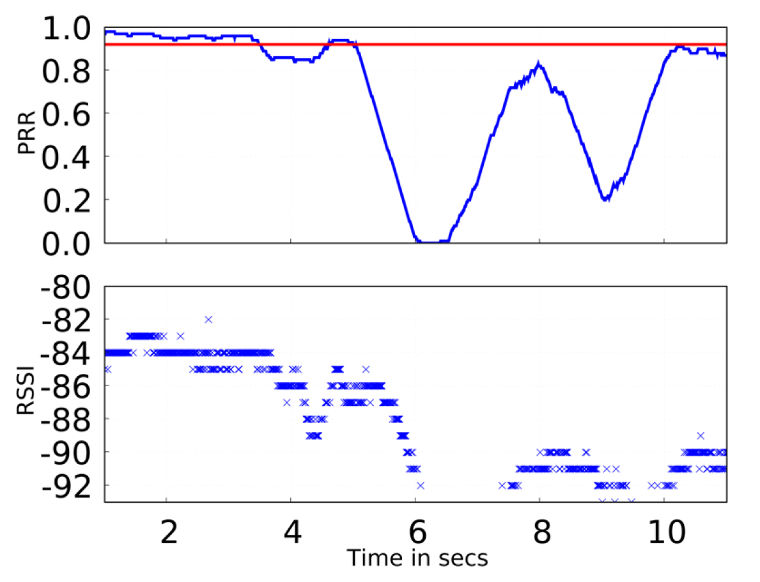
Wireless Link Dynamics
0.9
1s

Slide 6
Control and Data Rate Mismatch
Can lead to poor performance
Control Plane
Data Plane
1 beacon/30s
1 beacon/s
10 pkt/s
0 pkt/s
Link Layer

Slide 7
CTP Noe
Control Plane
Data Plane
Router
Application
Link Estimator
Forwarder
Link Layer

Slide 8
CTP Noe’s Approach
Enable control and data plane interaction
Two mechanisms for efficient and agile topology maintenance
  Datapath validation
  Adaptive beaconing
Control
Plane
Data
Plane

Slide 9
Summary of Results
90-99.9% delivery ratio
  Testbeds, configurations, link layers
Compared to MultihopLQI
  29% lower data delivery cost
  73% fewer routing beacons
  99.8% lower loop detection latency
Robust against disruption
Cause for packet loss vary across testbeds

Slide 10
Outline
Collection
Datapath validation
Adaptive beacons
Evaluation
Conclusion

Slide 11
Datapath validation
Use data packets to validate the topology
  Inconsistencies
  Loops
Receiver checks for consistency on each hop
  Transmitter’s cost is in the header
Same time-scale as data packets
  Validate only when necessary

Slide 12
Routing Loops
X
  Cost does not decrease
3.2
C
8.1
B
4.6
D
A
6.3
5.8

Slide 13

Routing Consistency
Next hop should be closer to the destination
Maintain this consistency criteria on a path
Inconsistency due to stale state
n_{i}
n_{i+1}
n_{k}

Slide 14
Detecting Routing Loops
Datapath validation
  Cost in the packet
  Receiver checks
Inconsistency
  Larger cost than
  on the packet
On Inconsistency
  Don’t drop the packets
  Signal the control plane
3.2 < 4.6?
X
8.1 < 4.6?
8.1
3.2
C
8.1
4.6<5.8?
4.6 < 6.3?
4.6
4.6
B
4.6
6.3
5.8 < 8.1?
5.8
D
A
6.3
5.8

Slide 15
Outline
Collection
Datapath validation
Adaptive beacons
Evaluations
Conclusion

Slide 16
How Fast to Send Beacons?
Using a fixed rate beacon interval
  Can be too fast
  Can be too slow
  Agility-efficiency tradeoff
Agile+Efficient possible?

Slide 17
Routing as Consistency
Routing as a consistency problem
  Costs along a path must be consistent
Use consistency protocol in routing
  Leverage research on consistency protocols
  Trickle

Slide 18
Trickle
Detecting inconsistency
  Code propagation: Version number mismatch
  Does not work for routing: use path consistency
Control propagation rate
  Start with a small interval
  Double the interval up to some max
  Reset to the small interval when inconsistent

Slide 19
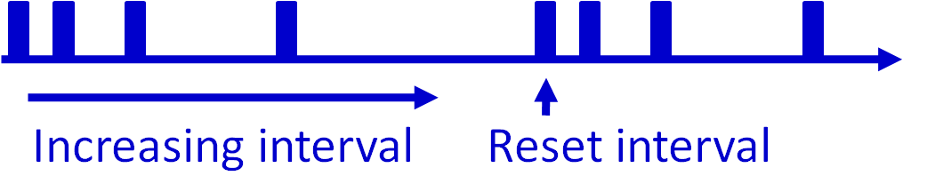
Control Traffic Timing
Extend Trickle to time routing beacons
Reset the interval
    ETX(receiver) >= ETX(sender)
    Significant decrease in gradient
    “Pull” bit
TX

Slide 20
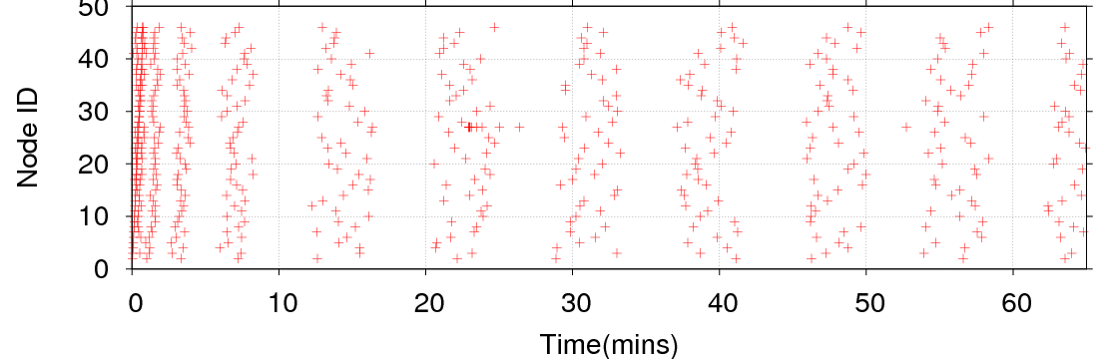
Adaptive Beacon Timing
~ 8 min
Tutornet
Infrequent beacons in the long run

Slide 21

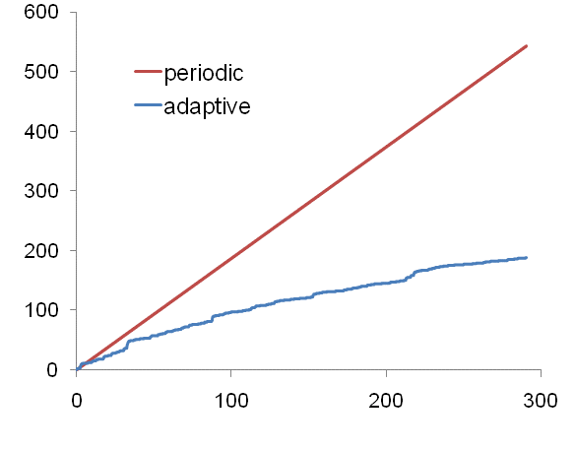
Adaptive vs Periodic Beacons
1.87
beacon/s
0.65
beacon/s
Tutornet
Time (mins)
Less overhead compared to 30s-periodic

Slide 22

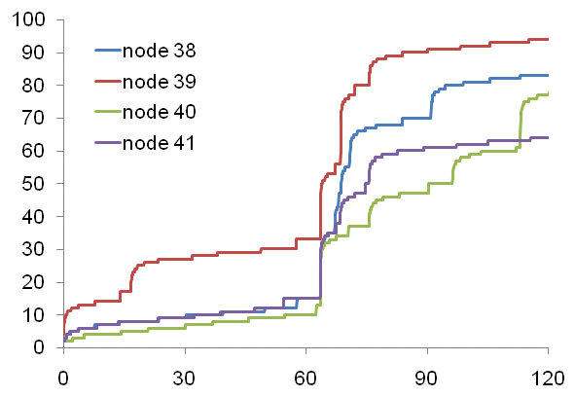
Node Discovery
A new node introduced
Path established in < 1s
Tutornet
Time (mins)
Efficient and agile at the same time

Slide 23
Outline
Collection
Datapath validation
Adaptive beacons
Evaluation
Conclusion

Slide 24
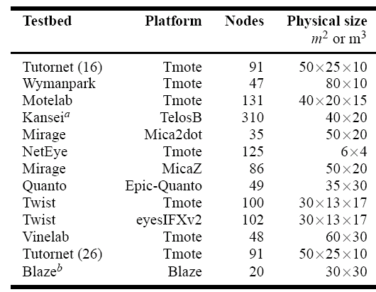
Experiments
12 testbeds
20-310 nodes
7 hardware
platforms
4 radio
technologies
6 link layers
Variations in hardware, software, RF environment, and topology

Slide 25
Evaluation Goals
Reliable?
  Packets delivered to the sink
Efficient?
  TX required per packet delivery
Robust?
  Performance with disruption

Slide 26
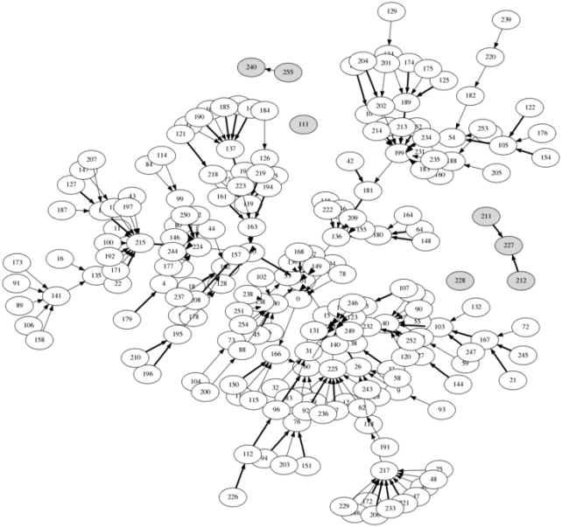
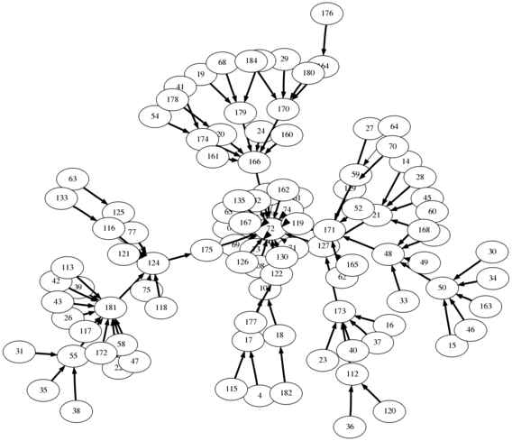
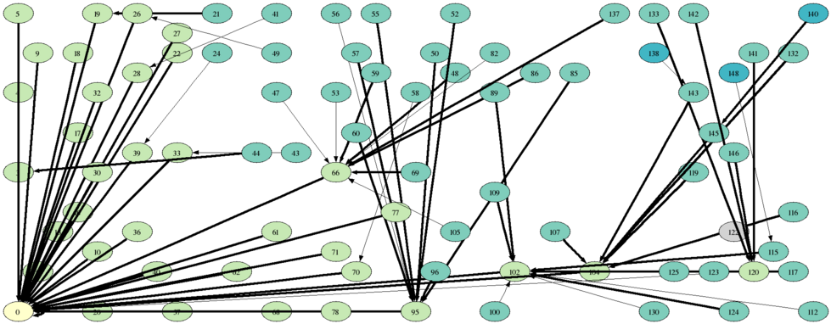
CTP Noe Trees
Kansei
Twist
Mirage

Slide 27
Reliable, Efficient, and Robust
Testbed | Delivery Ratio
Wymanpark | 0.9999
Vinelab | 0.9999
Tutornet | 0.9999
NetEye | 0.9999
Kansei | 0.9998
Mirage-MicaZ | 0.9998
Quanto | 0.9995
Blaze | 0.9990
Twist-Tmote | 0.9929
Mirage-Mica2dot | 0.9895
Twist-eyesIFXv2 | 0.9836
Motelab | 0.9607
False ack
Retransmit
High end-to-end delivery ratio
(but not on all the testbeds!)

Slide 28
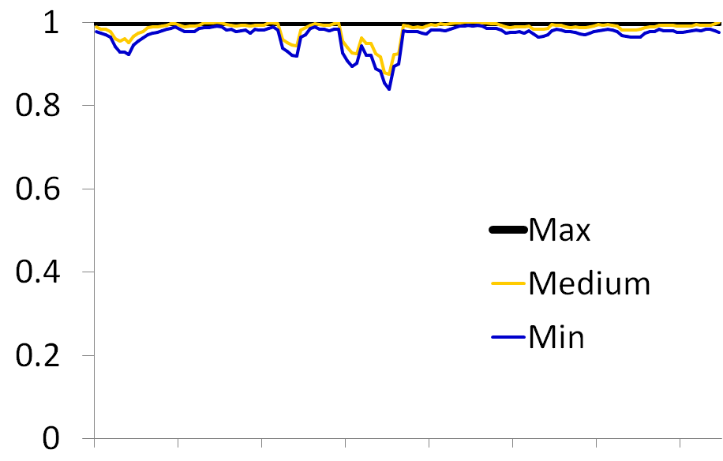

Reliable, Efficient, and Robust
0.98
5 10 15 20 25 30 35
Tutornet
Time (hrs)
High delivery ratio across time
(short experiments can be misleading!)

Slide 29
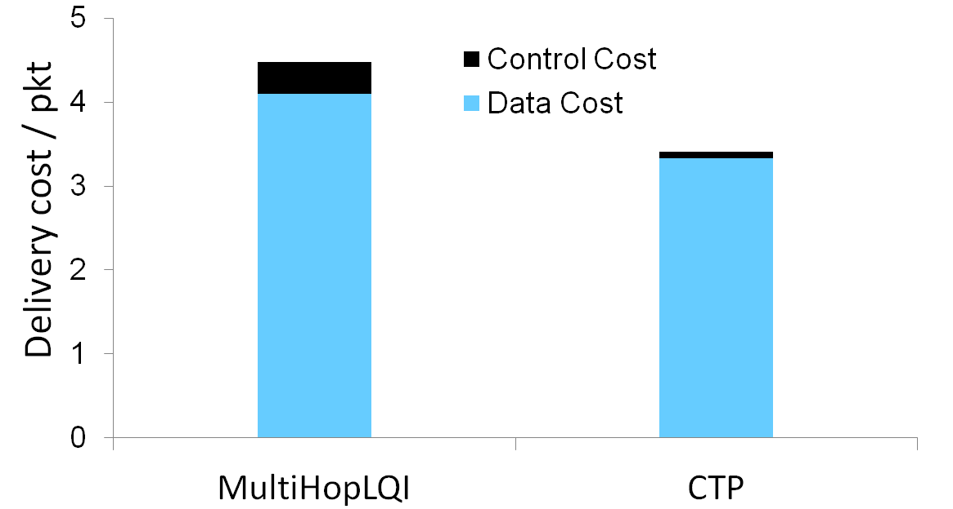
Reliable, Efficient, and Robust
Tutornet
CTP Noe
Low data and control cost

Slide 30
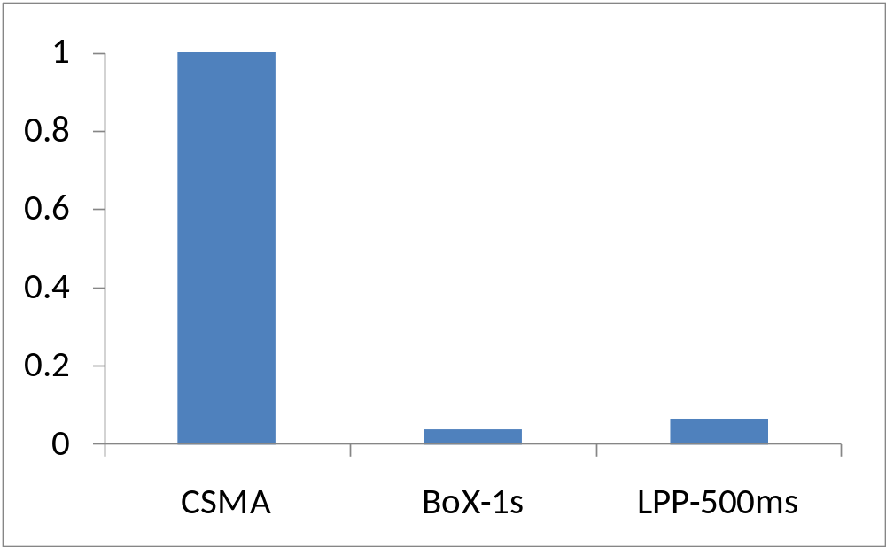

Reliable, Efficient, and Robust
0.028
0.066
Motelab, 1pkt/5min
Link Layer
Low duty-cycle with low-power MACs

Slide 31
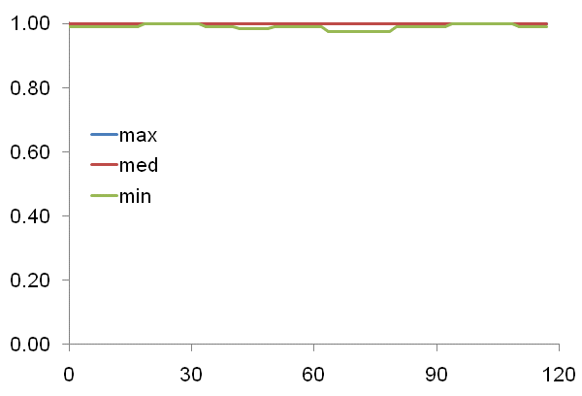

Reliable, Efficient, and Robust
10 out of 56 nodes
removed at
t=60 mins
Tutornet
Time (mins)
No disruption in packet delivery

Slide 32
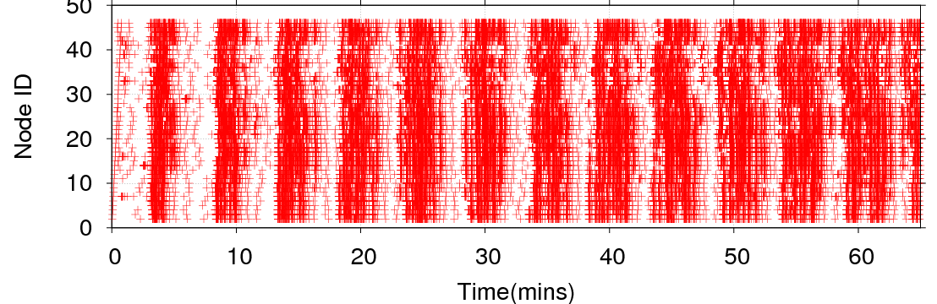
Reliable, Efficient, and Robust
Nodes reboot every 5 mins
Routing Beacons
~ 5 min
Tutornet
Delivery Ratio > 0.99
High delivery ratio despite serious network-wide disruption
(most loss due to reboot while buffering packet)

Slide 33
CTP Noe Performance Summary
Reliability
  Delivery ratio > 90% in all cases
Efficiency
  Low cost and 5% duty cycle
Robustness
  Functional despite network disruptions

Slide 34
Acknowledgment
For testbed access and experiment help
Anish Arora
Geoffrey Werner Challen
Prabal Dutta
David Gay
Stephen Dawson-Haggerty
Timothy Hnat
Ki-Young Jang
Xi Ju
Andreas Köpke
Razvan Musaloiu-E.
Vinayak Naik
Rajiv Ramnath
Mukundan Sridharan
Matt Welsh
Kamin Whitehouse
Hongwei Zhang
For bug reports, fixes, and discussions
Mehmet Akif Antepli
Juan Batiz-Benet
Jonathan Hui
Scott Moeller
Remi Ville
Alec Woo
and many others…
Thank You!

Slide 35
Conclusion
“Hard” networks → good protocols
  Tutornet & Motelab
Wireless routing benefits from data and control plane interaction
Lessons applicable to distance vector routing
  Datapath validation & adaptive beaconing
Data trace from all the testbeds available at
http://sing.stanford.edu/gnawali/ctp/

