Slide 1
eXtend Collection Tree Protocol
Bruno P. Santos¹
with
Marcos A. M. Vieira¹
Luiz F. M. Vieira¹
¹Universidade Federal de Minas Gerais, Brazil.

Slide 2
Communication paradigms in wns many-to-one, one-to-many, and any-to-any
Anycast route to the sink(s)
  Used to data collection from the network
Problem
  Impossible check data delivery
Notes:
First two paradigms allow the collection and dissemination of data respectively. However, with routing on
only one direction, it is infeasible to build reliable mechanisms to ensure the delivery of data end-to-end.

Slide 3
Communication paradigms in wns many-to-one, one-to-many, and any-to-any
Propagating or Anycast from Sink to nodes
  Used to data dissemination in the network
  Reconfigure nodes
Problem
  Impossible check data delivery
  How create unicast routes?
Notes:
First two paradigms allow the collection and dissemination of data respectively. However, with routing on
only one direction, it is infeasible to build reliable mechanisms to ensure the delivery of data end-to-end.

Slide 4
Communication paradigms in wns many-to-one, one-to-many, and any-to-any
More generic paradigm
  Enable unicast routes between any pair of nodes
  Reconfigure nodes
Problem
  Adds more complexity
  Requires large amounts of memory

Slide 5
eXtend Collection Tree Protocol (XCTP)
An extension of the Collection Tree Protocol
Uses CTP to create routing tree to collection
XCTP create reverse path enabling
  Sink to nodes
  Nodes to sink

Slide 6
Prior work
One-to-many
(Dissemination)
Unreliable
Many-to-one
(Collection)
Unreliable
Directed Diffusion,
DRIP, DIP, DHV,
Deluge
CTP, MultiHopLQI,
MintRoute
XCTP
Collection
Reliable
Hydro, RPL. AODV, DSR, Dymo
Any-to-any
Reliable
Notes:
Directed Diffusion and DIP, DRIP, DHV are used for dissemination of small data packets in the network.
Deluge is a protocol that operates under the one-to-many paradigm, which has the objective to propagate large amount of data
CTP is the de-facto standard collection routing protocol for Wireless Sensor Network and his results are better the MultiHopLQI and MintRoute.
Hydro, RPL. AODV, DSR, and Dymo are P2P protocols.
Hydro and RPL use tables schemes to stoge routes for any node. RPL uses several messages types to create DAGs to routing messages. RPL uses requires control packets to create downward routes, XCTP
does not have this overhead since XCTP takes advantage of thedata packets.
AODV, DSR and Dymo floods the network with messages RREQ. DSR uses packet header to store the route path. AODV and DSR are keep routes in memory.
XCTP focus in creating unicast routes to exchange messages in both directions root-to-node and vice-versa. XCTP create the routes using DATA PACKETS instead CONTROL PACKETS.
XCTP also allows non utilized downward routes to be removed through TTL-based policy avoiding memory overhead to store states with peer-to-peer routes that are underutilized.

Slide 7
XCTP Architecture
Control plane
Data plane
Router
Forward table
Interface to upper layer
Link Estimator
Reverse table
Forwarder
Link Layer
Notes:
The XCTP architecture major changes are highlighted in yellow and bold font
To accomplish the task of forwarding packets also in the reverse direction of the standard CTP data flow, we had to modify CTP architecture by adding new features to the protocol rules as well as incrementing the packet format.
We also created a reverse flow table.
The CTP rules were modified at the data and control planes to react appropriately to the two main events:
Reverse flow: correct and efficient installation of the reverse flow rules;
Topological changes: nodes must appropriately react when loops occur or when CTP unicast routes change.
The Router module is responsible for filling the Forward and Reverse tables
The Forward module queries the Forward and Reverse tables, and determines any router inconsistencies to inform the Router module
Upper Layer module is the interface provided to implement components that utilizes XCTP.

Slide 8
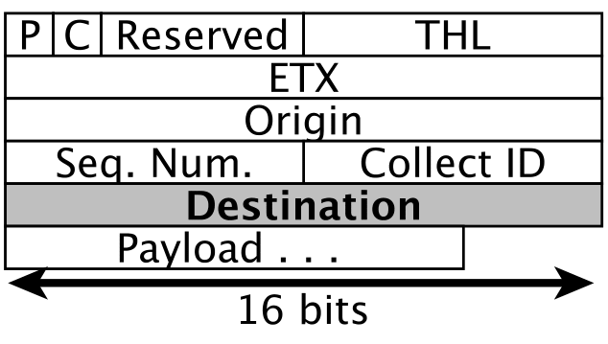
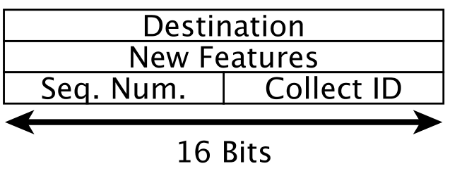
XCTP Packets
Data Packet
Acknowledgment Packet
Notes:
To allow the navigation of the reverse data packet, we added a 16 bits packet field to the data packet to represent the address of the message destination.
All fields are present in CTP data packet, except by “Destination” field
We created Acknowledgment packet type. The New Features field 16 bits is reserved for future features.

Slide 9
Outline
Collection Reliable
Reverse Flows
Topological Changes
Evaluation
Conclusion
Notes:
XCTP create rules in data and control planes to react

Slide 10
XCTP’s Reverse Flows
XCTP create reverse fluxes with
  Data Packet or
  Sink command
Read tables to downward packets
  Neighbor (from Link Layer), Reverse, and Forward
Fields Reverse Flow Table
  addr dest (tree descendant 2+ hops distance)
  next hop
  Time To Live (TTL)

Slide 11
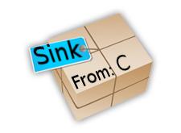
XCTP Create Reverse Flows
Tree to Sink
CTP create tree route
Table starts empty
Node C send a packet
Node A intercept a packet From C to Sink
Reverse route installed
A :Reverse Table
Dest | Next Hop | TTL
A :Reverse Table
Dest | Next Hop | TTL
C | B | 10
A
B
D
C

Slide 12
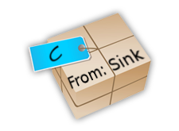
XCTP Read Reverse Flows
Tree to Sink
Sink send packet to C
Node A intercept the packet and read tables
  Neighbor table (Not found)
  Reverse Table (Found)
  Forward table
Node A send uncast message to B
B delivery to C
A :Reverse Table
Dest | Next Hop | TTL
A :Reverse Table
Dest | Next Hop | TTL
C | B | 10
A
B
D
C

Slide 13
Outline
Collection Reliable
Reverse Flows
Topological Changes
Evaluation
Conclusion
Notes:
XCTP create rules in data and control planes to react

Slide 14
Outline
Collection Reliable
Reverse Flows
Topological Changes
Evaluation
Conclusion
Notes:
XCTP create rules in data and control planes to react

Slide 15
Outline
Collection Reliable
Reverse Flows
Topological Changes
Evaluation
Conclusion
Notes:
XCTP create rules in data and control planes to react

