Slide 1
eXtend Collection Tree Protocol
Bruno P. Santos
with
Marcos Augusto M. Vieira
Luiz Filipe M. Vieira
Universidade Federal de Minas Gerais
March, 2015

Slide 2
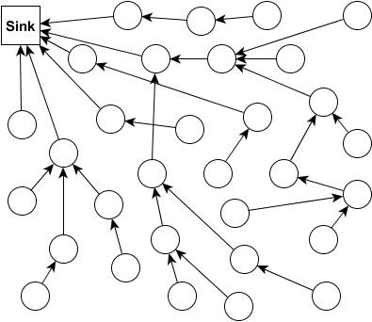
Many-to-ond (data collection)

