Slide 1
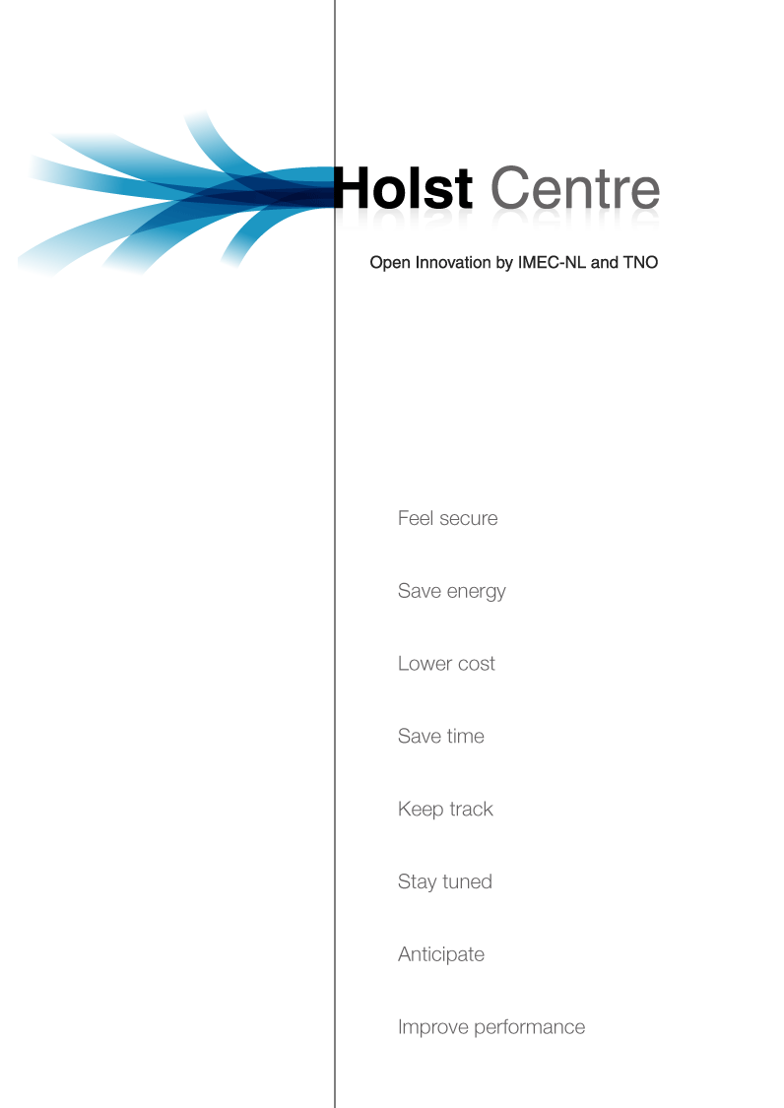


Slide 2
New approaches for IMEC Wireless Sensors applications
MAC protocols and TinyOS

Slide 3
Outline
Wireless Sensors Networks for Biomedical Applications
Current approach
Tinyos
Stand-Alone applications vs. Tinyos
MAC protocols and TinyOS
Consortium
Roadmap
Tinyos Setup
  Imec SensorCube
  Imec USB Stick
  TOSSIM
  PowerTOSSIM
Design and Implementation os MAC protocols
  TDMA scheme
  S-MAC
Polysomnography application

Slide 4
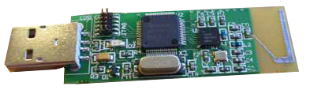
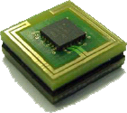
Wireless Sensors for Biomedical applications
IMEC platform
  Low Power Microcontroller MSP430 from Texas Instruments.
  Nordic Radio Transceiver
  USB stick as a bridge to connect the sensors nodes to a PC
Applications features
  Stand-alone. Current applications were developed using an ad-hoc approach.

Slide 5
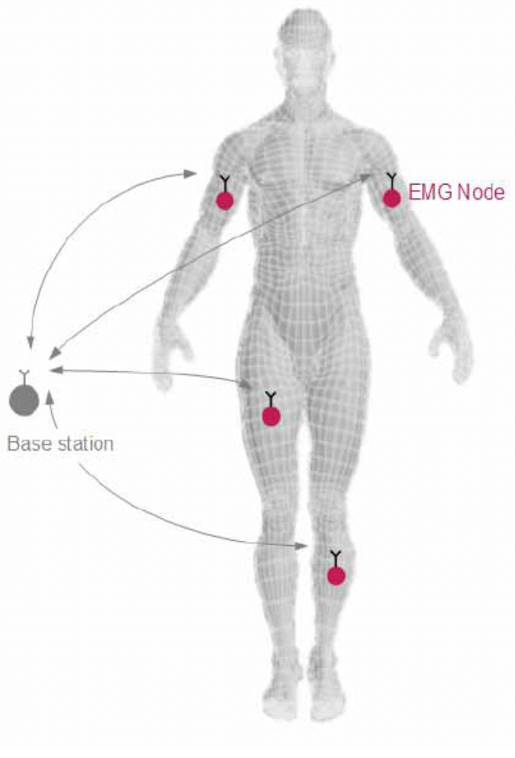
Current approach
Stand-alone applications
  IMEC EMGBAN
  One MAC protocol implemented based on a TDMA scheme.
Advantages
  Precise control of Hardware
Disadvantages
  Hard to reuse the applications
  It totally dependent on the Hardware

Slide 6

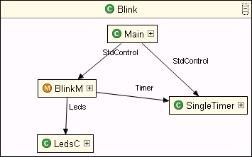
What is TinyOS?
It a small open source operating system specially designed for Wireless Sensor Networks
It is supported by a big scientific community, including many universities around the world (Berkeley, UCLA, ETH Zurich among others) and spin-off companies in the field (Crossbow Technologies, Moteiv, Intel, Boeing...)
FEATURES
TinyOS is based on components. The basic idea is just to connect all the components you need for your application
It supports many hardware platforms (MicaMotes, Telos nodes..)
There are many radio components already implemented (CC1000, CC2420, nRF2401)
Developing and simulation tools available.
Many open source project sharing MAC protocols and applications

Slide 7
Stand-alone appls. vs. Tinyos
Stand-alone |  | Tinyos
 | Simulation Tool | TOSSIM
 | Reuse | Based on components
Direct interaction with HW | HW control
 | Support | World wide community
 | Repository | World wide community, open source
 | Upgrades | Changing/adding components you can get new applications

Slide 8
MAC protocols
Contention based and random access
  Suitable for mesh network. The topology can be very dynamic since there is no rigid structure
  Allows multihoping, energy optimization, mesh topology
  Applications: spread networks, alarms o events transmission (e.g. Environment monitoring systems).
  B-MAC, S-MAC, Aloha protocol.
TDMA Based
  Suitable for star topology. The topology tends to be more static.
  Optimal under known/static conditions
  Appls: real time or continuos monitoring (e.g. EMGBAN)

Slide 9
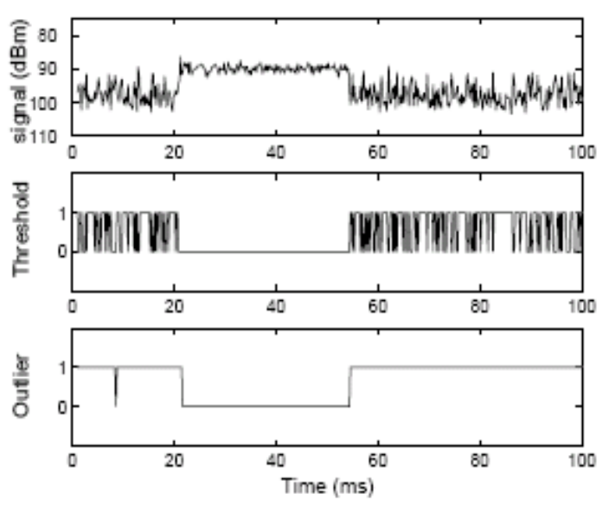
MAC Protocols in Tinyos
B-MAC: This is the default TinyOS protocol
  Carrier sense (not suitable for nRF2401)
  Allows multihoping
  Energy efficient, collision avoidance
S-MAC
  RTS-CTS protocol
  Energy efficient, duty cycle.
UCL-MAC: Aloha protocol already implemented in the Sensor Cube
  Energy efficient, duty cycle
  ACK scheme
TDMA:
  It has to be designed and implemented
Sleep
Listen

Slide 10
Consortium
IMEC-NL
Bert Gyselinckx (Management)
Fernando Brunetti (TDMA MAC protocol)
Nicolas DeVinq @Leuven (Polysomnography appl)
Tom Torfs @Leuven (HW Support)
IMEC Platform
SensorCubes & USB-Stick
EPFL
David Atienza
Andrea Acquaviva
Alexandru Susu
S-MAC protocol
Power management issues
Simulation

Slide 11
Proposed Road Map
IMEC
TDMA MAC
Design
Tinyos for
IMEC
USB_Stick
Polysom.
Appl. Test
TDMA MAC
protocol
Simulation
UCL
Implementation
TinyOS for IMEC
sensorcubes
Common
Platform
Benchmarking
&
Comparison
TOSSIM and Power TOSSIM for IMEC platform
SMAC Test in
SensorCubes
Energy optimization
EPFL
SMAC Implementation
In SensorCubes

Slide 12

Tinyos for Imec USB Stick
Almost same hardware of Sensor Cube
Previous work:
  TinyOS for sensorcubes (by UCL)
Tasks:
  New platform definition.
  Adaptation of Radio Components
  Changes made in:
    hardware.h
    nRF2401RadioC.nc
Test:
  Surge IMEC application (by UCL) is now working with sensor cubes and a USB stick as node 0 (Base Station)
SurgeImec
Appl

Slide 13
TOSSIM and Power TOSSIM for IMEC platform
TOSSIM is the simulator for TinyOS.
It simulates using an abstraction of the Mica2 node (atmega and CC1000 radio)
Power TOSSIM is a TOSSIM extension that simulates the power consumption of the Mica2 platform
Application
Previous work:
  UCL MAC protocol integration in TOSSIM
Tasks:
  Adaptation of radio (nRF2401 instead of CC1000) and MAC components
  Power consumption model of IMEC platform
MAC protocol
HW
abstraction
Radio
Abstraction

Slide 14
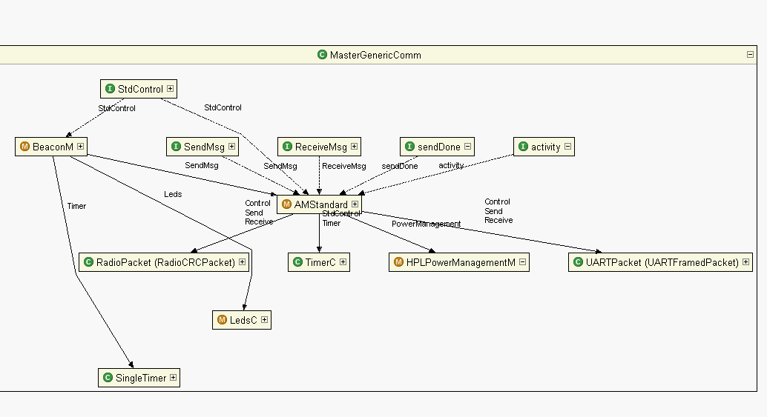
TDMA MAC Design 1/2
First Stage
  Start topology
  1 base Station
  Configurable number of sensors
  The base station transmits beacons every ‘n’ ms.
  After receiving a beacon every node wait for ‘m’ ms to send the data.
  The beacon contains commands as well.
  There is a time slot reserved for contention.
Reserved for contention access
n ms
B
N1
N2
N3
Nn
B
m ms
TDMA Master Components (MasterGenericComm)

Slide 15
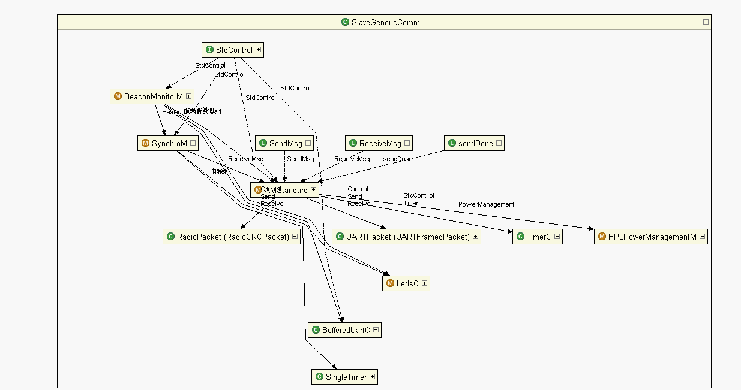
TDMA MAC Design 2/2
All the interfaces are respected, so the integration will be easy
Timing still has to be adjusted.
It is already working with 2 nodes
Further test will be done using TOSSIM
TDMA Slave Components (MasterGenericComm)
Second Stage
  Dynamic slots assignment
  Scaling capabilities, tree topology

Slide 16
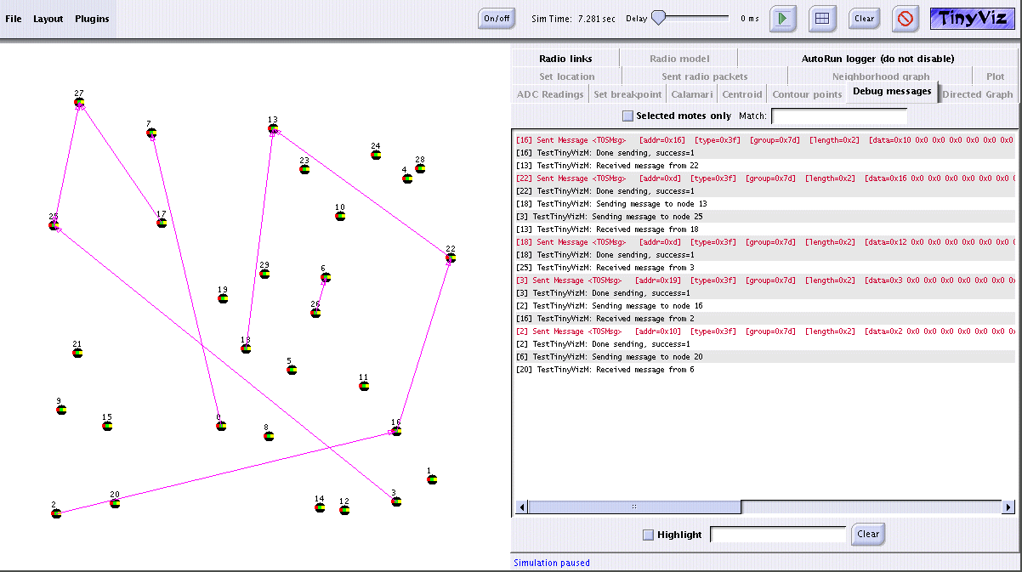
TDMA protocol simulation
To test the protocol with many nodes
TOSIMM simulates multiple instances of the same code!!!
Tasks:
Develop the TDMA approach all together, so we can have the same code either for the master as for the slave.

Slide 17
TOSSIM d PowerTOSSIM
TOSSIM is developed for mica(1) platform:
  40kbit RFM radio transceiver (less than nRF2401)
PowerTOSSIM developed for Mica2 motes
  7.3 MHz ATmega128L processor
  128KB of code memory, 512KB EEPROM
  4KB of data memory
  ChipCon CC1000 radio capable of transmitting at 38.4 Kbps with an outdoor transmission range of approximately 300m
    to use the CC1000 radio stack you have to write in the Makefile of the application you want to compile the following line:
Uses a quite basic CSMA like protocol for the radio stack.

Slide 18
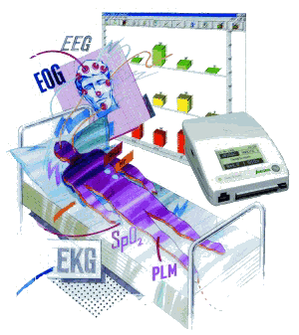
Polysomnography application
Sampling frequency: 100 Hz
Each node will support 2 sensors
  Any of
    EMG
    ECG
    EOG
TDMA based approach using Tinyos
Up to 7 nodes
Goals:
  Detection of “Rest Less Legs Syndrome” (EMG)
  REM (Rapid Eyes Movements)/non-REM sleep detection (EOG)
VIASYS sleep diagnosis
(www.jaeger-toennies.com)

Slide 19


