Slide 1
نطق الحروف
Letter Pronunciation
Fun Learning

Slide 2





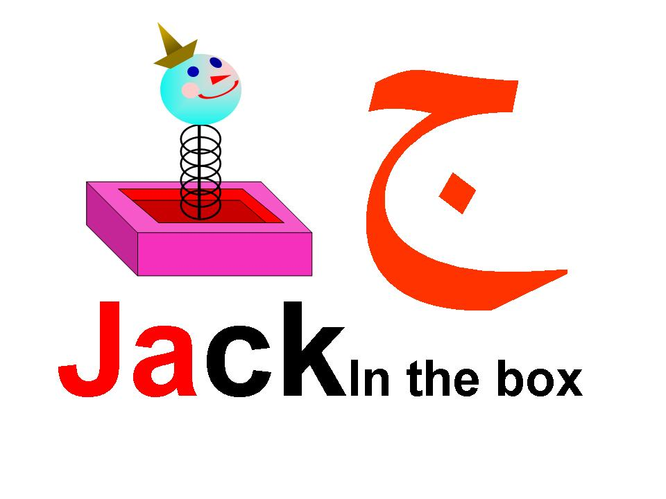
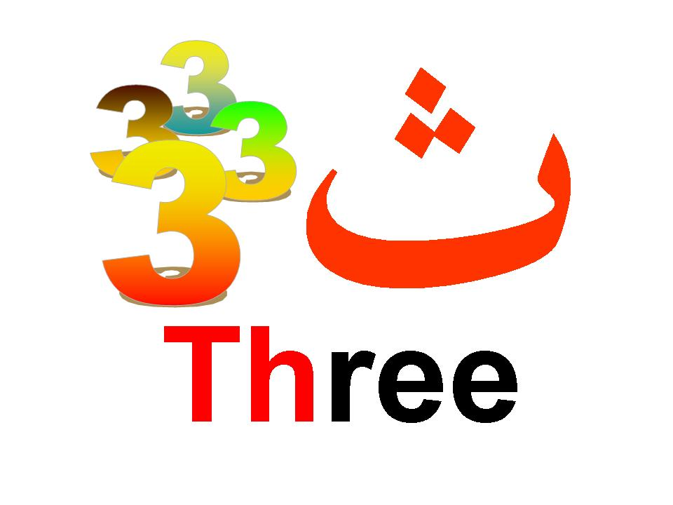



Fun Learning4u
Fun Learning4u
Fun Learning4u
Fun Learning4u
Fun Learning4u
Fun Learning4u
Fun Learning4u
Fun Learning4u
Fun Learning4u

Slide 4
Fun Learning4u
Fun Learning4u

Slide 5
Fun Learning4u

Slide 6



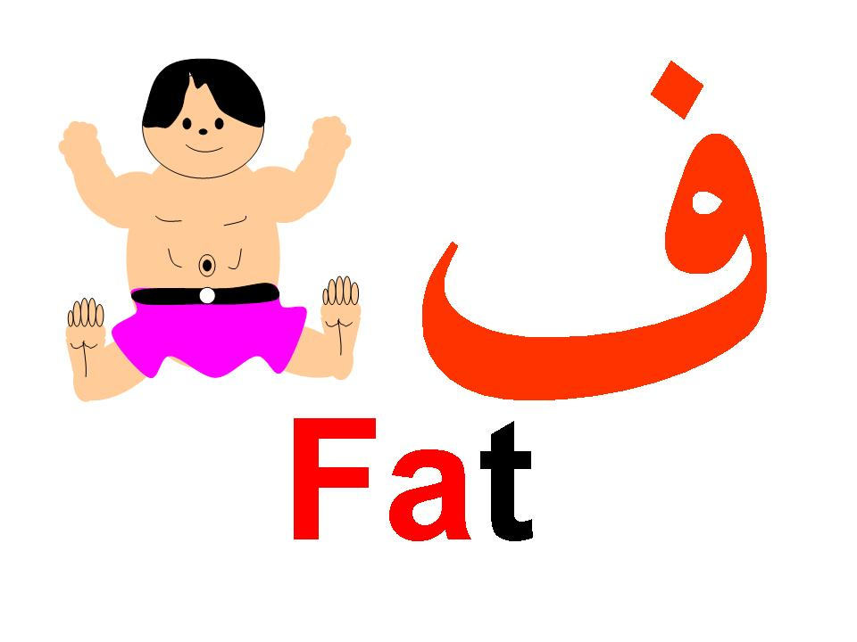




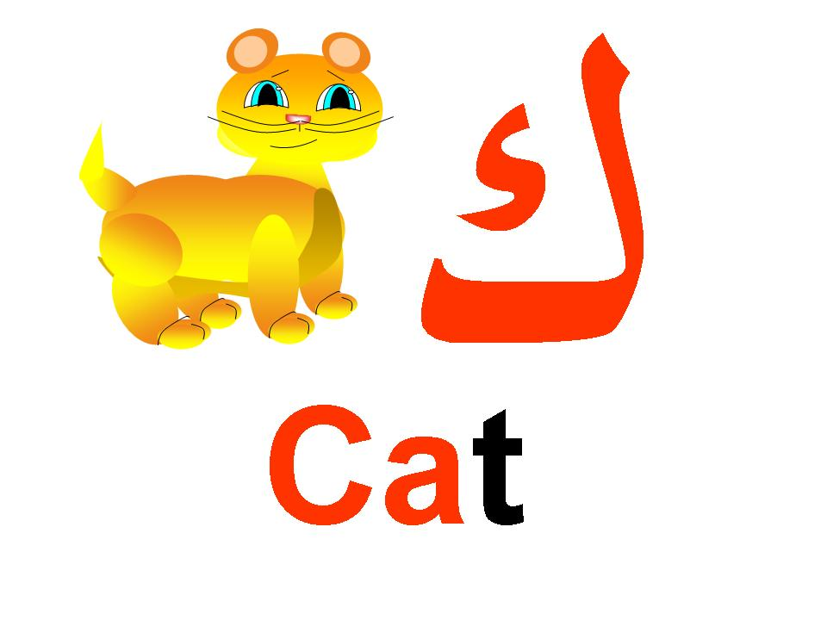

Slide 7








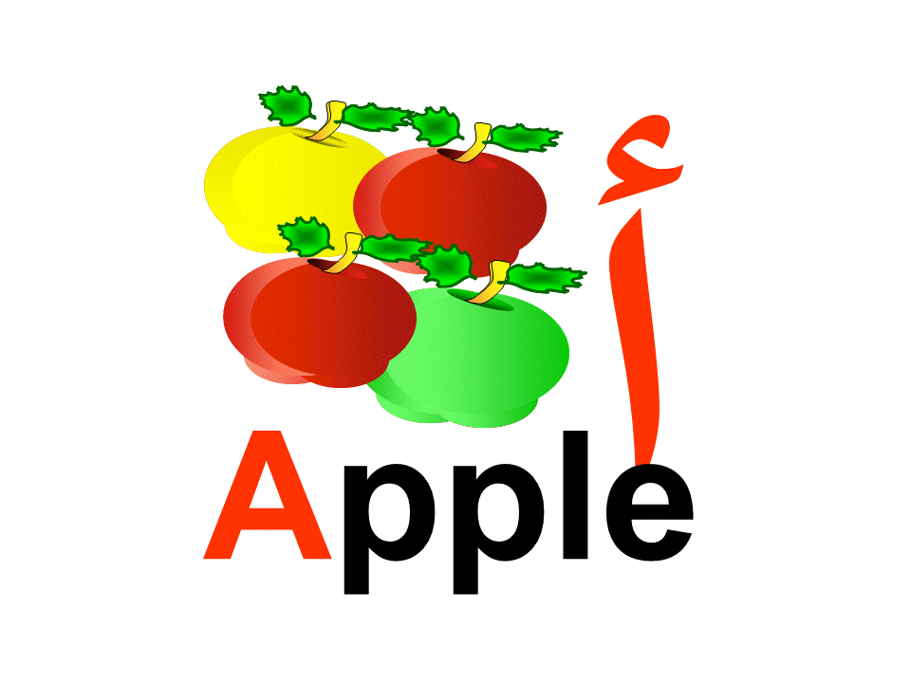

Slide 8





أ
Apple

Slide 9



ب
Banana

Slide 10
ت
Tack

Slide 11
3
ث
3
3
3
Three

Slide 12

ج
JackIn the box

Slide 13
د
Daddy

Slide 14
ذ
That

Slide 15
ر
Rug

Slide 16

ز
Zack

Slide 17
س
Sack

Slide 18
ش
Shampoo

Slide 19

ص
Sun

Slide 20
ض
Ducky

Slide 21
ط
Tummy

Slide 22
ف
Fat

Slide 23
ك
Cat

Slide 24
ل
Lamp

Slide 25
م
Masjid

Slide 26
ن
Nanny

Slide 27
هد
Happy

Slide 28
و
1
1
1
One

Slide 29
ى
Ya Ya!

Slide 30
ح
Halwa

Slide 31
  خ
Khuroof

Slide 32
ظ
Thurf

Slide 33
ع
Arabi

Slide 34
غ
Gazelle

Slide 35
ق
Qumar

