Slide 1

Deep Learning with

Slide 2
“What is deep learning?”

Slide 3
Machine learning is turning things (data) into numbers and finding patterns in those numbers.
The computer does this part. How?
Code & math.
We’re going to be writing the code.

Slide 4

Machine Learning vs. Deep Learning
Arti<cial Intelligence
Machine Learning
Deep Learning

Slide 5



Inputs
Rules
Output
Traditional programming
Cut vegetables
Season chicken
Preheat oven
Cook chicken for 30-minutes
Add vegetables
Starts with
Makes
Inputs
Output
Rules
Cut vegetables
Season chicken
Preheat oven
Cook chicken for 30-minutes
Add vegetables
Machine learning algorithm
Starts with
Figures out

Slide 6
“Why use machine learning (or deep learning)?”

Slide 7
Good reason: Why not?
Better reason: For a complex problem, can you think of all the rules?
(probably not)

Slide 8
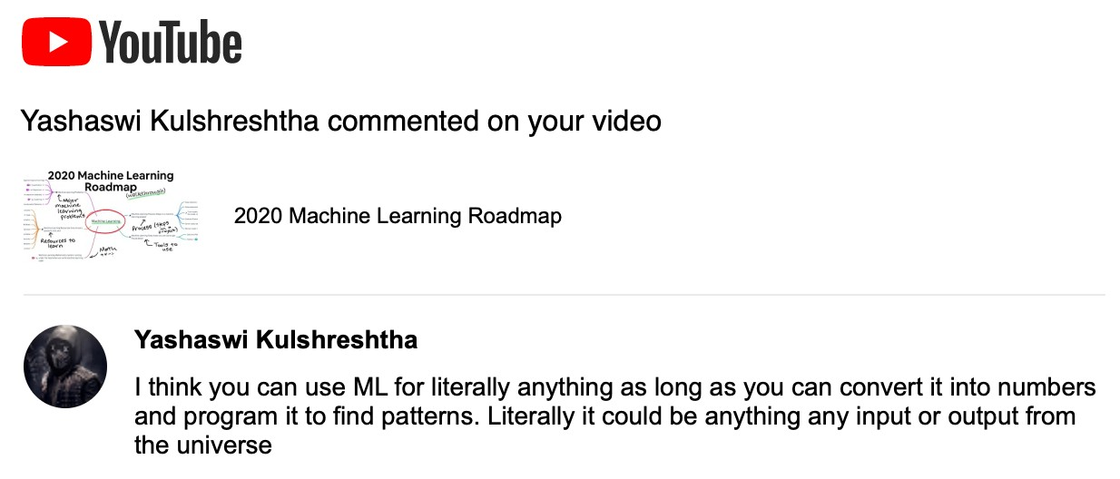
Source: 2020 Machine Learning Roadmap video.

Slide 9
(maybe not very simple…)
“If you can build a simple rule-based system that doesn’t require machine learning, do that.”
— A wise software engineer… (actually rule 1 of Google’s Machine Learning Handbook)

Slide 10

What deep learning is good for
Problems with long lists of rules—when the traditional approach fails, machine learning/deep learning may help.
Continually changing environments—deep learning can adapt (‘learn’) to new scenarios.
Discovering insights within large collections of data—can you imagine trying to hand-craft rules for what 101 different kinds of food look like?

Slide 11

What deep learning is not good for
(typically)
When you need explainability—the patterns learned by a deep learning model are typically uninterpretable by a human.
When the traditional approach is a better option — if you can accomplish what you need with a simple rule-based system.
When errors are unacceptable — since the outputs of deep learning model aren’t always predictable.
When you don’t have much data — deep learning models usually require a fairly large amount of data to produce great results.
(though we’ll see how to get great results without huge amounts of data)

Slide 12
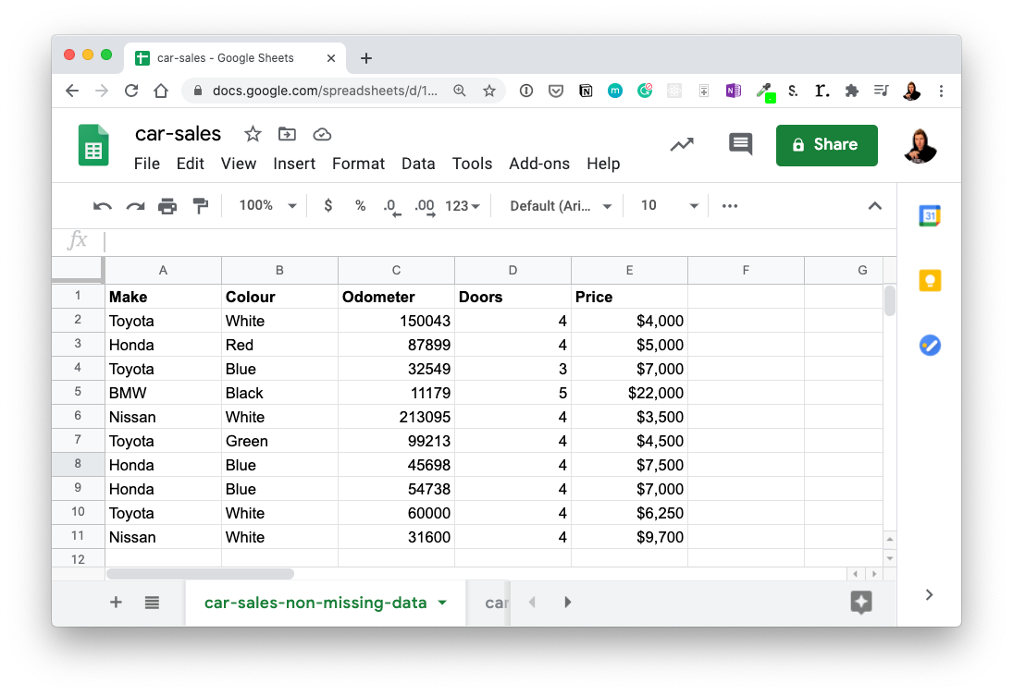


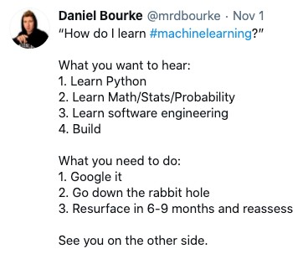


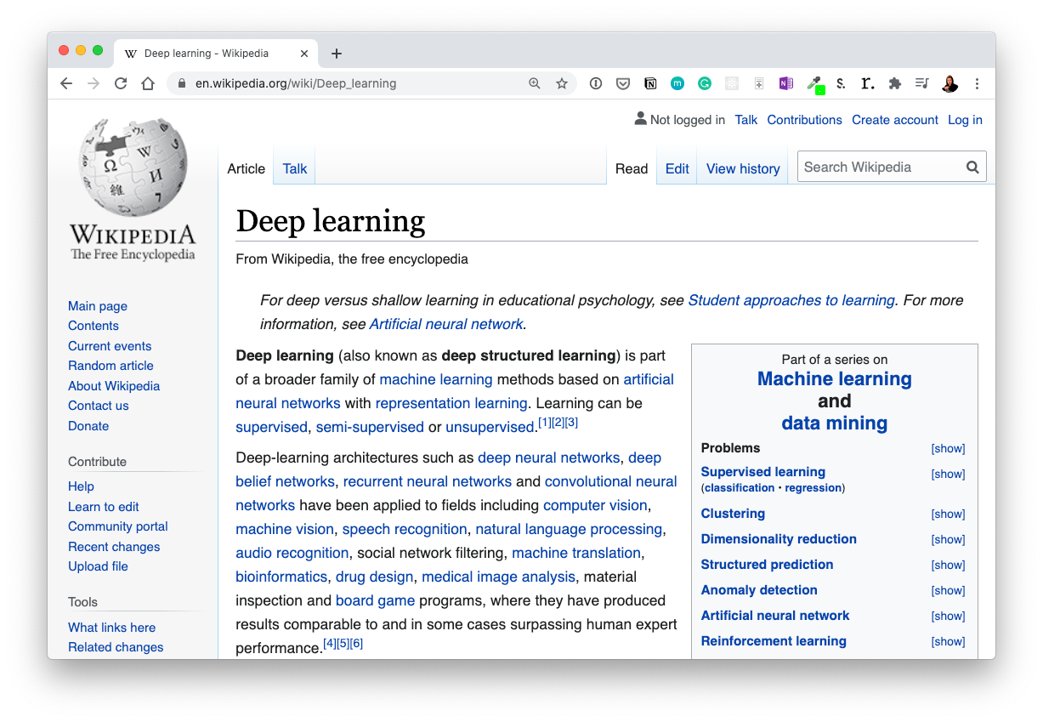


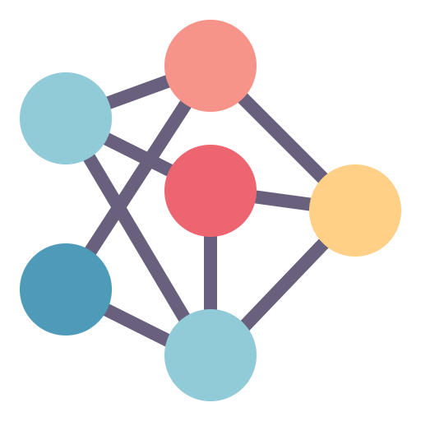

Machine Learning vs. Deep Learning
Machine Learning
Deep Learning
Algorithm: gradient
boosted machine
Algorithm: neural
network
Structured data
Unstructured data

Slide 13
Machine Learning vs. Deep Learning
(common algorithms)
Neural networks
Fully connected neural network
Convolutional neural network
Recurrent neural network
Transformer
…many more
Random forest
Gradient boosted models
Naive Bayes
Nearest neighbour
Support vector machine
…many more
(since the advent of deep learning these are
often referred to as “shallow algorithms”)
What we’re focused on building (with PyTorch)
(depending how you represent your problem, many algorithms can be used for both)
Structured data
Unstructured data

Slide 14
“What are neural networks?”

Slide 15
Neural Networks
(a human can
understand these)
Ramen, Spaghetti
(before data gets used
Each of these nodes is called a “hidden unit” or “neuron”.
with a neural network,
it needs to be turned
into numbers)
[[116, 78, 15],
[117, 43, 96],
[125, 87, 23],
…,
[[0.983, 0.004, 0.013],
[0.110, 0.889, 0.001],
Not a diaster
[0.023, 0.027, 0.985],
…,
(choose the appropriate
“Hey Siri, what’s the weather today?”
neural network for your
problem)
Learns representation
(patterns/features/weights)
Inputs
Numerical encoding
Representation outputs
Outputs

Slide 16
Anatomy of Neural Networks
Overall architecture
Input layer
(data goes in here)
# units/neurons = 2
Output layer
(outputs learned representation or prediction probabilities)
# units/neurons = 1
Each layer is usually combination of
linear (straight line) and/or non-
linear (not-straight line) functions
Hidden layer(s)
(learns patterns in data)
# units/neurons = 3
Note: “patterns” is an arbitrary term, you’ll often hear “embedding”, “weights”, “feature representation”, “feature vectors” all referring to similar things.

Slide 17
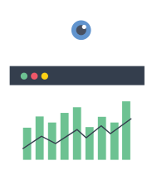

Types of Learning
Supervised Learning
Unsupervised & Self-supervised Learning
Transfer Learning
We’ll be writing code to do these,
but the style of code can be adopted across learning paradigms.

Slide 18
“What is deep learning actually used for?”

Slide 19
Source: 2020 Machine Learning Roadmap video.

Slide 20


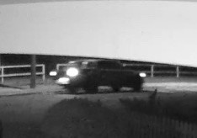
Deep Learning Use Cases
(some)
“Hey Siri, who’s the biggest big dog of them all?”
Speech recognition
Sequence to sequence (seq2seq)
Recommendation
Translation
To: daniel@mrdbourke.com Hey Daniel,
To: daniel@mrdbourke.com Hay daniel…
This deep learning course is incredible! I can’t wait to use what I’ve learned!
Not spam
C0ongratu1ations! U win $1139239230
Spam
Classi<cation/regression
Computer Vision
Natural Language Processing (NLP)

Slide 22

“What is PyTorch?”

Slide 23

What is PyTorch?
Most popular research deep learning framework*
Write fast deep learning code in Python (able to run on a GPU/many GPUs)
Able to access many pre-built deep learning models (Torch Hub/
torchvision.models)
Whole stack: preprocess data, model data, deploy model in your application/cloud
Originally designed and used in-house by Facebook/Meta (now open- source and used by companies such as Tesla, Microsoft, OpenAI)
*Source: paperswithcode.com/trends February 2022

Slide 24
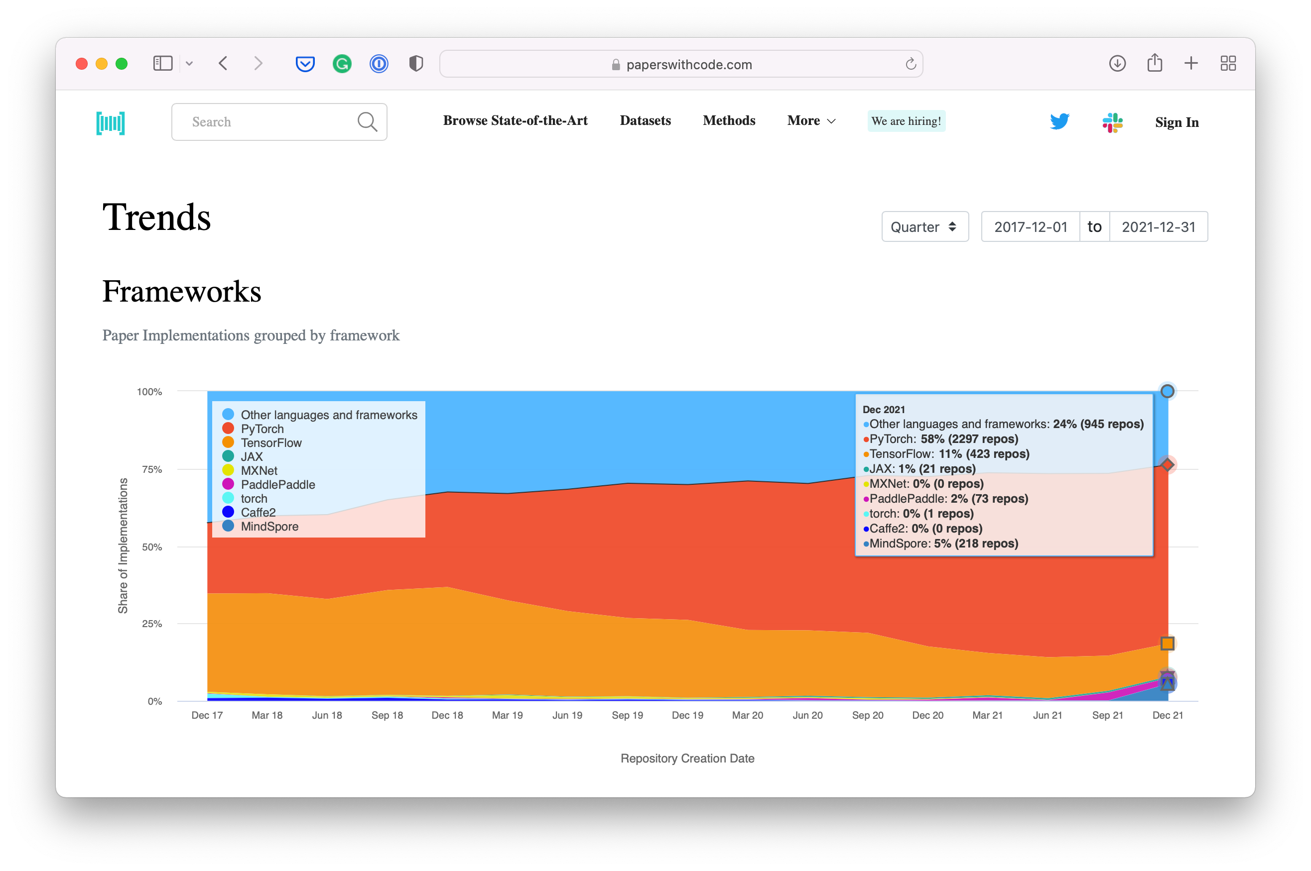

Why PyTorch?
Research favourite
Source: paperswithcode.com/trends February 2022

Slide 25

Why PyTorch?
and PyTorch
Source: @fchollet Twitter

Slide 26
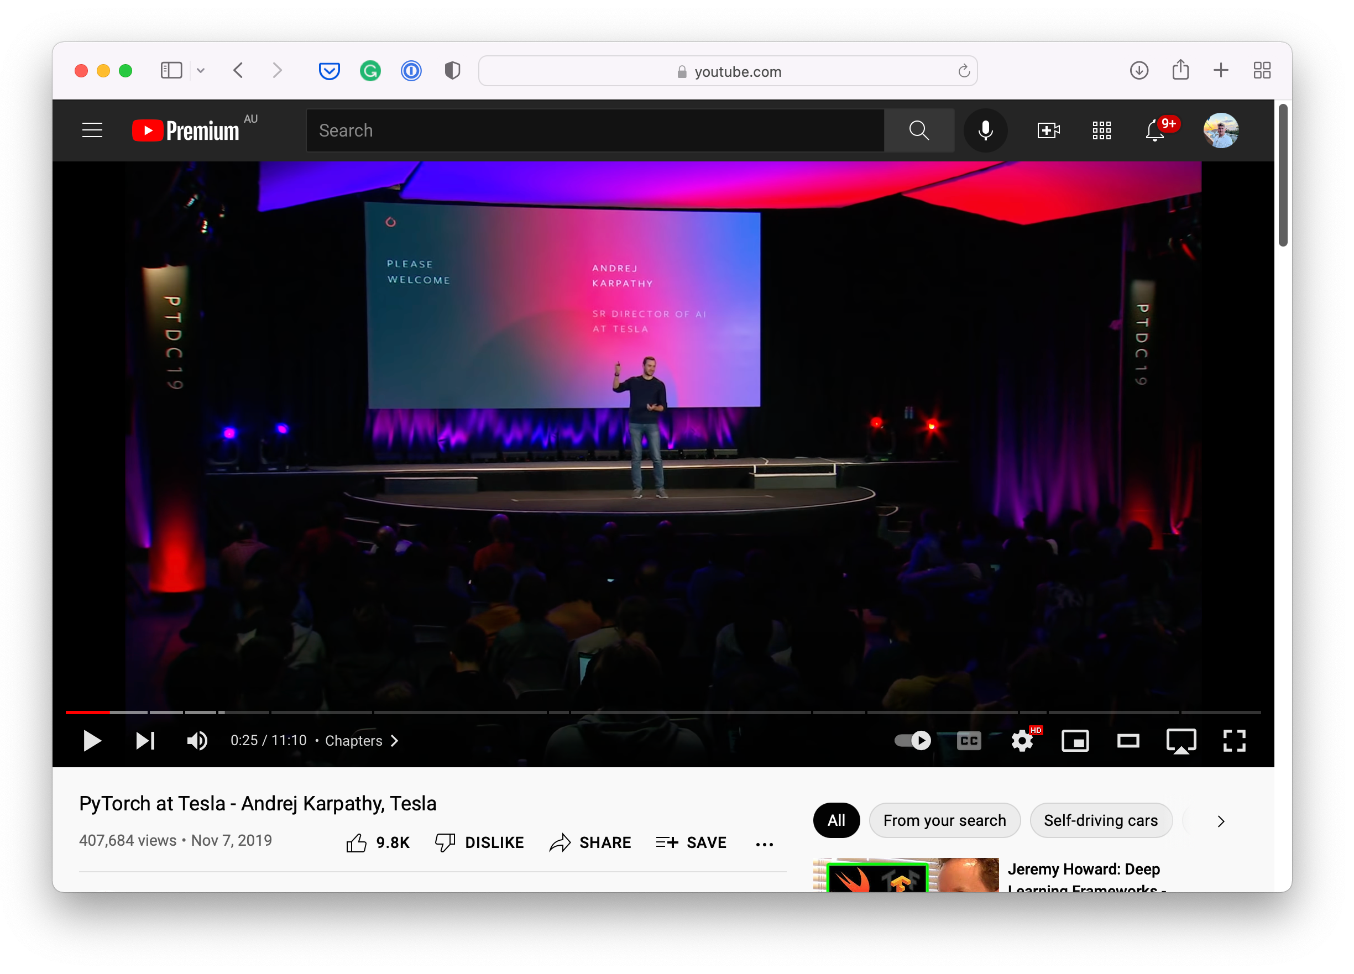
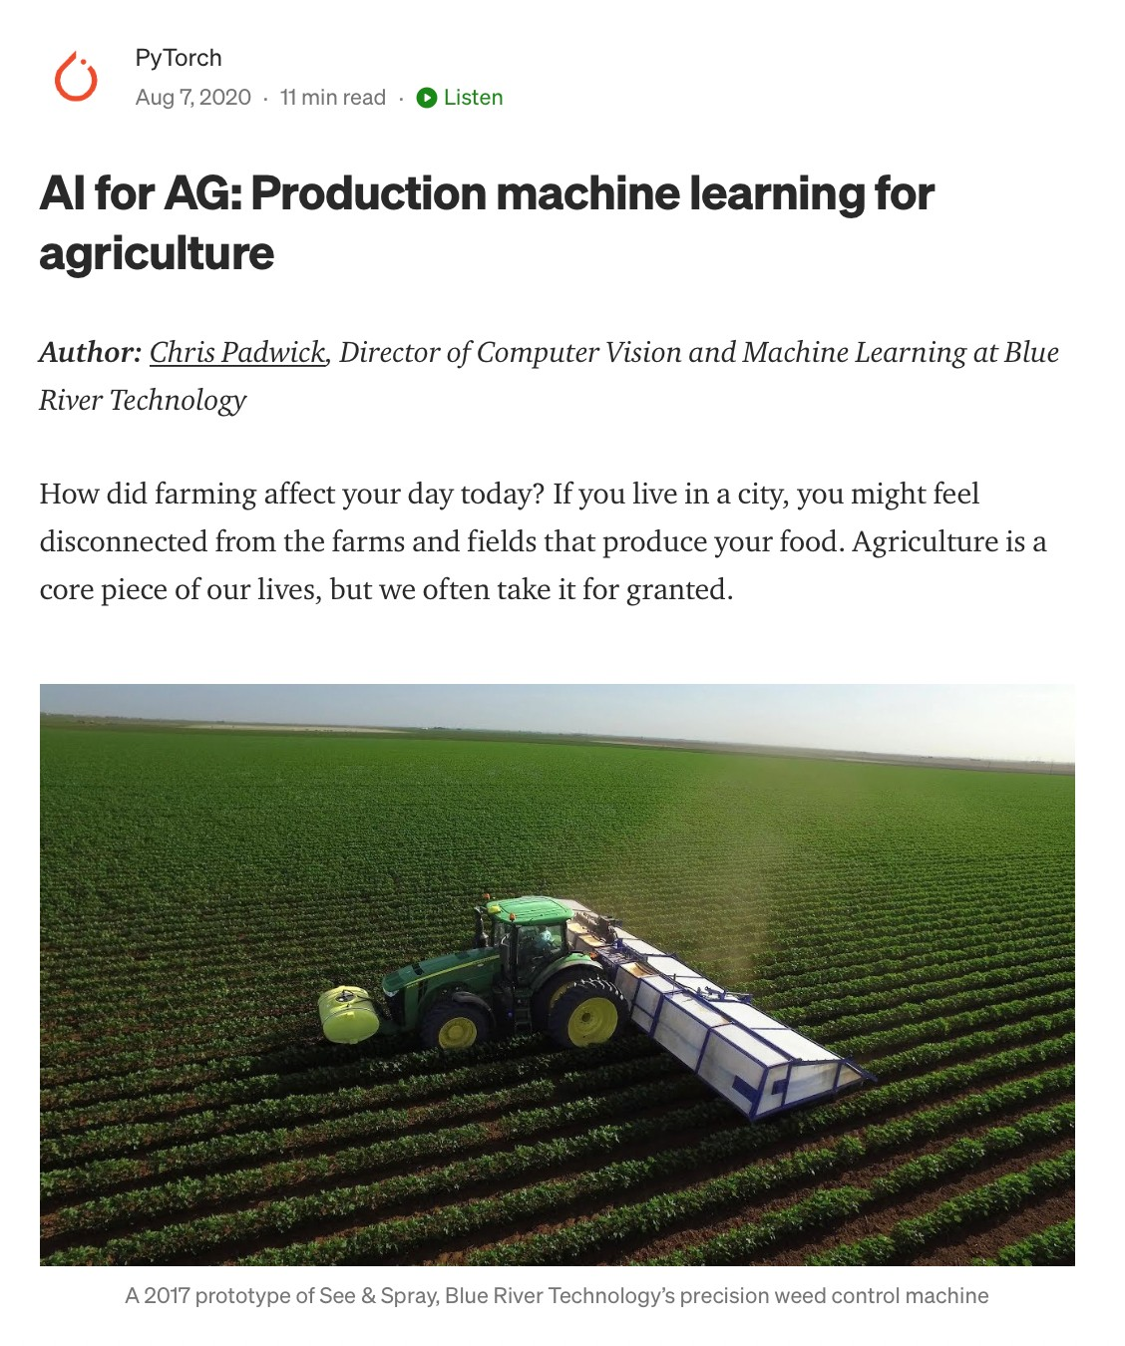




Why PyTorch?

Slide 27
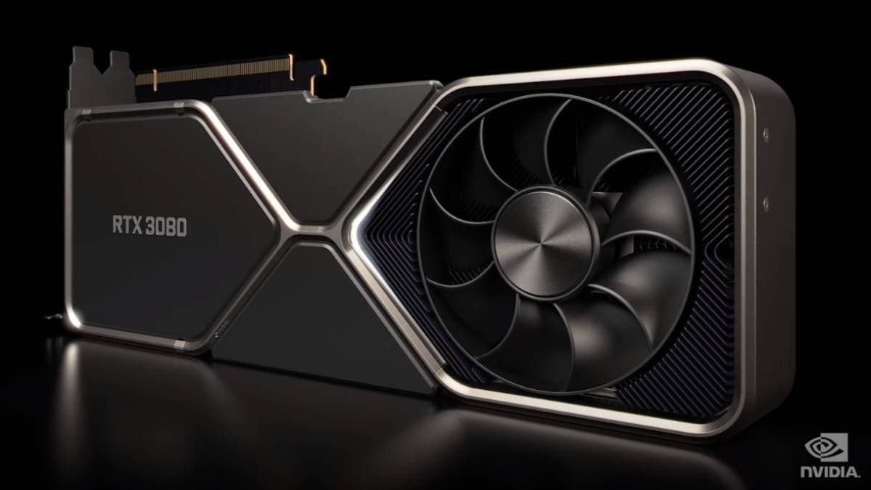
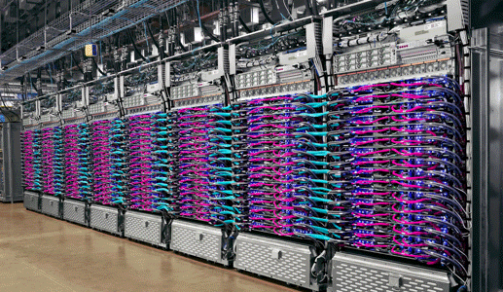
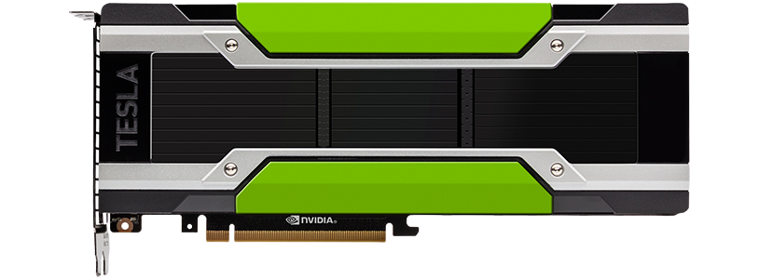
What is a GPU/TPU?
TPU (Tensor Processing Unit)
GPU (Graphics Processing Unit)

Slide 28
“What is a tensor?”

Slide 29
Neural Networks
(a human can
understand these)
Ramen, Spaghetti
(before data gets used
These are tensors!
with an algorithm, it
needs to be turned into
numbers)
[[116, 78, 15],
[117, 43, 96],
[125, 87, 23],
…,
[[0.983, 0.004, 0.013],
[0.110, 0.889, 0.001],
Not spam
[0.023, 0.027, 0.985],
…,
(choose the appropriate
“Hey Siri, what’s the weather today?”
neural network for your
problem)
Learns representation
(patterns/features/weights)
Inputs
Numerical encoding
Representation outputs
Outputs

Slide 30
These are tensors!
[[116, 78, 15],
[117, 43, 96],
[125, 87, 23],
…,
[[0.983, 0.004, 0.013],
[0.110, 0.889, 0.001],
Ramen, Spaghetti
[0.023, 0.027, 0.985],
…,
Learns representation
(patterns/features/weights)
Inputs
Numerical encoding
Representation outputs
Outputs

Slide 31
“What are we going to cover?”

Slide 32
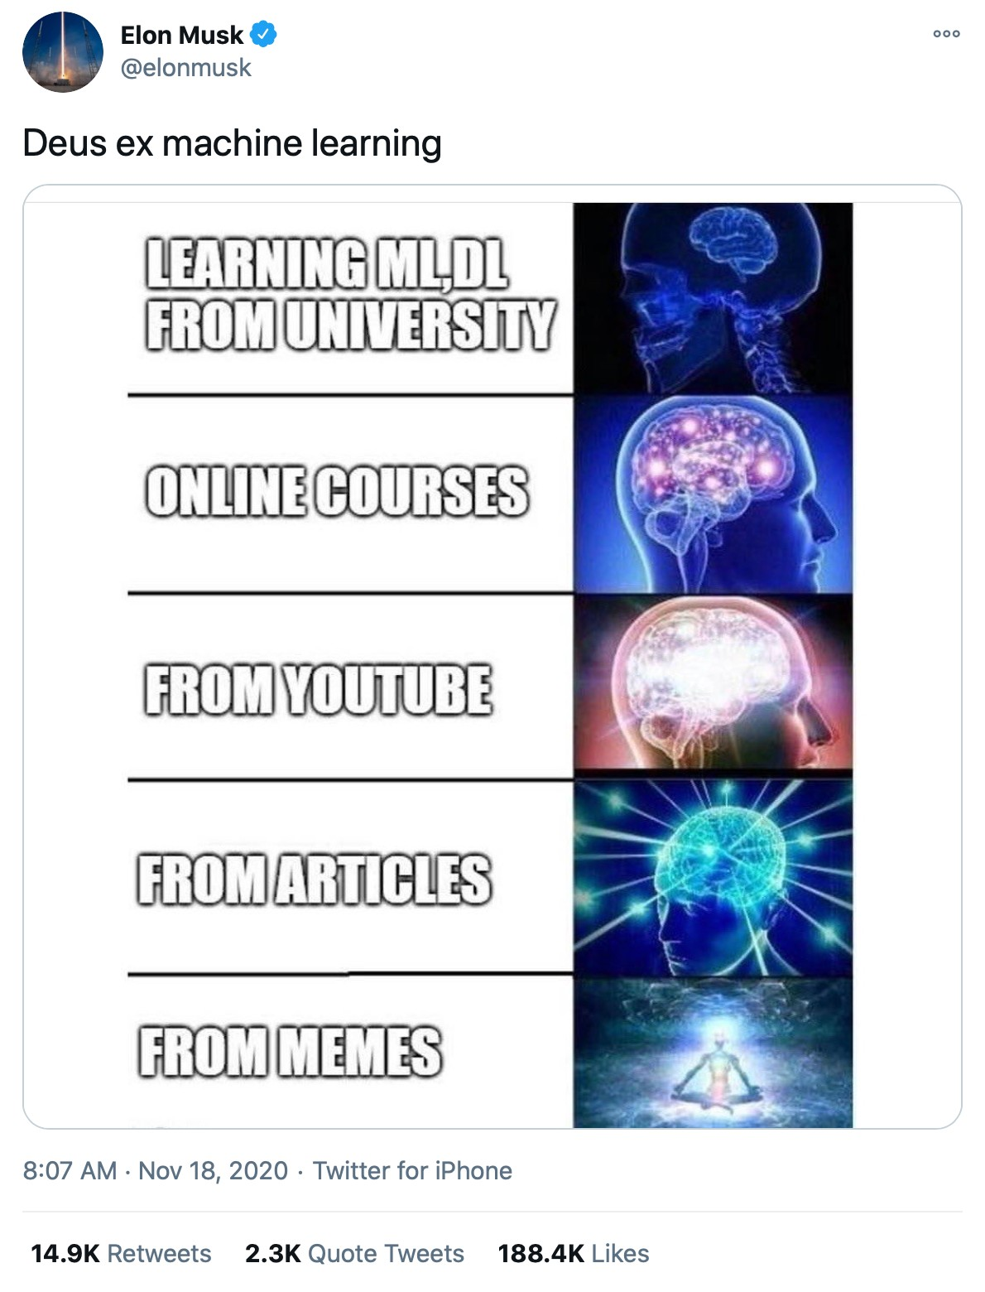
Source: @elonmusk Twitter

Slide 33


What we’re going to cover
(broadly)
Now:
PyTorch basics & fundamentals (dealing with tensors and tensor operations)
Later:
Preprocessing data (getting it into tensors)
Building and using pretrained deep learning models
Fitting a model to the data (learning patterns)
Making predictions with a model (using patterns)
Evaluating model predictions
Saving and loading models
Using a trained model to make predictions on custom data
(we’ll be cooking up lots of code!)
How:

Slide 34
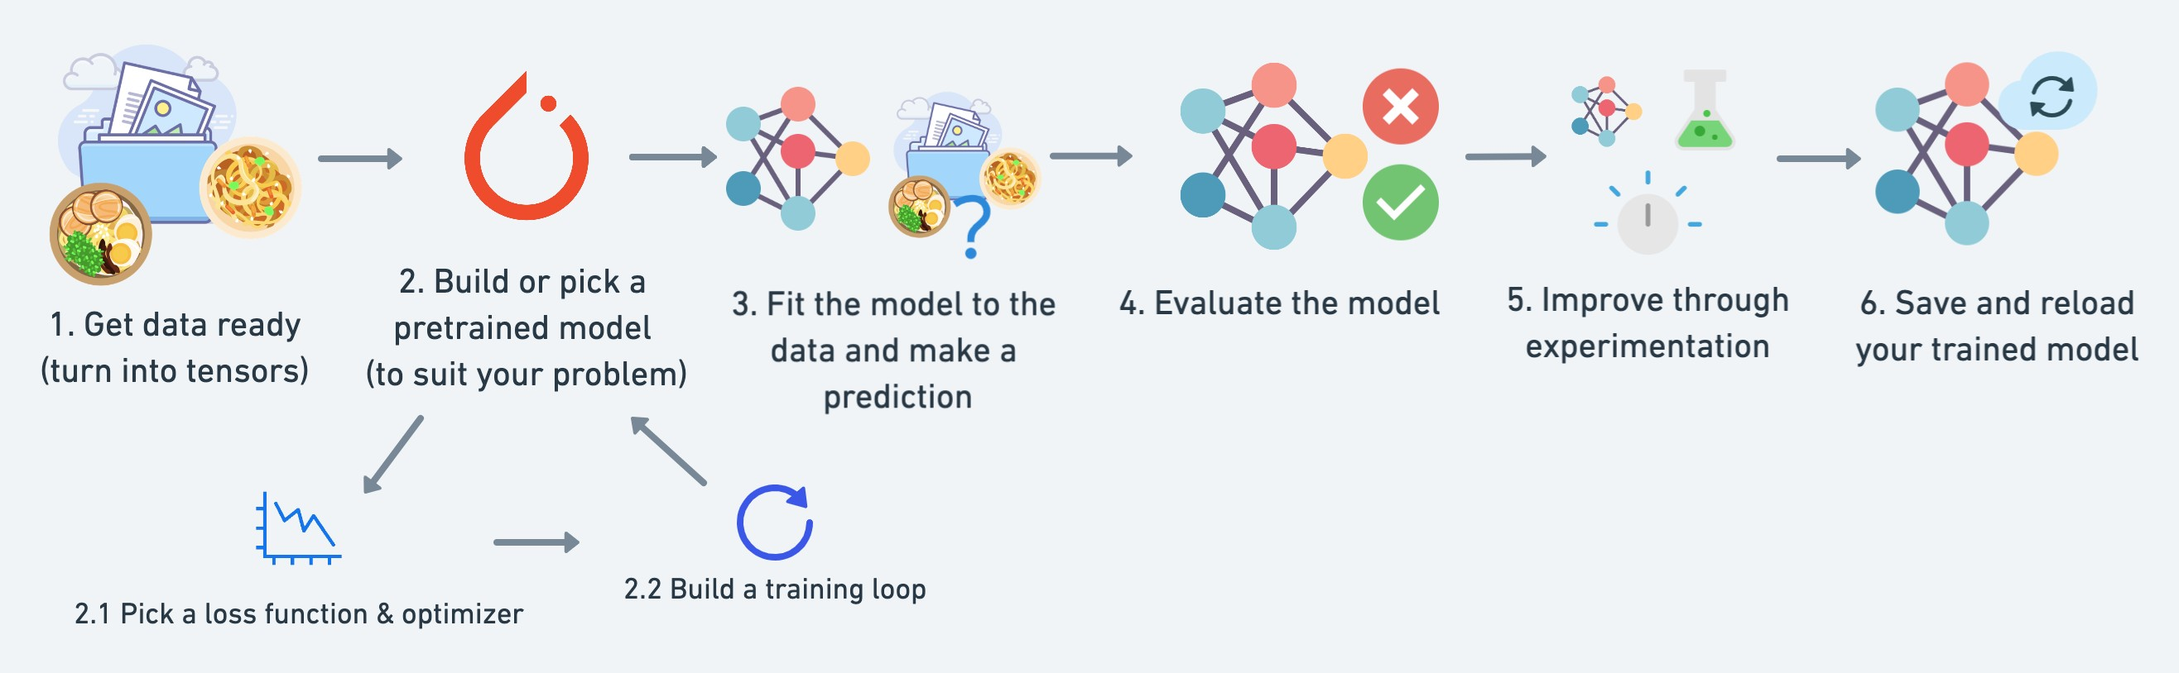
What we’re going to cover
A PyTorch workflow
(one of many)

Slide 35
“How should I approach this course?”

Slide 36
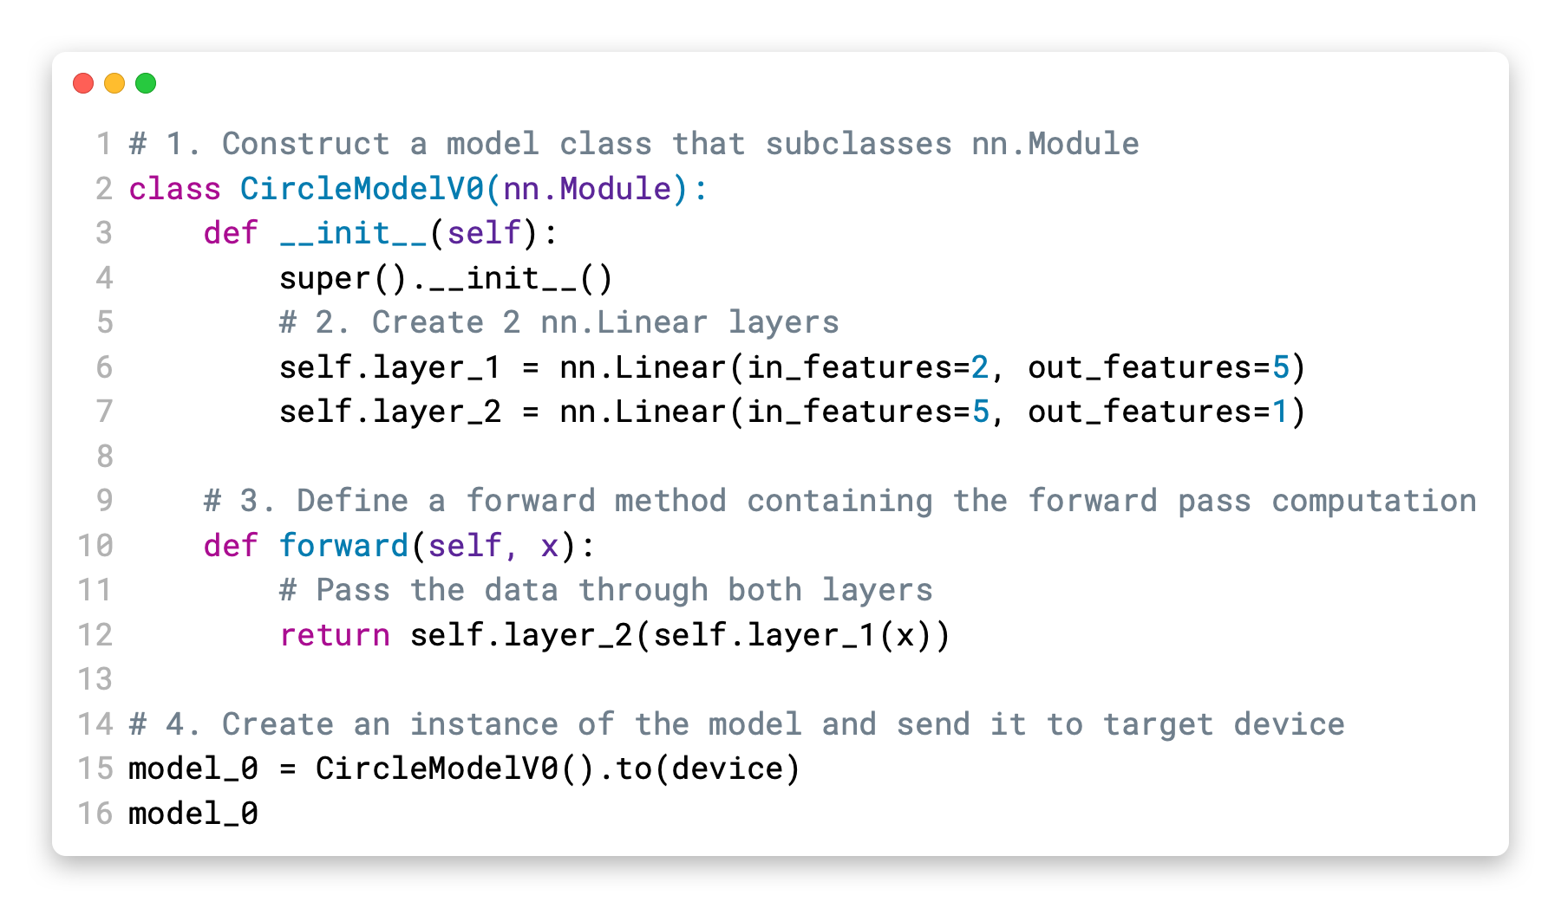









How to approach this course
Motto #2:
Experiment, experiment,
Motto #3: Visualize, visualize, visualize!
experiment!
1. Code along
2. Explore and experiment
3. Visualize what you don’t understand
Motto #1: if in doubt, run the code!
(including the
“dumb” ones)
4. Ask questions
5. Do the exercises
6. Share your work

Slide 37



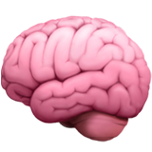
How not to approach this course
“I can’t learn
Avoid:
”

Slide 38


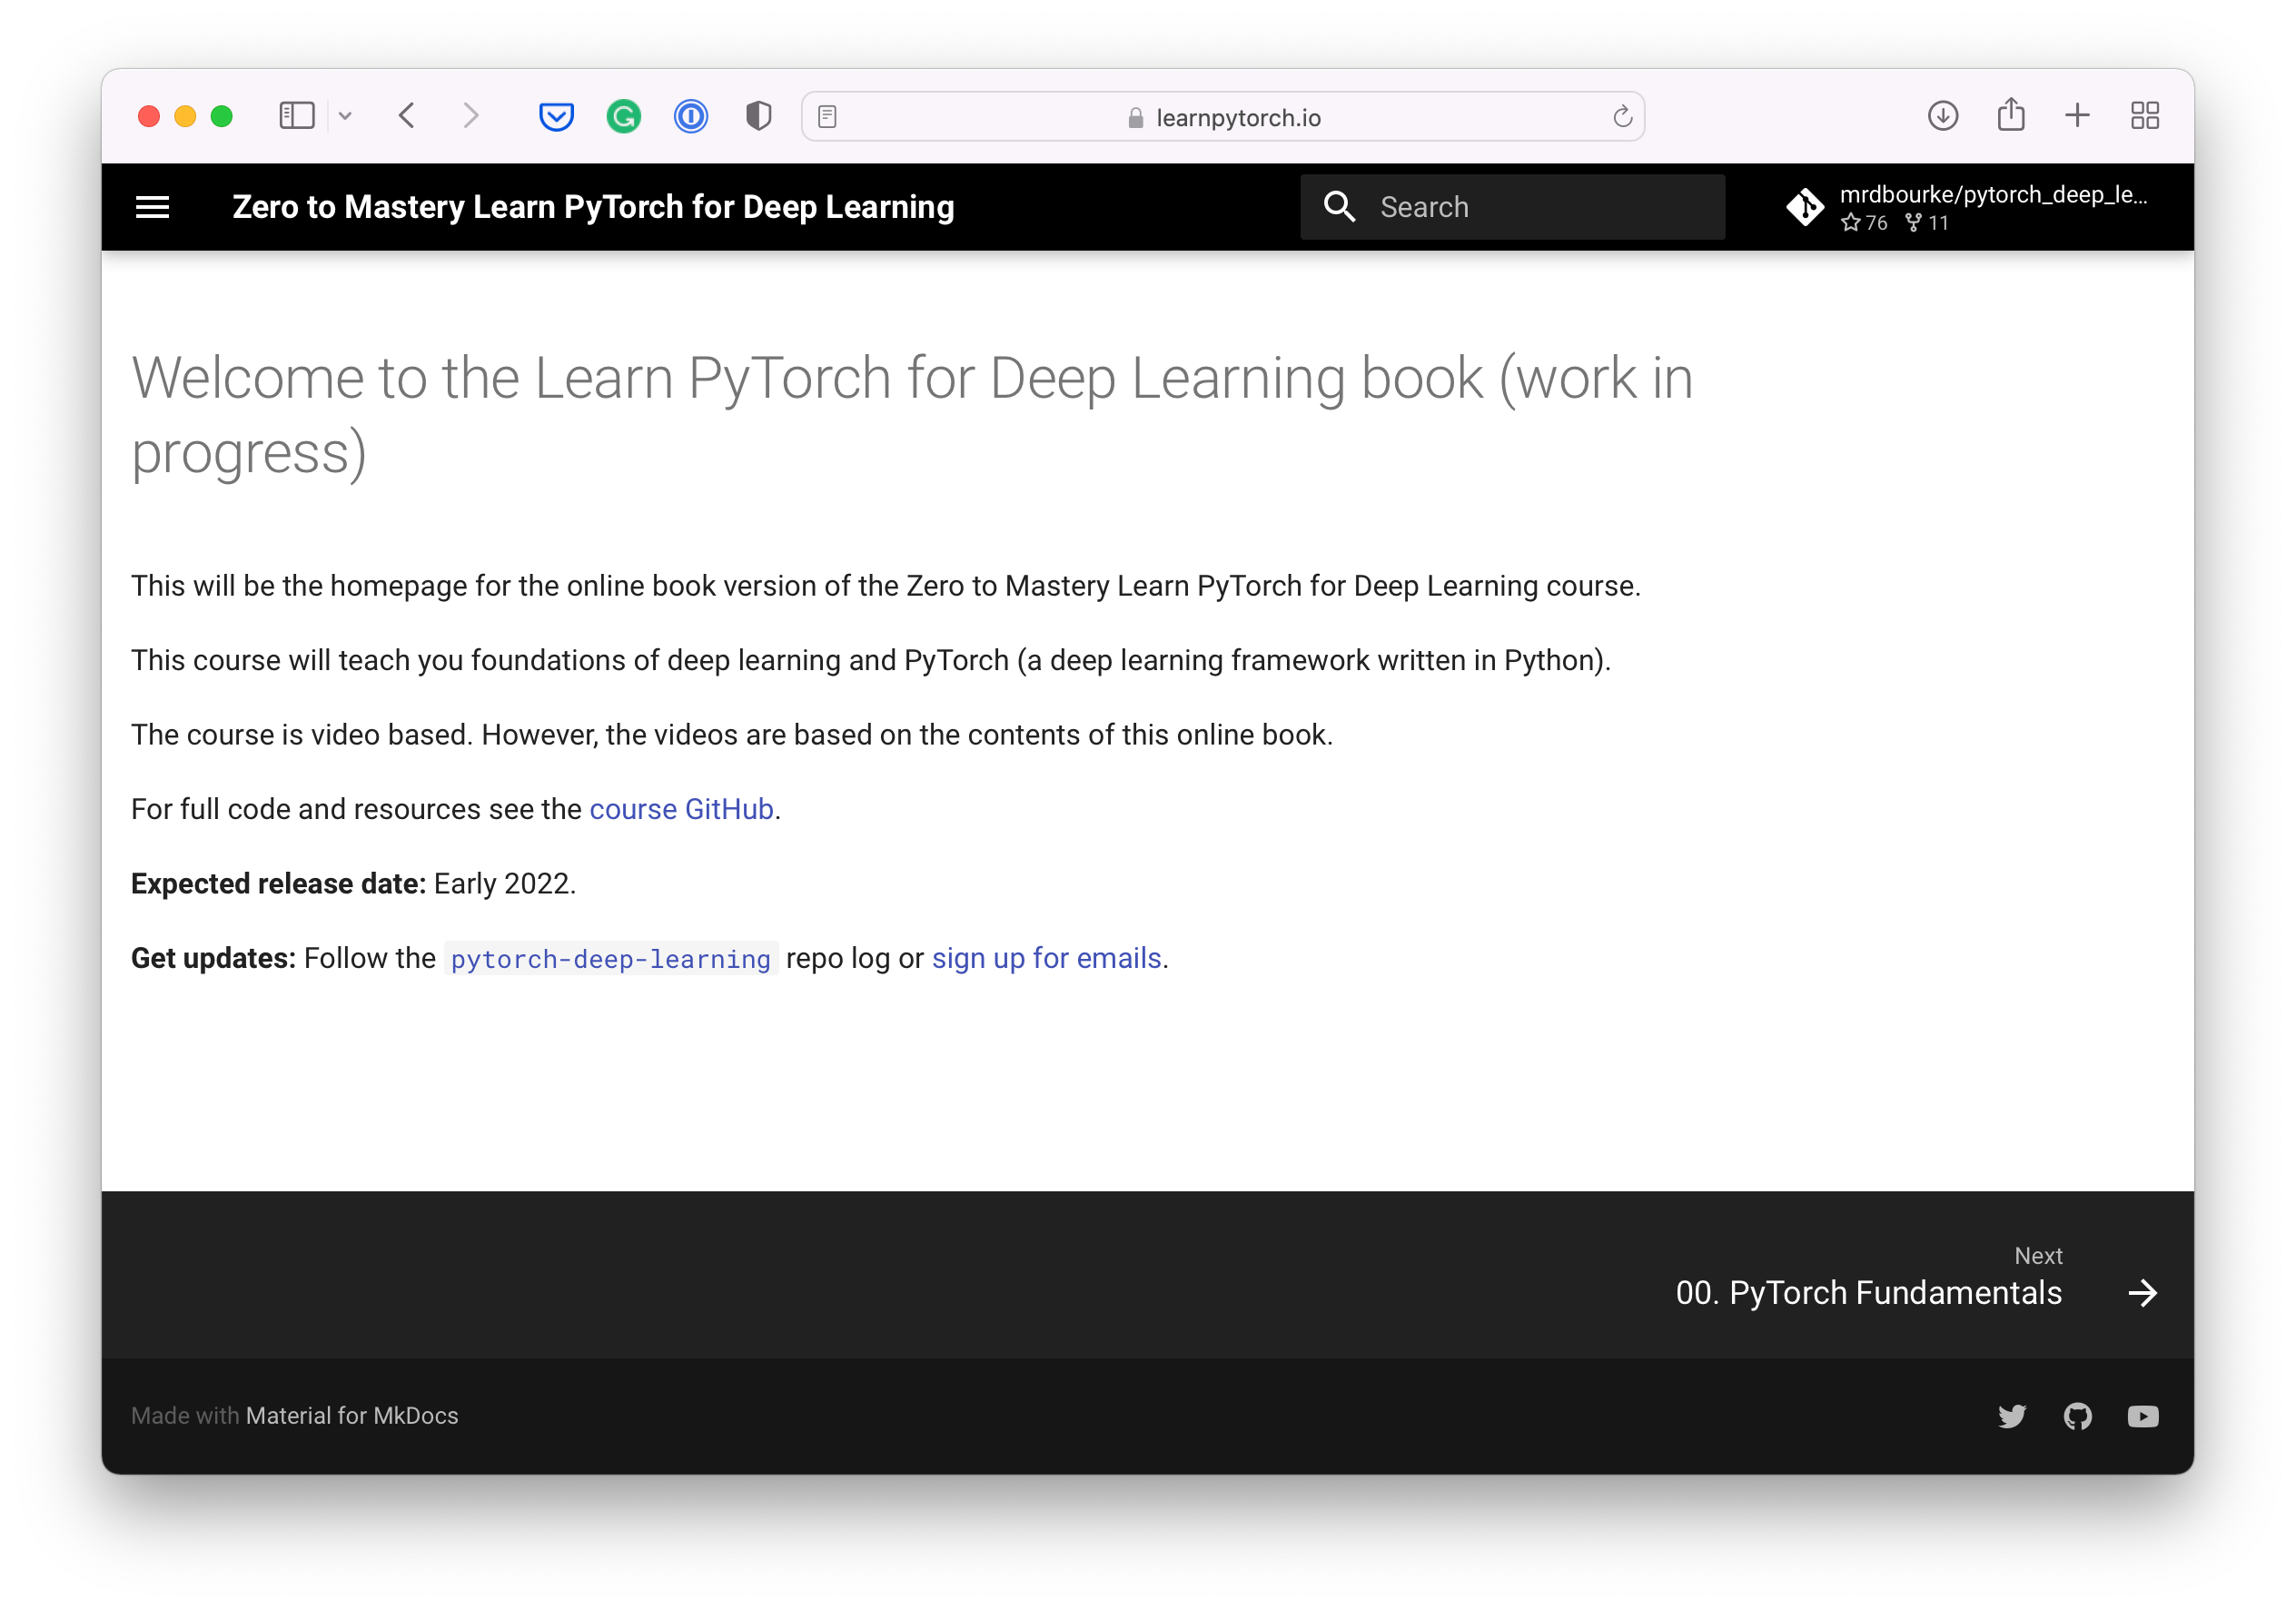

Resources
Course Q&A
This course
Course materials
Course online book
https://www.github.com/mrdbourke/pytorch-deep-learning
https://www.github.com/mrdbourke/pytorch-deep-learning/ discussions
https://learnpytorch.io
PyTorch website & forums
All things PyTorch

Slide 39
Let’s code!

Slide 40
Tensor dimensions
tensor([[[1, 2, 3],
[3, 6, 9],
dim=0
[2, 4, 5]]])
Dimension (dim)
0 1 2
tensor([[[1, 2, 3],
0
1
dim=1
[3, 6, 9],
torch.Size([1, 3, 3])
[2, 4, 5]]])
2
tensor([[[1, 2, 3],
[3, 6, 9],
dim=2
[2, | 4, | 5]]])
0 | 1 | 2

Slide 41
Dot product
A | B | C
D | E | F
G | H | I
J | K
L | M
N | O
A*J + B*L + C*N | A*K + B*M + C*O
D*J + E*L + F*N | D*K + E*M + F*O
G*J + H*L + I*N | G*K + H*M + I*O
torch.matmul(
,
)
3x3 3x2
Numbers on the inside must match
3x2
New size is same as outside numbers
5 | 0 | 3
3 | 7 | 9
3 | 5 | 2
4 | 7
6 | 8
8 | 1
5 | 0 | 3
44 | 38
126 | 86
58 | 63
torch.matmul(
,
)
* * *
 | 4 | 6 | 8
= = =
3x3
3x2
20 + 0
+ 24 =
3x2
44
For a live demo, checkout www.matrixmultiplication.xyz

Slide 42


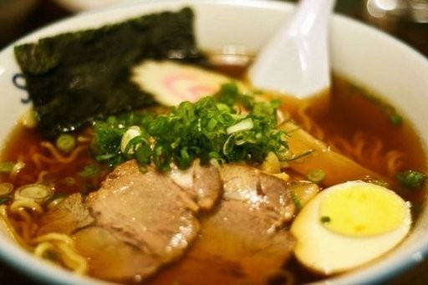
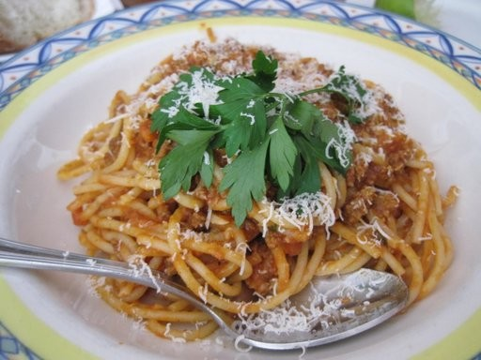
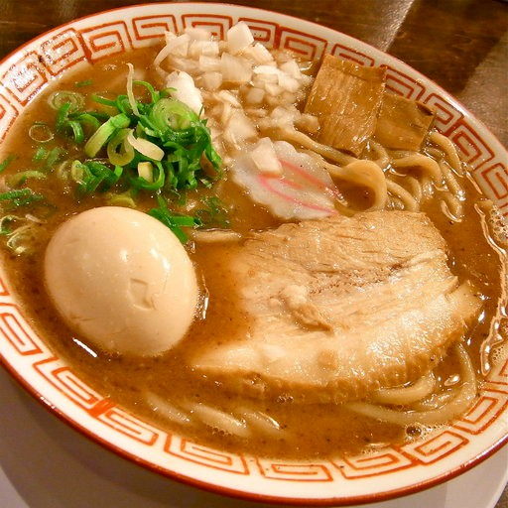
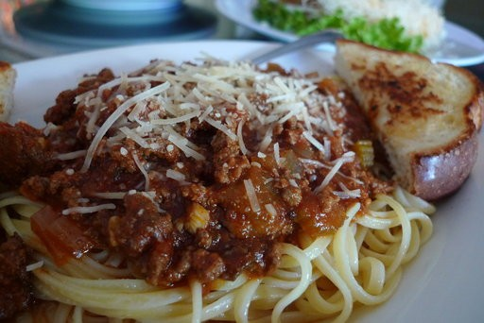
Supervised learning
2. Show examples
1. Initialise with random
weights (only at beginning)
[[0.092, | 0.210, | 0.415],
[0.778, | 0.929, | 0.030],
[0.019, …, | 0.182, | 0.555],
(overview)
[[116, 78, 15],
[117, 43, 96],
[125, 87, 23],
…,
[[0.983, 0.004, 0.013],
[0.110, 0.889, 0.001],
Ramen, Spaghetti
[0.023, 0.027, 0.985],
…,
3. Update representation outputs
4. Repeat with more examples
Learns representation
(patterns/features/weights)
Inputs
Numerical encoding
Representation outputs
Outputs

Slide 43
Tensor attributes
Attribute | Meaning | Code
Shape | The length (number of elements) of each of the dimensions of a tensor. | tensor.shape
Rank/dimensions | The total number of tensor dimensions. A scalar has rank 0, a vector has rank 1, a matrix is rank 2, a tensor has rank n. | tensor.ndim or tensor.size()
Speci<c axis or dimension (e.g. “1st axis” or “0th dimension”) | A particular dimension of a tensor. | tensor[0], tensor[:, 1]…

Slide 44

