Slide 1

Workflow

Slide 2
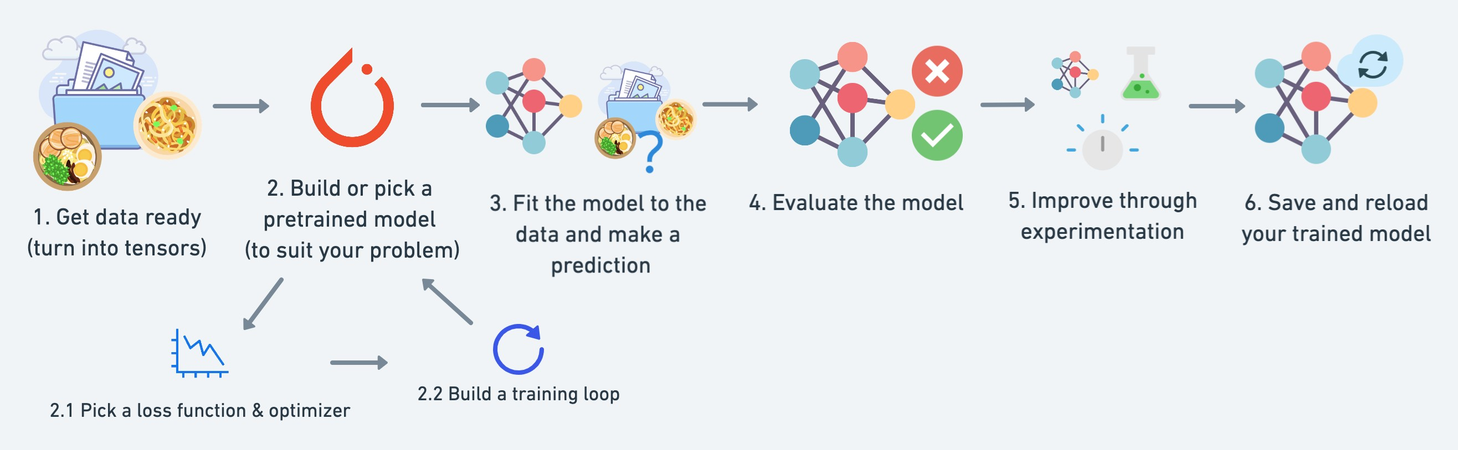
What we’re going to cover
A PyTorch workflow
(one of many)

Slide 3
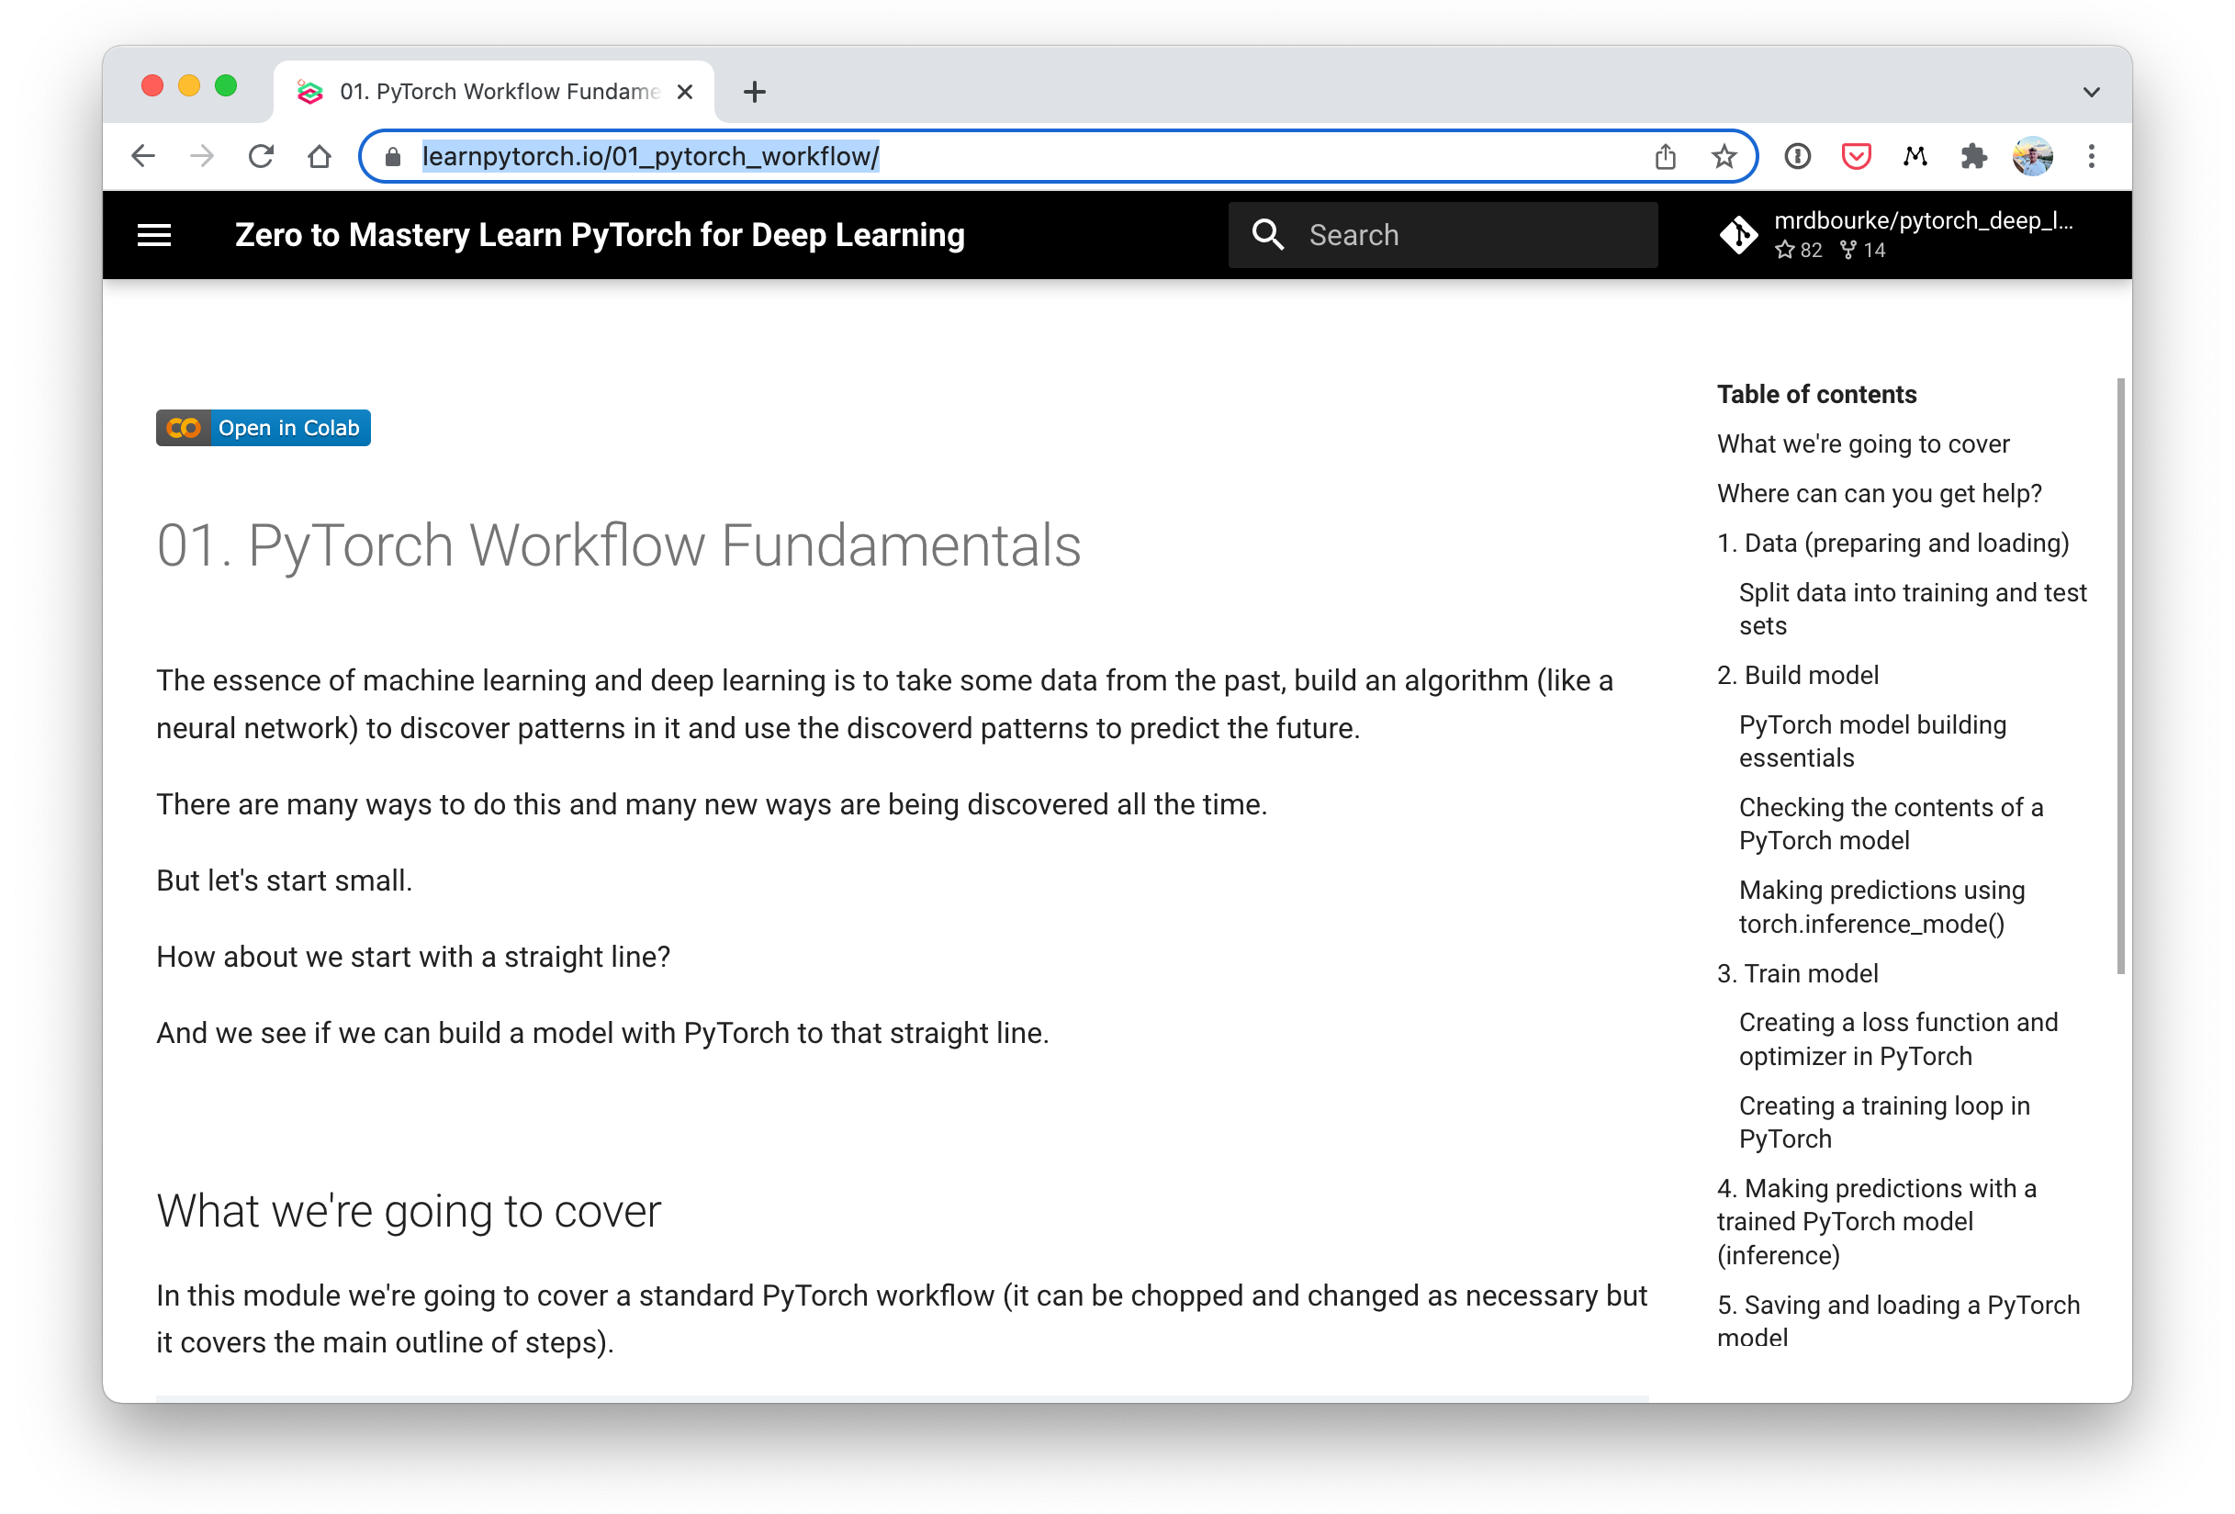
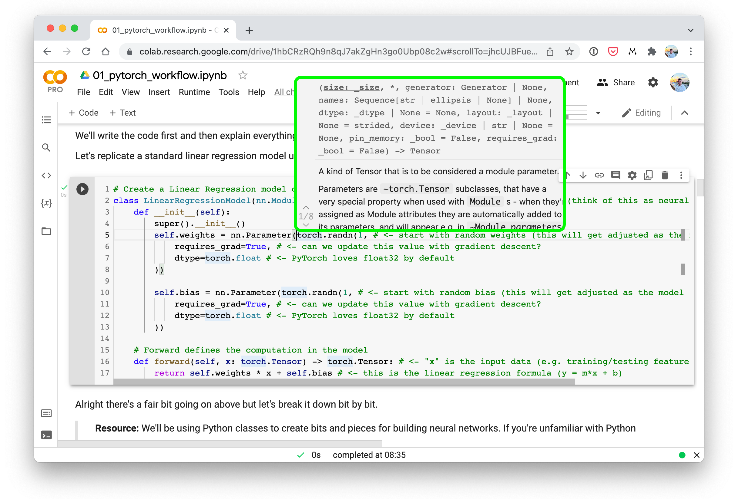



Where can you get help?
Follow along with the code
Try it for yourself
Press SHIFT + CMD + SPACE to read the docstring
Search for it
Try again
Ask
Motto #1: “If in doubt, run the code”
https://www.github.com/mrdbourke/pytorch-deep-learning/discussions

Slide 4
Let’s code!

Slide 5




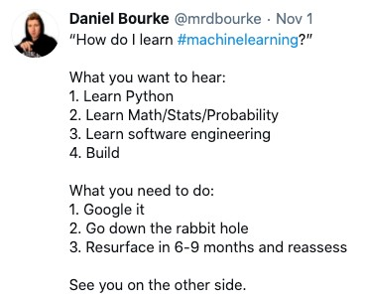

Machine learning: a game of two parts
Ramen, Spaghetti
[[116, | 78, | 15], |  | [[0.983, | 0.004, | 0.013],
[117, | 43, | 96], |  | [0.110, | 0.889, | 0.001],
[125, | 87, | 23], |  | [0.023, | 0.027, | 0.985],
…, |  |  |  | …,
Not spam
“Hey Siri, what’s the weather today?”
Learns representation (patterns/features/ weights)
Numerical encoding
Representation outputs
Inputs
Outputs

Slide 6
Part 1: Turn data into numbers
Part 2: Build model to learn patterns in numbers
Ramen, Spaghetti
[[116, 78, | 15], | [[0.983, 0.004, 0.013],
[117, 43, | 96], | [0.110, 0.889, 0.001],
[125, 87, | 23], | [0.023, 0.027, 0.985],
…, |  | …,
Not spam
“Hey Siri, what’s the weather today?”
Learns representation
(patterns/features/weights)
Representation outputs
Inputs
Numerical encoding
Outputs

Slide 7




Three datasets
(possibly the most important concept in machine learning…)
Model learns patterns from here
Course materials (training set)
Practice exam (validation set)
Final exam (test set)
See if the model is ready for the wild
Tune model patterns
Generalization
The ability for a machine learning model to perform well on data it hasn’t seen before.

Slide 8
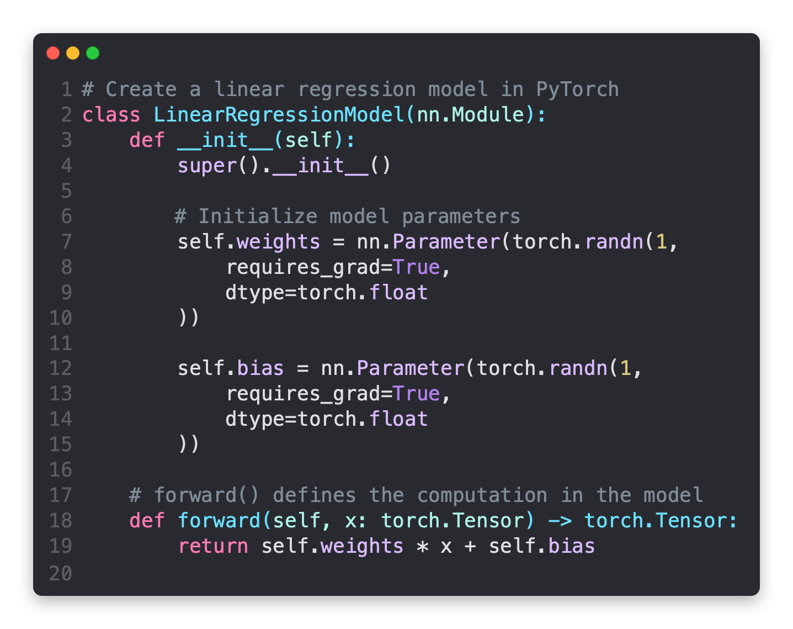
Subclass nn.Module
(this contains all the building blocks for neural networks)
Initialise model parameters to be used in various computations (these could be diMerent layers from torch.nn, single parameters, hard-coded values or functions)
requires_grad=True means PyTorch will track the gradients of this speciLc parameter for use with torch.autograd and gradient descent (for many torch.nn modules, requires_grad=True is set by default)
Any subclass of nn.Module needs to override forward()
(this deLnes the forward computation of the model)

Slide 9
PyTorch essential neural network building modules
PyTorch module | What does it do?
torch.nn | Contains all of the building blocks for computational graphs (essentially a series of computations executed in a particular way).
torch.nn.Module | The base class for all neural network modules, all the building blocks for neural networks are subclasses. If you're building a neural network in PyTorch, your models should subclass nn.Module. Requires a forward() method be implemented.
torch.optim | Contains various optimization algorithms (these tell the model parameters stored in nn.Parameter how to best change to improve gradient descent and in turn reduce the loss).
torch.utils.data.Dataset | Represents a map between key (label) and sample (features) pairs of your data. Such as images and their associated labels.
torch.utils.data.DataLoader | Creates a Python iterable over a torch Dataset (allows you to iterate over your data).
See more: https://pytorch.org/tutorials/beginner/ptcheat.html

Slide 10
torchvision.transforms torch.utils.data.Dataset
torch.utils.data.DataLoader
torchmetrics
torch.optim
torch.nn torch.nn.Module torchvision.models
torch.utils.tensorboard
See more: https://pytorch.org/tutorials/beginner/ptcheat.html

Slide 11
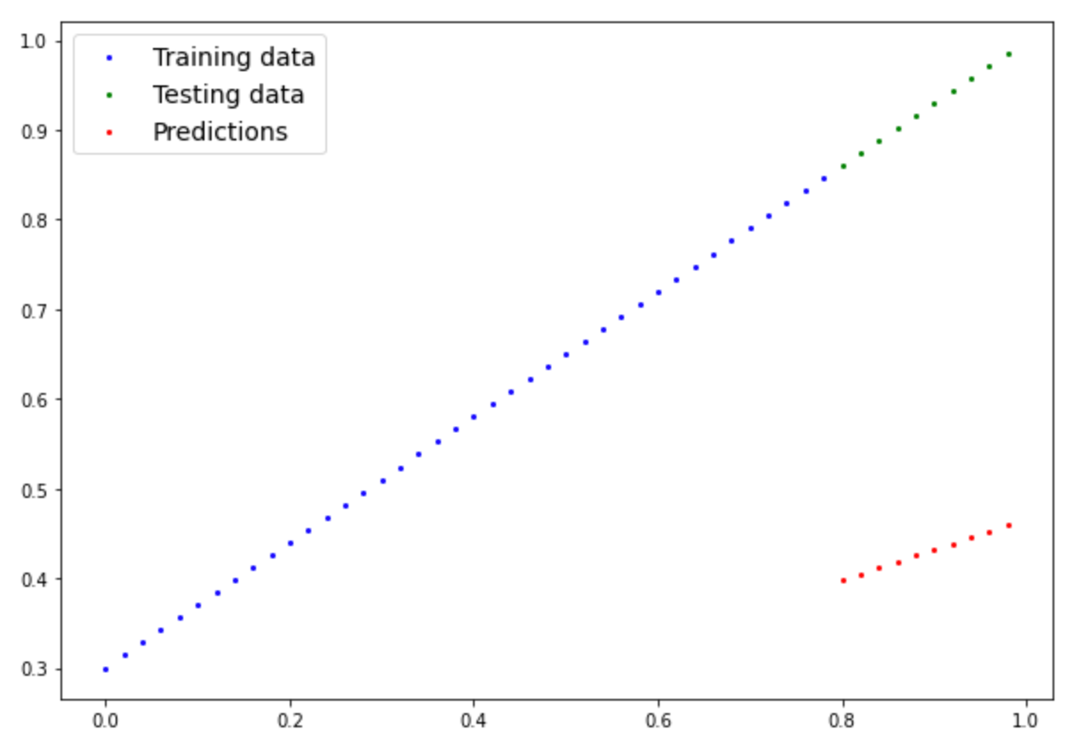
Mean absolute error (MAE)
DiMerence (y_pred[0] - y_test[0]) = 0.4618
Mean absolute error (MAE) = Repeat for all and take the mean
MAE_loss = torch.mean(torch.abs(y_pred-y_test)) or
MAE_loss = torch.nn.L1Loss
See more: https://pytorch.org/tutorials/beginner/ptcheat.html#loss-functions

Slide 12
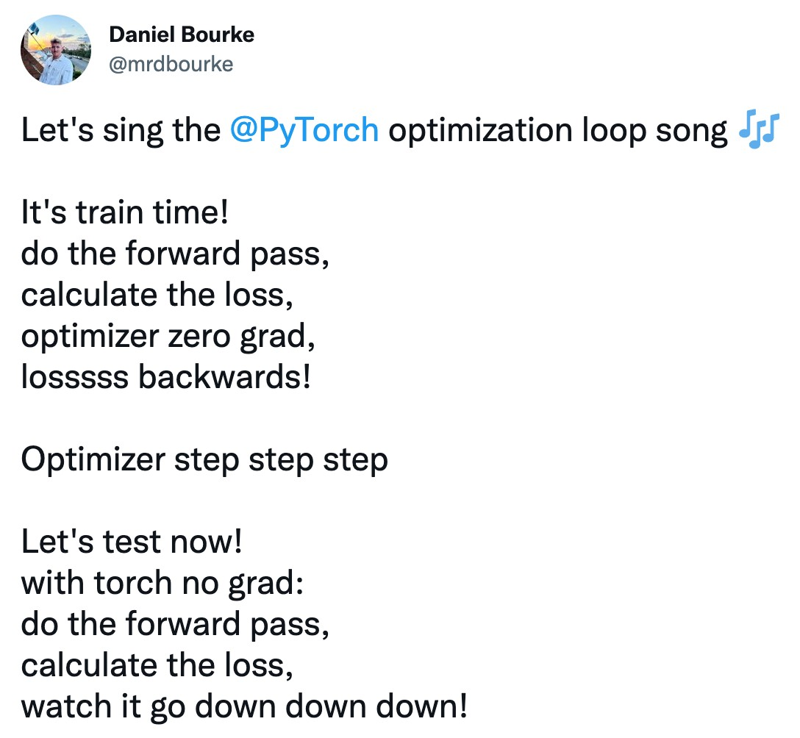
Source: @mrdbourke Twitter & see the video version on YouTube.

Slide 13
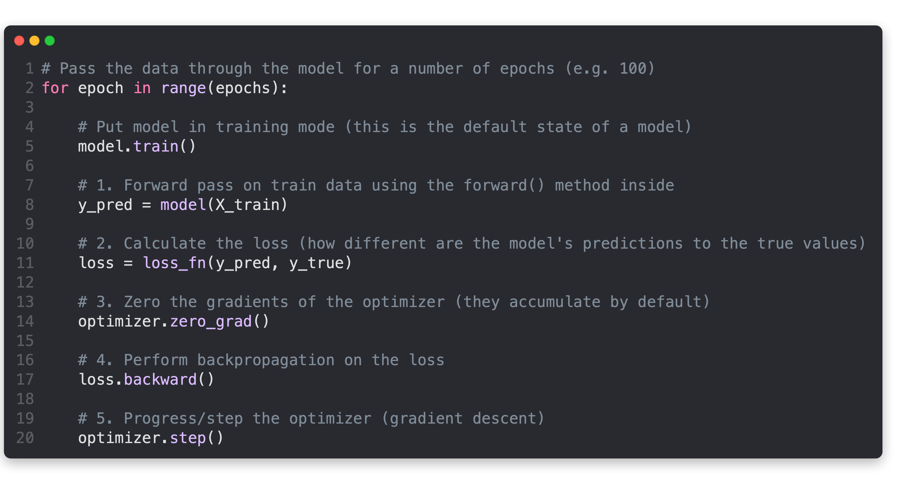
PyTorch training loop
Pass the data through the model for a number of epochs (e.g. 100 for 100 passes of the data)
Pass the data through the model, this will perform the
forward() method located within the model object
Calculate the loss value (how wrong the model’s predictions are)
Zero the optimizer gradients (they accumulate every epoch, zero them to start fresh each forward pass)
Perform backpropagation on the loss function (compute the gradient of every parameter with requires_grad=True)
Step the optimizer to update the model’s parameters with respect to the gradients calculated by loss.backward()
Note: all of this can be turned into a function

Slide 14
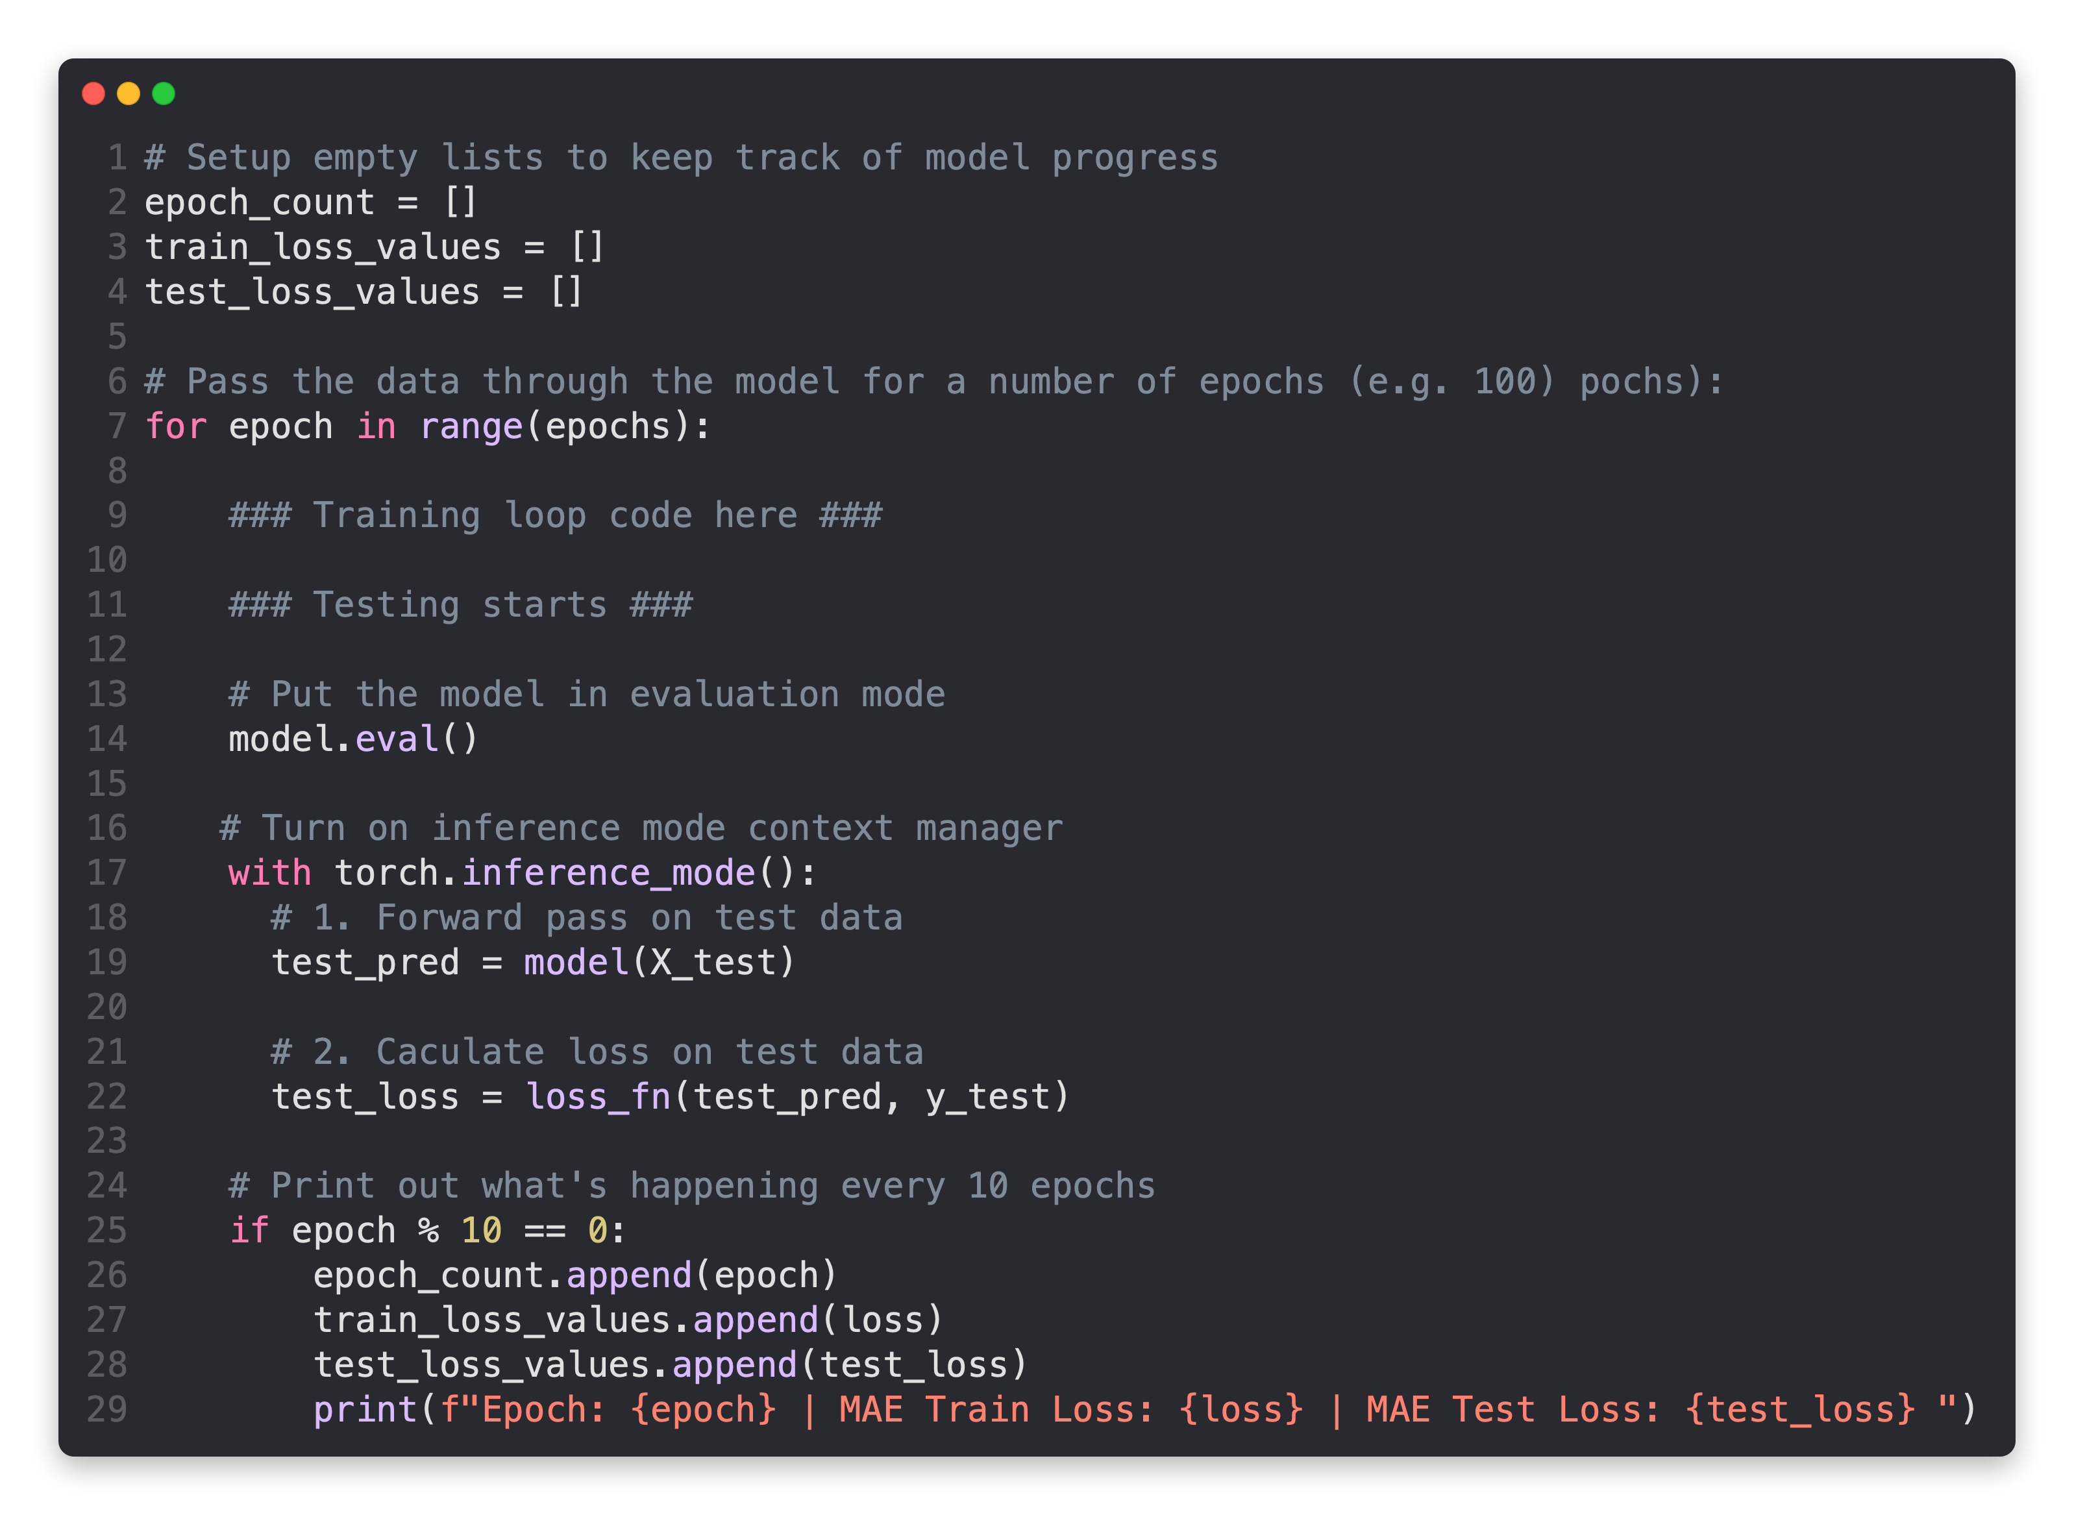
PyTorch testing loop
Create empty lists for storing useful values (helpful for tracking model progress)
Tell the model we want to evaluate rather than train (this turns oM functionality used for training but not evaluation)
Turn on torch.inference_mode() context manager to disable functionality such as gradient tracking for inference (gradient tracking not needed for inference)
Pass the test data through the model (this will call the model’s implemented forward() method)
(faster performance!)
Calculate the test loss value (how wrong the model’s predictions are on the test dataset, lower is better)
Display information outputs for how the model is doing during training/testing every ~10 epochs (note: what gets printed out here can be adjusted for speciLc problems)
Note: all of this can be turned into a function
See more: https://discuss.pytorch.org/t/model-eval-vs-with-torch-no-grad/19615 & PyTorch Twitter announcement of torch.inference_mode()

Slide 15
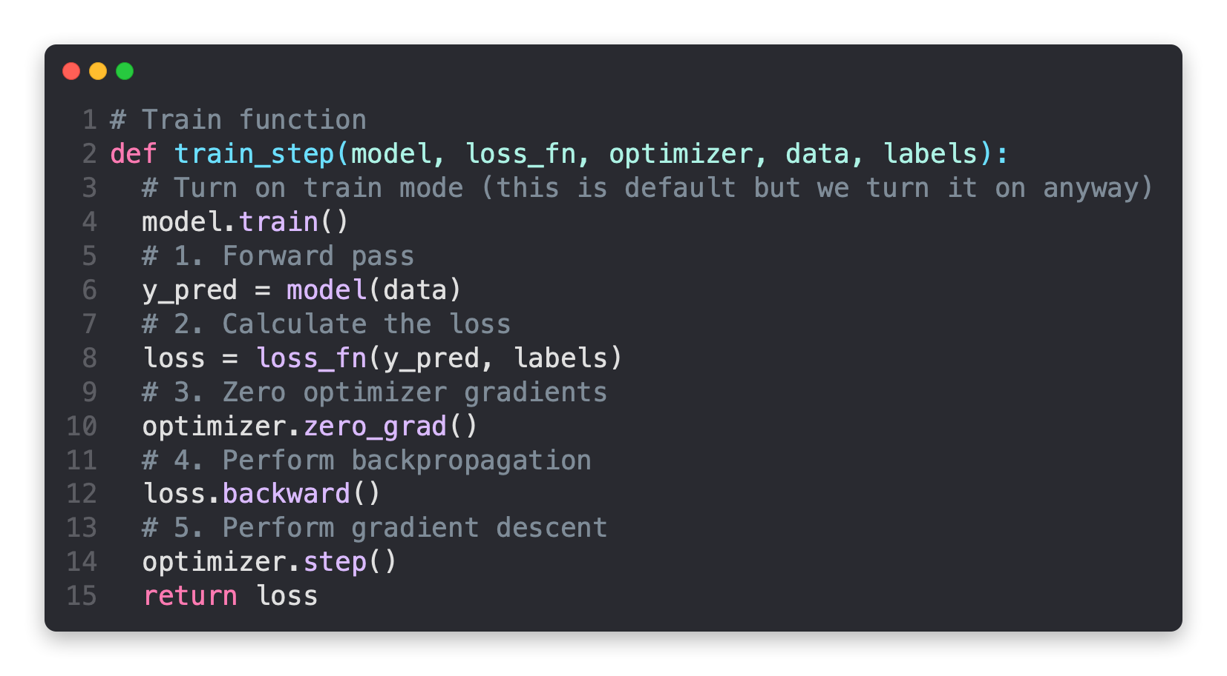
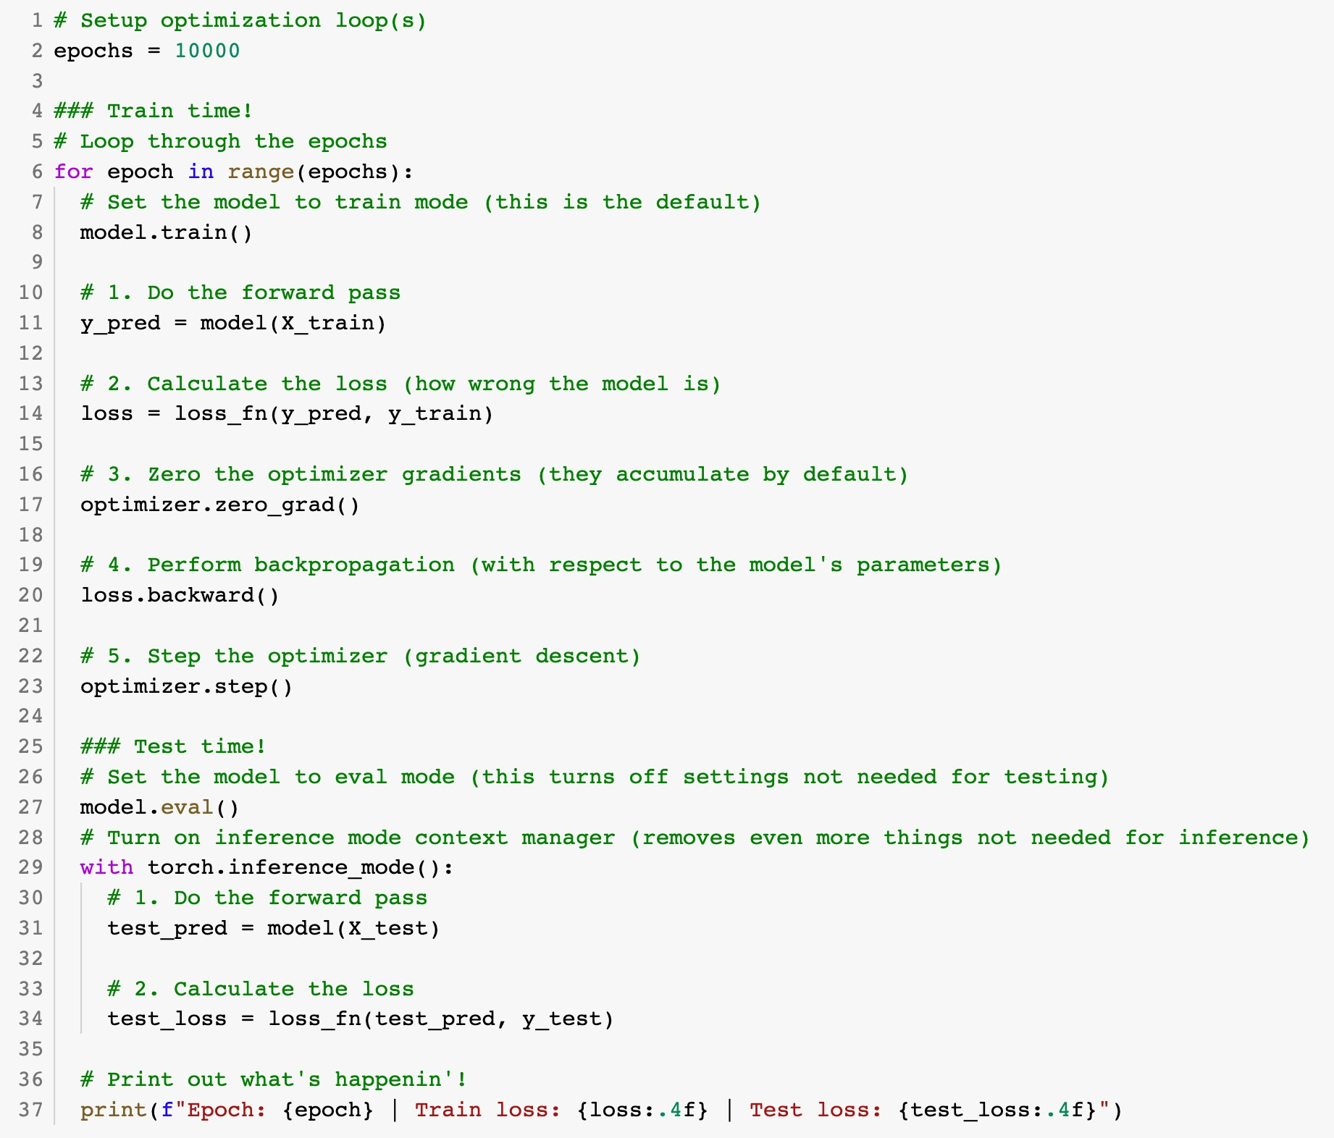
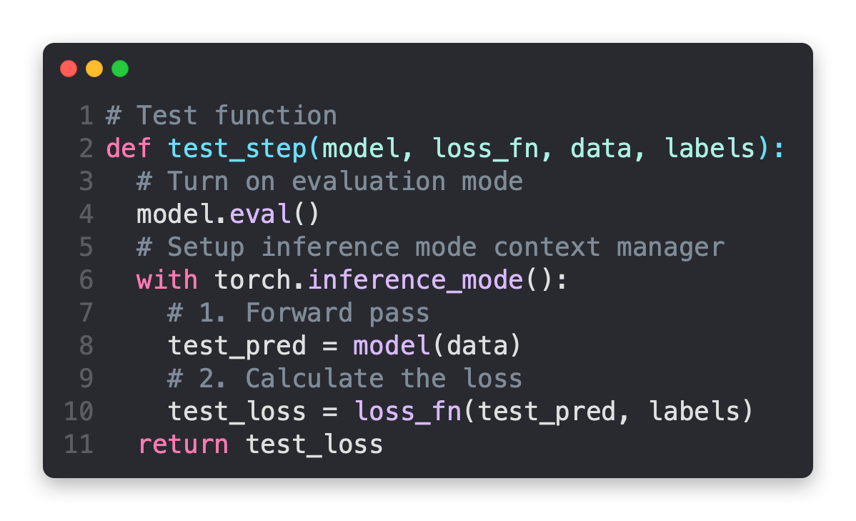

Slide 16
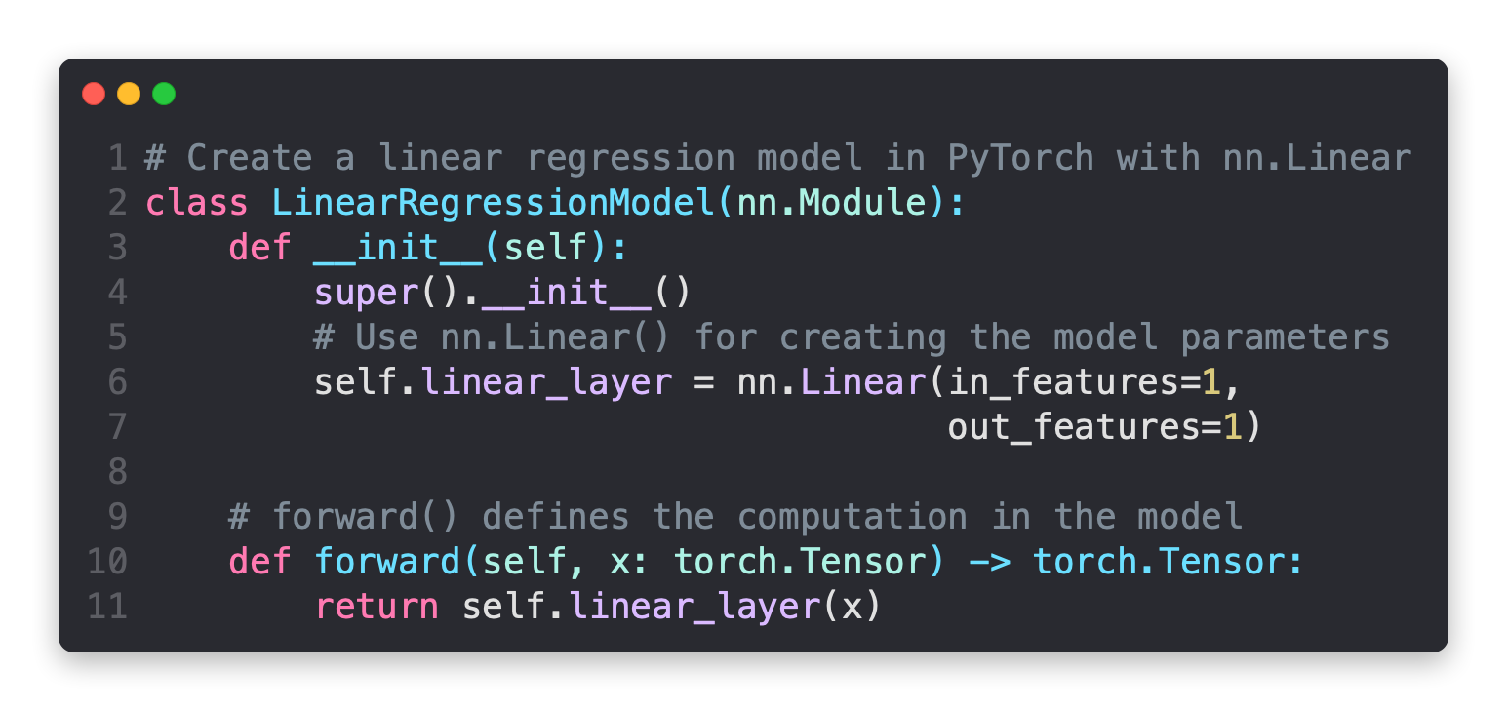
Linear regression model with nn.Linear
Linear regression model with nn.Parameter

Slide 17


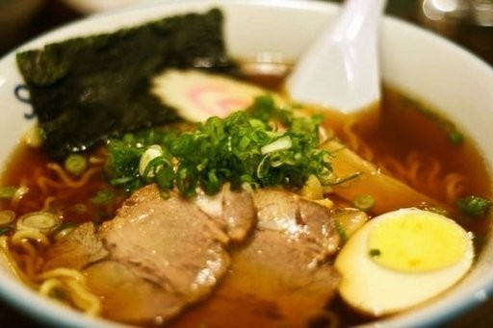
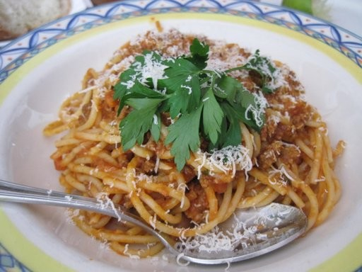
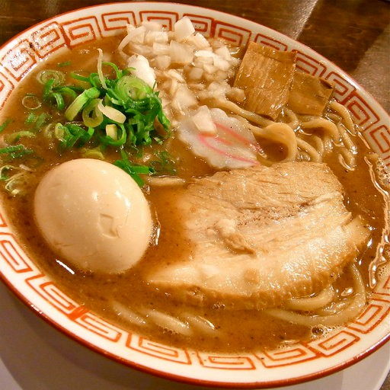
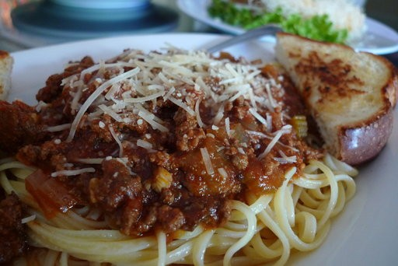
Supervised learning
2. Show examples
1. Initialise with random
weights (only at beginning)
[[0.092, | 0.210, | 0.415],
[0.778, | 0.929, | 0.030],
[0.019, | 0.182, | 0.555],
…,
(overview)
[[116, 78, 15],
[117, 43, 96],
[125, 87, 23],
…,
[[0.983, 0.004, 0.013],
[0.110, 0.889, 0.001],
[0.023, 0.027, 0.985],
…,
Ramen, Spaghetti
3. Update representation outputs
4. Repeat with more examples
Learns representation
(patterns/features/weights)
Inputs
Numerical encoding
Representation outputs
Outputs

Slide 18
Neural Networks
(a human can
understand these)
Ramen, Spaghetti
(before data gets used
These are tensors!
with an algorithm, it
needs to be turned into
numbers)
[[116, | 78, | 15], |  | [[0.983, | 0.004, | 0.013],
[117, | 43, | 96], |  | [0.110, | 0.889, | 0.001],
[125, | 87, | 23], |  | [0.023, | 0.027, | 0.985],
…, |  |  |  | …,
Not spam
(choose the appropriate
“Hey Siri, what’s the weather today?”
neural network for your
problem)
Learns representation
(patterns/features/weights)
Inputs
Numerical encoding
Representation outputs
Outputs

Slide 19
These are tensors!
[[116, 78, 15],
[117, 43, 96],
[125, 87, 23],
…,
[[0.983, 0.004, 0.013],
[0.110, 0.889, 0.001],
[0.023, 0.027, 0.985],
…,
Ramen, Spaghetti
Learns representation
(patterns/features/weights)
Inputs
Numerical encoding
Representation outputs
Outputs

Slide 20
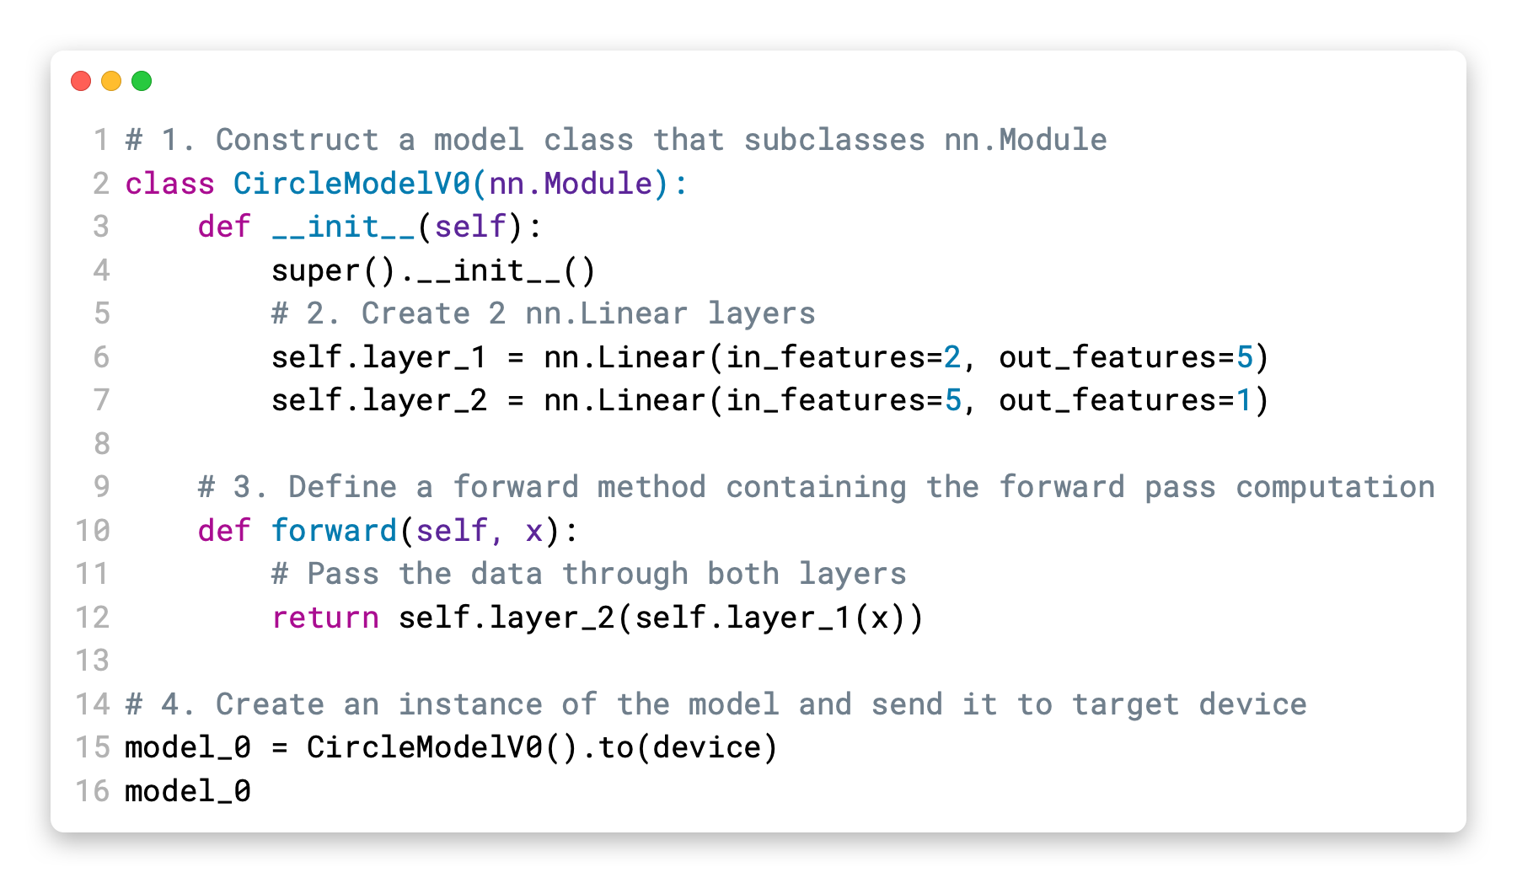









How to approach this course
Motto #2:
Experiment, experiment,
Motto #3: Visualize, visualize, visualize!
experiment!
1. Code along
2. Explore and experiment
3. Visualize what you don’t understand
Motto #1: if in doubt, run the code!
🛠
5. Do the exercises
🤗
6. Share your work
(including the
“dumb” ones)
4. Ask questions

Slide 21



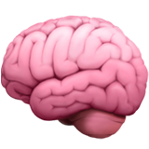
How not to approach this course
🔥
🔥
🧠
🔥
“I can’t learn
Avoid:
”

Slide 22
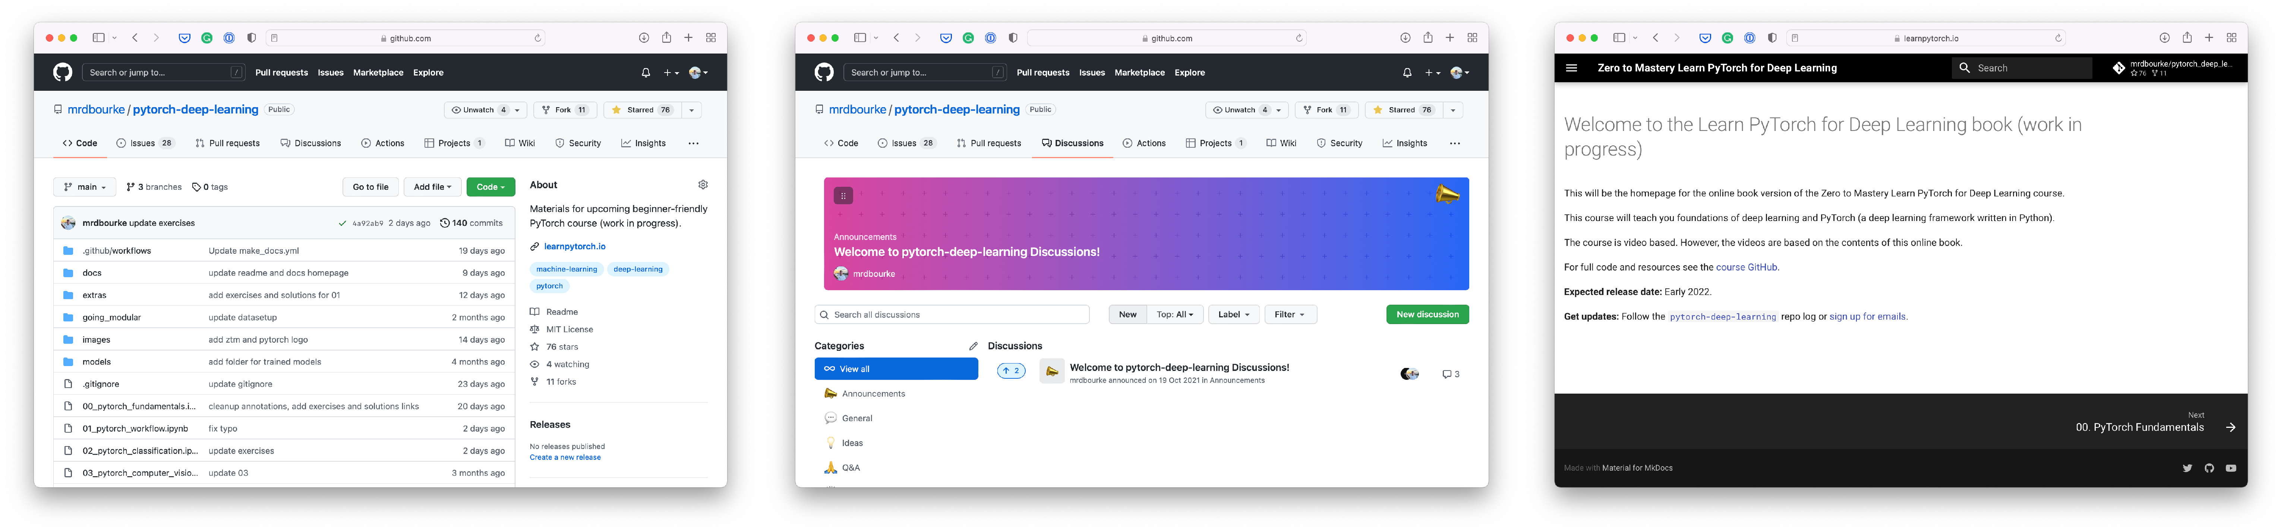

Resources
Course Q&A
This course
Course materials
Course online book
https://www.github.com/mrdbourke/pytorch-deep-learning
https://www.github.com/mrdbourke/pytorch-deep-learning/ discussions
https://learnpytorch.io
PyTorch website & forums
All things PyTorch

Slide 23
DiMerence (y_pred[0] - y_test[0]) = 0.4618

