Slide 1

Neural Network Classification with

Slide 2

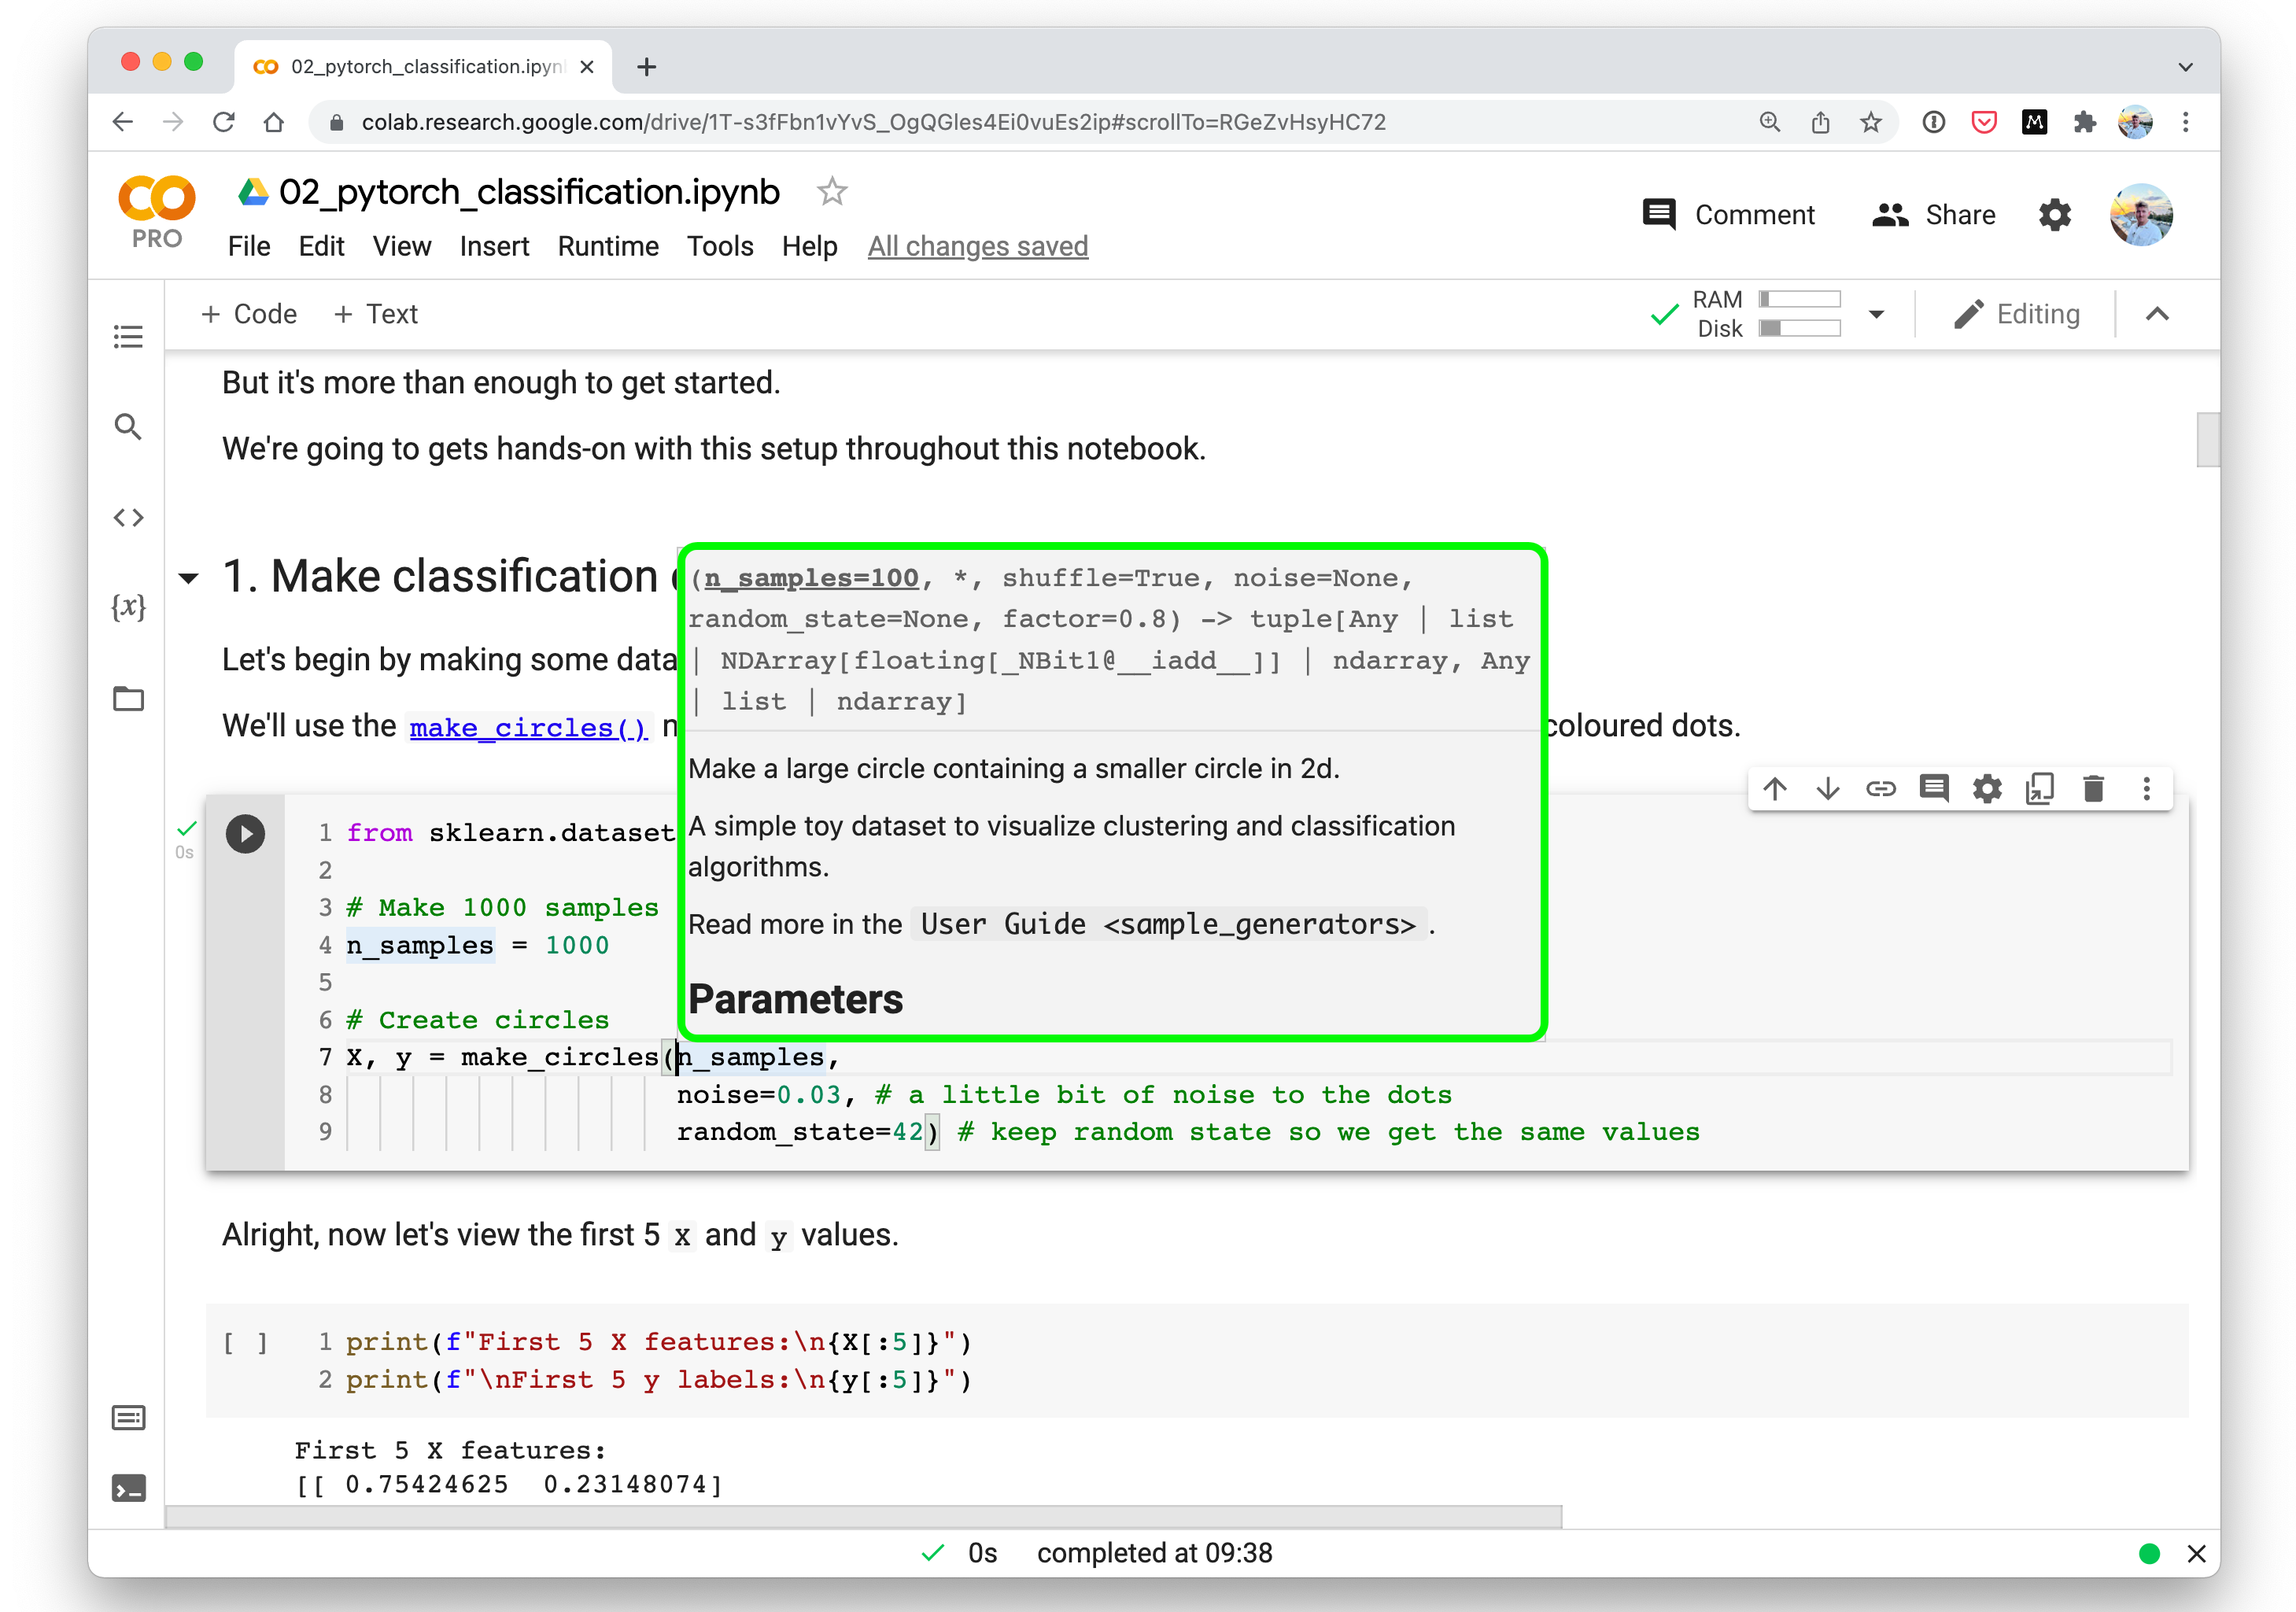



Where can you get help?
Follow along with the code
Try it for yourself
Press SHIFT + CMD + SPACE to read the docstring
Search for it
Try again
Ask
“If in doubt, run the code”
https://www.github.com/mrdbourke/pytorch-deep-learning/discussions

Slide 3
“What is a classification problem?”

Slide 4
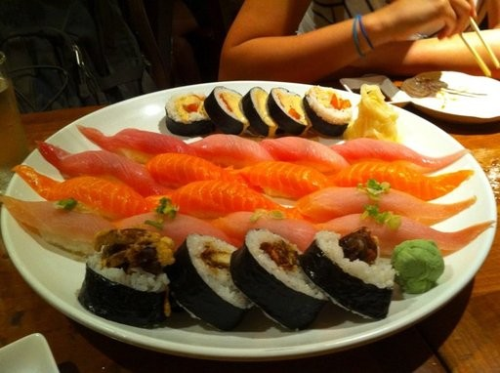
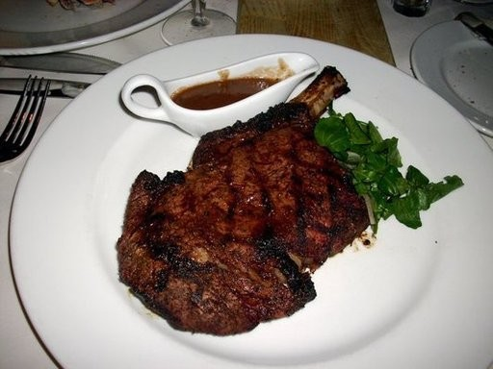
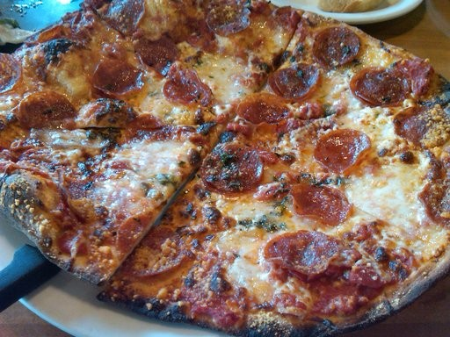
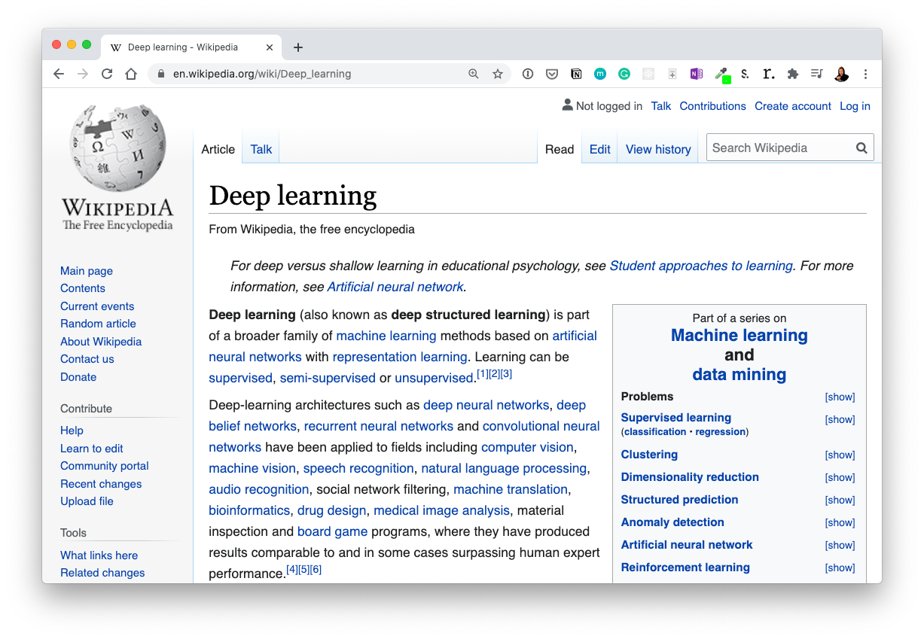
Example classification problems
“Is this email spam or not spam?” “Is this a photo of sushi, steak or pizza?”
To: daniel@mrdbourke.com Hey Daniel,
To: daniel@mrdbourke.com Hay daniel…
This deep learning course is incredible! I can’t wait to use what I’ve learned!
Not spam
C0ongratu1ations! U win $1139239230
Spam
Binary classification Multiclass classification
“What tags should this article have?”
(one thing or another)
(more than one thing or
another)
Machine learning Representation learning Artificial intelligence
(multiple label options per
sample)
Multilabel classification

Slide 5
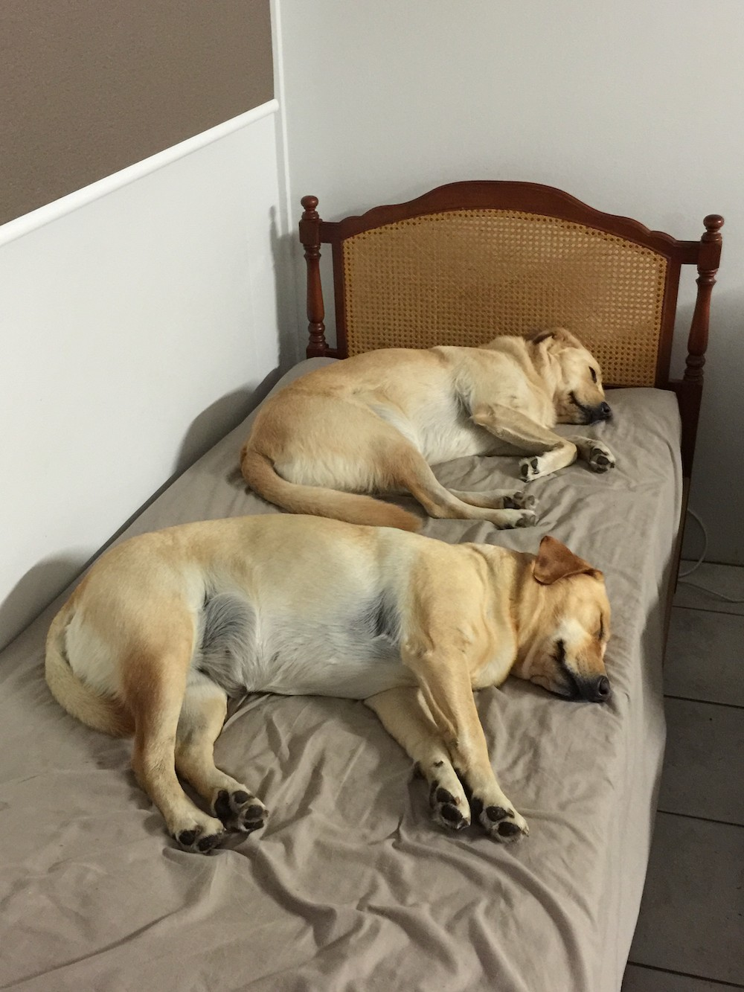

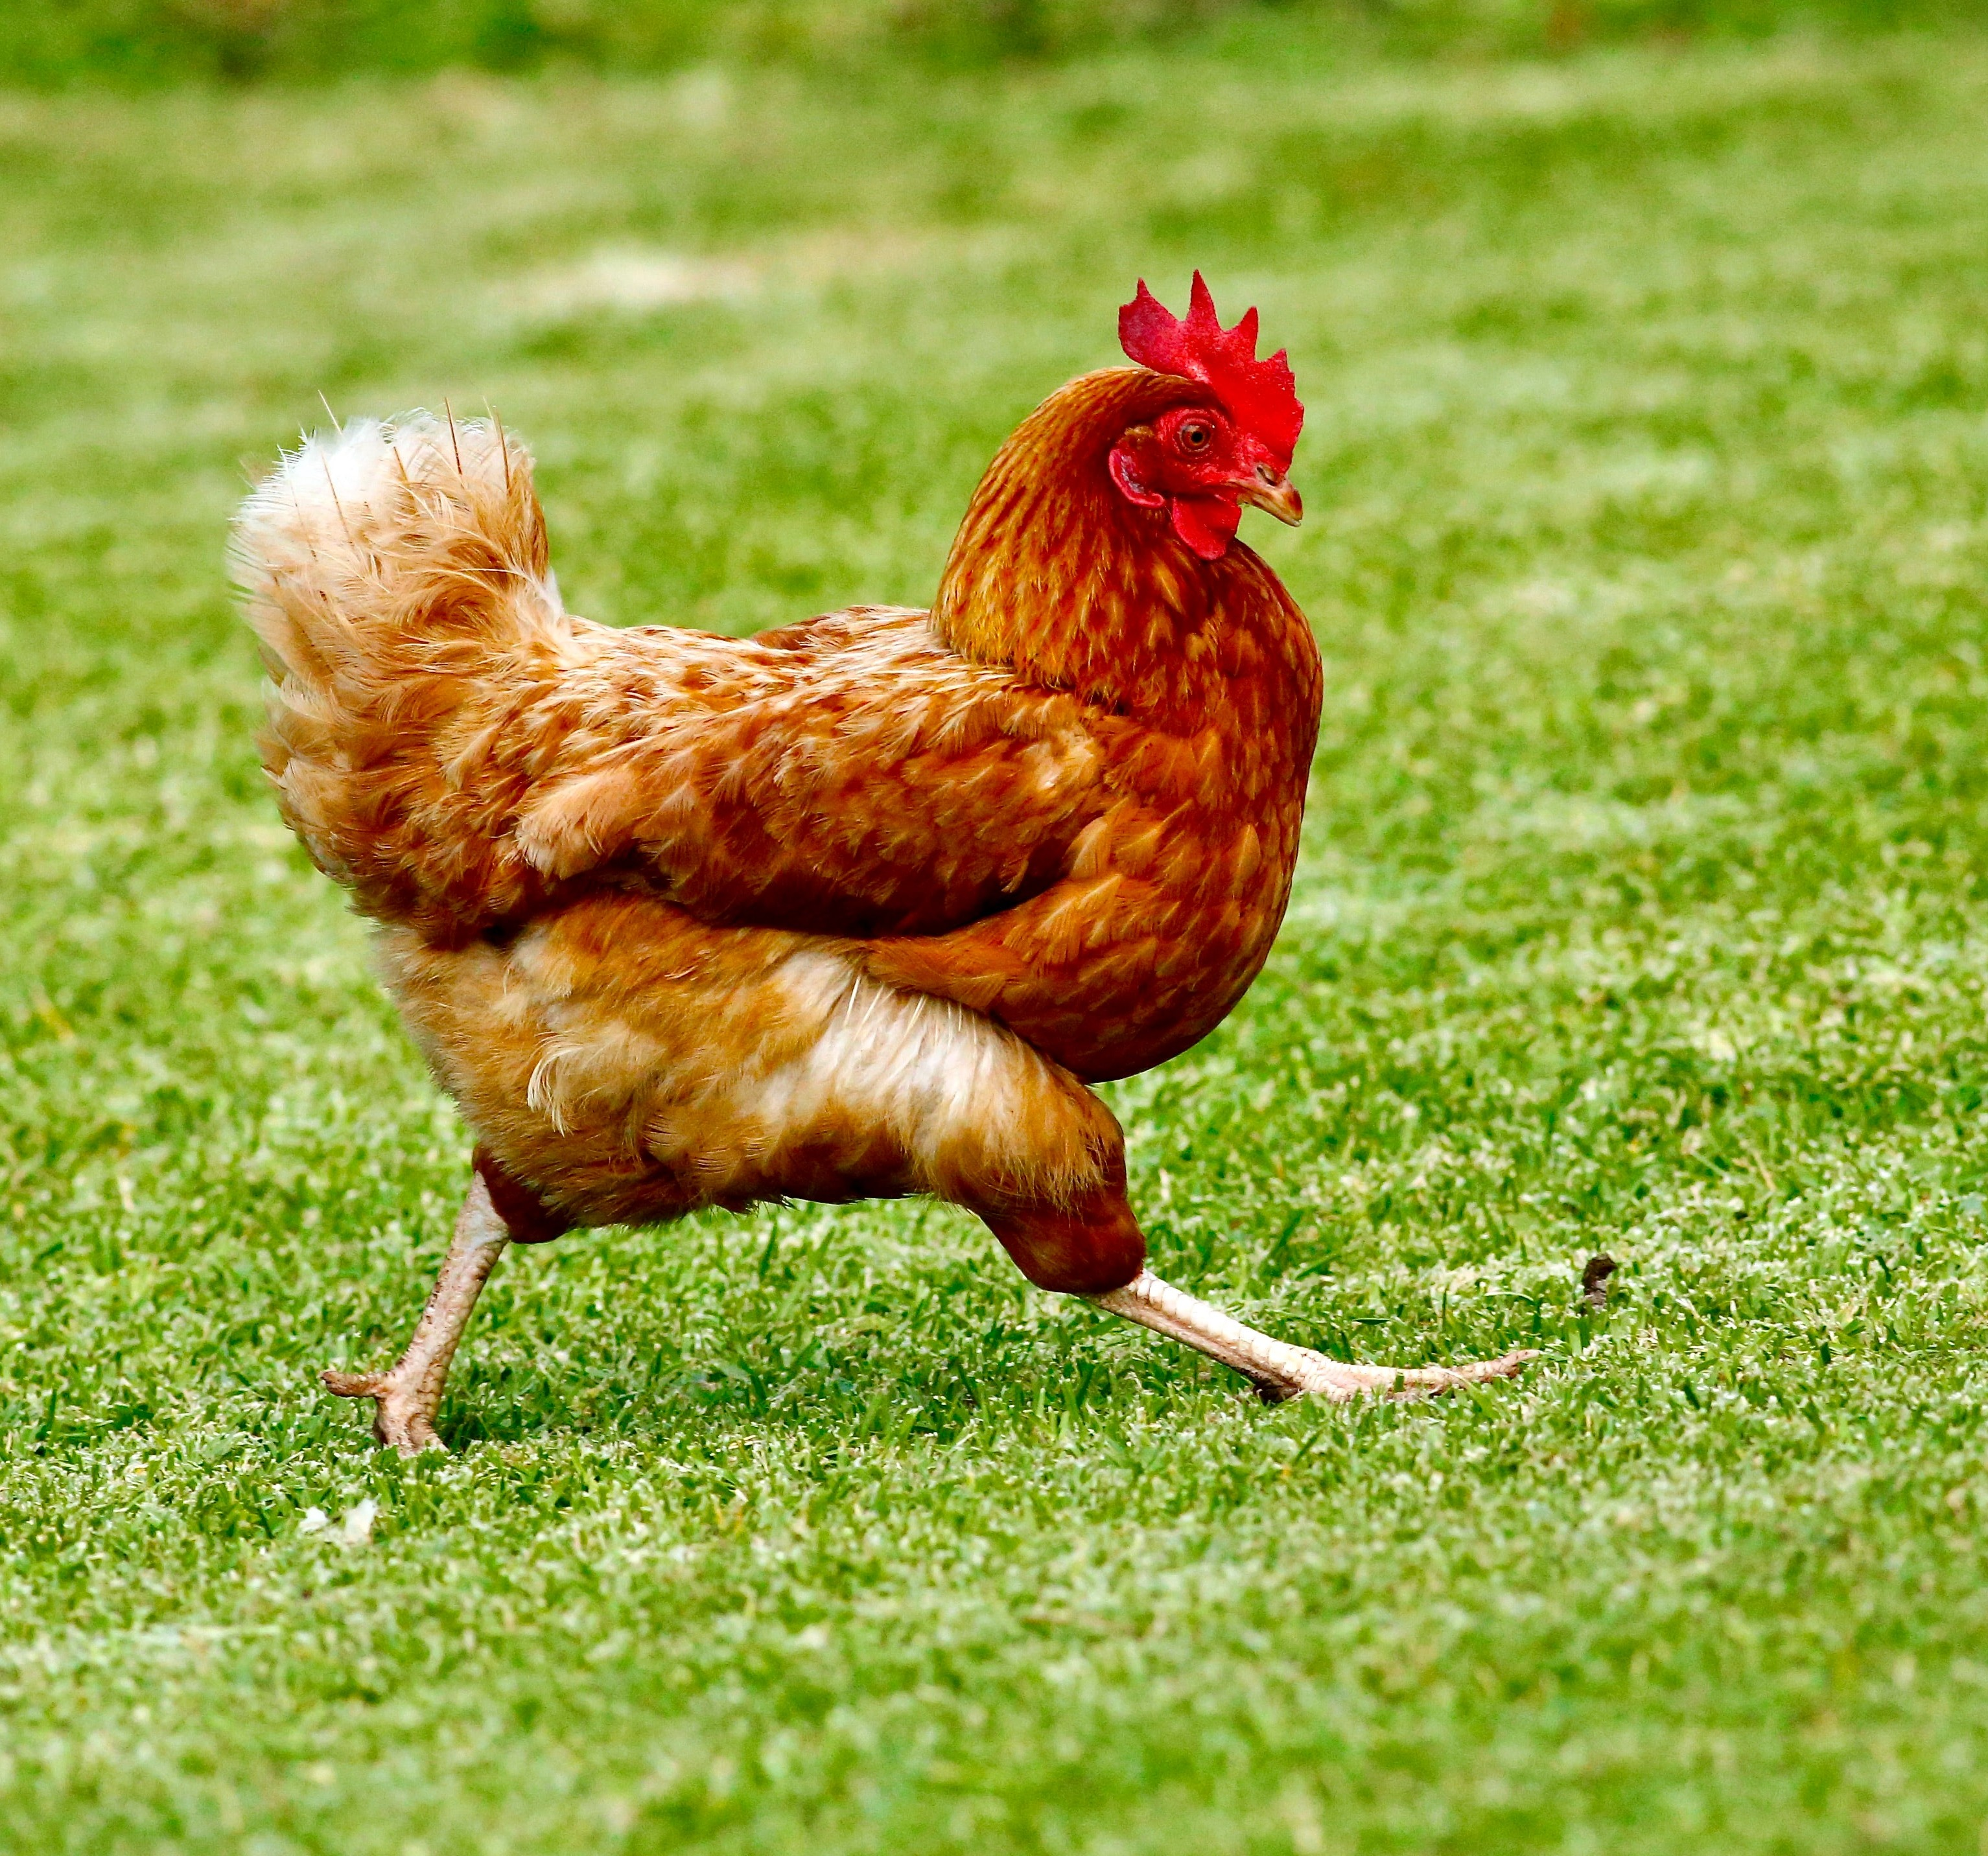
Binary vs. Multi-class Classification
Binary classification
(one thing or another)
Multiclass classification
(more than one thing or
another)

Slide 6


What we’re going to cover
(broadly)
Architecture of a neural network classification model
Input shapes and output shapes of a classification model (features and labels)
Creating custom data to view, fit on and predict on
Steps in modelling
Creating a model, setting a loss function and optimiser, creating a training loop, evaluating a model
Saving and loading models
Harnessing the power of non-linearity
Different classification evaluation methods
How:
(we’ll be cooking up lots of code!)

Slide 7

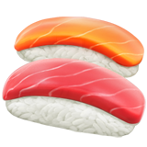
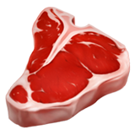

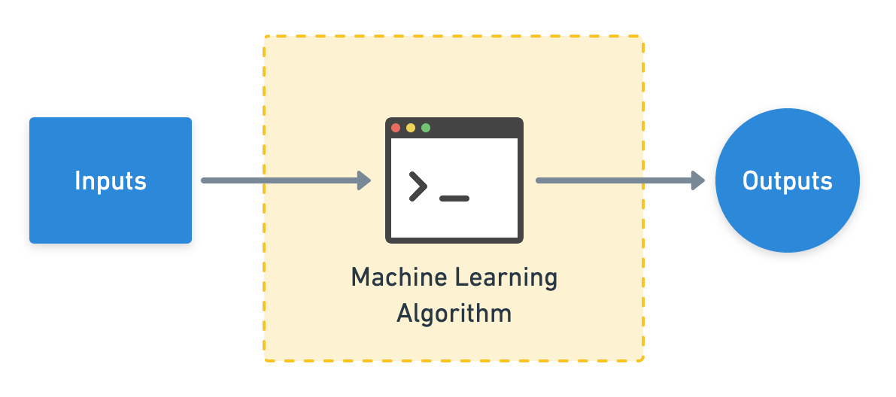


Classification inputs and outputs
224
W = 224
H = 224
C = 3
224
Sushi
Steak
Pizza
Actual output
(c = colour channels, R, G, B)
[[0.31, 0.62, 0.44…],
[[0.97, 0.00, 0.03],
[0.92, | 0.03, | 0.27…], | [0.81, | 0.14, | 0.05],
[0.25, | 0.78, | 0.07…], | [0.03, | 0.07, | 0.90],
…, |  |  | …,
(normalized pixel values)
Numerical encoding
Predicted output
(often already exists, if not,
(comes from looking at lots
you can build one)
of these)

Slide 8
Input and output shapes
(for an image classification example)
224
[[0.31, 0.62, 0.44…],
224
[0.92, 0.03, 0.27…],
[0.25, 0.78, 0.07…],
…,
[0.97, 0.00, 0.03]
(prediction probabilities)
(gets represented as a tensor)
[batch_size, colour_channels, width, height]
Shape = [3]
Shape = [None, 3, 224, 224]
or
Shape = [32, 3, 224, 224]
These will vary depending on the problem you’re working on.
(32 is a very common batch
size)

Slide 9
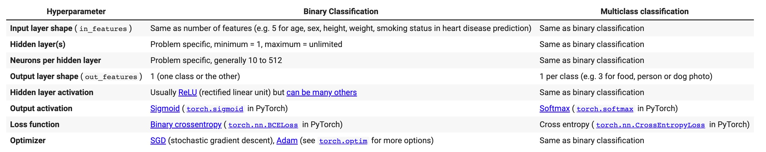
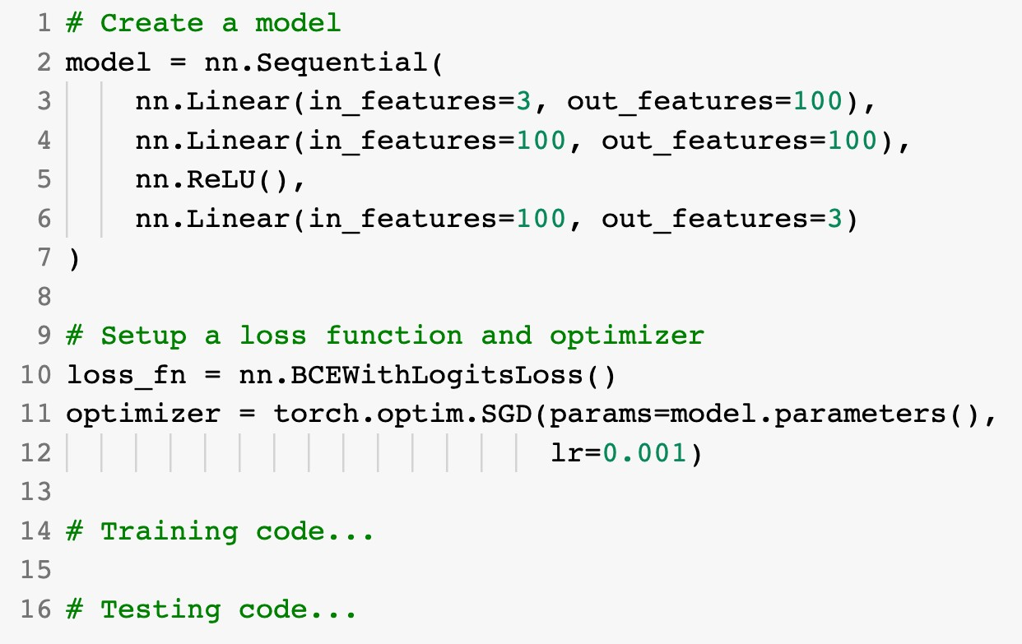
Architecture of a classification model
(typical)
(we’re going to be building
lots of these)
Sushi
Steak
Pizza

Slide 10
Let’s code!

Slide 11
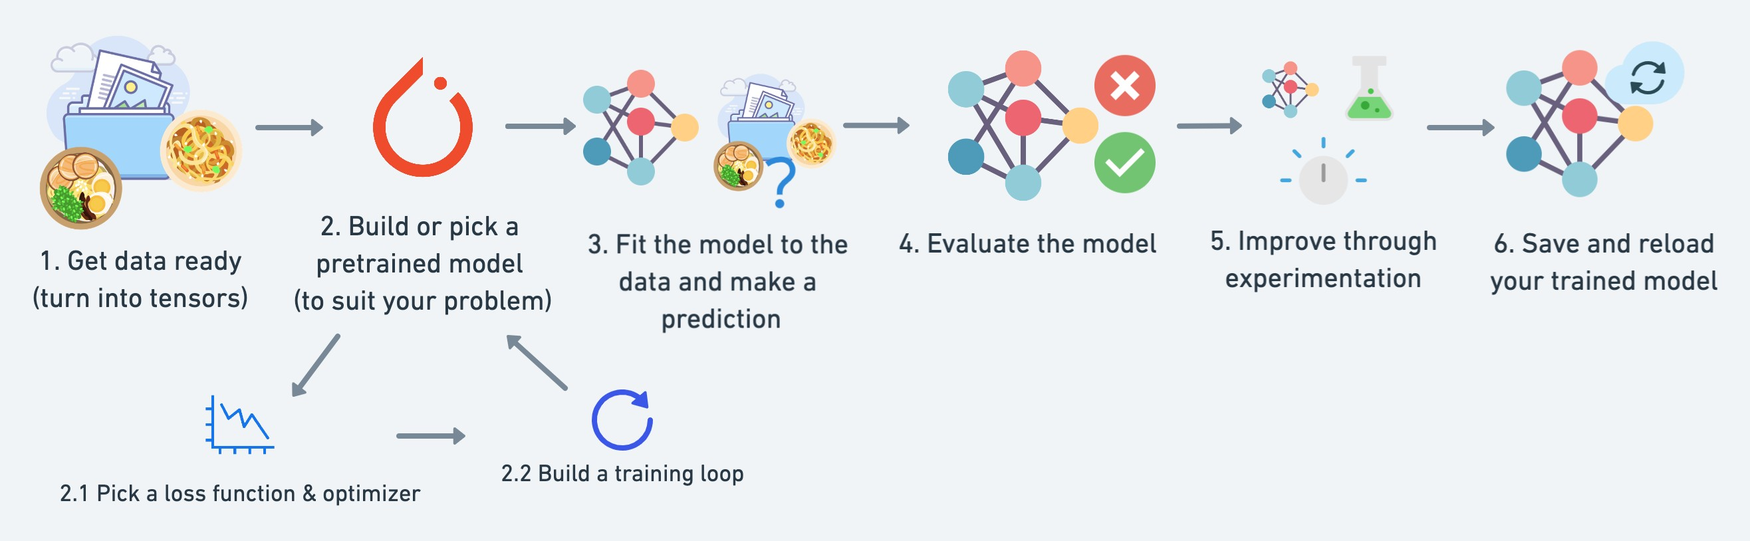
torchvision.transforms torch.utils.data.Dataset
torch.utils.data.DataLoader
torchmetrics
torch.optim
torch.nn torch.nn.Module torchvision.models
torch.utils.tensorboard
See more: https://pytorch.org/tutorials/beginner/ptcheat.html

Slide 12
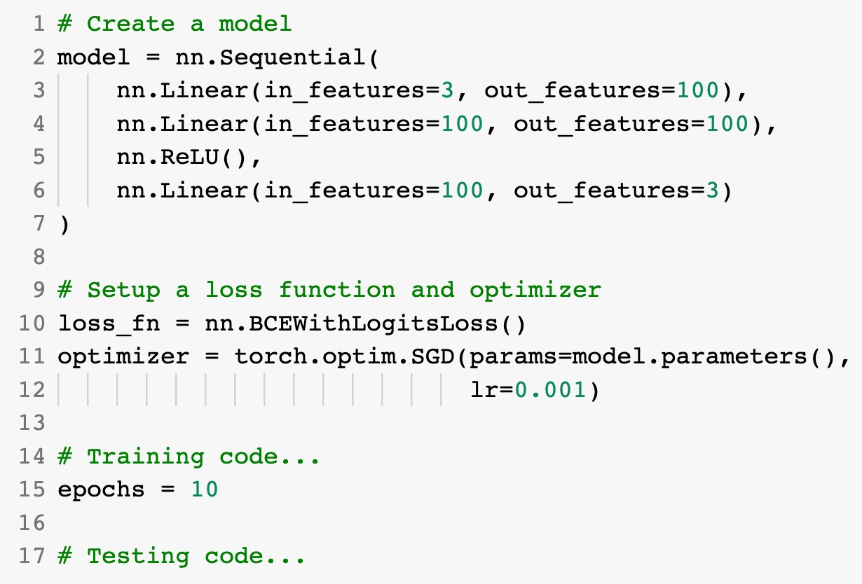
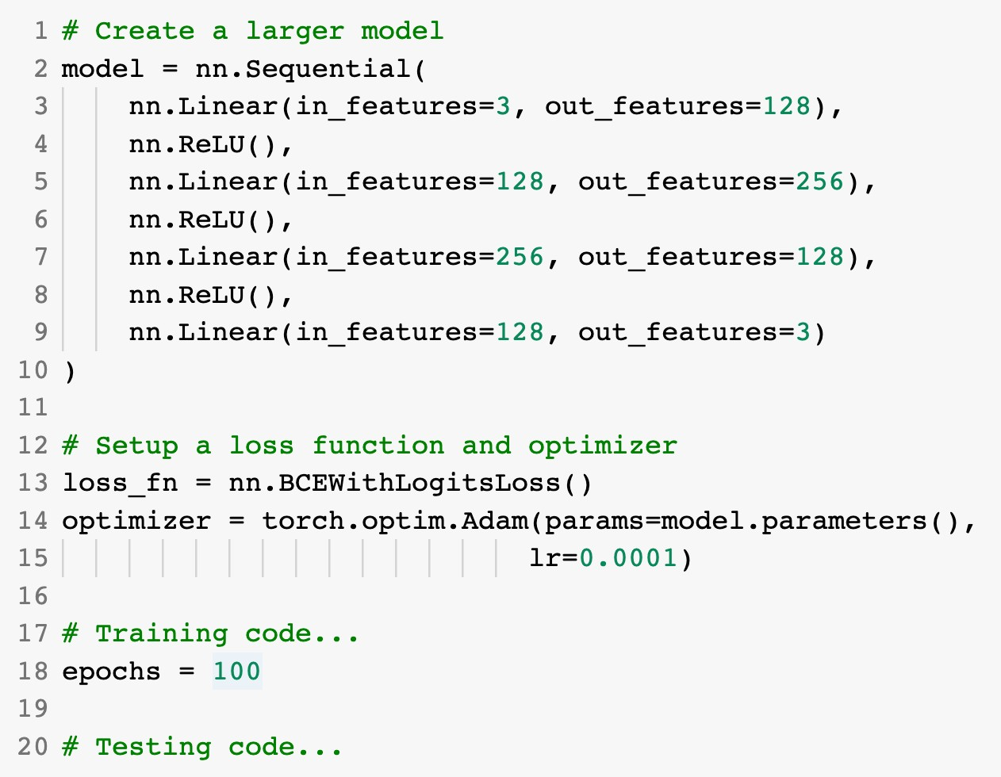
Improving a model
(from a model’s perspective)
Smaller model
Common ways to improve a deep model:
Adding layers
Increase the number of hidden units
Change/add activation functions
Larger model
Change the optimization function
Change the learning rate
(because you can alter each of
Fitting for longer
these, they’re hyperparameters)

Slide 13

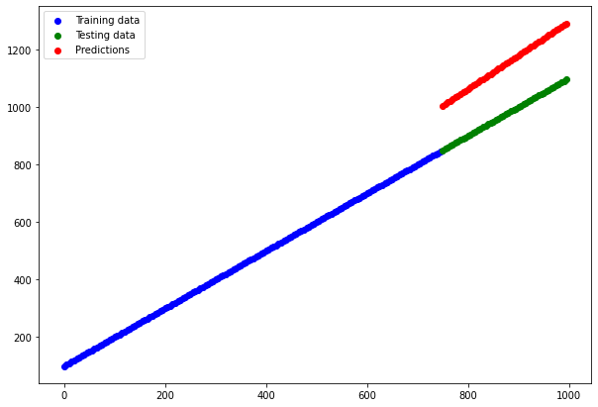
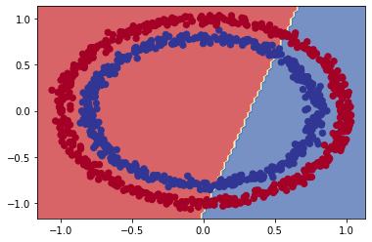
The missing piece: Non-linearity
“What could you draw if you had an unlimited amount of straight (linear) and non-
straight (non-linear) lines?”
Linear data
(possible to model with straight lines)
Non-linear data
(not possible to model with straight lines)

Slide 14
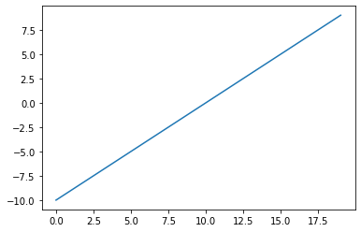
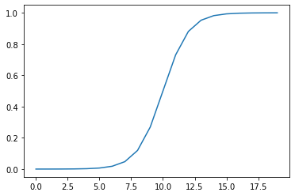
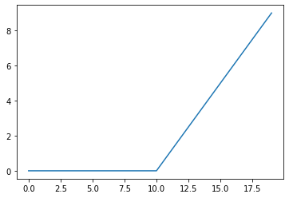
The missing piece: Non-linearity
A = torch.arange(-10, 10)
plt.plot(A)
plt.plot(torch.sigmoid(A))
plt.plot(torch.relu(A))
Linear activation
(same as original values)
Sigmoid activation
(non-linear)
ReLU activation
(non-linear)

Slide 15



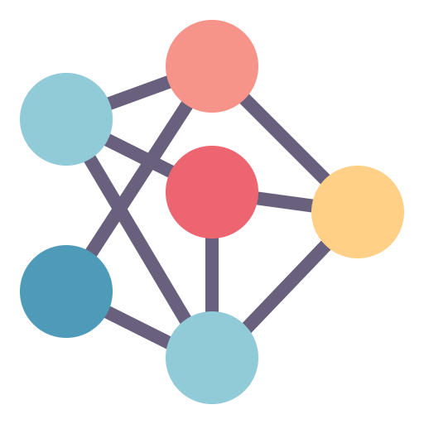
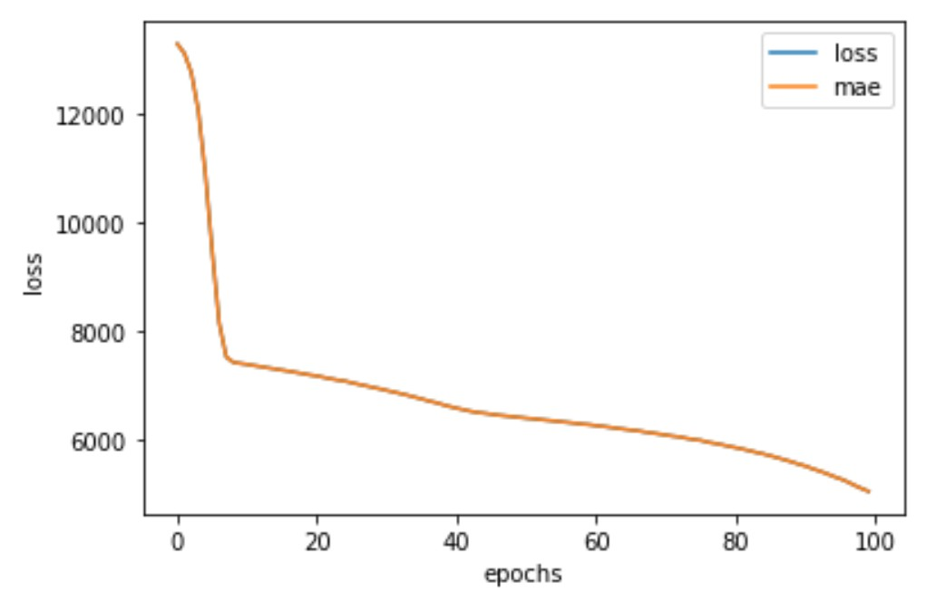
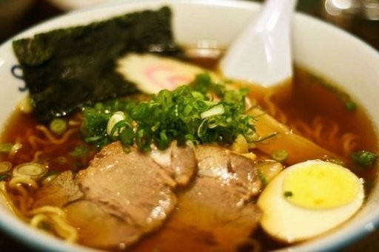
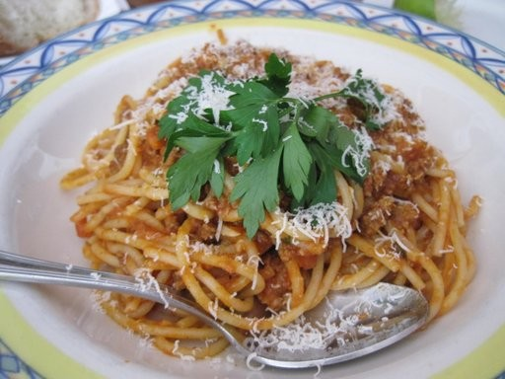
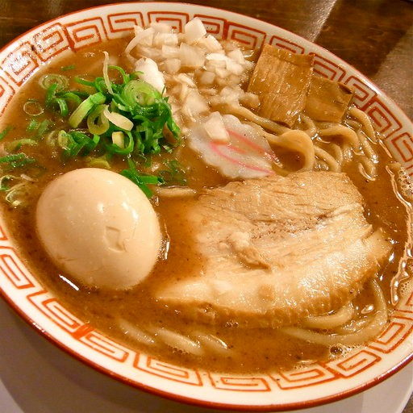
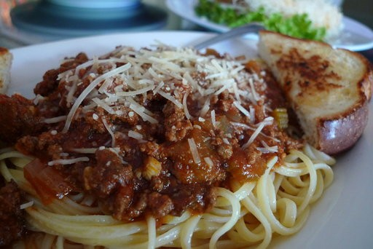
The machine learning explorer’s motto
“Visualize, visualize, visualize”
Data
Model
It’s a good idea to visualize these as often as possible.
Training
Predictions

Slide 16
The machine learning practitioner’s motto
“Experiment, experiment, experiment”
(try lots of things and see what
tastes good)

Slide 17
Steps in modelling with PyTorch
Construct or import a pretrained model relevant to your
problem
Prepare the loss function, optimizer and training loop
Loss — how wrong your model’s predictions are compared to the truth labels (you want to minimise this).
Optimizer — how your model should update its internal patterns to better its predictions.
Fit the model to the training data so it can discover patterns
Epochs — how many times the model will go through all of the training examples.
Evaluate the model on the test data (how reliable are our model’s predictions?)

Slide 18
Classification evaluation methods
Key: tp = True Positive, tn = True Negative, fp = False Positive, fn = False Negative
(some common)
Metric Name Metric Forumla Code When to use
tp + tn
⁼ tp + tn + fp + fn
torchmetrics.Accuracy() or
sklearn.metrics.accuracy_score()
Default metric for classification problems. Not the best for imbalanced classes.
Accuracy
Accuracy
torchmetrics.Precision() or
sklearn.metrics.precision_score()
Higher precision leads to less false positives.
Precision
Precision = ^{tp}
tp + fp
Recall = ^{tp}
torchmetrics.Recall() or
sklearn.metrics.recall_score()
Higher recall leads to less false negatives.
Recall
tp + fn
_{F1-score = 2 ⋅} precision ⋅ recall
torchmetrics.F1Score() or
sklearn.metrics.f1_score()
Combination of precision and recall, usually a good overall metric for a classification model.
F1-score
precision + recall
When comparing predictions to truth
Confusion matrix
NA
torchmetrics.ConfusionMatrix()
labels to see where model gets confused. Can be hard to use with large numbers of classes.

Slide 19
Anatomy of a confusion matrix
Confusion Matrix
False positives
99 (98.0%) | 2 (2.0%)
0 (0.0%) | 99 (100.0%)
True positive = model predicts 1 when truth is 1
0
True Label
True negative = model predicts 0 when truth is 0
False positive = model predicts 1 when truth is 0
False negative = model predicts 0 when truth is 1
1
0 1
Predicted Label
Correct predictions
(true positives,
False negatives
true negatives)

Slide 20




Three datasets
(possibly the most important concept in machine learning…)
Model learns patterns from here
Course materials (training set)
Practice exam (validation set)
Final exam (test set)
See if the model is ready for the wild
Tune model patterns
Generalization
The ability for a machine learning model to perform well on data it hasn’t seen before.

Slide 21
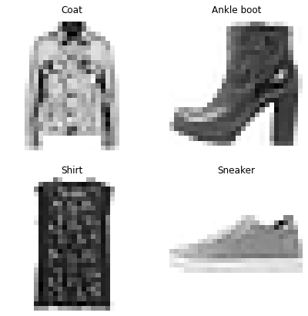
2. Show examples
1. Initialise with random
weights (only at beginning)
[[0.092, | 0.210, | 0.415],
[0.778, | 0.929, | 0.030],
[0.019, …, | 0.182, | 0.555],
[[116, 78, 15],
[117, 43, 96],
[125, 87, 23],
…,
[[0.983, 0.004, 0.013],
Coat, Ankle boot, Shirt, Sandal
[0.110, 0.889, 0.001],
[0.023, 0.027, 0.985],
…,
3. Update representation outputs (weights & biases)
4. Repeat with more examples
Learns representation
(patterns/features/weights)
Inputs
Numerical encoding
Representation outputs
Outputs

Slide 22
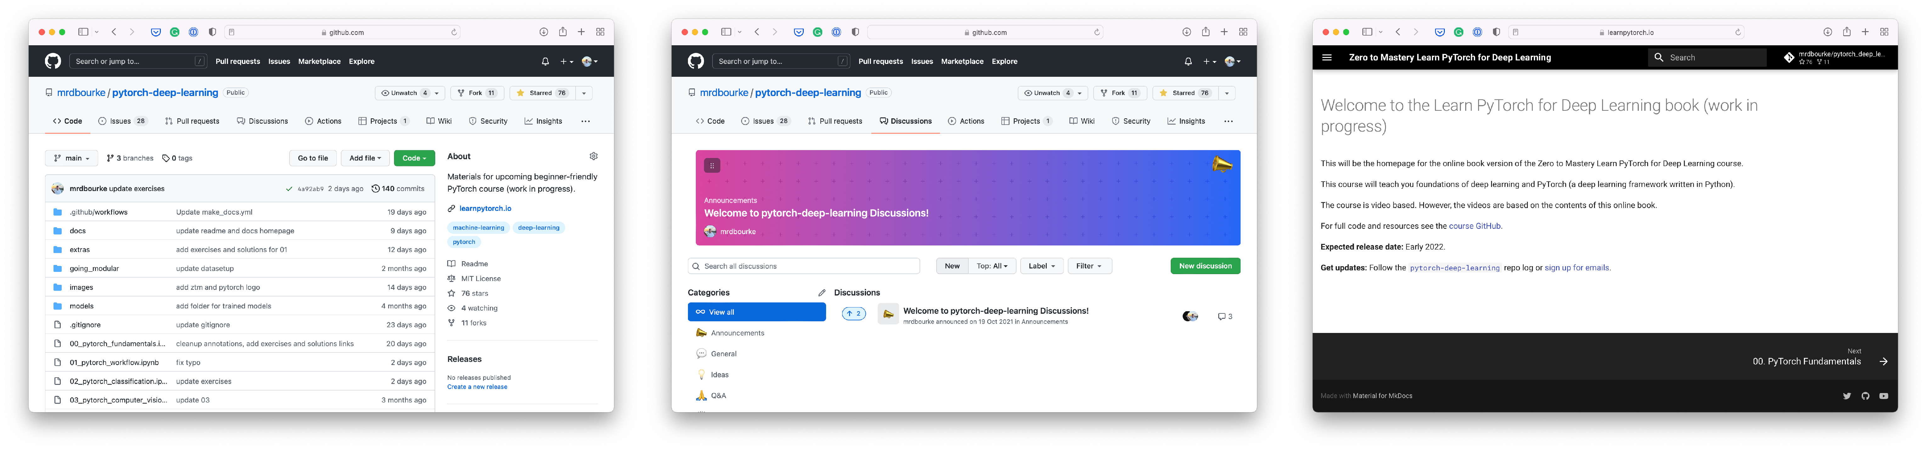

Resources
Course Q&A
This course
Course materials
Course online book
https://www.github.com/mrdbourke/pytorch-deep-learning
https://www.github.com/mrdbourke/pytorch-deep-learning/ discussions
https://learnpytorch.io
PyTorch website & forums
All things PyTorch

